Slide 1
Low-Complexity Multi-Resource Packet Scheduling for Network Function Virtualization
Xin Li , Chen Qian
University of Kentucky
Notes:
Good afternoon, everybody. It is my horner to be here, at keeping current, to give a presentation on a low-complexity multi-resource packet scheduling algorithm for network function virtualization. This is a joint with my advisor Dr, Chen Qian.
I am the speaker, Xin Li.

Slide 2
Motivation: Network Functions are Ubiquitous
Security Network Function
Firewall
IDS
Acceleration Network Function
WAN Optimizer
Proxy
Notes:
Network function, also known as middlleboxes, are playing important role in the network. Network Functions nowadays are ubiquitous in the network. Network functions are the networking devices that perform tasks other than packet forwarding. Network functions are built for different purposes.
One category of network functions is used to enhance the security of enterprise networks, campus networks, or any others. The examples are firewall and intrusion detection system.
Another category of network functions is used to accelerate the speed of the network. For instance, wide area network optimizer could be used to compress the traffic and web proxy is used for caching web pages.

Slide 3
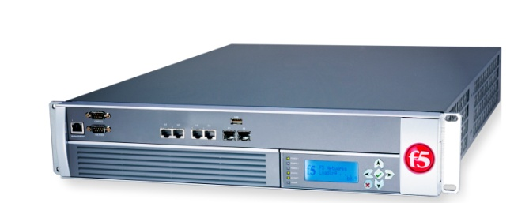


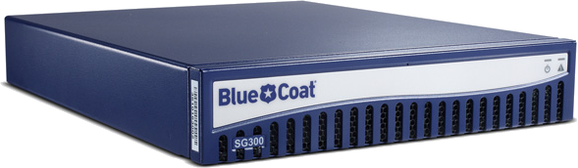



Motivation: Network Function Virtualizaiton
IDS
Hardware
Software
WAN Optimizer
Proxy
Notes:
Traditionally, these network functions are built in propriety dedicated hardware.
These hardware boxes incur high expenses for physical equipment as well as operational costs.
Hardware updates and replacements are not easy, which also involve in a great amount of human labor and financial cost.
To address these challenges, there is a trend in the networking community to build software version of these network functions. Based on software network functions, Network function virtualization is proposed to use virtualization technology to virtualize network functions nodes into blocks.

Slide 4
Motivation: Network Function Consolidation
General-purpose Platform
Consolidation [NSDI’12]
Notes:
These virtual network functions could be consolidated into general-purpose platform, such as X86. One paper in NSDI’12 talks about a particular architecture about how to consolidate different virtual network functions into a single physical machine.

Slide 5


Motivation: Flow Isolation
FCFS
Small flows are blocked.
Flow isolation is desired.
Notes:
However, a new problem arises when we have a physical machine consolidating different network functions.
Different traffic flows may require services provided by different virtual network functions.
If the packets is serviced in first-in-first-serve fashion,
The latency of a small flow maybe very large if it comes later than a big flow.
As a result, flow isolation is desired, which means that a flow is guaranteed to receive its share of service regardless of the demand of other flows.

Slide 6
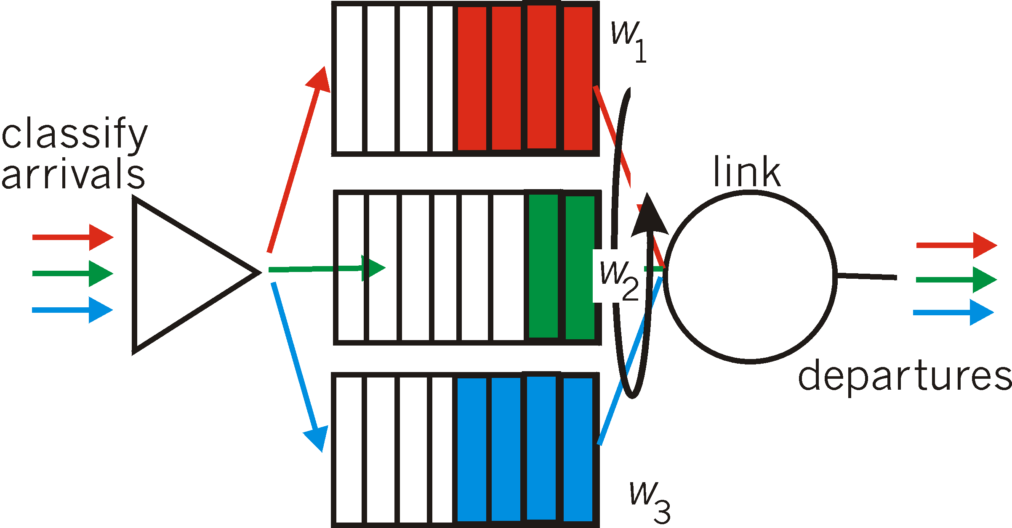
QoS Queuing Framework
Queuing
Classification
Scheduling
Notes:
Flow isolation is studied extensively in the past. It is called Quality of Service.
Showing on the screen is the framework of Quality of Service queuing.
When a packet arrive, we need to distinguish which flow it belongs to. A flow is usually defined as a set of packets with the same source and destination IP address and the same source and destination ports number.
After the packet classification, the packet will be buffered in the queue. Each queue is only associate with one single flow.
The last procedure is to decide which packet at the head of each queue is going to send to the output link. This procedure is called packet scheduling, and there are many packet scheduling algorithms out there.

Slide 7
Motivation: Multi-Resource Demands
CPU
NIC
High
Low
IDS
Low
High
WAN Optimizer
Notes:
However, these packet scheduling algorithms cannot apply directly to the flow isolation problem in the consolidated environment, because they only consider how to fairly share bandwidth in traditional forwarding devices, such as routers and switches.
The challenge for the consolidated environment is that the processing of a packet may require multiple resources. Different network functions comsume different profile of multi-resources.
For example, we have two network functions here, Intrusion detection system and wide area network optimizer. The packets need to processed first by CPU and then by the NIC. NIC is used to send packets to the outlink. However, Intrusion detection system consume more CPU resource than WAN optimizer. On the other hand, WAN optimizer utilize more NIC resource than intrusion detection system.

Slide 8
Problem
How to fairly share multiple resources
for packet processing in consolidated environment?
Notes:
So, the problem here is how to fairly share multiple resource for packet processing in consolidated environment. I will show our solution in minutes.

Slide 9
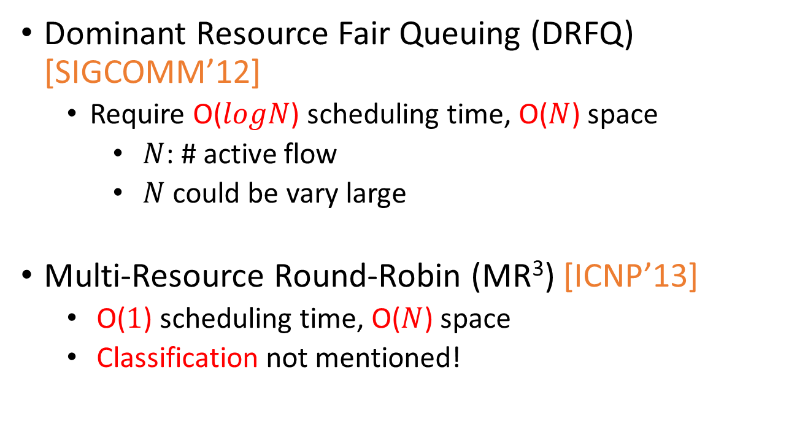
State-of-Art Solutions
Dominant Resource Fair Queuing (DRFQ) [SIGCOMM’12]
Require O($logN$) scheduling time, O($N$) space
$N$: # active flow
$N$could be vary large
Multi-Resource Round-Robin (MR³) [ICNP’13]
O($1$) scheduling time, O($N$) space
Classification not mentioned!
Notes:
Before going through our solution, Let’s first review state-of-art solutions.
Dominant resource fair queueing was published in SIGCOMM’12. It require O(logN) scheduling time and O(N) space, where N is the number of active flows. The problem is that N could be very large, and thus this algorithm could be slow and consume non-trivial memory space.
Another solution, called multi-resource round-bin was published in ICNP’13.
Even though the scheduling time reduced to O(1), but the space consumption is still O(N).
More importantly, classification procedure is not mentioned in this paper, which is very likely to be the bottleneck.

Slide 10
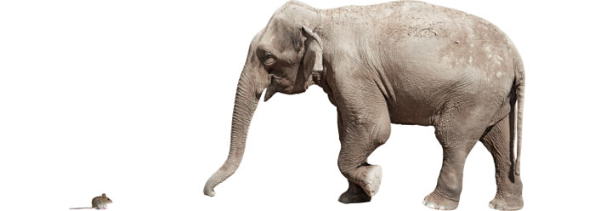

Basic idea
A small number of giant flows dominant
Top 10% largest flows contribute 90% traffic
Elephant flow V.S. Mice flow
Only precisely control Elephant flows
All Mice flows queue in one FIFO
Myopia
Notes:
Our idea is based on a key observation on the Internet. We found that a smaller number of giant flows domain the Internet, to be more specific, top 10% largest flows contribute 90% of all traffic in the network. In our work, we call the large flows, elephant flows and the others, the mice flows.
Our idea is that we only precisely control elephant flows, whereas all mice flows are queuing in one single FIFO.
And thus, we call our algorithm myopia. Our algorithm can only see elephant flows clearly.

Slide 11
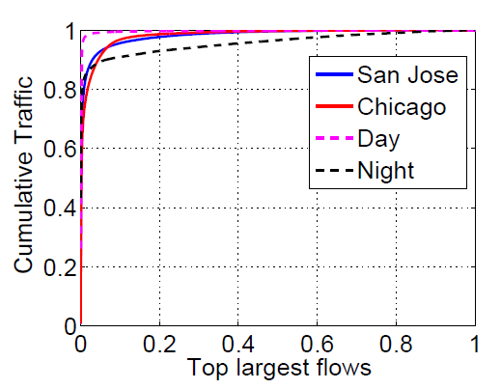
Flow Characteristics
A small number of giant flows dominant!
Top 10% largest flows contribute 90% traffic
Notes:
The flow characteristics observation is validated by real trace analysis. We analysis four different traces, which are representatives for different location and different time.
In this plot, the x axis represent the portion of top largest flows, and the y axis is the cumulative traffic. We can see that for all traces, top 10% largest flows contribute at least 90% of all the traffic.

Slide 12
Myopia Challenges
How to detect Elephant flows?
How to orchestrate Elephant and mice flows?
Notes:
We need to resolve two main challenges in myopia.
The first is How to detect elephant flows?
Once the elephant flows are detected, we also need to know how to orchestrate elephant and mice flows?
Let’s look at the first challenge.

Slide 13
Elephant Flow Detection
Elephant flow:
# packet/bytes is bigger than a threshold
Naïve solution: store the counter for each flow
Non-trivial memory space
DRAM
Low speed
Notes:
Elephant flow is defined as a flow whose packets/bytes numbers is bigger than a threshold. The threshold is specified by the networking operators.
To detect elephant flows, the naive solution is very simple: just have a counter for each flow and update it accordingly.
However, this solution will consume non-trivial memory space. To accommodate these counters, large but slow DRAM is used. As a result, the overall speed is low. High-speed network cannot be supported.

Slide 14

Elephant Flow Detection
Count-Min Sketch
Store approximate counts of flows in an efficient way
32
5
12
h1
11
17
19
23
11
h2
10
24
9
31
10
27
Update
14
h3
13
18
3
36
16
29
Notes:
In our solution, we utilize Count-min sketch.
Count-min sketch is a compact data structure which can store the approximate counts for each element.
We choose count-min sketch because it is space-efficient and there is provable tradeoff between space and accuracy of estimation.
Count-min sketch is a set of arrays, each is associated with one hash function.
The update procedure is as follows.
For each array, it a bucket index is calculated based on the packet’s flowID by the hash function. As I mentioned before, the flow id is the packets’ ip source and destination address and source and destination ports field. Then counter in the bucket would be updated. The same procedure is done in all arrays.

Slide 15
Elephant Flow detection
Count-Min Sketch
Store approximate counts of flows in an efficient way
32
5
12
h1
11
17
19
23
flowID
10
h2
11
24
9
31
10
27
Query
13
h3
14
18
3
36
16
29
Estimated
Pick Min
5
9
3
3
Notes:
So how can we get the size of flow?
Given the flow ID, we get the bucket indexes in the same way as updating.
We now have all the counters associated with this flow.
We pick the minimal value, and it is the flow’s estimated size.
Once a flow’s estimated size is bigger than the threshold, we then identify it as the elephant flow.

Slide 16
Myopia Challenges
How to detect Elephant flows?
How to orchestrate Elephant and Mice flows?
Notes:
We now know how to identify elephant and flow flows. The next question is how to orchestrate them.

Slide 17


Myopia Framework Overview
MRFQ Sub-system
Elephant Flow Table
Add queue
Add rule
Count-min Sketch
FIFO
Notes:
I will first show you the overview of our solution’s architecture.
Upon receiving a packet, it will first lookup the elephant flow table.
If there is match, then we know it belongs to a elephant flow and forward it to MRFQ Sub-system, which we will see in detail.
If there is no match, then it belongs to a mice flow and is sent to Count-min Sketch to update the counter.
If a new elephant flow is detected, a new rule would be added to the elephant table and a new queue will be allocated in MRFQ Sub-system; otherwise, the packet would be queued in the FIFO.
At last, the packets in MRFQ Sub-system and those in FIFO would be merged.

Slide 18
Myopia Framework Overview
MRFQ Sub-system
Elephant Flow Table
Add queue
Add rule
Count-min Sketch
FIFO
Notes:
Let’s first look at elephant flow table in detail.

Slide 19


Elephant Flow Table
MRFQ Sub-system
Count-min Sketch
Notes:
The elephant flow table is installed in TCAM, which means that the matching procedure would take only constant time. Once there is match, the packet would be buffered at the corresponding queue in the MRFQ Sub-system. Like traditional Quality of Service framework, each queue is only associated with one elephant flow.
If there is NO match, forward it to count-min sketch.

Slide 20
Myopia Framework Overview
MRFQ Sub-system
Elephant Flow Table
Add queue
Add rule
Count-min Sketch
FIFO
Notes:
Then, let’s look at MRFQ Sub-system.

Slide 21
Multi-Resource Fair Queuing Sub-system
Scheduling
Notes:
MRFQ means Multi-Resource Fair Queuing.
In the multi-resource fair queuing sub-system, like traditional Quality of Service framework, each queue is only associated with one elephant flow.
The scheduling algorithm still considers which packet at the head of queue to take, but the scheduling algorithm considers multiple resources.

Slide 22
Multi-Resource Fair Queuing Sub-system
Dominant Resource
CPU
NIC
High
Low
IDS
Low
High
WAN Optimizer
Notes:
To under the scheduling algorithm, it is better to know the concept of dominant resource at first.
For a particular packet, the resource that it consumes most is called the packet’s dominant resource.
For example, if a packet is served by intrusion detection system, it consumes more CPU time than the time spend at NIC card. As a result, CPU is this packet’s dominant resource. Likewise, it NIC is the dominant resource for anther packet served by Wide Network function.

Slide 23
Multi-Resource Fair Queuing Sub-system
Dominant Resource
Dominant Resource Fair Queuing
Share dominant resource fairly
Notes:
Dominant Resource Fair Queuing is trying to share dominant resource fairly among the elephant flows.

Slide 24
Multi-Resource Fair Queuing
Packet tag
Dominant resource used by the flow when the pkt is out
8
2
4
Notes:
Here we will show how the algorithm works.
When the packet is entering MRFQ sub-system, it will a tag on it, which specify the amount of dominant resource is used by the flow when the packet is out.

Slide 25
Multi-Resource Fair Queuing
Packet tag
Dominant resource used by the flow when the pkt is out
Tagging
8
2
4
Notes:
So how can we tag?
The tagged value is the sum of Prior packet’s tag and current packet’s domain resource usage.
For example, here we have a packet which will consumes 1 second’s of dominant resource. For the last packet in the corresponding queue, its tag value is 2. As a result, the tag value for the current packet is 3.

Slide 26
Multi-Resource Fair Queuing
Packet tag
Dominant resource used by the flow
Tagging
Prior packet’s tag
+
dominant resource
Scheduling
Smallest tag first
8
3
2
1
7
Notes:
When schedule the packet, we follow smallest tag first, which essentially means that the flow consumes least dominant resource in the past would be scheduled first. There is formalized proof in our paper to show why fairness is preserved in this scheme.

Slide 27
Myopia Framework Overview
MRFQ Sub-system
Elephant Flow Table
Add queue
Add rule
Count-min Sketch
FIFO
Notes:
Finally, we need to consider how can orchestrate elephant flows in MRFQ sub-system and mice flows in FIFO.

Slide 28
Merge
FIFO V.S. MRFQ-Subsystem
FIFO First
Benefits:
Packet order within the flow is preserved
Preference for Mice flows: higher throughput
Notes:
Our decision is that mice flows always have higher priority than elephant flows to be scheduled. Which means that once there is packets in FIFO, we need to schedule them first.
This decision yields two basic benefits.
The packet order within the flow is preserved. Sometimes, the packet disorder may hurt the throughput of TCP significantly.
Also, a preference for mice flows would yield higher throughput than FCFS.

Slide 29
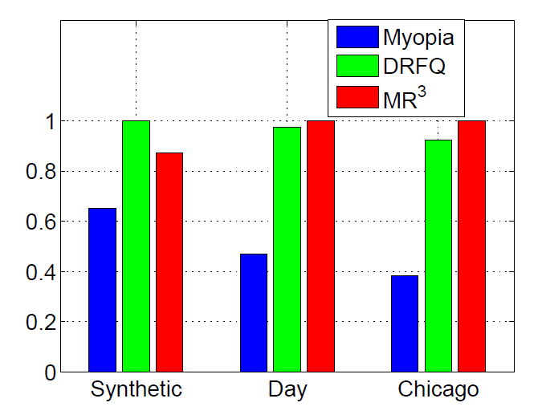
Evaluation
Prototype emulation
Click (Software Router)
Norm.
Time
Outperform in all traces
Notes:
Here we come to the evaluation part.
We build our prototype in click, a software router.
This plot shows the varying time to complete packet scheduling for 3 different traces by 3 different algorithms.
The y axis is normalized by the maximal completion time for each trace.
X axis represent different traces.
Different color bars represent different algorithms.
It is clear that our solution outperforms in all traces.

Slide 30
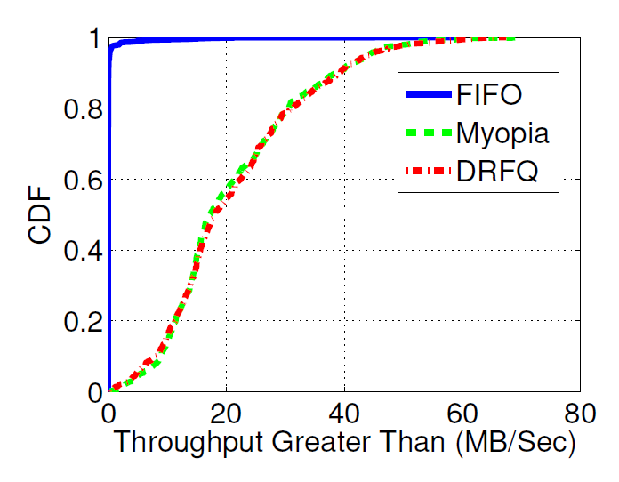
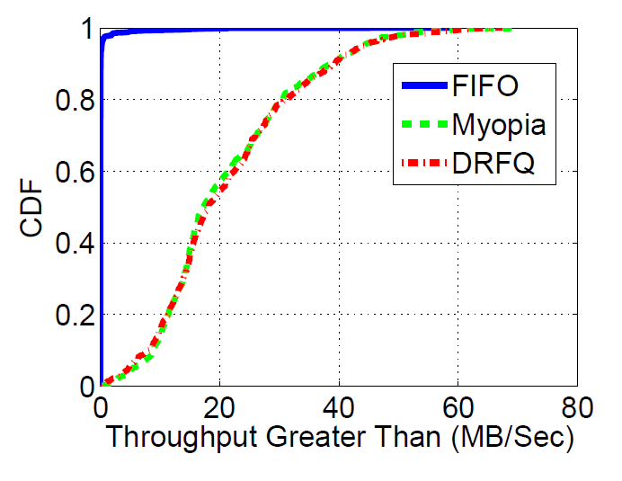
Evaluation
Simulation (NS3)
Throughput distribution
No isolation!
FCFS
Similar isolation!
Throughput less than (MB/s)
Notes:
We also do simulation on NS3 to measure the per-flow throughput distribution.
This is a CDF plot regarding per-flow throught.
We can see that there is no flow isolation for FCFS, as we expected. There are similar curves for our solution and DRFQ. DRFQ is proved to have flow isolation property. And it means that our solution also enjoys flow isolation.
Per-flow throughput
UDP

Slide 31
Summary
Flow size distribution
Elephant flows dominant the traffic
Multi-resource fairness
Dominant resource fairness
Low complexity
Efficient in classification, buffering and scheduling

Slide 32

Thank you!

Slide 33

Count-min Sketch improvement
Why error?
Hash collision
How to reduce collisions?
More space
Fast memories (SRAM) are too small
Less load

Slide 34
Count-min Sketch improvement
Why error?
Hash collision
How to reduce collisions?
More space
Fast memories (SRAM) are too small
Less load
Less load

Slide 35
Count-min Sketch improvement
Less load
Shielding
32
5
12
h1
11
17
19
23
Packet
11
h2
10
24
9
31
10
27
Update
14
h3
13
18
3
36
16
29
Not from elephant flow

Slide 36
Count-min Sketch improvement
Less load
Shielding
32
5
12
h1
11
17
19
23
Packet
11
h2
10
24
9
31
10
27
Update
No update!
14
h3
13
18
3
36
16
29
From elephant flow

Slide 37
Count-min Sketch improvement
Less load
Shielding
Conservative update
Packet
Update

Slide 38
Count-min Sketch improvement
Less load
Shielding
Conservative update
Redundant
Packet
Update
Redundant

