Slide 1
A Survey of Network Function Placement
Chen Qian, Xin Li
University of Kentucky

Slide 2
Network Function
Network Function
Middlebox
Networking device that perform functions other than packet forwarding

Slide 3
Network Function
Security Network Function
Firewall
IDS
Acceleration Network Function
WAN Optimizer
Proxy

Slide 4
Policy Chain
Correctness: sequential order
Efficiency: not traverse unnecessary ones
Http
Firewall
IDS
Proxy
Non http
Firewall

Slide 5
Network Functions Placement
Policy chain
Placement
Http
Firewall
IDS
Proxy
Firewall
Proxy
Considerations: bandwidth, latency, cost, etc.
S2
S4
S1
S3

Slide 6
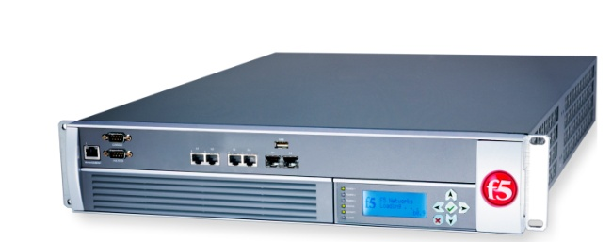


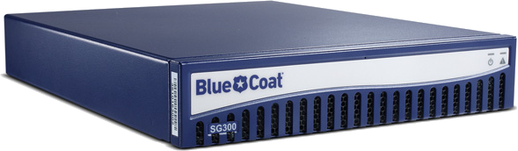

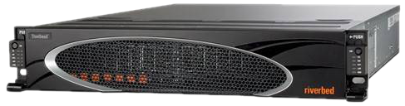

Network Functions Virtualizaiton
IDS
Hardware
Software
WAN Optimizer
More flexible and cheaper
Proxy

Slide 7
Survey of Network Function Placement
Hardware Network Function
Virtual Network Function (VNF)
Thread based
VM based
Other Forms

Slide 8
Survey of Network Function Placement
Hardware Network Function
Virtual Network Function (VNF)
Thread based
VM based
Other Forms

Slide 9

Placement: Hardware Network Functions
Stand-alone network functions (e.g. passive monitor)
Locating [Infocom’05]
Minimize cost -> Set Cover Problem (NP Hard)

Slide 10
Placement: Hardware Network Functions
Chained network functions
Traffic Steering
Simple [Sigcomm’13]
Firewall
IDS
Proxy
Policy Chain:
Http
Firewall
Proxy
IDS
Placement determine routing paths ->Minimize latency
S1
S2
Dst

Slide 11
Placement: Hardware Network Functions
Recap
NF types | Location | Traffic Steering | Placement Objective
independent | in-line | optional | max coverage / min. cost
chained | off-line | compulsory | min latency

Slide 12
Survey of Network Function Placement
Hardware Network Function
Virtual Network Function (VNF)
Thread based
VM based
Other Forms

Slide 13
Placement: Virtual Network Functions
Thread based (e.g. consolidation [NSDI’12])
Light weight
No resource isolation
Virtual machine based (e.g. E2 [SOSP’15] )
Additional overhead
Resource isolation

Slide 14
Placement: Virtual Network Functions
Thread based (e.g. consolidation [NSDI’12])
Threads
VPN Web Mail IDS Proxy
Firewall
Resource consumption is proportional to traffic
Protocol Parsers
Session Management

Slide 15
Placement: Virtual Network Functions
Thread based VNF placement
Firewall
IDS
Proxy
Policy Chain:
Http
Process (0.4)
Process (0.3)
Process (0.3)
N3
N1
P: N1→ N3
N2
Load Balance
Monolithic consolidating

Slide 16

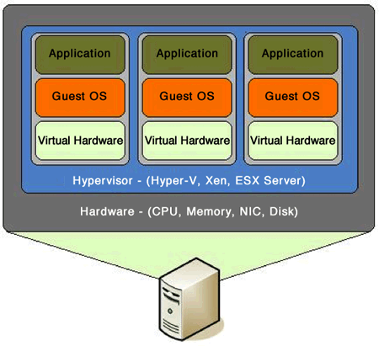

Placement: Virtual Network Functions
Virtual machine based (e.g. E2 [SOSP’15] )
Overhead

Slide 17
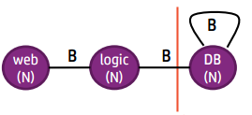

Placement: Virtual Network Functions
Virtual machine based placement (VM placement)
TMVPP [INFOCOM’10], Oktopus [SIGCOMM’11], CloudMirror [SIGCOMM’14]
placement
IDS
WAN Optimizer
Proxy

Slide 18


Placement: Virtual Network Functions
Recap
Other aspects
Location dependency, handling mangling network functions, order preserver, etc.
VNF form | On path? | Isolation?
Thread
VM

Slide 19

Mangling Network Functions
Header modification
NAT
Firewall
H₁
Monolithic consolidation can handle
mangling network functions
Internet
H₂
S₁
S₂

Slide 20
Survey of Network Function Placement
Hardware Network Function
Virtual Network Function (VNF)
Thread based
VM based
Other Forms

Slide 21
Placement: Other forms
Coordinated Distributed Network Functions
Csamp [NSDI’08]
On path load balance
Host-based Network Functions
ETTM [NSDI’11]
Monolithic consolidation

Slide 22
Challenges and Future work
Take advantages of traffic pattern of policy chains
Different from production VMs
Coordinate placement and other mechanisms to incorporate mangling network functions.

Slide 23

Thanks!

