Slide 1
Internet and World Wide Web
Assignment 2
高乔 0830300012
练力行 0830300023
李锦伦 0830300021

Slide 2
What can our ASM2 do?
Download files with multiple sessions.
Resume broken transfer.

Slide 3
Major cpp file description
Mydownload.cpp: The program first analyse the input URL, divided it into address, path and the file name. Then get the size of the file, last is to download and combine the thread together. Resume broken transfer
DownloadHelper.cpp: Add the download task, we set the default thread is 3.

Slide 4
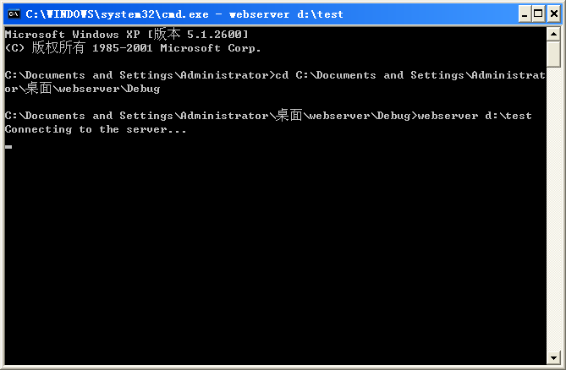
First, initialize the server

Slide 5
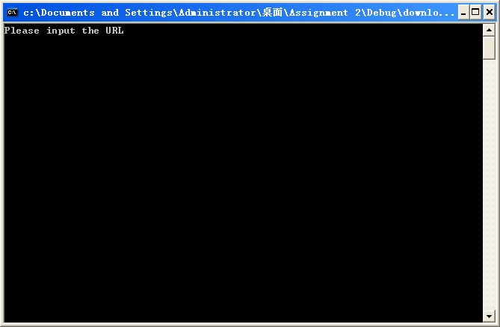
Second, run the client.

Slide 6
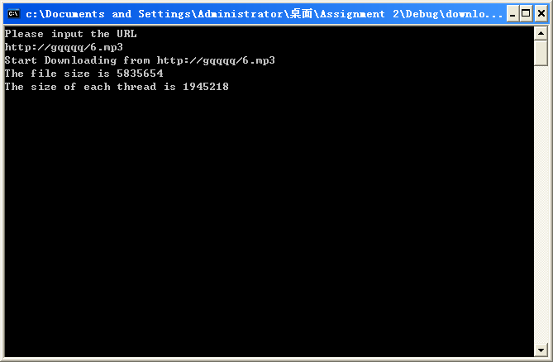

While downloading

Slide 7

Download over

Slide 8
Now we will demonstrate the program.
Thanks

