Slide 1
The Best Neighborhood for the locations of the Groceries Contractor in Toronto(Scarborough)
Applied Data Science Capstone
Summer 2020

Slide 2
Part 1: Problem Description
A grocery contractor in an administrative district of Toronto (Scarborough). The contractor provides venues: different types of restaurants, bakeries, breakfast spots, breweries and cafes, fresh and high-quality food. The contractor wants to build a warehouse to store food raw materials and ingredients purchased from various places, so that they can distribute faster and save some costs.
The contractor should build this warehouse where it is closest to its customers in order to minimize the cost of transpotation in addition to the example above. which neighborhood (in that borough) would be a better choice for the contractor to build the warehouse in that neighborhood. Finding the right neighborhood is our mission and our recommender system will provide this contractor with a sorted list of neighborhoods in which the first elemnt of the list will be the best suggested neighborhood.

Slide 3
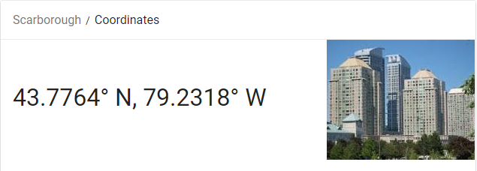
Part 2: Data We Need(1)
We will need information about the geographic location of a particular administrative district and the community of that administrative district. We specifically and technically refer to the latitude and longitude numbers of that administrative region. We assume that it is Toronto's "Scarborough". This is easily provided to us by the contractor because the contractor has decided his municipality. The zip code belonging to that administrative district (Scarborough) is also enough for us. In fact, we will first find the corresponding postal code in Scarborough. The websites on Wikipedia given in this chapter are as follows: https://en.wikipedia.org/wiki/List_of_postal_codes_of_Canada:_M

Slide 4
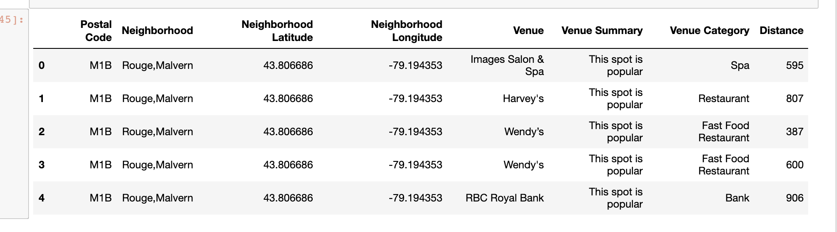
Part 2: Data We Need(2)
We will need data about different venues in different neighborhoods of that specific borough. In order to gain that information we will use "Foursquare" locational information. By locational information for each venue we mean basic and advanced information about that venue. For example there is a venue in one of the neighborhoods. As basic information, we can obtain its precise latitude and longitude and also its distance from the center of the neighborhood. But we are looking for advanced information such as the category of that venue and whether this venue is a popular one in its category or maybe the average price of the services of this venue. A typical request from Foursquare will provide us with the following information:https://foursquare.com/

Slide 5
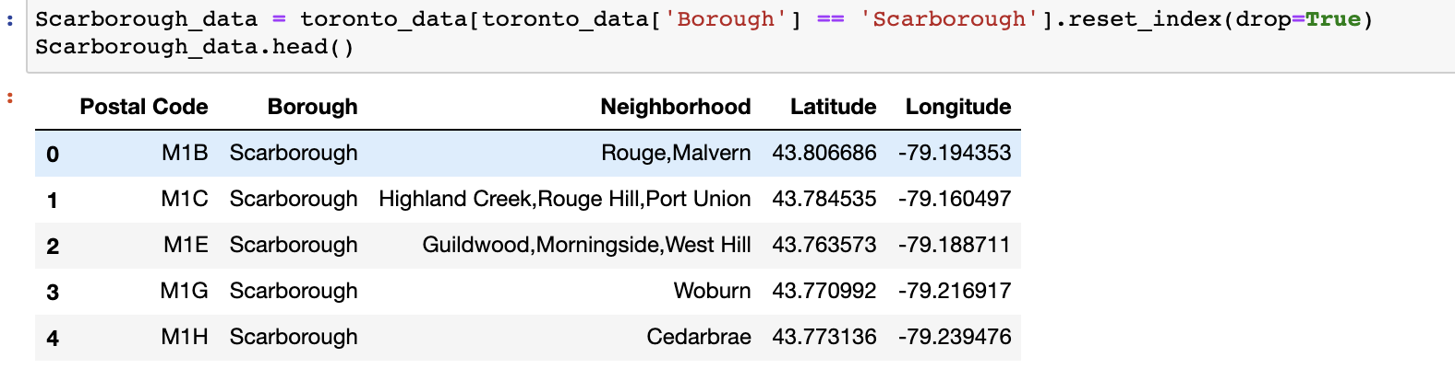
data cleaning
Identifying Postal Codes (and then Neighborhoods) in "Scarborough"

Slide 6
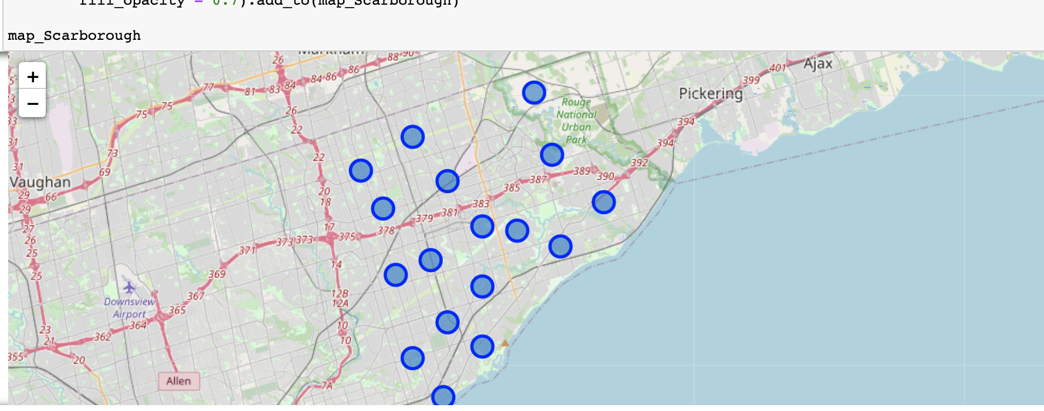
data visualization
mapping the neighborhood of"Scarborough"

Slide 7
Connecting to Foursquare
Connecting to Foursquare and Retrieving Locational Data for Each Venue in Every Neighborhood

Slide 8
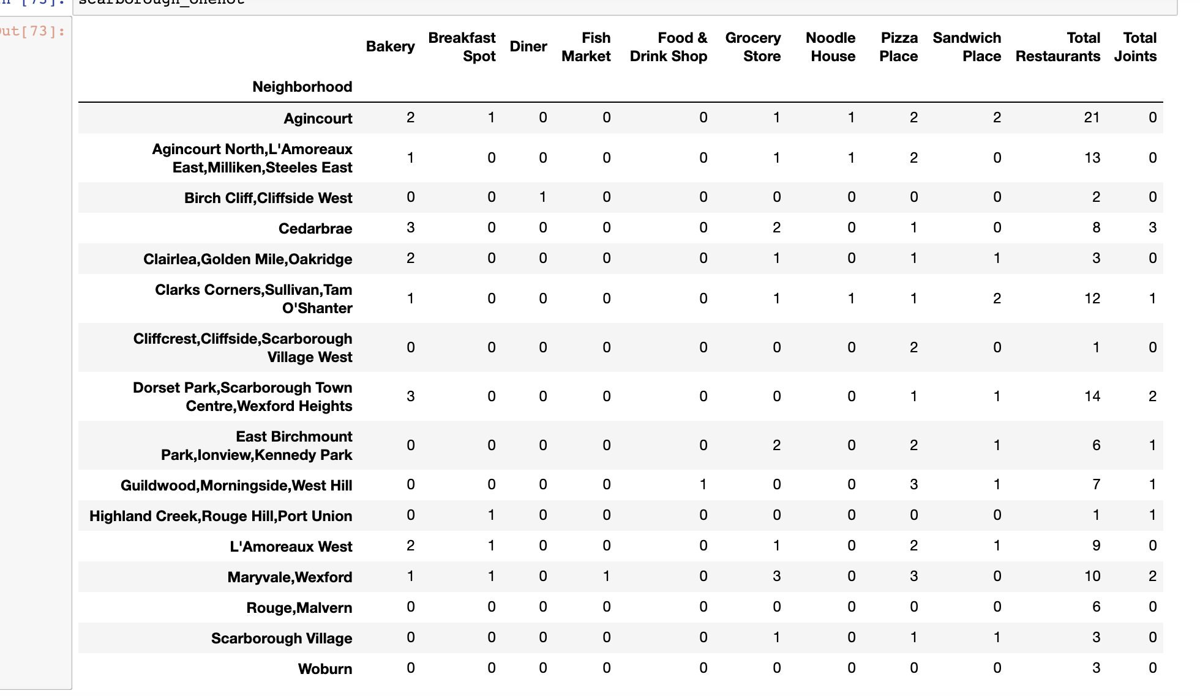
Processing the Retrieved Data and Creating a DataFrome for All the Venues inside the Scarborough
When the data is completely gathered, we will perform processing on that raw data to find our desirable features for each venue. Our main feature is the category of that venue. After this stage, the column "Venue's Category" wil be One-hot encoded and different venues will have different feature-columns. After On-hot encoding we will integrate all restaurant columns to one column "Total Restaurants" and all food joint columns to "Total Joints" column.

Slide 9
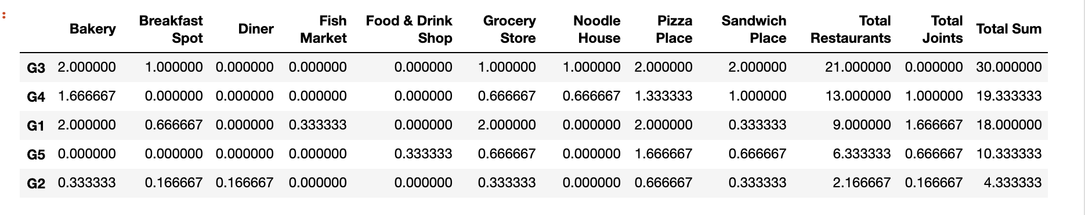
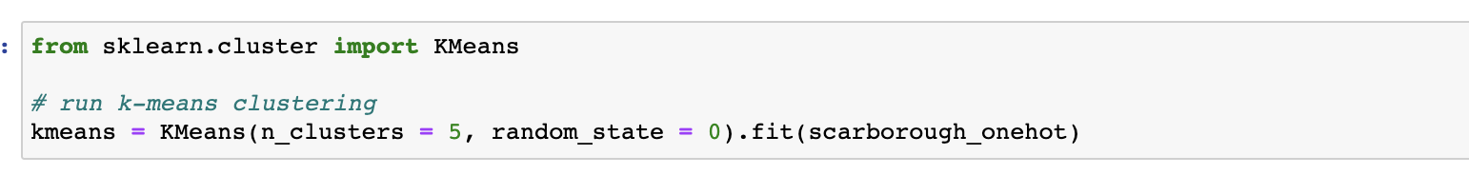
Applying one of Machine Learning Techniques (K-Means Clustering)

Slide 10
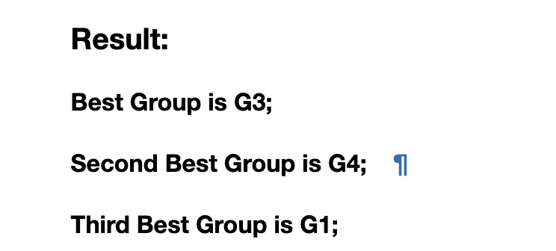
Decision Making and Reporting Results

Slide 11
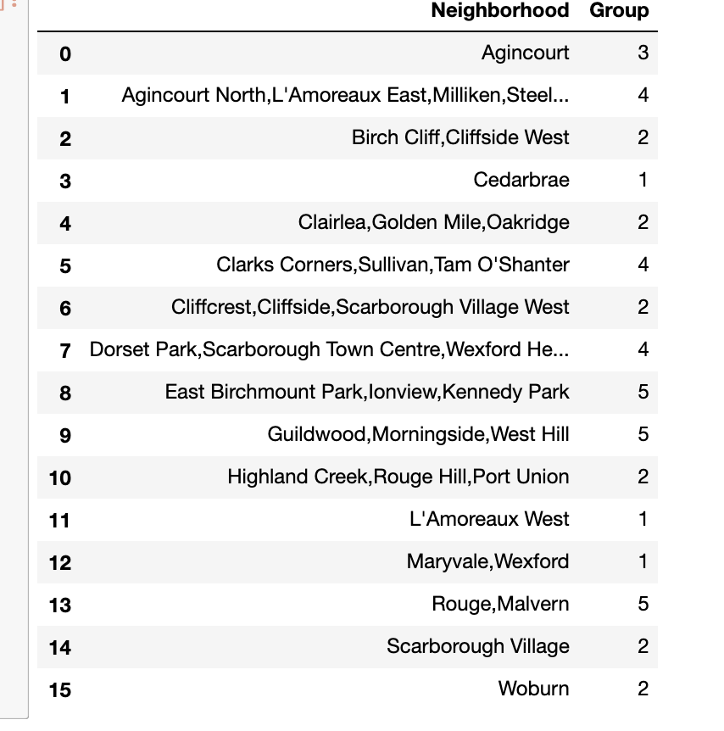
Decision Making and Reporting Results

Slide 12
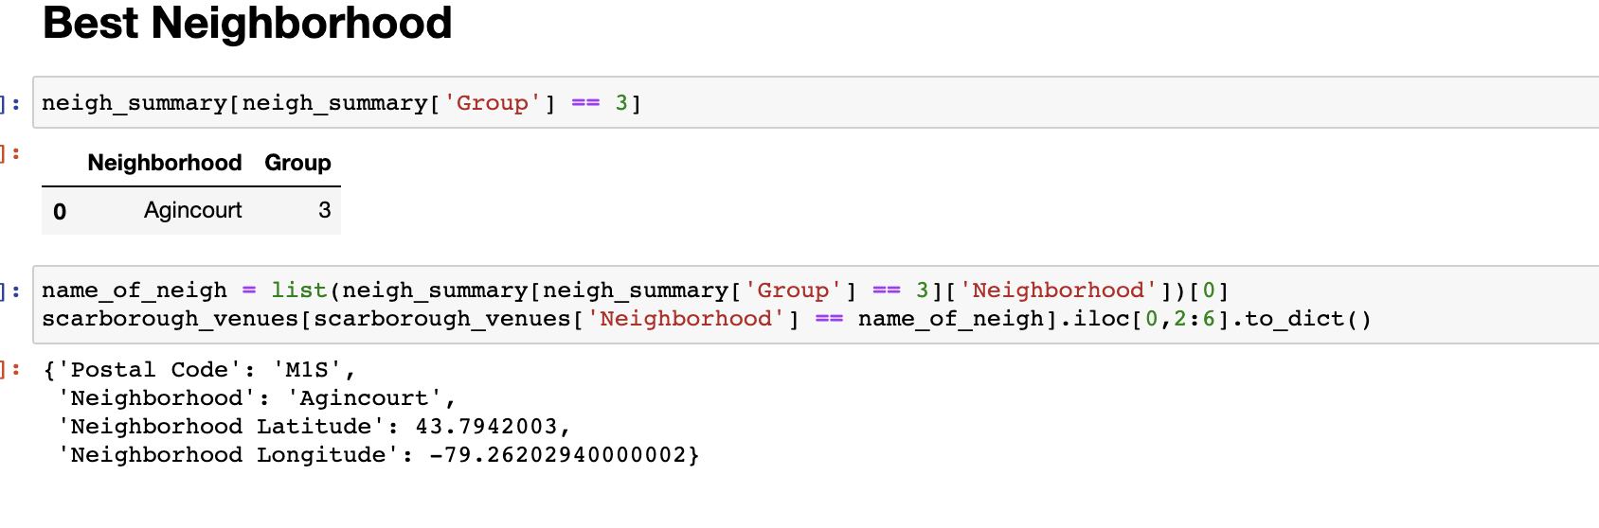
Decision Making and Reporting Results

