Slide 1
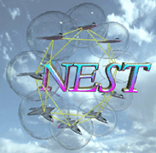
Routing Minitask Report
Palo Alto Research Center (PARC)
Group members:
UC Berkeley (UCB)
Notre Dame (ND)
Ohio State (OSU)
Vanderbilt University (VU)
University of Virginia (UVA)
June 2004

Slide 2

Motivation
Routing Modeling:
  Networks
  Applications
  Metrics
Layered Architecture:
  Algorithm Repository
  Component Sharing
  Plug and Play
Routing Strategies:
  Tree-based
  Flooding-based
  Search-based
Application Scenarios:
  Dynamic-to-static
  Dynamic-to-mobile
  Many-to-one
Rmase
Application-oriented
Routing Strategy Comparisons

Slide 3

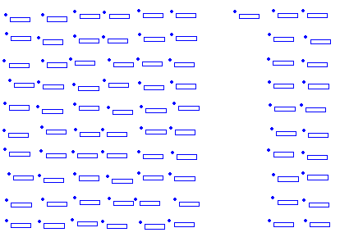
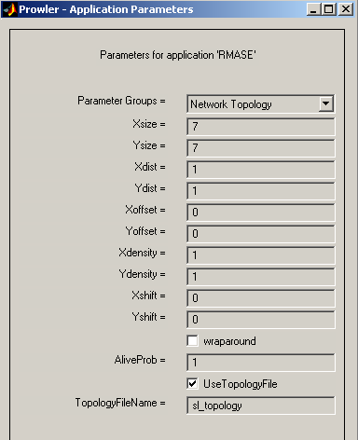
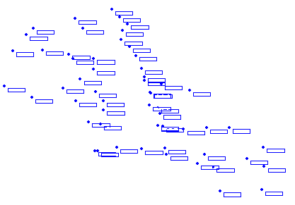
Rmase Modeling: Network Topology
Uniform or random networks, with holes
Application: LIS
User given topologies
Application: SL

Slide 4
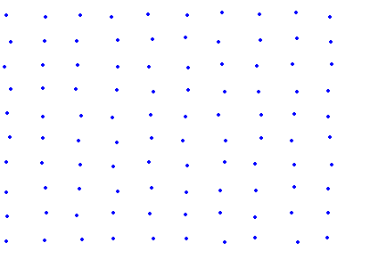
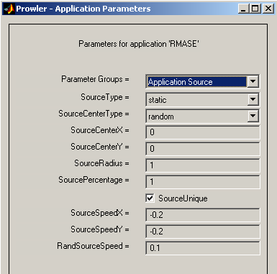
Rmase Modeling: Application Scenarios
User given trace: (ID, Time)
Source
speed
center
radius
rate
Destination

Slide 5
Rmase Modeling: Performance Metrics
Latency (s): T_{received} – T_{sent}
Throughput (p/s): R/T
Loss Rate: L/(L+R)
Success Rate: ΣR/ΣS
Energy Use: ΣU
Energy Efficiency: ΣR/ΣU
Lifetime Predication: E_{max} – (U+σ)
U ← ΣU/N
σ² ← Σ(U–U)²/N
T: time
R: received packets
L: lost packets
S: original packets
U: used energy
N: total nodes
E: energy

Slide 6
Layered Routing Architecture
Motivation
  Component Reuse
  Component Reconfiguration
General Flow
  Commands flow down
  Events flow up
stat
app
flood2Dgrad
Events
Commands
routing2Dmany
Commands
  Send_Packet
Events
  Packet_Received
  Packet_Sent
  Clock_Tick
  Init_Application
check_duplicate
aggregate_queue
mac

Slide 7
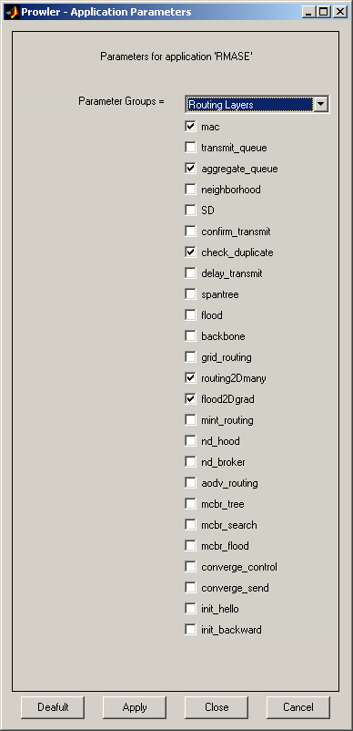
Common Routing Components
app
init_hello
init_backward
control
routing
support
delay_transmit
check_duplicate
confirm_transmit
neighborhood
max_hops
tggregate_queue
transmit_queue
mac

Slide 8
Taxonomy of Algorithm Repository
Structure-based
Connectionless
Path-based
AODV+
Tree-based
Backbone- (UVA)
Adaptive- (PARC)
Broker* (ND)
Mint* (UCB)
Grid* (OSU)
Flood-based
Grad- (VU)
Constrained- (PARC)
Radial Coord.- (PARC)
Search-based
LRTA-(PARC)
Control Packets: *: periodic, -: initialization, +: repair
Structure Maintenance: asymmetric, symmetric

Slide 9
Component Strategies of Routing Algorithms
LRTA
(PARC)
ATree
(PARC)
bottom-up
tree
top-down
tree
Broker
(ND)
confirmation
asymmetric
Backbone
(UVA)
Mint
(UCB)
learning
Grid
(OSU)
snoop
symmetric
link
estimation
suppression
delay
transmit
directed
flooding
RC
(PARC)
CF
(PARC)
Grad
(VU)
duplication
aggregation

Slide 10
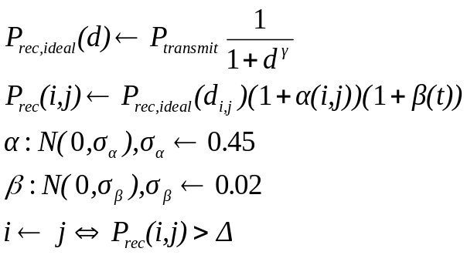
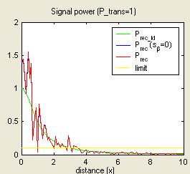
Application-oriented Comparisons
Assumptions
  Radio Model:
  Radio Strength: constant
  Algorithm Parameters: default
Applications
  LIS: A Line in the Sand (OSU)
  RFT: Red Force Tagging (ND)
  PEG: Pursuer/Evader Game (UCB)
  SL: Shooter Localization (VU)
  OSU: OSU Testbed (OSU)

Slide 11
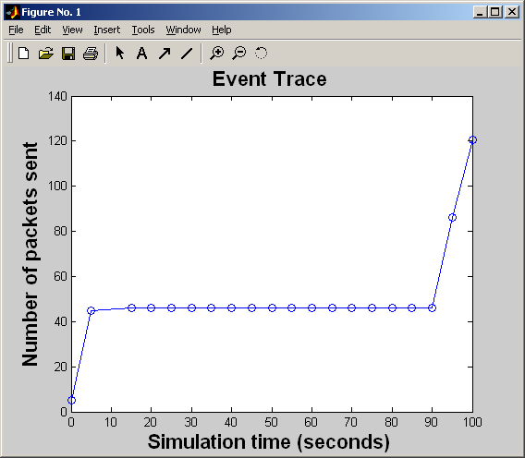
A Line in the Sand
Source: given trace
Destination: static at (0,0)
Simulation time: 100 s
Total runs: 10
Application: LIS

Slide 12
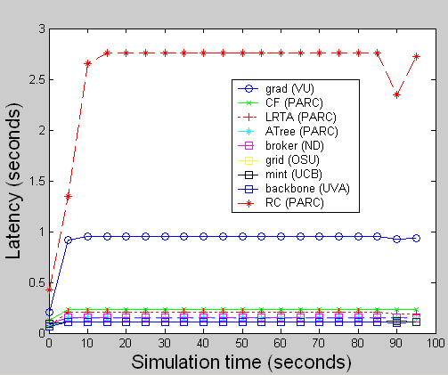
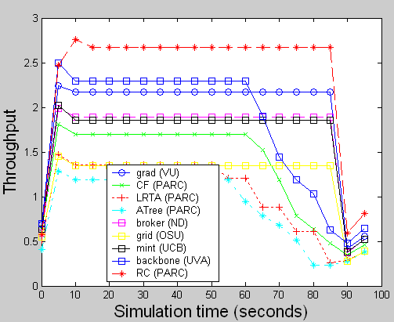
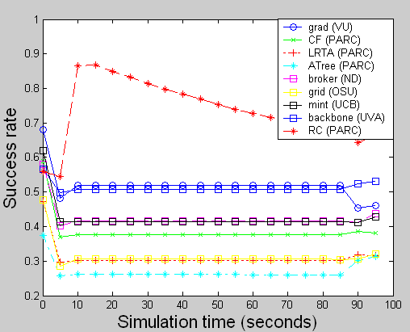
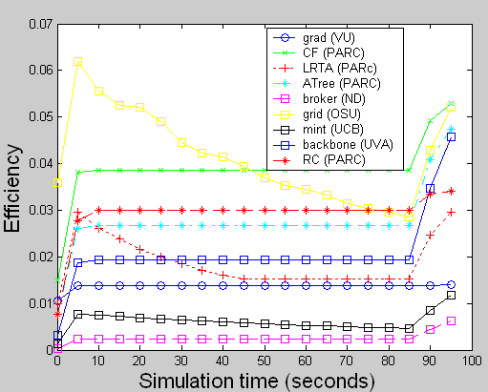
LIS Experiments

Slide 13
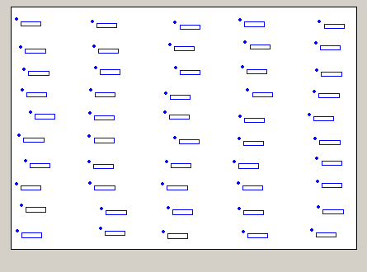
Red Force Tagging
Source:
  dynamic, speed 0.2/s
  Rate 1p/s
Destination:
  static at (0, 0)
Simulation time: 50 s
Total runs: 10
RFT Application

Slide 14
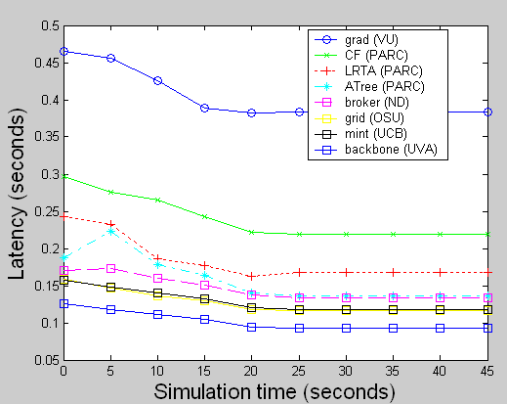
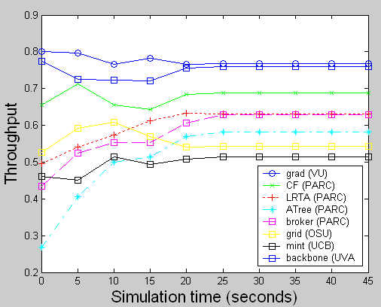
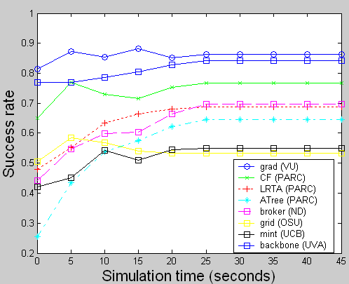
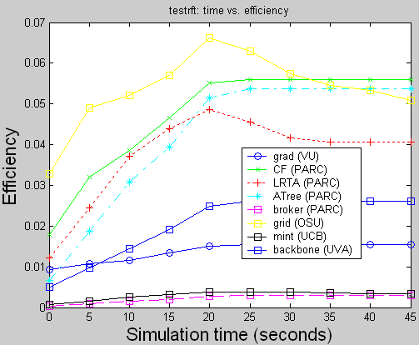
RFT Experiments

Slide 15
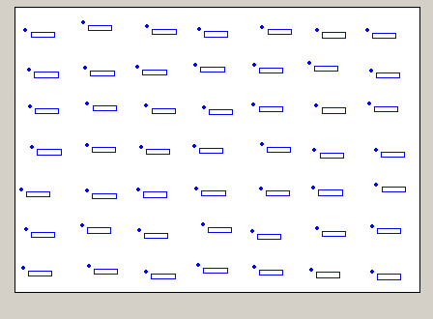
Pursuer/Evader Game
Source:
  dynamic, speed 0.2/s
  Rate 1p/s
Destination:
  Mobile, speed 0.2/s
Simulation time: 20 s
Total runs: 10
P
E
PEG Application

Slide 16
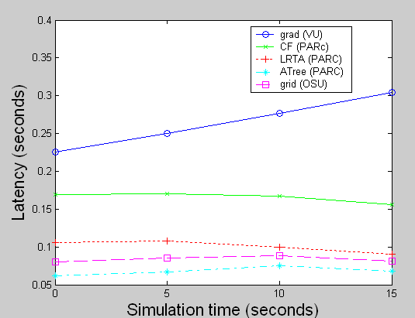
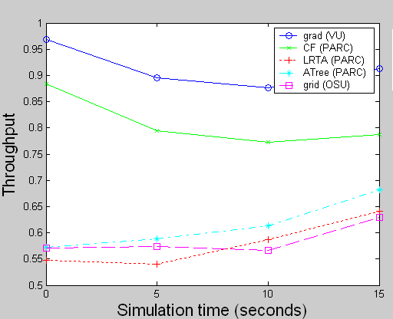
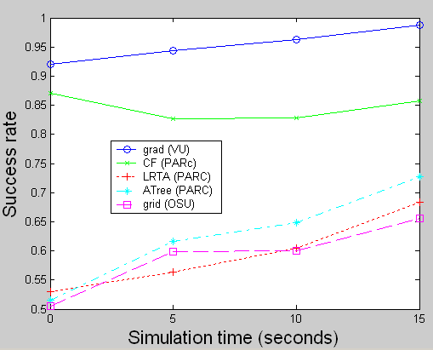
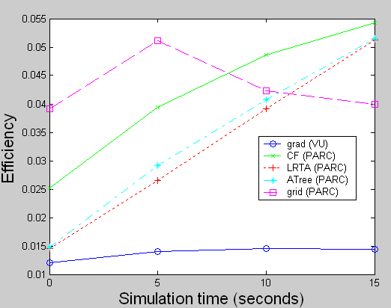
PEG Experiments

Slide 17
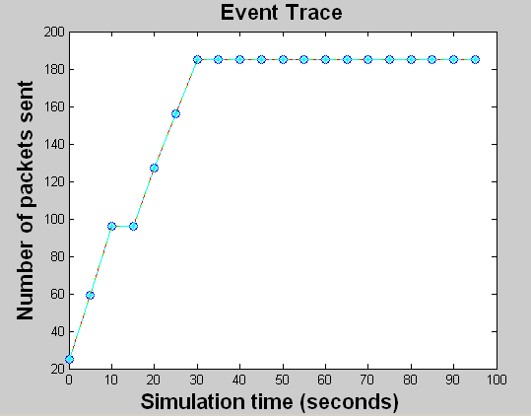
Shooter Localization
Source: given trace
Destination: static given
Simulation time: 100 s
Total runs: 10
Application: SL

Slide 18
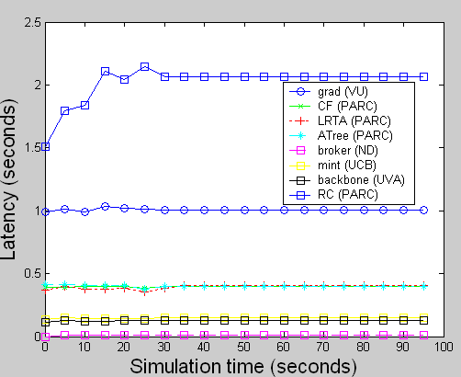
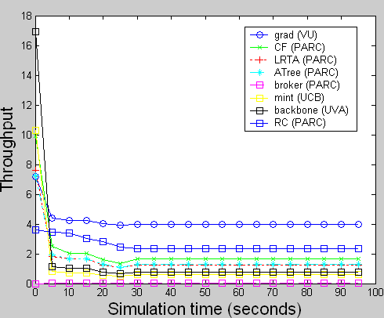
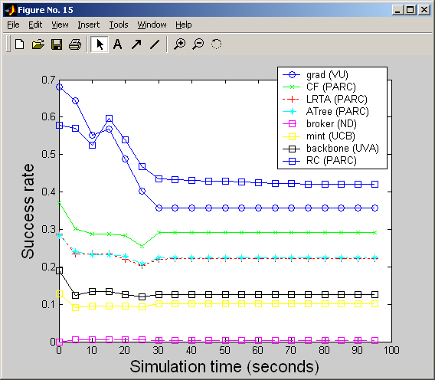
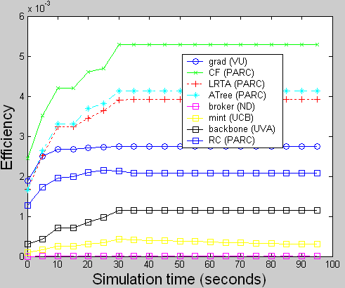
SL Experiments

Slide 19
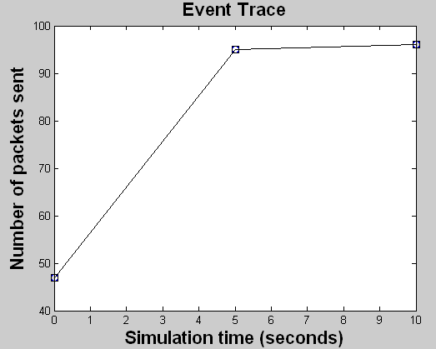
OSU Testbed
Source: give trace
Destination: static at (0, 0)
Simulation time: 15 s
Total runs: 10
OSU Application

Slide 20
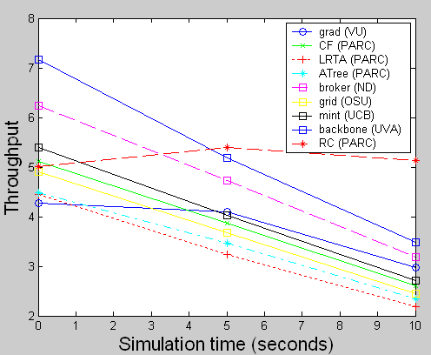
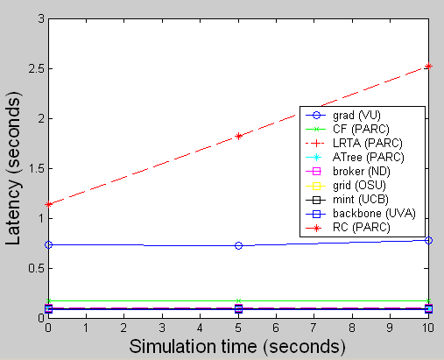
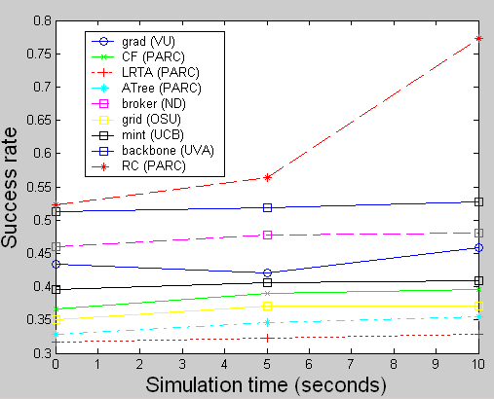
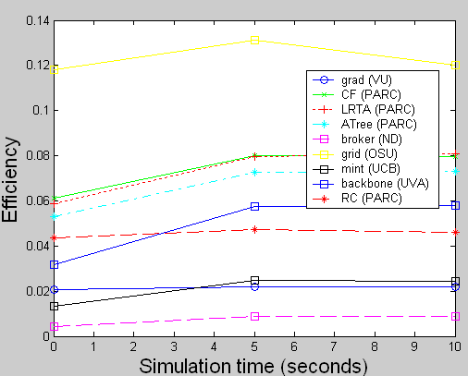
OSU Experiments

Slide 21
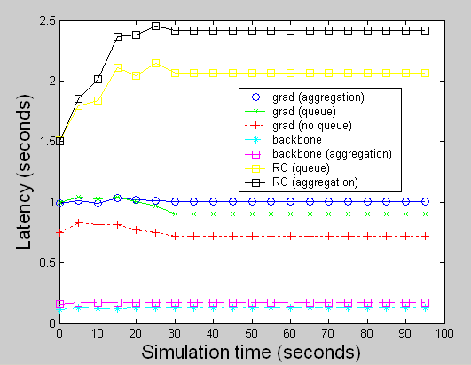
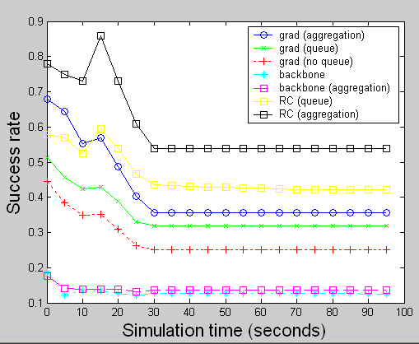
Plug-Play Routing Components
grad:
  with aggregation
  with transmit queue
  without queue
RC:
  with aggregation
  with transmit queue
backbone:
  with aggregation
  without aggregation

Slide 22
Lessons Learned: Modeling and Simulation
Rmase
Plug/play reusable routing components
Model routing applications
Analyze routing algorithms
Optimize routing performance

Slide 23
Lessons Learned: Routing Strategies
Dynamic
snoop
Burst
learning
suppression
confirmation
directed
flooding
Real-time
delay
transmit
Long-live
Reliable
duplication
tree

Slide 24
Take Away Points
Performance of routing strategies depends on
  the network and application types
  metrics the application cares about
The relationship between simulation and hardware
  Simulation makes assumptions
  Hardware verifies assumptions
Hardware
Experiments
Model
Generations
Hardware
Simulation
Algorithm
Implementation
Algorithm
Design

Slide 25
Thanks
Young-ri Choi (OSU/UTexas), Hongwei Zhang (OSU)
Miklos Maroti (VU), Manish Kushwaha (VU)
Marian Iordache (ND)
Alex Woo (UCB)
Tian He (UVA)

