Slide 1

代码质量
-- 李歆然
2015-12-28

Slide 2

Coding
Check
——代码质量摸底
Style
——统一编码风格
Find
——最有效的找Bug
Prevention
——最低成本的质量保证

Slide 3
目录
1
Base--准备工作
2
Check--代码质量摸底
3
Style--规范代码风格
4
Find--已有缺陷大搜索
5
Prevention--规避潜在缺陷

Slide 4
Base--准备工作
01

Slide 5
Base--准备工作
CHANCES
CheckStyle
Eclipse插件
FindBugs
PMD

Slide 6
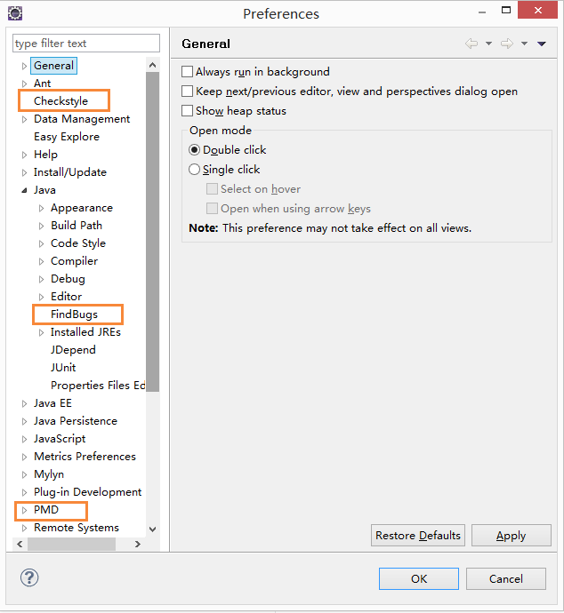
Base--准备工作
CHANCES
基础
PMD URL : http://eclipse-cs.sf.net/update/
FindBugs URL : http://findbugs.cs.umd.edu/eclipse
CheckStyle URL : http://sourceforge.net/projects/pmd/files/pmd-eclipse/update-site/
三者安装方式相同，以CheckStyle为例
•Eclipse 中选择"Help"->"Install New Software "
•在Work with 中输入"http://sourceforge.net/projects/pmd/files/pmd-eclipse/update-site/" 回车
•选择和Eclipse相对应的插件版本，进行安装
安装
验证

Slide 7
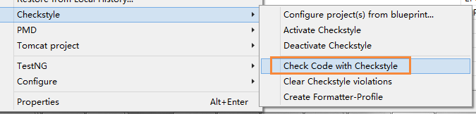
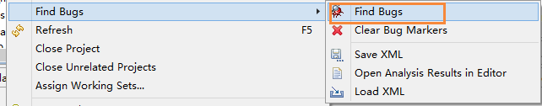
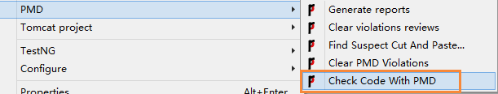
Base--准备工作
CHANCES
使用--选中项目-右键-选择需要的功能
CheckStyle
FindBugs
PMD

Slide 8
Check--代码质量摸底
02

Slide 9
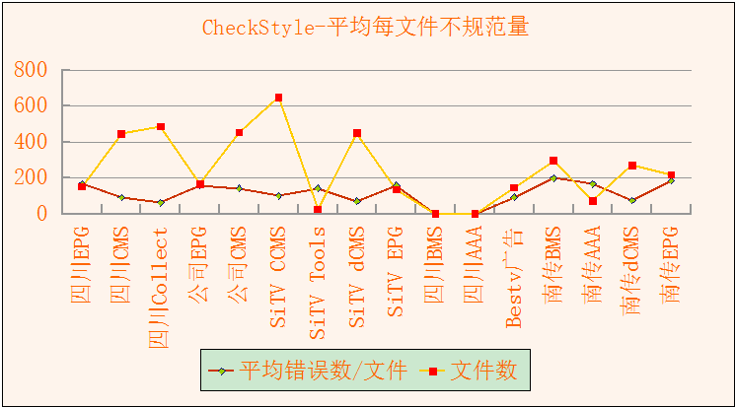
Check--代码质量摸底
CHANCES

Slide 10
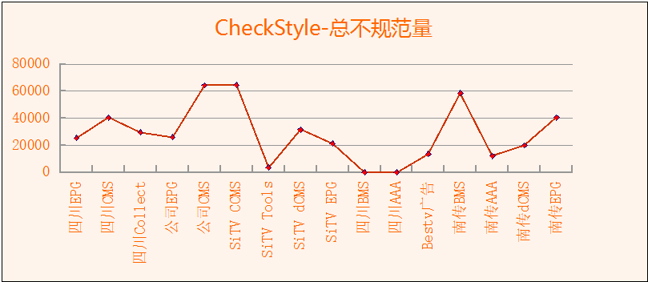
Check--代码质量摸底
CHANCES

Slide 11
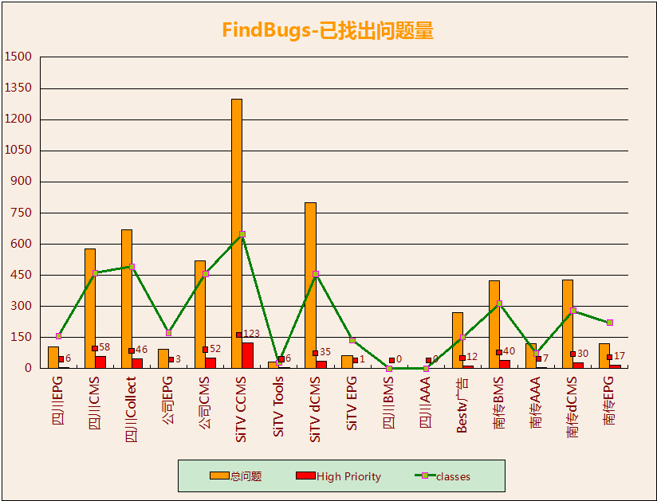
Check--代码质量摸底
CHANCES

Slide 12
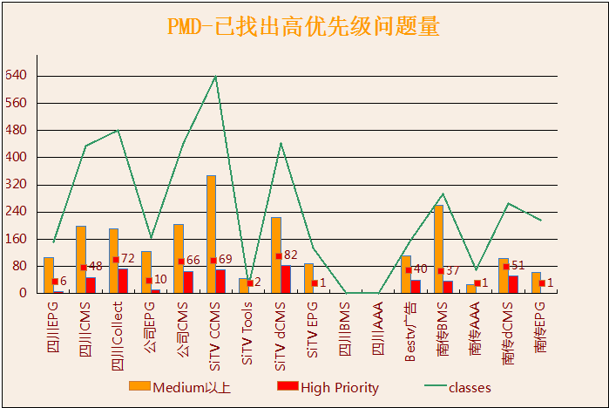
Check--代码质量摸底
CHANCES

Slide 13
Style--规范代码风格
03

Slide 14
Style--规范代码风格
CHANCES
官网：http://checkstyle.sourceforge.net/ 总154种检查，我们检查83种
定义规则
导入Eclipse
以checkStyle为准定义规则
对比不相符的代码、更新
CheckStyle
Formatter
执行Clean Up
CodeTemplates
Clean Up
Check Code With CheckStyle
以checkStyle为准定义规则
以checkStyle为准定义规则

Slide 15
Style--规范代码风格
CHANCES
注释
命名
JavadocMethod 检查方法是否有注释
JavadocStyle 检查javadoc的格式。
JavadocType 检查类是否缺少注释（允许未知标签）
JavadocVariable 检查变量是否缺少注释（只检查常量）
AbstractClassName 检查抽象类的命名 ^Abstract.+$'.
ConstantName 检查常量名 ^[A-Z][A-Z0-9]*(_[A-Z0-9]+)*$'.
LocalVariableName 检查局部的非final的变量名 ^[a-z][a-zA-Z0-9]*$'.
MemberName 检查非静态变量 ^[a-z][a-zA-Z0-9]*$'.
MethodName 检查方法的命名 ^[a-z][a-zA-Z0-9]*$'.
PackageName 检查包的命名 ^[a-z]+(\.[a-zA-Z_][a-zA-Z0-9_]*)*$
ParameterName 检查方法的参数的命名 ^[a-z][a-zA-Z0-9]*$'.
StaticVariableName 检查静态的非final的变量名 ^[a-z][a-zA-Z0-9]*$'.
TypeName 检查类和接口的命名 ^I[A-Z][a-zA-Z0-9]*$'.
块
导入
AvoidNestedBlocks 检查不需要的嵌套’{}’
EmptyBlock 检查空的代码块
LeftCurly 检查’{’和代码是否同行
NeedBraces 检查是否需要大括号（if else）
RightCurly 检查’}’和代码是否同行
AvoidStarImport 检查是否有使用*进行import
ImportOrder 检查import的分组和顺序
RedundantImport 检查是否有重复的import
UnusedImports 检查是否有未使用的import

Slide 16
Style--规范代码风格
CHANCES
长度
编码
FileLength 检查java文件的长度，默认为1500
LineLength 检查代码行的长度，默认为80
MethodLength 检查方法和构造函数的长度，默认为60
ParameterNumber 检查方法和构造函数的参数个数，默认为5
NestedIfDepth 检查嵌套的层次深度。最多5层
NestedForDepth 检查嵌套的层次深度。最多3层
NestedTryDepth 检查try-catch 异常处理，最多3层
ReturnCount 限制return个数。默认为3（限制逻辑）
EmptyStatement 检查空的代码段
EqualsAvoidNull 检查空字符串进行equals（）比较
MagicNumber 检查是否有magic numbers硬写到代码里的整数常量
FinalLocalVariable 检查未改变过的局部变量是否声明为final
空白
设计
FileTabCharacter 检查是否有Tab字符
MethodParamPad 允许方法名后紧跟左边圆括号"("
NoWhitespaceAfter 检查分隔符后的空白
NoWhitespaceBefore 检查分隔符前的空白
OperatorWrap 检查操作符的空白规则
ParenPad 检查圆括号的空白规则
WhitespaceAfter 检查分隔符后是否有空白
WhitespaceAround 检查分隔符周围是否有空白
ThrowsCount 限制抛出异常的数量（默认设置为3）
VisibilityModifier 检查类成员的可见度
（类的属性为私有，静态才能有public，属性需带有修饰符）

Slide 17
Style--规范代码风格
CHANCES
其他
空白样例
ModifierOrder 检查修饰符的顺序是否遵照java语言规范。
RedundantModifier 检查接口和注释中是否有重复的修饰符
Regexp 检查程序是否有System.out.println
TodoComment TODO检查，是否出现未办事项
TrailingComment 确保代码没有尾行注释
Translation 检查property文件中是否有相同的key
UpperEll 检查long型约束是否有大写的“L”
IllegalCatch 检查是否catch了不能接受的错误
IllegalThrows 检查是否抛出了未声明的异常
IllegalType 检查未使用过的类
List list = new ArrayList();
int a = -4 + -9;
b = a++ / --number;
c += 4;
boolean value = true && false;

Slide 18
Style--规范代码风格
CHANCES
不规范代码-四种处理方式
Format
Clean up
不正确的缩进、
空白（分隔符、操作符、圆括号）、
4个空格代替Tab键、
引用需用this
研发修改
参数需定义成final、
变量需定义成final、
命名不规范、
缺少注释、
比较需使用equals()、
行超过80字符、
代码重构NestedIfDepth、NestedForDepth、NestedTryDepth、ReturnCount、ThrowsCount、FileLength、MethodLength、ParameterNumber
可忽略
ArrayTypeStyle、
AvoidInlineConditionals、
InnerAssignment、
MissingSwitchDefault、
ModifiedControlVariable、
MultipleStringLiterals、
ParameterAssignment、
MutableException、
FinalParameters、
AnonInnerLength、
UncommentedMain

Slide 19
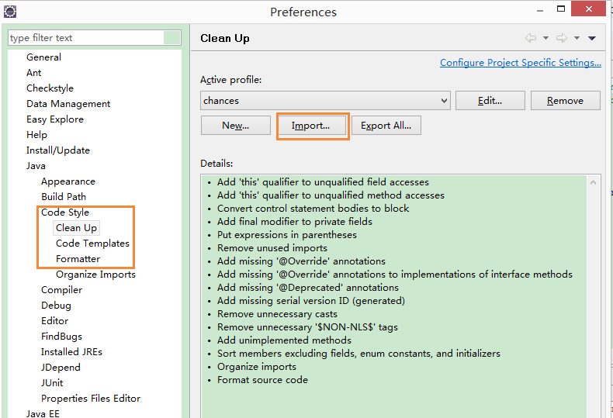
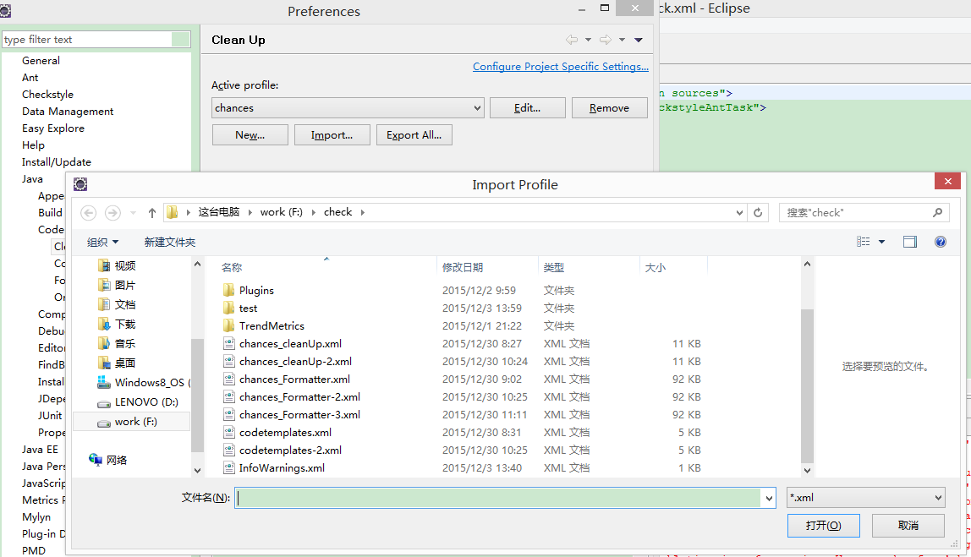
Style--规范代码风格
CHANCES
导入已设置好的Clean Up、Code Templates、Formatter、CheckStyle

Slide 20
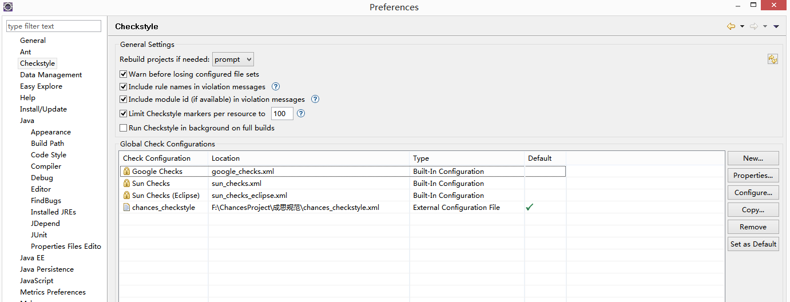
Style--规范代码风格
CHANCES
导入已设置好的Clean Up、Code Templates、Formatter、CheckStyle

Slide 21
Style--规范代码风格
CHANCES
验证格式设置是否有效
第一步
项目-右键-Source-Format
四川CMS
统计项 | 修改前 | 修改后 | 效果
文件数 | 446 | 446
问题数 | 40578 | 15909 | 24669
Errors per file | 91 | 36 | 55
第二步
项目-右键-Source-Clean Up
第三步
项目-右键-CheckStyle-Check Code With CheckStyle

Slide 22
Find--已有缺陷大搜索
04

Slide 23
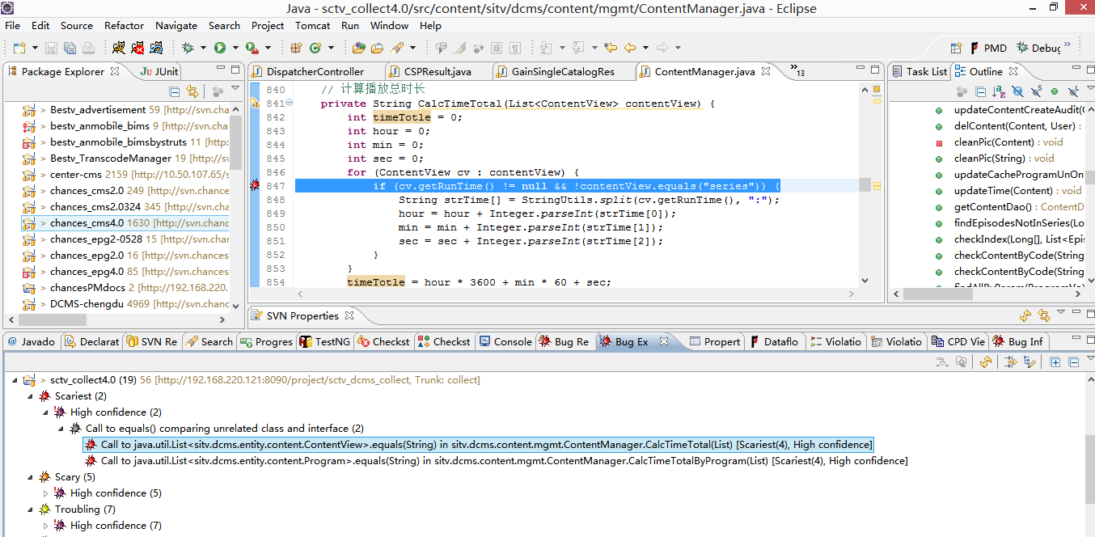
Find--已有缺陷大搜索
CHANCES
官网：http://findbugs.sourceforge.net/总424种检查，我们只检查高优先级部分

Slide 24
Find--已有缺陷大搜索
CHANCES
检测规则
高优先级问题
Bad practice Warnings 坏的实践
Correctness Warnings 代码正确性问题
Experimental Warnings 实验性问题
Internationalization Warnings 代码国际化问题
Malicious code vulnerability 恶意代码
Multithreaded correctness 多线程的正确性
Performance Warnings 性能问题
Security Warnings 安全问题
Dodgy code Warnings 危害代码
错误描述 | 统计数 | 样例
Redundant nullcheck of value known to be non-null | 73 | Redundant nullcheck of obj, which is known to be non-null in chances.dcms.collect.ws.notify.CSPResult.equals(Object)
Reliance on default encoding | 68 | Found reliance on default encoding in chances.epg.stb.STBProfileRepository.loadProfile(): new java.io.FileReader(File)
Boxing/unboxing to parse a primitive | 55 | Boxing/unboxing to parse a primitive sitv.ccms.old.manager.OldManager.getProgram(int, int, String, int, String, String, String, String, String, String, String, String, String)
Field isn't final but should be | 39 | sitv.ccms.entity.arrange.StationCategoryItemTask.STATUS_INIT isn't final but should be
Static DateFormat | 29 | DateUtils.java:28 sitv.ccms.commons.utils.DateUtils.YYMMDD is a static field of type java.text.DateFormat, which isn't thread safe [Troubling(12), High confidence]
Comparison of String parameter using == or != | 24 | Des.java:244 Comparison of String parameter using == or != in chances.commons.crypto.Des.strDec(String, String, String, String) [Troubling(14), High confidence]
Store of non serializable object into HttpSession | 19 | Store of non serializable chances.dcms.system.mgmt.UserSessionContext into HttpSession in chances.dcms.system.mgmt.UserSessionContext.setUserSessionContext(HttpServletRequest, UserSessionContext)
Dead store to local variable | 18 | Dead store to tmp in chances.advertisement.commons.utils.WebDavUtil.checkDir(WebdavResource, String, String, String) [Of Concern(15), High confidence]
Class names shouldn't shadow simple name of superclass | 12 | The class name chances.webui.common.taglib.TextTag shadows the simple name of the superclass org.apache.struts2.views.jsp.TextTag
Condition has no effect | 12 | Useless condition: it's known that end != -1 at this point
Return value of method without side effect is ignored | 11 | Return value of chances.dcms.entity.biz.Position.getCode() ignored, but method has no side effect
Dead store to local variable that shadows field | 10 | EnumDataAction.java:66 Dead store to children rather than field with same name in chances.advertisement.system.view的.EnumDataAction.buildTree() [Scary(9), High confidence]
Call to equals() comparing unrelated class and interface | 8 | Call to java.util.List<chances.dcms.entity.content.ContentView>.equals(String) in chances.dcms.content.mgmt.ContentManager.CalcTimeTotal(List)
Repeated conditional tests | 7 | Repeated conditional test in chances.dcms.system.taglib.RoleTag.doEndTag() [Scary(6), High confidence]
Call to equals() comparing different types | 6 | LostContentAction.java:46 Call to Long.equals(String) in sitv.ccms.lost.action.LostContentAction.lostContentSearch() [Scariest(1), High confidence]
Class defines equals() and uses Object.hashCode() | 4 | UserEpgUrl.java:85 chances.epg.web.UserEpgUrl defines equals and uses Object.hashCode() [Troubling(14), High confidence]

Slide 25
Find--已有缺陷大搜索
CHANCES
Correctness Warnings
Bad practice Warnings
Dodgy code Warnings
private String validCacheProgramForImport(CacheProgram cp) {
String msg = "";
if (cp == null) {
msg = "缓存内容:" + cp.getName() + "不存在\n";
}
return msg;
}
private Boolean isMigrateItem(WorkOrder workOrder) {
try {
....
}
} catch (Exception e) {
LOGGER.error(e.toString(), e);
}
return null;
}
错误描述：Redundant nullcheck of value known to be non-null
private java.lang.Object __equalsCalc = null;
public synchronized boolean equals(java.lang.Object obj) {
if (!(obj instanceof CSPResult)) return false;
CSPResult other = (CSPResult) obj;
if (obj == null) return false;
}
Security Warnings
Malicious code
Internationalization Warnings
错误描述：HTTP Response splitting vulnerability
public String accessBusiness(@PathVariable String type,@PathVariable String code,ModelMap model, HttpServletRequest request, HttpServletResponse response) {
try {
response.sendRedirect(redirect);
}
...
return null;
}
public static int STATUS_CANCEL = -1; // 作废
public static int STATUS_INIT = 0; // 待分配
public static int STATUS_WORKING = 1; // 处理中
错误描述：Reliance on default encoding
public static void writeFile(File file, String string) throws IOException {
FileWriter writer = new FileWriter(file);
try{
writer.write(string);
}finally{
if(writer!= null) writer.close();
}
}

Slide 26
Find--已有缺陷大搜索
CHANCES
官网：https://pmd.github.io/pmd-5.4.1/index.html 大部分问题在官网可找到样例

Slide 27
Find--已有缺陷大搜索
CHANCES
检测规则
高优先级问题
Basic 基本规则
Braces 条件分支的规则
Clone clone 实现规则
Code Size 代码大小的规则
Controversial 一些有争议的规则
Coupling 耦合规则
Design 检查有问题的设计
Empty Code 空代码
Finalizers 终结函数规则
Java Logging 日志规则
Migration JDK版本移植的规则
Optimization 最佳规则
Strict Exceptions 严格的异常
Strings 字符串
Type Resolution 类解析规则
Unnecessary 不必要的代码
Unused Code 无用代码
错误描述 | 错误量 | 规则
Avoid reassigning parameters such as 'origin' | 423 | AvoidReassigningParameters
System.out.println is used | 405 | SystemPrintln
There is log block not surrounded by if | 275 | GuardLogStatementJavaUtil
Overridable method 'calculate' called during object construction | 225 | ConstructorCallsOverridableMethod
Avoid throwing raw exception types. | 169 | AvoidThrowingRawExceptionTypes
The Logger variable declaration does not contain the static and final modifiers | 151 | LoggerIsNotStaticFinal
Avoid instantiating String objects; this is usually unnecessary. | 109 | StringInstantiation
Avoid instantiating Long objects.Call Long.valueOf() instead | 108 | LongInstantiation
Avoid instantiating Integer objects. Call Integer.valueOf() instead. | 79 | IntegerInstantiation
An empty method in an abstract class should be abstract instead | 36 | EmptyMethodInAbstractClassShouldBeAbstract
Avoid using a branching statement as the last in a loop. | 26 | AvoidBranchingStatementAsLastInLoop
Return an empty array rather than null. | 23 | ReturnEmptyArrayRatherThanNull
A class which only has private constructors should be final | 19 | ClassWithOnlyPrivateConstructorsShouldBeFinal
Avoid throwing null pointer exceptions. | 10 | AvoidThrowingNullPointerException
Class contains more than one logger. | 9 | MoreThanOneLogger
Avoid instantiating Boolean objects; reference Boolean.TRUE or Boolean.FALSE or call Boolean.valueOf() instead. | 5 | BooleanInstantiation
No abstract method which means that the keyword is most likely used to prevent instantiation. Use a private or protected constructor instead. | 4 | AbstractClassWithoutAnyMethod
Use of modifier volatile is not recommended. | 4 | AvoidUsingVolatile
Object clone() should be implemented with super.clone() | 3 | ProperCloneImplementation
Class contains multiple getInstance methods. Please review. | 3 | SingleMethodSingleton
getInstance method always creates a new object and hence does not comply to Singleton Design Pattern behaviour. Please review | 2 | SingletonClassReturningNewInstance

Slide 28
Find--已有缺陷大搜索
CHANCES
Basic
Clone Implementation
Controversial
规则：BooleanInstantiation
错误描述：Avoid instantiating Boolean objects; reference Boolean.TRUE or Boolean.FALSE or call Boolean.valueOf() instead.
代码：
Boolean boo = new Boolean(tv[i + 1].toString());
处理：
Boolean buz = Boolean.valueOf(false);
规则：ProperCloneImplementation
错误描述：Object clone() should be implemented with super.clone()
代码：
public Region clone() {
Region result = new Region(this.left, this.top, this.width, this.height);
return result;
}
规则：AvoidUsingVolatile
错误描述：Use of modifier volatile is not recommended.
private volatile boolean elementTagIsOpen;
private volatile boolean elementIsEmpty;
Basic
Design
Migration
规则：AvoidBranchingStatementAsLastInLoop
错误描述：Avoid using a branching statement as the last in a loop.
代码：for (Subject s : subjects) {
message = message + "专辑:" + s.getName() + ";";
break；
处理：for (int i = 0; i < 10; i++) {
if (i*i > 25) {
break;
规则：ReturnEmptyArrayRatherThanNull
错误描述：
代码：public String[] getListTagArray() {
if (StringUtils.isNotBlank(keyword)) {
return keyword.split(" ");
}
return null;
处理：public String[] bonnePratique() {
//...
return new String[0];
错误描述：Avoid instantiating Long objects.Call Long.valueOf() instead
代码：record.setChooseId(new Long(chooseId));
处理：Long i = Long.valueOf(0);
代码： return new Integer(updateQuery.executeUpdate());
处理： Integer i = Integer.valueOf(0);

Slide 29
Prevention--规避潜在缺陷
05

Slide 30
Prevention--规避潜在缺陷
CHANCES
ONE
使用CheckStyle检查格式
two
使用FindBugs检查
Three
使用PMD检查
Four
处理好格式和潜在问题，提交到SVN

Slide 31
Thanks!
与公司一起成长

