Slide 1
Recommender System
A Survey

Slide 2
Types of Recommender System
Content Based Filtering
Collaborative Filtering

Slide 3
Depends on underlying data
Model Based
Memory Based

Slide 4
User Cases
Movie Recommendation i.e., Netflix
Music Recommendation i.e., Last.fm, Pandora Radio
Product Recommendation i.e., Amazon
News Recommendation i.e., Google News, Toutiao
People Recommendation i.e., LinkedIn

Slide 5
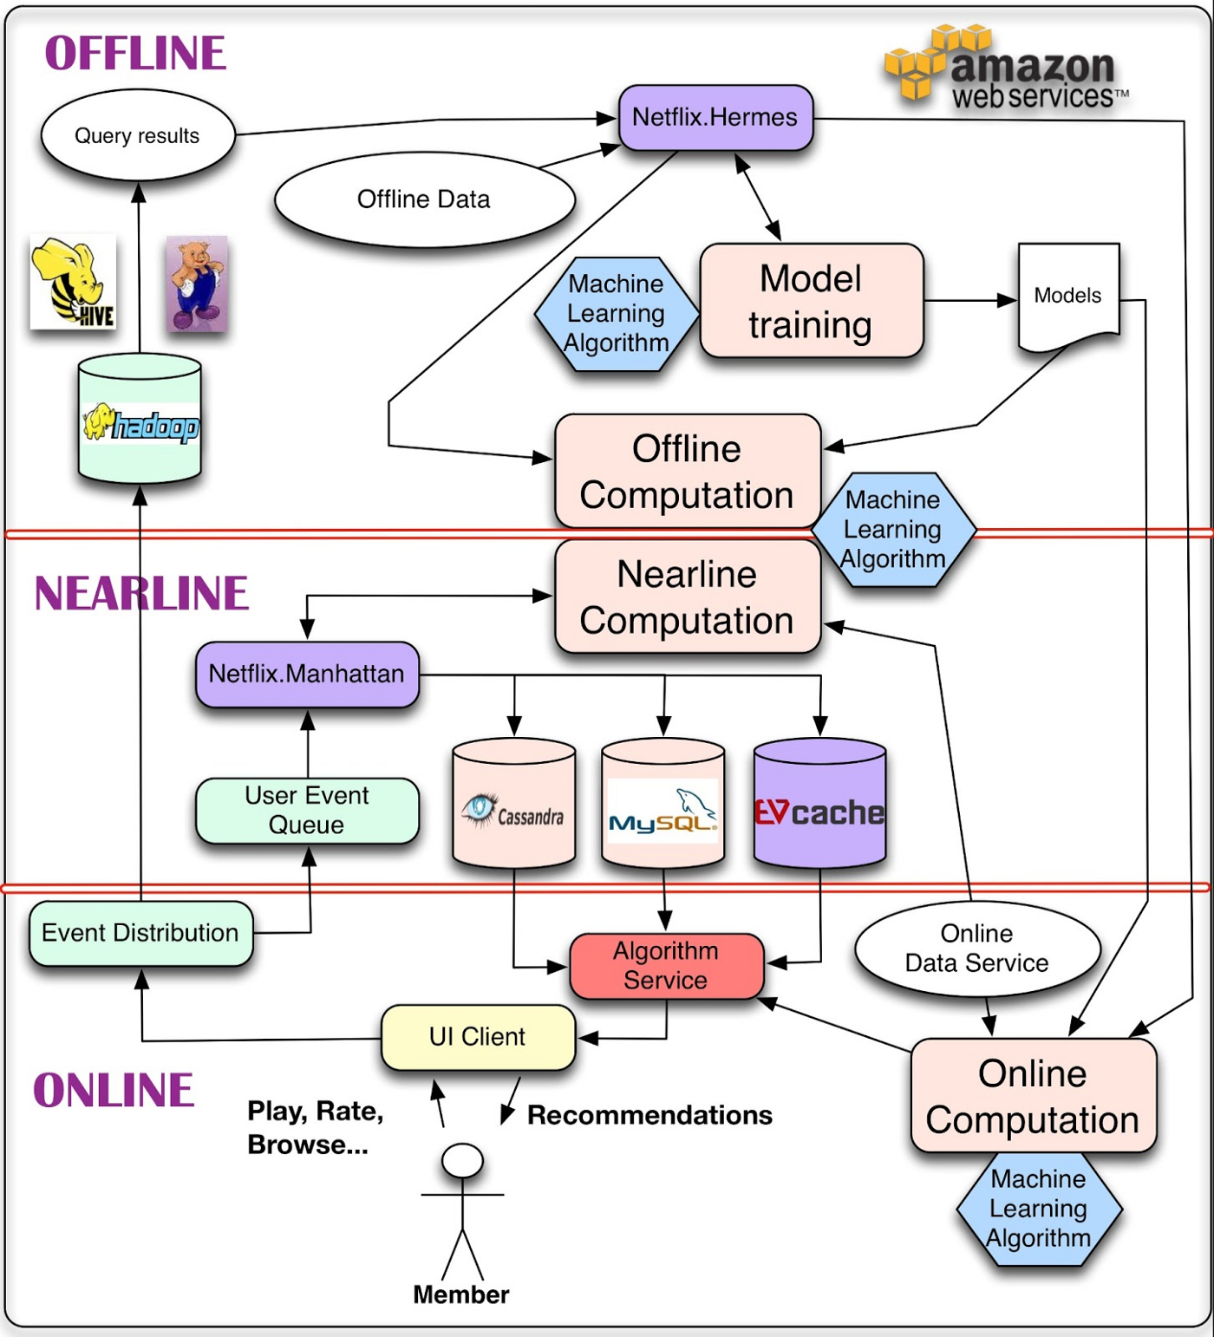
System Architecture

Slide 6
Collaborative Filtering
Collabrative Filtering is best suited to problem with known data on users, but lack of data for items or lack of feature extraction for items of interest. [6]
Collabrative Filtering approaches build a model from user's past behavior (items previously purchased or selectec/rated) as well as similar decision made by others. [10]

Slide 7
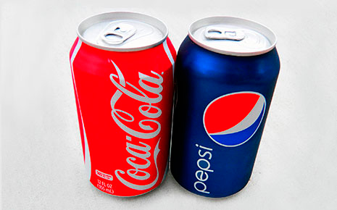
Item-Item

Slide 8
User-Item

Slide 9
User-User

Slide 10


Trending

Slide 11
Novelty ~ Diversification
Notes:
https://arxiv.org/pdf/1710.11214.pdf

Slide 12
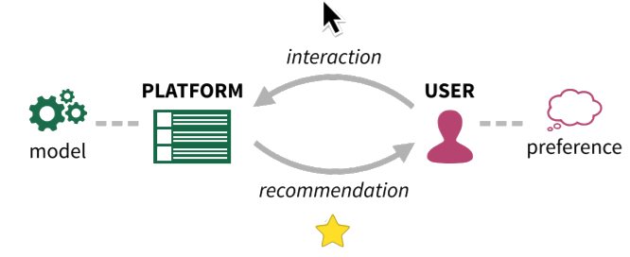
Feedback
Notes:
https://dorukkilitcioglu.com/2018/10/09/recommender-filter-serendipity.html

Slide 13
Deep Learning
Neural Collaborative Filtering
ALS – Alternating Least Squares
xDeepFM – xTreme Deep Factorization Machines

Slide 14
Reinforcement Learning for Recommender Systems

Slide 15
Evaluation Metrics – Rating Metrics
Root Mean Square Error (RMSE) Measure of average error in predicted ratings
R Square (R^2) Essentially how much of the total variation is explained by the model
Mean Absolute Error (MAE)
Explained Variance - How much of the variance in the data is explained by the model

Slide 16
Evaluation Metrics – Ranking Metrics
Precision The proportion of recommended items that are relevant
Recall Measures the proportion of relevant items that are recommended
Normalized Discounted Cumulative Gain (NDCG) Evaluates how well the predicted items for a user are ranked based on the relevance
Mean Average Precision (MAP) Average precision for each user normalized over all users

Slide 17
Classification Metrics
Area Under Curve (AUC) Integral area under the receiver operating characteristic curve
Logistic Loss (Logloss) The negative log-likelihood of the true labels given the prediction of a classifier

Slide 18
Discussions - Sparsity
The number of items sold on majority e-commerce sites is extremely large. The most active users will only have rated a small subset of the overall database. Thus, even the most popular items have very few ratings. [10]

