Slide 1
Reflection, Refraction, and Hamiltonian Monte Carlo
王耀东
2019/6/2

Slide 2
Content：
Review (Hamiltonian Monte Carlo)
Introduction(discontinous space/ variable selection)
Reflection and Refraction with Exact Hamiltonian Dynamics
Reflection and Refraction with Leapfrog Dynamics
Tailed balance（leap frog）
Volume Conservation (main topic)
Refraction
Reflection

Slide 3
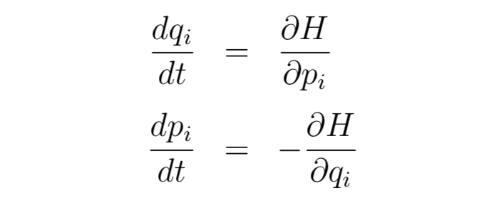
Review (Hamiltonian dynamics)
The potential energy, U(q)
is proportional to the height of the surface
Kinetic energy K(p)
|P|^2/(2m)
Hamilton’s energy
Hamiltonian dynamics operates on a d-dimensional position vector, q, and a d-dimensional momentum vector, p, so that the full state space has 2d dimensions. The system is described by a function of q and p known as the Hamiltonian, H(q,p).
Hamilton’s equations

Slide 4
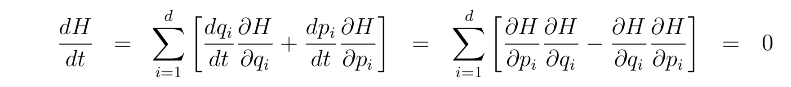
Review(Hamiltonian dynamics)
Hamiltonian dynamics property
Reversibility
Conservation of the Hamiltonian
Volume preservation
volume preservation is equivalent to the determinant of the Jacobian matrix of Ts having absolute value one

Slide 5

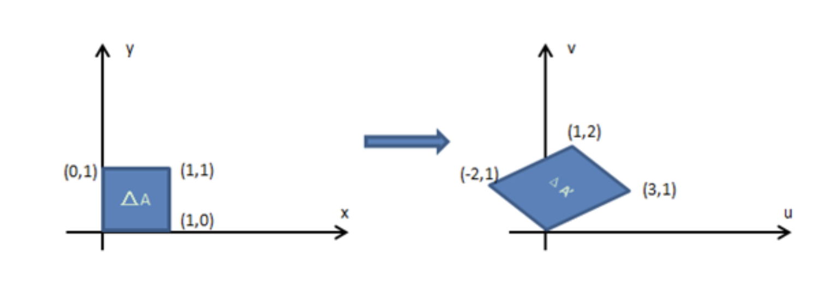
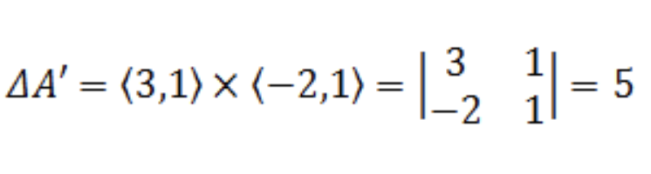
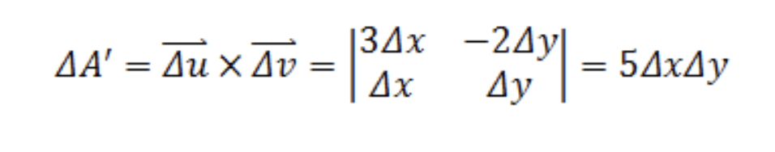
Review(Hamiltonian dynamics)
Volume preservation
Linear transformation

Slide 6
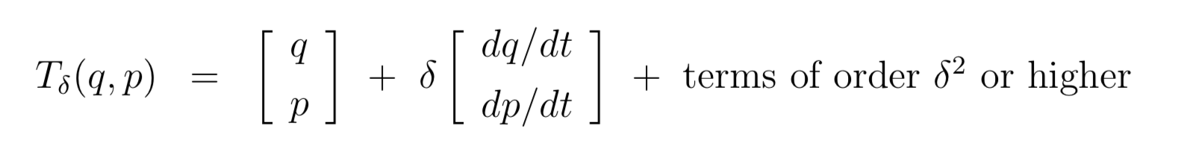
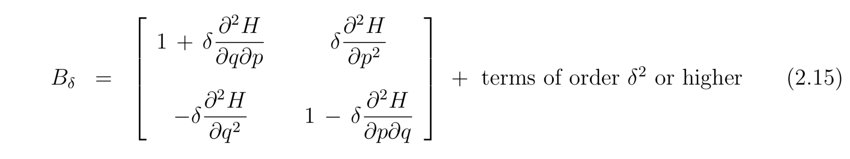
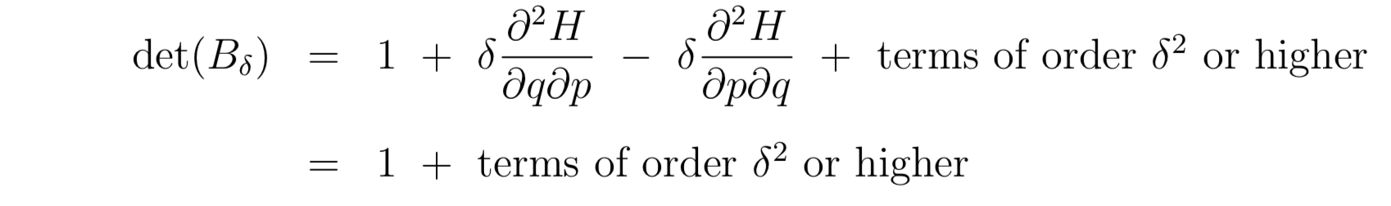
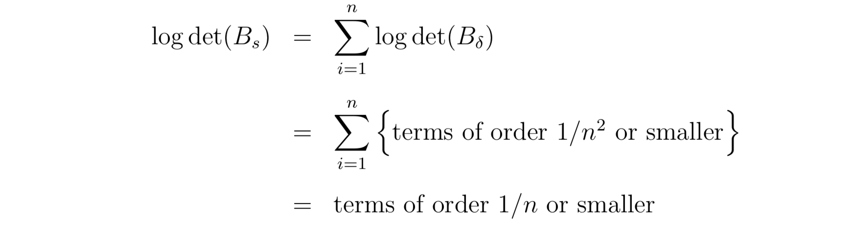
Review(Hamiltonian dynamics)
Volume preservation（numerical way）

Slide 7
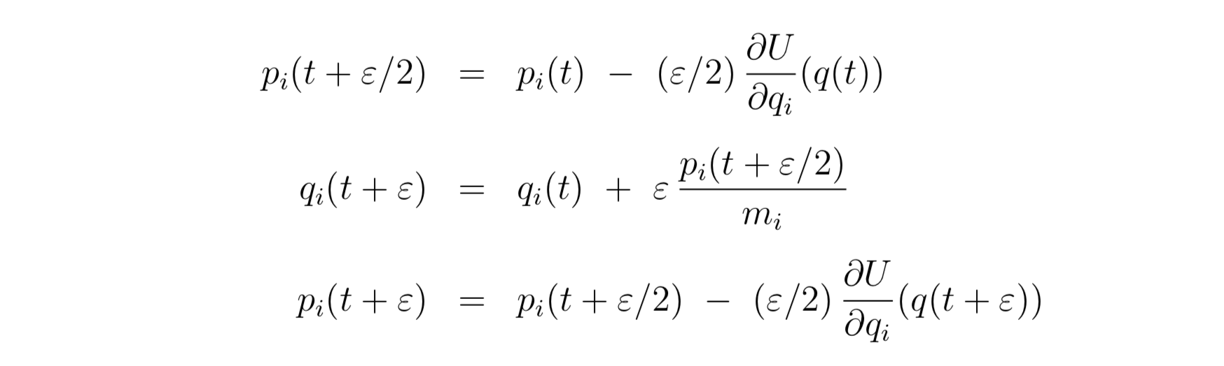
Review(Leapfrog method)

Slide 8

MCMC from Hamiltonian dynamics
Using Hamiltonian dynamics to sample from a distribution requires translating the density function for this distribution to a potential energy function and introducing “momentum” variables to go with the original variables of interest (now seen as “position” variables). We can then simulate a Markov chain in which each iteration resamples the momentum and then does a Metropolis update with a proposal found using Hamiltonian dynamics.
canonical distributions (from statistical mechanics)
T=1,E(x)=-log(P(x))-log(Z)

Slide 9
Review(Hamiltonian MCMC)
Step 1
new values for the momentum variables are randomly drawn from their Gaussian distribution, independently of the current values of the position variables
Step 2
Starting with the current state, (q, p), Hamiltonian dynamics is simulated for L steps using the Leapfrog method
Step 3
Metropolis update is performed, using Hamiltonian dynamics to pro- pose a new state.

Slide 10
Introduction(discontinous space/ variable selection)

Slide 11
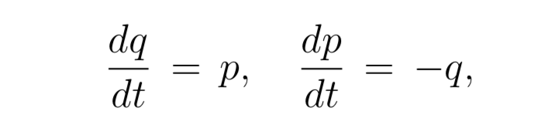
Reflection and Refraction with Exact Hamiltonian Dynamics
Piecewise smooth function(分段函数)
Exact Hamiltonian Dynamics
the mapping Ts is a rotation by s radians clockwise around the origin in the (q,p) plane.

Slide 12
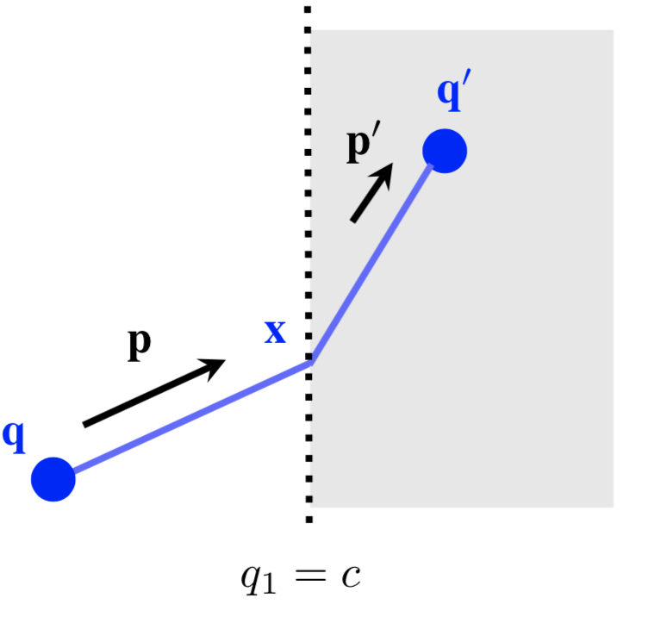



Reflection and Refraction with Exact Hamiltonian Dynamics
decompose the momentum vector p into a
component p⊥ perpendicular to the boundary and a component p∥ parallel to the boundary.
Let ∆U be the (signed) difference in potential energy
on the two sides of the discontinuity.
instantaneously replaced by
then p⊥ is instantaneously replaced by − p⊥.

Slide 13
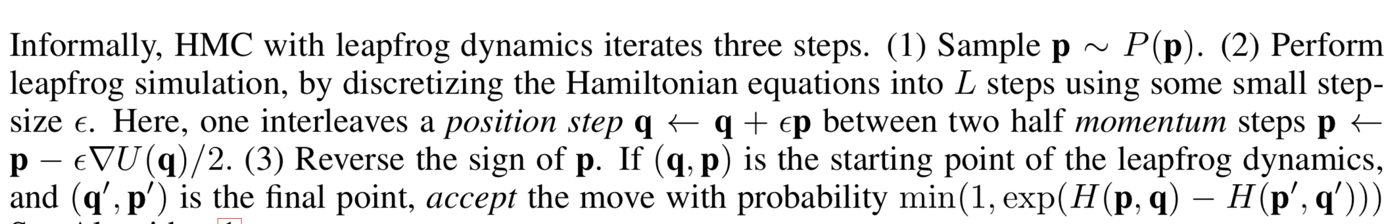
Reflection and Refraction with Leapfrog Dynamics
Recently, Pakman et al. [11, 10] proposed methods for HMC-based sampling from piecewise Gaus- sian distributions by exactly solving the Hamiltonian equations, and accounting for what we refer to as refraction and reflection above. However, since Hamiltonian equations of motion can rarely be solved exactly, the applications of this method are restricted to distributions whose log-density is piecewise quadratic.

Slide 14
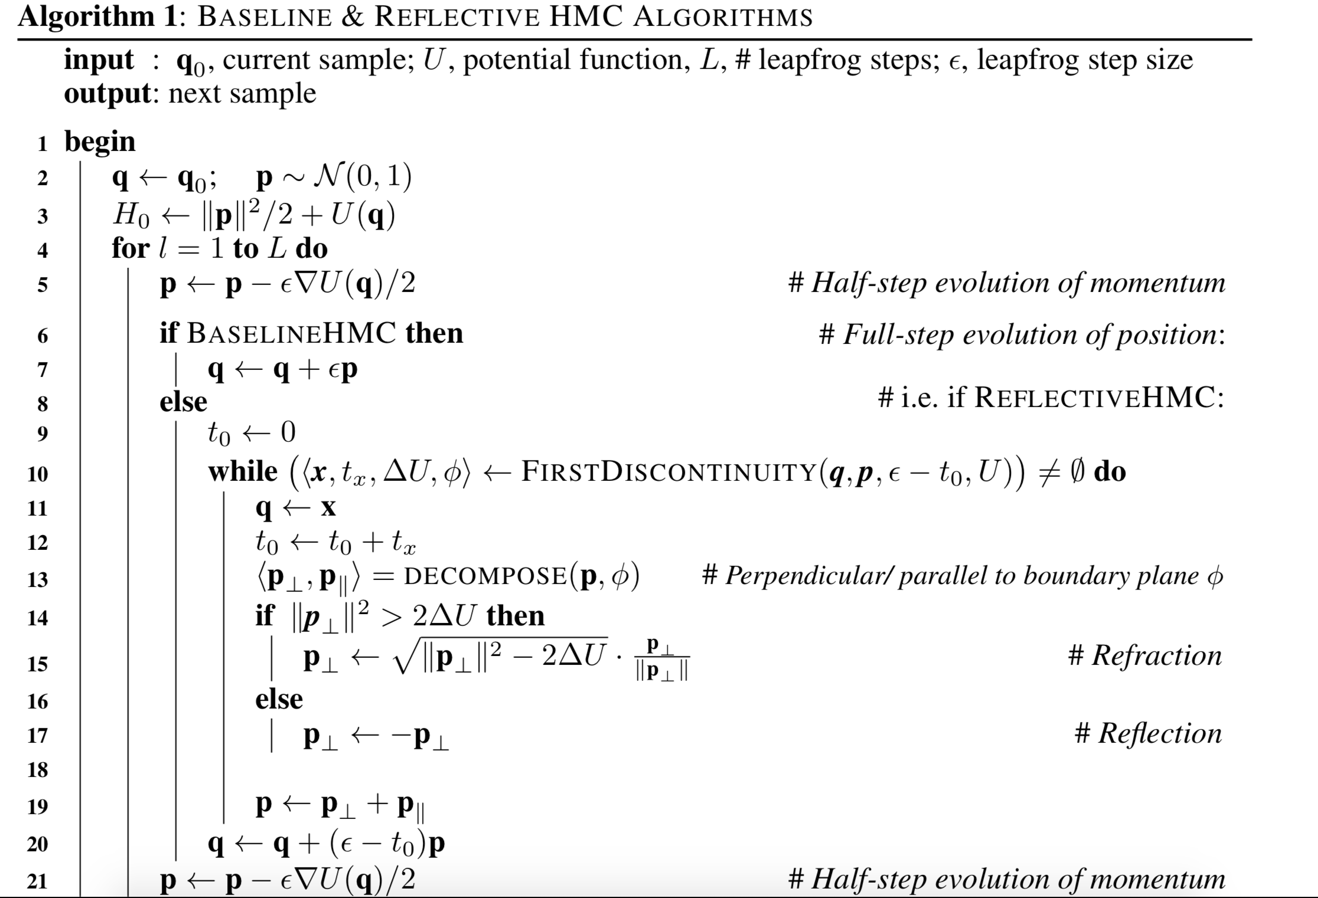
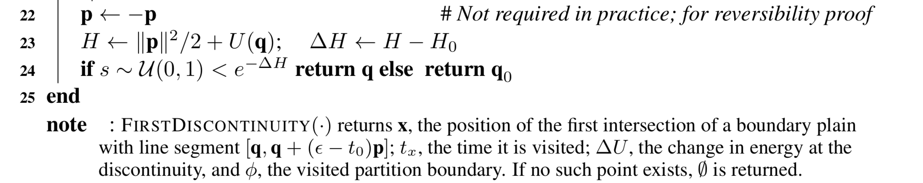

Slide 15
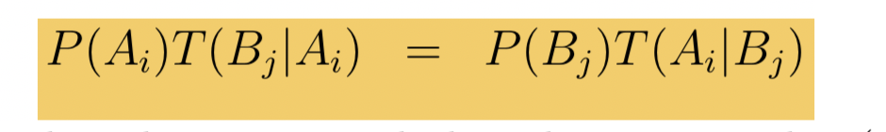
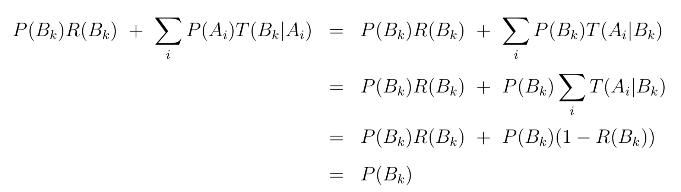
Reflection and Refraction with Leapfrog Dynamics
Detailed Balance
Let the image of Ak with respect to the operation of L leapfrog steps, plus a negation of the momentum, be Bk.
The probability of the next state being in Bk can therefore be written as

Slide 16
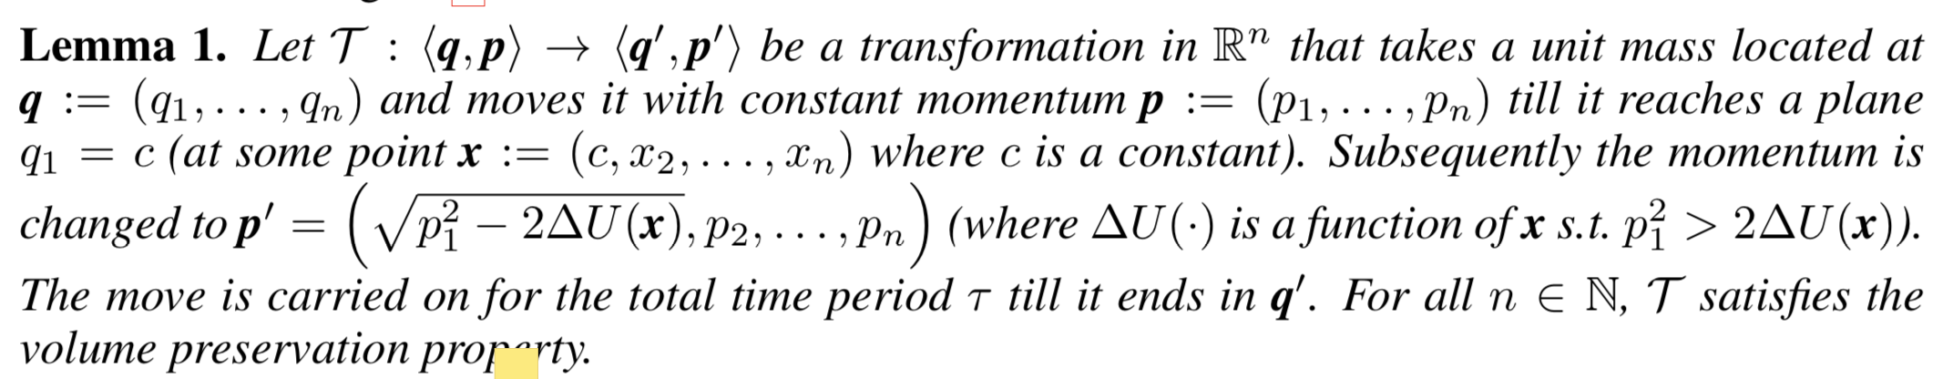
Reflection and Refraction with Leapfrog Dynamics

Slide 17
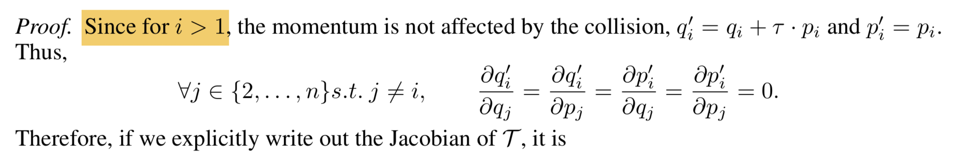
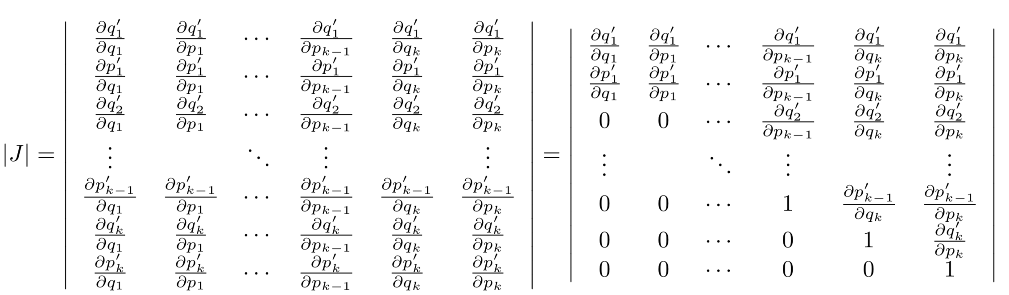
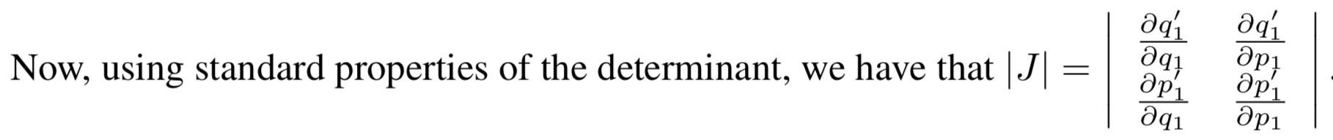
Reflection and Refraction with Leapfrog Dynamics

Slide 18
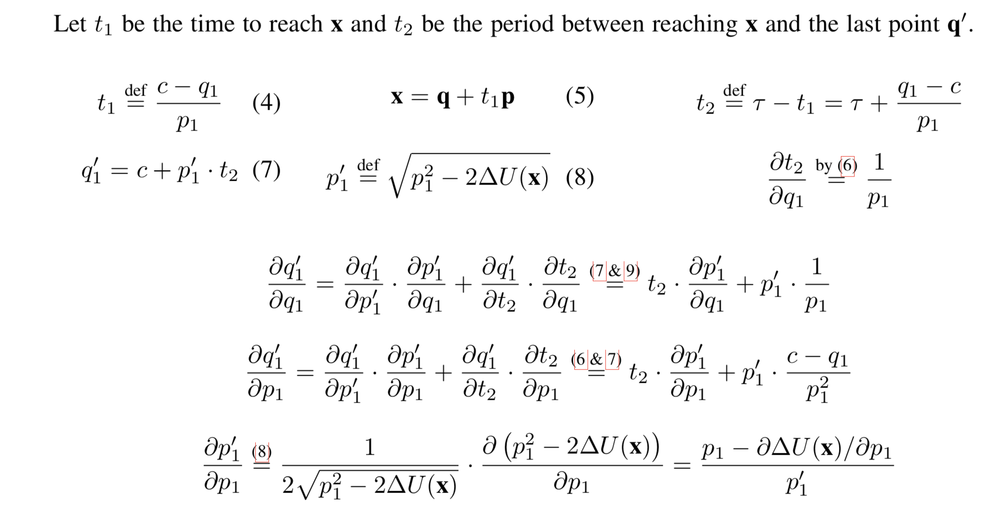
Reflection and Refraction with Leapfrog Dynamics

Slide 19
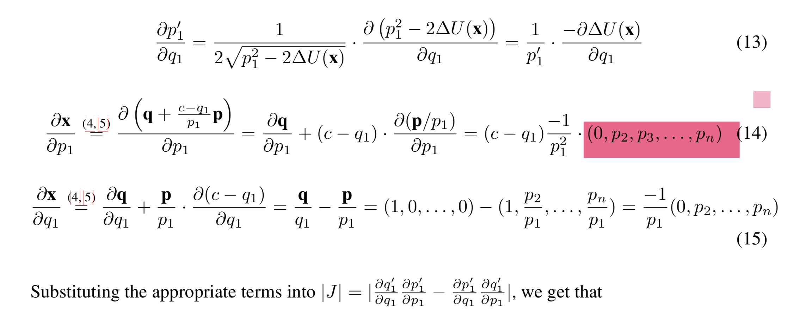
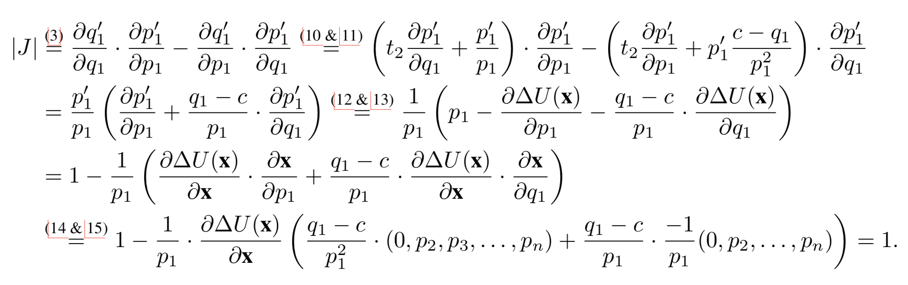
Reflection and Refraction with Leapfrog Dynamics

Slide 20
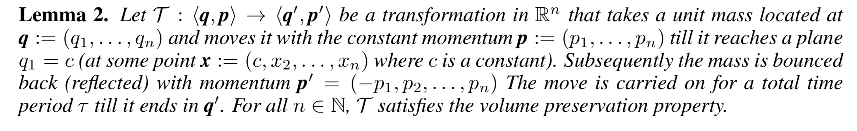
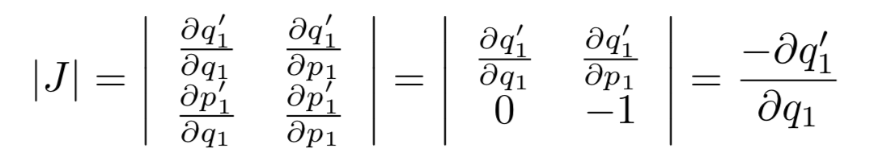
Reflection and Refraction with Leapfrog Dynamics

Slide 21
Thanks
1、spike and slab variable selection
2、ICML 2017 Probabilistic Path Hamiltonian Monte Carlo

