Slide 1
A brief review of feature-based time series forecasting
Li Li 2019/9/12

Slide 2
Abstract
Time series forecasting is an important and challenging problem in data mining. Hundreds of time series forecasting algorithms have been proposed
No single time-series forecasting method can perform best on all types of time series, selecting the most appropriate forecast model based on time series features has been a popular alternative approach in the last decades
The time series generated with certain features, as diverse and controllable benchmarking data, are stronger than existing datasets for algorithm evaluation
overview of the three aspects of feature-based time series forecasting: (1) feature-based representations of time series, (2) generation of time series, (3) applications of time-series features for forecasting

Slide 3
1 Introduction
Methods and applications of time series forecasting
Goodwin et al., 2014; Arroyo et al., 2011; Deb et al., 2017
No-Free-Lunch theorem
Wolpert, 1996 ; Wolpert and Macready, 1997
Adam, 1973 ; Collopy and Armstrong, 1992 ; Wang et al., 2009 ; Petropoulos et al., 2014 ; Kang et al., 2017
Features
Fulcher, 2018; Nanopoulos et al., 2001 ; Shah, 1997 ; Meade , 2000; Petropoulos et al., 2014
Reviews of time series forecasting
De Gooijer and Hyndman, 2006 ; Cheng et al., 2015; Deb et al., 2017
A comprehensive review of recent developments in feature-based time series forecasting is still lacking

Slide 4
1 Introduction
Fulcher B D. Feature-based time-series analysis[M]//Feature Engineering for Machine Learning and Data Analytics. CRC Press, 2018: 87-116.
Petropoulos, F., Makridakis, S., Assimakopoulos, V., & Nikolopoulos, K. (2014). ‘Horses for courses’ in demand forecasting. European Journal of Operational Research, 237(1), 152–163.
De Gooijer, J.G. and Hyndman, R.J. (2006) 25 years of time series forecasting. International Journal of Forecasting, 22, 443–473.
Cheng C, Sa-Ngasoongsong A, Beyca O, et al. Time series forecasting for nonlinear and non-stationary processes: a review and comparative study[J]. Iie Transactions, 2015, 47(10): 1053-1071.
Deb C, Zhang F, Yang J, et al. A review on time series forecasting techniques for building energy consumption[J]. Renewable and Sustainable Energy Reviews, 2017, 74: 902-924.
Taieb S B, Bontempi G, Atiya A F, et al. A review and comparison of strategies for multi-step ahead time series forecasting based on the NN5 forecasting competition[J]. Expert systems with applications, 2012, 39(8): 7067-7083.
Martinez C A, Velasquez J D. Conceptual developments in genetic programming for time series forecasting[J]. IEEE Latin America Transactions, 2015, 13(8): 2728-2733.
Cogollo M R, Velasquez J D. Methodological advances in artificial neural networks for time series forecasting[J]. IEEE Latin America Transactions, 2014, 12(4): 764-771.

Slide 5
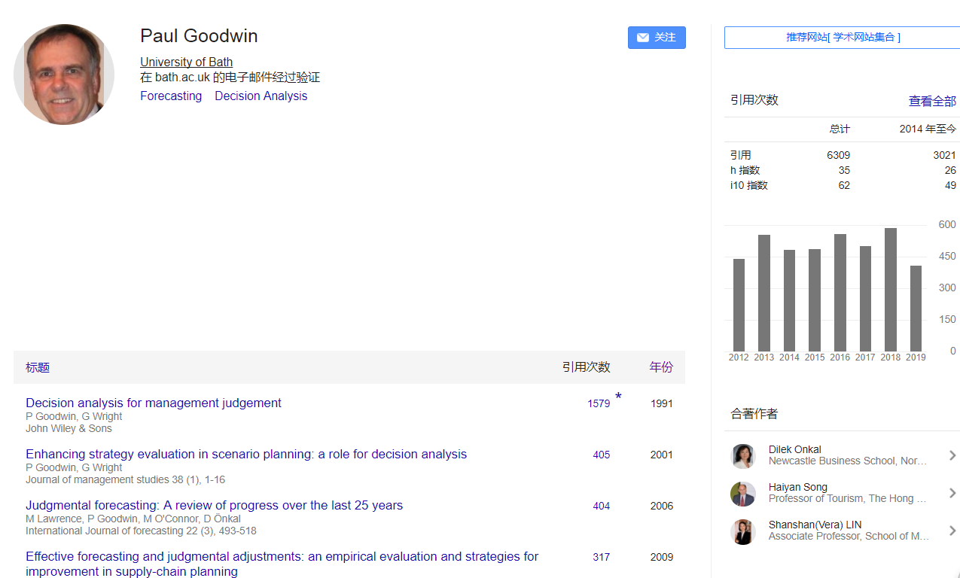
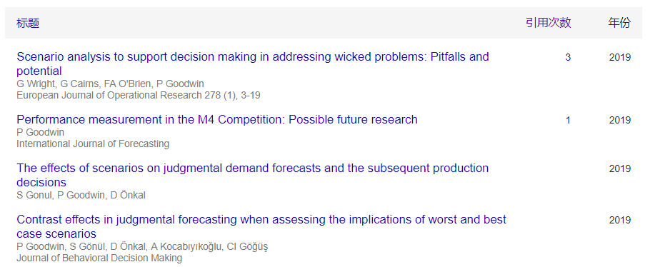

Slide 6
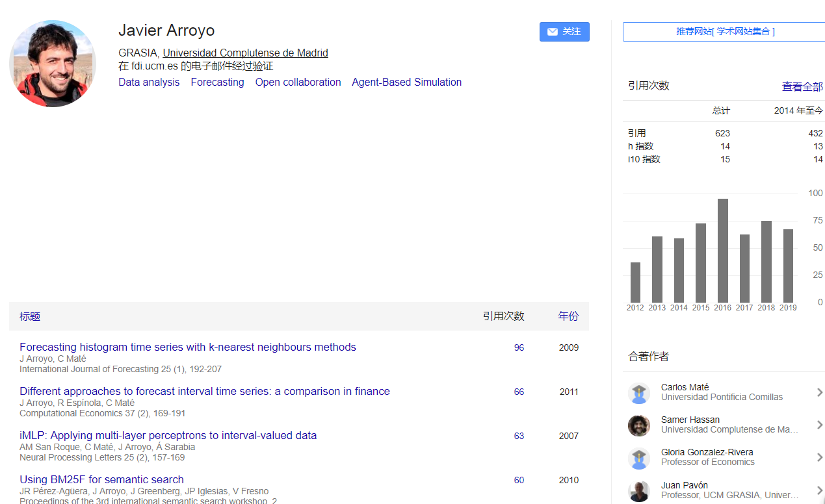

Slide 7
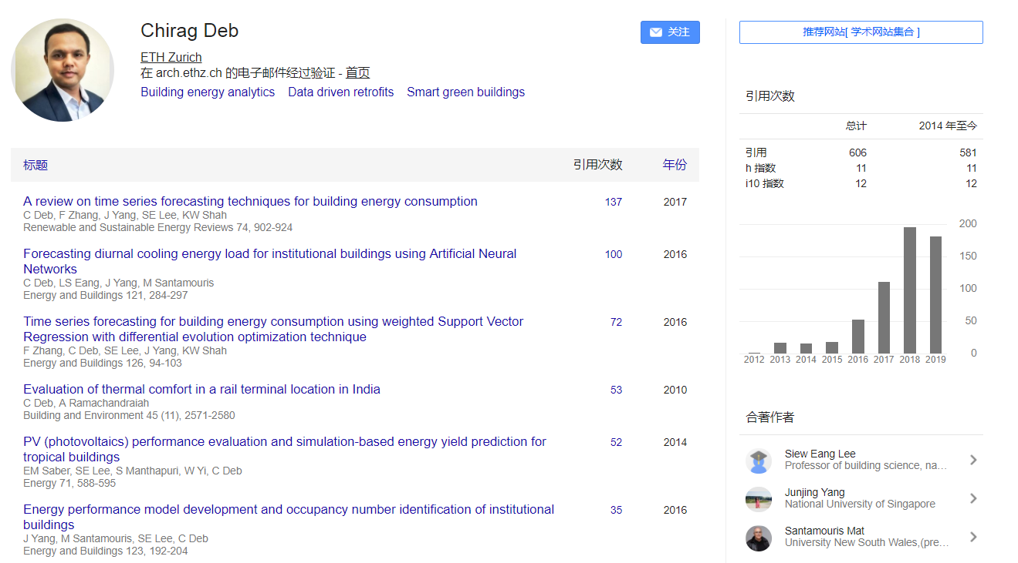


Slide 8
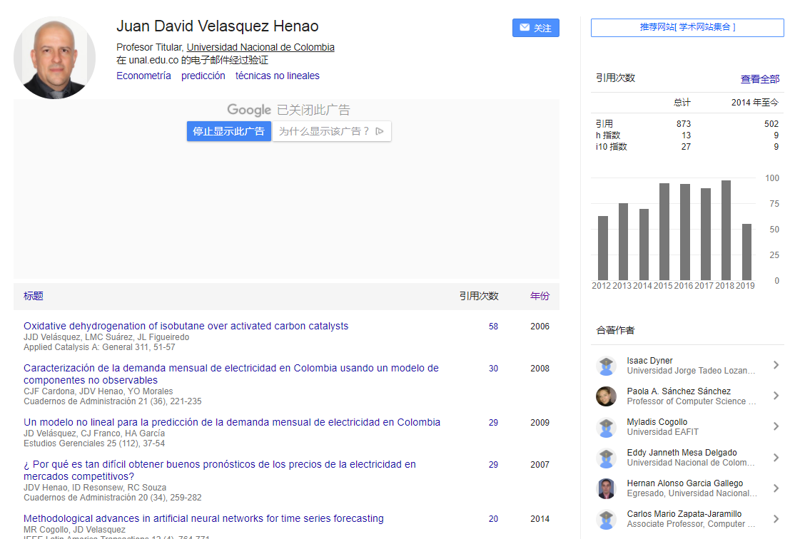
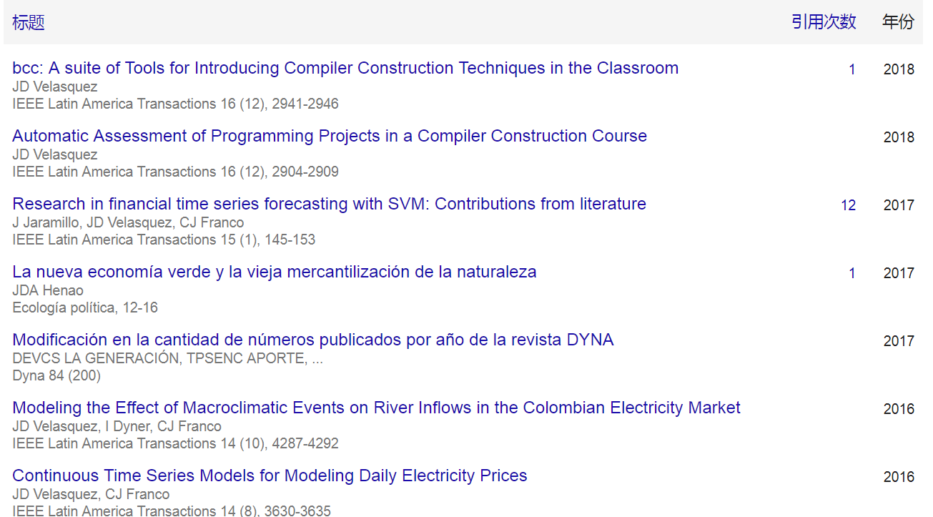

Slide 9
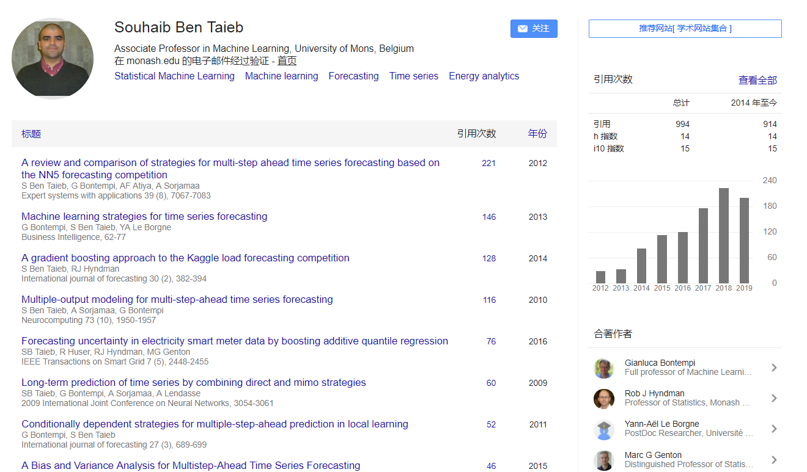

Slide 10
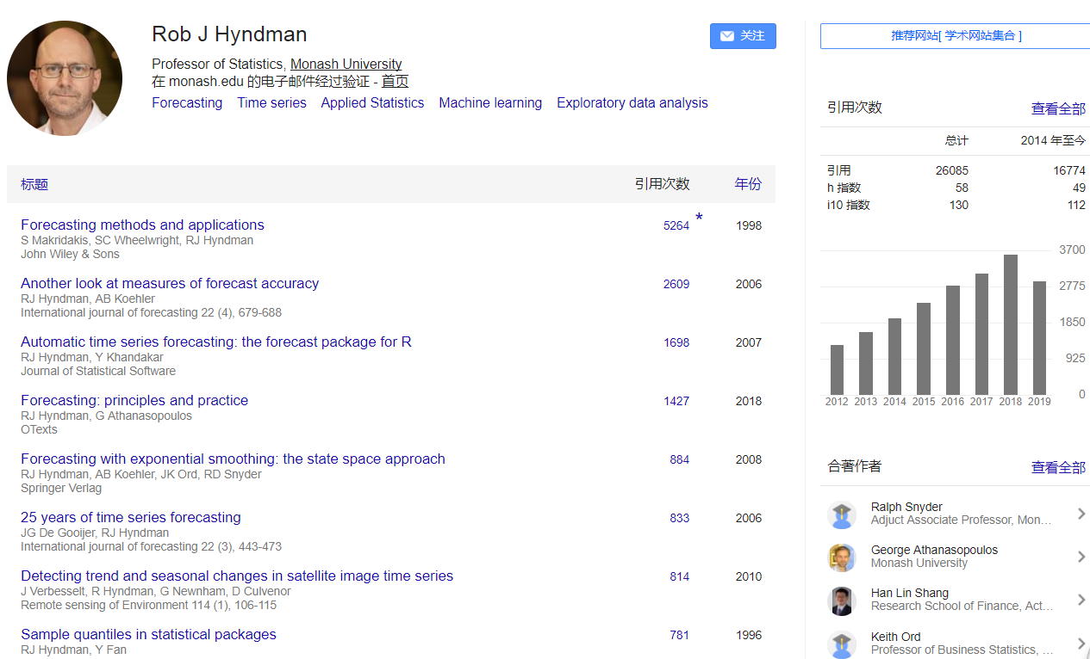

Slide 11
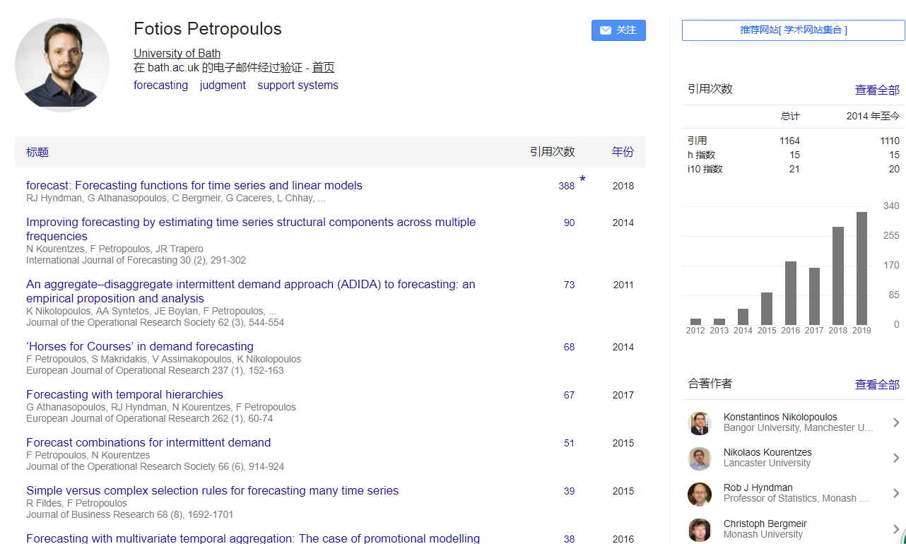

Slide 12
2 Feature-based representations of time series
Time series features
Fulcher, 2018; Deng, Runger, Tuv, & Vladimir, 2013 ; Fulcher & Jones, 2014; Kang, Belušić, & Smith-Miles, 2014, 2015; Mörchen, 2003; Nanopoulos et al., 2001; Wang et al., 2006
Global features
Distribution；autocorrelation properties；stationarity；entropy；Fourier transform
Scaling algorithms ；Statistical time-series models
Subsequence features
interval features, shapelets and pattern dictionaries
Deng et al., 2013; Ye and Keogh, 2009; Mueen et al., 2011; Lin et al. 2012; Lin et al., 2007
Hybrid features
Bagnall et al. (2015)

Slide 13
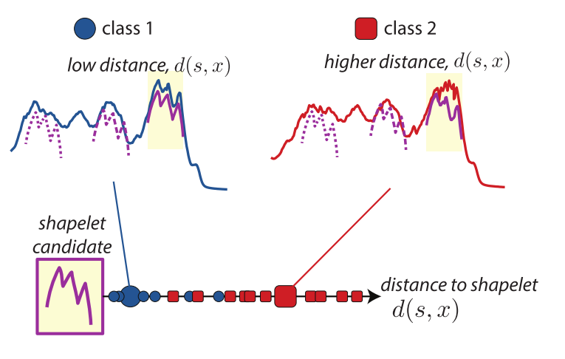
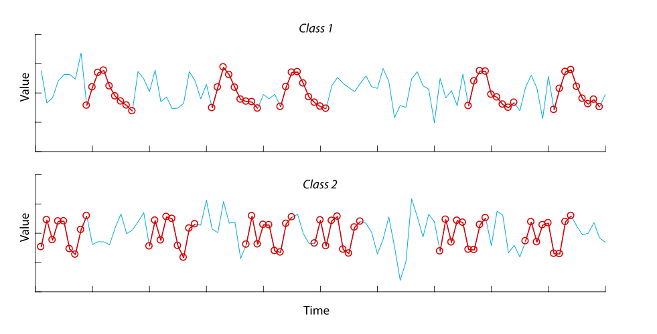

Slide 14
2 Feature-based representations of time series
feature vector
time series clustering; classification; anomaly detection
Wang et al., 2006 ; Fulcher et al., 2013; Fulcher and Jones, 2014; Nanopoulos et al., 2001; Hyndman et al., 2015 ; Talagala et al., 2019
Forecasting
Adam, 1973 ; Collopy and Armstrong, 1992 ; Wang et al., 2009 ; Petropoulos et al., 2014; Kang et al., 2017

Slide 15
2 Feature-based representations of time series
Fulcher, B. D., Little, M. A., & Jones, N. S. (2013). Highly comparative time-series analysis: the empirical structure of time series and their methods. Journal of the Royal Society Interface, 10(83), 20130048.
Fulcher, B., & Jones, N. (2014). Highly comparative feature-based time-series classification. IEEE Transactions on Knowledge and Data Engineering, 26(12), 3026–3037.
Fulcher B D, Jones N S. hctsa: A computational framework for automated time-series phenotyping using massive feature extraction[J]. Cell systems, 2017, 5(5): 527-531. e3.
Fulcher B D. Feature-based time-series analysis[M]//Feature Engineering for Machine Learning and Data Analytics. CRC Press, 2018: 87-116.
Hyndman R J, Wang E, Laptev N. Large-scale unusual time series detection[C]//2015 IEEE international conference on data mining workshop (ICDMW). IEEE, 2015: 1616-1619.
Y. Kang, R. Hyndman, and K. Smith-Miles. Visualising forecasting algorithm performance using time series instance spaces. Int. J. Forecasting 33, 345 (2017).

Slide 16
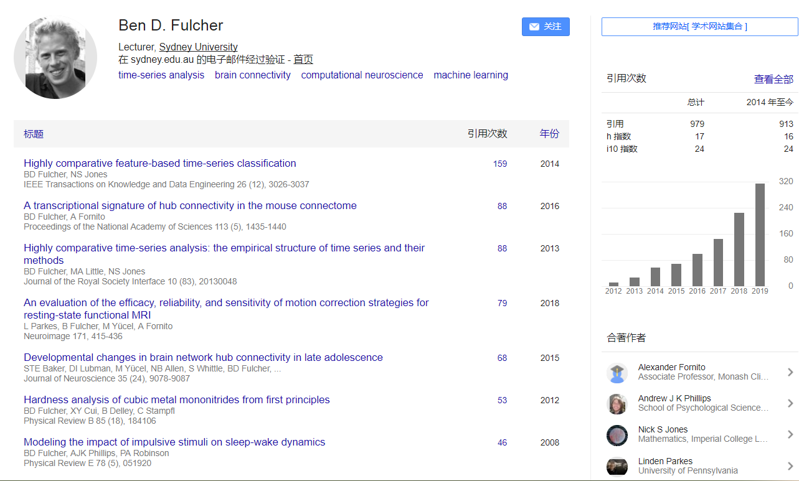

Slide 17
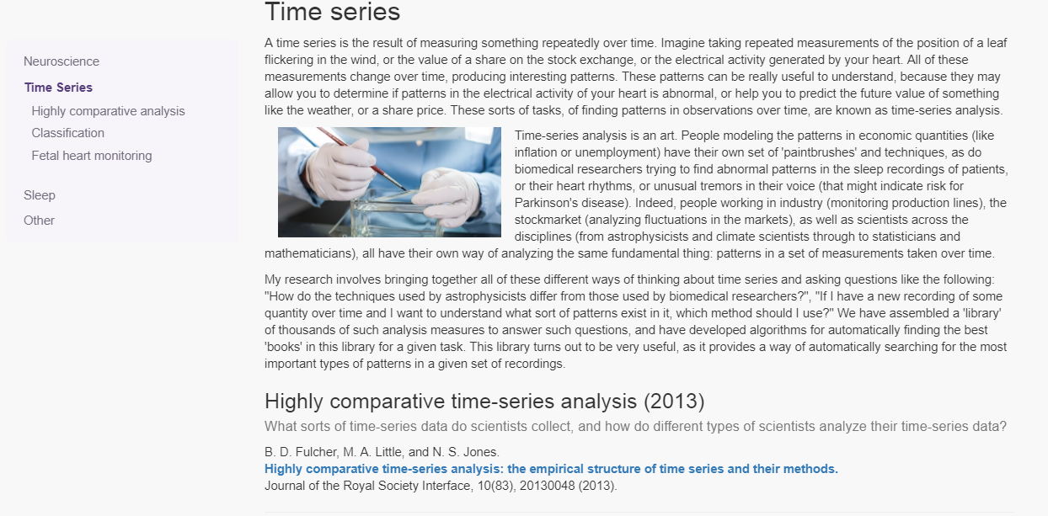

Slide 18

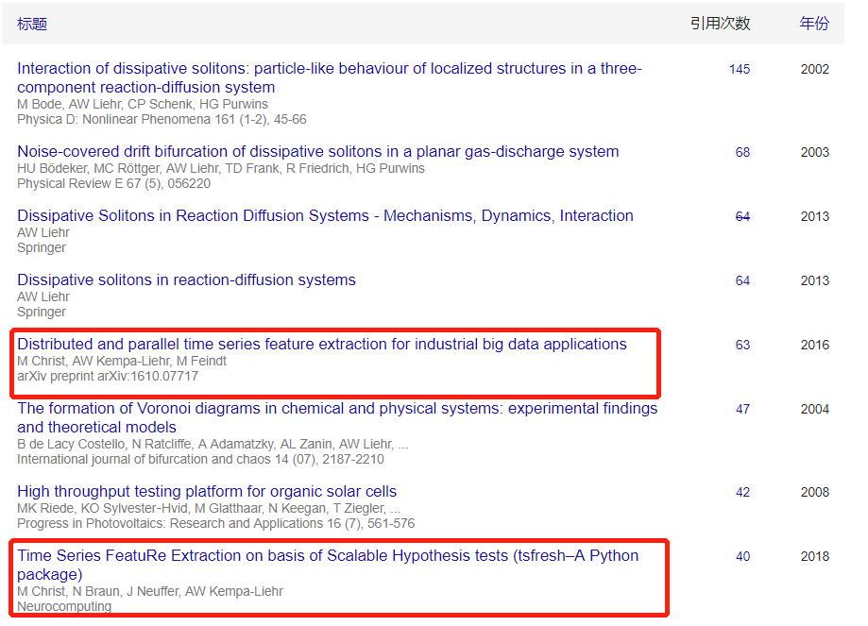

Slide 19
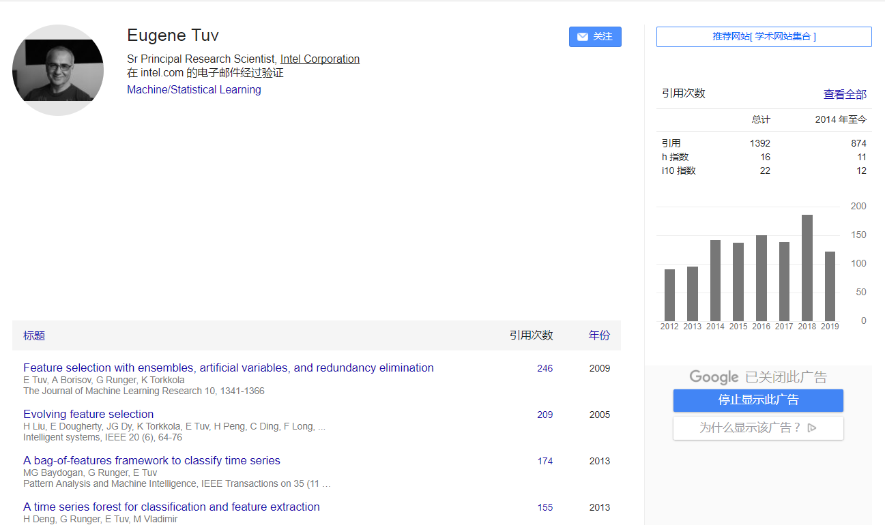
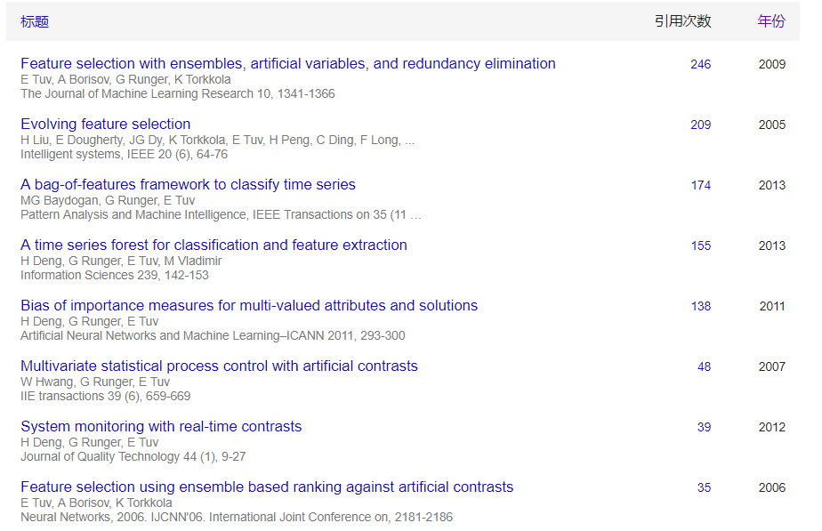

Slide 20
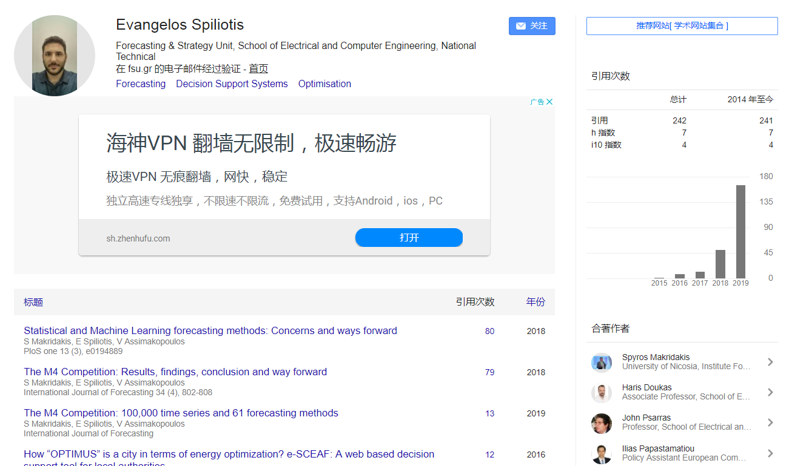
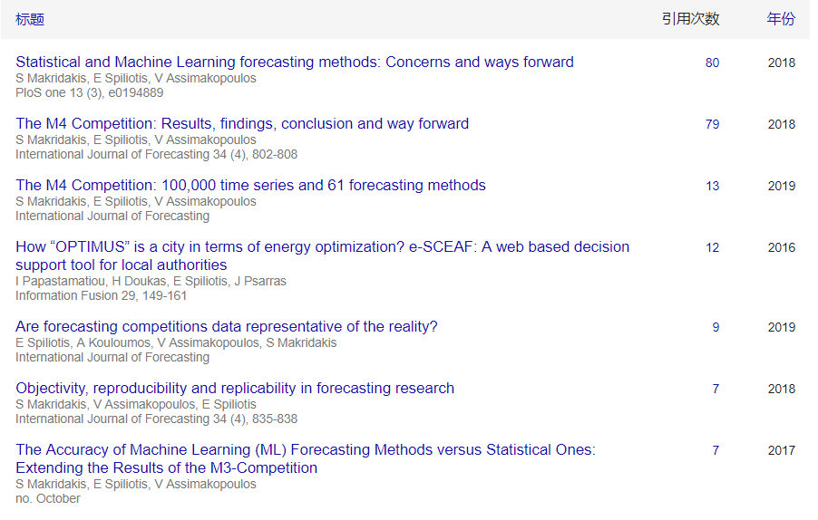

Slide 21
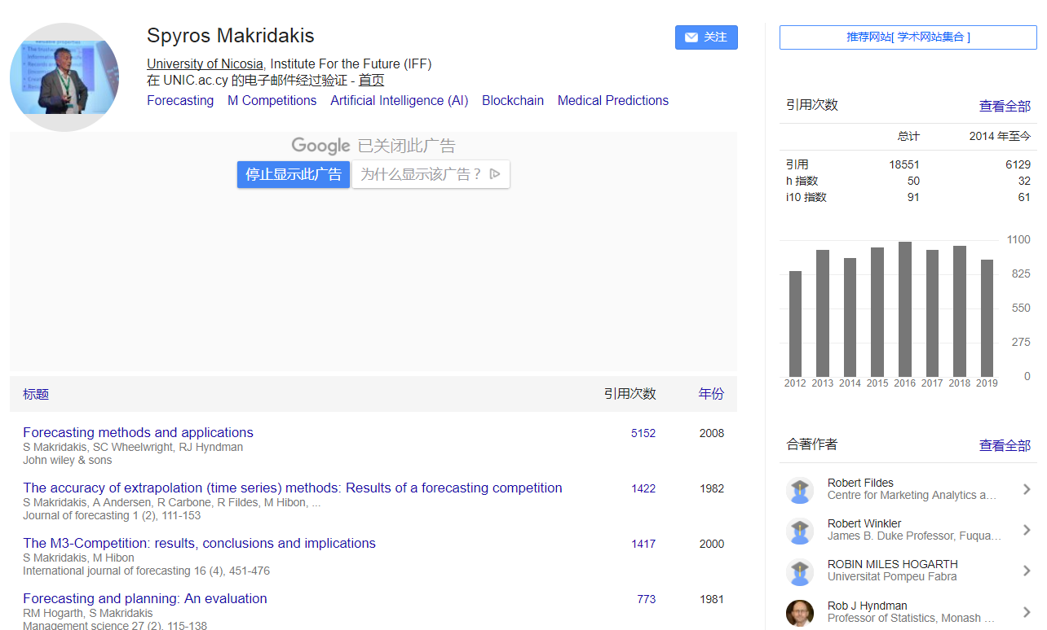
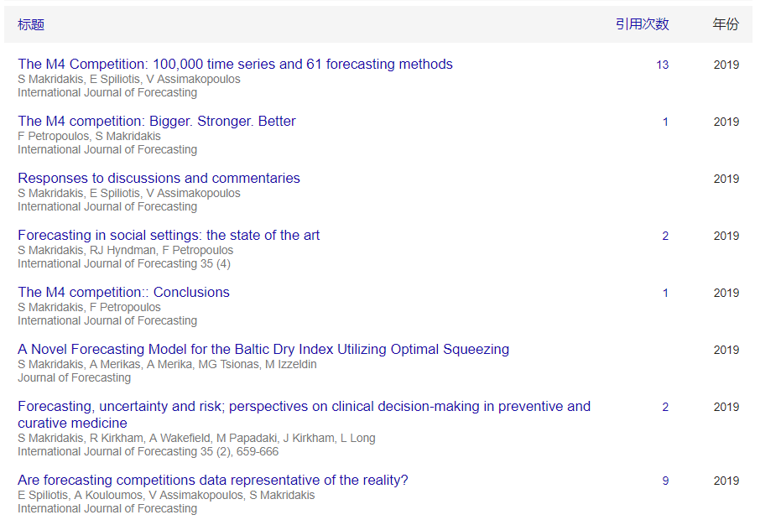

Slide 22
3 Generation of time series
need for more comprehensive time series benchmarks
Keogh and Kasetty, 2003 ; K. Smith-Miles and Bowly, 2015; Muñoz et al., 2017 ; Kang et al., 2017
Some attempts
collect from real data ( Ismail Fawaz et al., 2019; Makridakis et al., 2018 )
generate datasets (Vinod, et al., 2009; Bagnall et al., 2017)
generation of time series with certain features
K. Smith-Miles and Bowly, 2015; Muñoz et al., 2016; Muñoz et al., 2017 ; Kang et al., 2017
Kegel, Hahmann et al., 2017; Kegel, Lars et al., 2017, Talagala et al., 2018; Kang et al., 2018
Smith-Miles, K., & Bowly, S. (2015). Generating new test instances by evolving in instance space. Computers & Operations Research, 63, 102–113
Yanfei Kang, Rob J Hyndman, Feng Li (2018). GRATIS: GeneRAting TIme Series with diverse and controllable characteristics. https://arxiv.org/abs/1903.02787.

Slide 23
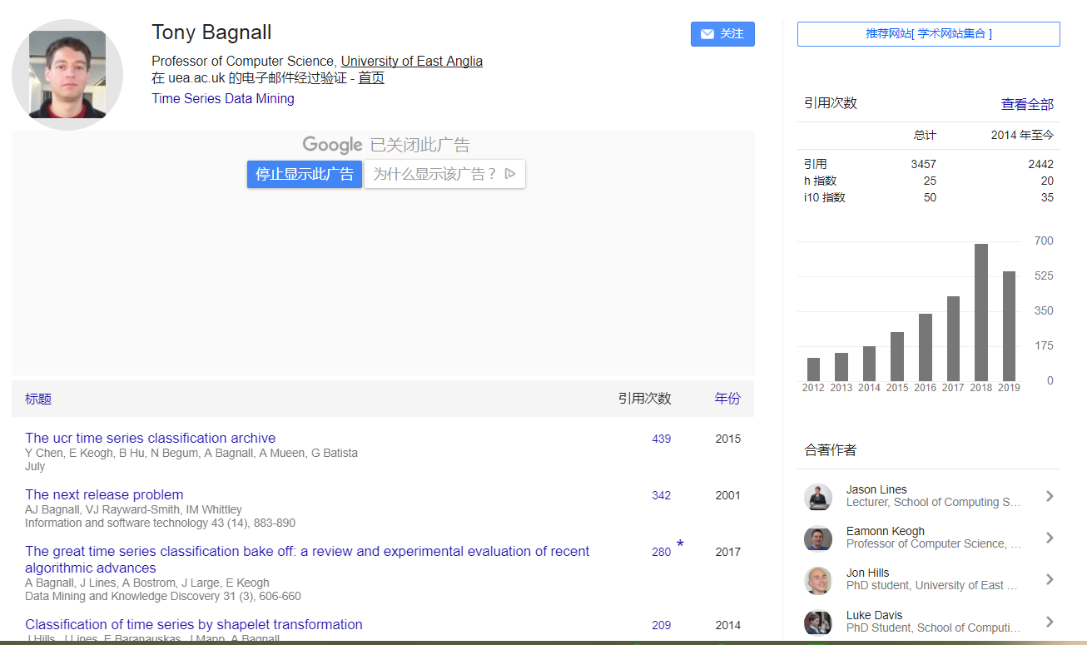
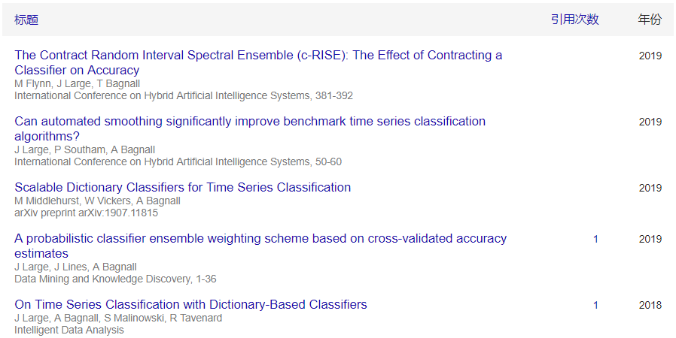

Slide 24
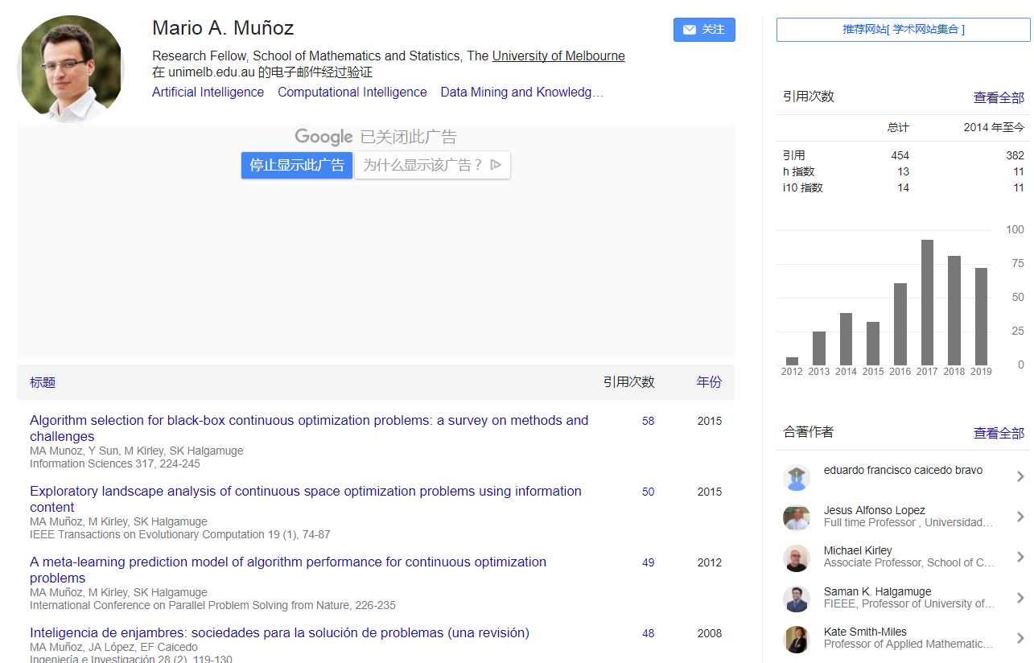
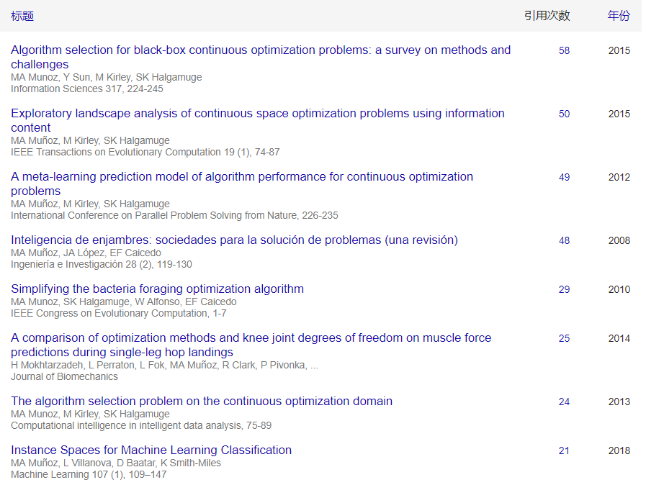

Slide 25
4 Applications of time-series features for forecasting
select the most appropriate forecast model based on time series features
rule-based forecasting
Collopy and Armstrong, 1992; Adya et al., 2001; Armstrong et al., 2001; Shah, 1997
univariate time series forecasting
Meade, 2000; Paras et al., 2009; McGovern et al., 2010; Petropoulos et al.,2014
Kang et al., 2017; Montero-Manso et al., 2018; Makridakis et al., 2018
automated feature extraction from time series
Fulcher et al., 2013; Fulcher and Jones, 2014; Fulcher and Jones, 2017; Christ et al., 2016
Hatami et al., 2017; Wang and Oates, 2015; Li et al., 2019

Slide 26
R Learning

Slide 27
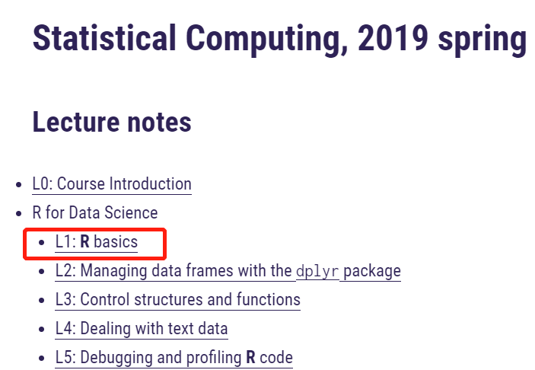
Overview of R
Installation
R nuts and bolts
Numbers/Attributes/Vectors/Matrices/Lists/Factors/Data Frames
Getting data in and out of R
Reading and Writing Data
Subsetting R objects
Subsetting a Vector/Matrix/Lists/
https://yanfei.site/

Slide 28
Thank you

