Slide 1


GPU-acceleration for high dimensional kNN
李雪堃 李宜谦 李俞乐

Slide 2

CONTENT
1
kNN OpenMP
2
kNN CUDA
3
kNN CUBLAS
4
RESULT
Notes:
关注公众号：今日双鸭山

Slide 3

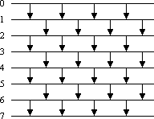
KNN OpenMP
Main Parts
The computation of distance matrix
The distances between query points and
references points will be assigned to CPU threads.
Sort by distance
To get better parallel efficiency, we use odd-
even sort in the implementation

Slide 4
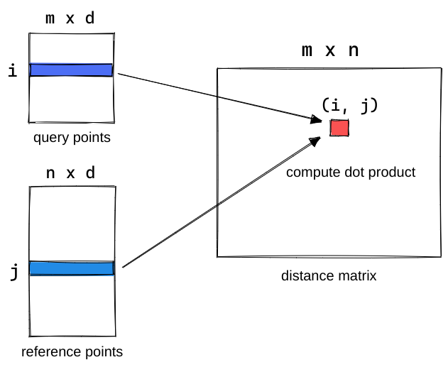
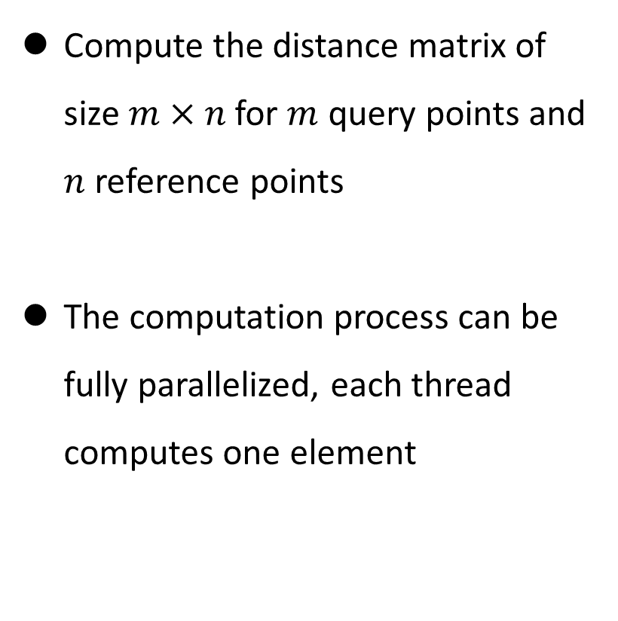
KNN CUDA
Distance Matrix Computation Kernel
Compute the distance matrix of size $m×n$ for $m$ query points and $n$ reference points
The computation process can be fully parallelized, each thread computes one element

Slide 5
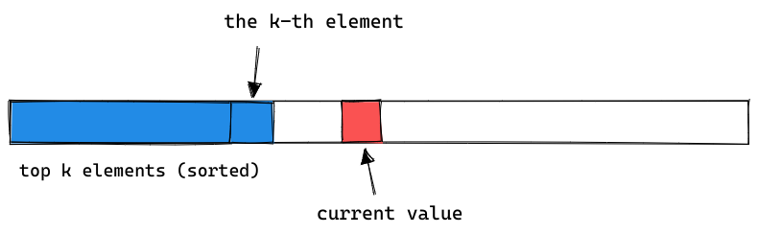
KNN CUDA
Modified Insertion Sort Kernel
Each thread sorts one row of distance matrix using insertion sort
Insertion sort can be optimized
We only want the k smallest
When current value is larger than the k-th value, we do nothing
Also shift and store the indices and distances while sorting

Slide 6
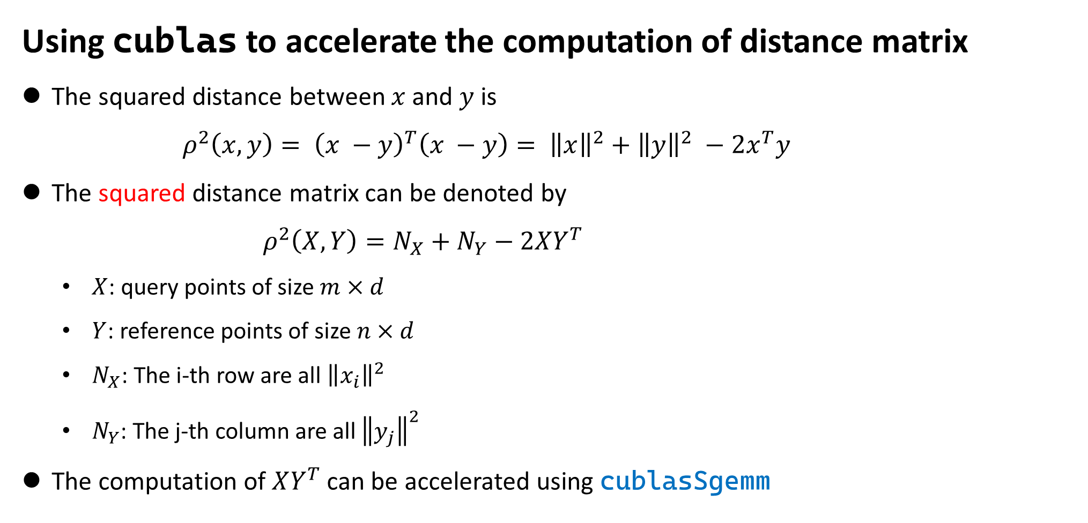
KNN CUBLAS
Using cublas to accelerate the computation of distance matrix
The squared distance between $x$ and $y$ is
$ρ^{2}\left(x, y\right)= {\left(x −y\right)}^{T}\left(x −y\right)= {\left\|x\right\|}^{2}+{\left\|y\right\|}^{2} −2x^{T}y$
The squared distance matrix can be denoted by
$ρ^{2}\left(X, Y\right)=N_{X}+N_{Y}−2XY^{T}$
$X$: query points of size $m×d$
$Y$: reference points of size $n×d$
$N_{X}$: The i-th row are all ${\left\|x_{i}\right\|}^{2}$
$N_{Y}$: The j-th column are all ${\left\|y_{j}\right\|}^{2}$
The computation of $XY^{T}$ can be accelerated using cublasSgemm

Slide 7
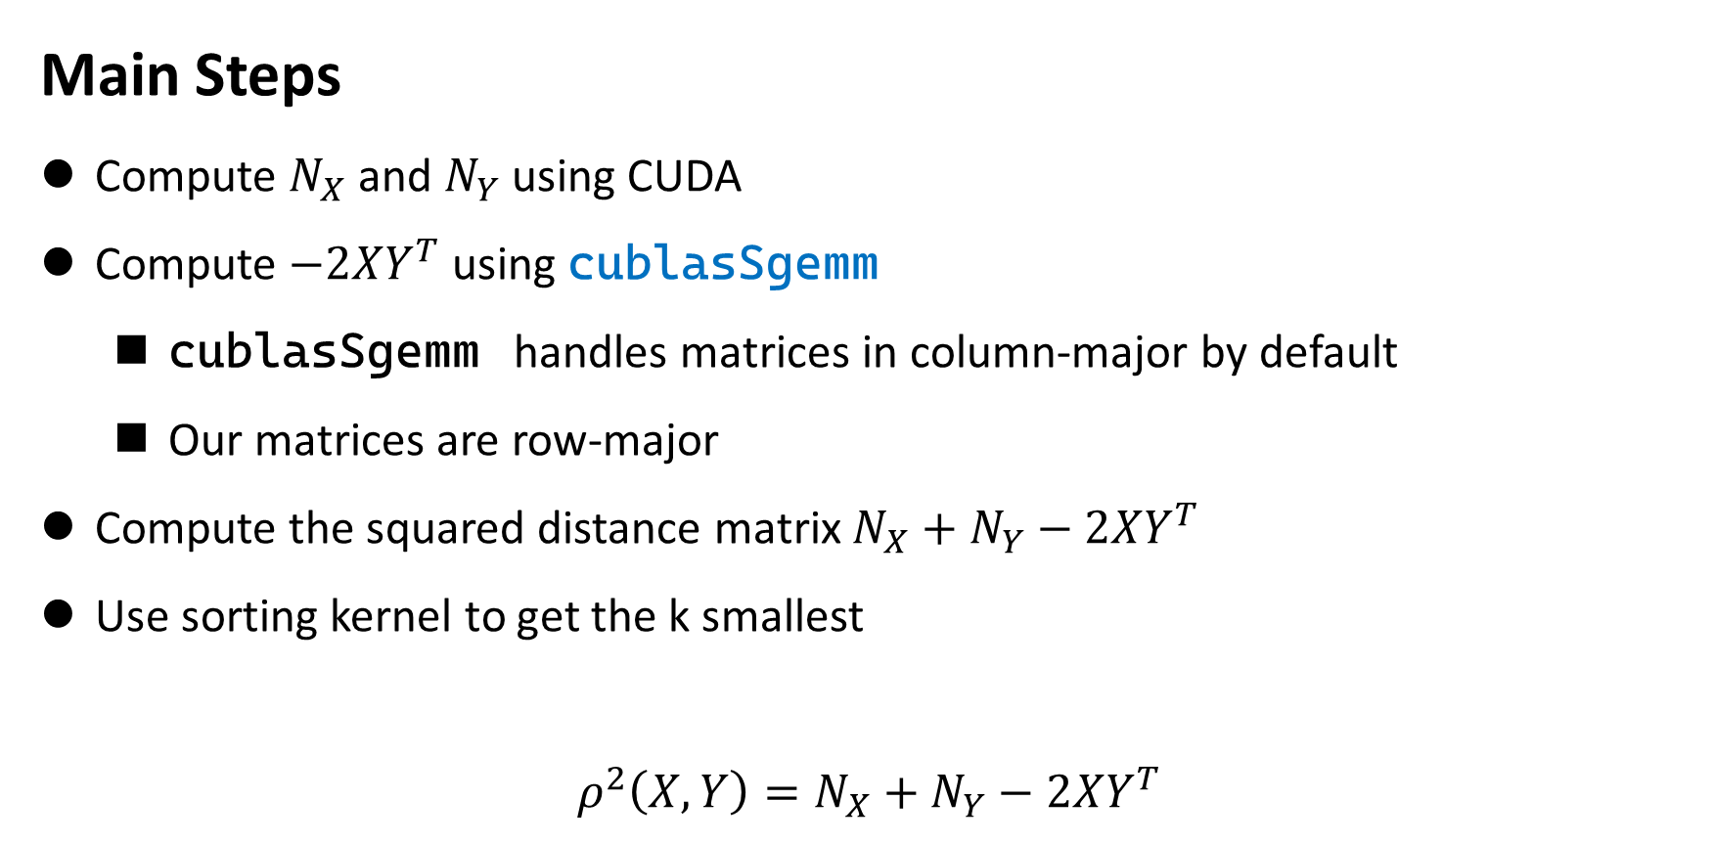
KNN CUBLAS
Main Steps
Compute $N_{X}$ and $N_{Y}$ using CUDA
Compute $−2XY^{T}$ using cublasSgemm
cublasSgemm handles matrices in column-major by default
Our matrices are row-major
Compute the squared distance matrix $N_{X}+N_{Y}−2XY^{T}$
Use sorting kernel to get the k smallest
$$ρ^{2}\left(X, Y\right)=N_{X}+N_{Y}−2XY^{T}$$

Slide 8
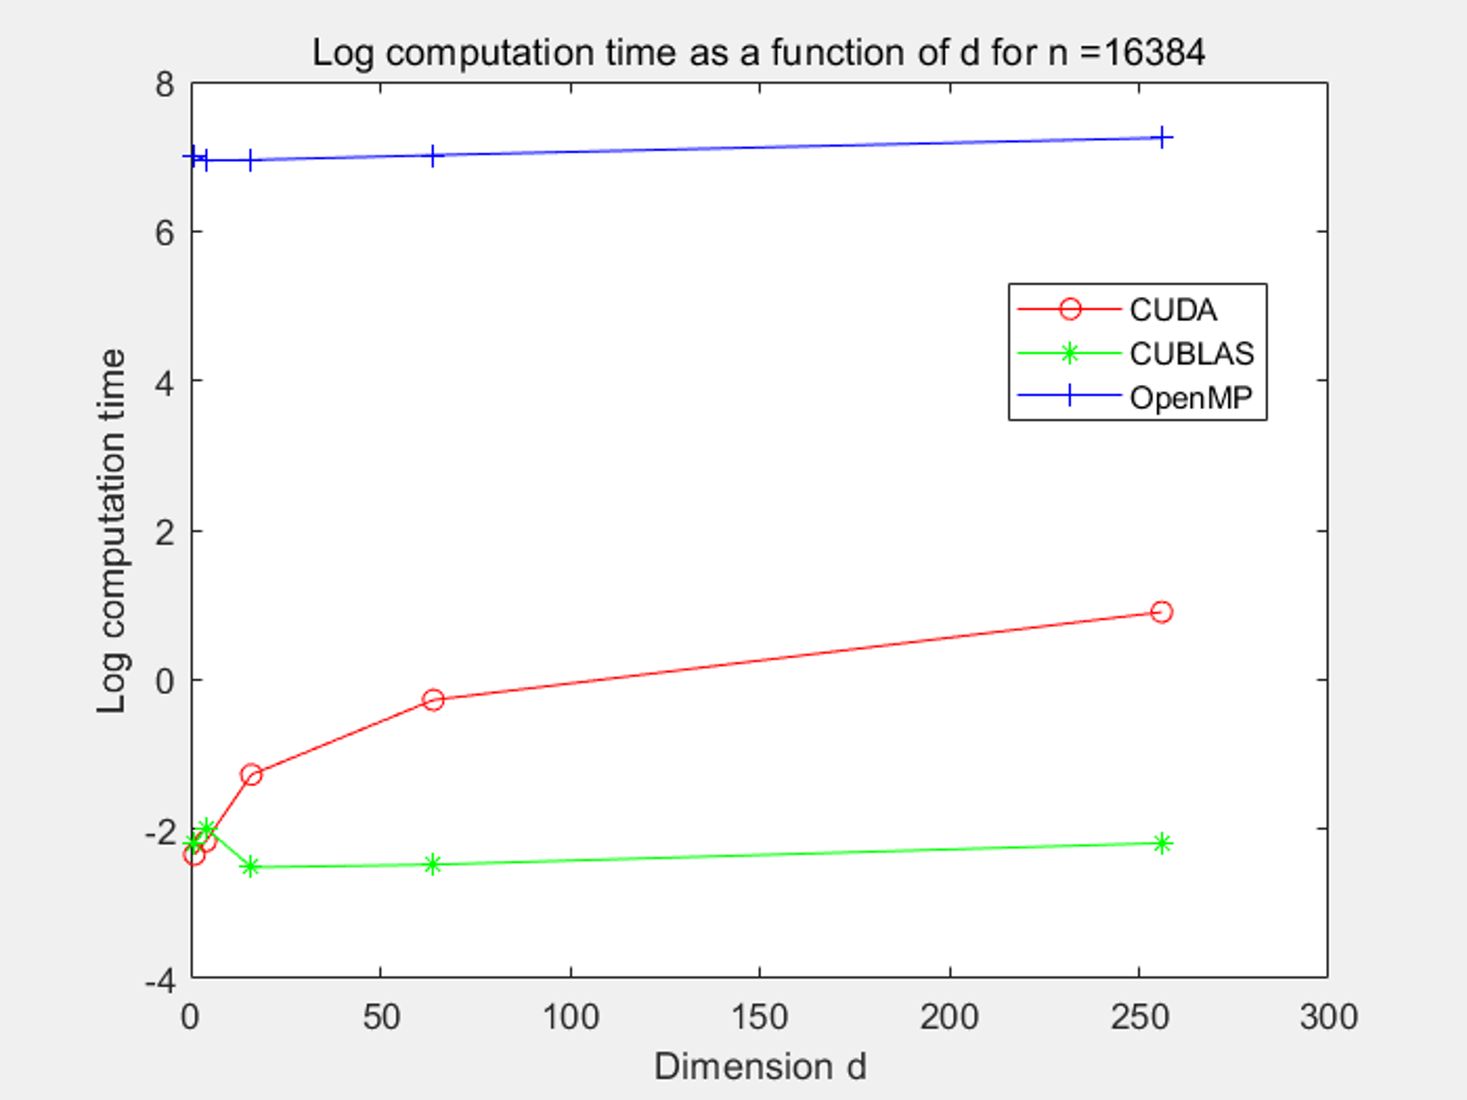
RESULT
OpenMP vs CUDA vs CUBLAS
m = n = 16384
Poor performance of OpenMP when n is large
CUDA grows slowly
CUBLAS remains stable

Slide 9
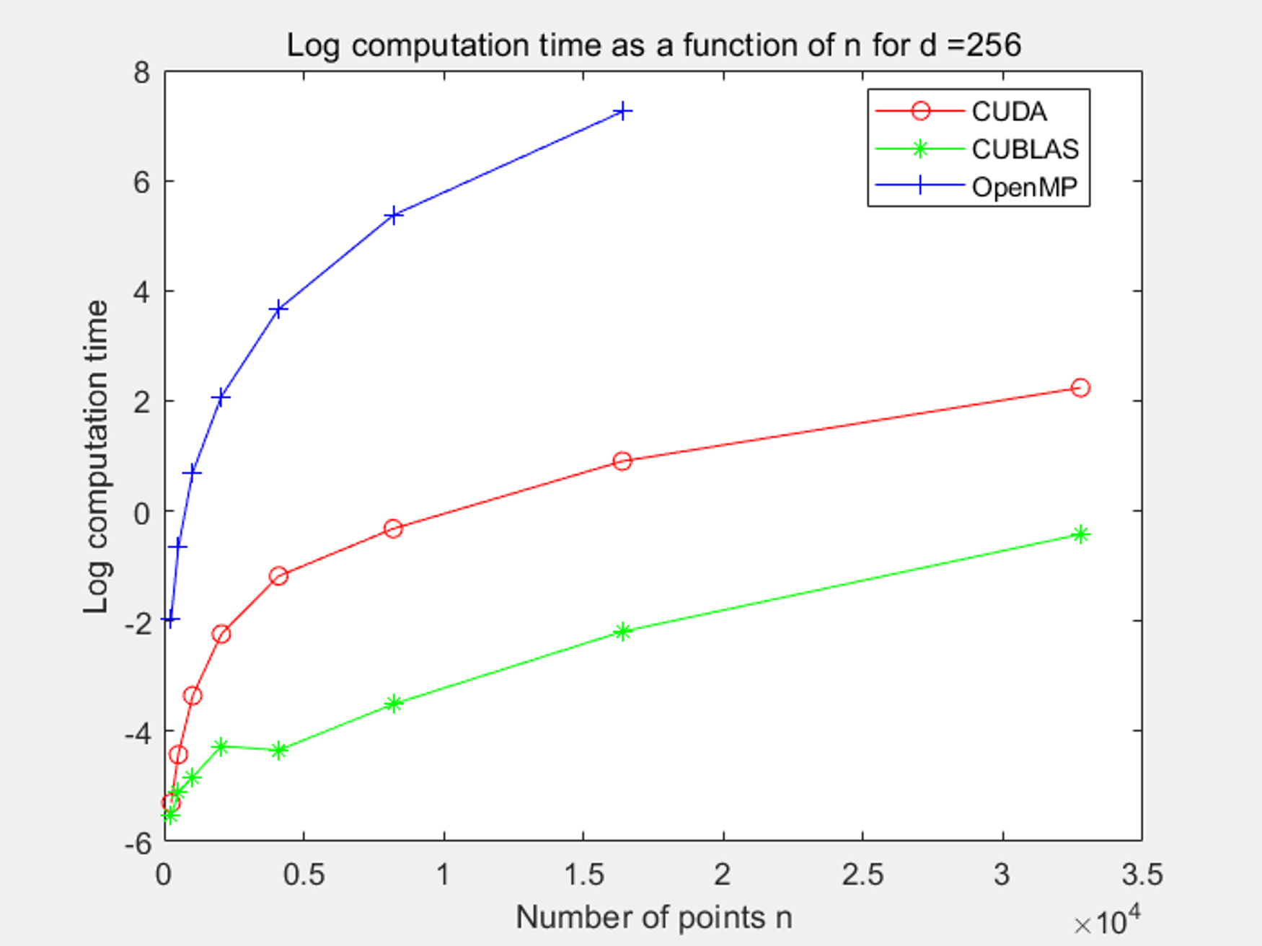
RESULT
OpenMP vs CUDA vs CUBLAS
Fixed dimension = 256
They are all growing
OpenMP is growing much faster than the other two

Slide 10
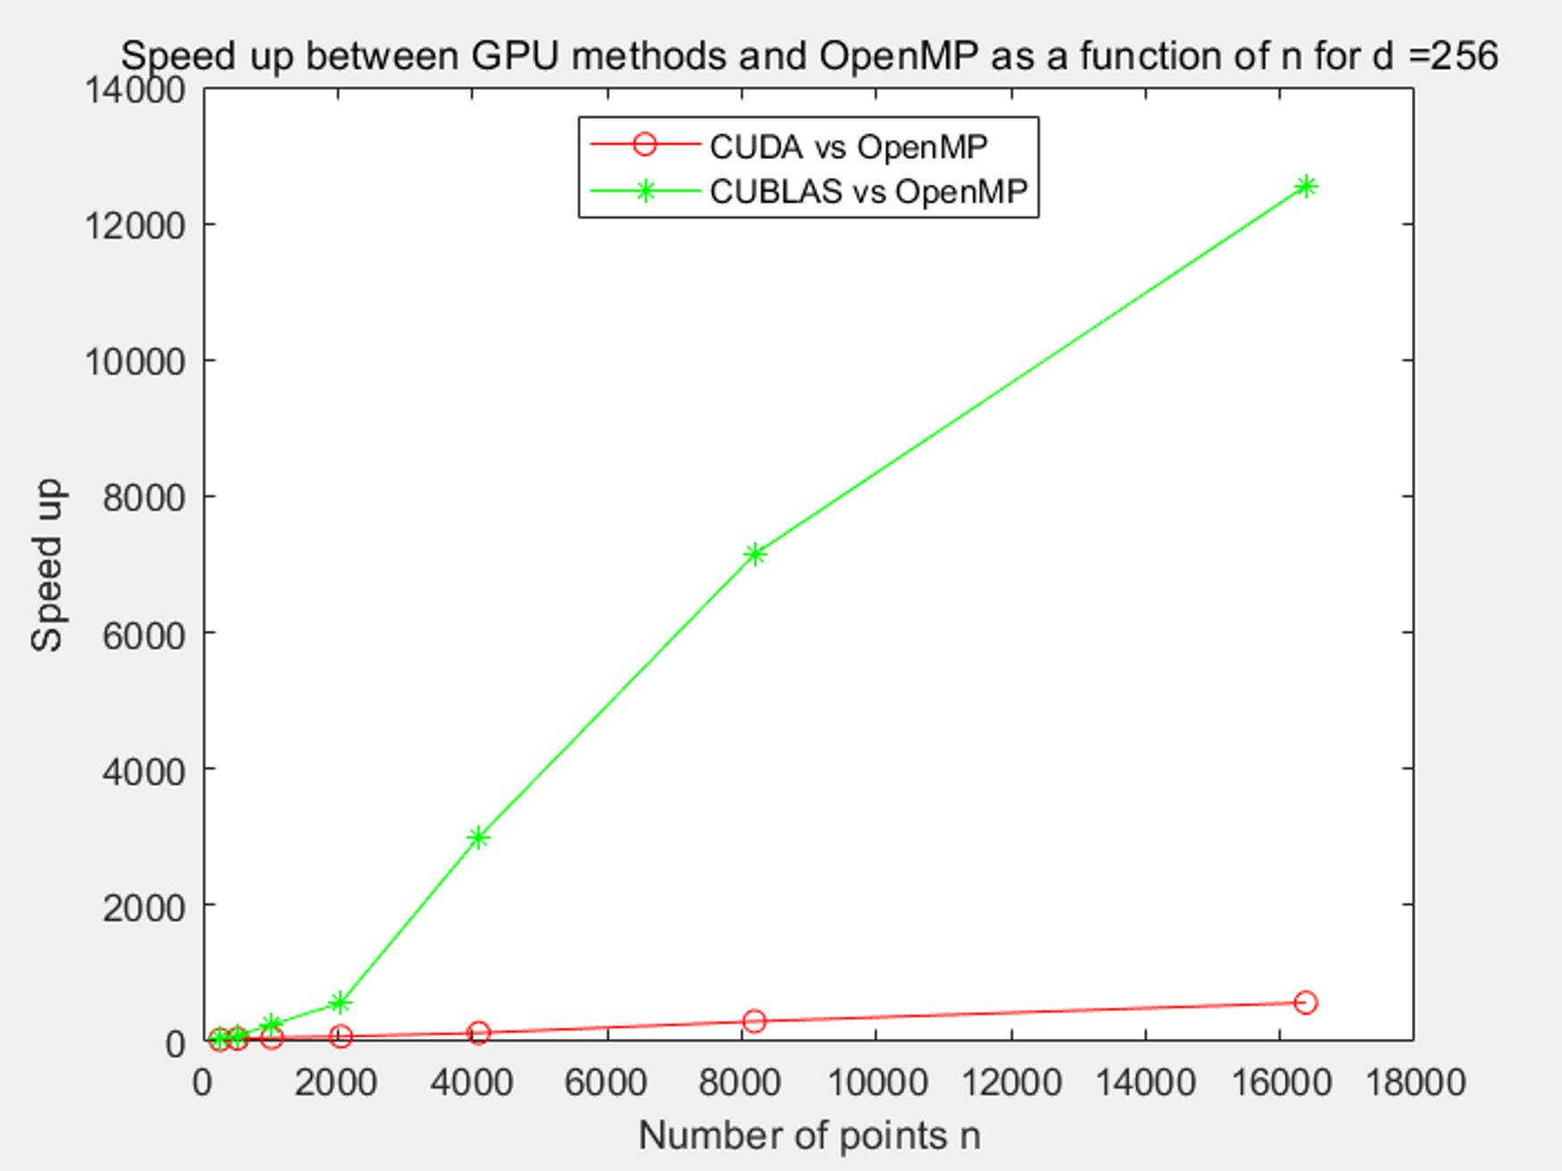
RESULT
Speedups
Compared to OpenMP
CUBLAS is much faster than CUDA

Slide 11
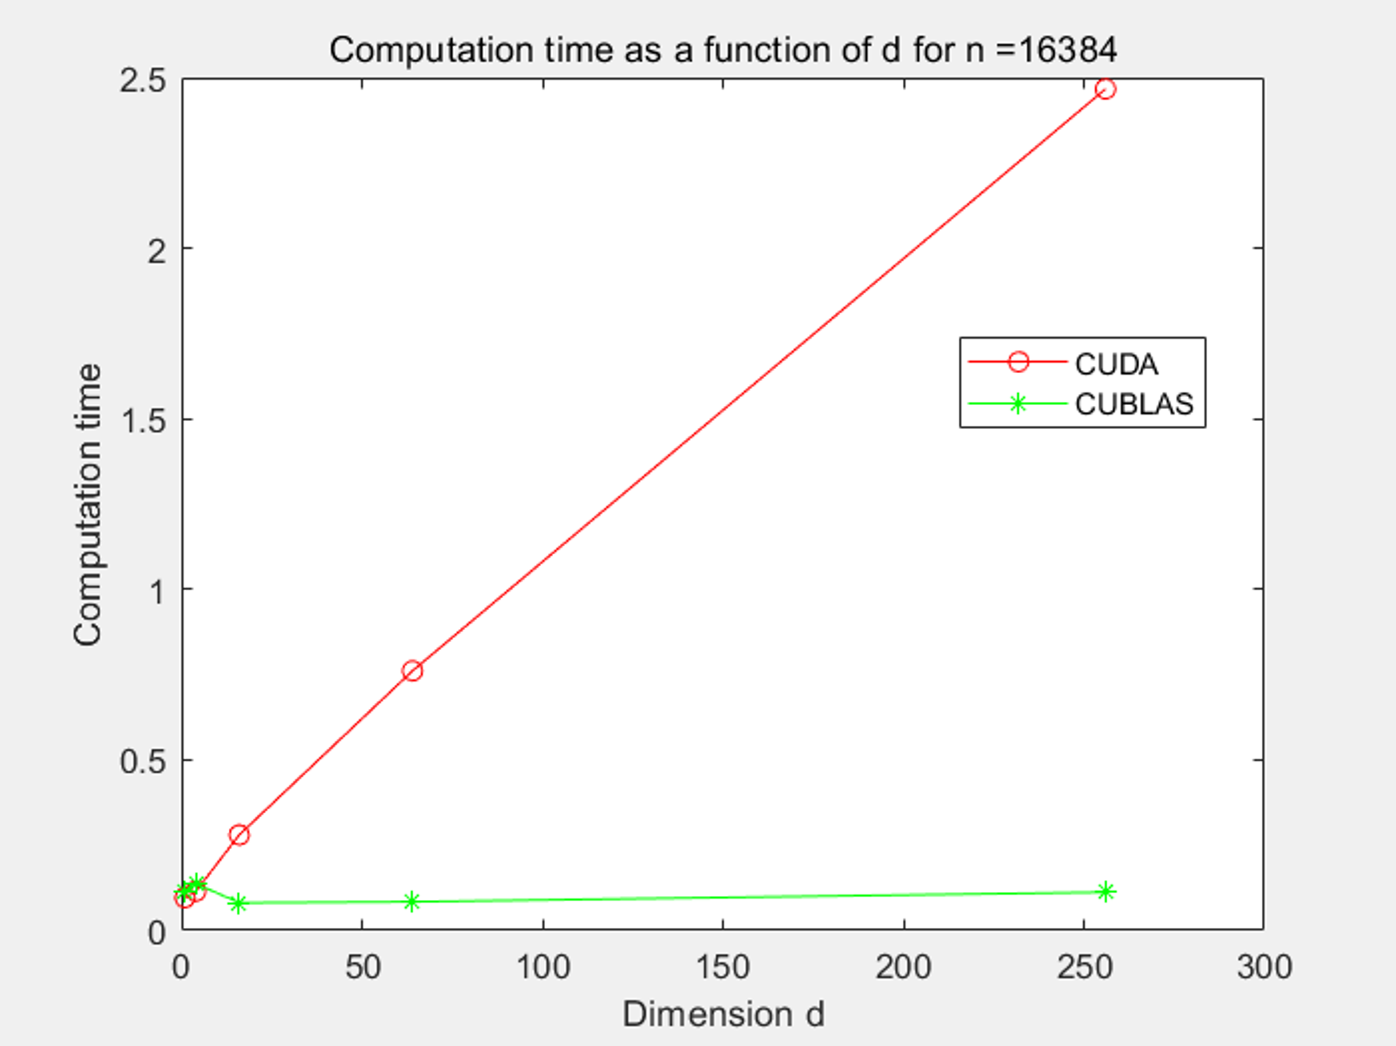
RESULT
CUDA vs CUBLAS
m = n = 16384
CUBLAS is way more faster than CUBLAS
For high dimensional data, CUBLAS is preferred

Slide 12
REFERENCE
Fast k Nearest Neighbor Search using GPU, Vincent Garcia
http://citeseerx.ist.psu.edu/viewdoc/download?doi=10.1.1.159.9386&rep=rep1&type=pdf
k-Nearest Neighbor Search: Fast GPU-Based Implementations and Application to High-Dimensional Feature Space, Vincent Garcia
http://citeseerx.ist.psu.edu/viewdoc/download;jsessionid=064592F4CB50DE20D130694460A83334?doi=10.1.1.172.2896&rep=rep1&type=pdf)
We reproduce the results in this two papers

