Slide 1


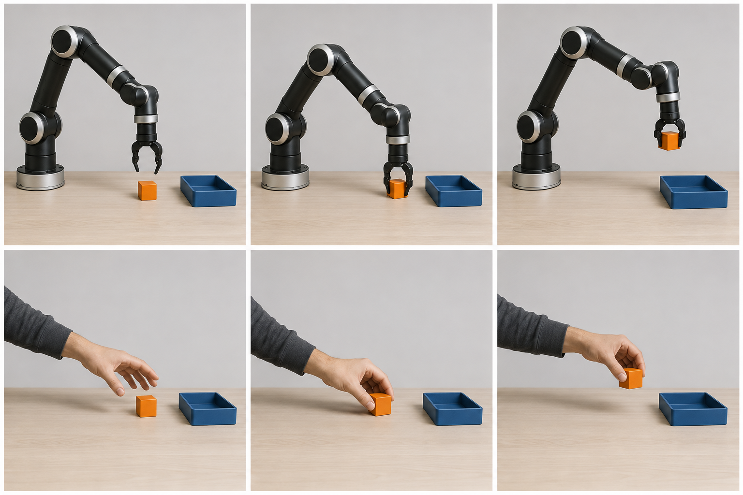



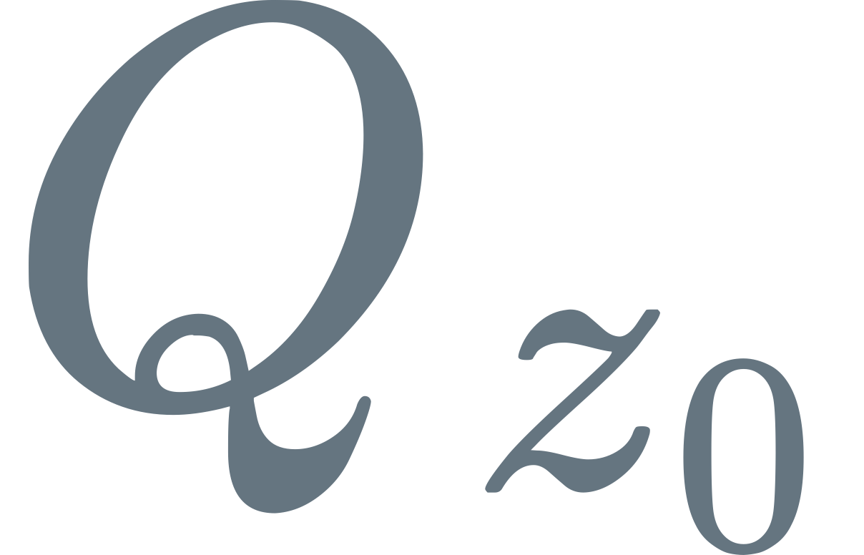
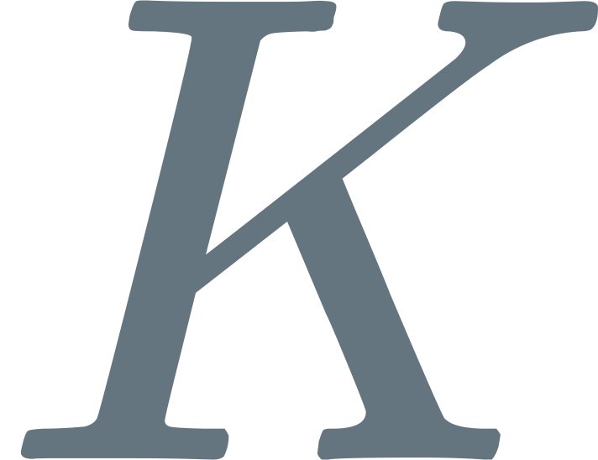

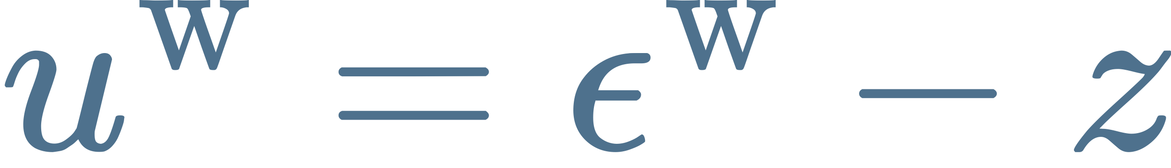
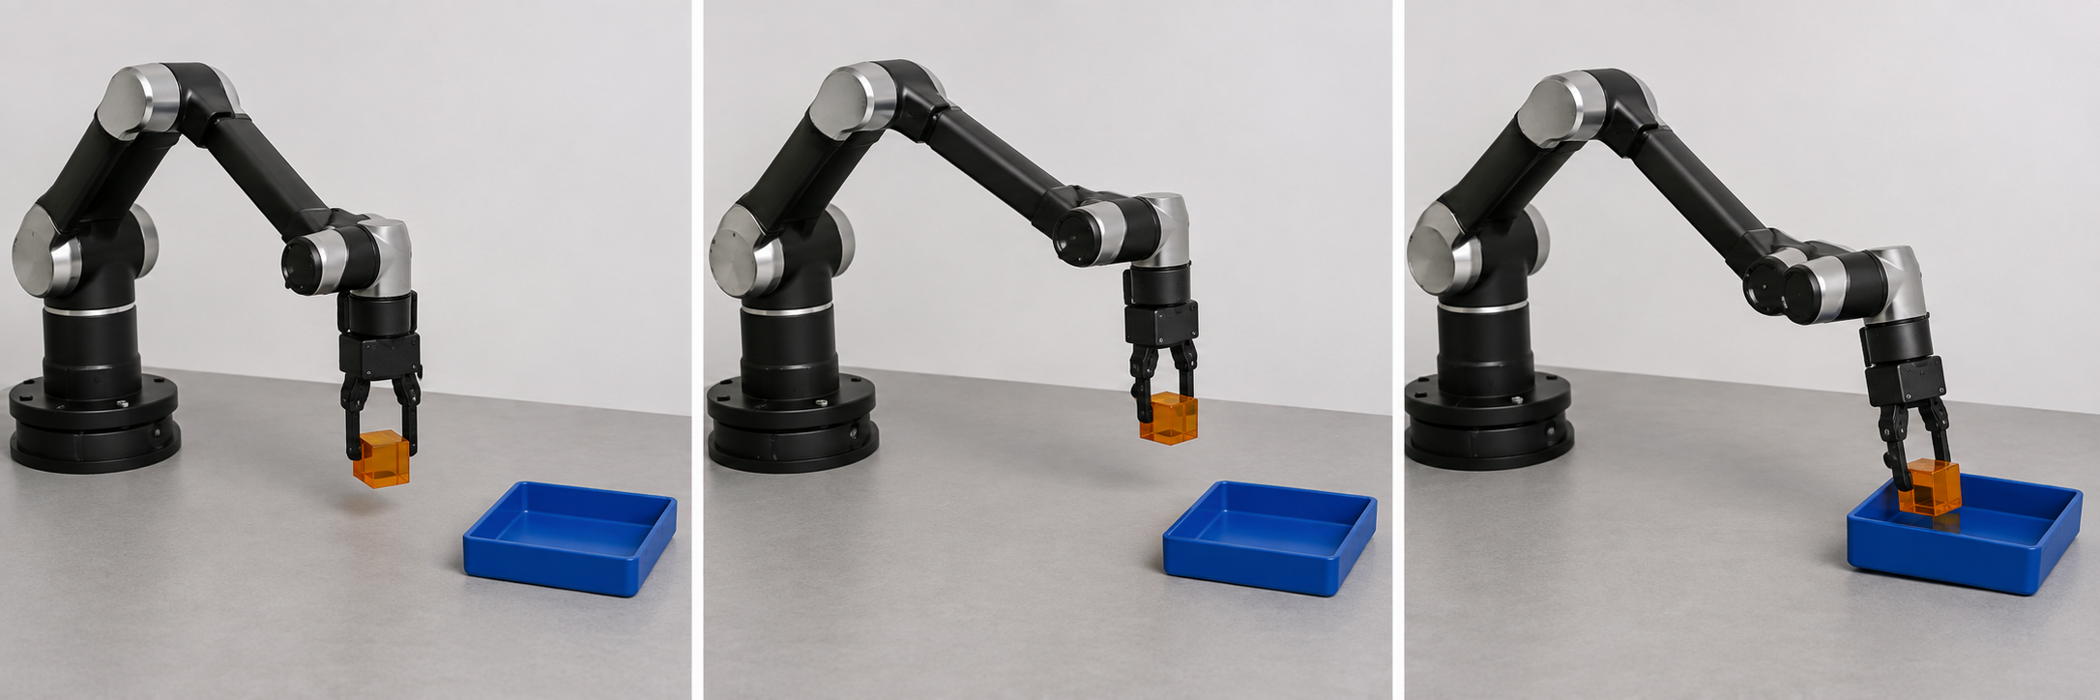




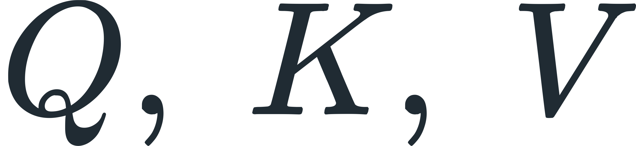
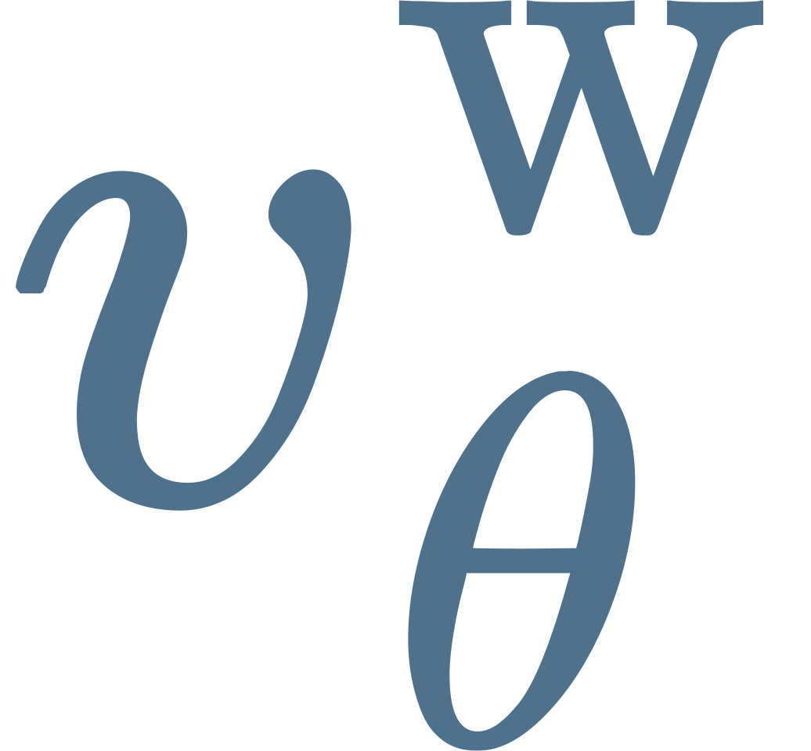
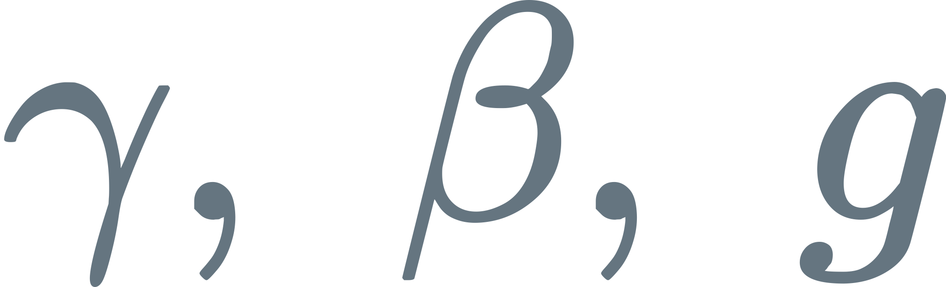


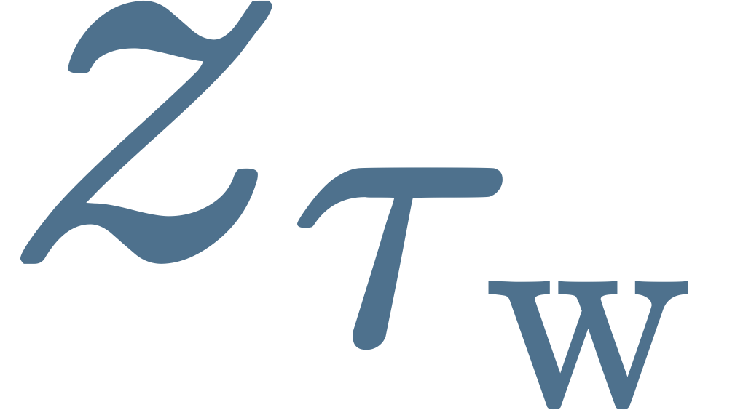

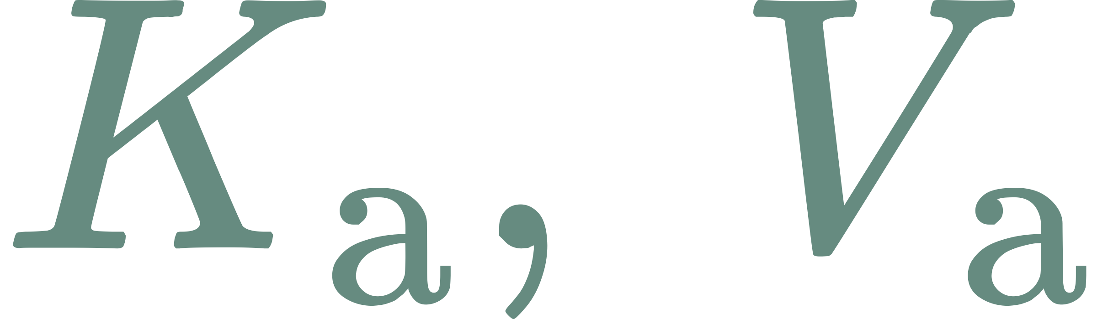
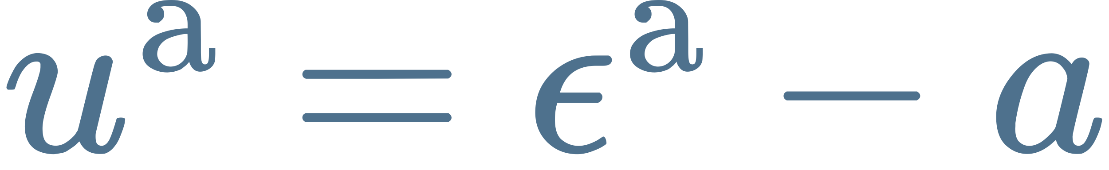
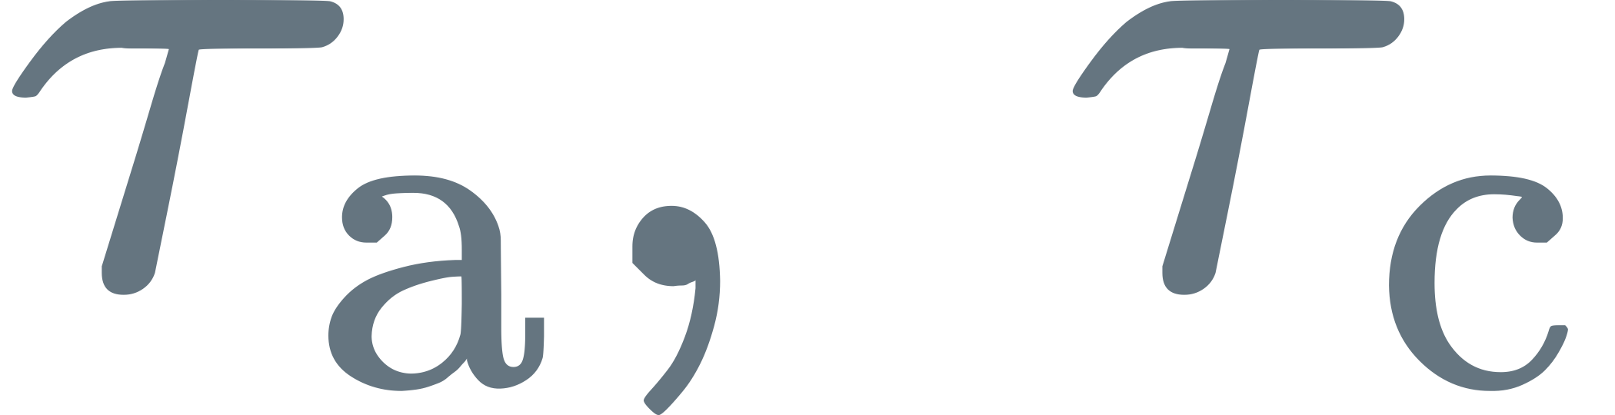


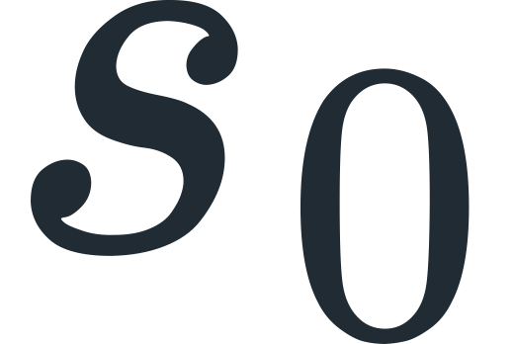

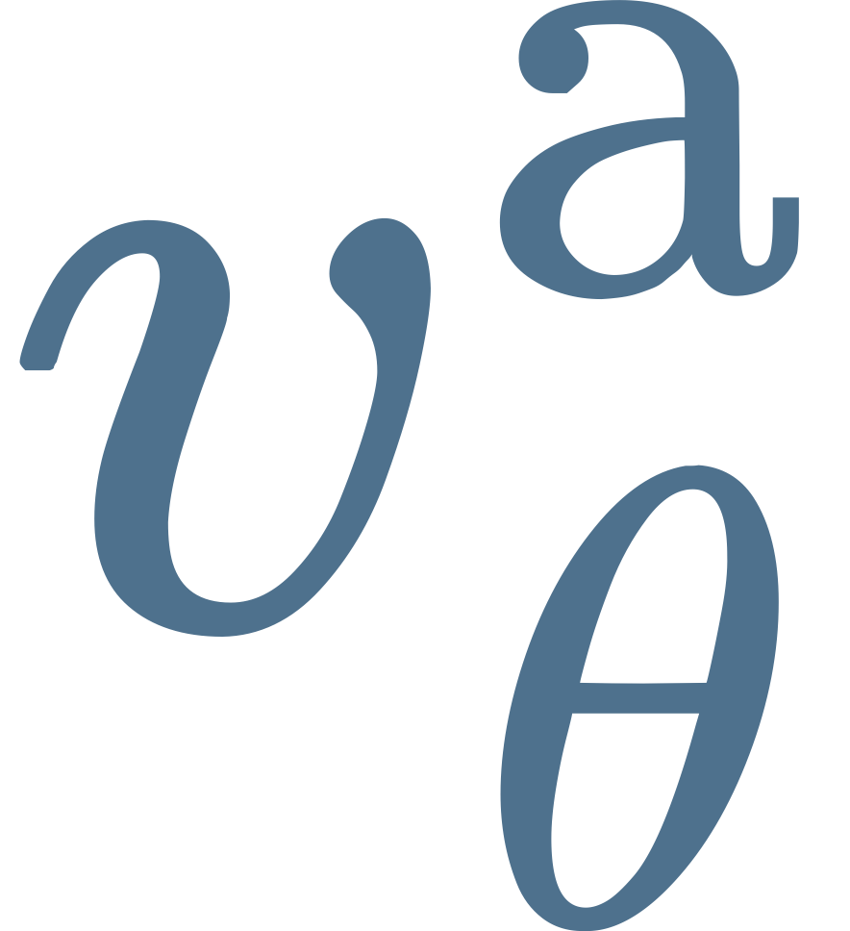


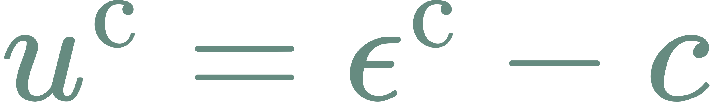
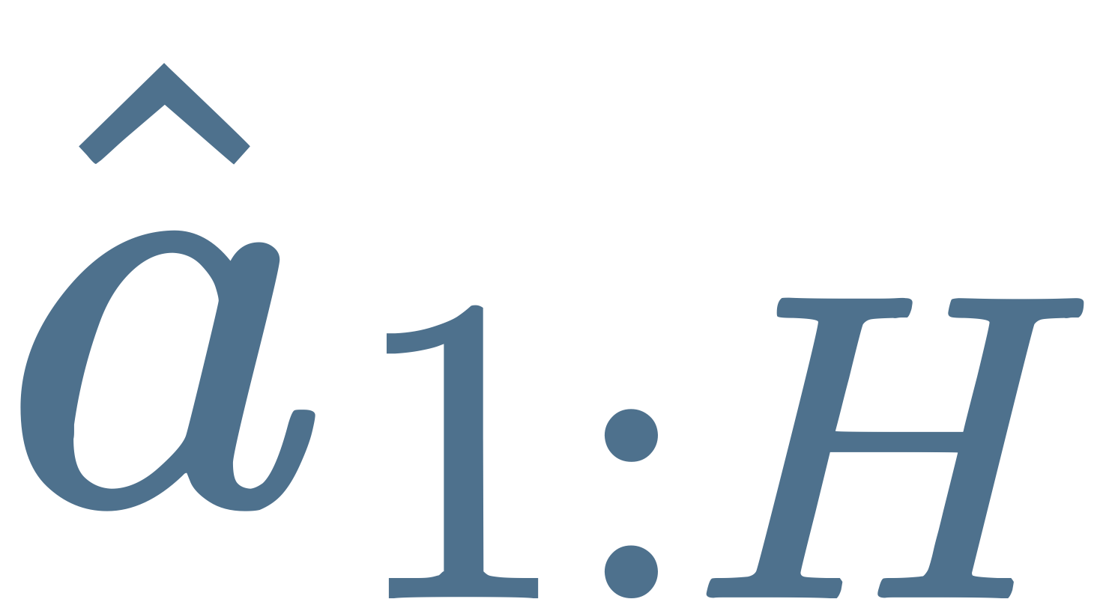
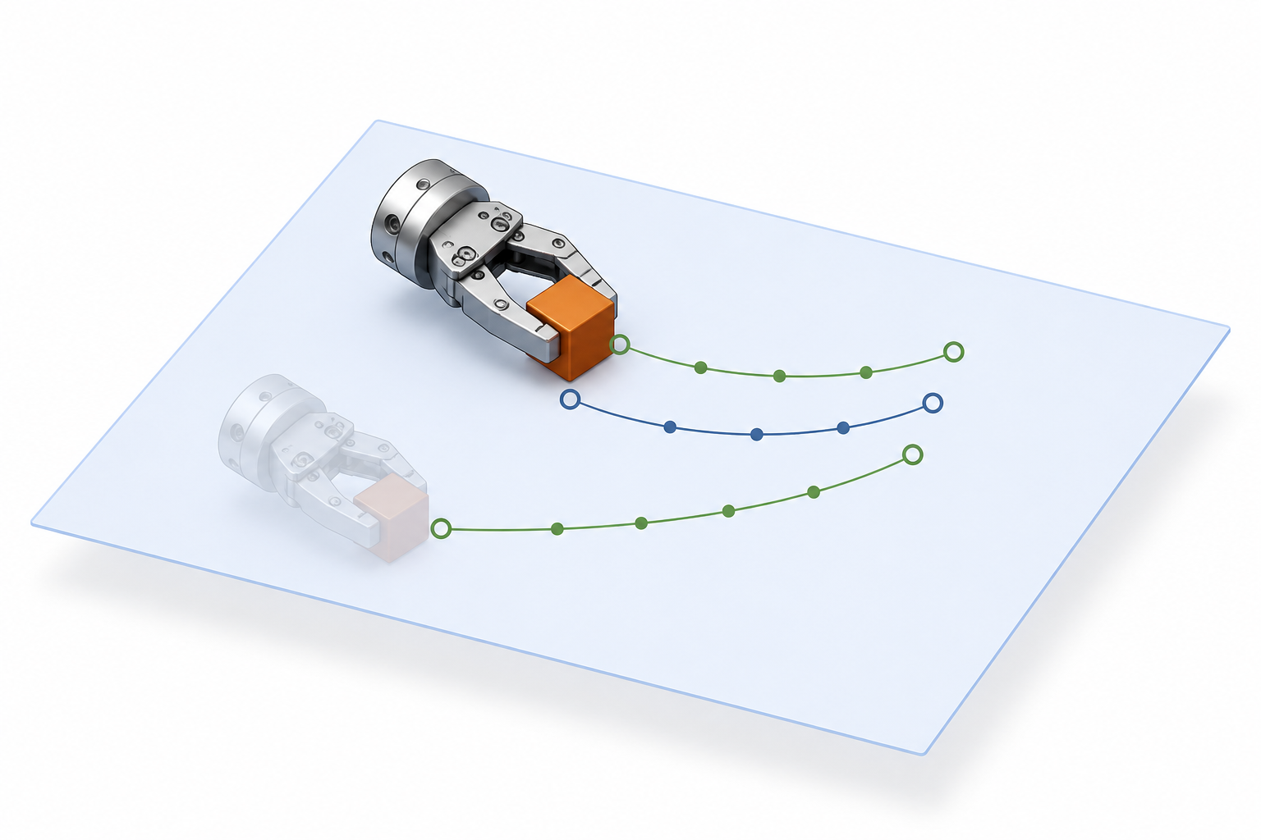

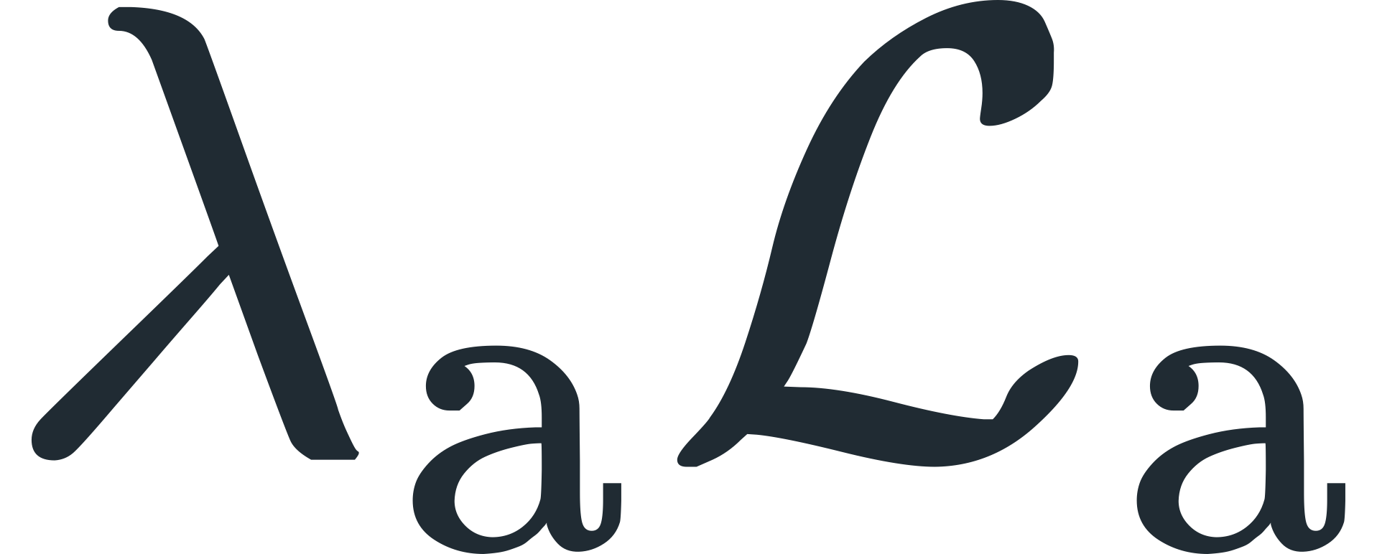


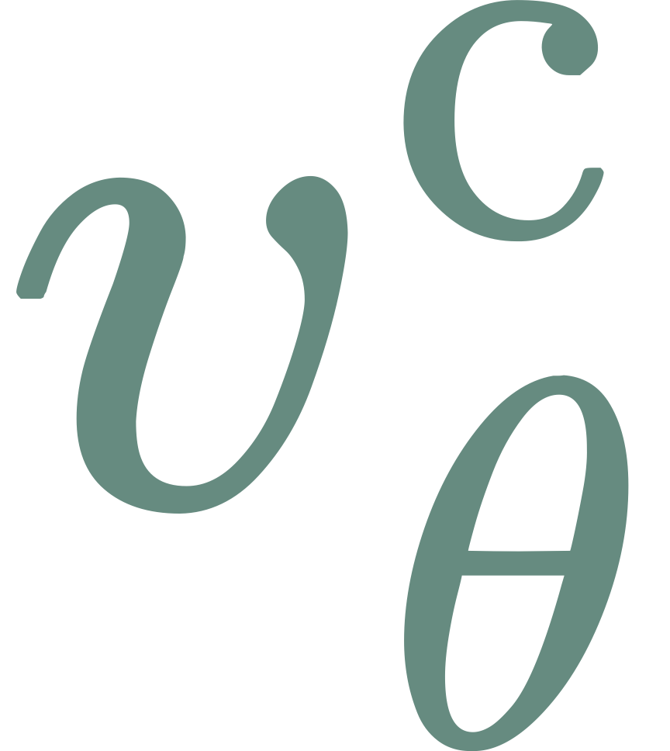
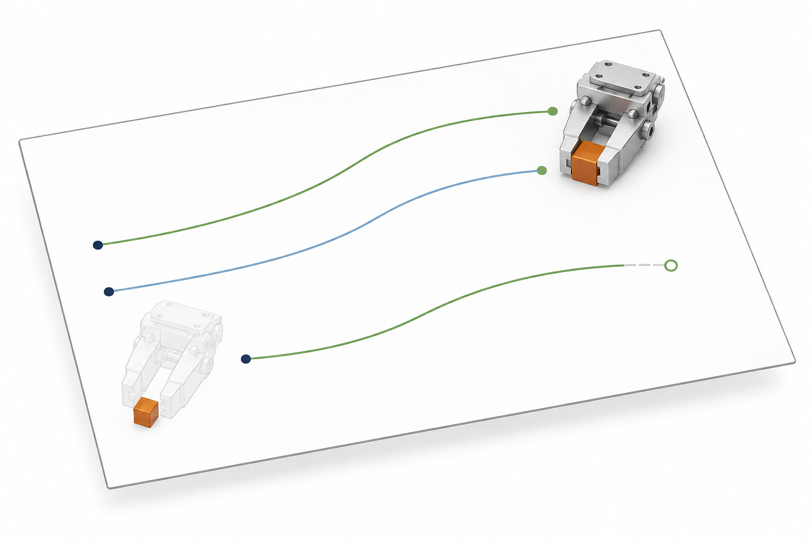
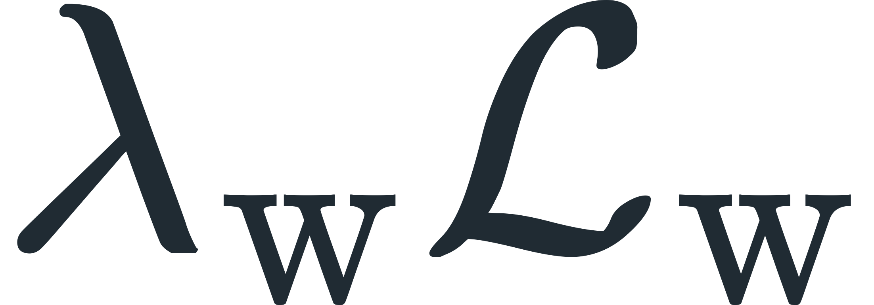
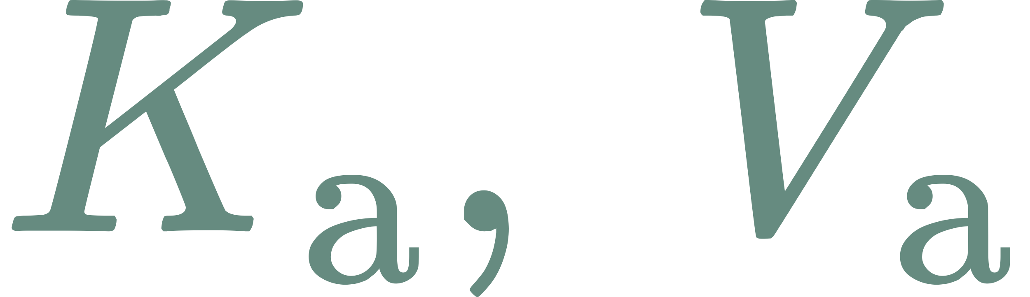
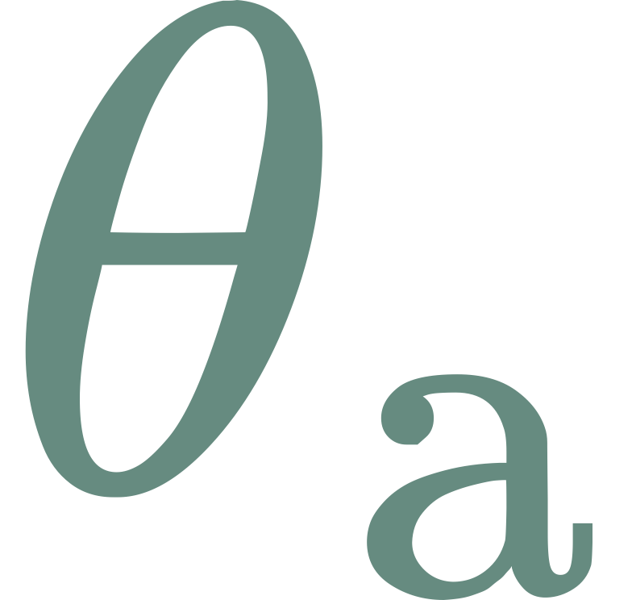
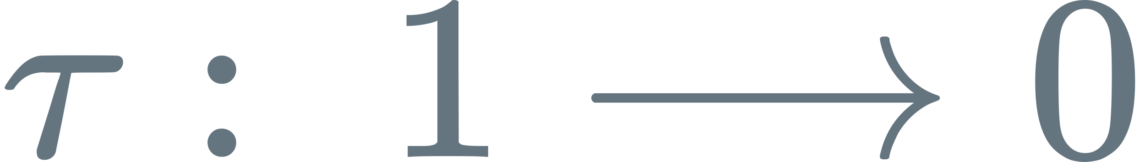
Robot / human data
Label masks
Coupled transformer layers
Velocity matching and joint sampling
Robot
Preserved observation
Joint attention
Human
Video
Action
Fixed view canvas
Filled cells: supervised targets
Future video
Video stream
Pretrained backbone
AdaLN
Residual
Text Attn
FFN
VAE Encoder
Video context
Euler step
VAE Decoder
Video reads
action
Frozen
Frozen
Action stream
Actions and visual effects
Action chunk
AdaLN
Residual
Text Attn
FFN
Source
normalization
Typed projections
Euler step
Independent noise
Action reads
video
Action context
Action and consequence
Shared head geometry
Action
Execute prefix
Command layout
Anchor-relative tracks
Reciprocal gradients
Consequence
Visual consequence
Pose
Video weights
Gripper
Euler step
Action weights
Joints
JAM: Joint Action–World Modeling
Shared schedule
Notes:
JAM framework. Input-side revision: camera views occupy fixed slots in a spatial canvas before the frozen VAE. Robot and human sources share a training stage while each microbatch uses one source. The availability table shows illustrative label patterns, not a claim that every robot dataset contains consequence labels. The human motor-action slot is absent. The human consequence route in the active adapter projects supplied hand poses through camera calibration, while trackers are another label source. The motor diagram groups pose, gripper and joint coordinates, followed by source-specific normalization and separate learned projections. Missing coordinate slots remain masked. Consequences use observation-anchor displacements in normalized image coordinates plus visibility, and enter their own projection. The view-slot and coordinate diagrams are schematic and do not specify the exact number of cameras or action dimensions. Sources: local paper Sections/3_JointModeling.tex and Sections/4_Pretraining.tex, remote JAM model/jam.py, action_stream.py, objective.py and infer/sampler.py at commit 27a9703. Distinct AdaLN and QKV projections operate sequentially in each stream. Queries attend to concatenated video and action-stream keys and values. The clean observation prefix attends only to itself. A clean state token is excluded from the generation objective. Cream language-token motifs beside ell enter both text-attention modules. Action and consequence tokens share the Action stream and have separate output projections, shown as two readouts in a common slab. Training predicts u=epsilon-x separately for world latents, motor commands and visual consequences. Each loss is a mean over valid coordinates and supervised examples, with noise weighting omega and modality weighting lambda. Filled mask cells contribute; struck pale cells represent missing targets and contribute zero. Their illustrated pattern is schematic. The two gradient lanes show weighted action loss reaching video keys and values and then video parameters, and weighted world loss reaching action-stream keys and values and then action parameters. Both memories remain attached to autograd. The separate K and V rails are a visual concatenation of existing tokens, not new learned memory modules. Gray-green tokens represent clean observation or state, blue tokens represent video or action, and sage tokens represent consequences according to each source rail. The prefix visibility inset shows that clean observation queries read observation keys only. The main matrix depicts generated-query connectivity. Raised off-diagonal cells depict cross-stream token reads followed by mixed updates; their colors are schematic modality identities, not measured attention strengths. Gamma, beta and g summarize AdaLN scale, shift and residual gates. Distinct projections share attention head geometry but not projection weights. Training loss acts on predicted velocities before Euler integration; short upward branches from the head output paths indicate this. During policy sampling all heads use the same decreasing integration schedule, and the world VAE decoder is frozen. The Euler boxes show one parallel update, repeated along the shared schedule. Execution applies a prefix of the action chunk. Consequence targets contain scaled image-normalized displacement and visibility. The figure writes the fixed displacement gain g and the normalized visibility component explicitly. Missing target validity and low visibility are distinct. Conceptual images in assets/robot-human-demonstrations.png, future-video-v8.png, point-tracks-v5.png and visual-consequence-v5.png were generated with image_gen as explanatory illustrations. They are neither dataset examples nor measured JAM outputs. The action coordinate grid and attention grid are schematic. LaTeX symbols are vector SVG images with source in assets/latex-v11/symbols.tex.

Slide 2
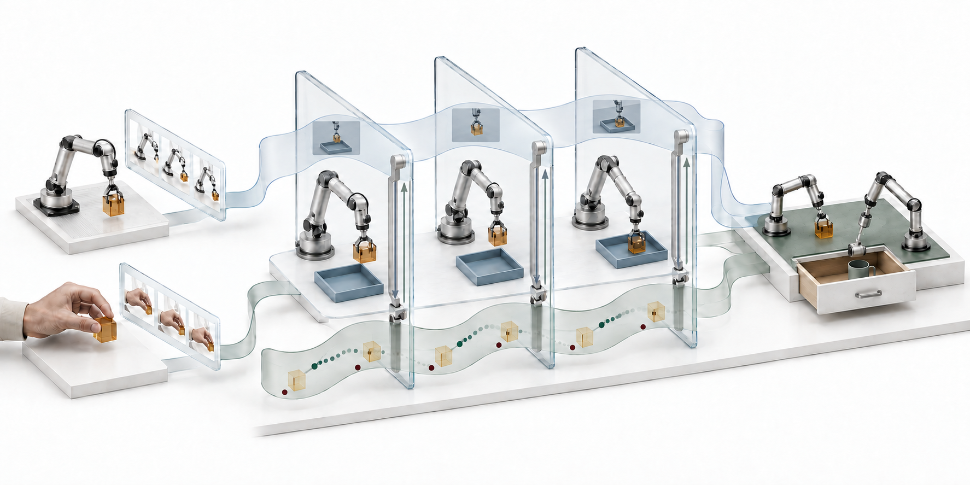
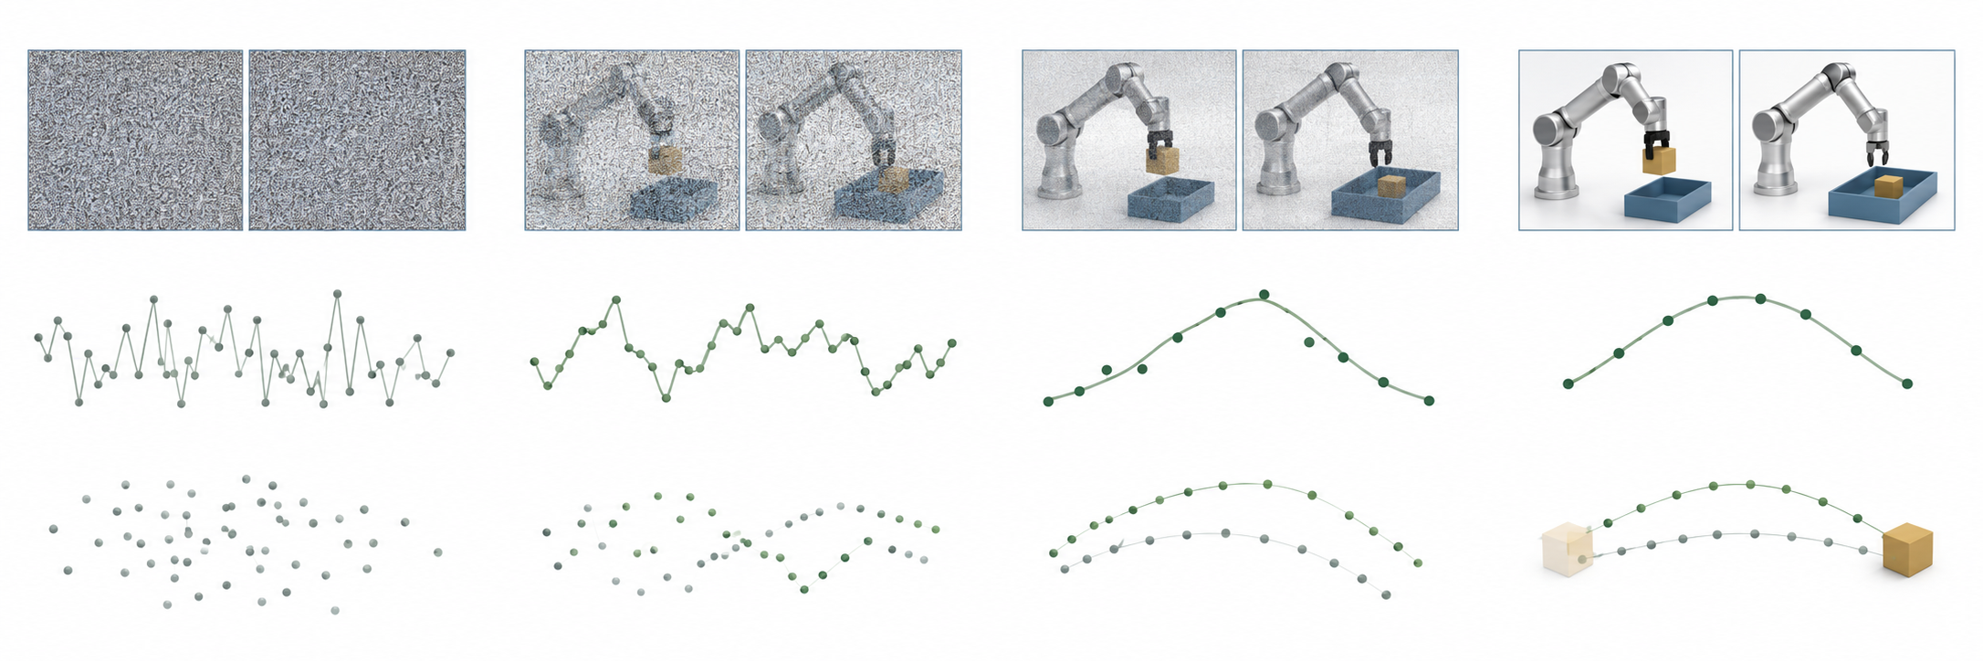
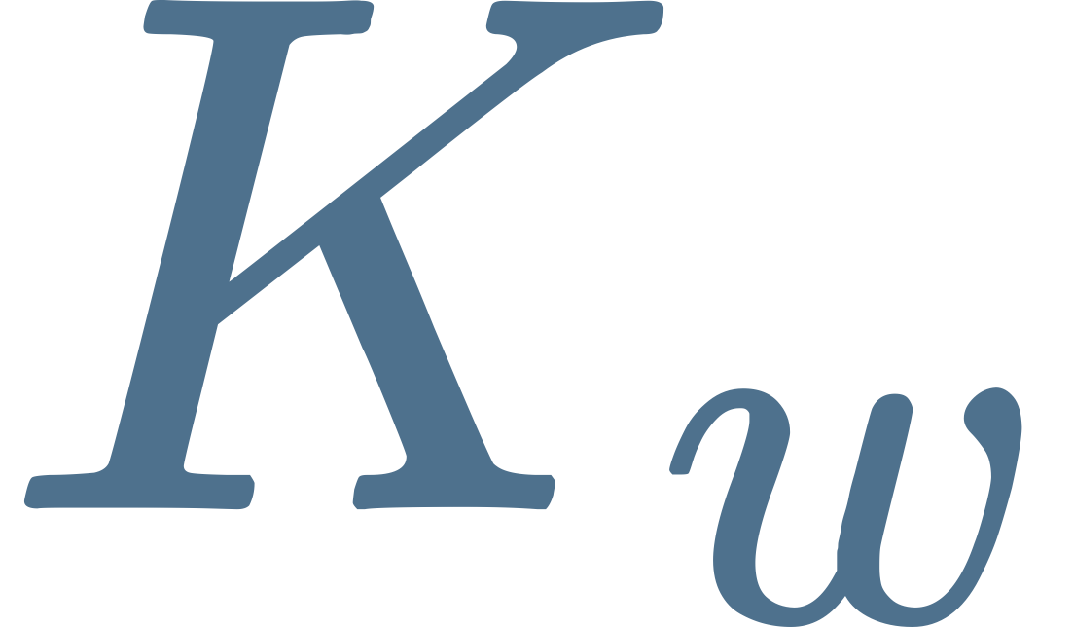
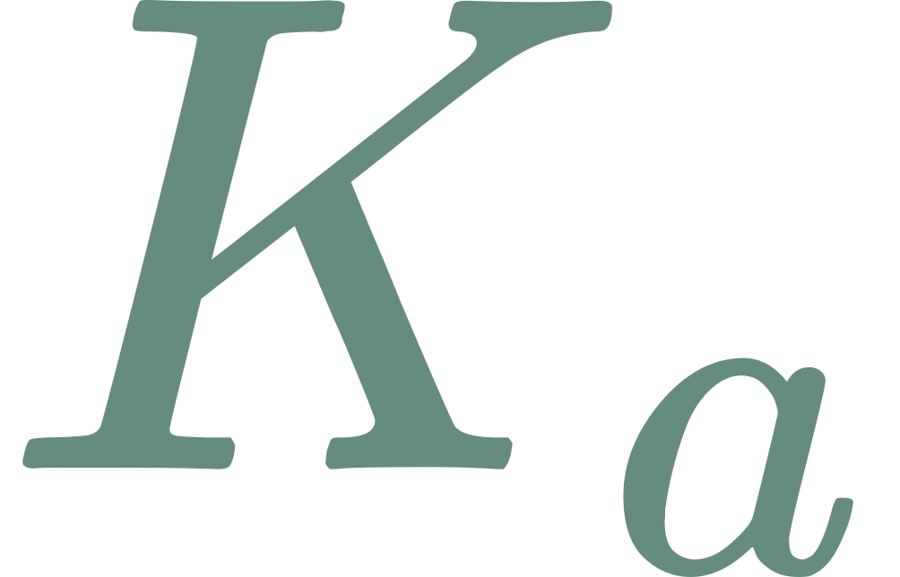
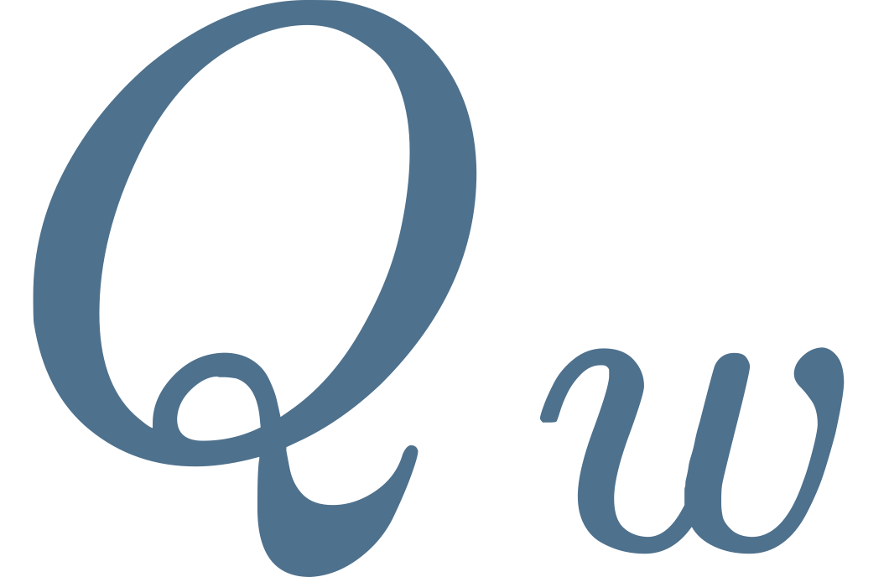

JAM: Action-Grounded World Pretraining
Layerwise reciprocal attention
Scene, embodiment and task shifts
Video features
Action denoising
Future-video denoising
Action + effect features
Attention architecture
Coupled video–action denoising
Query-to-key visibility
Video and action guide each other at every step
Noise
Joint refinement
Prediction
Independent
One-way
JAM
Video
stream
Commands
Action
stream
Cross-stream reads
Visual effects
Separate queries, shared key/value access
Schematic
Notes:
JAM teaser v9. Main hero and all sample progressions are conceptual illustrations made with built-in image_gen, not measured rollouts or empirical denoising traces. Asset prompts are in teaser/assets-v7 and teaser/assets-v9. Sources: paper repository https://github.com/lixuan27/World-Action-Model-Pretraining and server snapshots in teaser/evidence-v8, read 2026-09-08. sampler.py defines the default diagonal inference policy with 10 Euler steps and shift=5. Uniform u=1-k/10 maps to tau=5u/(1+4u); bottom grid places the 11 values on a decreasing-noise coordinate, not a wall-time axis. Image columns show selected conceptual states and are not exact step indices or quantitative quality. Future-video latent, action, and consequence samples start as independent Gaussian noise. Each model call performs reciprocal layerwise K/V reads between the Video stream and Action stream, which jointly contains actions and consequences with separate projection/output heads. Predicted velocities update all generated coordinates with negative delta tau. Clean observation prefix is restored after each update, while language and state stay fixed. No backpropagation occurs in sampling. Arrow pairs depict forward information exchange. Training differs from sampling: independently sampled modality noise levels, flow targets epsilon-x_clean, and available-coordinate masked losses train both streams through attached K/V. Missing modalities use pure noise and masked losses. These implementation details are retained in notes instead of displayed equations. Left visibility matrices compare controlled architectures conceptually, not measured rankings. Shared K/V access does not imply tied projections. Prefix visibility is omitted from the 2x2 generated-stream comparison. Right main-hero evaluation scenes represent planned held-out settings, as labeled. All labels use Toppan Bunkyu Mincho, all math labels are LaTeX-derived SVG. Labels, brackets, arrows and schedule dots are native editable PowerPoint objects. Raster illustrations are separately saved assets.

