Slide 1
dataproject
File created on: 4/24/2022 12:05:46 PM

Slide 2
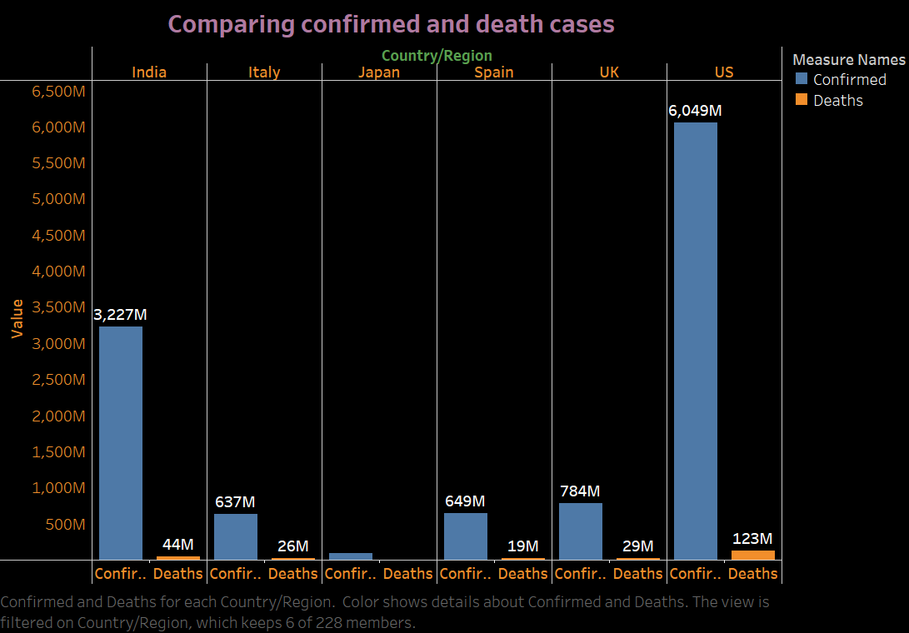

Slide 3
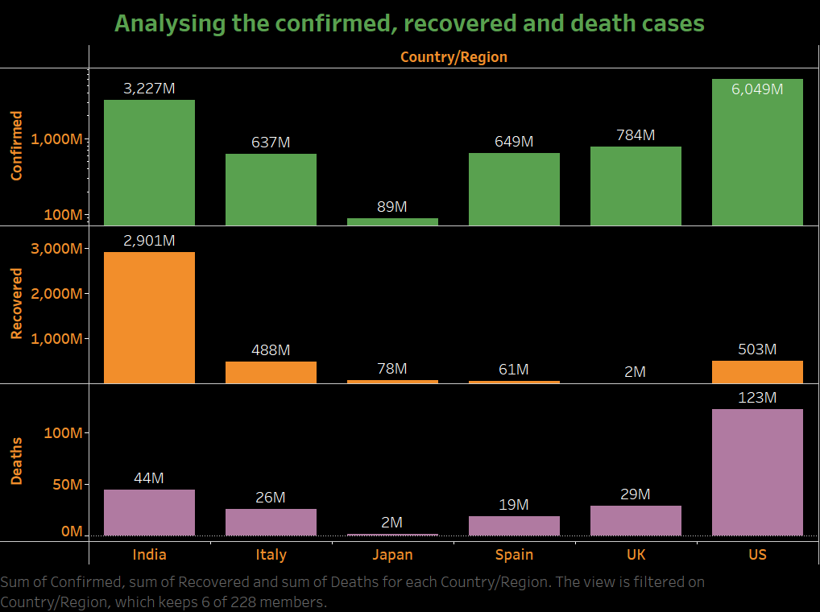

Slide 4
