Slide 1
CSCI-109-HW4
AI and Turing Machine
Yang Li (yli546@usc.edu)

Slide 2
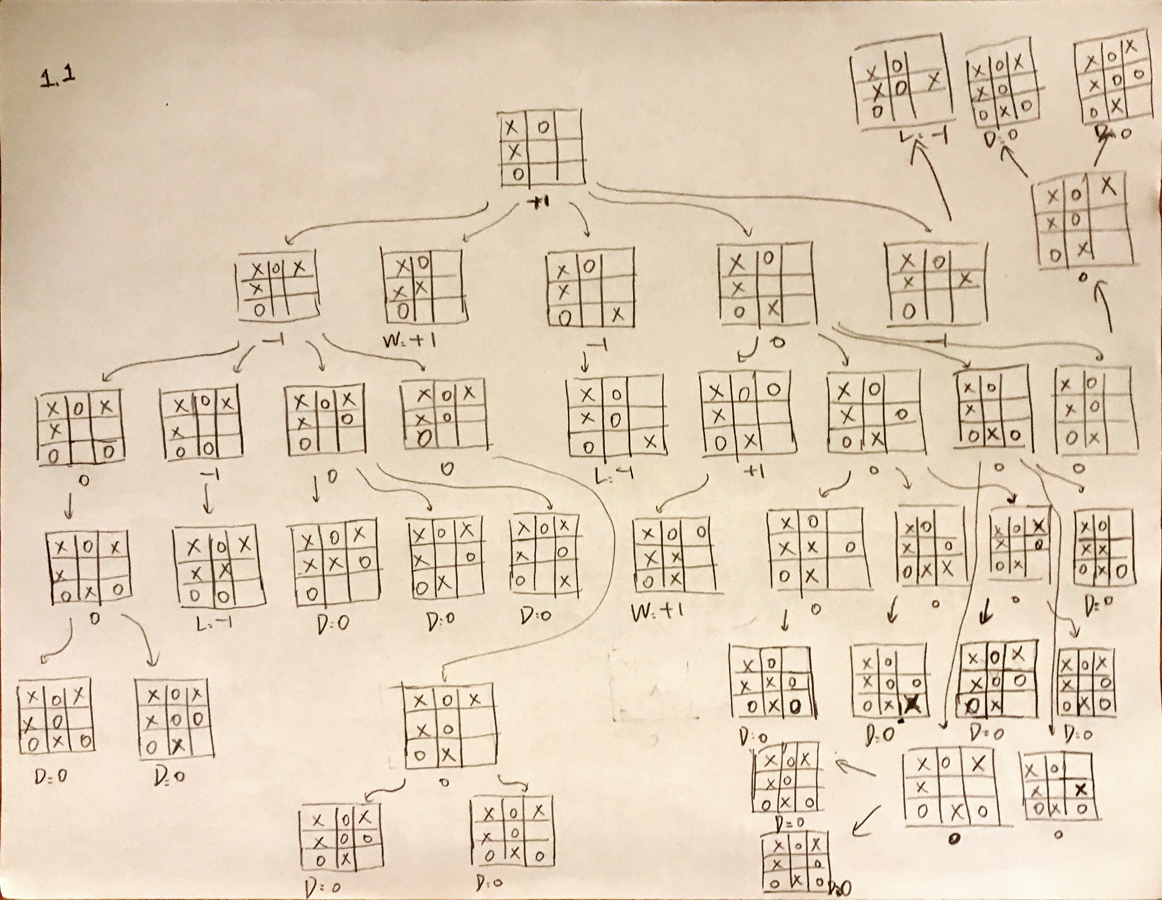

Slide 3
1.2
X | O
X | X
O
is the winning strategy, because there is two pathways that would win, but the opponents could only stop one.

Slide 4
2.1
3
0
2
0
0
1
1
4
1
1
0

Slide 5
2.2
3
S
4
S
2
S
1
S
0
C
C
C
C
2.3
This finite state machine is impossible to achieve because this finite state machine would be infinite, which contradicts the definition of finite state machines.

Slide 6
3.1
a,a,L
b,b,L
5A
7
_,_,L
a,_,L
_,_,L
b,_,L
_,_,L
4
_,_,R
_,_,L
0
3
b,b,R
_,_,L
a,_,R
1
b,_,R
b,b,L
a,a,L
6R
2
a,a,R
b,b,R
a,a,R

Slide 7
3.2
Step | State | Tape |  |  |  |  |  |  | Transition | Note
1 | 0 |  | *a | b | a | b | a |  | _,Right,1 | Found an a. Write _, swtich to 1.
2 | 1 |  |  | *b | a | b | a |  | b, Right, 1 | Found an b. Write b, stay in 1
3 | 1 |  |  | b | *a | b | a |  | a, Right, 1 | Found an a. Write a, stay in 1
4 | 1 |  |  | b | a | *b | a |  | b, Right, 1 | Found an b. Write b, stay in 1
5 | 1 |  |  | b | a | b | *a |  | a, Right, 1 | Found an a. Write a, stay in 1
6 | 1 |  |  | b | a | b | a | * | _, Left, 3 | Found a _. Write _, swtich to 3
7 | 3 |  |  | b | a | b | *a |  | _, Left, 7 | Found an a. Write _, switch to 7
8 | 7 |  |  | b | a | *b |  |  | b, Left, 7 | Found an b. Write b, stay in 7
9 | 7 |  |  | b | *a | b |  |  | a, Left, 7 | Found an a. Write a, stay in 7
10 | 7 |  |  | *b | a | b |  |  | b, Left, 7 | Found an b. Write b, stay in 7
11 | 7 |  | * | b | a | b |  |  | _, Right, 0 | Found a _. Write _, switch to 0
12 | 0 |  |  | *b | a | b |  |  | _, Right, 2 | Found an b. Write_, switch to 2
13 | 2 |  |  |  | *a | b |  |  | a, Right, 2 | Found an a. Write a, stay in 2
14 | 2 |  |  |  | a | *b |  |  | b, Right, 2 | Found an b. Write b, stay in 2
15 | 2 |  |  |  | a | b | * |  | _, Left, 4 | Found an _. Write _, switch to 4
16 | 4 |  |  |  | a | *b |  |  | _, Left, 7 | Found an b. Write _, switch to 7
17 | 7 |  |  |  | *a |  |  |  | a, Left, 7 | Found an a. Write a, stay in 7
18 | 7 |  |  | * | a |  |  |  | _, Right, 0 | Found a _. Write _, switch to 0
19 | 0 |  |  |  | *a |  |  |  | _, Right, 1 | Found an a. Write _, switch to 1
20 | 1 |  |  |  |  | * |  |  | _, Left, 3 | Found a _. Write _, switch to 3
21 | 3 |  |  |  | * |  |  |  | _, Left, 5 | Found a _. Write _, switch to 5
22 | 5 |  |  | * |  |  |  |  | Accept

Slide 8
3.3
Step | State | Tape |  |  |  |  | Transition | Note
1 | 0 |  | *a | b | b |  | _, Right, 1 | Found an a. Write _, switch to 1.
2 | 1 |  |  | *b | b |  | b, Right, 1 | Found an b. Write b, stay in 1
3 | 1 |  |  | b | *b |  | b, Right, 1 | Found an b. Write b, stay in 1
4 | 1 |  |  | b | b | * | _, Left, 3 | Found a _. Write _, switch to 3
5 | 3 |  |  | b | *b |  | b, Left, 6 | Found an b. Write b, switch to 6
6 | 6 |  |  | *b | b |  | Reject
3.4
This Turing machine is processing strings of palindromes, so that it accepts palindrome strings, and it rejects non-palindrome strings.

