Slide 1
Hauptseminar: Logjam
by Li Yang Wu

Slide 2
Content
Logjam
Diffie-Hellman Key Exchange
Number Field Sieve
Transport Layer Security Handshake
Logjam Summary
Breaking 1024 bit Groups

Slide 3




Logjam
The situation:
Client
Server
Network
Man in the Middle

Slide 4
Logjam
Attack on network security protocol
  Secure client-server communication
Exploits TLS 1.2 handshake flaw
Downgrade security level in Diffie-Hellman
In theorie: easy to avoid
In practice: high success

Slide 5
Logjam
Approach:
Preparation:
Build Database
very long
Downgrade
Security Level
Compute
Session Key
Hardcore
Trolling
in real-time!

Slide 6
Content
Logjam
Diffie-Hellman Key Exchange
Number Field Sieve
Transport Layer Security Handshake
Logjam Summary
Breaking 1024 bit Groups

Slide 7
DH Key Exchange
Given:
  Communication partners A and B
  Insecure communication channel
  Message space
Determine:
  Public key cryptosystem
  Key space
  ... with exponential ciper-cryptanalyst ratio

Slide 8
DH Key Exchange
Define key space:
  Choose prime q
  Define number field GF(q) = ℤ/qℤ
  Choose basis α in GF(q)
Draw keys:
  Choose private key D in GF(q)
  Calculate public key E = α^{D} mod q
We have: D_{A}, D_{B}, E_{A}, E_{B}

Slide 9
DH Key Exchange
Session key:
E_{A}, E_{B}
A
Insecure Communication Channel
B
E_{B}^{DA}
E_{A}^{DB}
α^{DADB}
Session Key
Remember: E = α^{D} mod q

Slide 10
DH Key Exchange
Cryptanalyst:
  Knowledge: α, q, E_{A}, E_{B}
  Objective: D_{A} or D_{B}
  Calculate Logarithm: D = log_{α}E mod q
  Cost: O(sqrt(q))
  Cost of taking α^{DADB} mod q is only O(log(q))
  => Exponential cipher-cryptanalyst ratio

Slide 11
Content
Logjam
Diffie-Hellman Key Exchange
Number Field Sieve
Transport Layer Security Handshake
Logjam Summary
Breaking 1024 bit Groups

Slide 12
Number Field Sieve
Approach:
Precomputation
Polynomial
Selection
Sieving
Linear
Algebra
Descent
offline
online

Slide 13
Number Field Sieve
Polynomial Selection:
  Find polynomial f and choose m s.t. f(m) = 0 mod q
  Based on f, find a ring of integers O and homomorphism s.t. φ : ℤ[γ] → ℤ/qℤ, where γ is some root of f
Benefit: Express knowledge about logs of factors of α with linear equations.

Slide 14
Number Field Sieve
Sieving:
  Define the set of "good" prime ideals B in O
  Sieve through pairs of integers (c,d) that are related to elements in B
  Form matrices from these relations
  Modify matricies to express only information about log factors of α
Output: Some matrices A_{i}

Slide 15
Number Field Sieve
Linear Algebra:
  Take matrices A_{i}
  Compute rank r and extract matrices A_{i}' with sizes of its ranks
  Find set P of primes p_{i} with bounded
  Compute det(A) mod p for each p_{i} in P
  Find relations between the r+1th row and A_{i}'
  Calculate logs of prime factors of α

Slide 16
Number Field Sieve
Descent:
  Find l s.t. α^{l}E ≡ p₁p₂...p_{t} mod q, for small p_{i}'s
  Find logs of p_{i}'s with database
  Compute D from these logs

Slide 17
Number Field Sieve
Refined Approach:
Precomputation
Poly. Selec.:
Sieving:
Lin. Alg.:
Descent:
Find
polynomial
representation
of GF(q)
Formulate
relations be-
tween some
integers and
logs of α in
form of
matrices
Calculate logs
of prime
factors of α
Decompose
α's and E to
calculate D
with help of
the database

Slide 18
Content
Logjam
Diffie-Hellman Key Exchange
Number Field Sieve
Transport Layer Security Handshake
Logjam Summary
Breaking 1024 bit Groups

Slide 19
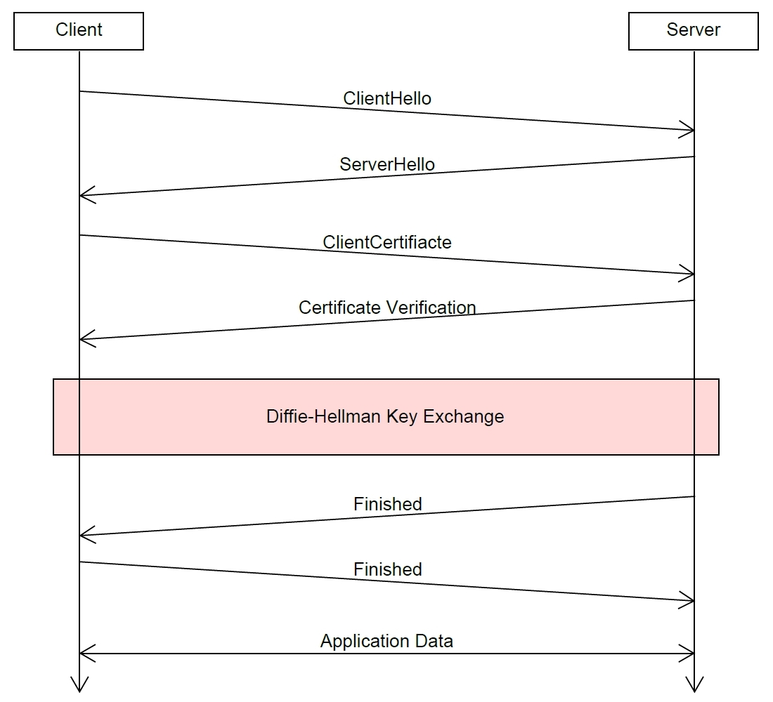
TLS Handshake

Slide 20
Content
Logjam
Diffie-Hellman Key Exchange
Number Field Sieve
Transport Layer Security Handshake
Logjam Summary
Breaking 1024 bit Groups

Slide 21
Logjam Summary
Preparation:
  Select some well known 512 bit primes p for DH
  Do the precomputation according to NFS

Slide 22
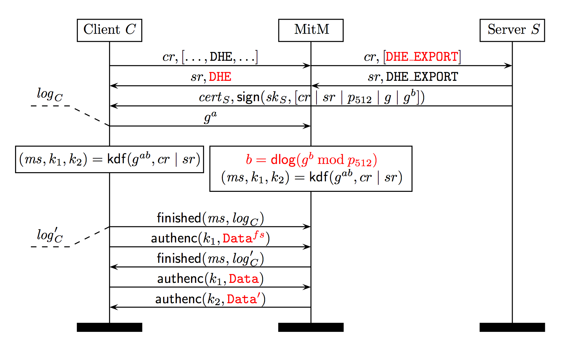
Logjam Summary

Slide 23
Logjam Summary
Results:
  Select some well known 512 bit primes p for DH
  Do the precomputation according to NFS

Slide 24
Content
Logjam
Diffie-Hellman Key Exchange
Number Field Sieve
Transport Layer Security Handshake
Logjam Summary
Weak DH Parameters
Breaking 1024 bit Groups

Slide 25
Weak DH Parameters
Use Pollard's lamda method and Pohlig-Hellman decomposition for an improved log calculation if E is chosen small and q is not chosen "safe".
  Pollard's lambda method calculates logs efficiently, if it is known to lie in a fixed bound {b, ..., b+w}
  Pohlig-Hellman decomposition extracts information about logs given some prime factors of q-1

Slide 26
Weak DH Parameters
Improved attack:
  Decompse q-1 in prime factors
  Extract information of the log from factors for which the log is feasible to compute (Pohlig-Hellman)
  Express the missing information as a new log problem with fixed bounds.
  Solve with Pollard's lambda method

Slide 27
Content
Logjam
Diffie-Hellman Key Exchange
Number Field Sieve
Transport Layer Security Handshake
Logjam Summary
Breaking 1024 bit Groups

Slide 28
Breaking 1024 bit Groups
Only a cost estimation
Motivation: Edward Snowden leaks
  Assertion: NSA decripts all communication
Assumptions:
  Optimistic cost extrapolation of recent records in factorization and log computation
  Existence of specialized hardware for certain tasks

Slide 29
Breaking 1024 bit Groups
Result:
  Total cost slightly over $11B
  Budget for Consolidated Cryptographic Program plus some additional investments: over $11B

