Slide 1
Employee Data Analysis using Excel
STUDENT NAME: LIYA RAHMAN. A
REGISTER NO: 2213211042053
DEPARTMENT: B.Com (Corporate Secretaryship)
COLLEGE: PRESIDENCY COLLEGE, CHENNAI.

Slide 2
PROJECT TITLE
Employee Performance Analysis using Excel

Slide 3


AGENDA
Problem Statement
Project Overview
End Users
Our Solution and Proposition
Dataset Description
Modelling Approach
Results and Discussion
Conclusion
3/21/2024 Annual Review

Slide 4

PROBLEM STATEMENT
The goal of this project is to analyze the performance and characteristics of employees using available employee data. The analysis will focus on identifying key patterns and insights in terms of employee salary distribution, department-wise analysis, and work location effects on salary and employment type. This study aims to help companies improve decision-making in resource allocation and performance tracking.

Slide 5

PROJECT OVERVIEW
The project involves analyzing employee data using Excel tools. The dataset includes various attributes such as salary, gender, department, employment type, and work location. By leveraging Excel functions such as Pivot Tables, Charts, and other analytical tools, this project will provide insights into employee performance patterns.

Slide 6

WHO ARE THE END USERS?
The analysis will benefit:
HR departments: To understand workforce distribution and salary structures.
Department heads: To track the performance of their teams based on salary and employment type.
Top management: For decision-making on resource allocation and budgeting.

Slide 7

OUR SOLUTION AND ITS VALUE PROPOSITION
We propose using Excel's advanced analytical capabilities to:
Identify patterns in employee salaries across different departments.
Analyze the impact of employment type (e.g., permanent vs. fixed-term) on salary.
Explore work location trends and their relationship with employee salaries.
Provide insights on gender-based salary distribution to identify any gaps or inconsistencies.

Slide 8
Dataset Description
The dataset contains employee records with attributes like:
Emp ID: Unique identifier for each employee.
Name: Employee's full name.
Gender: Gender of the employee (Male/Female).
Department: The department the employee belongs to (e.g., Training, Business Development).
Salary: Employee's annual salary.
Start Date: The date when the employee started working.
FTE: Full-Time Equivalent, indicating the percentage of time worked by the employee.
Employee type: Indicates whether the employee is Permanent or on Fixed Term.
Work location: The employee's primary work location, including both remote and on-site locations.

Slide 9

THE "WOW" IN OUR SOLUTION
Automated Dashboards: Excel's dynamic features, such as slicers and conditional formatting, can create interactive dashboards that allow end users to filter and visualize data in real time.
Scenario Analysis: Using "What-if" analysis to simulate the impact of changes (e.g., increasing employee training hours) on performance metrics.
Trend Forecasting: Excel’s built-in forecasting tools can project future performance trends, helping management plan ahead.
3/21/2024 Annual Review
9

Slide 10
MODELLING
We use Excel for the analysis, applying the following techniques:
Data cleaning: Converting dates and handling missing values.
Pivot Tables: To summarize salary data by department, gender, and work location.
Charts and Visualizations: For clear representation of patterns (e.g., bar charts for salary comparison across departments).
Conditional Formatting: To highlight salary ranges and performance variations.
Filters: To analyze specific groups of employees (e.g., full-time vs. part-time).
10

Slide 11
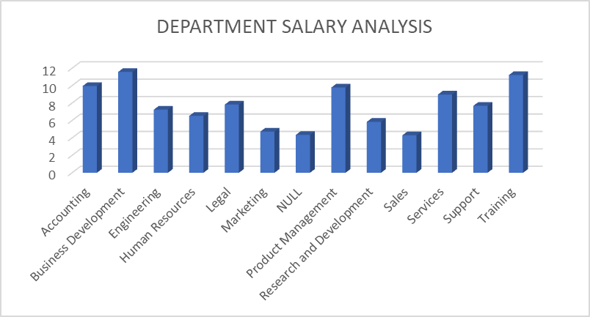
RESULTS
11

Slide 12
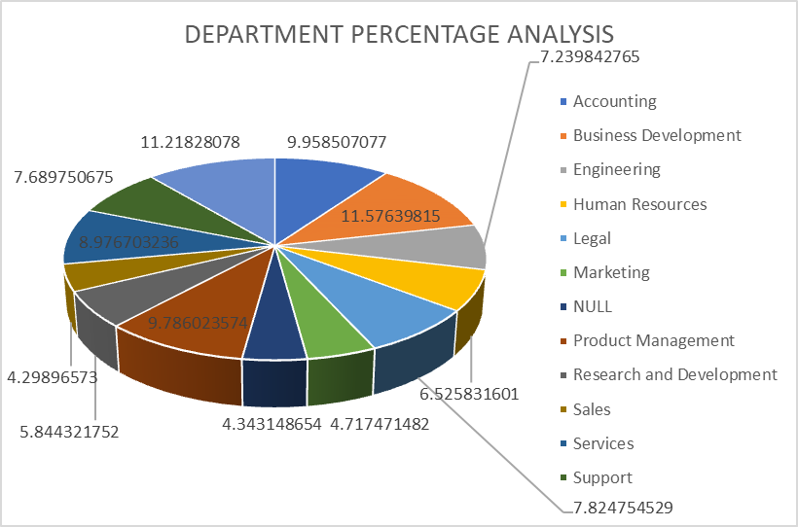
RESULTS
12

Slide 13
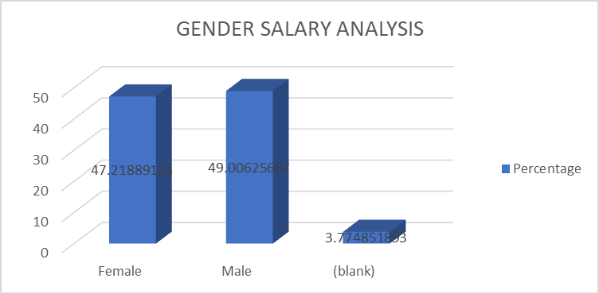
RESULTS
13

Slide 14
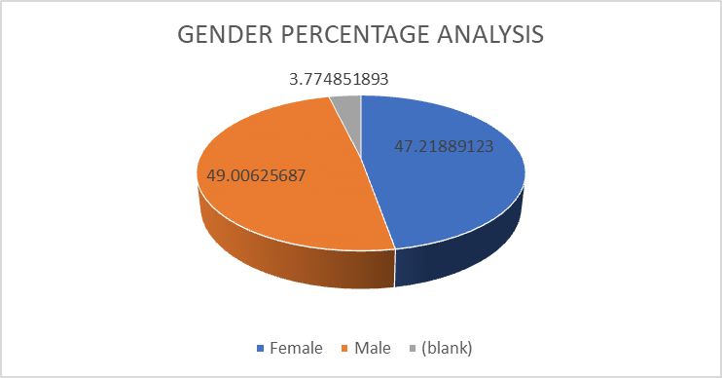
RESULTS
14

Slide 15
conclusion
This analysis of employee performance provides key insights that can guide HR and management in better resource allocation and performance tracking. By identifying salary patterns, employment type impacts, and work location trends, the company can make data-driven decisions to enhance productivity and fairness across the workforce.

