Slide 1
Code First Girls
Introduction to Data & SQL
By Experion
Helmet Store Database
By
Liya, Yusra , Olivia

Slide 2
Project Summary
– developed to organise and optimise several areas of a helmet shop’s operation
– has several features
Maintaining the helmet inventory
Managing customer orders
Managing customer information
Shipment details & Tracking
Managing customer reviews

Slide 3
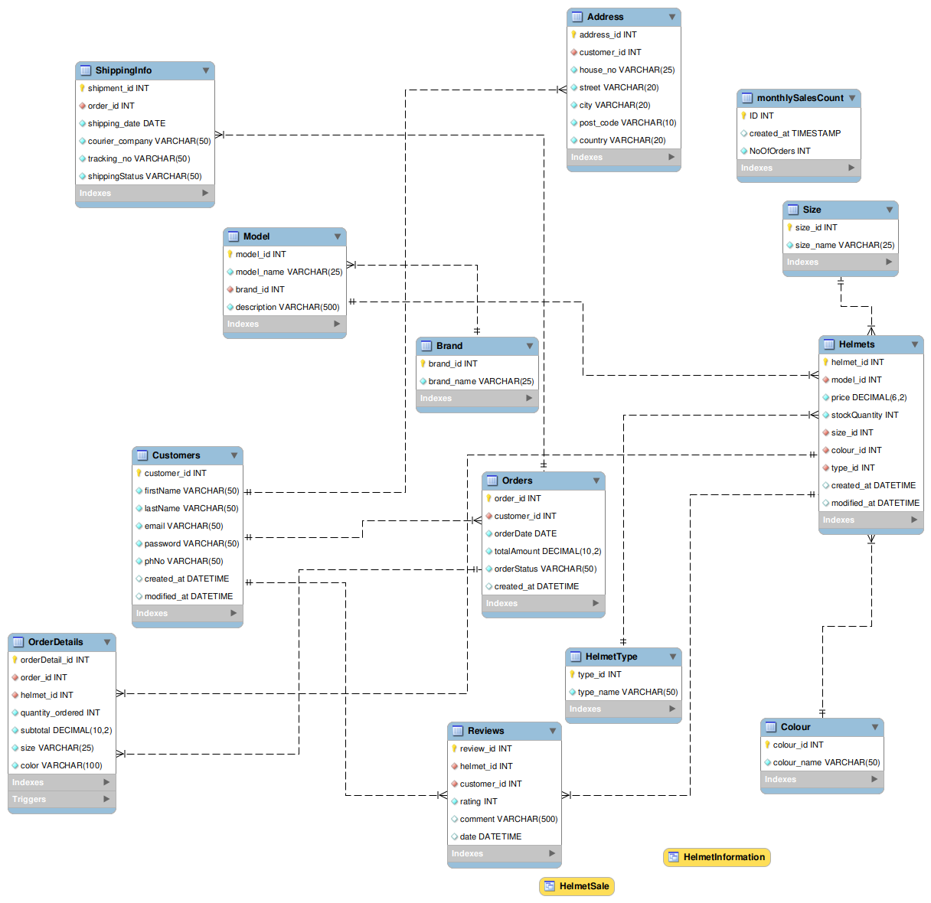
Notes:
13 tables in total
Tables are normalised to 3NF to minimise redundancy

Slide 4
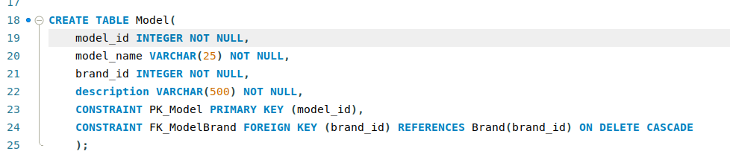
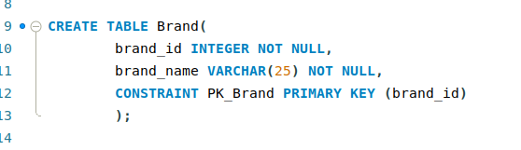
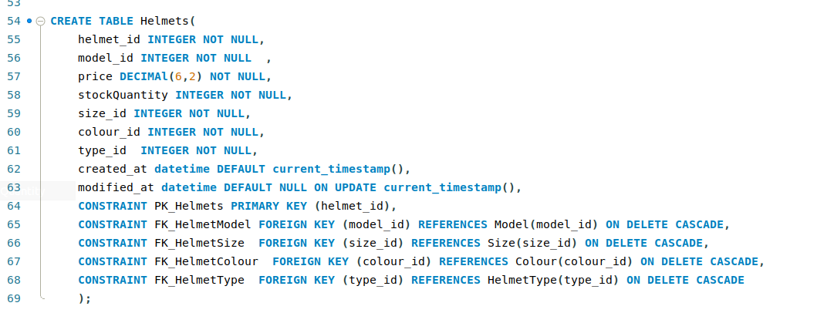
Creating tables with primary and foreign keys

Slide 5
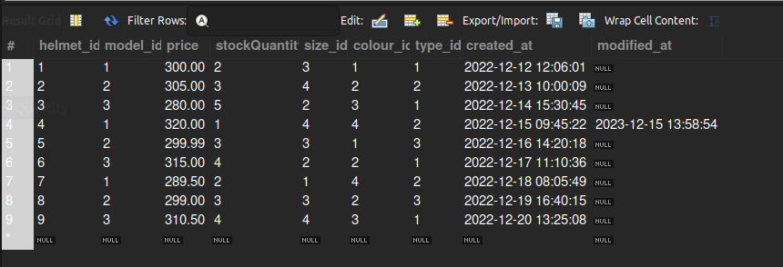
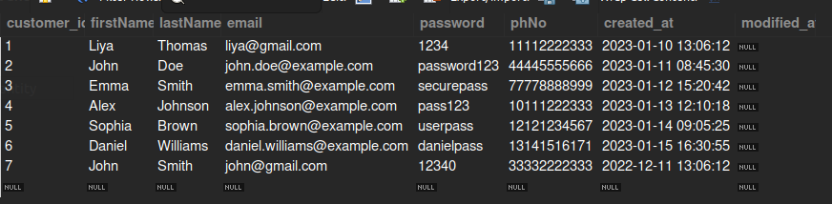
Sample datas in tables
Helmet table
Customer table

Slide 6
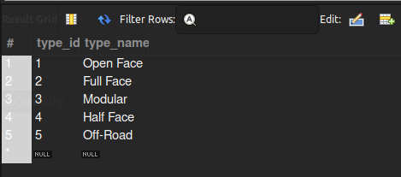
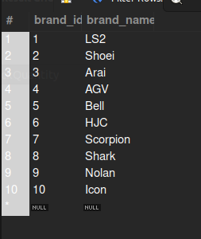
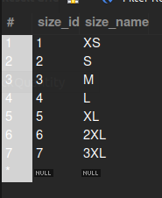
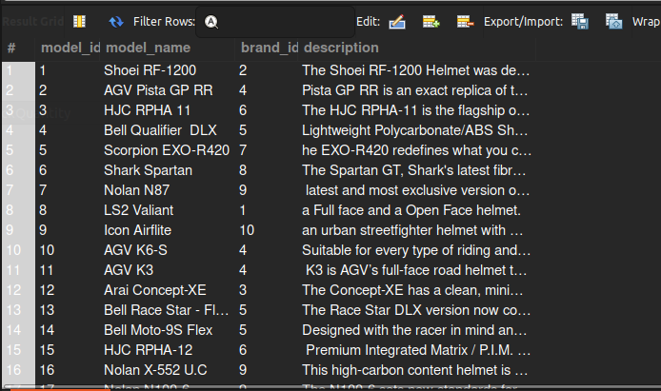
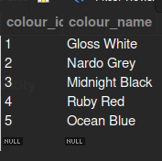
Helmet Type table,
Model table,
Brand table,
Size table, colour table

Slide 7
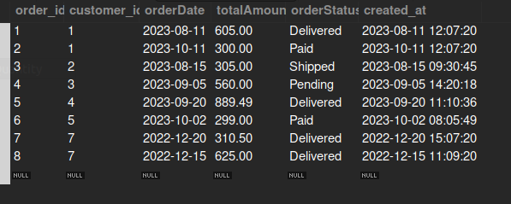
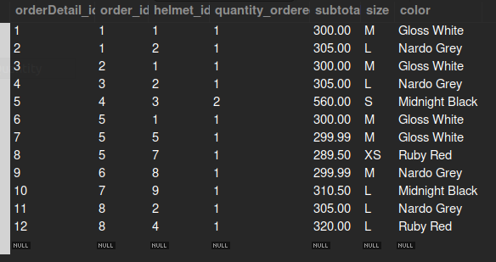
orders table
orderDetails table

Slide 8
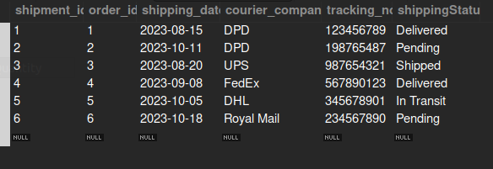
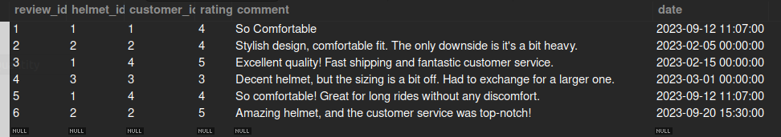
Shipment Info table,
Reviews table

Slide 9
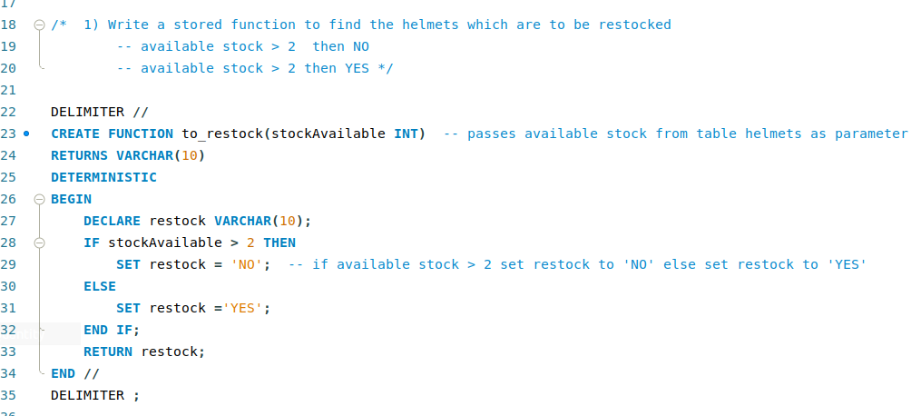
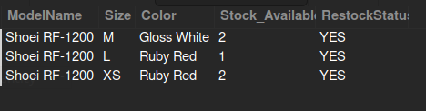
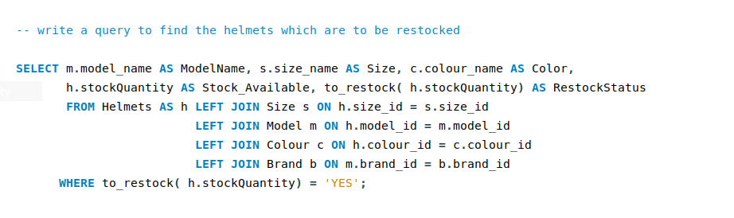
Stored Function to find the helmets which are to be restocked

Slide 10
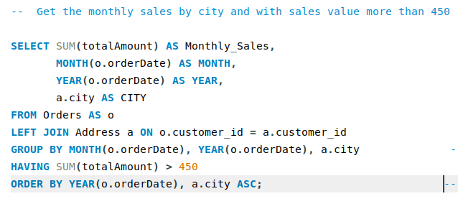
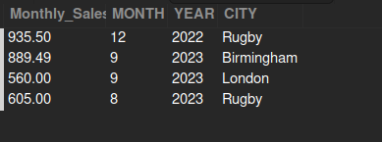
Group by and having

Slide 11
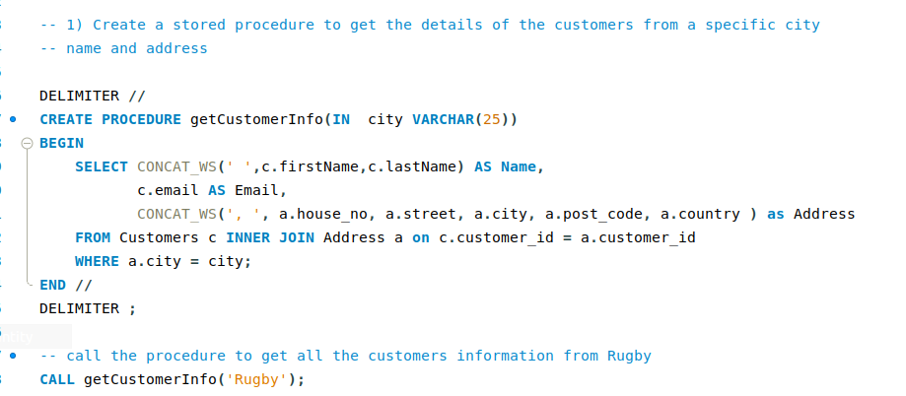

STORED PROCEDURE to get all customers information in a particular city

Slide 12
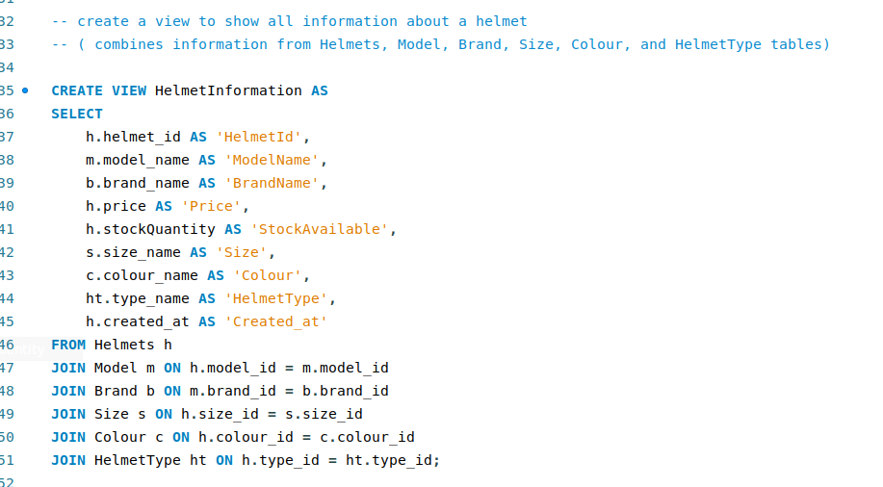

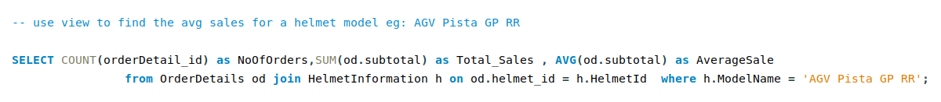
View to get all information of helmets

Slide 13
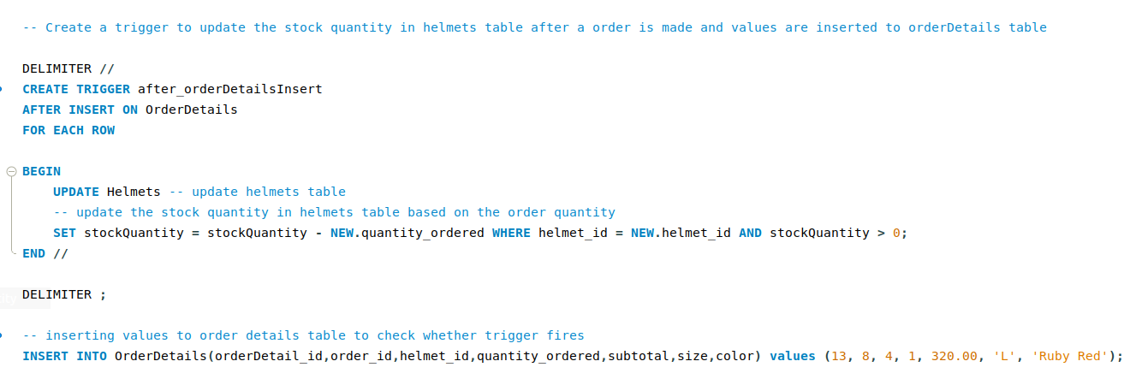
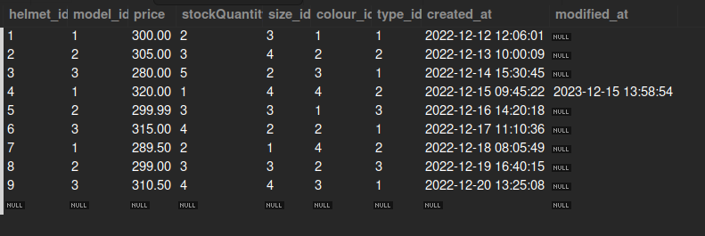

Trigger to update helmet stock after an order is confirmed
Before insert
After insert

Slide 14
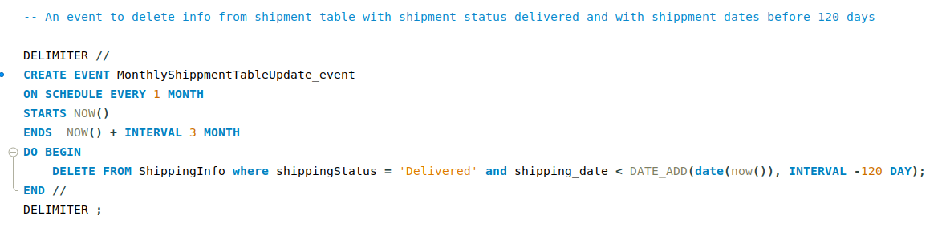
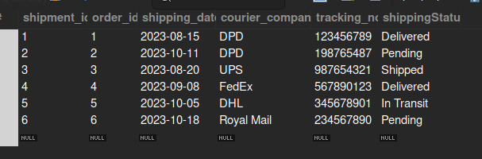
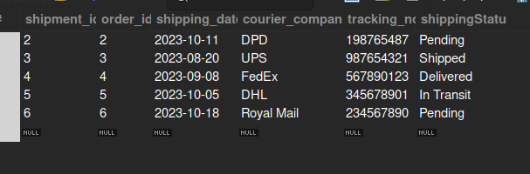
Event to delete shipping info of delivered products
Before event
After event

Slide 15
Thank you

