Slide 1
Fast Iterative Graph Computation: A Path Centric Approach
Pingpeng Yuan (HUST), Wenya Zhang (HUST), Changfeng Xie (HUST), Ling Liu (GATECH), Hai Jin (HUST), Kisung Lee (GATECH)

Slide 2
Content
Introduction
Tree Partition
Storage
Computing Model
Example
Experiments
Conclusion

Slide 3
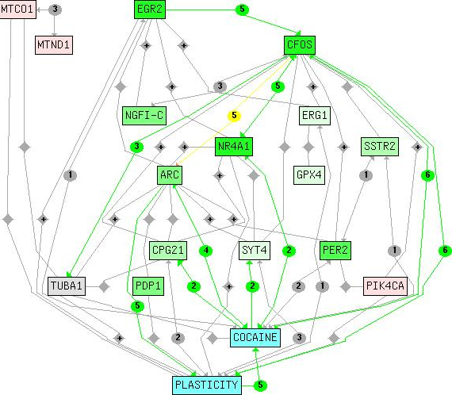
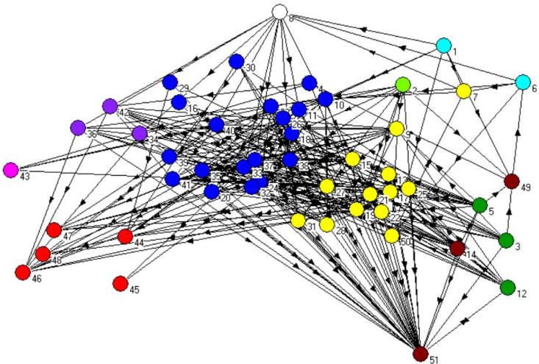
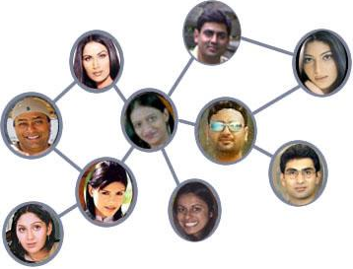
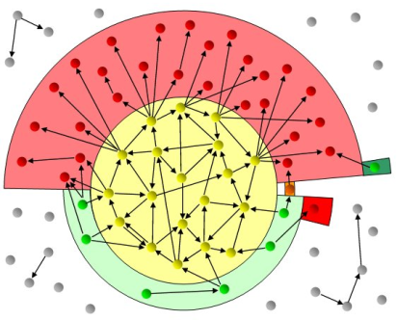
Graphs are everywhere
Biological Network
Ecological Network
Web Graph
Social Network

Slide 4
Challenges to process large graph
Varying on graph scale, degrees, diameter
 | amazon | twitter | uk2007 | webbase | yahoo
nodes | 735,323 | 41,652,230 | 105,896,555 | 118,142,155 | 1,413,511,394
arcs | 5,158,388 | 1,468,365,182 | 3,738,733,648 | 1,019,903,190 | 6,636,600,779
diameter | 13.42 | 5.29 | 22.78 | 37.08 | 928.62
average degree | 7.015 | 35.253 | 35.306 | 8.633 | 4.695
max in-degree | 1 076 | 770 155 | 975 418 | 816 127 | 7 637 656
max out-degree | 10 | 2 997 469 | 15 402 | 3 841 | 2 513
Challenges
How to store graphs efficiently
Poor locality
Varying tasks
…

Slide 5
Fast graph processing systems
Improve
locality
Locality
Storage/the volume of Data access
Faster
methods
constant
10⁴
10⁶
10⁸
10¹⁰
10¹²
Peta+
log n
Storage size
~ n
Data size (n: # of vertices/edges)

Slide 6
Vertex centric model
Scatter updates along outgoing edges
Gather updates from incoming edges
1
2
3
4
5
6
7
8
9
10
11

Slide 7
Vertex-centric model
Iterates over vertices
parfor each vertex v
for each edge e to v
gather update from e
if v has update
for each edge e from v
scatter update along e

Slide 8
Edge centric model
Parallel processing edges
Scatter updates along outgoing edges
Gather updates from incoming edges
Iterates over edges

Slide 9
Gathering Updates
Partition 1
Edges
Vertices
Partition 100
X
Y
X
Vertices
Y
Shuffler
Scatter - Shuffle – Gather
Reduce random access for large number of partitions

Slide 10
The problems of current computation models

Slide 11
The problems of current computation models
Ghost vertices maintain adjacency structure and replicate remote data.
Too much interactions among partitions
“ghost” vertices

Slide 12
The Problems of current computation models
Generally, vertices are sorted and stored
Many cache misses
Two vertices of an edge may be far apart
Large scale I/O
Does not work well with storage
1
10000

Slide 13
Our idea: Path-centric model
Tree partitions: reduce interactions among partitions
Storage
Lightweight compression: reduce IO
Sorted adjacency list
Computation model
Scatter or gather: faster method
Process graph following paths: Improve locality
Notes:
以顶点为中心：并行处理顶点
以边为中心：并行处理边
以路径为中心：并行处理路径.减少了并行处理图数据时的相互干扰

Slide 14
Preliminary
Edge traversal tree/forest
Each edge of a graph is accessed only once
Different from traditional traversal tree in which each vertex is accessed only once
Multiple appearances of a vertex are dummy copies of the vertex.
Forward traversal tree
Reverse traversal tree

Slide 15
Example
1
2
4
1
3
4
6
3
5
7
8
8
6
1’
2’
3’
2
5
4’
5’
8’
7
A Forward Edge Traversal Tree of the Graph
A graph

Slide 16
Current Partitioning Approaches
Problem: execution flows are broken
1
3
4
8
6
2
5
7
Solution: partition the graph into trees

Slide 17
Tree Partitions
A tree partition is
consisted of sub-trees of edge traversal trees of a graph
All edges whose source vertex is in that subset

Slide 18
1
2
4
6
3
5
7
8
1’
2’
3’
4’
5’
8’

Slide 19
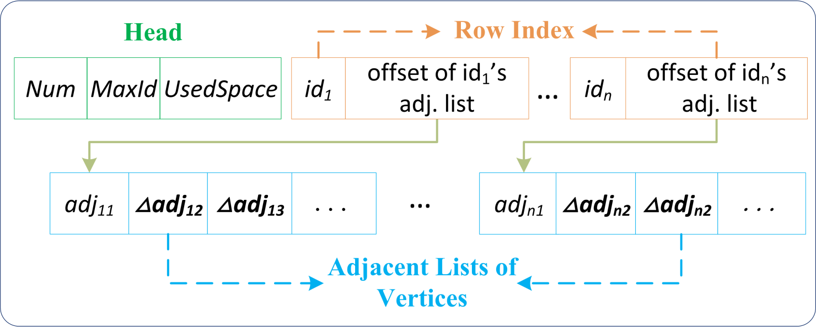
Storage – chunk storage structure
Compressed adjacency lists
Sort the adjacency lists of each vertex – helps order memory accesses, reduce TLB misses.
Delta compression – reduces storage used
Cache-blocked edge visits – exploit temporal locality
Row index – quickly locate edges

Slide 20
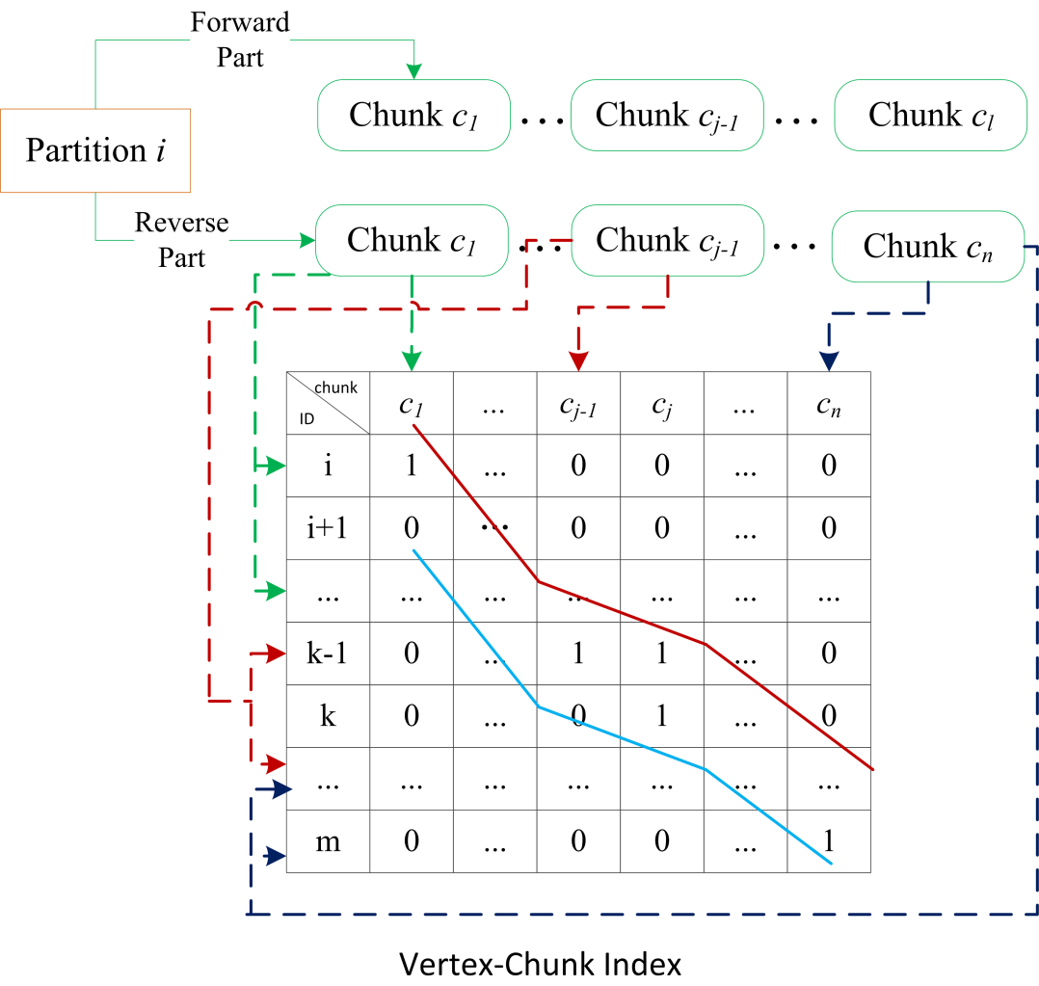
Storage
Partition
Forward part
Reverse part
Chunk
Vertex – chunk index

Slide 21
Partitioning the Graph
P1
P2
V
1
2
3
4
SOURCE | DEST
1 | 2,4
2 | 3
3 | 1
4 | 5,6
V
5
6
7
8
SOURCE | DEST
5 | 2,3
6 | 7,8
7 | 4,5,8

Slide 22
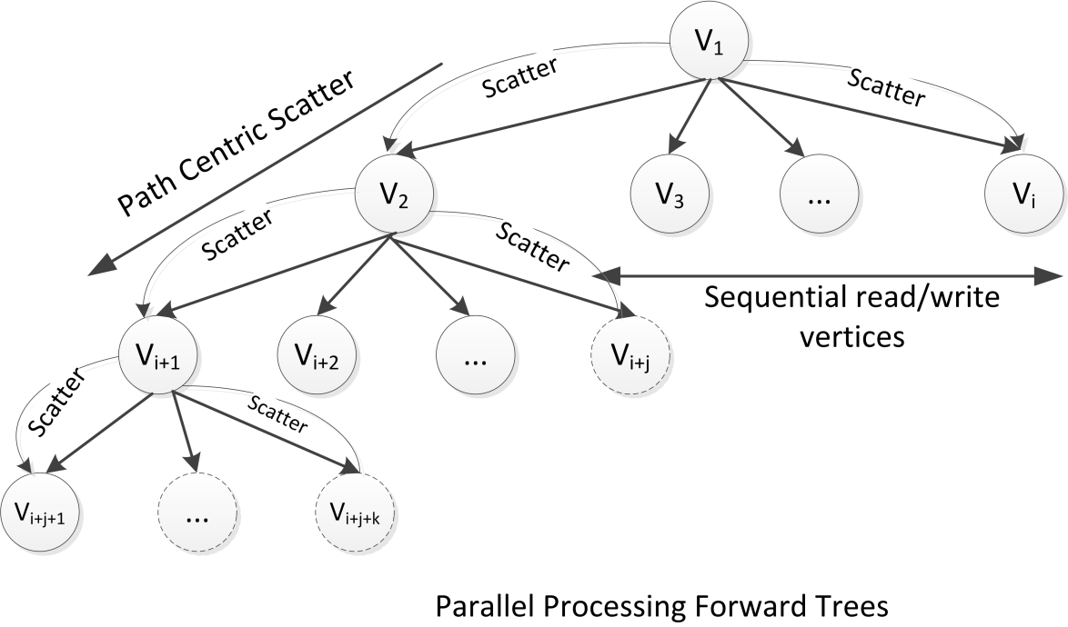
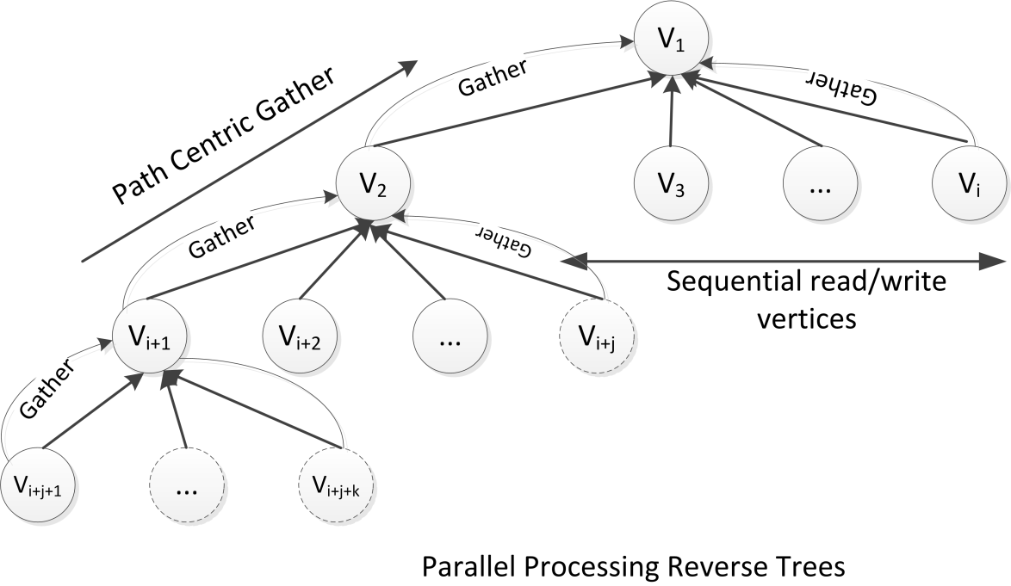
Computing model
Two operations: scatter or gather
Scatter
Scatter updates along out edges
Gather
Gather updates along in edges

Slide 23
Putting all together
Algorithm Gather
Input: i
1: for each chunk c of reverse part of partition i do
2: read the row index i of c;
3: for each row r of i do
4: read the offset of r;
5: read the adjacency set s of r using offset;
6: read the vertex values of all vertex in s;
7: update the vertex of r;
8: end for
9: end for
Algorithm Scatter
Input: i
1: for each chunk c of forward part of partition i do
2: read the row index i of c;
3: for each row r of i do
4: read the offset of r;
5: read the adjacency set s of r using offset;
6: update the vertex values of all vertices in s;
7: end for
8: end for

Slide 24
PageRank
1: for each iteration do
2: parfor each p of Partitions do
3: Gather(p);
4: end parfor
5: sync;
6: end for

Slide 25
Path-Centric Model
1
3
SOURCE | DEST
1 | 2,4
2 | 3
3 | 1
4 | 5,6
4
P1
1
2
3
4
8
6
2
5
7
P2
5
6
7
8

Slide 26
Path-Centric Model
1
3
SOURCE | DEST
5 | 2,3
6 | 7,8
7 | 4,5,8
4
P1
1
2
3
4
8
6
2
5
7
P2
5
6
7
8

Slide 27
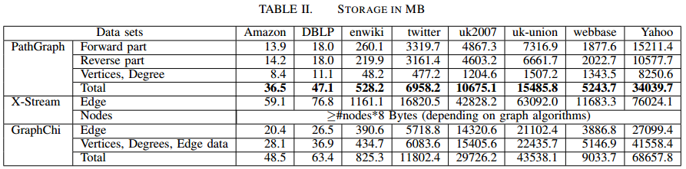
Experimental results – disk
The storage size of PathGraph is smaller than the storage size of GraphChi and X-Stream
Edges: GraphChi is 0.72X-1.51X PathGraph; X-Stream is 2.1X-4.5X PathGraph

Slide 28
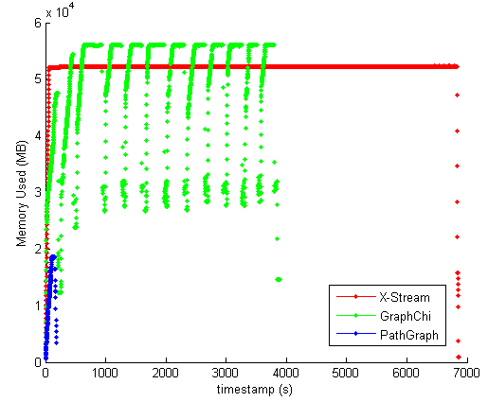
Experimental results – memory used

Slide 29
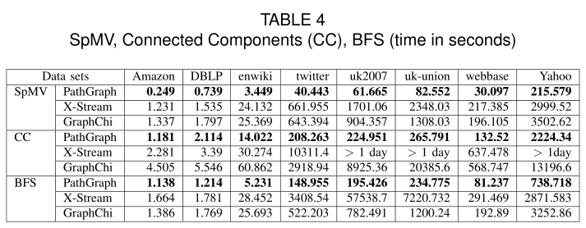
Experiments – SpMV, CC, BFS
SpMV: PathGraph improves X-Stream by nearly a factor of 2.1-28.4; GraphChi by a factor of 2.4-16
CC: GraphChi (2.6-76.7); X-Stream (1.9-49.5)
BFS: X-Stream (1.5-294); GraphChi (1.2-5.1)

Slide 30
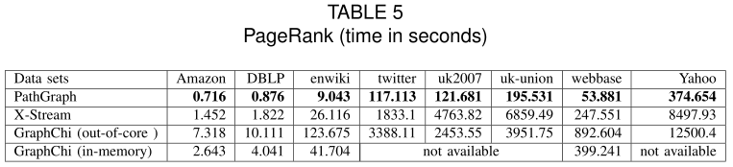
Experiments - PageRank
in-memory graphs: X-Stream is faster than GraphChi.
out-of-core graphs: GraphChi is faster than X-Stream (uk2007 and ukunion). GraphChi is far slower than X-Stream (Yahoo)

Slide 31
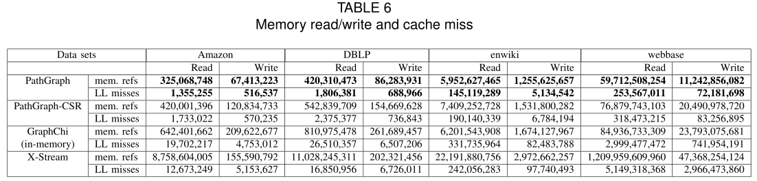
Experimental results – cache miss
Significant reduction in cache miss
Much more saving on memory reference
Thus, CPU is able to do more work on data residing in the cache

Slide 32
Conclusion
Partitioning graphs into trees in order to guarantee the complete path as possible as we can
Storing adjacent vertices together in order to improve locality
Parallel process graph along paths
Simple computation model: Scatter or Gather
Notes:
以顶点为中心：并行处理顶点
以边为中心：并行处理边
以路径为中心：并行处理路径.减少了并行处理图数据时的相互干扰

Slide 33

Please visit http://grid.hust.edu.cn/triplebit for further information

Slide 34
Reverse edge traversal tree
8
6
7
4
6’
1
7’
3
2
5
1’
5’
4’
7’

Slide 35
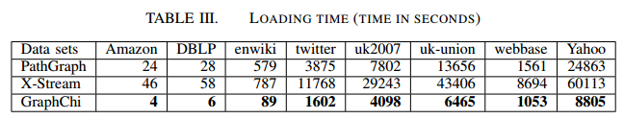
Experiments - Loading Data

