Slide 1
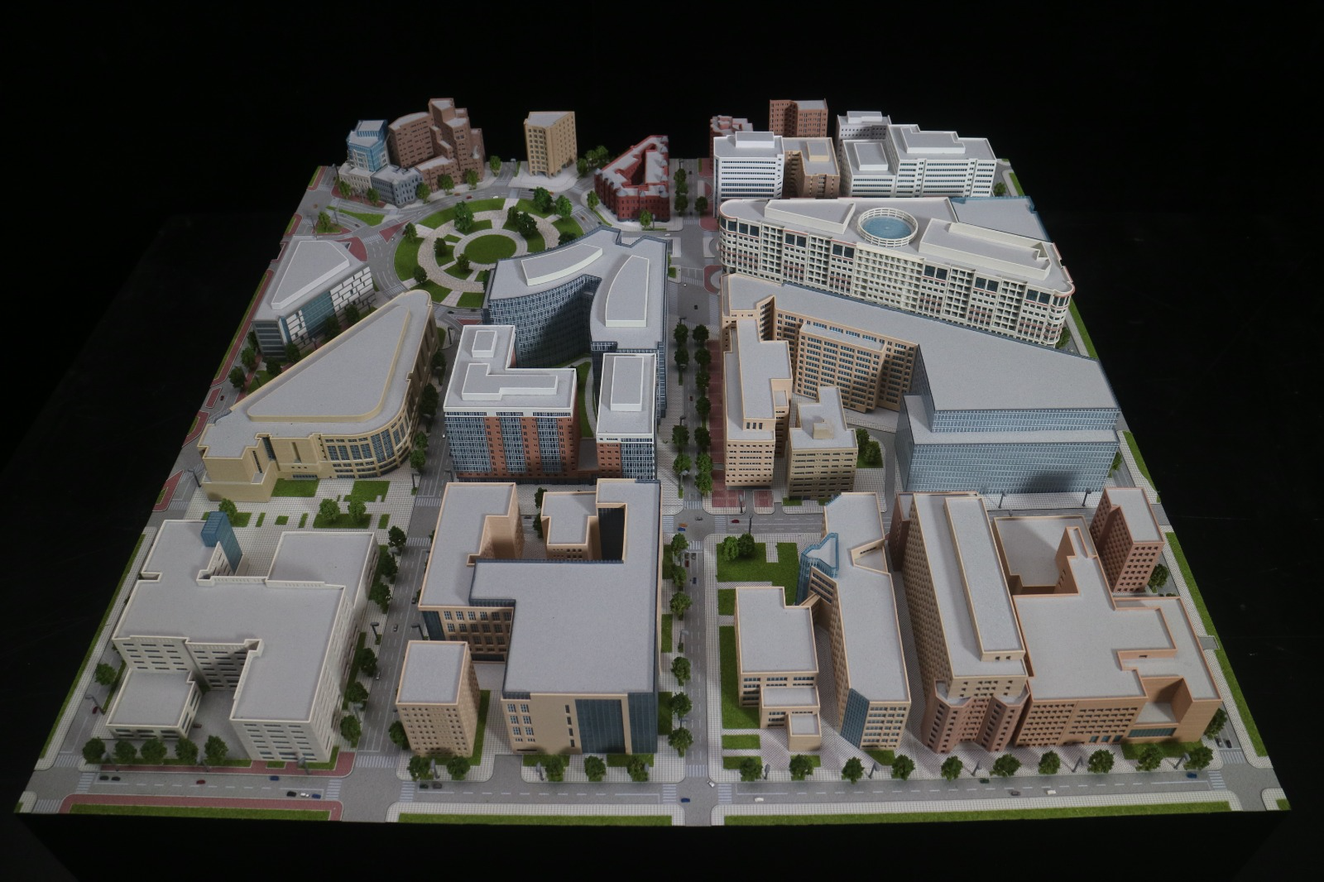

Slide 2
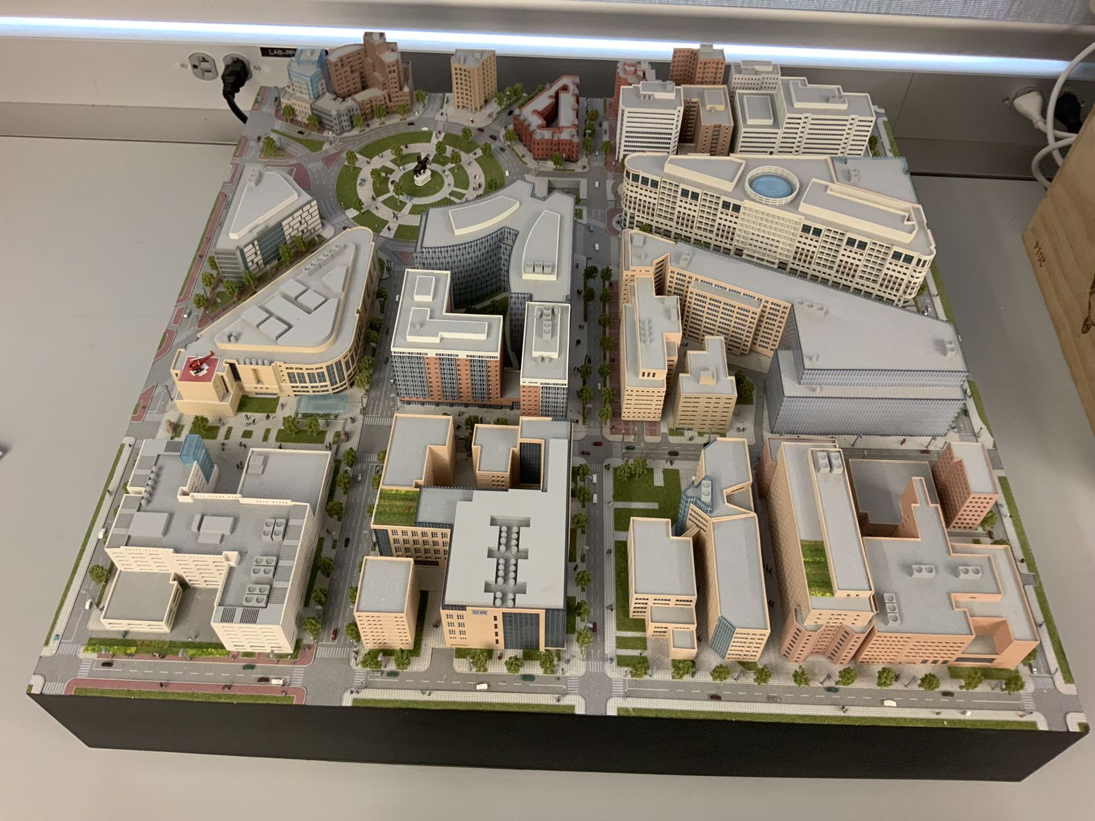

Slide 3
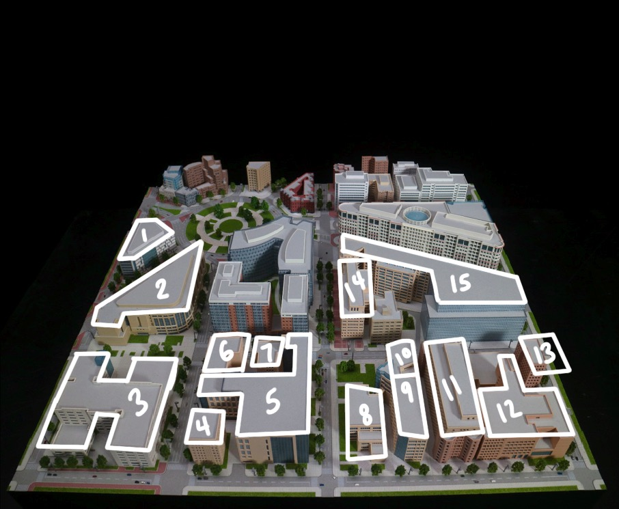
1- Milken Institute School of Public Health
2- George Washington University Hospital
3- Ross Hall
4- J. William Fulbright Hall
5- School of Engineering and Applied Science (SEH)
6- Jacqueline Bouvier Kennedy Onassis (JBKO) Hall
7- Munson Hall
8- Smith Hall of Art
9- Phillips Hall
10- Rome Hall
11- District House
12- University Student Center
13- Lafayette Hall
14- The George Washington University Medical Faculty Associates Ambulatory Care Center
15- Rice Hall
Notes:
https://virtualtour.gwu.edu/virtual-tour-map#ctdl-UMAP_2019121051598

Slide 4
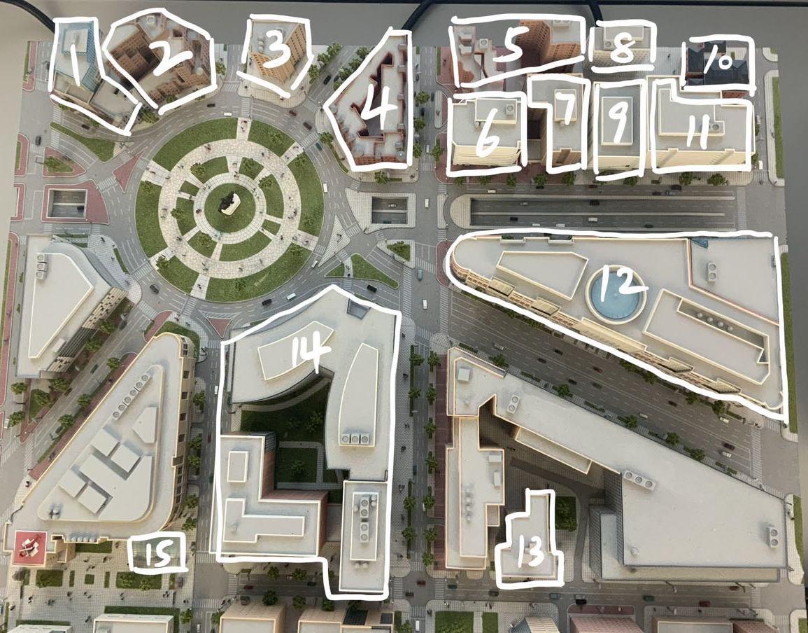
1- Embassy of Spain
2- The Chancellor
3- One Washington Circle Hotel
4- Embassy of Tajikistan
5- Winston House Apartments
6- Department of Global Health
7- Reit Management Research Inc.
8- GW Training Center
9- GWU HOR Center
10- 2100 L Street
11- IISS-Americas
12- International Finance Corporation
13- President Condominium
14- The Avenue
15- Foggy Bottom Metro Station

