Slide 1
The Impact of Social Media on Stock Prices
Qixu Cao, Xiaoman Dong, Yigao Li, Taoran Yu
Notes:
Welcome to data analysis project presentation. This is group 1 and our topic is on The Impact of Social Media on Stock Prices. For social media we specifically means twitter.

Slide 2
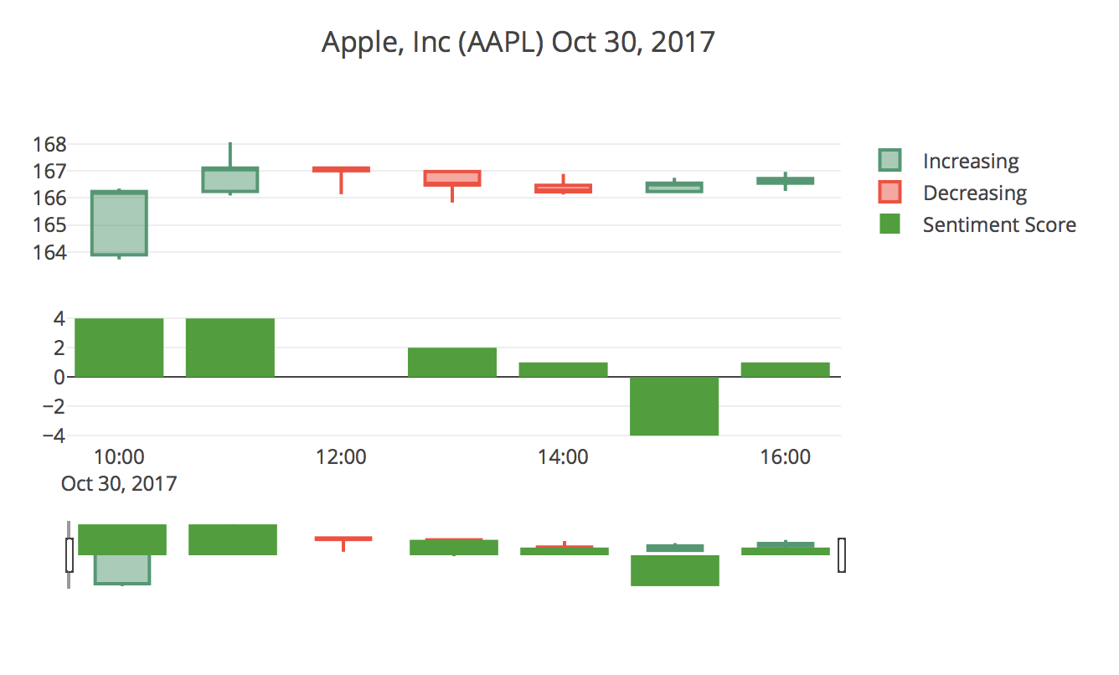
Example
Notes:
There are many professional publications about considering twitter being an influenctial factor on stock market. The graph showing above is a chart between stock price change and sentiment score. it is a random stock on random time. Our approach combines machine learning and hypothesis testing, and this reasearch will give a deeper analysis on what information of twitter users could influence stock price, so we could reach a high accuracy on predicting stock prices.

Slide 3
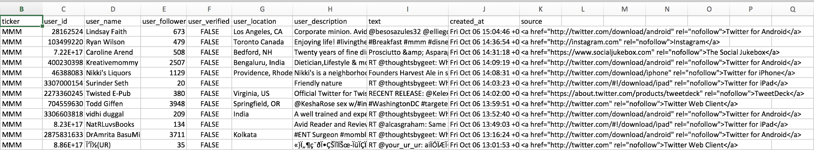
Dataset
Original Twitter dataset
Notes:
We have scraped over 60 thousand rows of data from both twitter and stock. The attributes includes some user information that we suspect could affect the accuracy, such as verified or not and user followers. We have also collected the stock data to associate with twitter.

Slide 4
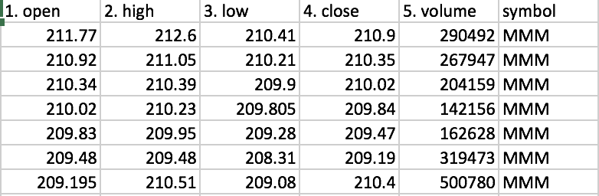
Dataset
Original Stock dataset from SP500

Slide 5
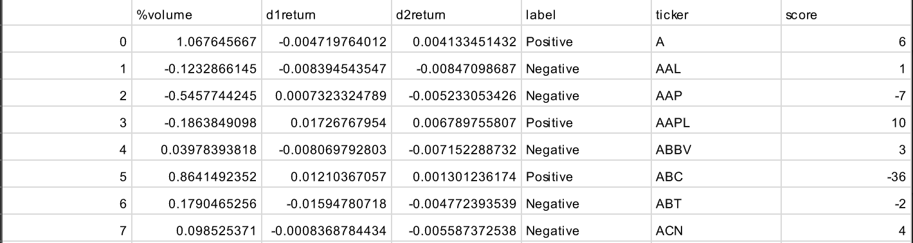
Dataset for Machine Learning

Slide 6
Hypothesis Test
We think
The stock price of a company can be predicted based on the
Twitter users’ attitude toward a company on the previous day
The volume change of its stock
The price change of its stock

Slide 7
Hypothesis Test
Variables
Volume percentage change of previous day
Stock price change of day 1 (close price - open price)
Sentiment score (positive word counts-negative word counts)

Slide 8
Result by Using Machine Learning Methods
Machine Learning Methods | Classification Accuracy
Support Vector Machine | 0.52
Naive Bayes | 0.48
Notes:
This is our hypothesis test result, we can see that by applying SVM, the prediction accuracy is .52, while Naive Base only achieved at 48% accuracy, Which is lower than our expectation

Slide 9
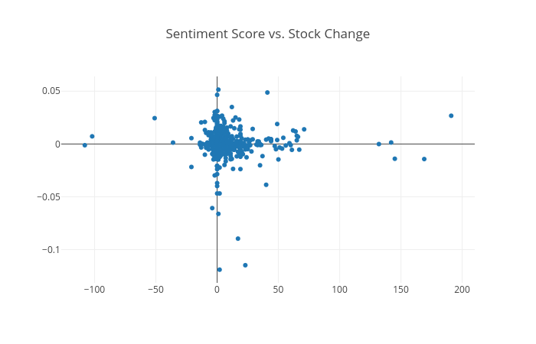
Prediction Analysis

Slide 10
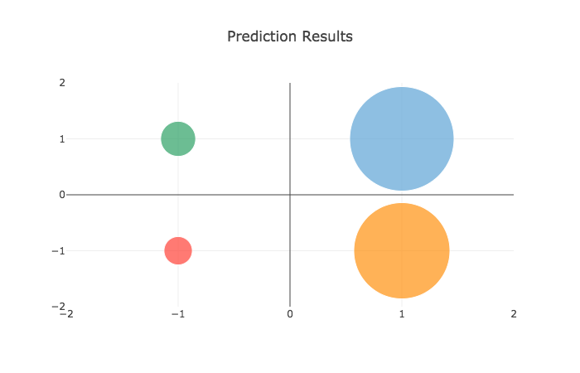

Slide 11
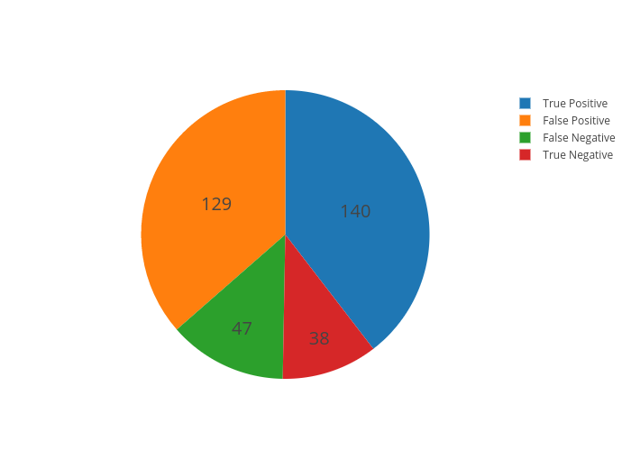

Slide 12
Issues with Twitter Data
Positive Attitude:“What a raise! Nice job #AMZN!!! #Monday #make #it #happen” -- El (Followers: 60, Not Verified)
AMZN: 10/25/2017 open: $978.00 close: $972.91 -0.52%
Negative Attitude:“CVS Bid for Aetna Followed a Long Hunt @WSJ ow.ly/h18630gdu4u Shows #CVS has problems, esp. w/retail stores & #PBM in the crosshairs.” -- Ted Okon (Followers: 3953, Verified)
CVS: 10/30/2017 open: $68.77 close: $68.44 -0.48%

Slide 13
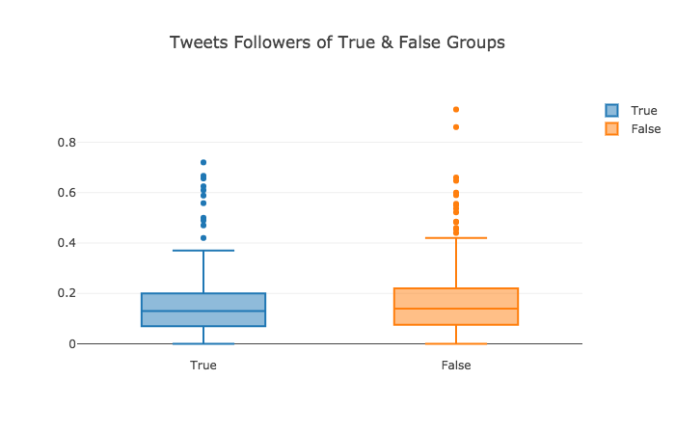
Factor: Number of Followers
T test statistics: -1.09 P-value: 0.276

Slide 14
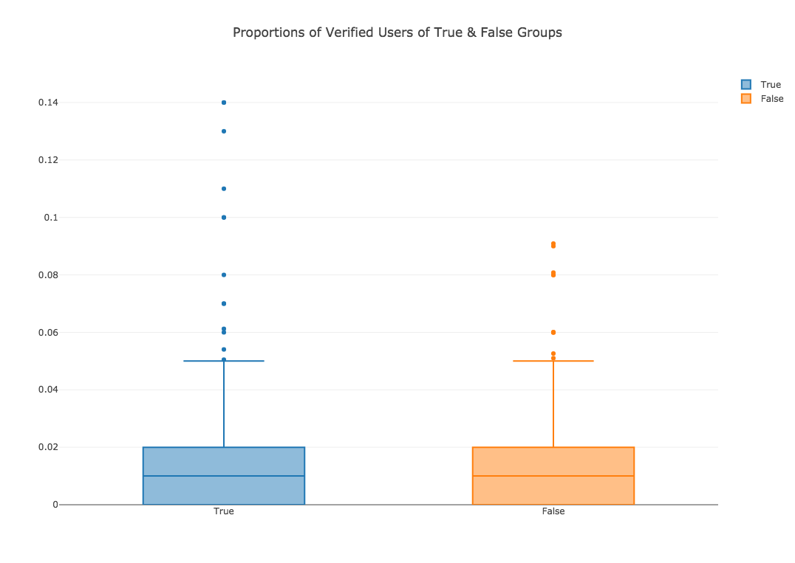
Factor: Verified or Not Verified Users
T test statistics: 2.2 P-value: 0.0445

Slide 15
Additional Sentiment Analysis
Collect new data to test
Filter Twitter data
At least 6% of tweets posted by Verified Users for 1 stock
Machine Learning Methods | Old Classification Accuracy | New Classification Accuracy
Support Vector Machine | 0.52 | 0.67
Naive Bayes | 0.48 | 0.66

Slide 16
Conclusion
In this project, we used sentiment analysis on Twitter data and achieved the result that we could predict the following day’s stock price trend with 67% accuracy for S&P 500 stocks.

Slide 17
Limitations & Improvement
One week Twitter data
Better NLP
Other machine learning models, like Q-learning

