Slide 1
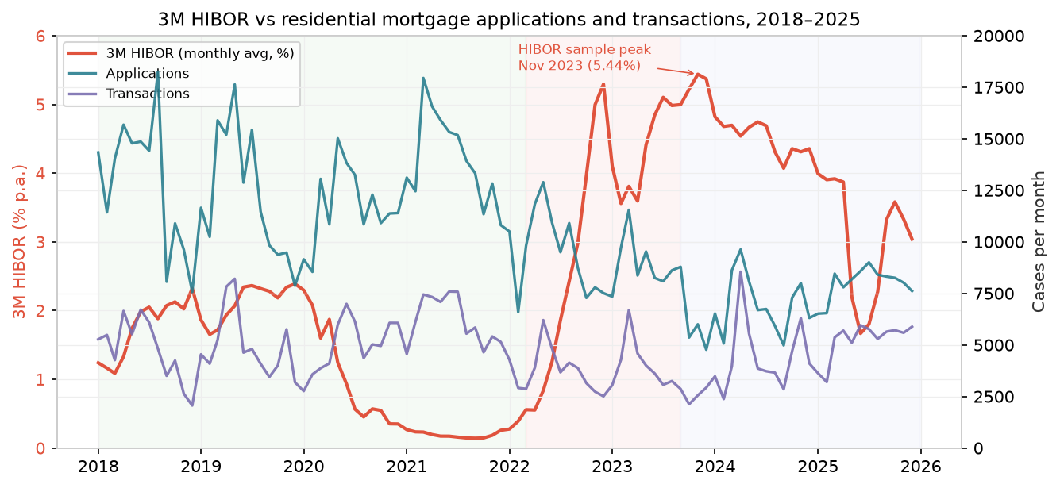
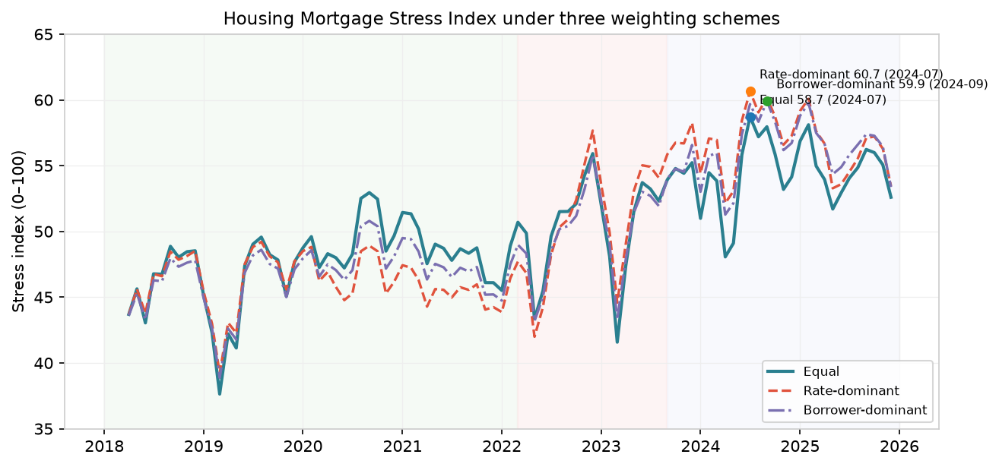
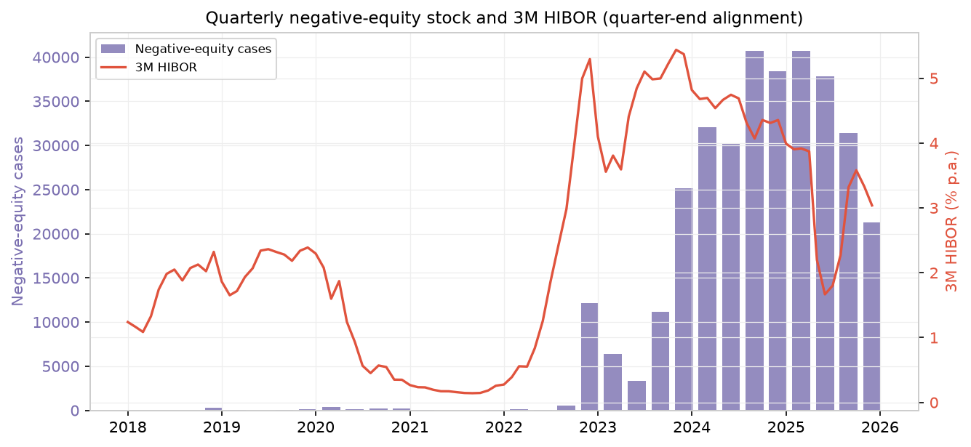
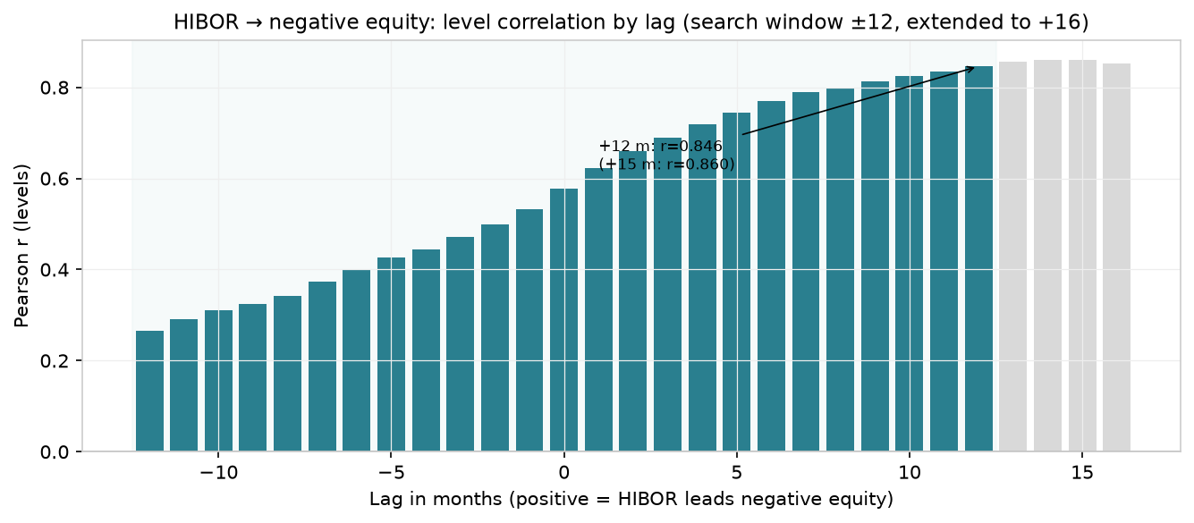
The Impact of the Interest-Rate Hiking Cycle on Hong Kong Residential Mortgage Risks
DSC5002 · Group 31 · 2018–2025 monthly exploratory analysis · HKMA / Land Registry / Census & Statistics Department
1
2
3
Objective & data
Rates, activity & negative equity
Stress index & lead-lag
How did the 2022–2024 rate-hiking cycle transmit into mortgage demand, transactions and negative equity? We integrate 96 months (2018-01 → 2025-12) of HKMA mortgage & negative-equity surveys, HIBOR, Land Registry residential ASPs, and Census & Statistics unemployment and CPI into one dataset.
Comparison windows (analyst-defined)
Pre-hiking 2018-01–2022-02 · Hiking 2022-03–2023-08 · Post-hiking 2023-09–2025-12. Aug 2023 is a transition date, not the sample HIBOR peak (3M HIBOR peaked at 5.44% in Nov 2023).
Stress index
Four z-scored components → 50 + 10 × Σ weight×z, clipped 0–100: 3M HIBOR, negative-equity cases, transaction contraction, unemployment. Three weighting schemes (equal, rate-, borrower-dominant).
Fig 1. Rates and mortgage activity move in opposite directions.
Fig 2. Equal 58.7 (2024-07) · Rate 60.7 (2024-07) · Borrower 59.9 (2024-09).
Lead-lag diagnostics
Pearson correlations over −12…+12 months: corr(driver.shift(lag), outcome); positive lag = first variable leads. Exploratory, not causal / Granger.
Fig 3. Negative equity is a quarterly stock; it lags rate shocks.
Fig 4. HIBOR→negative-equity peaks at the +12-month search boundary (r=0.85); +15 months is higher, so 12 is a limit, not a period.
Key findings · Applications −25.3%, approvals −17.8%, transactions −24.3% in the hiking window · Transactions and mortgage activity are largely synchronous (r=0.67 at zero lag) · Negative equity is a lagged risk · The composite index is moderately robust to weighting. All findings are exploratory correlations, not causal estimates.

