Slide 1
Fundamentals of Python
Data Structures
Modeling and Simulation

Slide 2
Models and Simulation
A model is a simplified description of a real-world situation or process
A simulation starts with a model in an initial state and runs a process on it until a final state is reached
Parameters vary the initial states, and feedback from the final states can be used to improve the model
Fundamentals of Python: Data Structures

Slide 3
Examples
Traffic flows on highways
Life cycles of organisms
Power grid usage during heat waves
Fundamentals of Python: Data Structures

Slide 4
Case Study: Supermarket Checkout
How many checkout clerks are needed at various times of the day?
What is the maximum amount of time a customer should have to wait in line?
Fundamentals of Python: Data Structures

Slide 5
Important Factors in the Situation
frequency of customer arrival
number of cashiers available
amount of time to serve a customer
total period of time
Fundamentals of Python: Data Structures

Slide 6
Variability of the Factors
customers don’t always show up at regular intervals
number and types of items in a cart may vary
time to transfer items from cart to counter may vary
  age of customer
  distracted by children
Fundamentals of Python: Data Structures

Slide 7
Simulating Time
As in complexity analysis, use abstract units or ticks of an abstract clock (each unit represents a minute, in this case)
If a customer arrives once every 4 minutes on the average
  generate a random number between 0 and 1 on each tick
  if that number is less than .25, then add a new customer to the checkout line
Fundamentals of Python: Data Structures

Slide 8
Queues for Checkout Lines
Each arriving customer goes at the rear of a cashier’s queue
On each tick of the clock, the customer at the front of the queue receives a unit of service
When a cashier is finished serving a customer, that customer is popped from the queue
Fundamentals of Python: Data Structures

Slide 9
Classes for the Simulation
Queue (array or link-based)
Customer
Cashier
MarketModel
MarketView
Fundamentals of Python: Data Structures

Slide 10
Responsibilities of Customer
Maintains its arrival time and its amount of service time
Knows when its cashier has provided enough service
Generates a new instance according to the probability of arrival
Fundamentals of Python: Data Structures

Slide 11
Responsibilities of Cashier
Maintains a queue of customers
Adds and removes customers to/from its queue
Gives the front customer a unit of service and removes it from the queue when its service is finished
Fundamentals of Python: Data Structures

Slide 12
Responsibilities of MarketModel
Runs the simulation
Creates the cashiers
Sends new customers to the cashiers
Maintains the abstract clock, tracking the total running time
During each tick, tells the cashiers to provide another unit of service
Fundamentals of Python: Data Structures

Slide 13
Inputs to the Simulation
The total running time
The average processing time per customer
The probability of arrival of new customers
The number of cashiers
Fundamentals of Python: Data Structures

Slide 14
Outputs of the Simulation
For each cashier
  the cashier’s ID number
  the total number of customers processed
  the average wait time per customer
  the number of customers left in the line at the end of the simulation
Fundamentals of Python: Data Structures

Slide 15
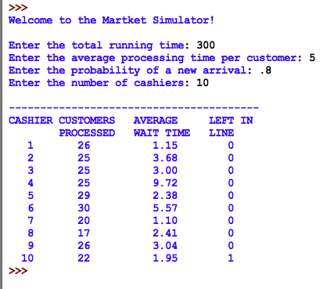
Terminal-Based User Interface
Fundamentals of Python: Data Structures

Slide 16
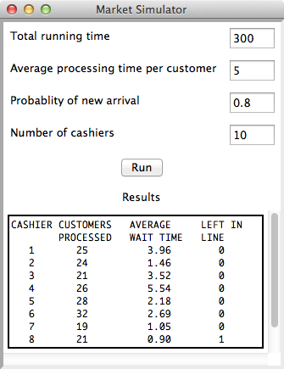
GUI-Based UI
Fundamentals of Python: Data Structures

Slide 17
For Next Time:
Lists
Chapter 9
Fundamentals of Python: Data Structures

