Slide 1
Fundamentals of Python
Data Structures
Introduction to Graphs

Slide 2
Categories of Collections
Unordered – bag, set, dictionary
Linear – list, stack, queue
Hierarchical – tree, heap
Graph
Fundamentals of Python: Data Structures

Slide 3
What Is A Graph?
A collection of items, each of which can have zero or more successors and zero or more predecessors
Trees and lists are just special cases of graphs
Fundamentals of Python: Data Structures

Slide 4
Graphs in Everyday Life
A road map
A map of airline routes
Links between Web pages
Relationships between students and courses
Diagram of flow capacities in a communication or transportation network
Fundamentals of Python: Data Structures

Slide 5
Examples
D
A
C
F
B
A
B
E
G
C
D
D
C
F
E
A
B
E
G
F
G
Fundamentals of Python: Data Structures

Slide 6
Vertex, Edge, Label, and Weight
The nodes in a graph are also called vertices
The connections between vertices are called edges
Vertices and edges can be labeled or unlabeled
A numeric edge label is also called a weight
Fundamentals of Python: Data Structures

Slide 7
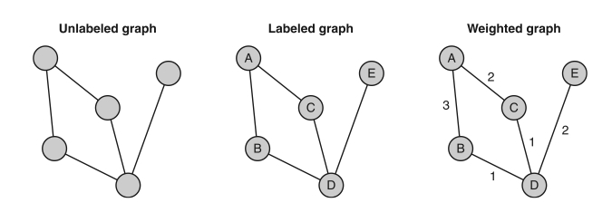
Examples
Fundamentals of Python: Data Structures

Slide 8
Connections
A graph is connected if there is at least one edge from each vertex to some other vertex
A graph is complete if there is an edge from each vertex to every other vertex
Fundamentals of Python: Data Structures

Slide 9
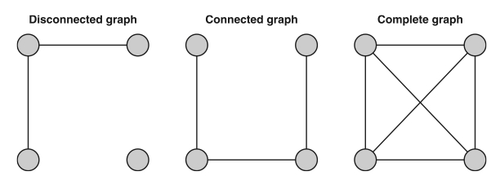
Examples
Fundamentals of Python: Data Structures

Slide 10
Paths and Cycles
A path is a sequence of edges that allows one vertex to be reached from another vertex
A simple path is a path in which a vertex is not visited more than once
A cycle is a path in which a vertex is visited more than one
Fundamentals of Python: Data Structures

Slide 11
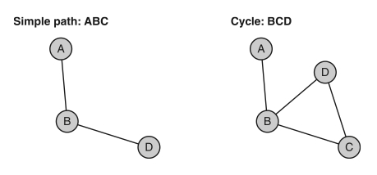
Examples
Fundamentals of Python: Data Structures

Slide 12
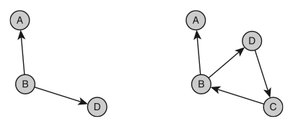
Directed Graphs (Digraphs)
Each edge in a directed graph points in one direction, allowing movement from a source vertex to a destination vertex
These edges are called directed edges
Fundamentals of Python: Data Structures

Slide 13
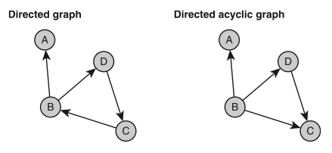
Directed Acyclic Graphs (DAGs)
A directed acyclic graph is a directed graph with no cycles
Fundamentals of Python: Data Structures

Slide 14
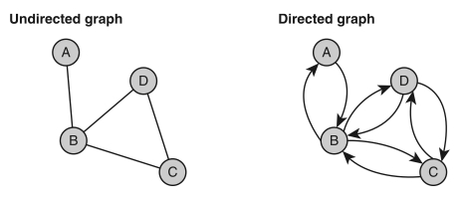
Directed and Undirected Graphs
The edges in an undirected graph support movement in both directions
Fundamentals of Python: Data Structures

Slide 15
Sparse and Unsparse Graphs
Sparse graphs are connected graphs with a minimal number of edges (roughly N edges)
Unsparse graphs have close to the maximum number of edges (roughly N² edges)
Fundamentals of Python: Data Structures

Slide 16
Adjacent Vertices
Vertex A is adjacent to vertex B if there is a directed edge from B to A
Fundamentals of Python: Data Structures

Slide 17
Incident Edges
Edge BA is incident to vertex B if it is a directed edge from B to A
Fundamentals of Python: Data Structures

Slide 18
Adjacency Matrix Representation
A two-dimensional array A with N rows and N columns
Each cell A[i][j] contains 1 if there is an edge from vertex i to vertex j, or contains 0 otherwise
Fundamentals of Python: Data Structures

Slide 19
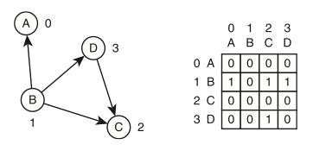
Adjacency Matrix (Directed Graph)
When an edge has a weight, the weight can go in the matrix, with a non-weight value indicating the absence of an edge
Non-numeric labels can be kept in a separate array
Fundamentals of Python: Data Structures

Slide 20
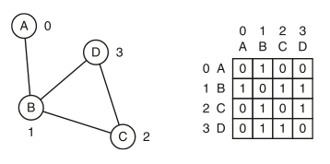
Adjacency Matrix (Undirected Graph)
Fundamentals of Python: Data Structures

Slide 21
Adjacency List Representation
An array A of N linked lists
The ith linked list contains a node for vertex j if and only if there is an edge from vertex i to vertex j
Fundamentals of Python: Data Structures

Slide 22
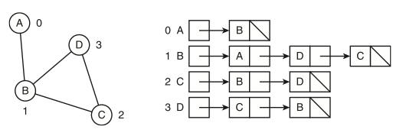
Adjacency List (Undirected Graph)
When an edge has a weight, the weight can also go in the corresponding node, and the nodes can be ordered from least cost to greatest cost
Undirected graphs have two nodes for each edge
Fundamentals of Python: Data Structures

Slide 23
Analysis: Detect an Edge
Constant time for adjacency matrix, which uses the vertex numbers as indexes into the array
Linear with length of adjacency list, because we index into the array and then search a linked list
Fundamentals of Python: Data Structures

Slide 24
Analysis: Return the Adjacent Vertices
Constant time for the adjacency list, because we index into the array and then return a copy of its linked list
Linear with the total number of vertices for the adjacency matrix, because we must traverse the row indexed by the vertex
Fundamentals of Python: Data Structures

Slide 25
Analysis: Memory Usage
Adjacency matrix always has N² array cells, so some may go to waste, especially with sparse graphs
The number of nodes equals the number of edges in adjacency list, so memory becomes an issue only when graphs are really dense
Fundamentals of Python: Data Structures

Slide 26
For Next Time:
Graph Algorithms
Fundamentals of Python: Data Structures

