Slide 1
Fundamentals of Python
Data Structures
Graph Algorithms

Slide 2
Basic Graph Algorithms
Traversal
Search for an item starting from a given vertex
Find all of the vertices to which a given vertex is connected by paths
Find the shortest path between two vertices
Find the shortest paths between one vertex and all the other vertices
Fundamentals of Python: Data Structures

Slide 3
A Generic Graph Traversal
Start at a given vertex
Visit all the vertices reachable from the starting vertex
Might not visit all the vertices in the graph
Fundamentals of Python: Data Structures

Slide 4
A Generic Traversal Algorithm
traverseFromVertex(graph, startVertex)
Instantiate a collection (a list will do for now)
Mark all vertices in the graph as unvisited
Add the startVertex to the collection
While the collection is not empty
Pop the vertex from the collection
If the vertex has not been visited
Mark the vertex as visited
Process the vertex
Add all adjacent unvisited vertices to the
collection
Fundamentals of Python: Data Structures

Slide 5
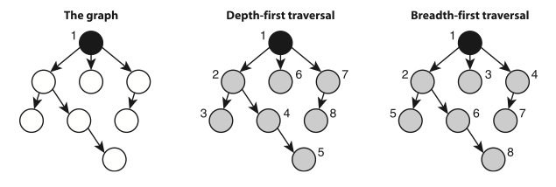
Depth-First and Breadth-First Traversals
Use a stack to force the traversal to move deeply into the graph before backtracking to another path
Use a queue to force the traversal to visit all adjacent vertices before moving to the next level
Fundamentals of Python: Data Structures

Slide 6
Add a Collection Parameter
traverseFromVertex(graph, startVertex, collection = ArrayStack())
Mark all vertices in the graph as unvisited
Add the startVertex to the collection
While the collection is not empty
Pop the vertex from the collection
If the vertex has not been visited
Mark the vertex as visited
Process the vertex
Add all adjacent unvisited vertices to the collection
depthFirstTraverse(graph, startVertex)
traverseFromVertex(graph, startVertex)
breadthFirstTraverse(graph, startVertex)
traverseFromVertex(graph, startVertex, LinkedQueue())
Fundamentals of Python: Data Structures

Slide 7
Add a Collection Parameter
traverseFromVertex(graph, startVertex, collection = ArrayStack())
Mark all vertices in the graph as unvisited
Add the startVertex to the collection
While the collection is not empty
Pop the vertex from the collection
If the vertex has not been visited
Mark the vertex as visited
Process the vertex
Add all adjacent unvisited vertices to the collection
depthFirstTraverse(graph, startVertex)
traverseFromVertex(graph, startVertex)
Fundamentals of Python: Data Structures

Slide 8
Add a Collection Parameter
traverseFromVertex(graph, startVertex, collection = ArrayStack())
Mark all vertices in the graph as unvisited
Add the startVertex to the collection
While the collection is not empty
Pop the vertex from the collection
If the vertex has not been visited
Mark the vertex as visited
Process the vertex
Add all adjacent unvisited vertices to the collection
depthFirstTraverse(graph, startVertex)
traverseFromVertex(graph, startVertex)
breadthFirstTraverse(graph, startVertex)
traverseFromVertex(graph, startVertex, LinkedQueue())
Fundamentals of Python: Data Structures

Slide 9
Recursive Depth-First Traversal
depthFirstSearch(graph, startVertex)
Mark all vertices in the graph as unvisited
dfs(graph, startVertex)
dfs(graph, v)
Mark v as visited
Process v
For each vertex w adjacent to v
If w has not been visited
dfs(graph, w)
Fundamentals of Python: Data Structures

Slide 10
Topological Ordering
The vertices in a directed acyclic graph have an ordering
Example: the courses for a CS major have prerequisites
In what order can I take a given set of courses?
Fundamentals of Python: Data Structures

Slide 11
Topological Sort
Traverse the graph and assign a numeric rank, in ascending order, to the vertices
There might be more than one such ordering for a given DAG
Fundamentals of Python: Data Structures

Slide 12
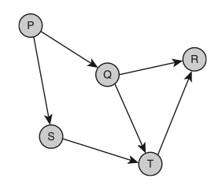


Example
Directed Acyclic Graph Topological Sorts
Fundamentals of Python: Data Structures

Slide 13
Topological Sort Algorithm
topologicalSort(graph)
Instantiate a stack
Mark all vertices in the graph as unvisited
For each vertex v in the graph
If v is unvisited
dfs(graph, v, stack)
Return stack
dfs(graph, v, stack)
Mark v as visited
For each vertex w adjacent to v
If w has not been visited
dfs(graph, w, stack)
stack.push(v)
Fundamentals of Python: Data Structures

Slide 14
All-Pairs Shortest-Paths Problem
Given a weighted graph, find the shortest paths between each pair of vertices for which there is a path
Useful for planning or scheduling trips between cities, designing networks, etc.
Fundamentals of Python: Data Structures

Slide 15
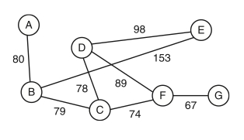
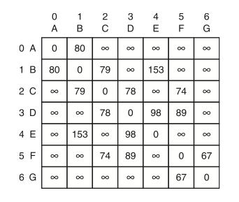
The graph shows vertices and edges; weights are distances between adjacent cities
The distance matrix shows distances (weights) between adjacent vertices; ∞ means the distance of a path not yet known
Fundamentals of Python: Data Structures

Slide 16
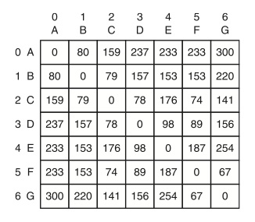
The all-pairs algorithm fills in the shortest distances between all the pairs
Fundamentals of Python: Data Structures

Slide 17
Floyd’s Algorithm
Published by Robert Floyd in 1962
Inputs: N by N matrix A for a graph of N vertices
Outputs: Same matrix, but with the length of each path replaced by the length of the shortest path, or ∞ if there is no path
Fundamentals of Python: Data Structures

Slide 18
Floyd’s Algorithm
for i = 0 to n – 1
for r = 0 to n – 1
for c = 0 to n – 1
A_{rc} = min(A_{rc}, A_{ri} + A_{ic})
A_{rc} = distance from vertex r to vertex c
A_{ri} = distance from vertex r to vertex i
A_{ic} = distance from vertex i to vertex c
Runtime complexity?
Fundamentals of Python: Data Structures

Slide 19
Single-Source Shortest-Paths Problem
Given a weighted directed acyclic graph, find the shortest paths from a single source vertex to the other vertices for which there are paths
Useful for planning or scheduling trips between cities, designing networks, etc.
Fundamentals of Python: Data Structures

Slide 20
Dykstra’s Algorithm
Output is a two-dimensional list with N rows and 3 columns
  First column: a vertex
  Second column: the distance from the source vertex
  Third column: the immediate predecessor on this path
Also uses a list of Booleans to track the status of the search for each vertex
Fundamentals of Python: Data Structures

Slide 21
The Initialization Step
for each vertex in the graph
Store vertex in the current row of the results list
If vertex = source vertex
Set the row's distance cell to 0
Set the row's path cell to undefined
Set included[row] to True
Else if there is an edge from source vertex to vertex
Set the row's distance cell to the edge's weight
Set the row's path cell to source vertex
Set included[row] to False
Else
Set the row's distance cell to infinity
Set the row's path cell to undefined
Set included[row] to False
Runtime complexity?
Fundamentals of Python: Data Structures

Slide 22
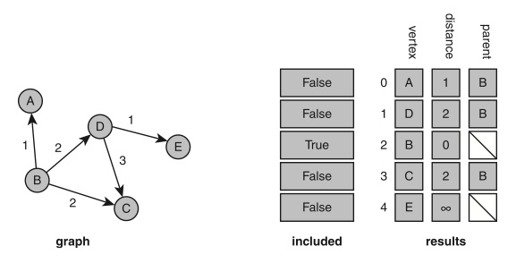
The Initial State of the Data Structures
Fundamentals of Python: Data Structures

Slide 23
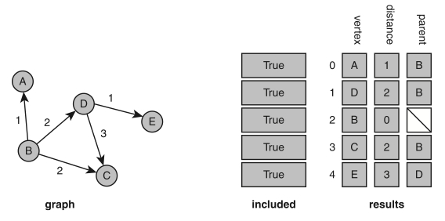
The Final State of the Data Structures
Fundamentals of Python: Data Structures

Slide 24
The Computation Step
Do
Find the vertex F that is not yet included
and has the minimal distance
Mark F as included
For each other vertex T not included
If there is an edge from F to T
Set new distance to F's distance + edge's weight
If new distance < T's distance in the results array
Set T's distance to new distance
Set T's path in the results array to F
While all vertices are not included
Runtime complexity?
Fundamentals of Python: Data Structures

Slide 25
For Next Time:
Graph Implementations
Fundamentals of Python: Data Structures

