Slide 1


Superpixel-enhanced Pairwise Conditional Random Field for Semantic Segmentation
Li Sulimowicz, Ishfaq Ahmad, Alexander Aved
Notes:
I am Li Sulimowicz, a PhD student from university of Texas at Arlington. Today I am honored to present you … coauthored with my advisor Ishfaq Ahmad, and Dr. Alexander Aved from US air force.

Slide 2
Overview
Introduction
Conditional Random Field
Conventional Higher-order Potentials
Inference and Learning
SP-enhanced CRFs
SP-pairwise Potential
Inference and Learning
Experimental Results
Conclusions
Notes:
We are going to have five parts:

Slide 3

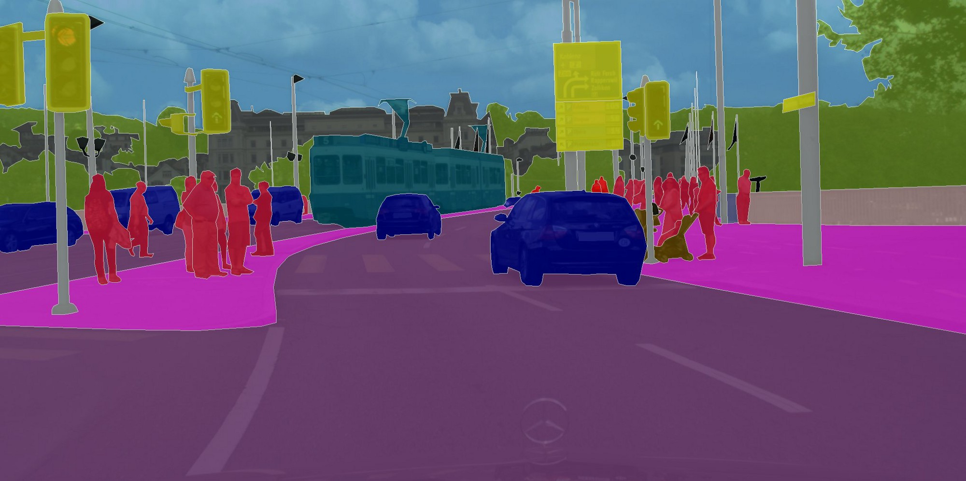
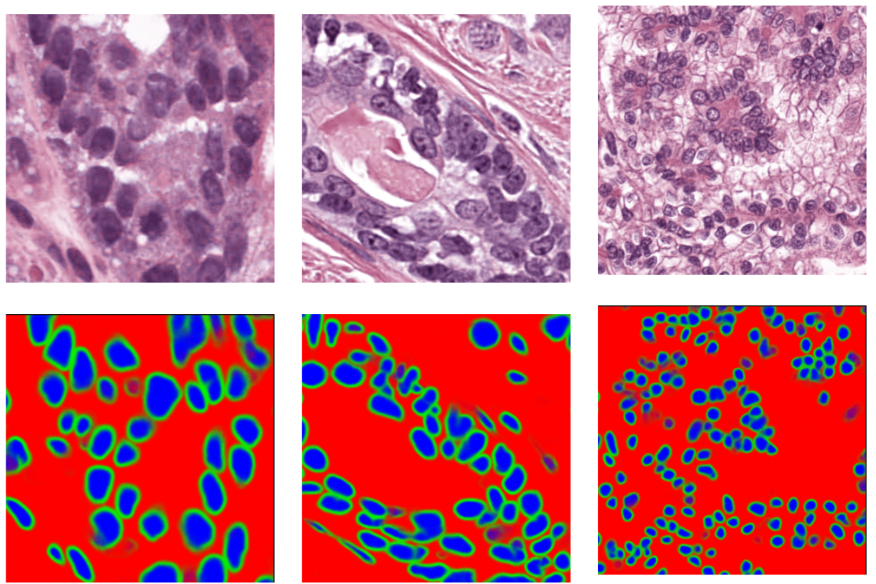
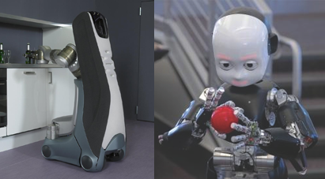
Introduction
Semantic Segmentation
Labelling the category of every pixel within an image
A key step for scene understanding
Applications
Autonomous driving
Computer-aided Medical Diagnosis
Robotics Perception
Conditional Random Fields
CRF is useful because the output from deep learning is blobby
Notes:
Semantic segmentation is a challengable task of labelling the category of each pixel in an image, and is the key and very first step for scene understanding.
Here we list three of the most popular applications. The first is the automomous driving which needs the autopilot to understand where the lanes, the cars and the pedestrians are. For the medical diagnosis, it can help the health care system save time and cost. In robotics perceptions, the robots need to at first understand the world in order to take actions. All of the applications will benefit human beings largely.
Conditional random field is very useful graphical model as a post processing for the image labelling tasks. It is usually used to make up for the blobby output from the deep learning now
As the rise of the deep learning and with usage of GPU, semantic segmentation is getting more and more important in computer vision applications

Slide 4
Overview
Introduction
Conditional Random Field
Conventional Higher-order Potentials
Inference and Learning
SP-enhanced CRFs
SP-pairwise Potential
Inference and Learning
Experimental Results
Conclusions
Notes:
Condtional Random field

Slide 5
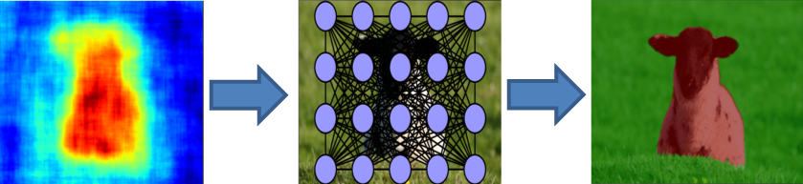
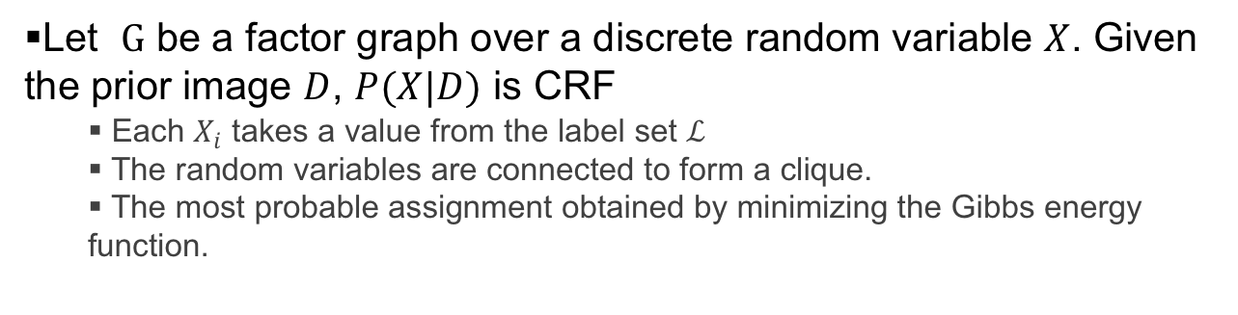
Conditional Random Field
Let $G$ be a factor graph over a discrete random variable $X$. Given the prior image $D$, $P(X|D)$ is CRF
Each $X_{i}$ takes a value from the label set $ℒ$
The random variables are connected to form a clique.
The most probable assignment obtained by minimizing the Gibbs energy function.
Heatmap from the pixel-wise classifier
CRF modelling
Output after the CRF inference
Notes:
$The definition of CRFs, G$ is a factor graph over a discrete random variable $X$. Given the priori image D in the computer vision task, $P(X|D)$ is CRF, which models a conditional distribution between the observed prior information $D$ and the target variable $X$
Each $X_{i}$ takes a value from the label set $ℒ$
The random variables are connected to form a random field, which is also called a clique. Thus, A clique is a set of random variables which are conditionally dependent on each other.
Each clique is assigned a potential, which is a penalty based on the observed info $D$.
The most probable assignment can be obtained by minimizing the Gibbs energy function.
From the figure below, we see the heatmap from the pixel-wise classifier, and we pass it to the CRF conditioned on the original image, we get a final result which has better appearance consistency.

Slide 6
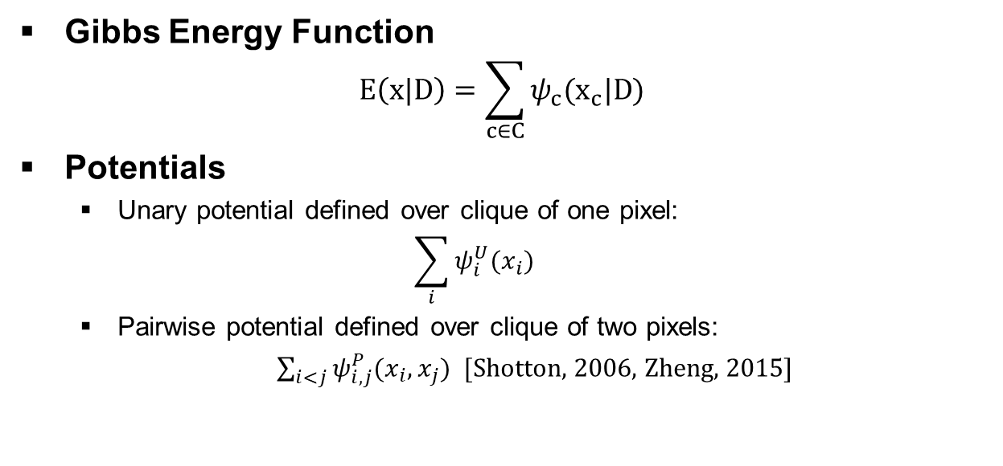
Conditional Random Field
Gibbs Energy Function
$$E\left(x|D\right)=\sum_{c∈C}{ψ_{c}(x_{c}|D)}$$
Potentials
Unary potential defined over clique of one pixel:
$$\sum_{i}{ψ_{i}^{U}(x_{i})}$$
Pairwise potential defined over clique of two pixels:
$\sum_{i<j}{ψ_{i,j}^{P}(x_{i}, x_{j})}$ [Shotton, 2006, Zheng, 2015]
Notes:
Energies are defined over cliques of random variables, and the gibbs energy function is the sum over the potentials of all cliques in the factor graph over X, conditioned on D.
The most basic CRF models has unary and pairwise potential.
The unary potential is defined over clique just of one pixel. And the pariwse potential is over clique of two pixels, each clique forms and edge in the factor graph. It usually take over cost from the previous classifier as –log p(x_i)
The pairwise potential is defined over cliques composed of two pixels, each clique forms an edge.
4 mins here

Slide 7
Overview
Introduction
Conditional Random Field
Conventional Higher-order Potentials
Inference and Learning
SP-enhanced CRFs
SP-pairwise Potential
Inference and Learning
Experimental Results
Conclusions

Slide 8
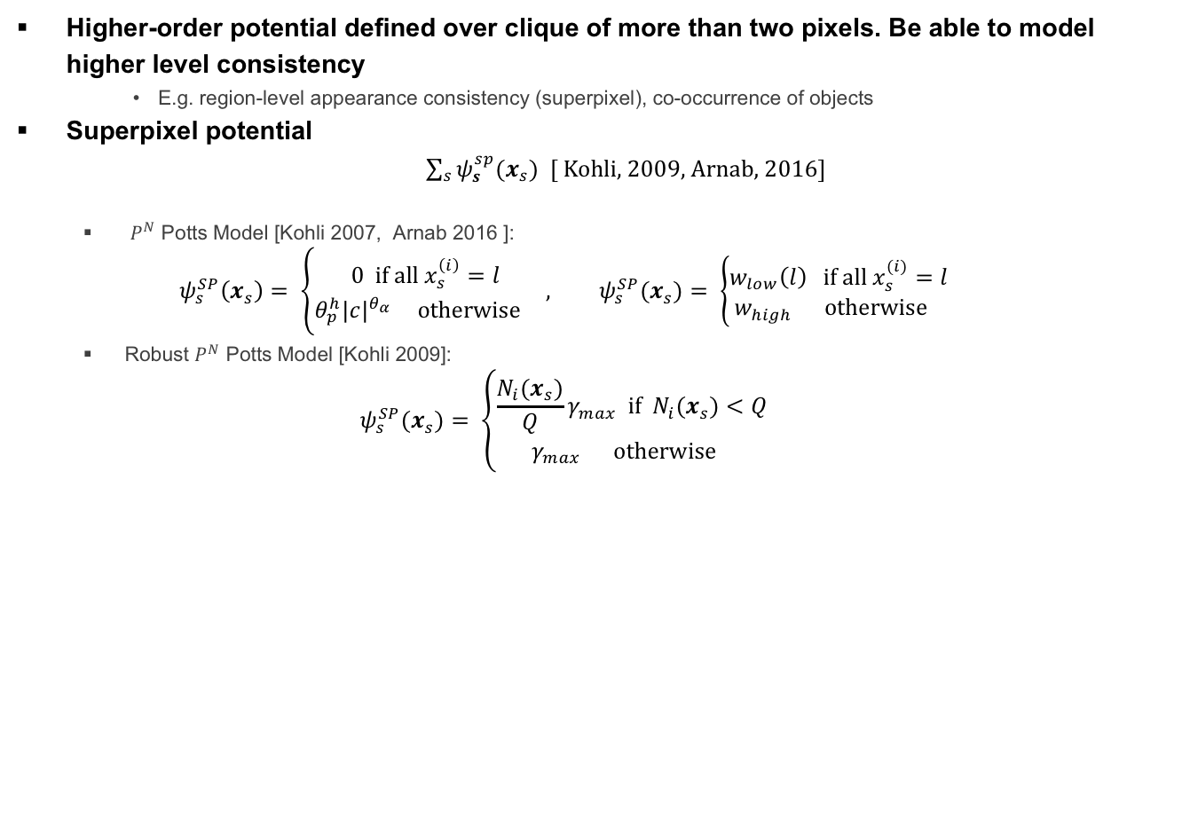
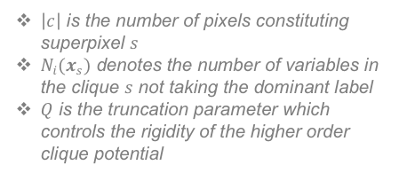
Conventional Higher-order Potentials
Higher-order potential defined over clique of more than two pixels. Be able to model higher level consistency
E.g. region-level appearance consistency (superpixel), co-occurrence of objects
Superpixel potential
$\sum_{s}{ψ_{s}^{sp}(x_{s}})$ [ Kohli, 2009, Arnab, 2016]
$P^{N}$ Potts Model [Kohli 2007, Arnab 2016 ]:
$$ψ_{s}^{SP}\left(x_{s}\right)= \left\{\begin{aligned}0 \text{if} \text{all} x_{s}^{\left(i\right)}=l \\ θ_{p}^{h}{|c|}^{θ_{α}} \text{otherwise} \end{aligned}\right. , ψ_{s}^{SP}(x_{s})= \left\{\begin{aligned}w_{low}\left(l\right) \text{if} \text{all} x_{s}^{(i)}=l \\ w_{high} \text{otherwise} \end{aligned}\right.$$
Robust $P^{N}$ Potts Model [Kohli 2009]:
$$ψ_{s}^{SP}(x_{s})= \left\{\begin{aligned}\frac{N_{i}(x_{s})}{Q}γ_{max} \text{if}{ N}_{i}(x_{s})<Q \\ γ_{max} \text{otherwise} \end{aligned}\right.$$
$\left|c\right|$ is the number of pixels constituting superpixel $s$
$N_{i}(x_{s})$ denotes the number of variables in the clique $s$ not taking the dominant label
$Q$ is the truncation parameter which controls the rigidity of the higher order clique potential
Notes:
Unlike pairwise CRFs, higher-order potential are defined over clique of more than two pixels. It is able to model higher level consistency, for example, region-level appearance consistency (superpixel), co-occurrence of objects etc. Here we focus on the superpixel potential, the most commonly used are p^n potts model and the robust p^n potts model.
For the potts model, like in paper kohli and Arnab, when all pixels in one superpixel take the same label, a low penalty is incurred, otherwise, a high penalty. It tries to make all pixels belonging to a segment take the same label, which can help remove spurious noise in each superpixel .
However, if all but one pixel in a superpixel take the same label then penalty is incurred as if they were all to take different labels. Due to such strict penalty, the potential might not be able to deal with inaccurate superpixels
For the robust potts model, it relaxes such constriction, and defined the potential in proportion to the number of variables in the clique not taking the dominant label, which is the Ni(x_s) in the equation. This solves the problem of the potts model, and allow some variables in the clique to take different labels.

Slide 9
Overview
Introduction
Conditional Random Field
Conventional Higher-order Potentials
Inference and Learning
SP-enhanced CRFs
SP-pairwise Potential
Inference and Learning
Experimental Results
Conclusions
Notes:
Let’s look at the inference and learning

Slide 10
Inference and Learning
Inference
[Krahenbuhl 2011, Zheng 2015] applies bilateral Gaussian filter-based approximation methods on fully-connected pairwise CRFs
[Vineet 2014, Arnab 2016] shows modified above method can be applied on SP-based CRFs.
 | Post-processing | End-to-End
Fully-connected Pairwise CRFs | DenseCRF [Krahenbuhl 2011] | CRFasRNN[Zheng 2015]
SP-based CRFs | Dense+Potts[Vineet 2014] | H-CRF-RNN[Arnab 2016]
Disadvantages of higher-order CRFs compared with pairwise CRFs
Higher complexity
Requires longer time for learning due to extra set of hyperparamters and/or weights
Different formulation for inference and learning algorithm
Notes:
Inference:
Because the inference is NP-hard, they are usually solved using by approximate method, where mean-field message passing is the state-of-the-art . [Krahenbuhl 2011, Zheng 2015] shows bilateral Gaussian filter-based approximation methods applied on fully-connected pairwise CRFs outperforms the best alternative methods in terms of speed and accuracy.
Vineet and Arnab further shows that similar method can be applied on higher-order CRFs .
(After the inference) The table listed below categorize the way CRF is used, post-processing after the classifer or trained end-to-end with deep learning classifier.
Here, we summarize the disadvantages of higher-order CRFs
Higher complexity compared with pairwise CRFs
Because it has extra set of hyperparamters and/or weights compared with baseline pairwise CRFS, which leads to longer time for learning
Needs to update the formulation for the inference and learning algorithm

Slide 11
Overview
Introduction
Conditional Random Field
Conventional Higher-order Potentials
Inference and Learning
SP-enhanced CRFs
SP-pairwise Potential
Inference and Learning
Experimental Results
Conclusions
Notes:
Now, here comes to our most important part: the proposed algorithm

Slide 12
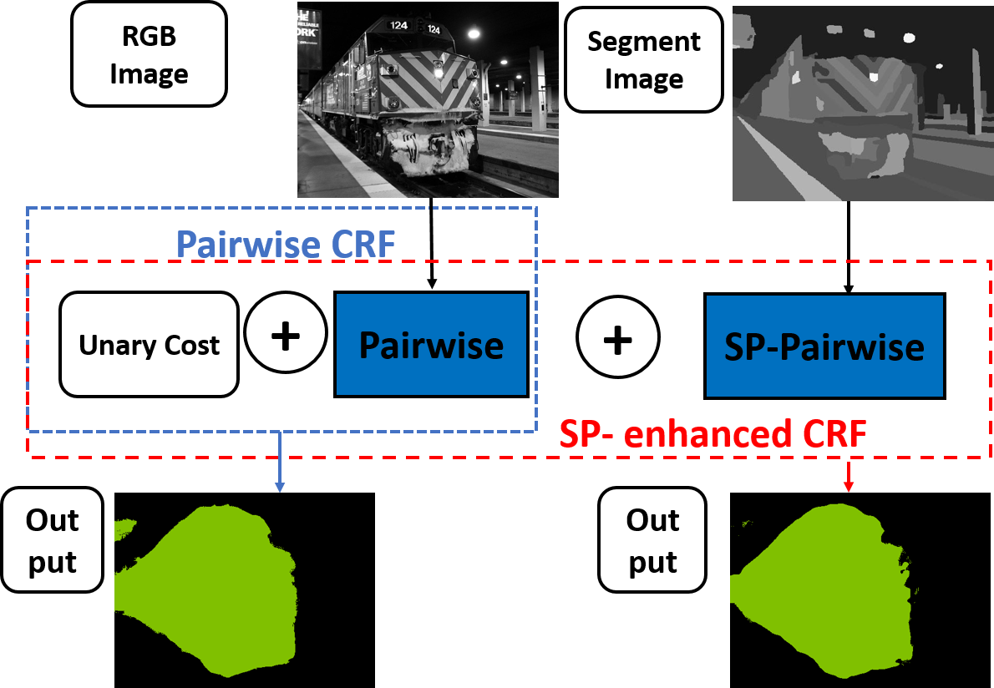
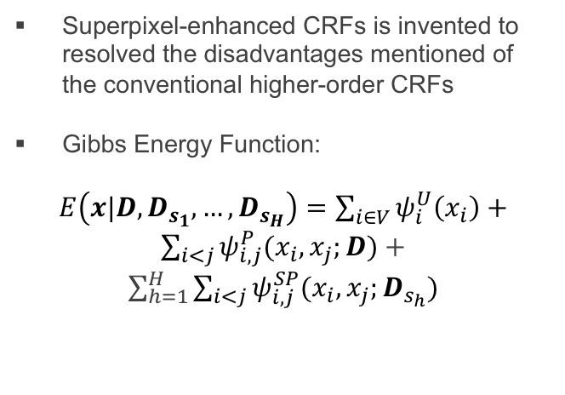
Superpixel-enhanced CRFs
Superpixel-enhanced CRFs is invented to resolved the disadvantages mentioned of the conventional higher-order CRFs
Gibbs Energy Function:
$E\left(x|D,D_{s_{1}}, …,D_{s_{H}}\right)=\sum_{i∈V}{ψ_{i}^{U}\left(x_{i}\right)+}$ $\sum_{i<j}{ψ_{i,j}^{P}(x_{i}, x_{j};D)}$ + $\sum_{h=1}^{H}{\sum_{i<j}{ψ_{i,j}^{SP}(x_{i}, x_{j};D_{s_{h}})}}$
Notes:
Superpixel-enhanced CRFs
Our model is simple but very elegant and effective. SP-enhanced CRF is composed of \traditional pairwise potential and extra superpixel-enhanced pairwise potential, as shown in the gibbs energy function: conditioned on D and other sets of segmented images. We would have unary, conventional pairwise CRFs and one to multiple terms of sp-enhanced pairwise potential in the function
Look at the right figure, the sp-pairwise potential take the same form of the pairwise potential, but with a segmented image as input. In the segmented image, each pixel takes the average GRB value of the sueprpixel that it belongs to.

Slide 13
Overview
Introduction
Conditional Random Field
Conventional Higher-order Potentials
Inference and Learning
SP-enhanced CRFs
SP-pairwise Potential
Inference and Learning
Experimental Results
Conclusions
Notes:
Now I am going to explain why this simple method works in two ways: conceptually and mathematically

Slide 14
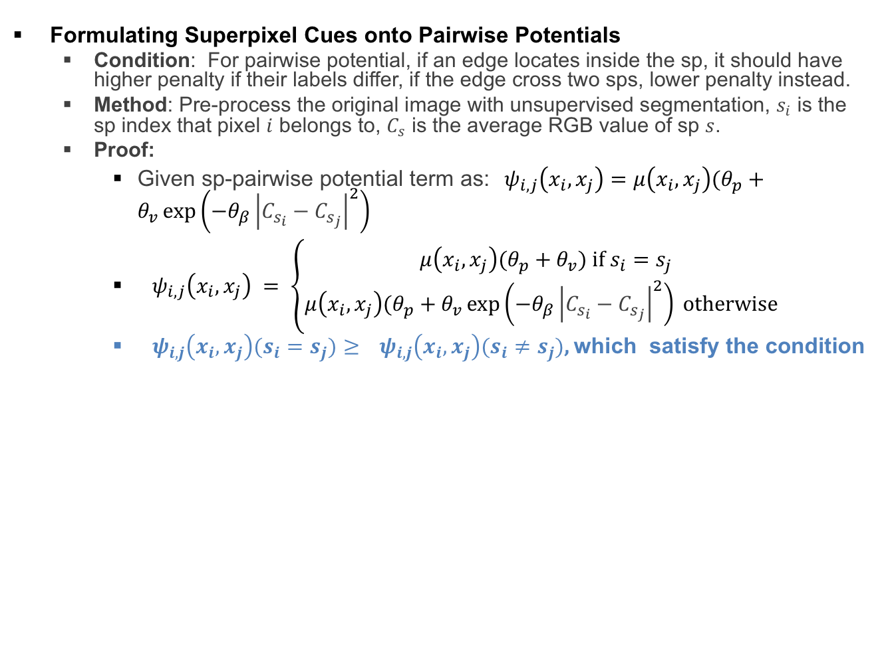
SP-Pairwise Potential
Conceptual Proof
Formulating Superpixel Cues onto Pairwise Potentials
Condition: For pairwise potential, if an edge locates inside the sp, it should have higher penalty if their labels differ, if the edge cross two sps, lower penalty instead.
Method: Pre-process the original image with unsupervised segmentation, $s_{i}$ is the sp index that pixel $i$ belongs to, $C_{s}$ is the average RGB value of sp $s$.
Proof:
Given sp-pairwise potential term as:${ ψ}_{i,j}\left(x_{i},x_{j}\right)=μ\left(x_{i},x_{j}\right)(θ_{p}+θ_{v}\exp\left(−θ_{β}{\left|C_{s_{i}}−C_{s_{j}}\right|}^{2}\right)$
${ ψ}_{i,j}\left(x_{i},x_{j}\right) = \left\{\begin{aligned}μ\left(x_{i},x_{j}\right)(θ_{p}+θ_{v}\text{) }\text{if} s_{i}=s_{j} \\ μ\left(x_{i},x_{j}\right)(θ_{p}+θ_{v}\exp\left(−θ_{β}{\left|C_{s_{i}}−C_{s_{j}}\right|}^{2}\right) \text{otherwise} \end{aligned}\right.$
${ ψ}_{i,j}\left(x_{i},x_{j}\right)(s_{i}=s_{j})≥$ ${ ψ}_{i,j}\left(x_{i},x_{j}\right)(s_{i}≠s_{j})$, which satisfy the condition
Notes:
Concepturally, we are trying to formulate superpixel cues onto pairwise potentials. Assume putting the pairwise CRF on a segmented image, in order to enforce the segment-level consistency, if an edge locates inside of the sp, it should have higher penalty if they have different labels, if the edge cross two sps, lower penalty instead.. this is the condition that we need to satisfy.
Our proposal is: we pre-process the original image with unsupervised segmentation, and each pixel takes the average RGB value of the superpixel it belongs to
Assume our pairwise potential is composed of compatibility function mu and the parameters and the variables from D.
in the equation, When S_i equals to S_j, which is to say pixel I and j belongs to the same superpixel, we have maximum value for this function. Is not difficult to draw the conclusion that first item is>= the second item where si not equals to sj. Which satisfy the condition.
This way, by pre-processing the original image in a very simple way, the conventional pairwise potential can carry out the superpixel cues successfully.

Slide 15
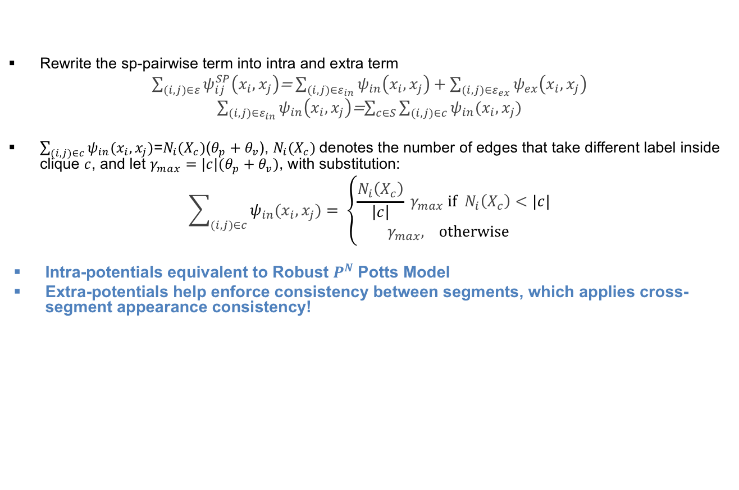
SP-Pairwise Potential
Mathematical Proof
Rewrite the sp-pairwise term into intra and extra term
$\sum_{(i,j)∈ε}{ψ_{ij}^{SP}\left(x_{i},x_{j}\right)}$= $\sum_{(i,j)∈ε_{in}}{ψ_{in}\left(x_{i},x_{j}\right)+\sum_{(i,j)∈ε_{ex}}{ψ_{ex}\left(x_{i},x_{j}\right)}}$
$\sum_{(i,j)∈ε_{in}}{ψ_{in}\left(x_{i},x_{j}\right)}$=$\sum_{c∈S}{\sum_{(i,j)∈c}{ψ_{in}(x_{i},x_{j})}}$
$\sum_{(i,j)∈c}{ψ_{in}(x_{i},x_{j})}$=$N_{i}(X_{c})$($θ_{p}+θ_{v}$), $N_{i}(X_{c})$denotes the number of edges that take different label inside clique $c$, and let $γ_{max}=|c|(θ_{p}+θ_{v})$, with substitution:
$$\sum_{(i,j)∈c}{ψ_{in}(x_{i},x_{j})}= \left\{\begin{aligned}\frac{N_{i}\left(X_{c}\right)}{\left|c\right|}{ γ}_{max} \text{if}{ N}_{i}\left(X_{c}\right)<|c| \\ γ_{max}\text{, } \text{otherwise} \end{aligned}\right.$$
Intra-potentials equivalent to Robust $P^{N}$Potts Model
Extra-potentials help enforce consistency between segments, which applies cross-segment appearance consistency!
Notes:
The mathematical proof.
We define intra-edge is an edge that locates inside of segment, and an extra-edge is an edge that crosses two segments. So the sum of sp-pairwise potentials can be divided into two parts: sum of potentials of intra-edges and extra-edges. Further, the intra-term can be decomposed into the form of higher order potentials: where the sum of pairwise intra potentials in a segment is the superpixel clique’s potential.
For each clique $c$, the superpixel potential is $N_{i}\left(X_{c}\right)ultipled by the hyperparameters,$where $N_{i}(X_{c})$is the number of edges that take different label inside clique $c$. We let $γ_{max}equals to the total numer of intra−edges multpied by parameters)$. With substitution, the superpixel potential in our porposed method has the same form of the robust p^n potts model. |c| is the total number of intra-edges inside of this segment.
This equation proves that our intra-potentials’ equivalency to the Robust P^N potts model for the conventional higher-order potential.
Moreover, the sum of all extra-potentials help enforce the cross-segment appearance consistency, like formulating a pairwise model on segments. With segments as unit. Which can explain why we gained higher accuracy compared with the conventional one.

Slide 16
Overview
Introduction
Conditional Random Field
Conventional Higher-order Potentials
Inference and Learning
SP-enhanced CRFs
SP-pairwise Potential
Inference and Learning
Experimental Results
Conclusions

Slide 17
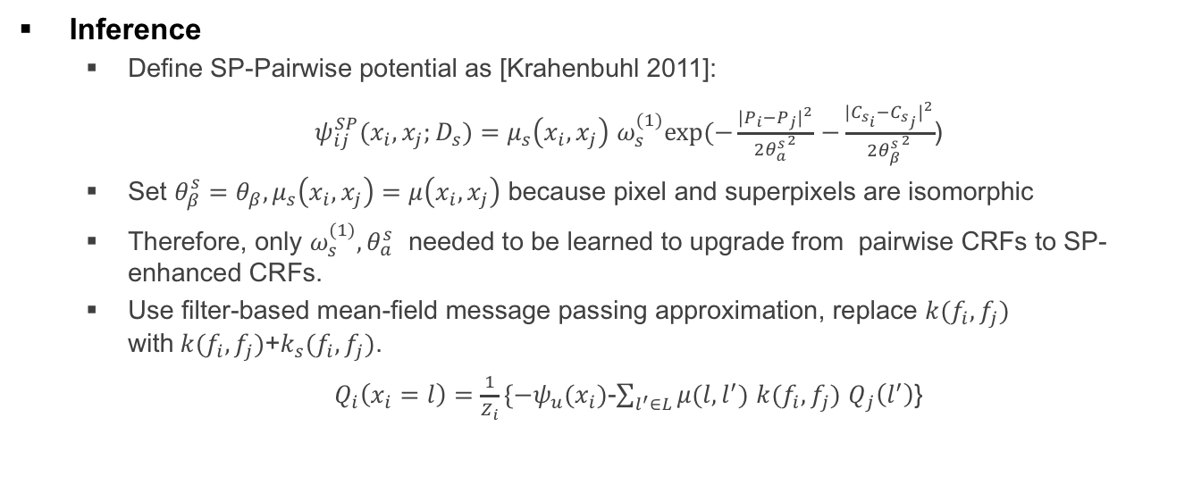
Inference and Learning
Inference
Define SP-Pairwise potential as [Krahenbuhl 2011]:
$ψ_{ij}^{SP}(x_{i},x_{j};D_{s})=$ $μ_{s}\left(x_{i},x_{j}\right)$ $ω_{s}^{(1)}exp⁡(−\frac{{|P_{i}−P_{j}|}^{2}}{2{θ_{a}^{s}}^{2}}$ $−\frac{{|C_{s_{i}}−C_{s_{j}}|}^{2}}{2{θ_{β}^{s}}^{2}}$)
Set $θ_{β}^{s}=θ_{β}, μ_{s}\left(x_{i},x_{j}\right)=μ\left(x_{i},x_{j}\right)$ because pixel and superpixels are isomorphic
Therefore, only $ω_{s}^{(1)}{, θ}_{a}^{s}$ needed to be learned to upgrade from pairwise CRFs to SP-enhanced CRFs.
Use filter-based mean-field message passing approximation, replace $k(f_{i}, f_{j})$ with$k(f_{i}, f_{j})$+$k_{s}(f_{i}, f_{j})$.
$Q_{i}\left(x_{i}=l\right)=\frac{1}{Z_{i}}\{−ψ_{u}(x_{i})$-$\sum_{l^{′}∈L}{μ(l,l^{′})}$ $k(f_{i}, f_{j})$ $Q_{j}\left(l^{′}\right)$}
Notes:
For each sp-pairwise potential we follow the formulation of Krahenbuhl with two gaussian kernels, with position term to control the nearness and the color term to control the color sensitiveness.
We set Set $θ_{β}^{s} and compatibility function μ_{s}\left(x_{i},x_{j}\right) equals to the ones of the pairwise potentail,$ because pixel and superpixels are isomorphic, because superpixels are composed of pixels, they have the same compatibility function both in theory and in practice make sense
Therefore, only one weight $ω_{s}^{(1)}$ and one hyperparameters $θ_{a}^{s}$ needed to upgrade the pairwise CRFs to SP-based higher-order CRFs. If multiple sp-pairwise terms exist, we set these two parameters all the same.
In this equation, it lists the the key step of filter-based mean-field approximation, which is to update the message passing iteratively. The inference of sp-pairwise term is achieved by adding the sp-enhanced pairiwise kernels to the kernel part of this equation.

Slide 18

Inference and Learning
Learning
For DenseCRF [Krahenbuhl 2011], with Potts model, we set $μ\left(x_{i},x_{j}\right)=1_{[x_{i}≠x_{j}]}$, for $ω_{s}^{(1)}{, θ}_{a}^{s}$ , grid search is used to learn.
Upgrade: For CRFasRNN[Zheng 2015], with a pre-trained model, $ω_{s}^{(1)}=rω^{(1)}, r∈\left(0,1\right].$ For $r{, θ}_{a}^{s}$ , grid search is used to learn.
Notes:
Here we explain how to learn parameters for our proposed method in two forms, post-processing DenseCRF and end-to-end CRFasRNN.
For the baseline DenseCRF, if we use potts model, we set the compatibility function to 1 when their labels differ. We just need to do a simple grid search to get a good setting of $the parameters$
For the baseline CRFasRNN, if we already have a pre-trained model, we can just need to use grid search to learn two hyperparameters, r and ${, θ}_{a}^{s}$ . R is r$atio between w\left(1\right)in sp term and w\left(1\right)in the original term, and in range 0 to 1$. This way, simple grid search is enough to upgrade a pre-trained deep learning model to incorporate superpixel-cues.

Slide 19
Overview
Introduction
Conditional Random Field
Conventional Higher-order Potentials
Inference and Learning
SP-enhanced CRFs
SP-pairwise Potential
Inference and Learning
Experimental Results
Conclusions
Notes:
We designed our experiments to compare with both types of CRFs, post-processing and end-to-end

Slide 20
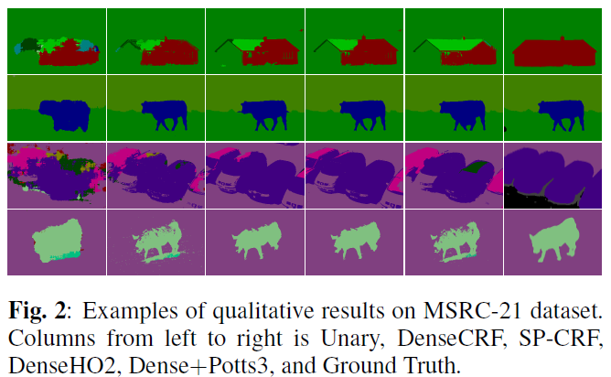
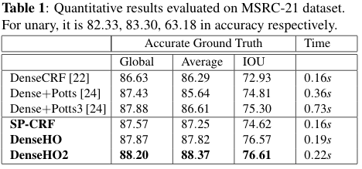
Experimental Results
Evaluation on DenseCRF
Notes:
Dense+Potts is the traditional higher order CRFs from Vinnet’s paper, Potts3 means it has three sets of segmentations. The lower part is our models. SP-CRF is the pairwise CRF which takes the segmented image as input other than the original image. DenseHO and DenseHO2 is sp-enhanced pairwise CRF, each has one and two sets of segmentations, respectively.
In our experiments conducted on MSRC dataset, DenseHO2
obtained 3.7% MeanIOU improvement with only 0.03s additional running time compared with DenseCRF, which reduced the error rate by nearly 14%. Even our simplest
model SP-CRF gained around 1.7% IOU accuracy boost, which demonstrates. This demonstrates the effectiveness and efficiency of our model.
On the right side shows the visual result comparison, by comparing the red and blue boxes, our method has better result might be due to our extra cross-segment level consistency

Slide 21
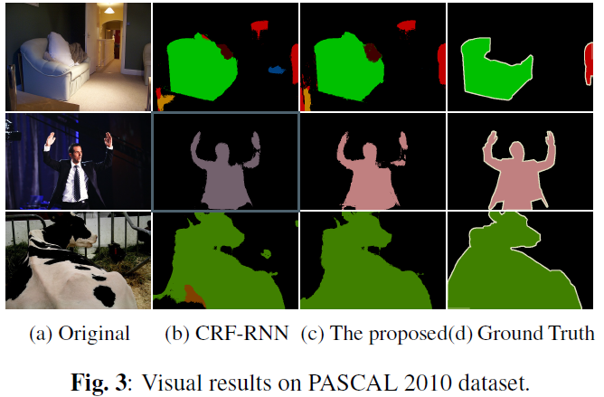
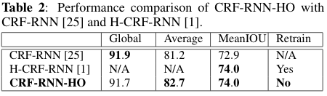
Experimental Results
Evaluation on CRF-RNN
Notes:
H-CRF-RNN is the conventional higher-order CRF from Arnab. Our proposed is CRF-RNN-HO.
We conducted simple grid search on a subset of training set in PASCAL VOC 2012 to obtain our parameters. The quantitative results shown in Table 2 indicate our method gains 1.5% higher accuracy in Average and 1.1% in MeanIOU compared with the baseline. Compared with H-CRF-RNN [1], we obtained equivalent performance boost. Importantly, our model achieved the accuracy improvement without a large amount of retraining on thousands of images that is required by H-CRF-RNN.

Slide 22
Overview
Introduction
Conditional Random Field
Conventional Higher-order Potentials
Inference and Learning
SP-enhanced CRFs
SP-pairwise Potential
Inference and Learning
Experimental Results
Conclusions

Slide 23
Conclusions
SP-enhanced pairwise CRF is the first of such pairwise CRFs to incorporate superpixel higher-order cues
Introduced the SP-Pairwise potentials for fully connected CRF family.
The proposed is easy to train, but yet effective and efficient
More possible applications: Instance Segmentation, Depth Estimation, Stereo and Optical Flow, Denoising etc.
Code is available here: https://github.com/liyin2015/superpixel_crfasrnn
Notes:
First, To our knowledge, SP-enhanced pairwise CRF is the first of such pairwise CRFs which is capable of incorporating superpixel-based cues in a pixel-by-pixel driven manner.
Second, we Introduced the SP-Pairwise potentials for fully connected CRF family.
The experimental results shows that our model is not only easier to train than corresponding higher-order CRFs but also improves the performance both in accuracy and speed.
The other possible applications: Instance Segmentation, Depth Estimation, Stereo and Optical Flow, Denoising etc.

Slide 24
Thank you!

