Slide 1
Malloc Just For Fun
Joshua Li

Slide 2
What is Malloc?
Gets some memory for you...(user space)
Come and go with Free...
I think it is only used a lot in C
Man malloc
It has two brothers, calloc and realloc

Slide 3
How does it work REALLY?
It works differently depending on which operating system malloc exists in.
Linux, malloc comes from glibc, named ptmalloc, which is a wrapper for sbrk/mmap syscall, man sbrk.
OpenBSD, malloc is in libc, BSDmalloc as a wrapper for mmap.
WINDOWS, malloc from msvcrt.dll runtime c library, using HeapAlloc.(googled)

Slide 4
What makes good malloc?
Portable, easy to migrate to other OS.
Faster, reduce time to manage.
Less space usage.
Configurable.
Reduce miss of cache(TLB)
Detect overflow/corrupted memory.
Consideration for different kinds of applications, from small program to large program.

Slide 5
Ptmalloc algorithms
Small requests(<= 64 bytes tunable), use cached pool of quicky recycled chunks.
In between(> 64 bytes tunable), use first-fit FIFO chunk list in BINs.
Large requests(>= 512 bytes tunable), use best-fit sorted chunk list in BINs.
Huge requests(>= 128KB tunable), mmap if can be used.

Slide 6
Ptmalloc internals - malloc_chunk
Struct malloc_chunk {
  size_t prev_size; /* size of previous chunk (if free) */
  size_t size; /* Size in bytes, including overhead */
  struct malloc_chunk* fd;
  struct malloc_chunk* bk;
};
With previous size, it is easy to coalesce nearby chunks.

Slide 7
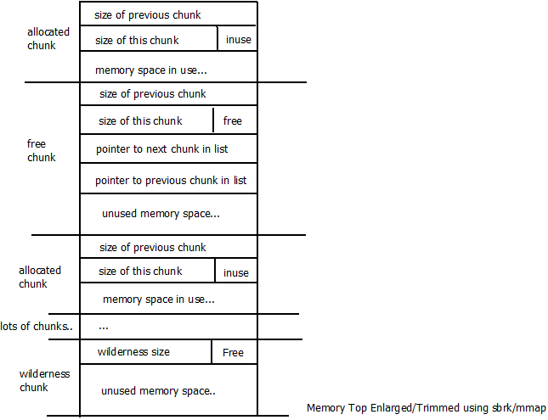
Ptmalloc internals - malloc_chunk

Slide 8
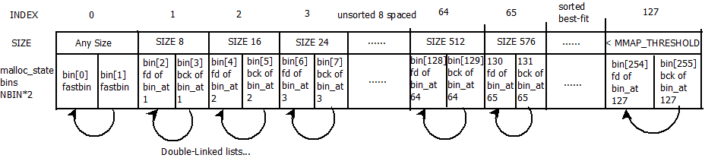
Ptmalloc internals - BINs
struct malloc_chunk* bins[NBINS * 2]; /* NBINS == 128 */
An array of bin heads for free chunks
Unsorted chunks(< 512 bytes), else sorted best-fit.

Slide 9
BINs algorithms
Bins with size < 512 bytes contain chunks with the same size.
Larger bins are logarithmically spaces.
BINs(number) | Interval
64 | 8
32 | 64
16 | 512
8 | 4096
4 | 32768
2 | 262144
1 | others

Slide 10
Ptmalloc internals – Top and Unsorted
Top Chunk
The mother of all other chunks, the border chunk, the main memory pool.
Unsorted Chunk
Freed Chunks (> fastbins size), are first put into unsorted chunk, then consolidated into BINs while mallocing.

Slide 11
Malloc flow
Malloc work flow

Slide 12
Questions for fun
What happens if...
malloc(0) -->>>>>
malloc(-1) -->>>>>
malloc(17) ----->>>>>
free(0) ---->>>>
free(p); free(p);

Slide 13
Why is malloc vulnerable?
Smallbin range corruption
Here it is:
bck = victim->bk;
bin->bk = bck;
bck->fd = bin;

Slide 14
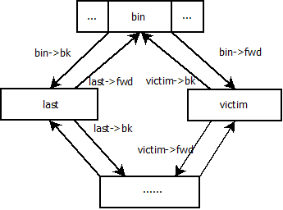
STEP I
Insert victim into smallbin[]

Slide 15
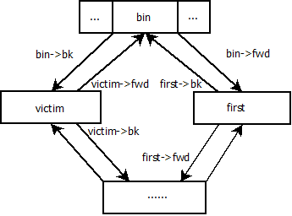
STEP II
After a few malloc calls, the other chunks are used.

Slide 16
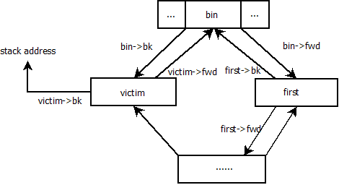
STEP III
Overwrite bk pointer of victim.

Slide 17
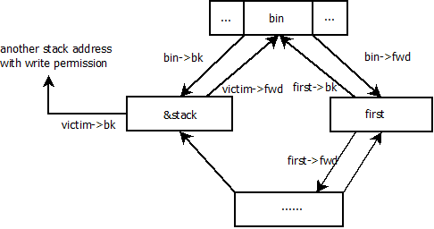
STEP IV
Last malloc the same size, here we are in wonder land.

Slide 18
Let's get real
光说不练，假把式。
光练不说，傻把式。
Trigger code.
Turn of ASLR
echo 0 > /proc/sys/kernel/ramdomize_va_space

Slide 19


