Slide 1
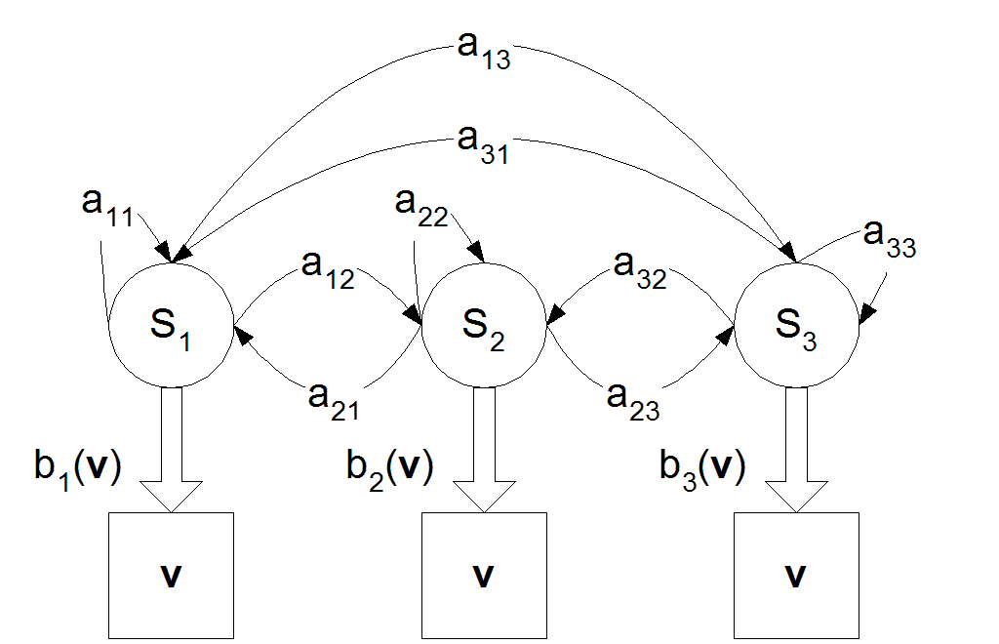
Introduction to Hidden Markov Model

Slide 2
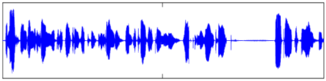

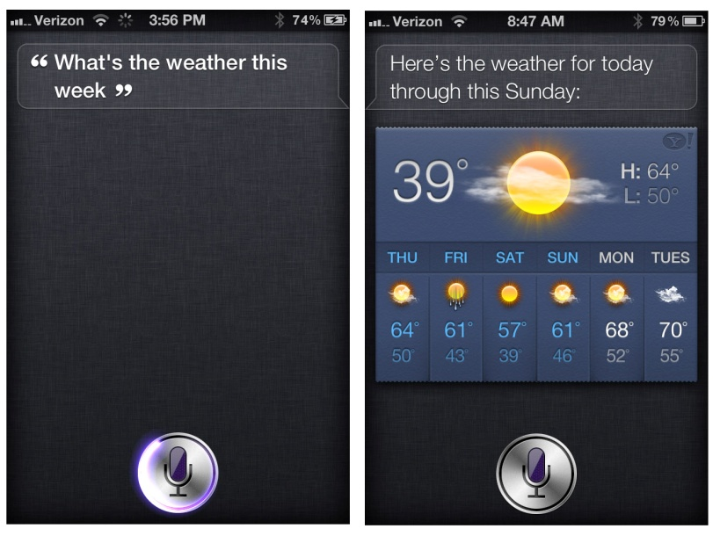

Speech Recognition
Given an audio waveform, to robustly extract & recognize any spoken words
Audio waveform
Iphone Siri
Spoken Words

Slide 3

Financial Forecasting
http://www.steadfastinvestor.com/
Predict future market behavior from historical data, news reports, expert opinions, …

Slide 4
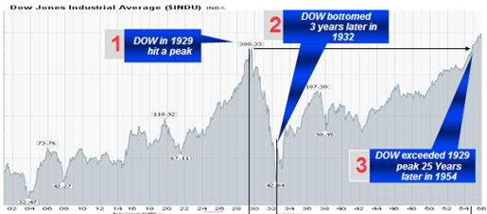
Sequential Applications
Target Tracking
Speech Recognition
Audio waveform
Spoken Words
Estimate motion of targets in 3D world from indirect, potentially noisy measurements
Financial Forecasting
Biological Sequence Analysis
Predict future market behavior from historical data, news reports, expert opinions, …
Exploit more general forms of sequential structure in DNA sequences

Slide 5
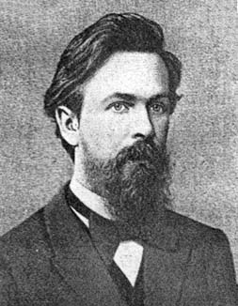
Hidden Markov Model
Hidden Markov Model
Andrei Andreyevich
Markov
Born: 14 June 1856 in Ryazan, Russia Died: 20 July 1922 in Petrograd (now St Petersburg), Russia
Markov is particularly remembered for his study of Markov chains, sequences of random variables in which the future variable is determined by the present variable but is independent of the way in which the present state arose from its predecessors. This work launched the theory of stochastic processes.

Slide 6
Outlines
Markov Chain
Hidden Markov Model
Decoding Problem
Viterbi Algorithm
Conclusion and Future Discussion

Slide 7
Markov Chain
Rainy
N states: {s₁, s₂ .. ., s_{N} }
Timestamps: t=0, t=1, …
The state at time t: q_{t} (q_{t} ∈{s₁, s₂ .. s_{N} })
s₂
Sunny
Cloudy
s₁
s₃

Slide 8
Markov Chain
Rainy
N states: {s₁, s₂ .. ., s_{N} }
Timestamps: t=0, t=1, …
The state at time t: q_{t} (q_{t} ∈{s₁, s₂ .. s_{N} })
s₂
t=0
q₀=s₃
Sunny
Cloudy
s₁
s₃
cloudy
s₃
q₀
t=0
yesterday

Slide 9
Markov Chain
t=1
q₁=s₂
Rainy
N states: {s₁, s₂ .. ., s_{N} }
Timestamps: t=0, t=1, …
The state at time t: q_{t} (q_{t} ∈{s₁, s₂ .. s_{N} })
s₂
Sunny
Cloudy
s₁
s₃
cloudy
rainy
s₃
s₂
q₀
q₁
t=0
t=1
yesterday
today

Slide 10
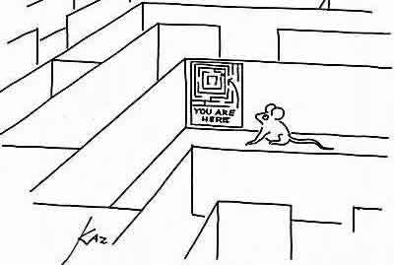
Markov Chain
Rainy
N states: {s₁, s₂ .. ., s_{N} }
Timestamps: t=0, t=1, …
The state at time t: q_{t} (q_{t} ∈{s₁, s₂ .. s_{N} })
The next state is only dependent on the current state.
s₂
Sunny
Cloudy
P(q₂ | q₁=s_{2,} q₀=s₃)= P(q₂ | q₁=s₂)
s₁
s₃
cloudy
rainy
?
s₃
s₂
q₀
q₁
q₂
t=0
t=1
t=2
yesterday
today
tomorrow
P(q₂ | q₁=s_{2,} q₀=s₃)=?

Slide 11
Markov Chain
P(q_{t+1}=s₁|q_{t}=s₂) = 1/2
P(q_{t+1}=s₂|q_{t}=s₂) = 1/2
P(q_{t+1}=s₃|q_{t}=s₂) = 0
N states: {s₁, s₂ .. ., s_{N} }
Timestamps: t=0, t=1, …
The state at time t: q_{t} (q_{t} ∈{s₁, s₂ .. s_{N} })
The next state is only dependent on the current state.
Rainy
P(q_{t+1}=s₁|q_{t}=s₁) = 0
P(q_{t+1}=s₂|q_{t}=s₁) = 0
P(q_{t+1}=s₃|q_{t}=s₁) = 1
s₂
1/2
P(q₂ | q₁=s_{2,} q₀=s₃)= P(q₂ | q₁=s₂)
Sunny
1/2
2/3
Transition probabilities:
a_{ij} ≡ P(q_{t+1}=S_{j} | q_{t}=S_{i})
a₃₁ =1/3, a₃₂ =2/3 , a₃₃ =0
Transition Matrix:
Cloudy
s₁
s₃
1/3
1
P(q_{t+1}=s₁|q_{t}=s₃) = 1/3
P(q_{t+1}=s₂|q_{t}=s₃) = 2/3
P(q_{t+1}=s₃|q_{t}=s₃) = 0

Slide 12
Discrete Markov Process
1, 2, …, N
1, 2, …, N
1, 2, …, N
1, 2, …, N
q₀
q₁
q₂
q₃
…
t₀
t₁
t₂
t₃
…
N states: S₁, S₂, ..., S_{N} State at “time” t, q_{t} = S_{i}
Markov Property
P(q_{t+1}=S_{j} | q_{t}=S_{i}, q_{t-1}=S_{k} ,...) = P(q_{t+1}=S_{j} | q_{t}=S_{i})
Transition probabilities
a_{ij} ≡ P(q_{t+1}=S_{j} | q_{t}=S_{i}) a_{ij} ≥ 0 and Σ_{j=1}^{N} a_{ij}=1
Initial probabilities
π_{i} ≡ P(q₀=S_{i}) Σ_{j=1}^{N} π_{i}=1

Slide 13
Sequential Process VS Markov Process
Consider a system which can occupy one of N discrete states or categories q_{t} ∈{s₁, s₂ .. s_{N} }
state at time t
Sequential Process
Markov Process
In the stochastic systems, the state evolution is random
For a Markov process, the next state depends only on the current state:
1, 2, …, N
1, 2, …, N
1, 2, …, N
1, 2, …, N
1, 2, …, N
1, 2, …, N
1, 2, …, N
1, 2, …, N
q₀
q₁
q₂
q₃
…
q₀
q₁
q₂
q₃
…
t₀
t₁
t₂
t₃
…
t₀
t₁
t₂
t₃
…
Any joint distribution can be factored into a series of conditional distributions:

Slide 14



Example of Markov Process
0.6
S₂
0.3
0.2
0.2
0.1
Weather Prediction
S₁: Sunny, S₂: Cloudy, S₃: Rainy
S₁
0.1
S₃
0.8
0.4
0.3
?

Slide 15
From Markov To Hidden Markov
The previous model assumes that each state can be uniquely associated with an observable event.
t=0
t=1
t=2
t=3
q₀
q₁
q₂
q₃
…
s₃
s₂
s₁
s₂
Hidden Markov Model: the state sequence is not directly observable, it can only be approximated from the sequence of observations produced by the system.
t=0
t=1
t=2
t=3
q₀
q₁
q₂
q₃
…
Hidden States
O₀
O₁
O₂
O₃
Observed States

Slide 16
Outlines
Markov Chain
Hidden Markov Model
Decoding Problem
Viterbi Algorithm
Conclusion and Future Discussion

Slide 17





Hidden Markov Model
the state sequence is not directly observable, it can only be approximated from the sequence of observations produced by the system.
atmosphere
pressure
t=0
t=1
t=2
t=3
q₀
q₁
q₂
q₃
…
Hidden States
O₀
O₁
O₂
O₃
Observed States
N “hidden” States, {S₁, S₂,… S_{N}} { }
M “Visible” States, {V₁, V₂,… V_{M}} { }
Sequence of hidden states Q ={q₁, q₂,…}
Sequence of observations O={O₁, O₂, …}

Slide 18
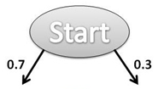



Hidden Markov Model
Π = [π_{i}]: N by 1 initial state probability vector
Hidden States
(atmosphere
pressure)
N: Number of states (N=2)
S₁
S₂
A = [a_{ij}]: N by N state transition probability matrix
B = b_{j}(V): N by M observation probability matrix
Observed States
(weather)
M: Number of observation symbols
(M=3)
V₁
V₂
V₃
λ = (A, B, Π), parameter set of HMM

Slide 19
Definition of Hidden Markov Model
N “hidden” States, {S₁, S₂,… S_{N}}
M “Visible” States, {V₁, V₂,… V_{M}}
Sequence of hidden states Q ={q₁, q₂,…}
Sequence of observations O={O₁, O₂, …}
Parameter set of HMM: λ = (A, B, Π)
Π = [π_{i}]: N by 1 initial state probability vector
A = [a_{ij}]: N by N state transition probability matrix
B = b_{j}(V): N by M observation probability matrix

Slide 20
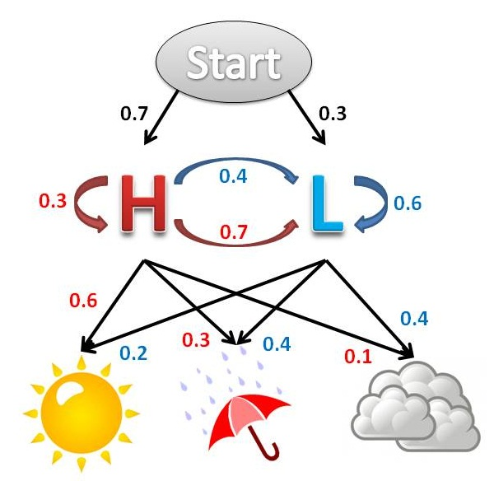
What can we do with HMM?
λ = (A, B, Π), parameter set of HMM
Sequence of hidden states
Q ={q₁, q₂,…}
Sequence of observations
O={O₁, O₂, …}
Decoding:
Given λ, and O,
find Q* such that
P (Q* | O, λ ) = max_{Q} P (Q | O , λ )
Evaluation:
Given λ, and O,
calculate P (O | λ)?
Learning:
Given X={O^{k}}_{k}, find λ* such that
P ( X | λ* )=max_{λ} P ( X | λ )

Slide 21
Outlines
Markov Chain
Hidden Markov Model
Decoding Problem
Viterbi Algorithm
Conclusion and Future Discussion

Slide 22
Decoding Problem
Given the HMM λ =(A, B, π) and the observation sequence O=o₁ o₂ ... o_{K} , calculate the most likely sequence Q* of hidden states s_{i} that produced this observation sequence O.
P (Q* | O, λ ) = max_{Q} P (Q | O , λ )
Start
Given observation sequence O={ }
What is the most likely sequence of and ?
0.6
0.4
0.7
S₁
S₂
Possible paths:
0.3
0.8
?
0.2
0.6
0.6
?
0.4
0.4
?
V₁
V₂
?
…

Slide 23
Brute-force Algorithm (Enumerate Sequences)
Given observation sequence O={ }
What is the most likely sequence of and ?
Start
0.6
0.4
0.7
8 possible paths
P (Q , O | λ )
S₁
S₂
0.3
0.8
0.6 * 0.6 * 0.3 * 0.4 * 0.7 * 0.4
0.2
0.6 * 0.6 * 0.3 * 0.4 * 0.3 * 0.6
0.6
0.6
0.4
0.4
0.6 * 0.6 * 0.7 * 0.6 * 0.8 * 0.4
V₁
V₂
0.6 * 0.6 * 0.7 * 0.6 * 0.2 * 0.6
0.4 * 0.4 * 0.2 * 0.4 * 0.3 * 0.6
P (Q* | O, λ ) = max_{Q} P (Q | O , λ )
max_{Q} P (Q , O |λ )
0.4 * 0.4 * 0.2 * 0.4 * 0.7 * 0.4
0.4 * 0.4 * 0.8 * 0.6 * 0.8* 0.4
Q ={ }
O={ }
0.4 * 0.4 * 0.8 * 0.6 * 0.2* 0.6
P (Q , O | λ ) ???
Q* ={ }
=
π(H) P( |H) P(H→H) P( |H) P(H→L) P( |L)
Exponential!!!
=
0.6 * 0.6 * 0.3 * 0.4 * 0.7 * 0.4

Slide 24
Outlines
Markov Chain
Hidden Markov Model
Decoding Problem
Viterbi Algorithm
Conclusion and Future Discussion

Slide 25
Viterbi Algorithm (dynamic programming)
Define variable δ_{k}(i) as the maximum probability of producing observation sequence o₁ o₂ ... o_{k} when moving along any hidden state sequence q₁… q_{k-1} and getting into q_{k}= s_{i} .
δ_{k}(i) = max P(q₁… q_{k-1} , q_{k}= s_{i} , o₁ o₂ ... o_{k})
where max is taken over all possible paths q₁… q_{k-1} .
…
O₁
O₂
O_{k-1}
O_{k}
...
q₁ q₂ q_{k-1} q_{k}
s₁
a_{1j}
s_{i}
s_{j}
a_{ij}
s_{N}
a_{Nj}

Slide 26
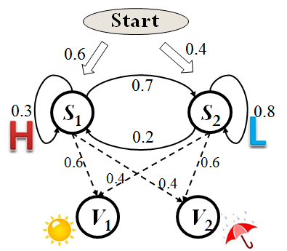
Viterbi Algorithm (dynamic programming)
δ_{k}(i) = max P(q₁… q_{k-1} , q_{k}= s_{i} , o₁ o₂ ... o_{k})
δ₁(i) = max P(q₁= s_{i} , o₁)
= P(q₁= s_{i} )P(o₁ |q₁= s_{i} )
= π_{i} b_{i} (o₁)
Suppose that we already have δ_{k}(i)
for all the hidden states,
How to generate δ_{k+1}(j) ?
δ_{k}(i)
δ_{k+1}(j)
…
O₁
O₂
O_{k}
O_{k+1}
...
q₁ q₂ q_{k} q_{k+1}
s₁
?
s_{i}
s_{j}
O={ }
δ₁(s₁) = 0.6*0.6=0.36
δ₁(s₂) = 0.4*0.4=0.16
s_{N}

Slide 27
Viterbi Algorithm
...
q₁ q₂ q_{k} q_{k+1}
k=1, δ₁(i) = π_{i} b_{i} (o₁)
s₁
a_{1j}
k→k+1,
δ_{k}(i)
δ_{k+1}(j)
?
s_{i}
s_{j}
a_{ij}
δ_{k+1}(j) = max P(q₁… q_{k} , q_{k+1}= s_{j} , o₁ o₂ ... O_{k+1})
= max_{i} P(q₁… q_{k} = s_{j} , q_{k+1}= s_{j} , o₁ o₂ ... o_{k} O_{k+1})
= max_{i} P(q₁… q_{k} = s_{j}, o₁ o₂ ... o_{k}) .
P(q_{k+1}= s_{j} , O_{k+1} | q₁… q_{k} = s_{j}, o₁ o₂ ... o_{k})
= max_{i} P(q₁… q_{k} = s_{j}, o₁ o₂ ... o_{k}) P(q_{k+1}= s_{j} , O_{k+1} | q_{k} = s_{j})
s_{N}
a_{Nj}
max P(q₁…q_{k-1}= s_{i} , o₁ o₂ ... o_{k-1})
P(q_{k+1}= s_{j} | q_{k} = s_{j}) P(O_{k+1} | q_{k+1} = s_{i})
δ_{k}(i)
a_{ij} b_{j} (o_{k} )
δ_{k+1}(j) = max_{i} [ a_{ij} b_{j} (o_{k} ) δ_{k}(i) ]

Slide 28
Viterbi Algorithm
Initialization:
δ₁(i) = max P(q₁= s_{i} , o₁) = π_{i} b_{i} (o₁) , 1<=i<=N.
Forward recursion:
δ_{k}(j) = max P(q₁… q_{k-1} , q_{k}= s_{j} , o₁ o₂ ... o_{k})
= max_{i} [a_{ij} b_{j} (o_{k} ) max P(q₁…q_{k-1}= s_{i} , o₁ o₂ ... o_{k-1})]
= max_{i} [ a_{ij} b_{j} (o_{k} ) δ_{k-1}(i) ] , 1<=j<=N, 2<=k<=K.
Termination: choose best path ending at time K
max_{i} [ δ_{K}(i) ]
Backtrack best path.
q₁ q₂ q_{k} q_{k+1}
s₁
a_{1j}
s_{i}
s_{j}
a_{ij}
s_{N}
a_{Nj}

Slide 29
Example of Viterbi Algorithm
Start
Initial Prob: π( s₁)=0.6, π( s₂)=0.4
Transition Prob: a₁₁ =0.3, a₁₂ =0.7, a₂₁ =0.2, a₂₂ =0.8
Observation Prob: b₁ (v₁ )=0.6, b₁ (v₂ )=0.4, b₂ (v₁ )=0.4, b₂ (v₂)=0.6
0.6
0.4
0.7
δ₁(s₁)
= π(s₁) b₁ (v₁ )
=0.6*0.6
=0.36
δ₂(s₁)
=Max[a₁₁ b₁ (v₂ ) δ₁(s₁),
a₂₁ b₁ (v₂ ) δ₁(s₂) ]
=Max[0.0432,0.0128]
=0.0432
δ₃(s₁)
=Max[a₁₁ b₁ (v₁ ) δ₂(s₁),
a₂₁ b₁ (v₁ ) δ₂(s₂) ]
=Max[0.007776,0.018144]
=0.018144
0.3
S₁
S₂
0.8
0.2
0.6
0.6
δ₁(s₂)
= π(s₂) b₂ (v₁ )
=0.4*0.4
=0.16
δ₂(s₂)
=Max[a₁₂ b₂ (v₂ ) δ₁(s₁),
a₂₂ b₂ (v₂ ) δ₁(s₂) ]
=Max[0.1512,0.0768]
=0.1512
δ₃(s₂)
=Max[a₁₂ b₂ (v₁ ) δ₂(s₁),
a₂₂ b₂ (v₁ ) δ₂(s₂) ]
=Max[0.012096,0.048384]
=0.048384
0.4
0.4
V₁
V₂
V₁
V₂
V₁
δ_{k}(s₁)
δ₁(s₁)
0.36
Prevnone
δ₂(s₁)
0.0432
Prev
s₁
δ₃(s₁)
0.018144
Prev
s₂
δ₁(s₁)
δ₂(s₁)
δ₁(s₂)
0.16
Prev
none
δ₂(s₂)
0.1512
Prev
s₁
δ₃(s₂)
0.048384
Prev
s₂
δ_{k}(s₂)
δ₁(s₂)
δ₂(s₂)
Q* ={ }
s₁
s₂
s₂

Slide 30
Time and Space Complexity
o₁ o₂ o₃ ………………………………………..o_{K}
State 1
State 2
δ_{k}(j)
State N
Time:
O(KN²) (N= |S|)
Space:
O(KN)

Slide 31
Outlines
Markov Chain
Hidden Markov Model
Decoding Problem
Viterbi Algorithm
Conclusion and Future Discussion

Slide 32
Conclusion and Future Discussion
Markov Chain
Markov property: Next state is only dependent the current state.
P(q_{t+1}=S_{j} | q_{t}=S_{i}, q_{t-1}=S_{k} ,...) = P(q_{t+1}=S_{j} | q_{t}=S_{i})
Hidden Markov Model
state sequence is not directly observable
can only be approximated from the sequence of observations
Decoding Problem
P (Q* | O, λ ) = max_{Q} P (Q | O , λ )
Viterbi Algorithm
Dynamic Programming

