Slide 1
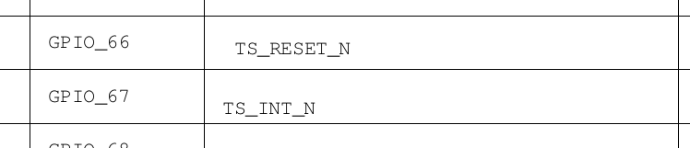

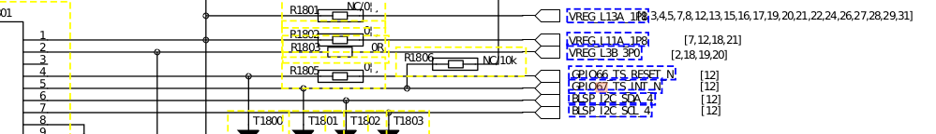

基于Qualcomm SDM660 TP的分析
1.原理图分析(硬件连接)
中断引脚
复位引脚
通信引脚

Slide 2
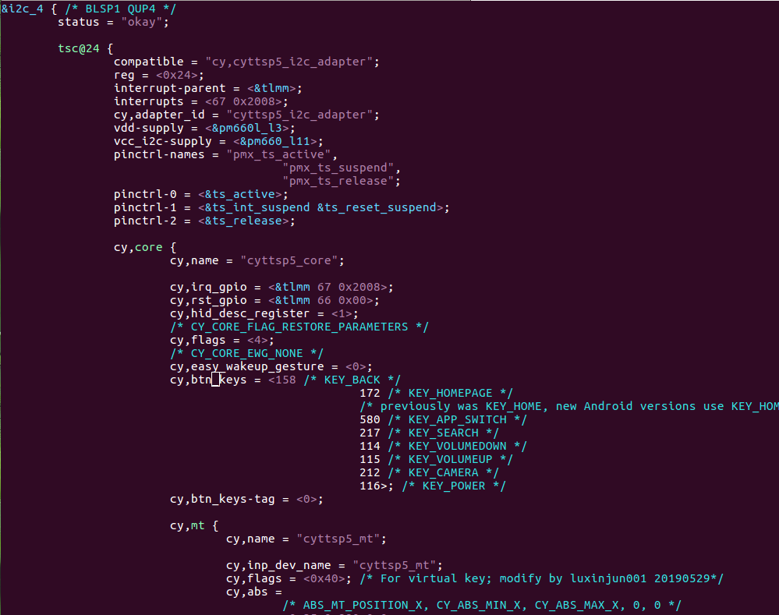
2.对应的dts文件
LA.UM.7.2.r1/kernel/msm-4.4/arch/arm64/boot/dts/qcom/sdm660-mtp.dtsi
中断引脚
复位引脚
通信引脚
cy,core
cy,mt
多点触摸节点
cy,btn
按键节点
cy,proximity
接近物体节点

Slide 3
3.驱动代码分析
3.1初始化代码
static const struct of_device_id cyttsp5_i2c_of_match[] = {
{ .compatible = "cy,cyttsp5_i2c_adapter", },
{ }
};
static struct i2c_driver cyttsp5_i2c_driver = {
.driver = {
.name = CYTTSP5_I2C_NAME,
.owner = THIS_MODULE,
.pm = &cyttsp5_pm_ops,
#ifdef CONFIG_TOUCHSCREEN_CYPRESS_CYTTSP5_DEVICETREE_SUPPORT
.of_match_table = cyttsp5_i2c_of_match,
#endif
},
.probe = cyttsp5_i2c_probe,
.remove = cyttsp5_i2c_remove,
.id_table = cyttsp5_i2c_id,
};
static int __init cyttsp5_i2c_init(void)
{
int rc = i2c_add_driver(&cyttsp5_i2c_driver);
pr_info("%s: Parade TTSP I2C Driver (Built %s) rc=%d\n",
__func__, CY_DRIVER_VERSION, rc);
return rc;
}
module_init(cyttsp5_i2c_init);
static void __exit cyttsp5_i2c_exit(void)
{
i2c_del_driver(&cyttsp5_i2c_driver);
}
module_exit(cyttsp5_i2c_exit);

Slide 4
3.2probe分析
/* Set default values on first probe */
if (cyttsp5_first_probe) {
cyttsp5_first_probe = false;
is_cyttsp5_probe_success = false;
cyttsp5_bus_ops_save = NULL;
}
if (!pdata || !pdata->core_pdata || !pdata->mt_pdata) {
dev_err(dev, "%s: Missing platform data\n", __func__);
rc = -ENODEV;
goto error_no_pdata;
}
if (pdata->core_pdata->flags & CY_CORE_FLAG_POWEROFF_ON_SLEEP) {
if (!pdata->core_pdata->power) {
dev_err(dev, "%s: Missing platform data function\n",
__func__);
rc = -ENODEV;
goto error_no_pdata;
}
}
cyttsp5_i2c_probe()
调用
cyttsp5_probe()

Slide 5
/* get context and debug print buffers */
cd = kzalloc(sizeof(*cd), GFP_KERNEL);
if (!cd) {
rc = -ENOMEM;
goto error_alloc_data;
}
/* Initialize device info */
cd->dev = dev;
cd->pdata = pdata;
cd->cpdata = pdata->core_pdata;
cd->bus_ops = ops;
cd->debug_level = CY_INITIAL_DEBUG_LEVEL;
cd->watchdog_interval = CY_WATCHDOG_TIMEOUT;
cd->show_timestamp = CY_INITIAL_SHOW_TIME_STAMP;
scnprintf(cd->core_id, 20, "%s%d", CYTTSP5_CORE_NAME, core_number++);
/* Initialize mutexes and spinlocks */
mutex_init(&cd->module_list_lock);
mutex_init(&cd->system_lock);
mutex_init(&cd->adap_lock);
mutex_init(&cd->hid_report_lock);
spin_lock_init(&cd->spinlock);

Slide 6
/* Initialize module list */
INIT_LIST_HEAD(&cd->module_list);
/* Initialize attention lists */
for (type = 0; type < CY_ATTEN_NUM_ATTEN; type++)
INIT_LIST_HEAD(&cd->atten_list[type]);
/* Initialize parameter list */
INIT_LIST_HEAD(&cd->param_list);
/* Initialize wait queue */
init_waitqueue_head(&cd->wait_q);
/* Initialize works */
INIT_WORK(&cd->startup_work, cyttsp5_startup_work_function);
INIT_WORK(&cd->watchdog_work, cyttsp5_watchdog_work);
/* Initialize HID specific data */
cd->hid_core.hid_vendor_id = (cd->cpdata->vendor_id) ?
cd->cpdata->vendor_id : CY_HID_VENDOR_ID;
cd->hid_core.hid_product_id = (cd->cpdata->product_id) ?
cd->cpdata->product_id : CY_HID_APP_PRODUCT_ID;
cd->hid_core.hid_desc_register =
cpu_to_le16(cd->cpdata->hid_desc_register);
/* Set platform easywake value */
cd->easy_wakeup_gesture = cd->cpdata->easy_wakeup_gesture;

Slide 7
pm_runtime_get_noresume(dev);
pm_runtime_set_active(dev);
pm_runtime_enable(dev);
/*
* call startup directly to ensure that the device
* is tested before leaving the probe
*/
dev_dbg(dev, "%s: call startup\n", __func__);
rc = cyttsp5_startup(cd, false);
pm_runtime_put_sync(dev);
rc = cyttsp5_mt_probe(dev);
if (rc < 0) {
dev_err(dev, "%s: Error, fail mt probe\n", __func__);
goto error_startup;
}
rc = cyttsp5_btn_probe(dev);
if (rc < 0) {
dev_err(dev, "%s: Error, fail btn probe\n", __func__);
goto error_startup_mt;
}
rc = cyttsp5_proximity_probe(dev);
if (rc < 0) {
dev_err(dev, "%s: Error, fail proximity probe\n", __func__);
goto error_startup_btn;
}

Slide 8
3.3数据上报分析
cyttsp5_probe()
static int cyttsp5_setup_irq_gpio(struct cyttsp5_core_data *cd)
{
struct device *dev = cd->dev;
unsigned long irq_flags;
int rc;
/* Initialize IRQ */
cd->irq = gpio_to_irq(cd->cpdata->irq_gpio);
if (cd->irq < 0)
return -EINVAL;
cd->irq_enabled = true;
if (cd->cpdata->level_irq_udelay > 0)
/* use level triggered interrupts */
irq_flags = IRQF_TRIGGER_LOW | IRQF_ONESHOT;
else
/* use edge triggered interrupts */
irq_flags = IRQF_TRIGGER_FALLING | IRQF_ONESHOT;
rc = request_threaded_irq(cd->irq, NULL, cyttsp5_irq, irq_flags,
dev_name(dev), cd);
return rc;
}
cyttsp5_setup_irq_gpio()
gpio_to_irq()
request_threaded_irq()
注册了中断处理函数，这就是重点了。当tp产生触摸操作时产生中断，在中断处理函数中去获取按压位置，再通过input_report_abs上报到/dev/input/eventX节点上以供上层使用。

Slide 9
3.4创建接口
static struct device_attribute attributes[] = {
__ATTR(drv_irq, S_IRUSR | S_IWUSR, cyttsp5_drv_irq_show,
cyttsp5_drv_irq_store),
__ATTR(drv_debug, S_IWUSR, NULL, cyttsp5_drv_debug_store),
__ATTR(sleep_status, S_IRUSR, cyttsp5_sleep_status_show, NULL),
__ATTR(easy_wakeup_gesture, S_IRUSR | S_IWUSR,
cyttsp5_easy_wakeup_gesture_show,
cyttsp5_easy_wakeup_gesture_store),
};
static int add_sysfs_interfaces(struct device *dev)
{
int i;
for (i = 0; i < ARRAY_SIZE(attributes); i++)
if (device_create_file(dev, attributes + i))
goto undo;
return 0;
undo:
for (i--; i >= 0; i--)
device_remove_file(dev, attributes + i);
dev_err(dev, "%s: failed to create sysfs interface\n", __func__);
return -ENODEV;
}
cyttsp5_probe
add_sysfs_interfaces(dev)
device_create_file()单个接口节点的创建
区别:sysfs_create_group()多个接口节点的创建

Slide 10
/*
* Show IRQ enable/disable status via sysfs
*/
static ssize_t cyttsp5_drv_irq_show(struct device *dev,
struct device_attribute *attr, char *buf)
{
struct cyttsp5_core_data *cd = dev_get_drvdata(dev);
ssize_t ret;
mutex_lock(&cd->system_lock);
if (cd->irq_enabled)
ret = snprintf(buf, CY_MAX_PRBUF_SIZE,
"Driver interrupt is ENABLED\n");
else
ret = snprintf(buf, CY_MAX_PRBUF_SIZE,
"Driver interrupt is DISABLED\n");
mutex_unlock(&cd->system_lock);
return ret;
}
对应cat,打印当前TP状态

Slide 11
/*
* Enable/disable IRQ via sysfs
static ssize_t cyttsp5_drv_irq_store(struct device *dev,
struct device_attribute *attr, const char *buf, size_t size)
{
struct cyttsp5_core_data *cd = dev_get_drvdata(dev);
switch (value) {
case 0:
if (cd->irq_enabled) {
cd->irq_enabled = false;
/* Disable IRQ */
disable_irq_nosync(cd->irq);
dev_info(dev, "%s: Driver IRQ now disabled\n",
__func__);
} else
dev_info(dev, "%s: Driver IRQ already disabled\n",
__func__);
break;
case 1:
if (cd->irq_enabled == false) {
cd->irq_enabled = true;
/* Enable IRQ */
enable_irq(cd->irq);
dev_info(dev, "%s: Driver IRQ now enabled\n",
__func__);
} else
dev_info(dev, "%s: Driver IRQ already enabled\n",
__func__);
break;
default:
dev_err(dev, "%s: Invalid value\n", __func__);
}
}
对应echo,实现时,要判断TP当前状态

Slide 12
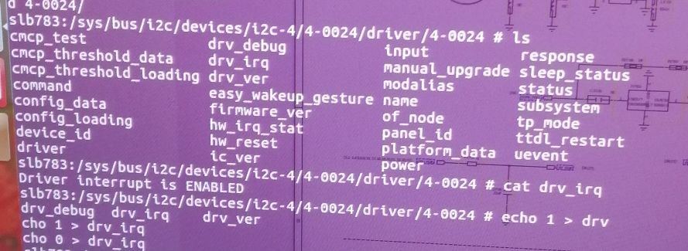
实验效果
挂载在i2c4上,设备树的节点对应
后面是分配的设备号
创建的节点名
控制

Slide 13
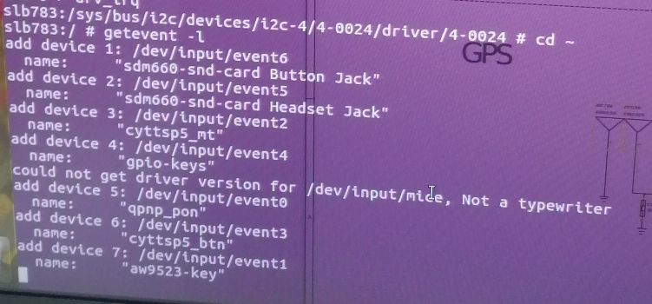
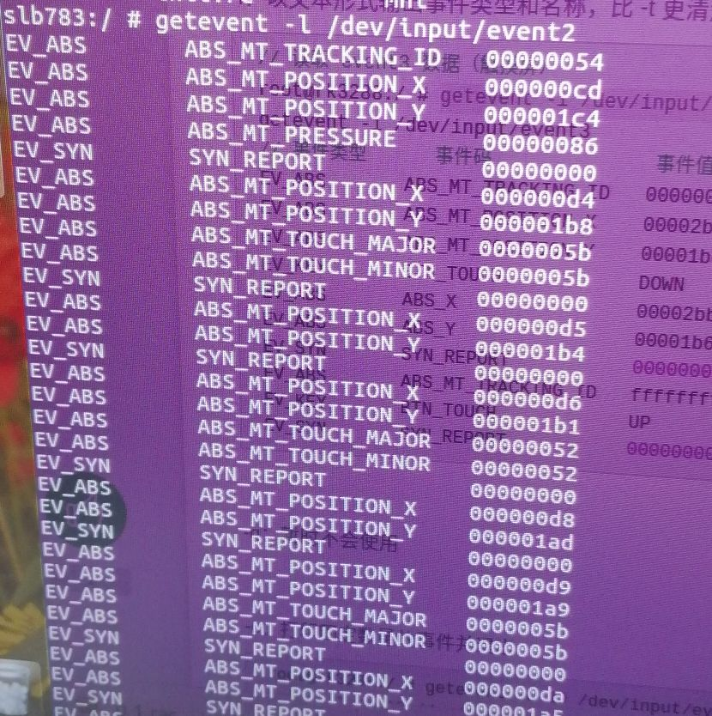
3.5如何查找注册的TP设备
getevent -l显示注册在input下面的设备
然后就可以找到对应的设备
显示报点的数据

