Slide 1
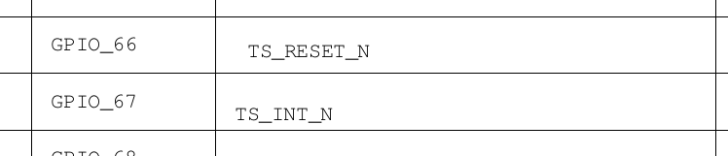

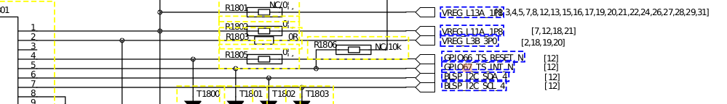

基于Qualcomm SDM660 TP的分析
1.原理图分析(硬件连接)
中断引脚
复位引脚
通信引脚

Slide 2
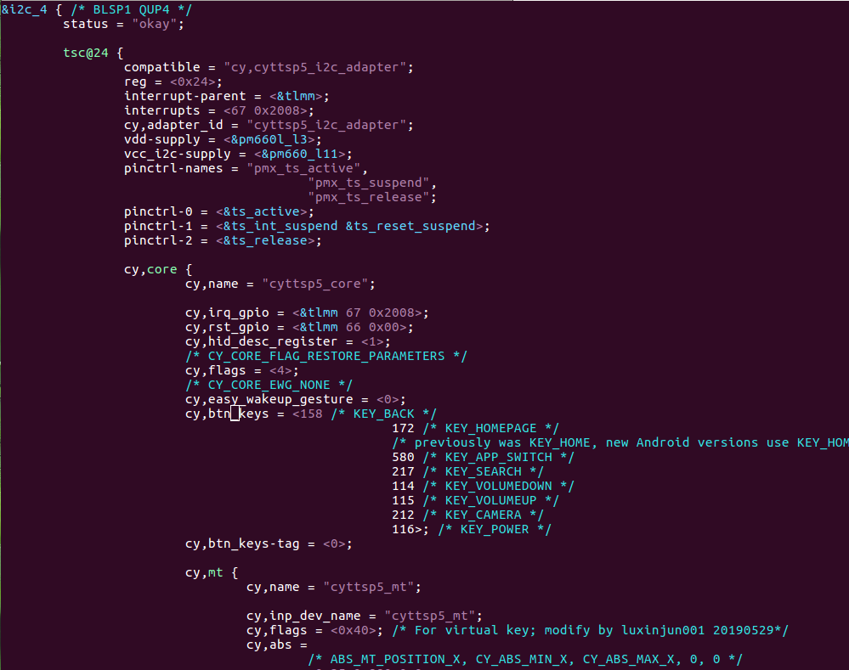
2.对应的dts文件
LA.UM.7.2.r1/kernel/msm-4.4/arch/arm64/boot/dts/qcom/sdm660-mtp.dtsi
中断引脚
复位引脚
通信引脚
cy,core
cy,mt
多点触摸节点
cy,btn
按键节点
cy,proximity
接近物体节点

Slide 3
3.驱动代码分析
3.1初始化代码
static const struct of_device_id cyttsp5_i2c_of_match[] = {
{ .compatible = "cy,cyttsp5_i2c_adapter", },
{ }
};
static struct i2c_driver cyttsp5_i2c_driver = {
.driver = {
.name = CYTTSP5_I2C_NAME,
.owner = THIS_MODULE,
.pm = &cyttsp5_pm_ops,
#ifdef CONFIG_TOUCHSCREEN_CYPRESS_CYTTSP5_DEVICETREE_SUPPORT
.of_match_table = cyttsp5_i2c_of_match,
#endif
},
.probe = cyttsp5_i2c_probe,
.remove = cyttsp5_i2c_remove,
.id_table = cyttsp5_i2c_id,
};
static int __init cyttsp5_i2c_init(void)
{
int rc = i2c_add_driver(&cyttsp5_i2c_driver);
pr_info("%s: Parade TTSP I2C Driver (Built %s) rc=%d\n",
__func__, CY_DRIVER_VERSION, rc);
return rc;
}
module_init(cyttsp5_i2c_init);
static void __exit cyttsp5_i2c_exit(void)
{
i2c_del_driver(&cyttsp5_i2c_driver);
}
module_exit(cyttsp5_i2c_exit);

Slide 4
3.2probe分析
/* Set default values on first probe */
if (cyttsp5_first_probe) {
cyttsp5_first_probe = false;
is_cyttsp5_probe_success = false;
cyttsp5_bus_ops_save = NULL;
}
if (!pdata || !pdata->core_pdata || !pdata->mt_pdata) {
dev_err(dev, "%s: Missing platform data\n", __func__);
rc = -ENODEV;
goto error_no_pdata;
}
if (pdata->core_pdata->flags & CY_CORE_FLAG_POWEROFF_ON_SLEEP) {
if (!pdata->core_pdata->power) {
dev_err(dev, "%s: Missing platform data function\n",
__func__);
rc = -ENODEV;
goto error_no_pdata;
}
}
cyttsp5_i2c_probe()
调用
cyttsp5_probe()

Slide 5
/* get context and debug print buffers */
cd = kzalloc(sizeof(*cd), GFP_KERNEL);
if (!cd) {
rc = -ENOMEM;
goto error_alloc_data;
}
/* Initialize device info */
cd->dev = dev;
cd->pdata = pdata;
cd->cpdata = pdata->core_pdata;
cd->bus_ops = ops;
cd->debug_level = CY_INITIAL_DEBUG_LEVEL;
cd->watchdog_interval = CY_WATCHDOG_TIMEOUT;
cd->show_timestamp = CY_INITIAL_SHOW_TIME_STAMP;
scnprintf(cd->core_id, 20, "%s%d", CYTTSP5_CORE_NAME, core_number++);
/* Initialize mutexes and spinlocks */
mutex_init(&cd->module_list_lock);
mutex_init(&cd->system_lock);
mutex_init(&cd->adap_lock);
mutex_init(&cd->hid_report_lock);
spin_lock_init(&cd->spinlock);

Slide 6
/* Initialize module list */
INIT_LIST_HEAD(&cd->module_list);
/* Initialize attention lists */
for (type = 0; type < CY_ATTEN_NUM_ATTEN; type++)
INIT_LIST_HEAD(&cd->atten_list[type]);
/* Initialize parameter list */
INIT_LIST_HEAD(&cd->param_list);
/* Initialize wait queue */
init_waitqueue_head(&cd->wait_q);
/* Initialize works */
INIT_WORK(&cd->startup_work, cyttsp5_startup_work_function);
INIT_WORK(&cd->watchdog_work, cyttsp5_watchdog_work);
/* Initialize HID specific data */
cd->hid_core.hid_vendor_id = (cd->cpdata->vendor_id) ?
cd->cpdata->vendor_id : CY_HID_VENDOR_ID;
cd->hid_core.hid_product_id = (cd->cpdata->product_id) ?
cd->cpdata->product_id : CY_HID_APP_PRODUCT_ID;
cd->hid_core.hid_desc_register =
cpu_to_le16(cd->cpdata->hid_desc_register);
/* Set platform easywake value */
cd->easy_wakeup_gesture = cd->cpdata->easy_wakeup_gesture;

Slide 7
pm_runtime_get_noresume(dev);
pm_runtime_set_active(dev);
pm_runtime_enable(dev);
/*
* call startup directly to ensure that the device
* is tested before leaving the probe
*/
dev_dbg(dev, "%s: call startup\n", __func__);
rc = cyttsp5_startup(cd, false);
pm_runtime_put_sync(dev);
rc = cyttsp5_mt_probe(dev);
if (rc < 0) {
dev_err(dev, "%s: Error, fail mt probe\n", __func__);
goto error_startup;
}
rc = cyttsp5_btn_probe(dev);
if (rc < 0) {
dev_err(dev, "%s: Error, fail btn probe\n", __func__);
goto error_startup_mt;
}
rc = cyttsp5_proximity_probe(dev);
if (rc < 0) {
dev_err(dev, "%s: Error, fail proximity probe\n", __func__);
goto error_startup_btn;
}

Slide 8
3.3数据上报分析
cyttsp5_probe()
static int cyttsp5_setup_irq_gpio(struct cyttsp5_core_data *cd)
{
struct device *dev = cd->dev;
unsigned long irq_flags;
int rc;
/* Initialize IRQ */
cd->irq = gpio_to_irq(cd->cpdata->irq_gpio);
if (cd->irq < 0)
return -EINVAL;
cd->irq_enabled = true;
if (cd->cpdata->level_irq_udelay > 0)
/* use level triggered interrupts */
irq_flags = IRQF_TRIGGER_LOW | IRQF_ONESHOT;
else
/* use edge triggered interrupts */
irq_flags = IRQF_TRIGGER_FALLING | IRQF_ONESHOT;
rc = request_threaded_irq(cd->irq, NULL, cyttsp5_irq, irq_flags,
dev_name(dev), cd);
return rc;
}
cyttsp5_setup_irq_gpio()
gpio_to_irq()
request_threaded_irq()
注册了中断处理函数，这就是重点了。当tp产生触摸操作时产生中断，在中断处理函数中去获取按压位置，再通过input_report_abs上报到/dev/input/eventX节点上以供上层使用。

Slide 9
3.4创建接口
static struct device_attribute attributes[] = {
__ATTR(drv_irq, S_IRUSR | S_IWUSR, cyttsp5_drv_irq_show,
cyttsp5_drv_irq_store),
__ATTR(drv_debug, S_IWUSR, NULL, cyttsp5_drv_debug_store),
__ATTR(sleep_status, S_IRUSR, cyttsp5_sleep_status_show, NULL),
__ATTR(easy_wakeup_gesture, S_IRUSR | S_IWUSR,
cyttsp5_easy_wakeup_gesture_show,
cyttsp5_easy_wakeup_gesture_store),
};
static int add_sysfs_interfaces(struct device *dev)
{
int i;
for (i = 0; i < ARRAY_SIZE(attributes); i++)
if (device_create_file(dev, attributes + i))
goto undo;
return 0;
undo:
for (i--; i >= 0; i--)
device_remove_file(dev, attributes + i);
dev_err(dev, "%s: failed to create sysfs interface\n", __func__);
return -ENODEV;
}
cyttsp5_probe
add_sysfs_interfaces(dev)
device_create_file()单个接口节点的创建
区别:sysfs_create_group()多个接口节点的创建

Slide 10
/*
* Show IRQ enable/disable status via sysfs
*/
static ssize_t cyttsp5_drv_irq_show(struct device *dev,
struct device_attribute *attr, char *buf)
{
struct cyttsp5_core_data *cd = dev_get_drvdata(dev);
ssize_t ret;
mutex_lock(&cd->system_lock);
if (cd->irq_enabled)
ret = snprintf(buf, CY_MAX_PRBUF_SIZE,
"Driver interrupt is ENABLED\n");
else
ret = snprintf(buf, CY_MAX_PRBUF_SIZE,
"Driver interrupt is DISABLED\n");
mutex_unlock(&cd->system_lock);
return ret;
}
对应cat,打印当前TP状态

Slide 11
/*
* Enable/disable IRQ via sysfs
static ssize_t cyttsp5_drv_irq_store(struct device *dev,
struct device_attribute *attr, const char *buf, size_t size)
{
struct cyttsp5_core_data *cd = dev_get_drvdata(dev);
switch (value) {
case 0:
if (cd->irq_enabled) {
cd->irq_enabled = false;
/* Disable IRQ */
disable_irq_nosync(cd->irq);
dev_info(dev, "%s: Driver IRQ now disabled\n",
__func__);
} else
dev_info(dev, "%s: Driver IRQ already disabled\n",
__func__);
break;
case 1:
if (cd->irq_enabled == false) {
cd->irq_enabled = true;
/* Enable IRQ */
enable_irq(cd->irq);
dev_info(dev, "%s: Driver IRQ now enabled\n",
__func__);
} else
dev_info(dev, "%s: Driver IRQ already enabled\n",
__func__);
break;
default:
dev_err(dev, "%s: Invalid value\n", __func__);
}
}
对应echo,实现时,要判断TP当前状态

Slide 12
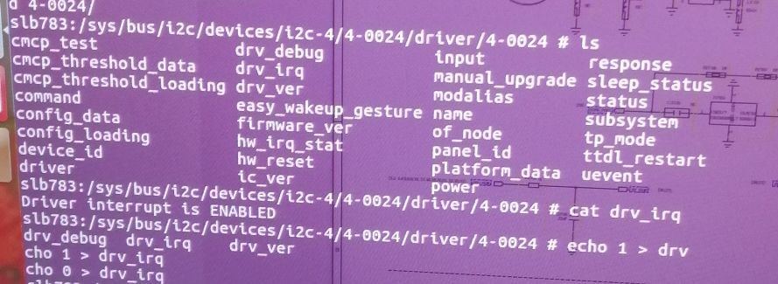
实验效果
挂载在i2c4上,设备树的节点对应
后面是分配的设备号
创建的节点名
控制

Slide 13
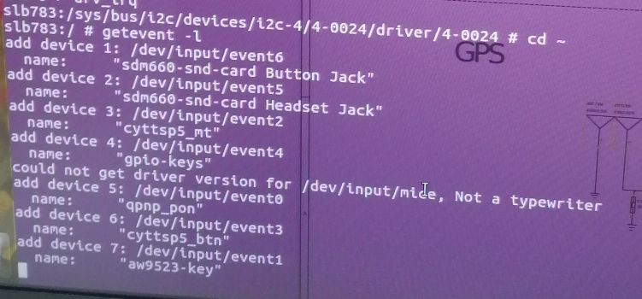
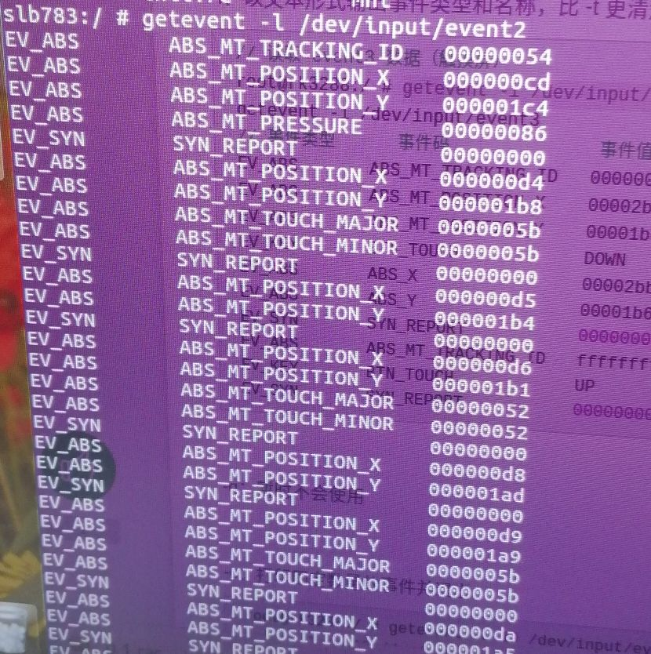
3.5如何查找注册的TP设备
getevent -l显示注册在input下面的设备
然后就可以找到对应的设备
显示报点的数据

Slide 14
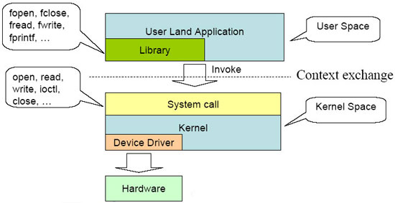
4.什么是内核态和用户态
内核态：在内核空间执行，通常是驱动程序，中断相关程序，内核调度程序，内存管理及其操作程序。
用户态：用户程序运行空间。
二.什么是进程上下文与中断上下文
1.进程上下文：
（1）进程上文：其是指进程由用户态切换到内核态是需要保存用户态时cpu寄存器中的值，进程状态以及堆栈上的内容，即保存当前进程的进程上下文，以便再次执行该进程时，能够恢复切换时的状态，继续执行。
（2）进程下文：其是指切换到内核态后执行的程序，即进程运行在内核空间的部分。
2.中断上下文：
（1）中断上文：硬件通过中断触发信号，导致内核调用中断处理程序，进入内核空间。这个过程中，硬件的一些变量和参数也要传递给内核，内核通过这些参数进行中断处理。中断上文可以看作就是硬件传递过来的这些参数和内核需要保存的一些其他环境（主要是当前被中断的进程环境。
（2）中断下文：执行在内核空间的中断服务程序。

Slide 15
5.Linux内核空间内存申请函数kmalloc、kzalloc、vmalloc的区别
void *kmalloc(size_t size, gfp_t flags)；
kmalloc() 申请的内存位于物理内存映射区域，而且在物理上也是连续的，它们与真实的物理地址只有一个固定的偏移，因为存在较简单的转换关系，所以对申请的内存大小有限制，不能超过128KB。
kfree()
kzalloc()
kzalloc() 函数与 kmalloc() 非常相似，参数及返回值是一样的，可以说是前者是后者的一个变种，因为 kzalloc() 实际上只是额外附加了 __GFP_ZERO 标志。所以它除了申请内核内存外，还会对申请到的内存内容清零。
void *vmalloc(unsigned long size);
vmalloc() 函数则会在虚拟内存空间给出一块连续的内存区，但这片连续的虚拟内存在物理内存中并不一定连续。由于 vmalloc() 没有保证申请到的是连续的物理内存，因此对申请的内存大小没有限制，如果需要申请较大的内存空间就需要用此函数了。
vfree()

Slide 17
LCD亮灭屏代码分析
1.背光注册流程
// mdss_fb.c
mdss_fb_probe()
mdss_fb_register()
led_classdev_register()
// fbi 结构赋值
// 注册 backlight sys节点及set函数实现
mdss_fb_register(struct msm_fb_data_type *mfd)
struct fb_info *fbi = mfd->fbi;
.....
fix = &fbi->fix;
var = &fbi->var;
fbi->fbops = &mdss_fb_ops; //ops
register_framebuffer()
//register fbx
mdss_fb_blank
mdss_fb_blank_sub
case FB_BLANK_UNBLANK:
mdss_fb_blank_unblank(mfd); //light up
break;
case FB_BLANK_HSYNC_SUSPEND:
case FB_BLANK_POWERDOWN:
mdss_fb_blank_blank(mfd, req_power_state); // light off
break;
static struct fb_ops mdss_fb_ops = {
...
.fb_blank = mdss_fb_blank, /* blank display */
...
};

Slide 18
// 注册 backlight sys节点及set函数实现
led_classdev_register(&pdev->dev, &backlight_led)
static struct led_classdev backlight_led = {
.name = "lcd-backlight",
.brightness = MDSS_MAX_BL_BRIGHTNESS / 2,
.brightness_set = mdss_fb_set_bl_brightness,
.brightness_get = mdss_fb_get_bl_brightness,
.max_brightness = MDSS_MAX_BL_BRIGHTNESS,
};
// 背光set函数

Slide 19
1.mdss_fb_blank_blank & unblank
// (drivers\video\msm\mdss\mdss_fb.c)
/* 亮灭lcm代码追踪 */
mdss_fb_blank_blank
mdss_fb_set_backlight // <1> 背光
mfd->mdp.off_fnc(mfd); // <2> 显示
mdss_fb_blank_unblank
ret = mfd->mdp.on_fnc(mfd);
mdss_fb_set_backlight

Slide 20
<1> 背光
背光的控制方式由 dsi中的 qcom,mdss-dsi-bl-pmic-control-type 属性值控制 ！
qcom,mdss-dsi-bl-pmic-control-type = "bl_ctrl_wled" ， “bl_ctrl_pwm”;
// mdss_fb_set_backlight 函数追踪
mdss_fb_set_backlight() // mdss_fb.c
pdata->set_backlight(pdata, temp);
// (drivers\video\msm\mdss\mdss_dsi_panel.c)
ctrl_pdata->panel_data.set_backlight = mdss_dsi_panel_bl_ctrl;
switch (ctrl_pdata->bklt_ctrl) {
case BL_WLED:
led_trigger_event(bl_led_trigger, bl_level);
break;
case BL_PWM:
mdss_dsi_panel_bklt_pwm(ctrl_pdata, bl_level);
break;
case BL_DCS_CMD:
if (!mdss_dsi_sync_wait_enable(ctrl_pdata)) {
mdss_dsi_panel_bklt_dcs(ctrl_pdata, bl_level);
break;
}

Slide 21
<2> 显示
// (drivers\video\fbdev\msm\mdp3_ctrl.c)
mdp3_interface->on_fnc
mdp3_interface->off_fnc
event_handler
mdp3_interface->on_fnc =mdp3_ctrl_on ()
mdp3_clk_enable(1, 0);
rc = panel->event_handler(panel,
MDSS_EVENT_LINK_READY, NULL); // 开电 ①
rc |= panel->event_handler(panel,
MDSS_EVENT_UNBLANK, NULL); // 执行亮屏指令 ②
rc |= panel->event_handler(panel,
MDSS_EVENT_PANEL_ON, NULL);
mdp3_clk_enable(0, 0);
mdp3_interface->off_fnc = mdp3_ctrl_off();
rc = panel->event_handler(panel, MDSS_EVENT_BLANK, // 执行灭屏指令 ②
(void *) (long int)mfd->panel_power_state);
rc = panel->event_handler(panel, MDSS_EVENT_PANEL_OFF, // 关电 ①
(void *) (long int)mfd->panel_power_state);
mdp3_ctrl_init()

Slide 22
① 开关panel电源
// mdss_dsi.c event_handler MDSS_EVENT_LINK_READY|MDSS_EVENT_PANEL_OFF
dsi_panel_device_register
ctrl_pdata->panel_data.event_handler = mdss_dsi_event_handler;
mdss_dsi_event_handler()
MDSS_EVENT_LINK_READY|MDSS_EVENT_PANEL_OFF
mdss_dsi_on() | mdss_dsi_off()
mdss_dsi_panel_power_ctrl(struct mdss_panel_data * pdata, int power_state)(struct mdss_panel_data *pdata,int power_state)
case MDSS_PANEL_POWER_OFF:
mdss_dsi_panel_power_off(pdata); // ☆
case MDSS_PANEL_POWER_ON:
mdss_dsi_panel_power_on(pdata); // ☆

Slide 23
② 开关panel
/* MDSS_EVENT_UNBLANK | MDSS_EVENT_BLANK (drivers\video\msm\mdss\mdss_dsi.c)*/
mdss_dsi_event_handler()
case MDSS_EVENT_UNBLANK:
if (ctrl_pdata->on_cmds.link_state == DSI_LP_MODE)
rc = mdss_dsi_unblank(pdata); // ☆
break;
case MDSS_EVENT_PANEL_ON:
ctrl_pdata->ctrl_state |= CTRL_STATE_MDP_ACTIVE;
if (ctrl_pdata->on_cmds.link_state == DSI_HS_MODE)
rc = mdss_dsi_unblank(pdata);
pdata->panel_info.esd_rdy = true;
break;
case MDSS_EVENT_BLANK:
if (ctrl_pdata->off_cmds.link_state == DSI_HS_MODE)
rc = mdss_dsi_blank(pdata, power_state); // ☆
break;
case MDSS_EVENT_PANEL_OFF:
ctrl_pdata->ctrl_state &= ~CTRL_STATE_MDP_ACTIVE;
if (ctrl_pdata->off_cmds.link_state == DSI_LP_MODE)
rc = mdss_dsi_blank(pdata, power_state);
rc = mdss_dsi_off(pdata, power_state);
break;
// mdss_dsi_unblank |mdss_dsi_blank 函数追踪
mdss_dsi_unblank()
ATRACE_BEGIN("dsi_panel_on");
mdss_dsi_ctrl_pdata ctrl_pdata->on(pdata);
ATRACE_END("dsi_panel_on");
mdss_dsi_blank()
ATRACE_BEGIN("dsi_panel_off");
mdss_dsi_ctrl_pdata ctrl_pdata->off(pdata);
ATRACE_END("dsi_panel_off");

Slide 24
// 解析lcm dts ，开关panel 回调函数赋值 (drivers\video\fbdev\msm\mdss\Mdss_dsi_panel.c)
/* 0.解析lcm的dtsi，开关屏函数赋值 */
mdss_dsi_panel_init
mdss_dsi_ctrl_pdata ctrl_pdata->on = mdss_dsi_panel_on;
mdss_dsi_ctrl_pdata ctrl_pdata->off = mdss_dsi_panel_off;
/* 1. 解析 on/off cmd data */
mdss_dsi_parse_dcs_cmds(np, &pt->on_cmds,
"qcom,mdss-dsi-on-command","qcom,mdss-dsi-on-command-state");
mdss_dsi_parse_dcs_cmds(np, &ctrl_pdata->off_cmds,
"qcom,mdss-dsi-off-command", "qcom,mdss-dsi-off-command-state");
/* 2. 执行开关屏命令参数函数 */
mdss_dsi_panel_on()
mdss_dsi_panel_cmds_send(ctrl, on_cmds, CMD_REQ_COMMIT);
mdss_dsi_cmdlist_put()
mdss_dsi_panel_off()
mdss_dsi_panel_cmds_send(ctrl, &ctrl->off_cmds, CMD_REQ_COMMIT);
mdss_dsi_cmdlist_put

