Slide 1


SQL Fundamentals
Thomas Nield

Slide 2




About the Instructor
Thomas Nield, business consultant at Southwest Airlines
Author of Getting Started with SQL (O’Reilly) and Learning RxJava (Packt)
Current Interests: operations research, machine learning, and mathematical optimization
https://medium.com/@thomasnield9727
thomasnield9727
https://github.com/thomasnield

Slide 3
What We Will Learn
Understand the role of databases, SQL, and NoSQL in the business technology landscape
Leverage relational databases and SQL to organize and query data
Query and transform data using SQL
Database design principles and execution
Writing and updating data

Slide 4
Why Learn SQL?
Business and Technology professionals can both reap benefits from learning SQL.
SQL is a highly lucrative skill to have according to StackOverflow’s Annual Survey.
    It can be utilized and open up many career paths in both business and IT.
      Business Side - Analytical, managerial, strategic, research, and project roles
Technology Side - Database design, database administration (DBA), systems engineering, IT project management, and software development
Data is ubiquitous and collected everywhere, so knowing how to access and analyze it is key to being productive.

Slide 5
Section I
Introduction to Databases

Slide 6
Module I - Intro to Databases
Agenda for this module:
High-level overview of databases
Relational databases
Purpose of SQL
Making a distinction between SQL, NoSQL, and “Big Data”
Lightweight vs Centralized Databases
Setting up SQLite

Slide 7
What is a Database?
Broad definition: A database is anything that collects and organizes data
Examples:
Excel spreadsheets
Text files (CSV, XML, JSON)
File cabinet with organized documents
When referred to professionally, a database is typically a Relational Database Management System (RDBMS)

Slide 8
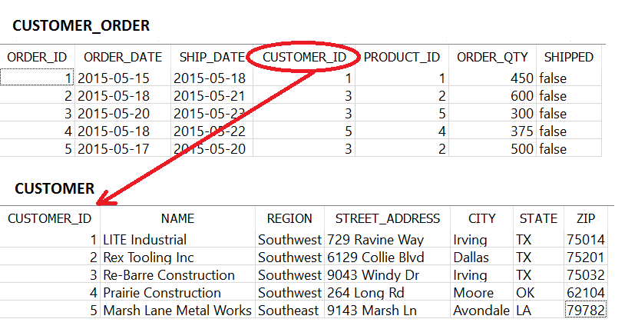
Relational Databases
A relational database management system (RDBMS) is simply a type of database holding tables that may have relationships
A field in a table can point to another table for information, as shown below:

Slide 9
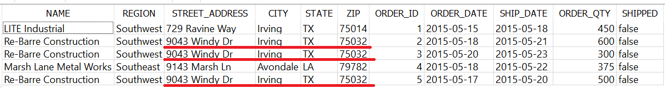
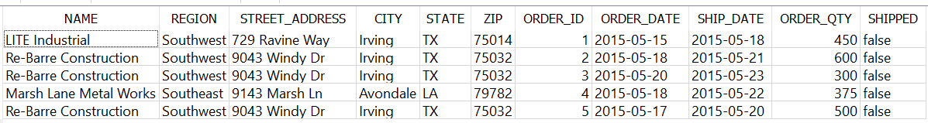
Why Separate Tables?
This idea of separating different types of data (e.g. CUSTOMER versus a CUSTOMER_ORDER) is known as normalization
Putting both CUSTOMER and CUSTOMER_ORDER information in one table would be bloated, redundant and difficult to maintain
Example of a non-normalized table:
Imagine if we needed to change an address.
We would have to do it three times!

Slide 10
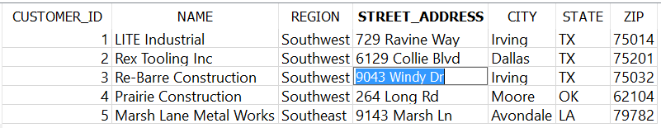
Why Separate Tables?
This is why it is better to separate the CUSTOMER and CUSTOMER_ORDER information into separate tables
You only need to update the address in one place

Slide 11
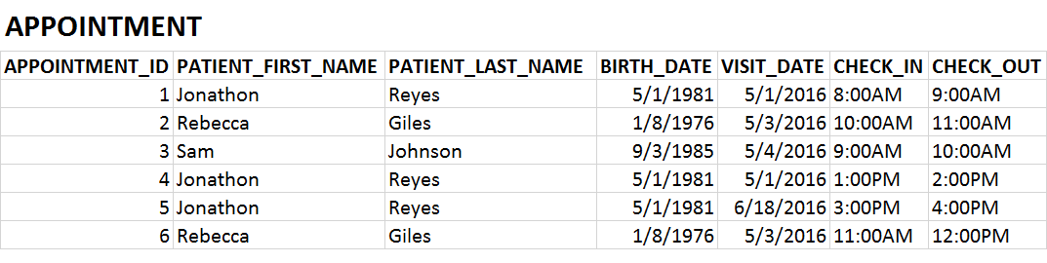
Exercise 1.1
Is this table normalized?

Slide 12
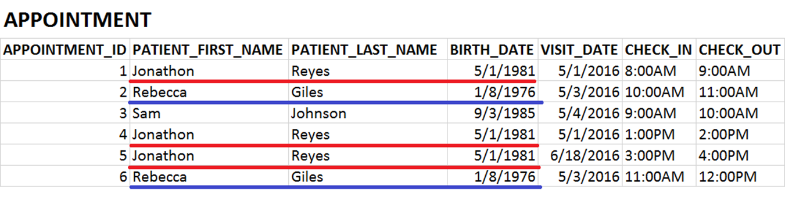
Exercise 1.1
Is this table normalized? It is not!

Slide 13
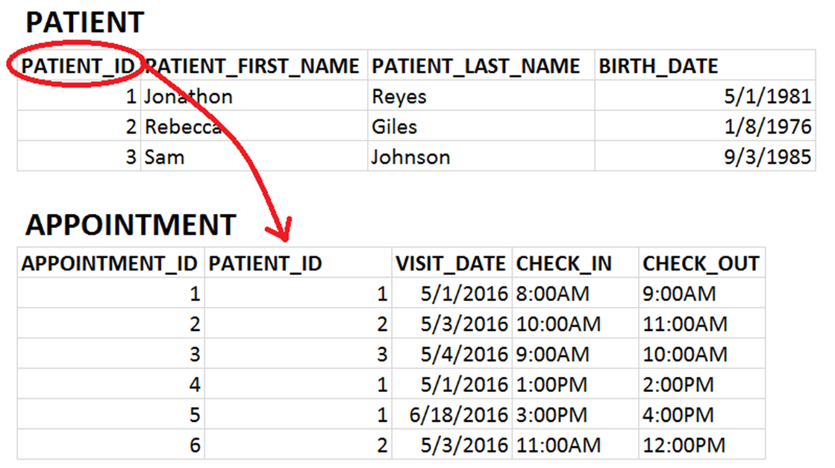
Exercise 1.1
PATIENT and APPOINTMENT data should be in separate tables

Slide 14
Types of Databases
Relational databases and SQL are not proprietary to one company or organization
Many companies and organizations have created their own relational database software.
Do not be confused by “SQL” being used to brand database software, like Microsoft SQL Server, MySQL, and SQLite. SQL is the universal language used on all RDBMS platforms
MySQL Oracle IBM DB2 | Microsoft Access Microsoft SQL Server PostgreSQL | SQLite MariaDB SAP Sybase

Slide 15
Lightweight Databases
When you want a simple solution for a small number of users, lightweight databases are a great place to start.
They store data in a file that can be shared, but can break down when edited simultaneously.
Common Lightweight Databases
Microsoft Access
SQLite
H2

Slide 16
Centralized Databases
When you need to support tens, hundreds, or thousands of users and applications, you need a centralized database.
These databases are designed to handle a high volume of traffic efficiently.
Some examples of centralized database platforms.
Oracle
Microsoft SQL Server
MySQL
PostgreSQL
Teradata

Slide 17

Typical Centralized Database Setup
CLIENT
Centralized databases use a
Client/Server Setup
SERVER
SQL User 1
Laptop with MySQL
CLIENT
SQL User 2

Slide 18

Typical Centralized Database Setup
CLIENT
For production, you typically use a server computer to host the database rather than a laptop or desktop
SQL User 1
CLIENT
Server with MySQL
SQL User 2

Slide 19

Typical Centralized Database Setup
CLIENT
For production, you typically use a server computer to host the database rather than a laptop or desktop
SQL User 1
Cloud Server with MySQL
CLIENT
SQL User 2

Slide 20
What is SQL?
SQL is a declarative programming language to retrieve, transform, join, and write data to relational databases.
Across most relational database platforms, SQL is fairly standardized.
Everything you learn in this class should apply to all platforms (MySQL, Microsoft SQL Server, Oracle, etc).
Do note that occasionally there are some nuances with SQL on different platforms.
For example, dates and times can be handled differently.
Microsoft SQL server augments the SQL language using T-SQL.

Slide 21
NoSQL and “Big Data”
NoSQL stands for “not only SQL”, and is often used to describe “Big Data” platforms that may leverage SQL but are not relational.
NoSQL databases include MongoDB, Couchbase, Apache Cassandra, and Redis.
These platforms store massive amounts of data in a variety of raw and unstructured formats (e.g. documents, key-value).
Most of these solutions are distributed across multiple machines, which is difficult to do with relational databases.

Slide 22
NoSQL and “Big Data”
Other “Big Data” solutions such as Apache Hadoop and Apache Spark can be interacted with using SQL, but are not limited to relational databases.
Therefore most of the knowledge in this course can be applied to “Big Data” solutions.
Caution using NoSQL and Big Data: “When all you have is a hammer, everything starts to look like a nail.”
Do not fall into the trap of treating all data problems as Big Data problems, because most are not.
Be aware of the “Silver Bullet Syndrome”: https://www.youtube.com/watch?v=3wyd6J3yjcs

Slide 23
SQL vs NoSQL
Feature | SQL | NoSQL | Winner
Integrity/Consistency | Data is enforced with logical relationships, minimized redundancy, and “Up-to-date” consistency. | Simple key-value and document storage does not enforce any rules or structure. Redundancy and write latency is common. | SQL
Design changes | Easy to “add” to database, but harder to modify. | NoSQL can quickly and arbitrarily change what data it stores. | NoSQL
Analysis | SQL is a universal language that makes accessing and analyzing data simple. | SQL support is sparse, and proprietary languages are esoteric and hardly universal. | SQL
Programming | Programmers of Java, Python, and .NET have to map entities to tables, which can be tedious. But data integrity is given. | Programming against a NoSQL database is quick and simple, but onus is on programmer to validate data. | Draw
Performance | Relational databases can store data for most use cases, but struggle with true “big data” cases. Integrity constraints also slow down performance. | NoSQL is capable of storing vast amounts of data with horizontal scaling. It also performs quickly due to horizontal scaling and no integrity constraints. | NoSQL

Slide 24
SQL vs NoSQL
In short…
SQL = integrity and accuracy
NoSQL = speed and scalability
SQL should be a prerequisite before learning NoSQL and “Big data”.
If you are absolutely uncertain which to use, always start with SQL.

Slide 25
What We Will Use
Upon entering a workplace, there is a good chance you will need access to an existing centralized database.
We will not be using centralized databases in this course, but we will be using SQLite.
The experience between lightweight and centralized databases should largely be the same.

Slide 26
Exercise 1.2
Identify the following as being a lightweight or centralized database:
1. Facebook’s MySQL database holding all user data
2. A SQLite database holding an iPhone user’s data locally on the hard drive
3. An Oracle database with shopping data for an e-commerce site

Slide 27
Exercise 1.2
Identify the following as being a lightweight or centralized database:
Facebook’s MySQL database holding all user data
CENTRALIZED
2. A SQLite database holding an iPhone user’s data locally on the hard drive
LIGHTWEIGHT
3. An Oracle database with shopping data for an e-commerce site
CENTRALIZED

Slide 28
SQLite
We will be using SQLite with SQLiteStudio in this Learning Path.
SQLite is a lightweight database and can be found on:
Android, iPhone, iPad, and Windows 10
Car consoles, thermostats, and other gadgets
Satellites and the Airbus A350 XWB
SQLite excels where simplicity and low overhead is needed.

Slide 29
Setting Up a SQLite Environment
There are many options to set up a SQLite environment quickly and easily on your computer:
SQLiteStudio (https://sqlitebrowser.org/)
DB Browser (https://sqlitebrowser.org/)
SQLiteOnline (https://sqliteonline.com/)
Choose a client and follow the instructions on its site to install it.

Slide 30
Setting Up a SQLite Environment
The three recommended programs are all good, and it might be worth playing with all three to find your favorite.
SQLiteStudio has a familiar database explorer layout you will find in most SQL clients.
SQLiteOnline conveniently works in a web browser and requires no setup.
DB Browser is the most advanced and powerful SQLite client.

Slide 31
Getting Files for this Class
The few resources needed for this class are available on GitHub (see description for this video)
Unzip the contents to a location of your choice, and note where you put them
Contents include:
Some SQLite database files
Class notes with all examples (in three formats)

Slide 32
Section II
Retrieving Data with SELECT

Slide 33
Module II - SELECT
Agenda for this module:
Retrieving all columns from a table with SELECT
Picking specific columns from a table with SELECT
Calculating expressions with SELECT
Concatenating text from several fields

Slide 34
Basic Math Operators in SQL
Operator | Description | Example
+ | Adds two numbers | STOCK + NEW_SHIPMENT
- | Subtracts two numbers | STOCK - DEFECTS
* | Multiplies two numbers | PRICE * 1.07
/ | Divides two numbers | STOCK / PALLET_SIZE
% | Divides two numbers, but returns the remainder | STOCK % PALLET_SIZE
These are the basic math operators you can expect on any SQL platform.
Any math operators beyond these will be done with functions.

Slide 35
Exercise 2.1
SELECT all records (with all fields) from the CUSTOMER_ORDER table

Slide 36
Exercise 2.1
SELECT all records (with all fields) from the CUSTOMER_ORDER table
ANSWER:
SELECT * FROM CUSTOMER_ORDER;

Slide 37
Exercise 2.2
SELECT the ORDER_ID and SHIP_DATE fields from the CUSTOMER_ORDER table

Slide 38
Exercise 2.2
SELECT the ORDER_ID and SHIP_DATE fields from the CUSTOMER_ORDER table
ANSWER:
SELECT ORDER_ID, SHIP_DATE FROM CUSTOMER_ORDER;

Slide 39
Exercise 2.3
SELECT the PRODUCT_ID, DESCRIPTION, and a REDUCED_PRICE (which subtracts $1.10 from each PRICE) from the PRODUCT table

Slide 40
Exercise 2.3
SELECT the PRODUCT_ID, DESCRIPTION, and a REDUCED_PRICE (which subtracts $1.10 from each PRICE) from the PRODUCT table
ANSWER:
SELECT PRODUCT_ID,
DESCRIPTION,
PRICE - 1.10 as REDUCED_PRICE
FROM PRODUCT

Slide 41
Section III
Filtering Data with WHERE

Slide 42
Module III – Filtering Data
Agenda for this module:
Set up the weather_stations database.
Filtering records on numeric fields
Filtering records on text fields
Filtering boolean (true/false) fields
Working with dates and times
Mixing AND/OR

Slide 43
Exercise 3.1
SELECT all records where TEMPERATURE is between 30 and 50 degrees

Slide 44
Exercise 3.1
SELECT all records where TEMPERATURE is between 30 and 50 degrees
SELECT * FROM station_data
WHERE temperature BETWEEN 30 AND 50;
OR
SELECT * FROM station_data
WHERE temperature >= 30 and temperature <= 50;

Slide 45
Exercise 3.2
SELECT all records where station_pressure is greater than 1000 and a tornado was present

Slide 46
Exercise 3.2
SELECT all records where station_pressure is greater than 1000 and a tornado was present
SELECT * FROM STATION_DATA
WHERE station_pressure > 1000 AND tornado;
OR
SELECT * FROM STATION_DATA
WHERE station_pressure > 1000 AND tornado = 1;

Slide 47
Exercise 3.3
SELECT all records with report codes E6AED7, B950A1, 98DDAD

Slide 48
Exercise 3.3
SELECT all records with report codes E6AED7, B950A1, 98DDAD
SELECT * FROM STATION_DATA
WHERE report_code IN ('E6AED7','B950A1','98DDAD’)
OR
SELECT * FROM STATION_DATA
WHERE report_code = 'E6AED7‘
OR report_code = 'B950A1‘
OR report_code = '98DDAD'

Slide 49
Exercise 3.4
SELECT all records WHERE station_pressure is null

Slide 50
Exercise 3.4
SELECT all records WHERE station_pressure is null
SELECT * FROM STATION_DATA
WHERE station_pressure IS NULL;

Slide 51
Section IV
GROUP BY and ORDER BY

Slide 52
Module IV – GROUP BY/ ORDER BY
Agenda for this module:
Counting Records, GROUP BY, and ORDER BY
SUM, MIN, MAX, and AVG
Filtering aggregate values with HAVING

Slide 53
Exercise 4.1
Find the SUM of precipitation by year when a tornado was present, and sort by year descending.

Slide 54
Exercise 4.1
Find the SUM of precipitation by year when a tornado was present, and sort by year descending.
ANSWER:
SELECT year,
SUM(precipitation) as tornado_precipitation
FROM station_data
WHERE tornado = 1
GROUP BY year
ORDER BY year DESC

Slide 55
Exercise 4.2
SELECT the year and max snow depth, but only years where the max snow depth is at least 50.

Slide 56
Exercise 4.2
SELECT the year and max snow depth, but only years where the max snow depth is at least 50.
ANSWER:
SELECT year,
max(snow_depth) AS max_snow_depth
FROM STATION_DATA
GROUP BY year
HAVING max_snow_depth >= 50

Slide 57
Section V
CASE

Slide 58
Module V – CASE Expressions
Agenda for this module:
Using CASE Expressions
CASE Expressions with GROUP BY
The Zero/Null Case Trick

Slide 59
Exercise 5.1
SELECT the report_code, year, quarter, and temperature, where a “quarter” is “Q1”, “Q2”, “Q3”, or “Q4” reflecting months 1-3, 4-6, 7-9, and 10-12 respectively.

Slide 60
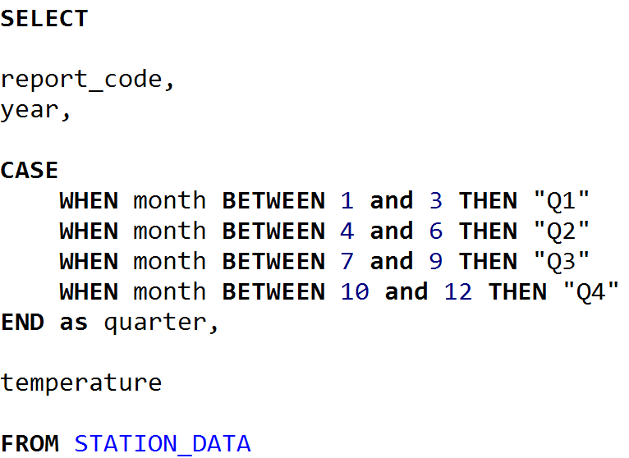
Exercise 5.1
SELECT the report_code, year, quarter, and temperature, where a “quarter” is “Q1”, “Q2”, “Q3”, or “Q4” reflecting months 1-3, 4-6, 7-9, and 10-12 respectively.

Slide 61
Exercise 5.2
Get the average temperature grouped by quarter and year, where a “quarter” is “Q1”, “Q2”, “Q3”, or “Q4” reflecting months 1-3, 4-6, 7-9, and 10-12 respectively.

Slide 62
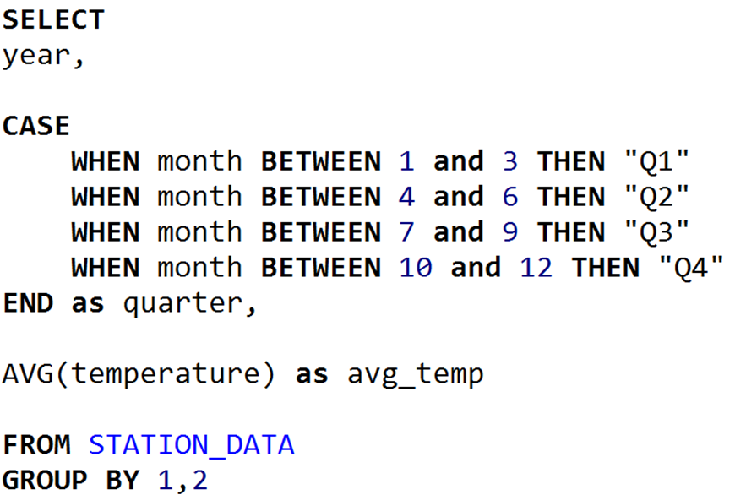
Exercise 5.2
Get the average temperature grouped by quarter and year, where a “quarter” is “Q1”, “Q2”, “Q3”, or “Q4” reflecting months 1-3, 4-6, 7-9, and 10-12 respectively.

Slide 63
Section VI
INNER JOIN and LEFT JOIN

Slide 64
Module VI – INNER JOIN/LEFT JOIN
Agenda for this module:
INNER JOIN
LEFT JOIN
Joining multiple tables
Using joins with GROUP BY

Slide 65
Revisiting Table Relationships
Remember when we were talking about tables having relationships with each other?
A table can supply data to another table, like CUSTOMER information for a CUSTOMER_ORDER

Slide 66
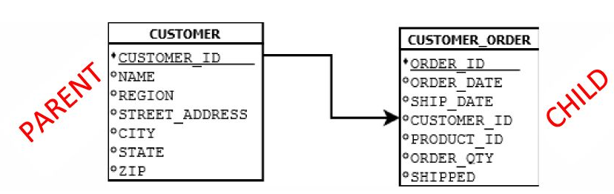
Parent/Child Tables
Because the CUSTOMER table supplies data to CUSTOMER_ORDER, it is the parent table to CUSTOMER_ORDER
Because the CUSTOMER_ORDER table receives data from CUSTOMER, it is the child table to CUSTOMER

Slide 67
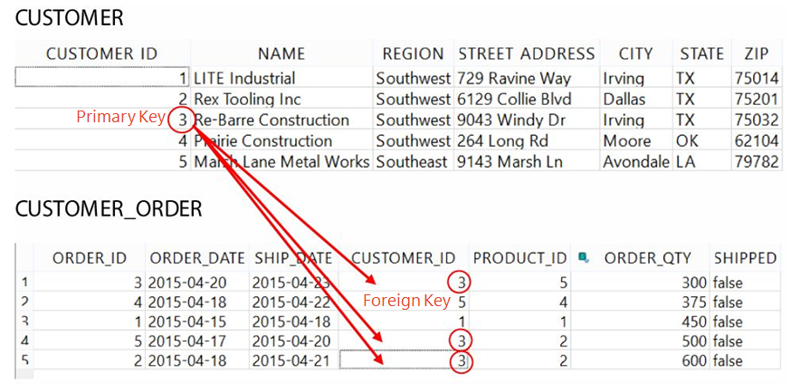
Primary/Foreign Keys
Typically, a parent table will have a primary key and the child table will have a foreign key.
The primary key is unique and can map to multiple foreign keys

Slide 68
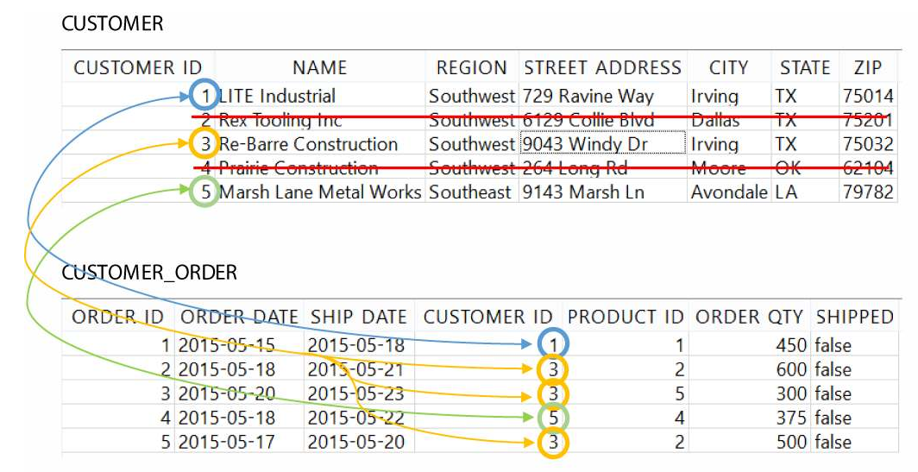
INNER JOIN

Slide 69
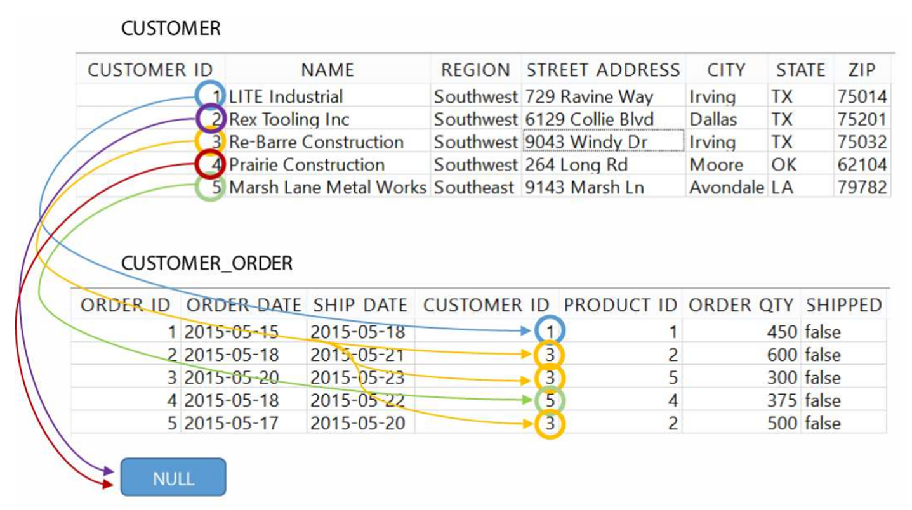
LEFT OUTER JOIN

Slide 70
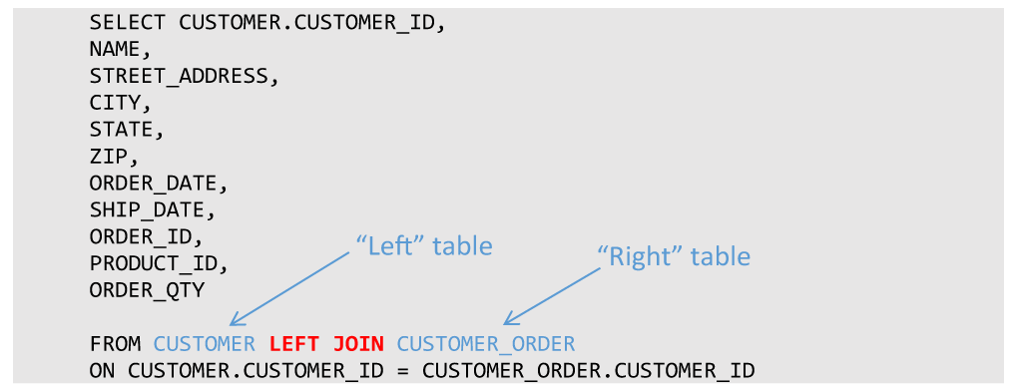
LEFT OUTER JOIN

Slide 71
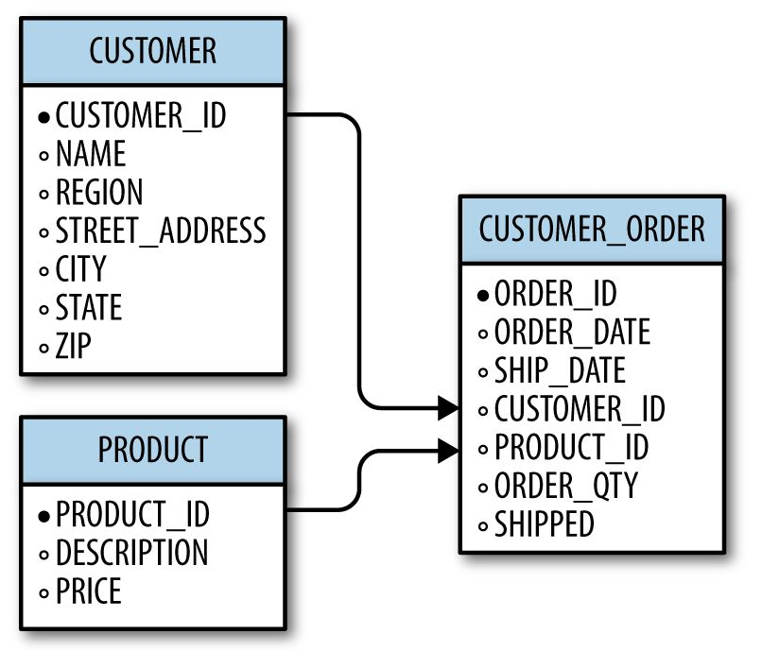
Joining Multiple Tables
It is not uncommon to have a table be a parent to one table, but a child to another
A given table can also be a child to more than one table, so what does this look like?
We can bring in a third table PRODUCT to supply product information to CUSTOMER_ORDER

Slide 72
Exercise 6.1
SELECT the ORDER_ID, ORDER_DATE, and DESCRIPTION (from PRODUCT)
(hint, you will need to INNER JOIN CUSTOMER_ORDER and PRODUCT)

Slide 73
Exercise 6.1
SELECT the ORDER_ID, ORDER_DATE, and DESCRIPTION (from PRODUCT)
(hint, you will need to INNER JOIN CUSTOMER_ORDER and PRODUCT)
ANSWER:
SELECT ORDER_ID, ORDER_DATE, DESCRIPTION
FROM CUSTOMER_ORDER INNER JOIN PRODUCT
ON CUSTOMER_ORDER.PRODUCT_ID = PRODUCT.PRODUCT_ID

Slide 74
Exercise 6.2
Find the total revenue by product. Include the fields PRODUCT_ID, DESCRIPTION, and then the TOTAL_REVENUE.
(Hint: you will need to join CUSTOMER_ORDER and PRODUCT. Then do a GROUP BY)

Slide 75
Exercise 6.2
Find the total revenue by product. Include the fields PRODUCT_ID, DESCRIPTION, and then the TOTAL_REVENUE.
(Hint: you will need to join CUSTOMER_ORDER and PRODUCT. Then do a GROUP BY)
ANSWER:
SELECT PRODUCT_ID,
DESCRIPTION,
COALESCE(SUM (ORDER_QTY * PRICE), 0) AS TOTAL_REVENUE
FROM PRODUCT LEFT JOIN CUSTOMER_ORDER
ON PRODUCT.PRODUCT_ID = CUSTOMER_ORDER.PRODUCT_ID
GROUP BY 1, 2

Slide 76
Section VII
Database Design

Slide 77
Module VII – Database Design
Agenda for this module:
Planning a database
Creating a database
Creating tables
Creating Views

Slide 78
Planning a Database
Design Questions
What are the business requirements?
What tables will I need to fulfill those requirements?
What columns will each table contain?
How will the tables be normalized?
What will their parent/child relationships be?

Slide 79
Planning a Database
Data Questions
How much data will be populated into these tables?
Who/what will populate data into these tables?
Where will the data come from?
Do we need processes to automatically populate these tables?

Slide 80
Planning a Database
Security Questions
Who should have access to this database?
Who should have access to which tables? Read-only access? Write access?
Is this database critical to business operations?
What backup plans do we have in the event of disaster/failure?
Should changes to tables be logged?
If the database is used for websites or web applications, is it secure?

Slide 81
The SurgeTech Project
Let’s design a database for a real-world scenario!
You are a staff member for the SurgeTech conference, a gathering of tech startup companies seeking publicity and investors. The organizer has tasked you with creating a database to manage the attendees, companies, presentations, rooms, and presentation attendance. How should this database be designed?
There are five entities here that can be turned into tables:
ATTENDEE
COMPANY
PRESENTATION
ROOM
PRESENTATION_ATTENDANCE

Slide 82
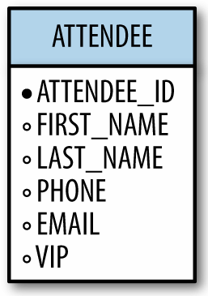
ATTENDEE
The attendees are guests (including some VIP’s) who have registered for the conference
Each attendee holds the following information:
ID
Name
Phone Number
Email
VIP status
To the right is our design for the ATTENDEE table

Slide 83
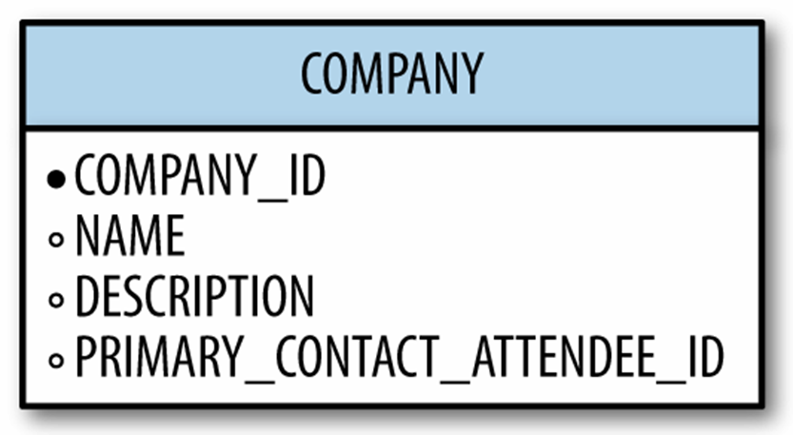
COMPANY
The startup companies need to be tracked as well.
Each company holds the following information:
Company ID
Name
Description
Primary contact attendee ID
To the right is our design for the COMPANY table:

Slide 84
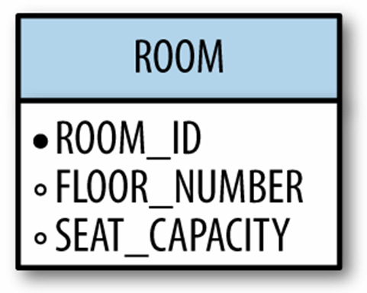
ROOM
Rooms are available for presentations.
Each room is defined with these attributes:
Room ID
Floor number
Seat capacity
To the right is our design for the ROOM table:

Slide 85
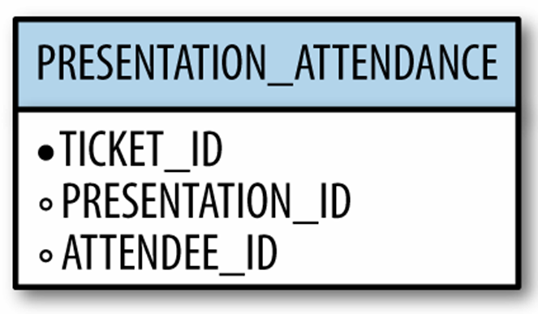
PRESENTATION_ATTENDANCE
When an ATTENDEE wants to attend a PRESENTATION, they can acquire a ticket with a ticket id.
We can use these tickets to keep track of presentation attendance.
Each presentation attendance is defined with these attributes:
Ticket ID
Presentation ID
Attendee ID
To the right is our design for the PRESENTATION_ATTENDANCE table:

Slide 86
Revisiting Primary/Foreign Keys
With table relationships it is important to distinguish the primary key from the foreign key
The field that supplies data to other tables is the primary key, and a field that receives data from another table is a foreign key.

Slide 87
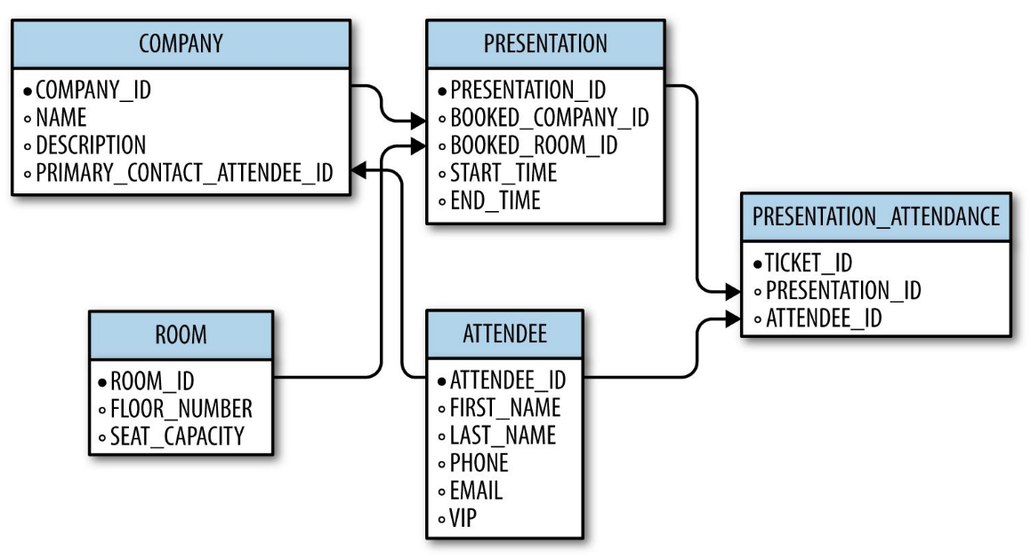
The Database Schema
With our knowledge of primary and foreign keys, we can create a database schema of all tables and their relationships for the SurgeTech conference

Slide 88
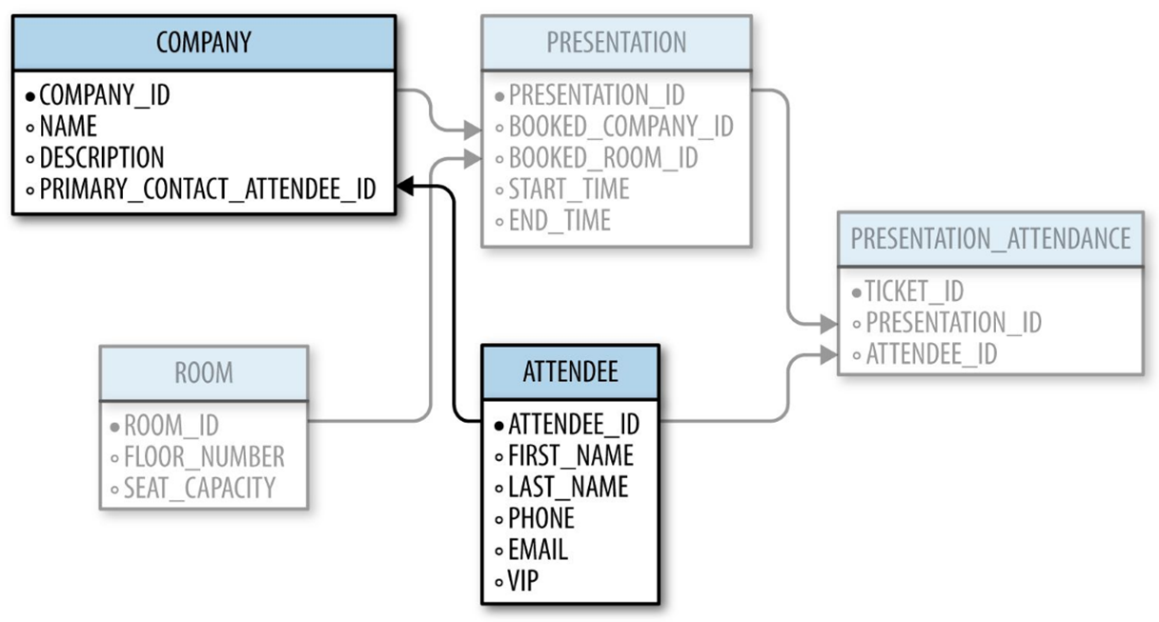
The Database Schema
It can be overwhelming seeing all tables and their relationships at once, so the secret to reviewing a database schema is to focus on 2-3 tables at a time.
*Primary Key → Foreign Key

Slide 89
Common Column Types
Type | Description
INTEGER | A simple, whole number
DOUBLE/DECIMAL | Supports none-whole, decimal numbers
BOOLEAN | A true/false value represented by 1 or 0 respectively
CHAR | A fixed number of text characters
VARCHAR | Any number of text characters, with an optional maximum
DATE | A calendar date value
TIME | A time value
DATETIME | A date and time value
TEXT | A longer piece of text (such as memos, articles, books, emails, etc)

Slide 90
Common Column Modifiers
Type | Description
PRIMARY KEY | Makes the column a PRIMARY KEY
FOREIGN KEY | Makes the column a FOREIGN KEY
NOT NULL | Enforces that values can never be null in that column
DEFAULT | Allows you to specify a default value for a column rather than it default to NULL

Slide 91
Section VIII
Writing Data

Slide 92
Module VIII – Writing Data
Agenda for this module:
INSERT records
UPDATE records
DELETE records
Transactions
Indexes

Slide 93
Exercise 9.1
Insert a new record into the COMPANY table for a company named “Pied Piper”, and provide a DESCRIPTION of “Compression platform for mobile and desktop” and a PRIMARY_CONTACT_ATTENDEE_ID of 1.

Slide 94
Exercise 9.1
Insert a new record into the COMPANY table for a company named “Pied Piper”, and provide a DESCRIPTION of “Compression platform for mobile and desktop” and a PRIMARY_CONTACT_ATTENDEE_ID of 1.
INSERT INTO COMPANY(NAME,DESCRIPTION, PRIMARY_CONTACT_ATTENDEE_ID)
VALUES ('Pied Piper','Compression platform for mobile and desktop', 1)

Slide 95
Exercise 9.2
Create a new ATTENDEE named Richard Hendricks, with an EMAIL of richard.hendricks@piedpiper.com and a VIP true value

Slide 96
Exercise 9.2
Create a new ATTENDEE named Richard Hendricks, with an EMAIL of richard.hendricks@piedpiper.com and a VIP true value
INSERT INTO ATTENDEE (FIRST_NAME, LAST_NAME, EMAIL, VIP)
VALUES ('Richard', 'Hendricks', 'richard.hendricks@piedpiper.com',1)

Slide 97
Exercise 9.3
Make Richard Hendricks’ ATTENDEE_ID the PRIMARY_CONTACT_ATTENDEE_ID for the COMPANY “Pied Piper”

Slide 98
Exercise 9.3
Make Richard Hendricks’ ATTENDEE_ID the PRIMARY_CONTACT_ATTENDEE_ID for the COMPANY “Pied Piper”
UPDATE COMPANY SET PRIMARY_CONTACT_ATTENDEE_ID = 5
WHERE COMPANY_ID = 2

Slide 99
Section IX
Going Forward

Slide 100
What Now?
You now have the fundamentals of SQL in your tool belt
Get comfortable with consistent use and practice.
If your job uses a specific database platform (e.g. MySQL, Oracle), apply this knowledge to learn that platform.
Keep practicing with SQLite!

Slide 101
What Now?
There are SQL features you can advance into:
Subqueries – query off of other queries just like they were tables
Indexing – Configure large tables to perform better with SELECT operations
Transactions – Perform multiple update commands into a single, fail-safe batch
Triggers – Configure databases to react to UPDATE/DELETE/INSERT commands
Database Administration – Fine-tune production databases for large corporate environments
Advanced Business Analysis – Use advanced SQL features to perform deeper business analysis

Slide 102
What Now?
SQL Resources
  Getting Started with SQL (O'Reilly) by Thomas Nield
  Learning SQL (O'Reilly) by Alan Beaulieu
  Using SQLite (O'Reilly) by Jay A. Kreibich
It can be lucrative to combine SQL with another technical skill
  Python - versatile scripting language
  R – statistical scripting language and environment
  Java – Build full software solutions

Slide 103
Want to Continue?
If you enjoyed this Learning Path, be sure to check out SQL for Analytics to continue your SQL journey.

