Slide 1
DFAMiner: Mining minimal separating DFAs from labelled samples
Daniele Dell’Erba, Yong Li, Sven Schewe
University of Liverpool

Slide 2
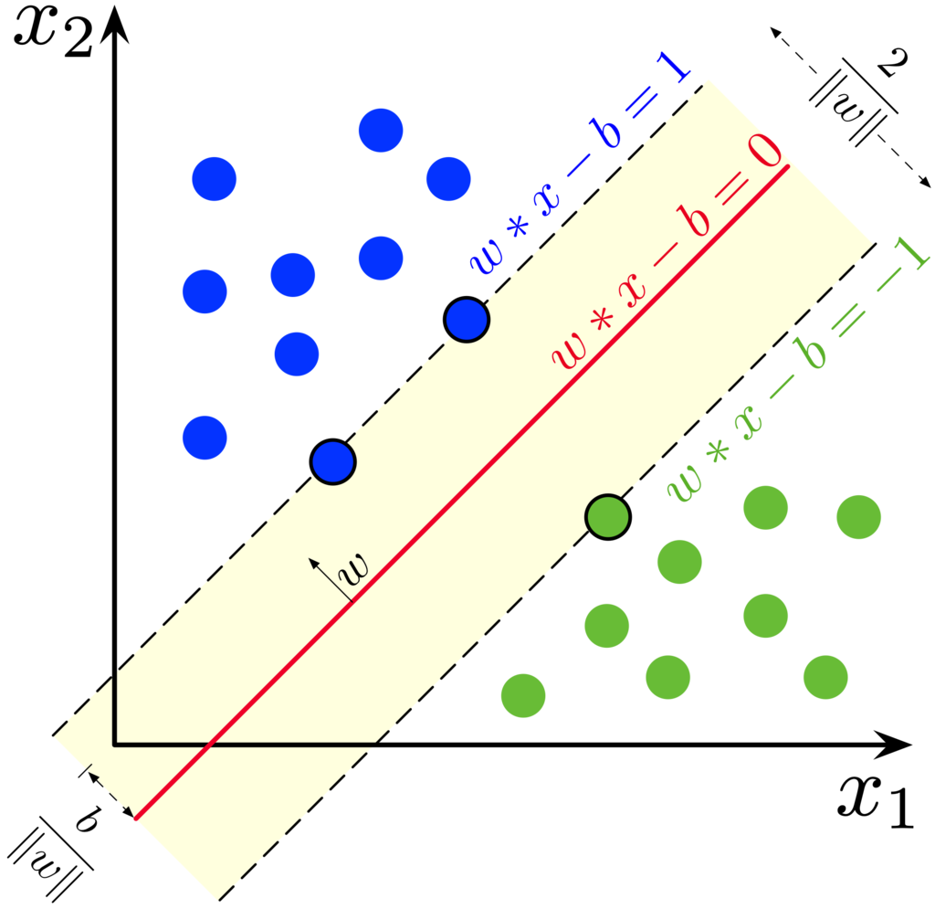

Separating machine in ML
Support Vector Machine: $x_{2}−x_{1}−0.5=0$

Slide 3
Separating in Verification
Loop invariants: i + j > 42
for(; i<10; i++)
…
j--;
…

Slide 4
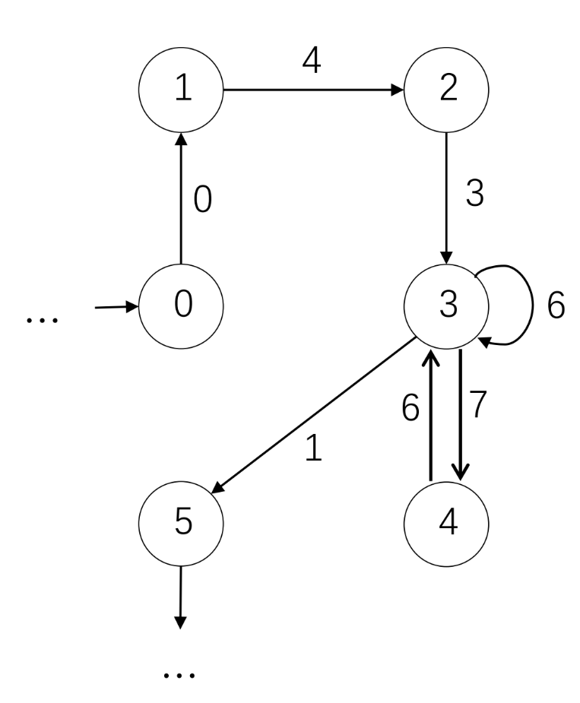
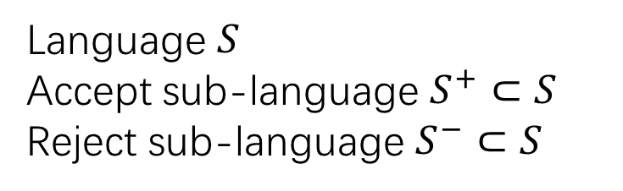
Separating in Automata
Language $S$
Accept sub-language $S^{+}⊂S$
Reject sub-language $S^{−}⊂S$
Example: parity automaton
Accept even words
. . . 0 4 3 6 6 1 . . .
Reject odd words
. . . 0 4 3 6 7 6 1 . . .
Dont-care words
. . . 0 4 3 6 7 6 6 1 . . .
Notes:
Daniele Dell’Erba created this slide

Slide 5
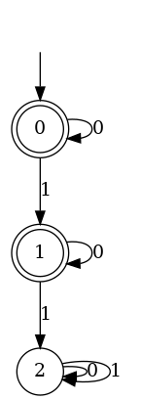
Separating in Automata
Separating automata for parity game solving:
$S=(S^{+},S^{−})$ where $S^{+}=\left\{000, 001, 100\right\}$
$$S^{−}=\{010,011, 101, 110,111\}$$

Slide 6
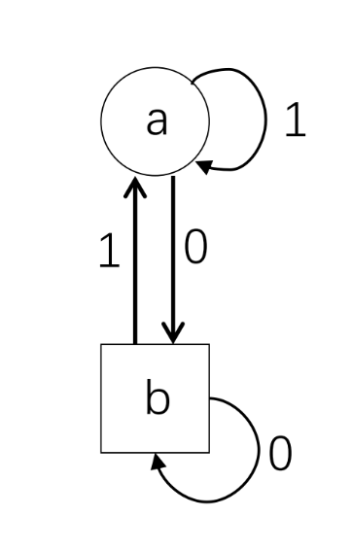
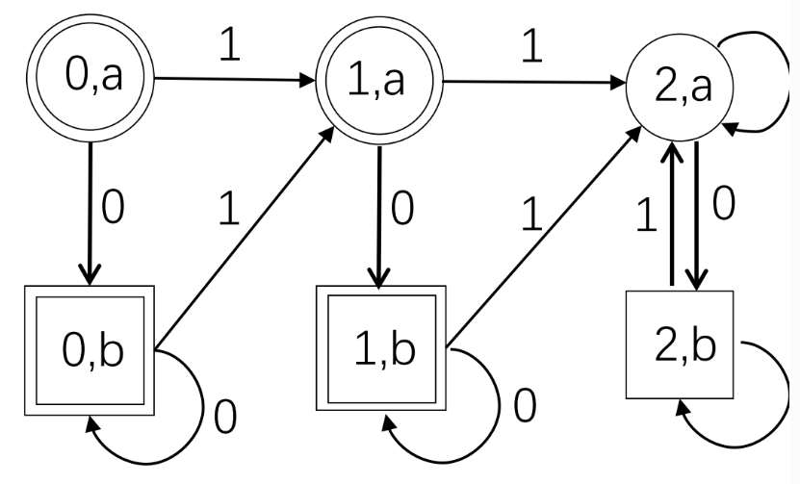
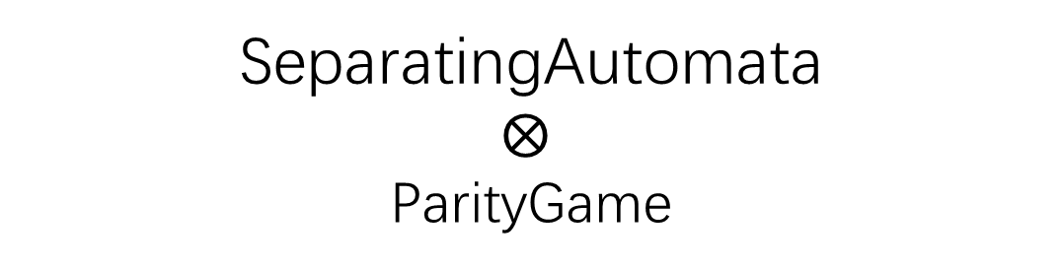
Separating in Automata
Separating automata for parity game solving:
$S=(S^{+},S^{−})$ where $S^{+}=\left\{000, 001, 100\right\}$
$$S^{−}=\{010,011, 101, 110,111\}$$
SeparatingAutomata
$$⨂$$
ParityGame
Notes:
Daniele Dell’Erba created this slide

Slide 7



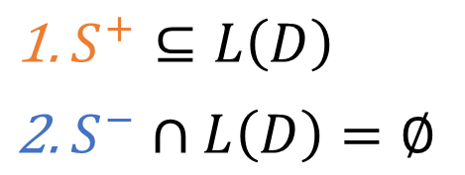
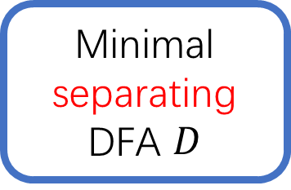
Minimization of separating DFA problem
$S=(S^{+},S^{−})$
Positive samples
$S^{+}$
Learning
Minimal separating DFA $D$
$S^{+}⊆L\left(D\right)$
$S^{−}∩L\left(D\right)=∅$
Negative samples
$S^{−}$

Slide 8


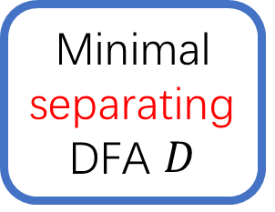

Current approach
AugmentedPrefix Tree Acceptor
$S=(S^{+},S^{−})$
$S^{+}$
APTA P
APTA construction
SAT encoding
Minimal separating DFA $D$
$S^{−}$

Slide 9
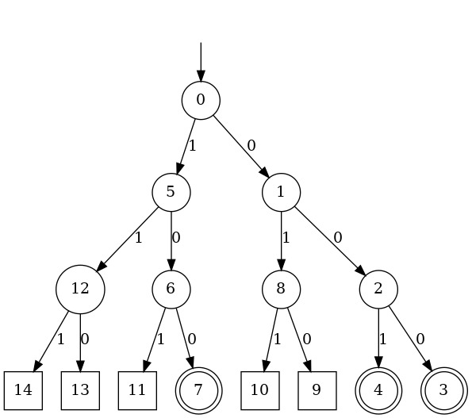


Construction of APTA
APTA construction
$$S^{+}=\left\{000, 001, 100\right\}$$
$$S^{−}=\{010,011, 101, 110,111\}$$
Rejecting
Accepting
Don’t-care

Slide 10
Current approach
AugmentedPrefix Tree Acceptor
$S=(S^{+},S^{−})$
$S^{+}$
APTA P
APTA construction
SAT encoding
Minimal separating DFA $D$
$S^{−}$
The number of nodes in P is exactly
the number of all prefixes of the words in S

Slide 11
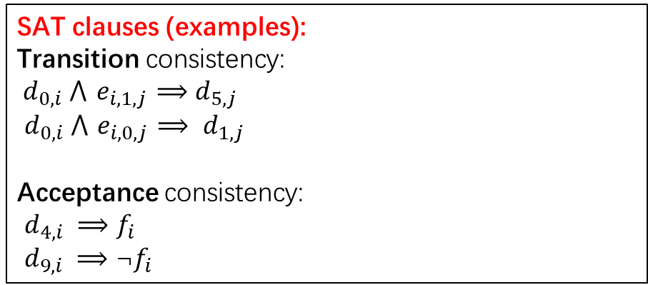
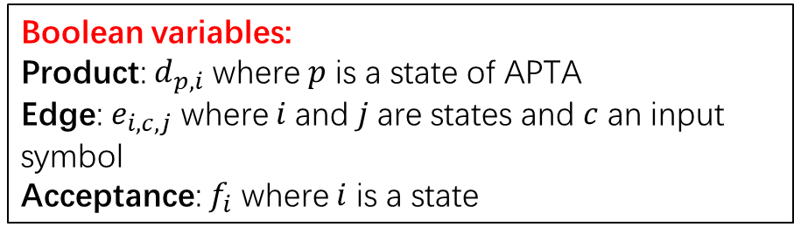
Encoding into SAT problem
Idea: Guess a DFA D of n states: i = 0, 1, . . . , n-1 where 0 is the initial state and verify with SAT solver whether such DFA exists
Boolean variables:
Product: $d_{p,i}$ where $p$ is a state of APTA
Edge: $e_{i,c,j}$ where $i$and $j$are states and $c$ an input symbol
Acceptance: $f_{i}$ where $i$ is a state
SAT Encoding
SAT clauses (examples):
Transition consistency:
${ d}_{0,i} ⋀{ e}_{i,1,j} ⟹$ $d_{5,j}$
$d_{0,i} ⋀{ e}_{i,0,j} ⟹ d_{1,j}$
Acceptance consistency:
$d_{4,i} ⟹f_{i}$
$d_{9,i} ⟹\text{¬}f_{i}$

Slide 12
Current approach
AugmentedPrefix Tree Acceptor
$S=(S^{+},S^{−})$
$S^{+}$
APTA P
APTA construction
SAT encoding
Minimal separating DFA $D$
$S^{−}$
The number of Boolean variables needed is
polynomial in the size of P

Slide 13
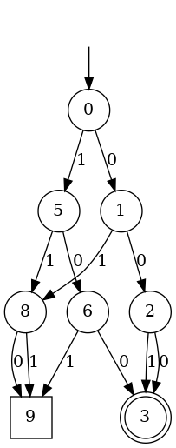
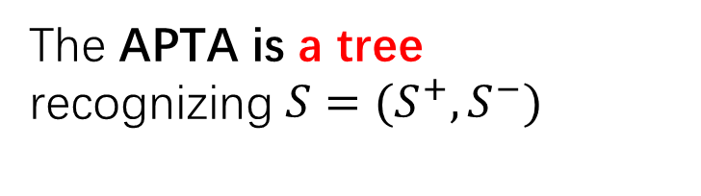
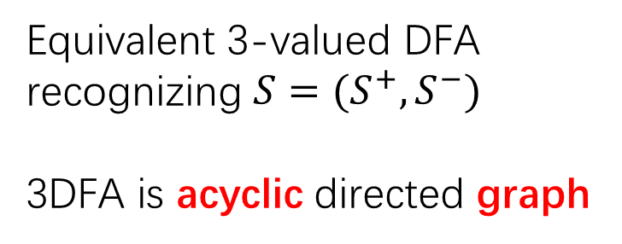
Our observation
The APTA is a tree
recognizing $S=(S^{+},S^{−})$
Equivalent 3-valued DFA recognizing $S=(S^{+},S^{−})$
3DFA is acyclic directed graph

Slide 14
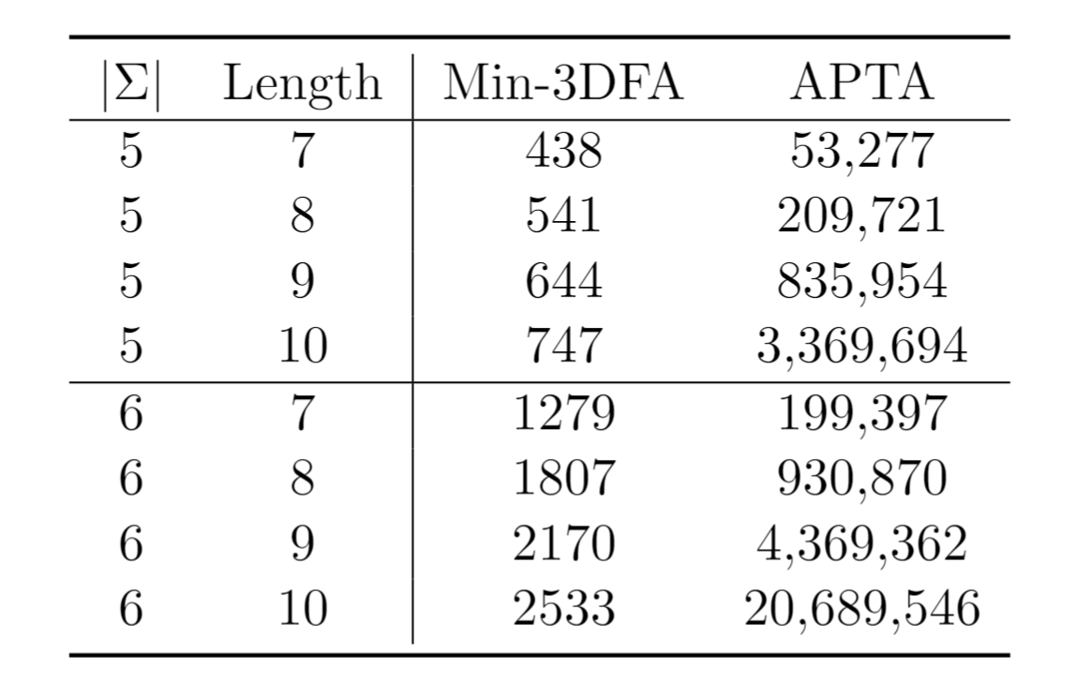
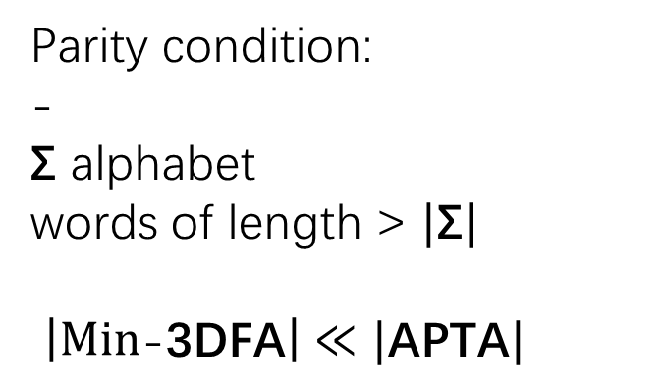
Size Comparison
Parity condition:
-
Σ alphabet
words of length > $|\text{Σ}|$
$\left|Min\text{−}\text{3}\text{DFA}\right|≪|\text{APTA}|$

Slide 15
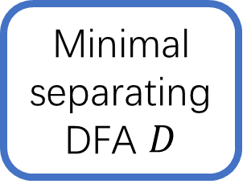



Our contribution
$S=(S^{+},S^{−})$
$S^{+}$
Incremental construction
Min-3DFA
SAT encoding
Minimal separating DFA $D$
$S^{−}$
Incremental construction of the Min-3DFA for $S=(S^{+},S^{−})$

Slide 16
Reduction Rules
$S=(S^{+},S^{−})$ where $S^{+}=\left\{000, 001, 100\right\}$
$$S^{−}=\{010,011, 101, 110,111\}$$
Bottom-up minimization
Merge equivalent states having:
Same accepting type
Same successor over each letter

Slide 17
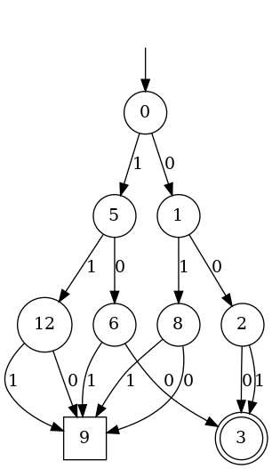
Observation
$S=(S^{+},S^{−})$ where $S^{+}=\left\{000, 001, 100\right\}$
$$S^{−}=\{010,011, 101, 110,111\}$$
Step 1
Merge states having
same accepting type

Slide 18
Observation
$S=(S^{+},S^{−})$ where $S^{+}=\left\{000, 001, 100\right\}$
$$S^{−}=\{010,011, 101, 110,111\}$$
Step 2
Merge states having
same successor over each letter

Slide 19
Question
We still need to build the APTA first
save space for the encoding step
How to avoid the construction of the APTA?
save time and space in both steps

Slide 20
Core idea of incremental construction
Order the words in lexicographical order
Decide the states that will not have more successors
Merge equivalent states

Slide 21
Core idea of incremental construction
Order the words in lexicographical order
Decide the states that will not have more successors
Merge equivalent states
Theorem 1:
Our incremental construction produces
the minimal 3DFA recognizing the given samples

Slide 22


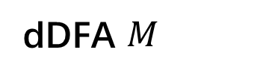
Alternative construction
dDFA $M$
$S=(S^{+},S^{−})$
Min-3DFA $M^{+}$
$S^{+}$
Incremental construction
SAT encoding
Minimal separating DFA $D$
Min-3DFA $M^{−}$
$S^{−}$
Incremental construction of the dDFA for $S=(S^{+},S^{−})$
22

Slide 23
Empirical evaluation
DFAMiner:
3DFA + SAT
dDFA + SAT
DFAInductor:
APTA + SAT
DFAIdentify:
APTA + SAT (graph coloring)

Slide 24
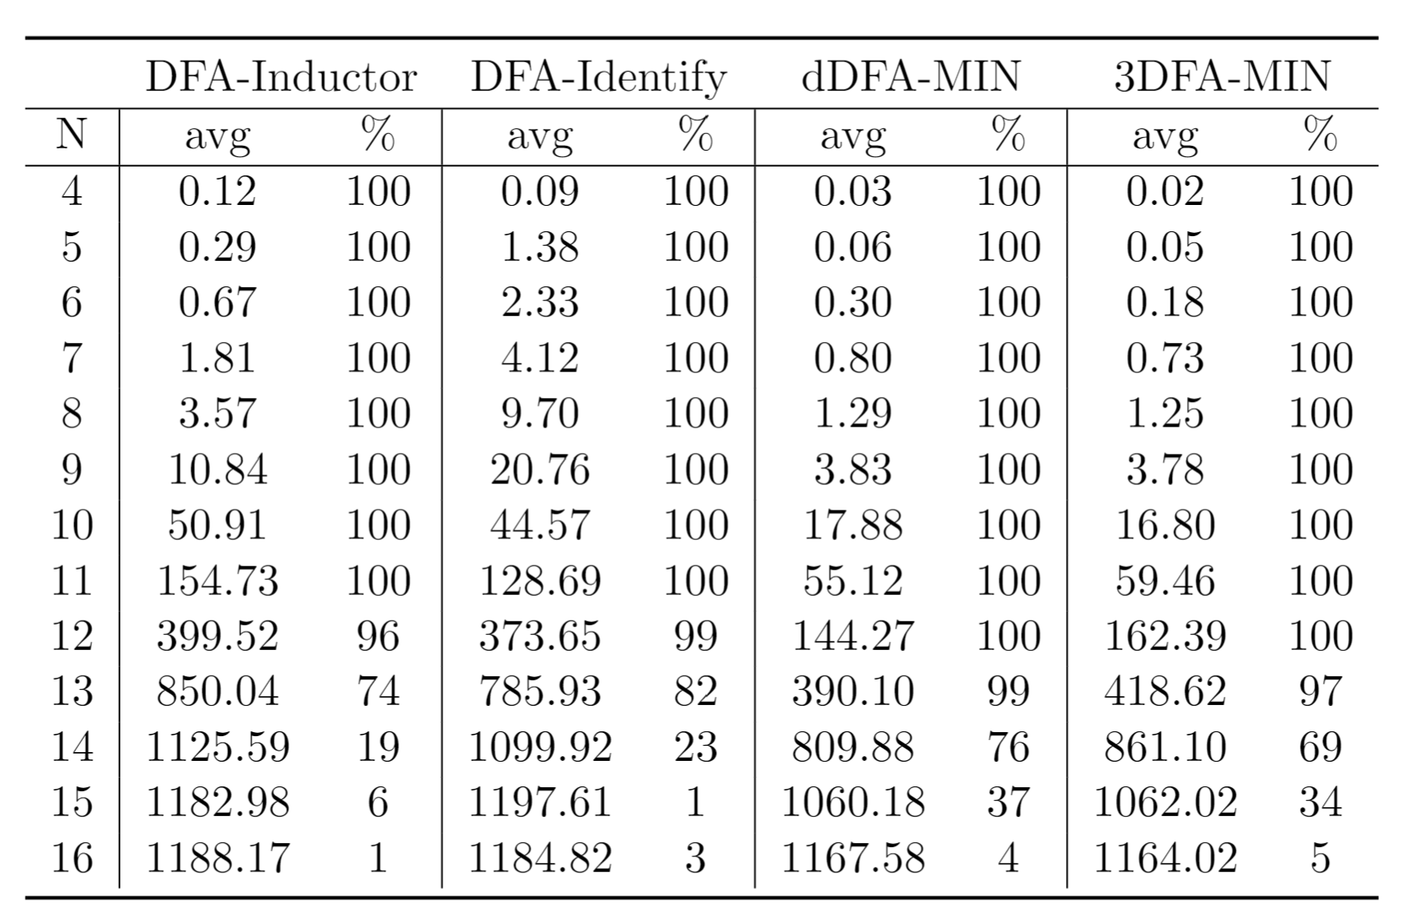
Runtime comparison on random samples
100 cases
50 * N samples
20min timeout

Slide 25
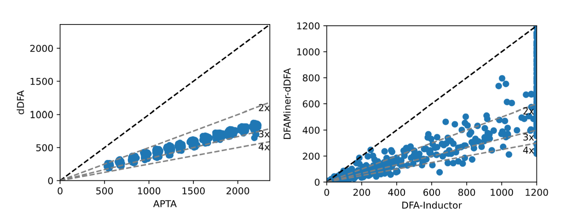
Scatter plots on random samples
Automata size comparison
for samples before SAT
Runtime comparison
on each case

Slide 26
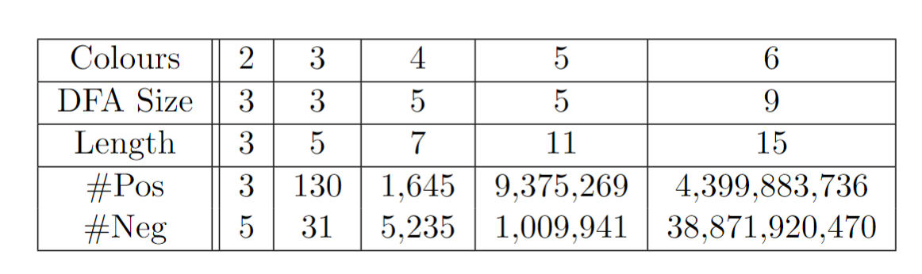
Results on parity game solving
Learning of the minimal safety automata for separating
■ even cycles: 000
■ odd cycles: 010

Slide 27
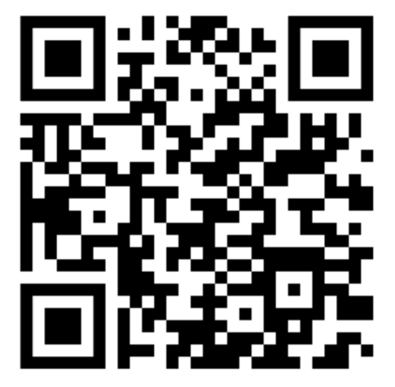
Summary
Incremental construction of 3DFA for samples
Significant performance improvement for learning separating DFA from samples
Application on a concrete problem (parity condition)
Future work:
Replacing deterministic automata with nondeterministic ones
Better sample generation for parity game solving
DFAMiner available at:
https://github.com/liyong31/DFAMiner

