Slide 1
Angluin-Style Learning of Deterministic Büchi and Co-Büchi Automata
Yong Li, Sven Schewe and Qiyi Tang
University of Liverpool

Slide 2




Angluin’s learning framework
Learner
Teacher
MQ($u$): Does $u$ belong to L
Membership queries
Yes/No
MQ results
Resolving queries
EQ($B$): Does $B$ recognise L
Equivalence queries
No + $v∈L⊝L(B)$
Yes
Output correct $B$

Slide 3




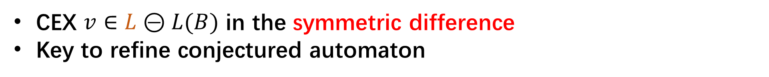
Angluin’s learning framework
CEX $v∈L⊝L(B)$ in the symmetric difference
Key to refine conjectured automaton
$$L$$
$$L(B)$$
$$v$$
$$v$$

Slide 4
Learning applications
Assumptions for compositional verification [Cobleigh et al 2003]
Finding bugs for network protocol implementations [de Ruiter &Poll, 2015]
Automata model for neural networks [Weiss et al 2019; Xu et al. 2021 ; Muškardin et al. 2022]
Extremely useful to learn and understand black-box systems

Slide 5
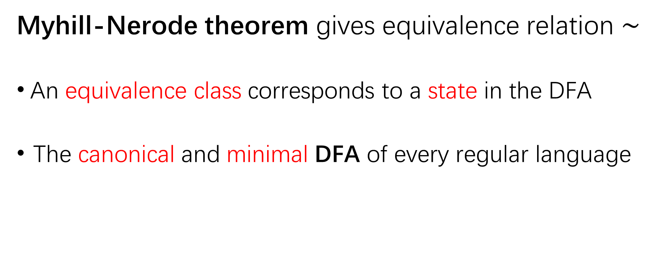
Foundation of Angluin’s DFA learning
Myhill-Nerode theorem gives equivalence relation $\sim$
An equivalence class corresponds to a state in the DFA
The canonical and minimal DFA of every regular language

Slide 6

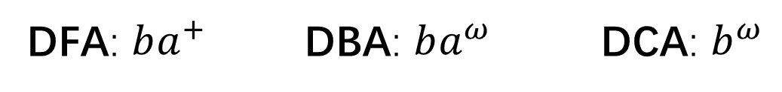


What about automata over infinite words?
More expressive than DFAs
No canonical and minimal forms of deterministic automata with Büchi, co-Büchi conditions (DBAs/DCAs)
$$b$$
$$a$$
$$a$$
DFA: $ba^{+}$ DBA: $ba^{ω}$ DCA: $b^{ω}$

Slide 7
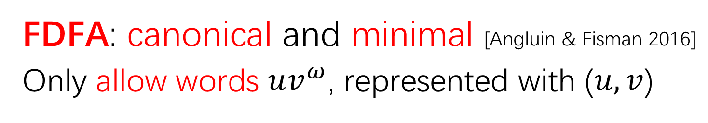
What about automata over infinite words?
More expressive than DFAs
No canonical and minimal forms of deterministic automata with Büchi, co-Büchi conditions (DBAs/DCAs)
FDFA: canonical and minimal [Angluin & Fisman 2016]
Only allow words $uv^{ω}$, represented with ($u,v$)

Slide 8
Our contributions
First Angluin-style learning algorithm for
DBAs/DCAs
(via FDFA learning)

Slide 9








Angluin’s learning framework
DBA Learner
DBA Teacher
MQ($u,v$)
MQ($uv^{ω}$): Does $uv^{ω}$ belong to L
Yes/No
FDFA
Learner
Resolving queries about DBAs
EQ($F$)
EQ($B[F]$): Does $B[F]$ recognise L
DBA $B[F]$
No + $(x,y)$
No + $uv^{ω}∈L⊝L(B\left[F\right])$
CEX Analysis
Yes
Output correct $B[F]$

Slide 10



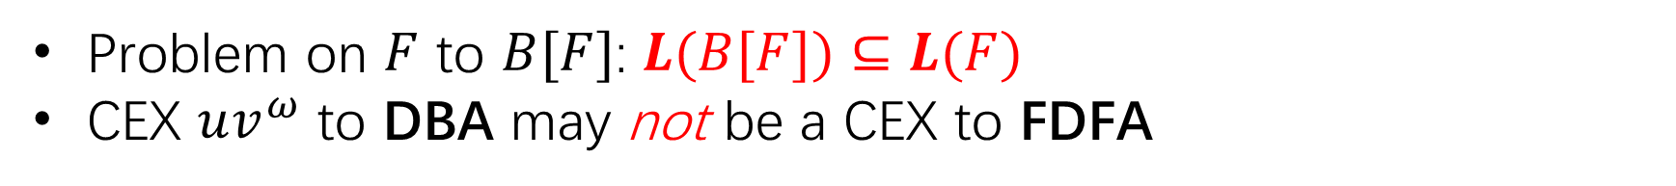



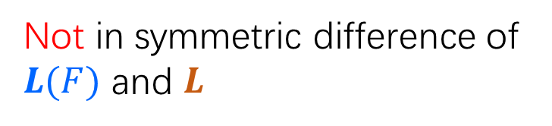
Main challenge
Problem on $F$ to $B[F]$: $L(B[F])⊆L(F)$
CEX $uv^{ω}$ to DBA may not be a CEX to FDFA
$$L(B[F])$$
$$L$$
$$L(F)$$
$uv^{ω}$
$uv^{ω}$
$uv^{ω}$
Good CEX
Not in symmetric difference of $L(F)$ and $L$

Slide 11
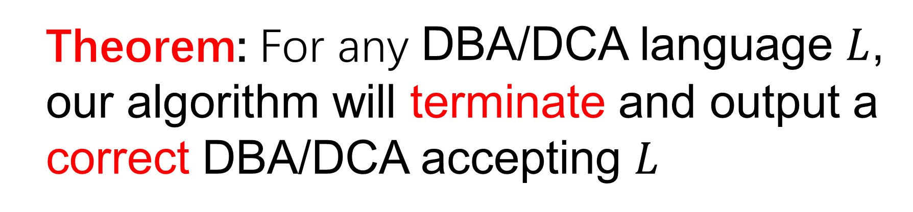
Main results
Theorem: For any DBA/DCA language $L$, our algorithm will terminate and output a correct DBA/DCA accepting $L$

Slide 12
Conclusion
First Angluin-style learning of DBAs/DCAs
Open problems:
Exact upper bound w.r.t. the minimal DBA?
Polynomial-time learning algorithm?

