Slide 1
DAG-Based Compositional Approaches for LTLf to DFA Conversions
Suguman Bansal, Yash Kankariya Yong Li
Georgia Institute of Technology, USA
University of Liverpool, UK

Slide 2
Linear Temporal Logic over finite traces (LTLf) [De Giacomo and Vardi; IJCAI 2013]
Describes behaviors of finite but unbounded length
Same syntax as Linear Temporal Logic (LTL)
Example: F (￢(X true) ∧ a)
“a holds at the last position”

Slide 3


LTLf synthesis [De Giacomo and Vardi; IJCAI 2015]
LTLf formula
Adversarial Environment
DFA
input
output
Solve DFA game
Reactive System

Slide 4
Our focus: LTLf to DFA [De Giacomo and Vardi; IJCAI 2013]
The foundation of such applications
The main bottleneck for LTLf synthesis

Slide 5
Current compositional methodology
Abstract Syntax Tree
LTLf
DFA
AST
Decomposition phase
Composition phase:
Leaves to root
AST: leaves are arbitrary LTLf formulas rather than atoms
Assumption: off-the-shelf DFA conversion tool for leaf formulas at hand, e.g. Mona
Notes:
DFA construction for leaves can be unfolding formulas or compositional

Slide 6
Our contributions
Highlight three optimizations in decomposition:
Balanced depth for AST unrolling
Duplicate removal
Formula transformation
Speedups up to 8000x against the state of art tools Lisa and Lydia

Slide 7
AST unrolling depth
(F a ∨ G b) ∧ (F a ∨ (c U d))
Lisa
Lydia
∧
∧
∨
∨
F
G
F
U
F a ∨ G b
F a ∨ (c U d)
a
b
a
c
d
Only outmost ops
Large leaf formulas
Polytime compositions
Until atoms
Small leaf formulas
Exptime projection/determinization in compositions
Notes:
Mention why large or small directly external conversion tool for leaf subformulas

Slide 8
AST unrolling depth
(F a ∨ G b) ∧ (F a ∨ (c U d))
Lisa
Lydia
Ours
∧
∧
∧
∨
∨
∨
∨
F
G
F
U
F a ∨ G b
F a ∨ (c U d)
a
b
a
c
d
Fa
Gb
Fa
cUd
Only outmost ops
Large leaf formulas
Polytime compositions
Until atoms
Small leaf formulas
Exptime projection/determinization in compositions
Until temporal ops
More balanced depth

Slide 9
Duplicate removal
(F a ∨ G b) ∧ (F a ∨ (c U d))
Directed Acyclic Graph (DAG)
∧
∧
∨
∨
∨
∨
Fa
Gb
Gb
Fa
cUd
Fa
cUd
Avoid redundant DFA constructions:
only lightweight syntax check of formulas

Slide 10
Formula transformation
(F a ∨ G b) ∧ (F a ∨ (c U d))
∧
∧
∨
∨
∨
Fa
Gb
Fa
cUd
Gb
cUd
Apply associative law to reduce the number of nodes (i.e., composition steps): 3 to 2

Slide 11
Empirical Evaluation
Lisa: Spot-based
Lisa-Explicit
Lydia: Mona-based
Lisa2: Spot-based or Mona-based
Lisa2-Spot vs. Lisa and Lisa-Explicit
Lisa2-Mona vs. Lydia
Benchmarks: LTLf track from SYNTCOMP 2023
Random + Structured (Counter, Counters, Nim)
4 hrs timeout

Slide 12
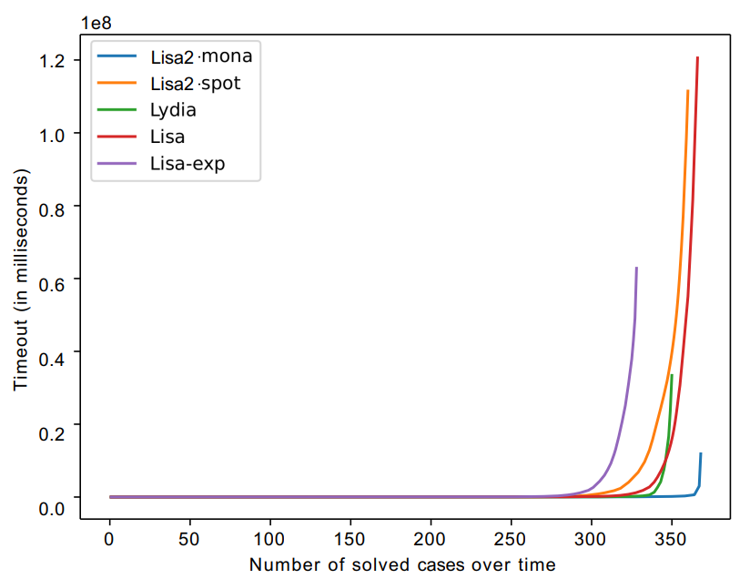
Cactus plot: All benchmarks
Lisa2-Mona: most benchmarks with least runtime
Lisa2-Spot: better than Lisa-Explicit
Notes:
Bottom right corner is the best

Slide 13
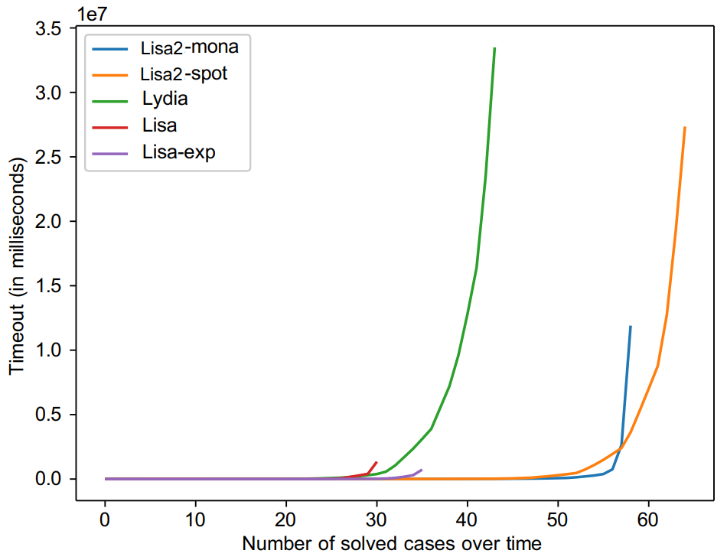
Cactus plot: structured benchmarks
Lisa2-Spot solves most structured benchmarks
Lisa2 is better than both Lisa and Lydia

Slide 14
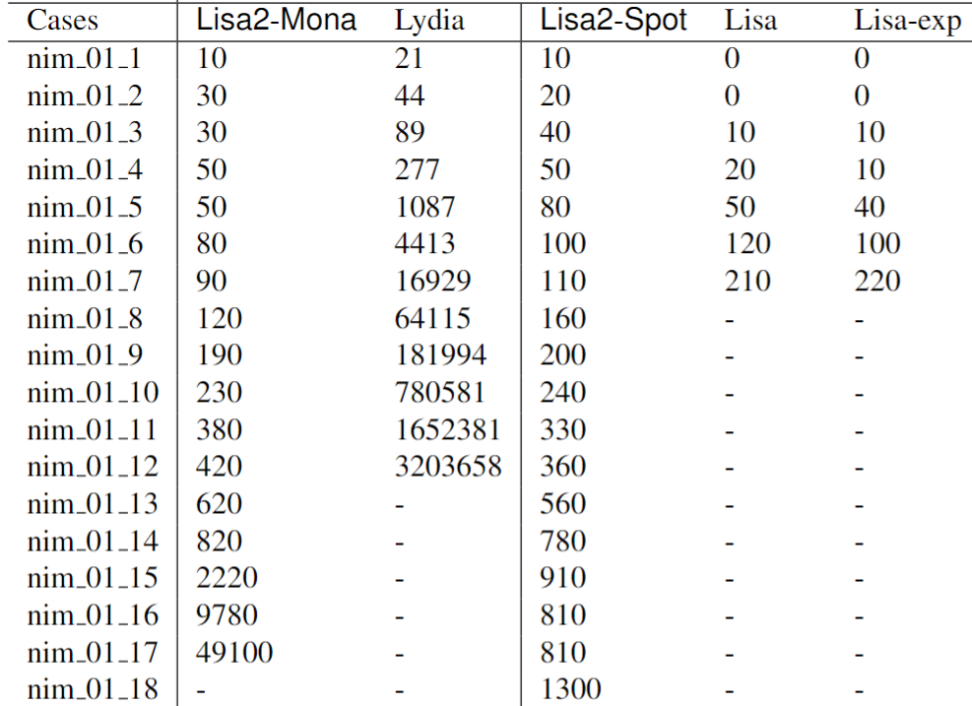
Comparison on challenging Nim benchmarks
Lisa2: more significant on most challenging class
Up to 8000x speedup
Lisa/Lydia failure: Large intermediate DFAs but small final DFA;
ours is more balanced

Slide 15
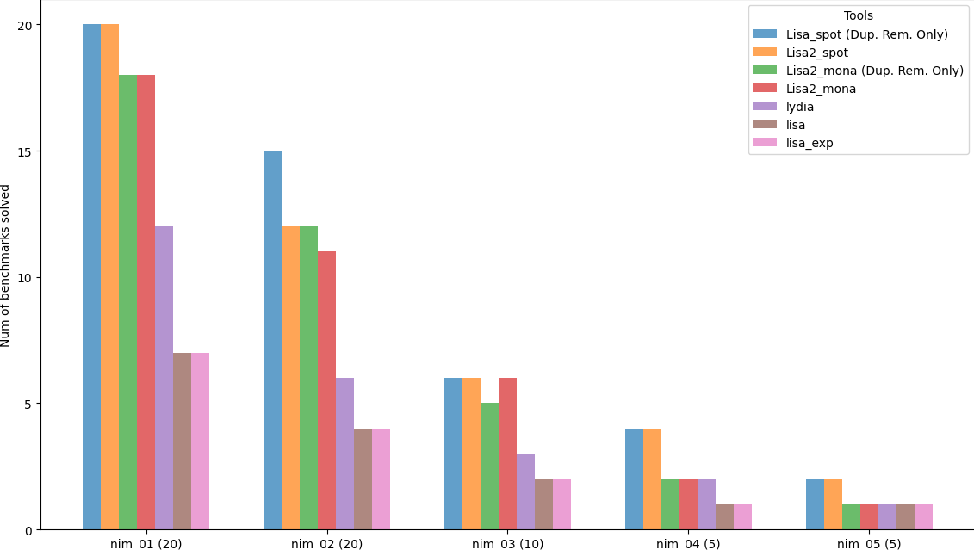
Effect of formula transformation
Lisa2-Mona:
transformation can improve performance but not stable
Hard to predict because of new formulas created
Worse
Better

Slide 16

Conclusion
Three optimizations in decomposition
Lisa2 improves significantly over state of the arts
Available at https://github.com/suguman-lab/lisa2
Open problems:
Can we dynamically construct DAG during composition?
Find Lisa2 here

Slide 17
Backup slides

Slide 18
Current compositional conversion
∧
∨
∨
(F a ∨ G b) ∧ (F a ∨ (c U d))
F
G
F
U
a
b
a
c
d
Decompose
Composition phase:
Leaves to root traversal

Slide 19
Current compositional conversion
∧
∨
∨
(F a ∨ G b) ∧ (F a ∨ (c U d))
F
G
F
U
a
b
a
c
d
Decompose
Composition phase:
Leaves to root traversal

Slide 20
AST unrolling depth
outmost op only
∧
Lisa
(F a ∨ G b) ∧ (F a ∨ (c U d))
F a ∨ G b
F a ∨ (c U d)
∧
Until atoms
Lydia
(Mona-based)
∨
∨
(F a ∨ G b) ∧ (F a ∨ (c U d))
F
G
F
U
a
b
a
c
d

Slide 21
Current compositional conversion
abstract syntrax tree (AST)
∧
∨
∨
(F a ∨ G b) ∧ (F a ∨ (c U d))
F
G
F
U
a
b
a
c
d

Slide 23
Reinforcement Learning with LTLf Spec [Toro Icarte et al. 2022]
Environment
LTLf formula
DFA
State &
Reward
action
DFA Reward
Machine
Agent

Slide 24
AST unrolling depth
(F a ∨ G b) ∧ (F a ∨ (c U d))
Lisa
Lydia
(Mona-based)
Ours
∧
∧
∧
∨
∨
∨
∨
F
G
F
U
F a ∨ G b
F a ∨ (c U d)
Fa
Gb
Fa
cUd
a
b
a
c
d
Until atoms
Small subformulas
Composition involves exptime projection/determinization
Only outmost ops
Large subformulas
Polytime compositions
More balanced depth

