Slide 1


Congruence Relations for Büchi Automata
Yong Li, Yih-Kuen Tsay, Andrea Turrini
Moshe Y. Vardi and Lijun Zhang

Slide 2
Why CRs are important
Complementation of nondeterministic Büchi automata (NBAs) [Sistla, Vardi & Wolper’87; Thomas’90]
Universality/inclusion checking for NBAs [Fogarty, Vardi’10; Abdulla et al.’10; Abdulla et al.’11]
Automata-theoretic verification framework in formal methods [Vardi & Wolper’86]

Slide 3
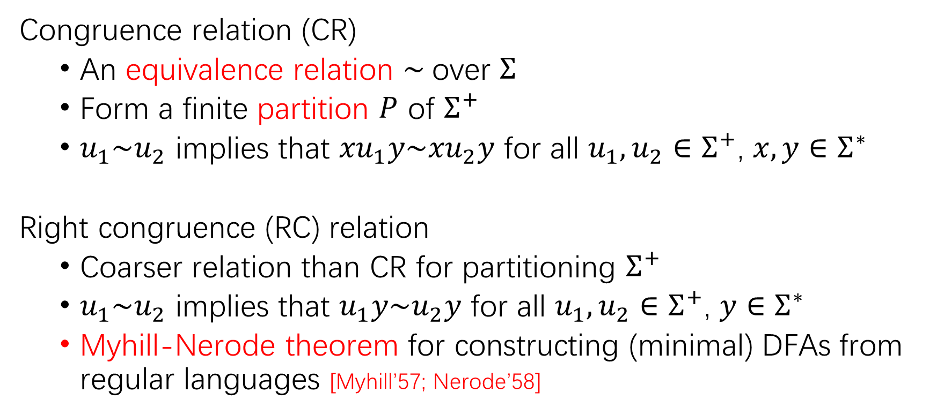
What are congruence relations (CRs)
Congruence relation (CR)
An equivalence relation $\sim$over $Σ$
Form a finite partition $P$ of $Σ^{+}$
$u_{1}\sim u_{2}$ implies that ${xu}_{1}y\sim {xu}_{2}y$ for all $u_{1},u_{2}∈$ $Σ^{+}$, $x, y∈$ $Σ^{∗}$
Right congruence (RC) relation
Coarser relation than CR for partitioning $Σ^{+}$
$u_{1}\sim u_{2}$ implies that $u_{1}y\sim u_{2}y$ for all $u_{1},u_{2}∈$ $Σ^{+}$, $y∈$ $Σ^{∗}$
Myhill-Nerode theorem for constructing (minimal) DFAs from regular languages [Myhill’57; Nerode’58]

Slide 4

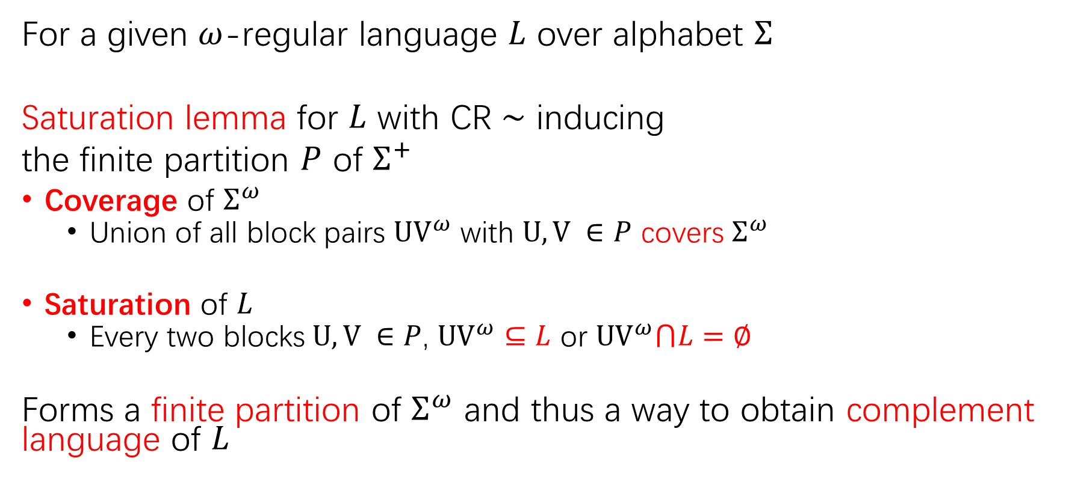


What CRs do [Sistla, Vardi & Wolper’87; Thomas’90]
For a given $ω$-regular language $L$ over alphabet $Σ$
Saturation lemma for $L$ with CR $\sim$ inducing
the finite partition $P$ of $Σ^{+}$
Coverage of $Σ^{ω}$
Union of all block pairs $UV^{ω}$ with $U, V ∈P$ covers $Σ^{ω}$
Saturation of $L$
Every two blocks $U, V ∈P$, $UV^{ω}⊆L$ or $UV^{ω}⋂L=∅$
Forms a finite partition of $Σ^{ω}$ and thus a way to obtain complement language of $L$
$$⊆L$$
$$⋂L=∅$$
Universe $Σ^{ω}$

Slide 5
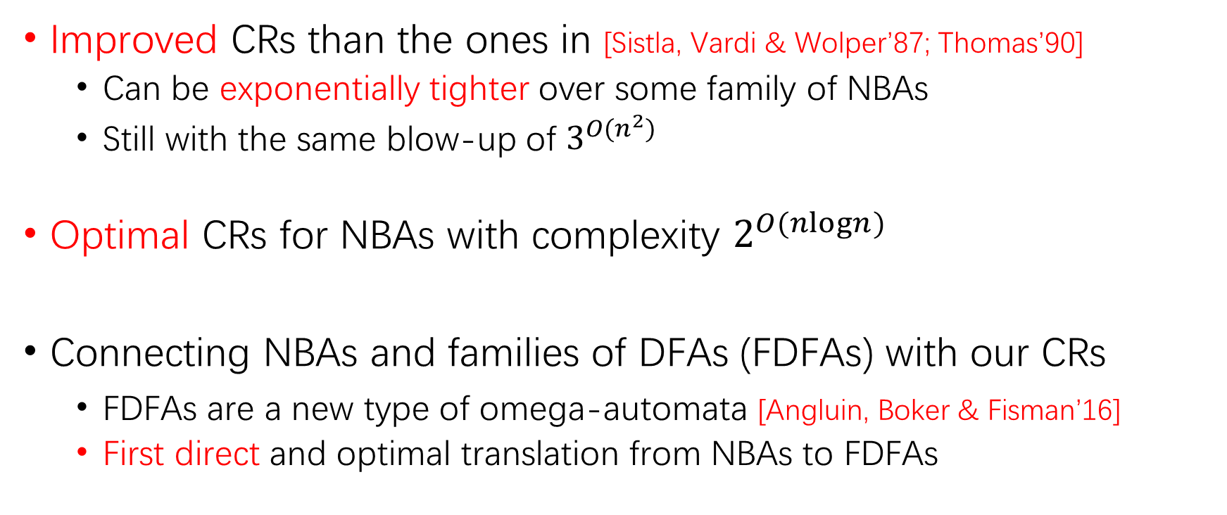
Our contributions
Improved CRs than the ones in [Sistla, Vardi & Wolper’87; Thomas’90]
Can be exponentially tighter over some family of NBAs
Still with the same blow-up of $3^{O(n^{2})}$
Optimal CRs for NBAs with complexity $2^{O(nlogn)}$
Connecting NBAs and families of DFAs (FDFAs) with our CRs
FDFAs are a new type of omega-automata [Angluin, Boker & Fisman’16]
First direct and optimal translation from NBAs to FDFAs

Slide 6
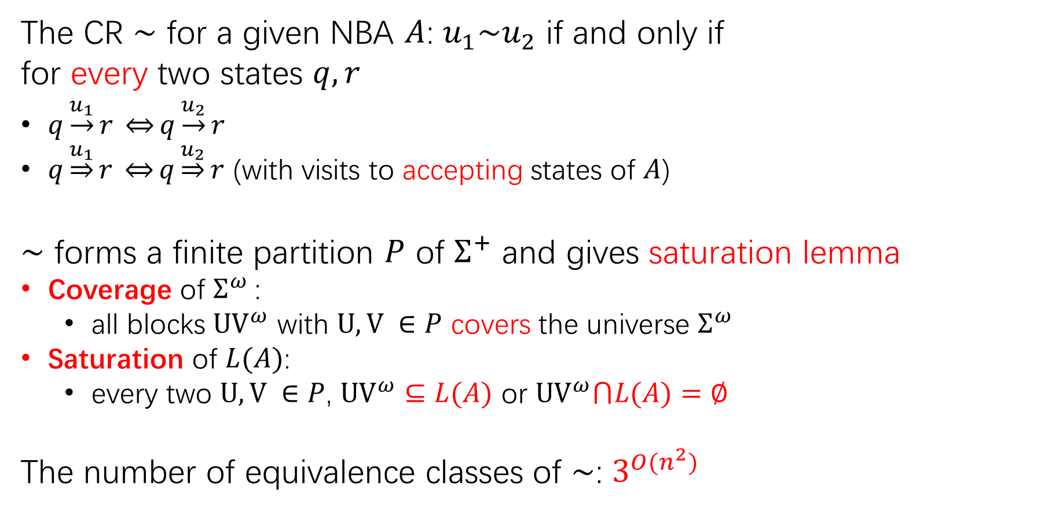
Classical CRs for NBAs [Sistla, Vardi & Wolper’87; Thomas’90]
The CR $\sim$ for a given NBA $A$: $u_{1}\sim u_{2}$ if and only if
for every two states $q,r$
$q\underset{→}{u_{1}}r \underset{⇔}{}q\underset{→}{u_{2}}r$
$q\underset{⇒}{u_{1}}r \overset{⇔}{}q\underset{⇒}{u_{2}}r$ (with visits to accepting states of $A$)
$\sim$ forms a finite partition $P$ of $Σ^{+}$ and gives saturation lemma
Coverage of $Σ^{ω}$:
all blocks $UV^{ω}$ with $U, V ∈P$ covers the universe $Σ^{ω}$
Saturation of $L(A)$:
every two $U, V ∈P$, $UV^{ω}⊆L(A)$ or $UV^{ω}⋂L(A)=∅$
The number of equivalence classes of $\sim$: $3^{O(n^{2})}$
Notes:
Start from the classical congruence relation; two words are related we can not distinguish the words with the reachability between the two states over the words; we can satisfy the saturation lemma and the complexity is ….

Slide 7
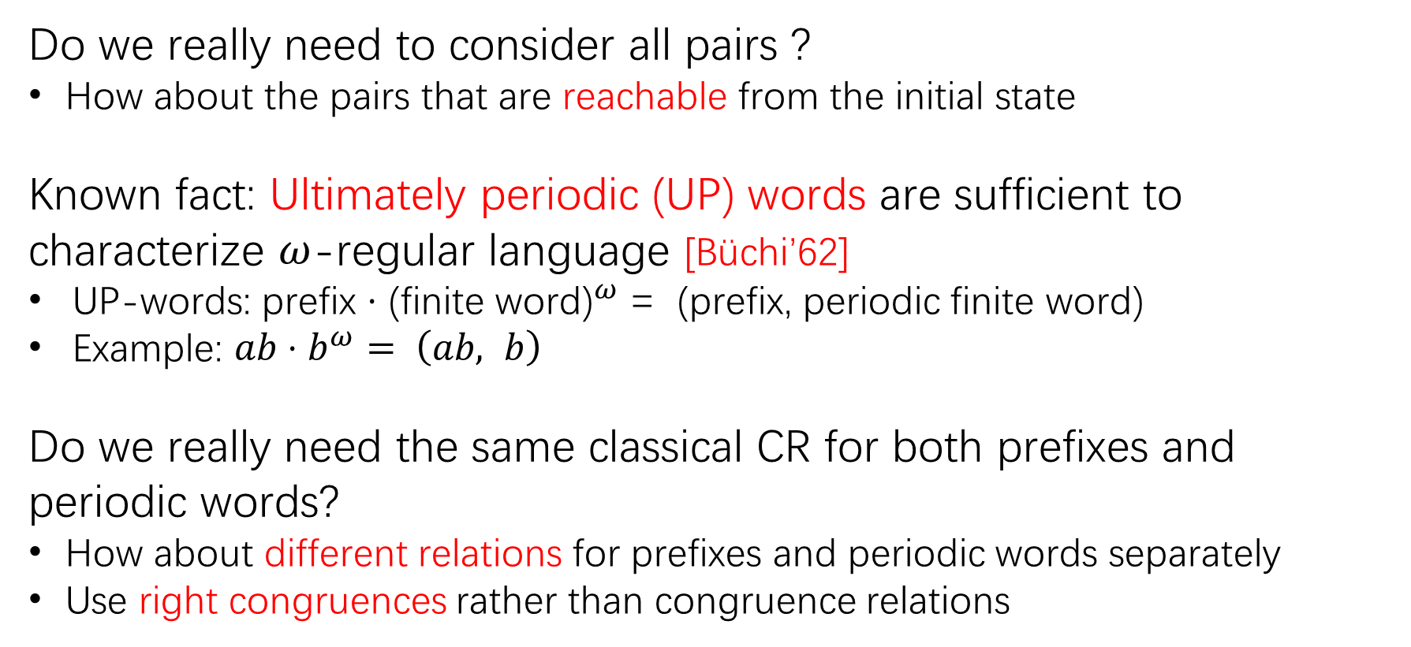
Insights
Do we really need to consider all pairs ?
How about the pairs that are reachable from the initial state
Known fact: Ultimately periodic (UP) words are sufficient to characterize $ω$-regular language [Büchi’62]
UP-words: prefix $⋅$ (finite word${\text{)}}^{ω}$ = (prefix, periodic finite word)
Example: $ab⋅b^{ω}$ $= \left(ab, b\right)$
Do we really need the same classical CR for both prefixes and periodic words?
How about different relations for prefixes and periodic words separately
Use right congruences rather than congruence relations

Slide 8
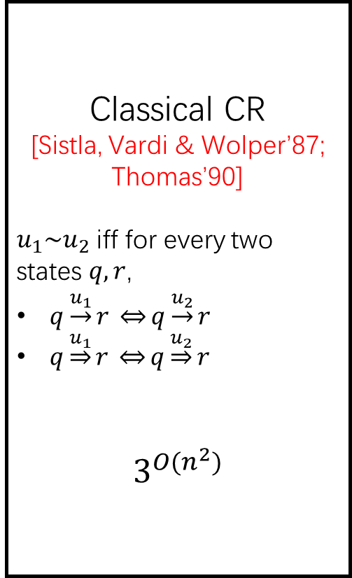
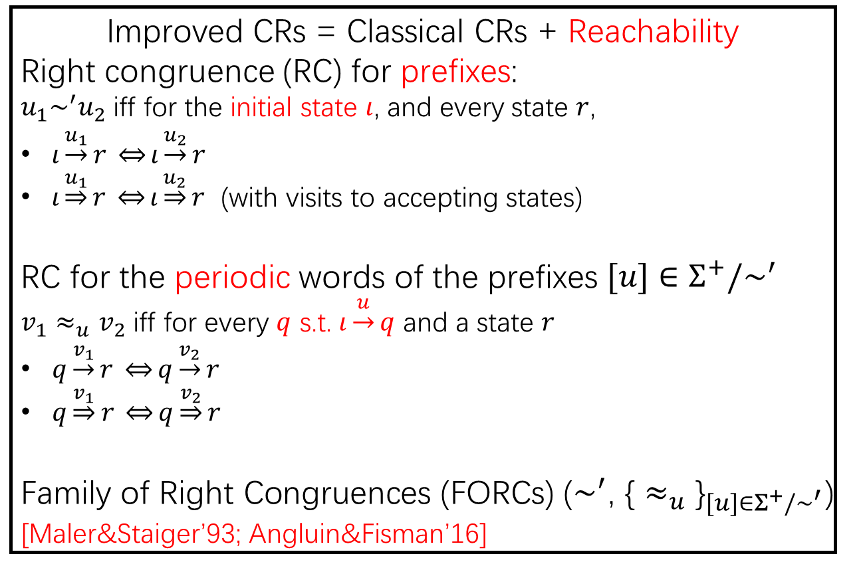
Improved CRs with Reachability
Classical CR
[Sistla, Vardi & Wolper’87; Thomas’90]
$u_{1}\sim u_{2}$ iff for every two states $q,r$,
$q\underset{→}{u_{1}}r \underset{⇔}{}q\underset{→}{u_{2}}r$
$q\underset{⇒}{u_{1}}r \overset{⇔}{}q\underset{⇒}{u_{2}}r$
$$3^{O(n^{2})}$$
Improved CRs = Classical CRs + Reachability
Right congruence (RC) for prefixes:
$u_{1}\sim ^{′}u_{2}$ iff for the initial state $ι$, and every state $r$,
$ι\underset{→}{u_{1}}r \underset{⇔}{}ι\underset{→}{u_{2}}r$
$ι\underset{⇒}{u_{1}}r \overset{⇔}{}ι\underset{⇒}{u_{2}}r$ (with visits to accepting states)
RC for the periodic words of the prefixes $[u]∈Σ^{+}/\sim ^{′}$
$v_{1}≈_{u}v_{2}$ iff for every $q$ s.t. $ι\underset{→}{u}q$ and a state $r$
$q\underset{→}{v_{1}}r \underset{⇔}{}q\underset{→}{v_{2}}r$
$q\underset{⇒}{v_{1}}r \overset{⇔}{}q\underset{⇒}{v_{2}}r$
Family of Right Congruences (FORCs) ($\sim ^{′}$, ${\text{\{}≈_{u}\text{\}}}_{[u]∈Σ^{+}/\sim ^{′}}$) [Maler&Staiger’93; Angluin&Fisman’16]
Notes:
Finite prefixes, require reach the same set of states, for periodic part, we require to visit the same states but also require as before, this means that we just restrict the first state q to be reachable from the initial state

Slide 9
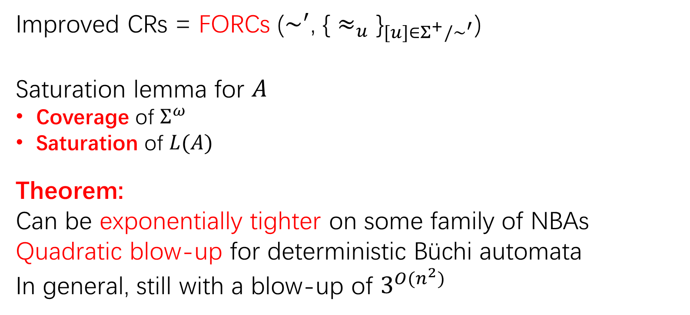
Improved CRs with Reachability
Improved CRs = FORCs ($\sim ^{′}$, ${\text{\{}≈_{u}\text{\}}}_{[u]∈Σ^{+}/\sim ^{′}}$)
Saturation lemma for $A$
Coverage of $Σ^{ω}$
Saturation of $L(A)$
Theorem:
Can be exponentially tighter on some family of NBAs
Quadratic blow-up for deterministic Büchi automata
In general, still with a blow-up of $3^{O(n^{2})}$
Notes:
Better results, in worst case, we fall back to the original complexity

Slide 10
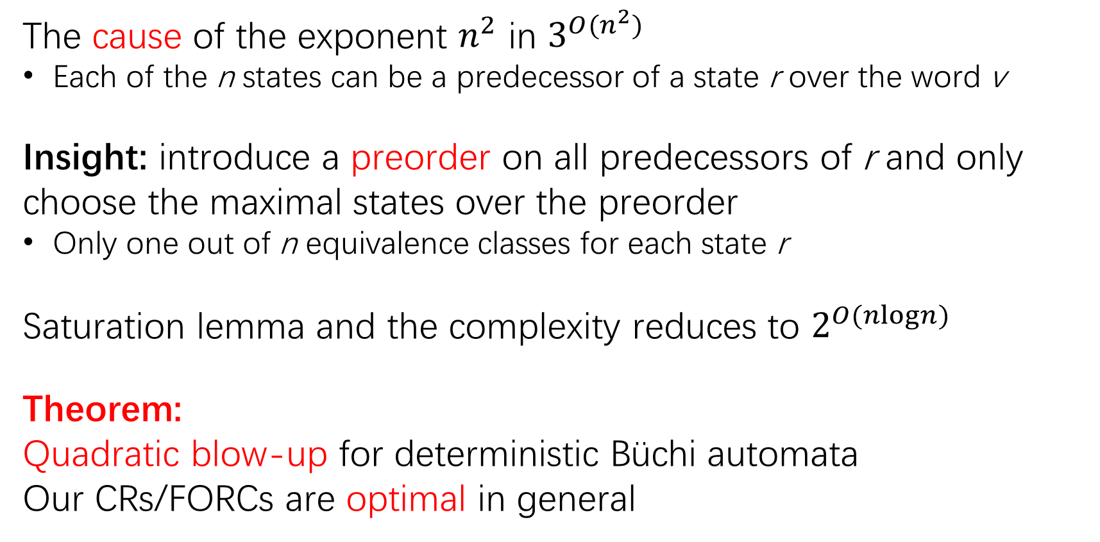
Optimal CRs/FORCs
The cause of the exponent $n^{2}$ in $3^{O(n^{2})}$
Each of the n states can be a predecessor of a state r over the word v
Insight: introduce a preorder on all predecessors of r and only choose the maximal states over the preorder
Only one out of n equivalence classes for each state r
Saturation lemma and the complexity reduces to $2^{O(nlogn)}$
Theorem:
Quadratic blow-up for deterministic Büchi automata
Our CRs/FORCs are optimal in general
Notes:
Refer to the paper for details

Slide 11
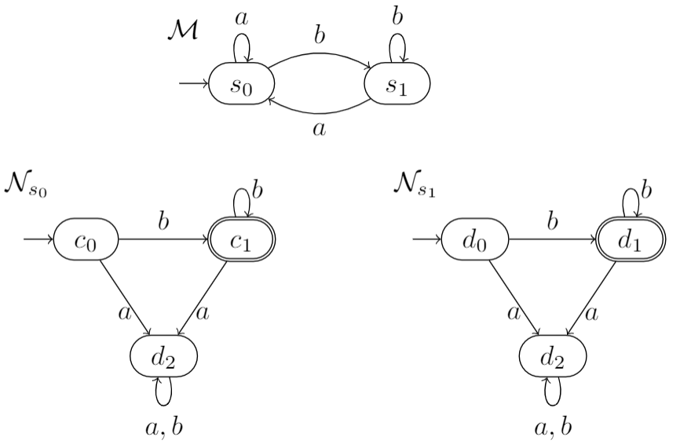
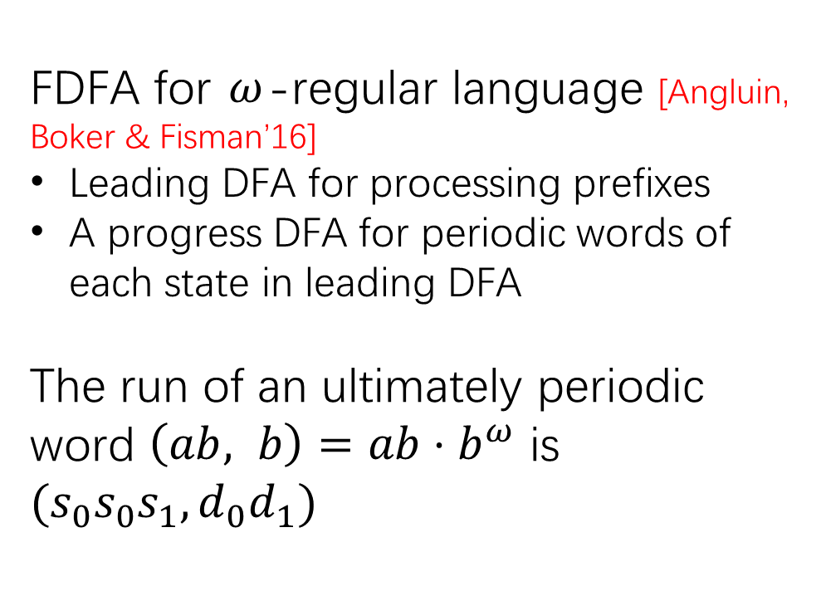
Connection to FDFAs: What are FDFAs
FDFA for $ω$-regular language [Angluin, Boker & Fisman’16]
Leading DFA for processing prefixes
A progress DFA for periodic words of each state in leading DFA
The run of an ultimately periodic word $\left(ab, b\right)=ab⋅b^{ω}$ is
$$(s_{0}s_{0}s_{1}, d_{0}d_{1})$$
FDFA for $ω$-regular language $Σ^{∗}⋅b^{ω}={\left\{a,b\right\}}^{∗}⋅b^{ω}$

Slide 12
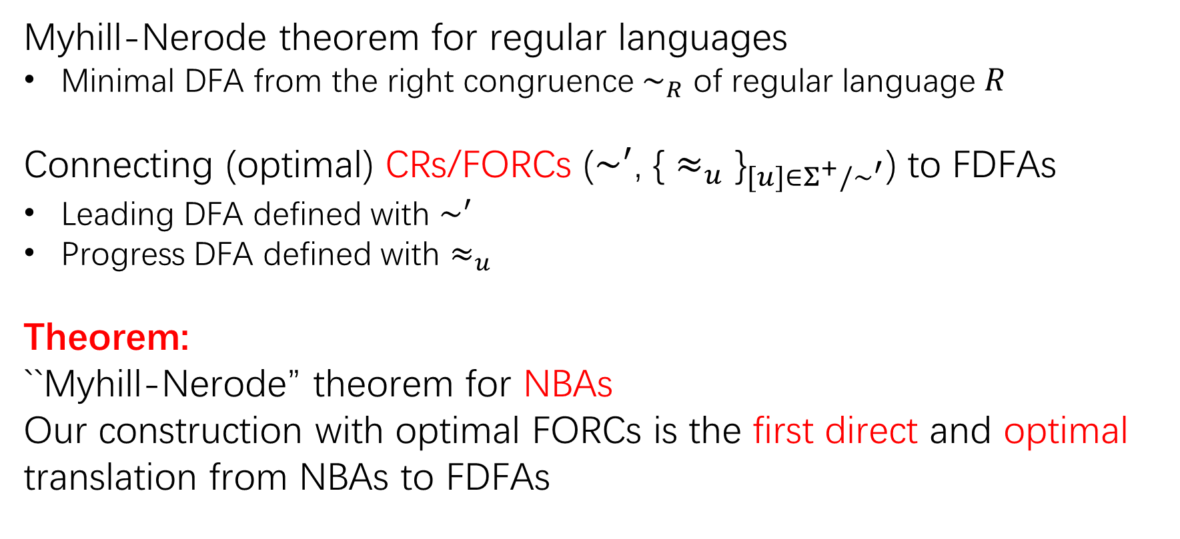
Connection to FDFAs
Myhill-Nerode theorem for regular languages
Minimal DFA from the right congruence $\sim _{R}$ of regular language $R$
Connecting (optimal) CRs/FORCs ($\sim ^{′}$, ${\text{\{}≈_{u}\text{\}}}_{[u]∈Σ^{+}/\sim ^{′}}$) to FDFAs
Leading DFA defined with $\sim ^{′}$
Progress DFA defined with $≈_{u}$
Theorem:
``Myhill-Nerode” theorem for NBAs
Our construction with optimal FORCs is the first direct and optimal translation from NBAs to FDFAs

Slide 13
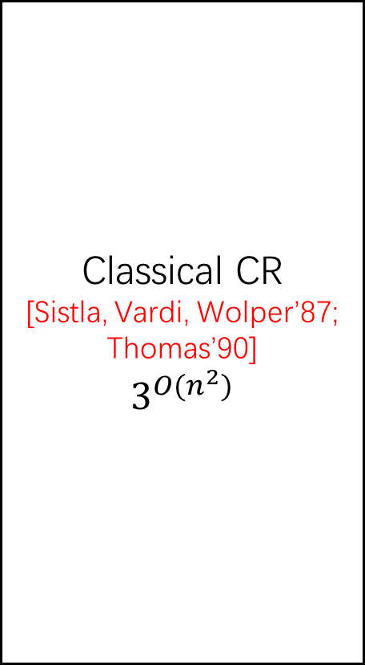
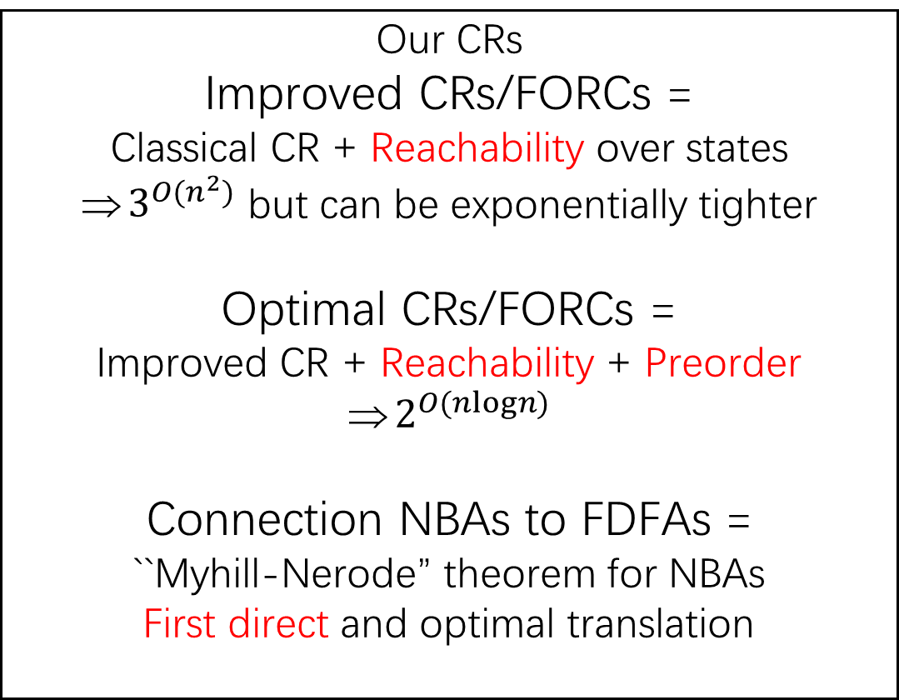
Conclusion: Our results
Classical CR
[Sistla, Vardi, Wolper’87; Thomas’90]
$$3^{O(n^{2})}$$
Our CRs
Improved CRs/FORCs =
Classical CR + Reachability over states
$3^{O(n^{2})}$ but can be exponentially tighter
Optimal CRs/FORCs =
Improved CR + Reachability + Preorder
$2^{O(nlogn)}$
Connection NBAs to FDFAs =
``Myhill-Nerode” theorem for NBAs
First direct and optimal translation
Notes:
Animation;

Slide 14
Conclusion
What we have done:
Improved CRs/FORCs exponentially better than classical ones
Optimal CRs/FORCs and Connecting NBAs to FDFAs
Myhill-Nerode theorem for NBAs
First direct and optimal translation from NBAs to FDFAs
Future work:
Better complementation algorithm via FORCs
Improving inclusion checking for NBAs via FORCs
Model checking based on FDFAs
Notes:
Model checking framework based on FDFAs instead of NBAs

Slide 15
Backup slides
Notes:
Model checking framework based on FDFAs instead of NBAs

Slide 16
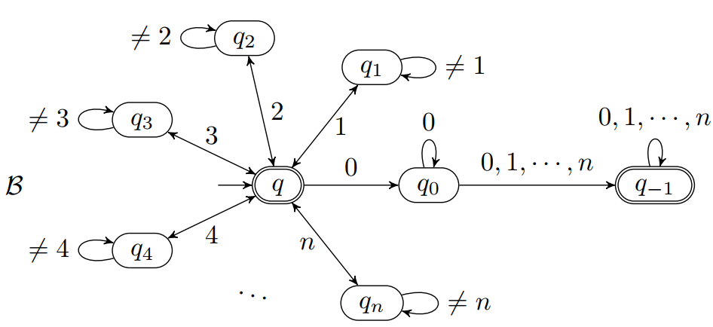
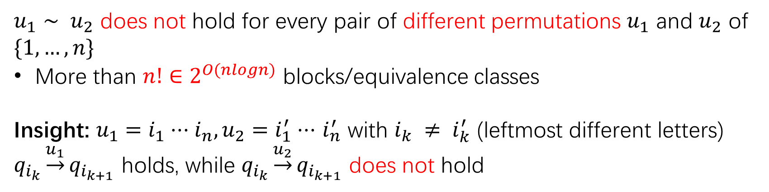
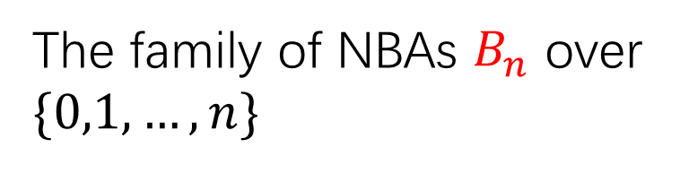
Reachability is important
The family of NBAs $B_{n}$ over $\{0,1,…,n\}$
$u_{1}∼ u_{2}$ does not hold for every pair of different permutations $u_{1}$ and $u_{2}$ of $\{1,…, n\}$
More than $n!∈2^{O(nlogn)}$ blocks/equivalence classes
Insight: $u_{1}=i_{1}⋅⋅⋅i_{n},u_{2}=i_{1}^{′}⋅⋅⋅$ $i_{n}^{′}$ with ${i_{k} ≠ i}_{k}^{′}$ (leftmost different letters)
$q_{i_{k}}\underset{→}{u_{1}}q_{i_{k+1}}$ holds, while $q_{i_{k}}\underset{→}{u_{2}}q_{i_{k+1}}$ does not hold

