Slide 1

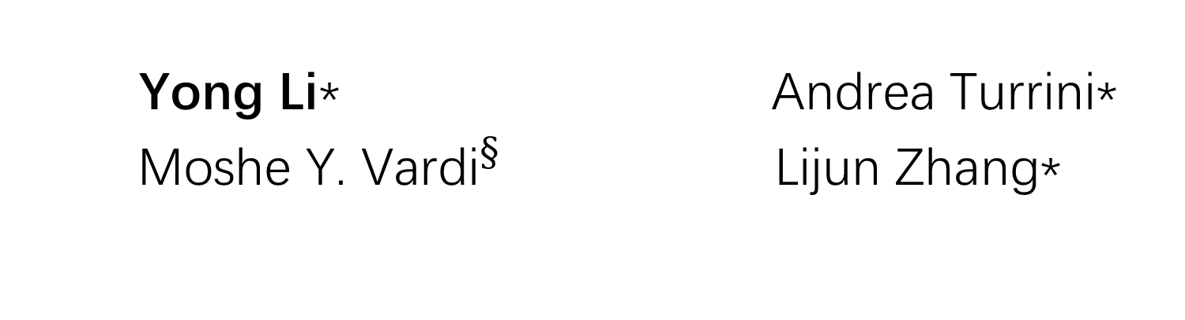
Synthesizing Good-Enough Strategies for LTLf Specifications
Yong Li* Andrea Turrini*
${\text{Moshe} \text{Y}\text{. }\text{Vardi}}^{§}$ Lijun Zhang*
*
$$§$$

Slide 2

Reactive systems/Strategies
A function ${σ:(input)}^{∗}→ output$
Physical
Environment
Sends inputs
Reactive
System
Replies outputs
Ongoing interaction
Notes:
Link back to the title, strategy on this slide

Slide 3
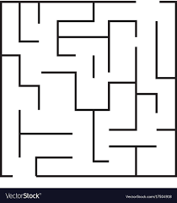

Application to robot navigation [He et .al. ICRA 2019]
Fixed grid
+
Moving obstacles
Find strategy
Reactive synthesis
for designing strategies

Slide 4
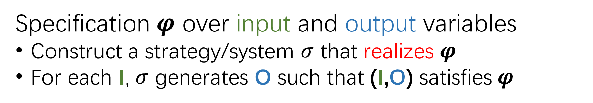


Reactive synthesis [Pnueli and Rosner; POPL 1989]
Automatically generate a correct strategy from a logical specification
$$φ$$
Reactive synthesis
$$σ$$
Specification $φ$ over input and output variables
Construct a strategy/system $σ$ that realizes $φ$
For each I, $σ$ generates O such that (I,O) satisfies$φ$

Slide 5
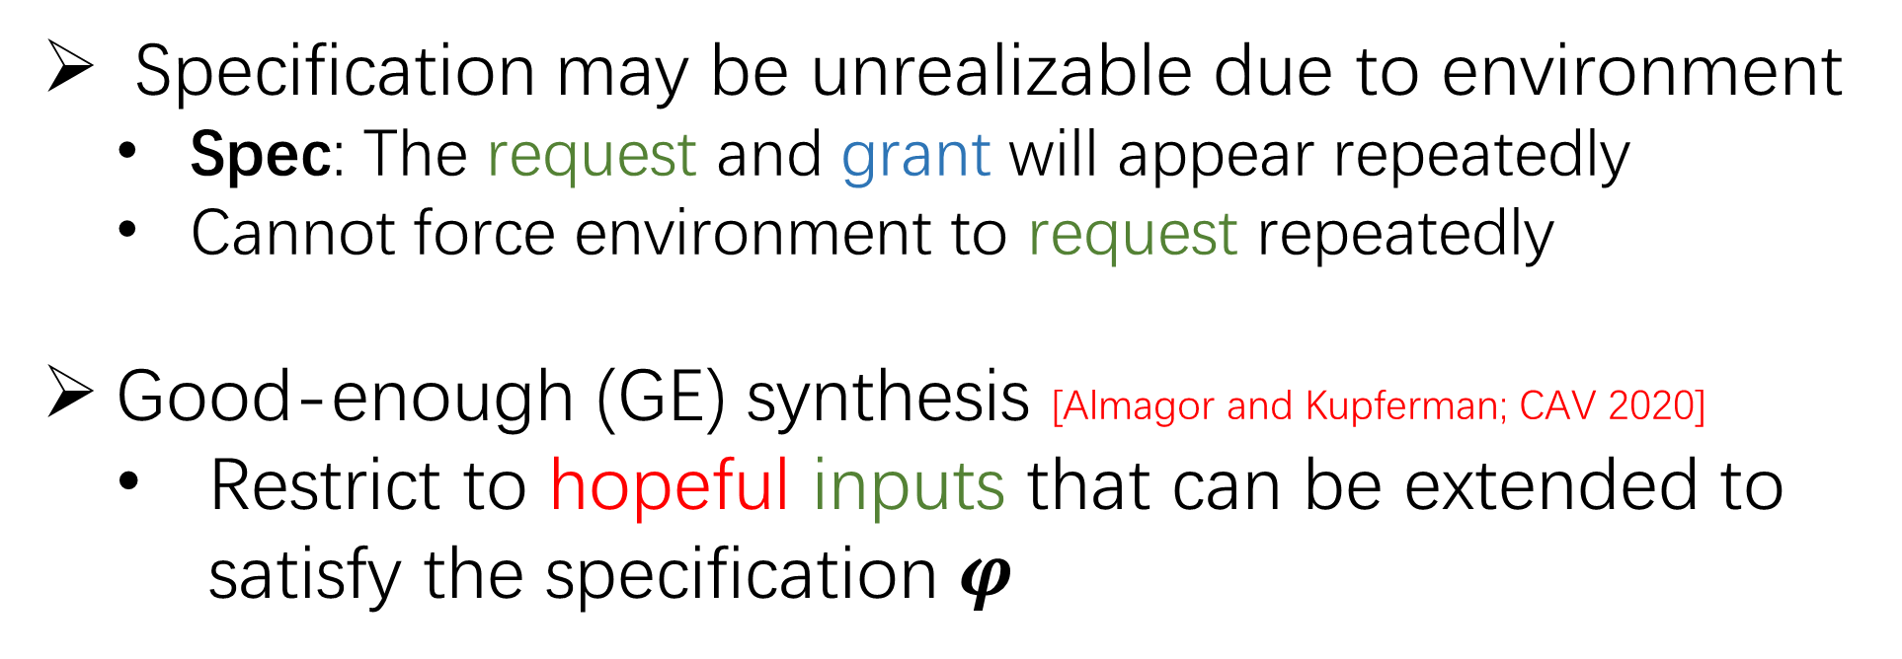
Classical synthesis is too strong
Specification may be unrealizable due to environment
Spec: The request and grant will appear repeatedly
Cannot force environment to request repeatedly
Good-enough (GE) synthesis [Almagor and Kupferman; CAV 2020]
Restrict to hopeful inputs that can be extended to satisfy the specification $φ$
Notes:
For this spec, if request infinitely often, grant infinitely

Slide 6
Overview: Classical vs. Good-enough
LTL synthesis
[Pnueli and Rosner; POPL 1989]
2EXPTIME-complete
LTLf synthesis
[De Giacomo and Vardi; IJCAI 2015]
2EXPTIME-complete
Synthesis for all inputs
LTL good-enough synthesis
[Almagor and Kupferman; CAV 2020]
2EXPTIME-complete
Synthesis for all hopeful inputs
LTL: Linear Temporal Logic LTLf: LTL on finite traces
Notes:
Animation;

Slide 7
Overview: Classical vs. Good-enough
LTL synthesis
[Pnueli and Rosner; POPL 1989]
2EXPTIME-complete
LTLf synthesis
[De Giacomo and Vardi; IJCAI 2015]
2EXPTIME-complete
Synthesis for all inputs
LTL good-enough synthesis
[Almagor and Kupferman; CAV 2020]
2EXPTIME-complete
LTLf good-enough synthesis
Our work
Synthesis for all hopeful inputs
LTL: Linear Temporal Logic LTLf: LTL on finite traces
Notes:
Animation;

Slide 8
Our contributions
Define and solve good-enough synthesis for LTLf formulas
Synthesize good-enough (GE)-strategies
Algorithm: Reduction to solving DBA games
Complexity: 2EXPTIME-complete
DBA: deterministic Büchi automaton

Slide 9
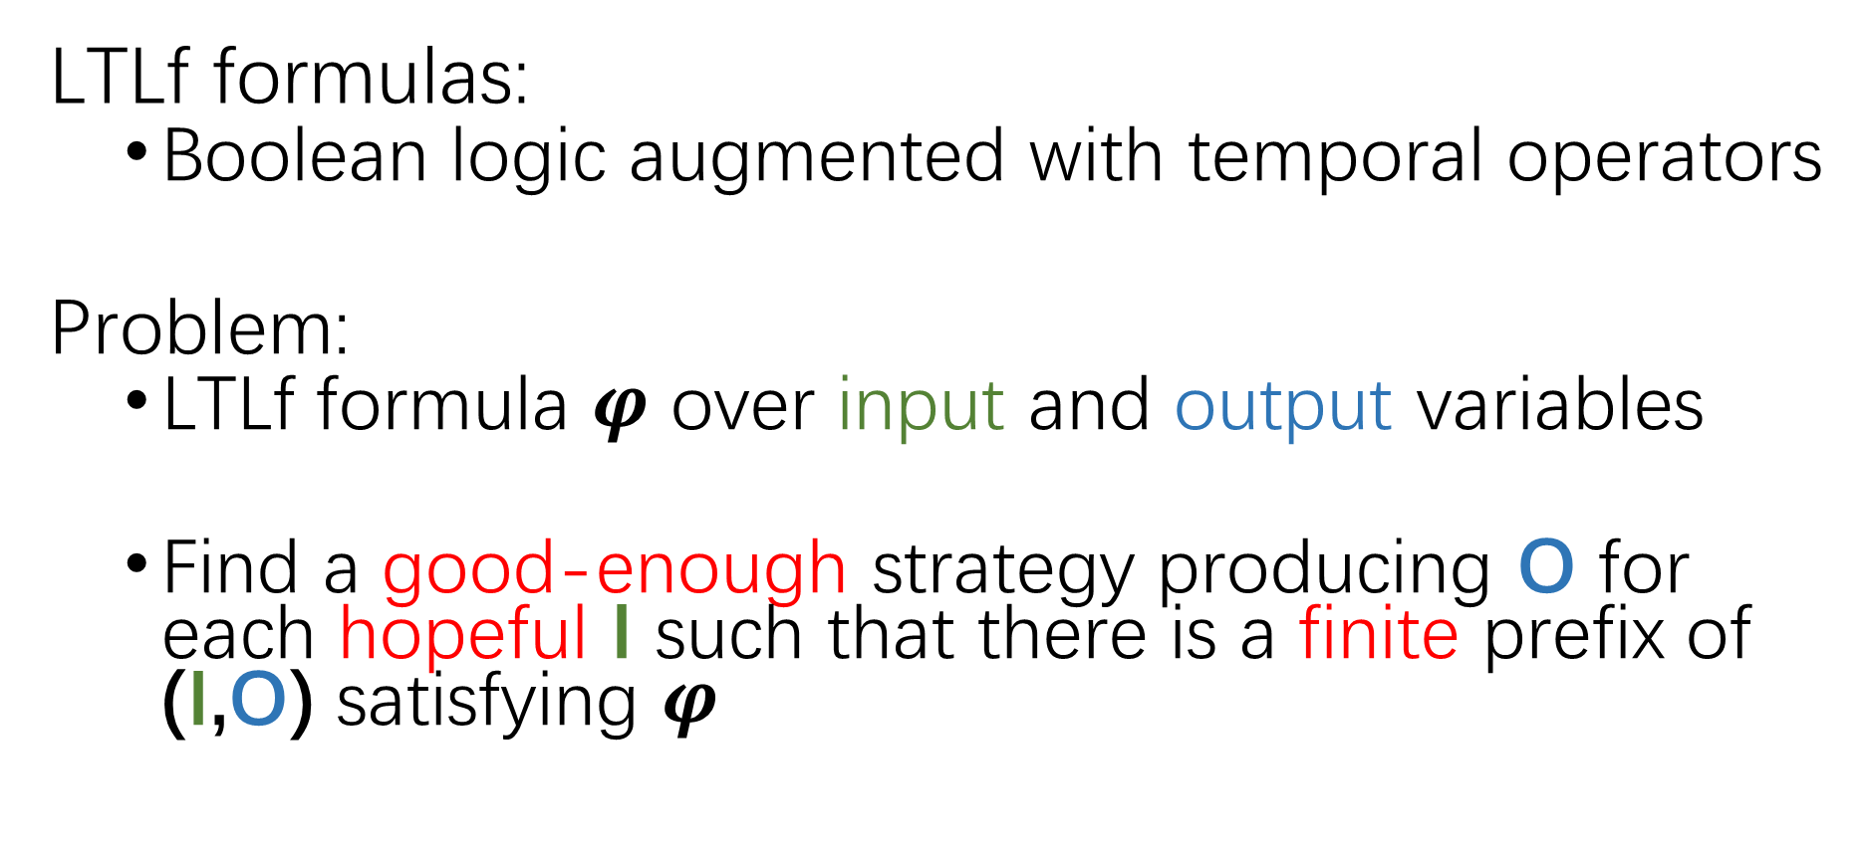
LTLf good-enough synthesis
LTLf formulas:
Boolean logic augmented with temporal operators
Problem:
LTLf formula $φ$ over input and output variables
Find a good-enough strategy producing O for each hopeful I such that there is a finite prefix of (I,O) satisfying $φ$
Notes:
Defined on LTLf, refine not possible for LTLf, one approach is by LTL synthesis

Slide 10
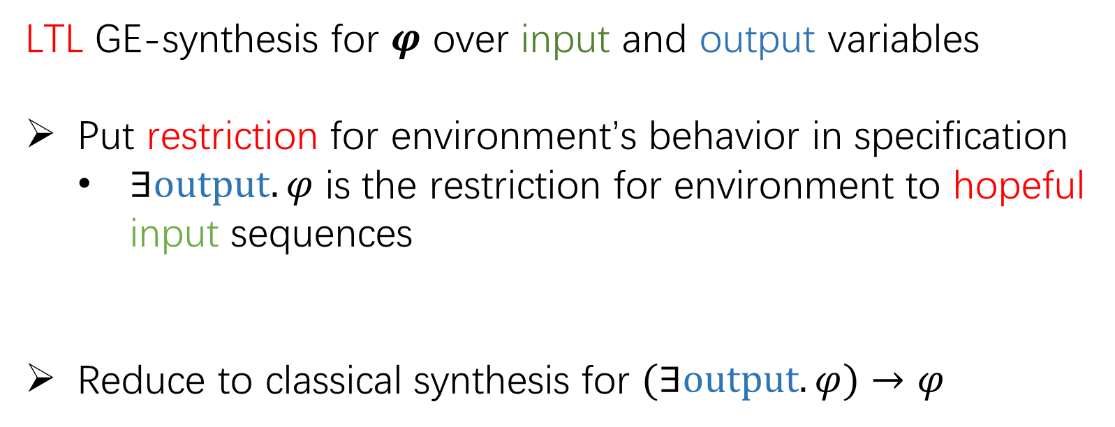
Solving LTL good-enough synthesis [Almagor and Kupferman; CAV 2020]
LTL GE-synthesis for $φ$ over input and output variables
Put restriction for environment’s behavior in specification
$∃output.φ$ is the restriction for environment to hopeful input sequences
Reduce to classical synthesis for $(∃output.φ)→φ$

Slide 11
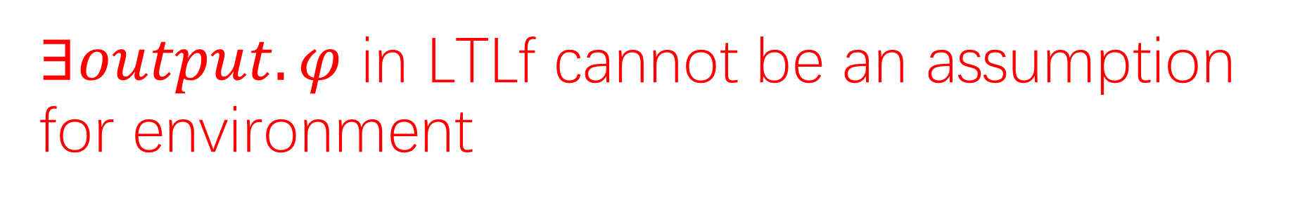

$∃output.φ$ in LTLf cannot be an assumption for environment
The interaction is infinite
Environment behavior is infinite
System/Strategy decides when to halt
The logic LTLf is defined on finite traces
$∃\text{output}.φ$ for LTLf cannot restrict the environment behavior

Slide 12


Attempt via LTL synthesis
Translate LTLf formula $φ$ to LTL formula$t(φ)$
Add extra output signal, e.g. term
Use term to indicate satisfaction of$φ$
Perform classical LTL synthesis for $(∃\text{output}.t\left(φ\right))→t(φ)$
Involve DPA construction for $(∃\text{output}.t\left(φ\right))→t(φ)$
…
$$φ$$
term
term
term
term
term
term
term
…
DPA: deterministic Parity automaton

Slide 13

Attempt via LTL synthesis
Translate LTLf formula $φ$ to LTL formula$t(φ)$
Add extra output signal, e.g. term
Use term to indicate satisfaction of$φ$
Perform LTL synthesis for $∃\text{output}.t(φ)→t(φ)$
Involve DPA construction for $∃\text{output}.t(φ)→t(φ)$
DOES NOT SCALE DUE TO DPA CONSTRUCTION!!!
…
$$φ$$
term
term
term
term
term
term
term
…

Slide 14
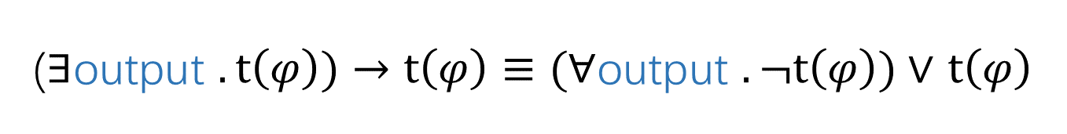
Crucial insights
DPAs are not needed; DBAs suffice
($∃\text{output}$ $.t\left(φ\right))→t\left(φ\right)≡(∀\text{output} .¬t\left(φ\right))∨$ $t\left(φ\right)$

Slide 15
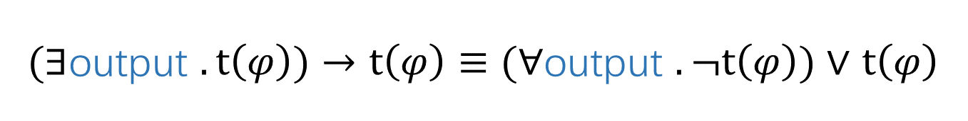
Crucial insights
$(∃\text{output}$ $.t\left(φ\right))→t\left(φ\right)≡(∀\text{output} .¬t\left(φ\right))∨$ $t\left(φ\right)$
Guarantee property

Slide 16
Crucial insights
$(∃\text{output}$ $.t\left(φ\right))→t\left(φ\right)≡(∀\text{output} .¬t\left(φ\right))∨$ $t\left(φ\right)$
Safety property
Guarantee property

Slide 17
Crucial insights
$(∃\text{output}$ $.t\left(φ\right))→t\left(φ\right)≡(∀\text{output} .¬t\left(φ\right))∨$ $t\left(φ\right)$
Safety property
Guarantee property
Obligation property

Slide 18
Crucial insights
$(∃\text{output}$ $.t\left(φ\right))→t\left(φ\right)≡(∀\text{output} .¬t\left(φ\right))∨$ $t\left(φ\right)$
Obligation is known to be representable with DBAs !!!
Safety property
Guarantee property
Obligation property

Slide 19
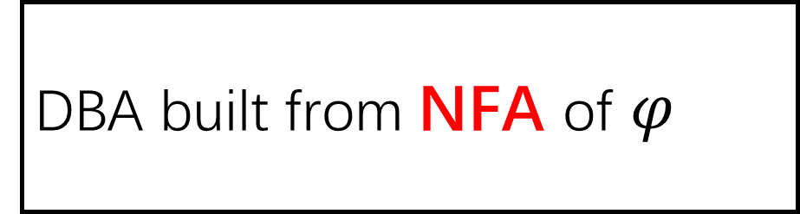
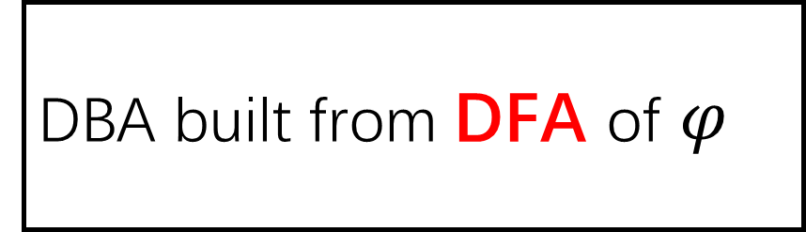
The algorithm
$(∃\text{output}$ $.t\left(φ\right))→t\left(φ\right)≡(∀\text{output} .¬t\left(φ\right))∨$ $t\left(φ\right)$
DBA built from NFA of $φ$
DBA built from DFA of $φ$
Union product B;
Solve DBA game on B

Slide 20
The algorithm
$(∃\text{output}$ $.t\left(φ\right))→t\left(φ\right)≡(∀\text{output} .¬t\left(φ\right))∨$ $t\left(φ\right)$
DBA built from NFA of $φ$
DBA built from DFA of $φ$
2EXPTIME !!!
Efficient in practice with DFAs/NFAs
Union product B;
Solve DBA game on B

Slide 21
Main theorem
Synthesizing good-enough strategies for LTLf specifications is 2EXPTIME-complete
Hardness proved by a polynomial reduction from 2EXPTIME Turing machines

Slide 22
Experimental evaluation
Reduction to DBA games
Lisa (Bansal et al, 2020)
Reduction to LTL synthesis
BoSy (Faymonville et al., 2017)
LTLSYNT (Duret-Lutz et al., 2016)
Benchmarks
1911 formulas from SYNTCOMP and existing literature
Evaluation: the number of solved cases and runtime

Slide 23
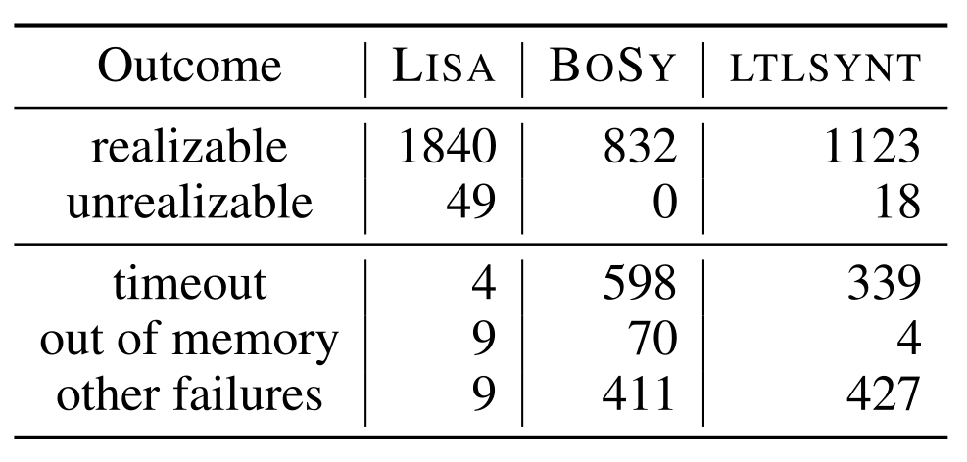
Lisa solves more cases than BoSy and LTLSYNT
1k more than BoSy

Slide 24
Lisa solves more cases than BoSy and LTLSYNT
700 more than LTLSYNT

Slide 25
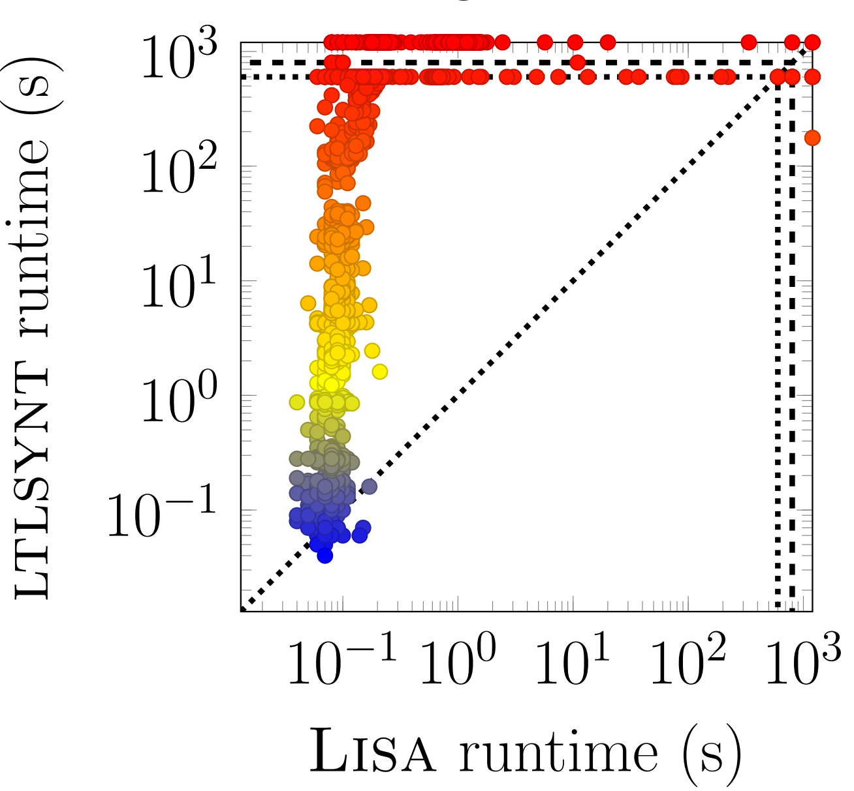
Lisa outperforms LTLSYNT on the benchmarks
Working with
DFA/NFA is better than with DPA

Slide 26
Conclusion and future work
Summary
Synthesizing GE-Strategies for LTLf is 2EXPTIME-complete
Algorithms based on LTL synthesis and on DBA games
Specialized algorithm via DBA games is more efficient than going through LTL synthesis
Future work
Better DBA construction
Add LTL assumptions for good-enough synthesis

