Slide 1

Improved Boomerang Attacks on the Lightweight Block Cipher KATAN
SV
Teh Je Sen, Dr.
Speaker
LI YU
School of Computer Science Universiti Sains Malaysia

Slide 2
Part 01
INTRODUCTION
Part 02
LITERATURE REVIEW
Part 03
METHODOLOGY(WORKING)
Part 04
RESULT AND DISCUSSION(WORKING)
OUTLINE
Part 05
CONCLUSION AND FUTURE WORK(NOT START)

Slide 3
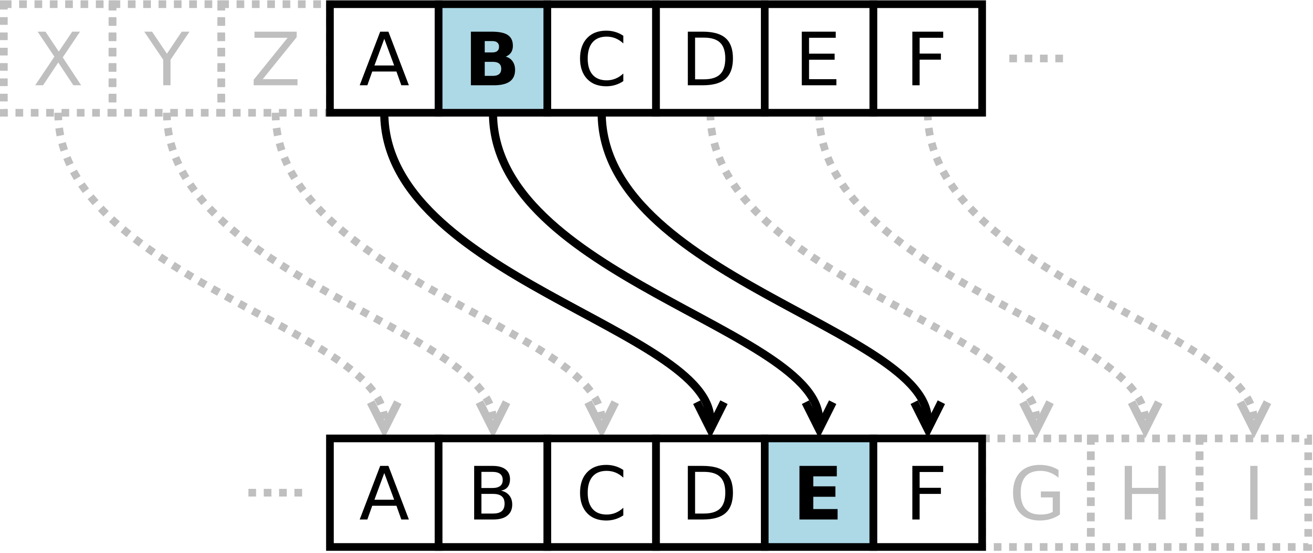
Background
Cryptography be used to protect information from curious eyes. The applications of modern cryptography including symmetric-key, public-key and hash function.
Put research pictures here
Caesar cipher is one of the simplest and most widely known encryption techniques.

Slide 4
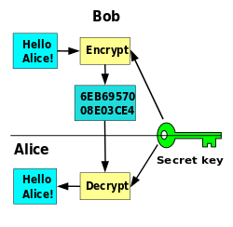
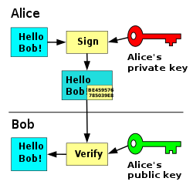
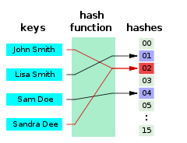
Background
Put research pictures here
Symmetric-key encryption
Public-key encryption
Hash function
These diagrams shows the principle of three encryptions.

Slide 5
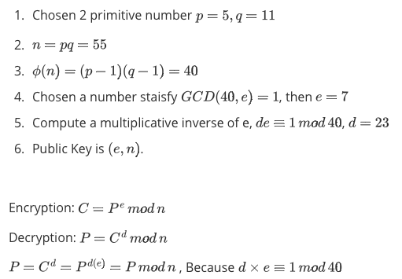
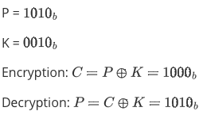

Background
A simple example of Symmetric-key encryption
A simple example of RSA
A simple example of Modular Hash function
These diagrams shows the principle of three encryptions.

Slide 6
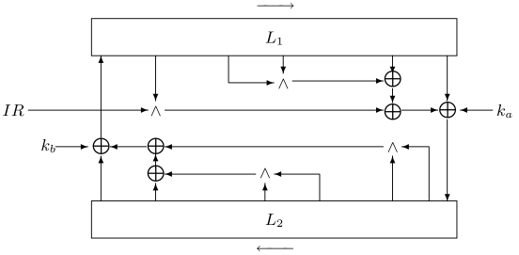
Background-Lightweight Cipher
Fig. The Outline of a round of the KATAN/KTANTAN ciphers
Cryptographic technologies are advancings: new techniques on attack, design, and implementation are extensively studied. One of the state-of-the-art techniques is “Lightweight Cryptography (LWC).” Lightweight cryptography is a cryptographic algorithm or protocol tailored for implementation in constrained environments including RFID tags, sensors, contactless smart cards, healthcare devices, and so on.

Slide 7
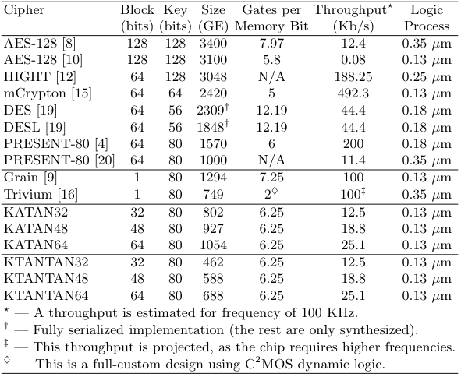
Background-Lightweight Cipher
KATAN family is a lightweight cipher and a hardware oriented block ciphers. . KATAN family has three variants of KATAN are KATAN32, KATAN48 and KATAN64. Each various contains six block ciphers divide into two flavors, in the first flavor is composed of three block ciphers, with 32,48 or 64 bit block size, and in the second flavor contains the other three ciphers with same block size. They are use 80-bit key size. KATAN use an extending key algorithm to make 80-bit key to 508bit sub-key.
Table 1. Comparison of Ciphers Designed for Low-End Environments (optimized for size).

Slide 8
Background-Lightweight Cipher
The first advantages of KATAN family.
The second advantages of KATAN family.
KATAN family has implemented the 8-bit LFSR counter.
The 8-bit LFSR counter took 60 gates but 8-bit counter took 80 gates.
The speed of the 8-bit LFSR is shorter than the one for 8-bit counter.
The 8-bit LFSR counter is more irregular manner than in a counter, can enhance security of KATAN
KATAN family has two(very similar but distinct) round function.
The choice of the round function is made according to the most significant bit of the round-counting LFSR. This irregular update also increases the diffusion of the cipher, as the nonlinear update affects both the differential and the linear properties of the cipher.

Slide 9
Background-Differential Attacks
The differential attack is one most effective methods to attack iterative block ciphers, and it is an important index for evaluating the security of block ciphers.
The process of Differential Attack:
Find the nonlinear part of the cipher, exp. S-BOX for Present, Modular Addition of KATAN
Create Differential Distributed Table(DDT)
Use DDT to find the best differential path
Use the best differential path to create a valid distinguisher.

Slide 10
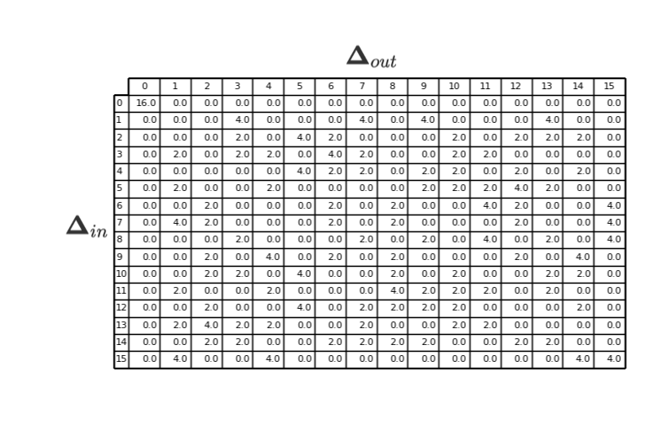

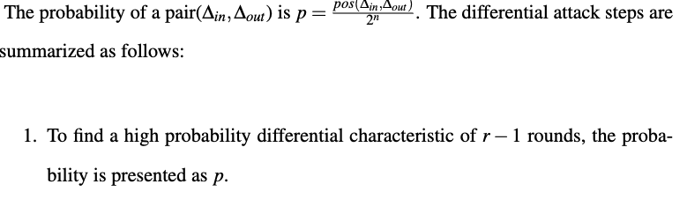
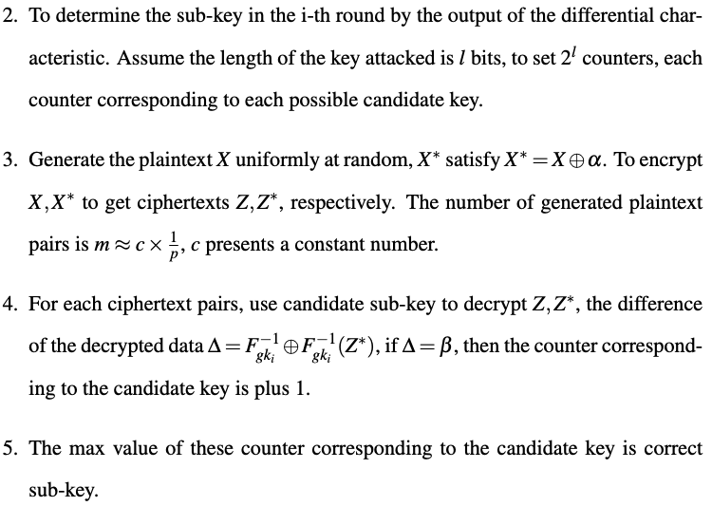
Background-Differential Attacks
The element of DDT satisfy:
Put research pictures here
Table 2. DDT for present cipher

Slide 11
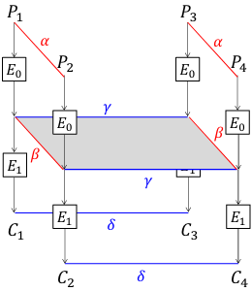
Background-Boomerang Attacks
The boomerang attack is currently the most powerful cryptanalysis method, it is based on the differential method, It is a chosen plaintext attack and is used to analyse symmetric cryptography, compare to differential cryptanalysis, which provides a more efficient method to analyse more complex ciphers. The boomerang attack attempts to generate a quartet structure at an intermediate value halfway through the cipher and it split an entire differential trails into two sub-trails.
Fig 2. Boomerang Attack

Slide 12
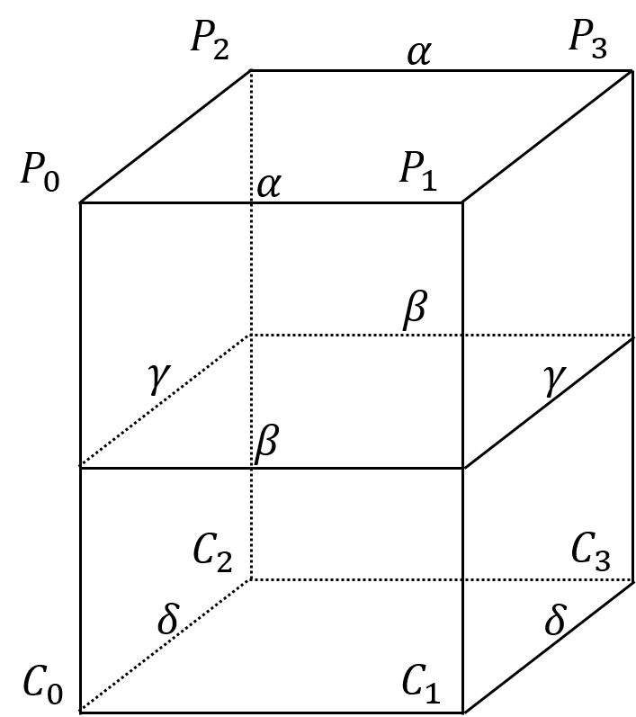
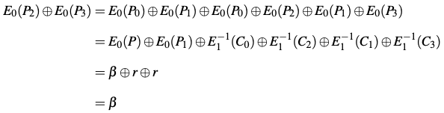

Background-Boomerang Attacks
Four plaintexts P1, P2, P3,P4 and with their respective ciphertexts C0, C1, C2, C3; The E(·) present the encryption operation and decompose the cipher into E = E0 ◦ E1 where E0 represent the first half of the cipher and E1 presents last half. There are four differential trails, α → β for $E_{0}$;r → δ for $E_{1}$ ; δ → r for $E_{1}^{−1}$ and β → α for $E_{0}^{−1}$
Fig 2. Boomerang Attack

Slide 13
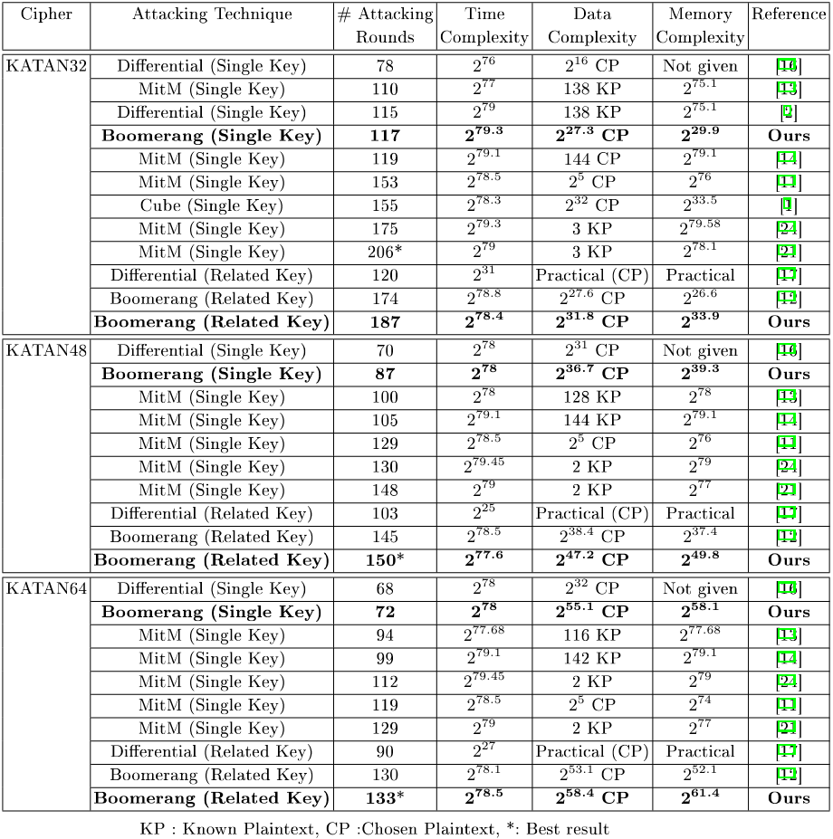
LITERATURE REVIEW
Teh al. list list the results of KATAN‘s various analyses, they achieved the best results. They use extend boomerang attack in related-key setting.
But, a study thinks, the result of boomerang attacks(including the amplified boomerang attack, and the rectangle attack) have not reliability enough.
Figure 3. Comparison of attacks against KATAN family.

Slide 14
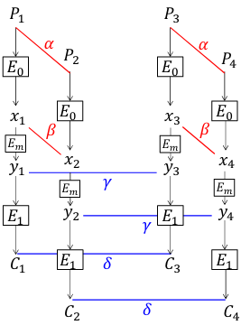
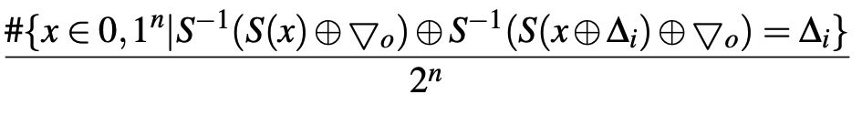
LITERATURE REVIEW
Murphy (2011) published re- sults of several experiments, to demonstrate the boomerang analysis can commonly give highly inaccurate probability values and he shows the boomerang attack is used to analyse DES and AES on some parameters, then the boomerang never comes back.
For the problem, Cid et al. (2018) gives a solution. It proposed new tools to improve the reliability of the sandwich attack, called Boomerang Connectivity Table(BTC).
The sandwich attack is a boomerang-style attack depicted in Fig 4, it defines E = E1 · Em · E0 where Em is a relatively short operation satisfying some differential propagation among four texts with probability r, then the entire probability is p2q2r.
The BTC can evaluate r in efficacy and easy-to-understand way when Em is composed of a single S-BOX layer. In this situation, for a given pair of (∆i,▽o), the probability that a right quartet is generated in each S-BOX in the middle S-BOX layer is given by:
Fig 4. Sandwich Attack

Slide 15
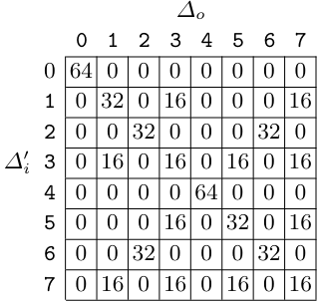
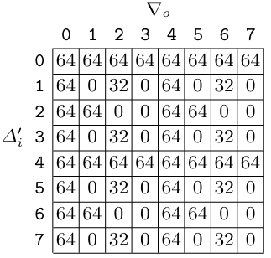
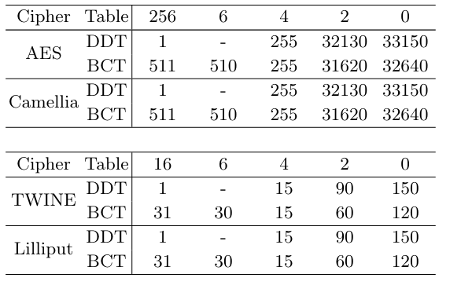
LITERATURE REVIEW
The left table shows the advantage of BCT, the BCT can find differentials with higher probability for ciphers based on S-BOX.
The right tables shows the advantage of BTC for ciphers based on Modular Addition, but the paper does not give practical examples.
Tab 5. DDT of 3-bit modular addition with ∆i = 0
Tab 6. BCT of 3-bit modular addition with ∆i = 0
Tab 4. Number of entries for each value for the DDT and BCT for the S-boxes in AES,Camellia, TWINE and Lilliput

Slide 16
Project Purpose
Murphy(2011) published results of several experiments, to demonstrate the boomerang analysis can commonly give highly inaccurate probability values and he shows the boomerang attack is used to analyse DES and AES on some parameters, then the boomerang never comes back. But Cid et al. (2018) gives a solution. It proposed new tools to improve the reliability of the sandwich attack, called Boomerang Connectivity Table(BTC).
The research questions of the study include:
The specific goals of the study include:
How can BCT be adapted to non-S-box ciphers?
Are the boomerang attacks on KATAN valid?
Can the boomerang attacks on KATAN be improved?
To propose BCT for the AND operation.
To investigate the validity of past boomerang attacks on KATAN
To propose improved boomerang attacks on KATAN

Slide 17
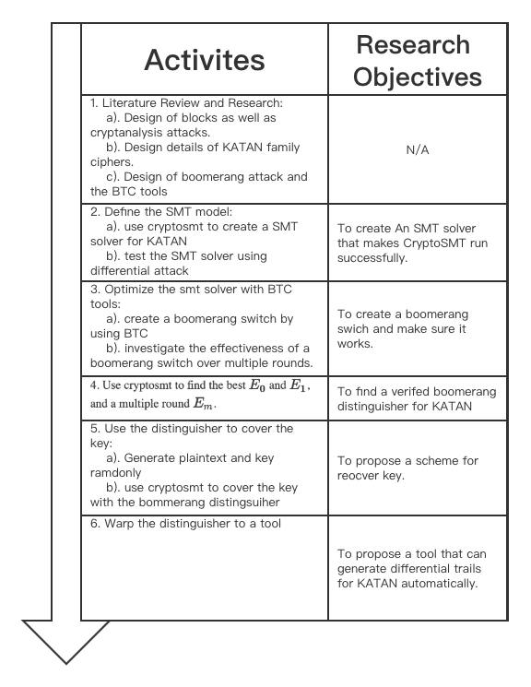
Methodology
The nonlinear part of KATAN is AND operation
BTC has not been practiced on ARX cipers.
Figure 4. Research Methodology

Slide 18
Reference
Biham, E., Dunkelman, O., & Keller, N. (2001). The rectangle attack—rectangling the serpent. In International conference on the theory and applications of crypto- graphic techniques (pp. 340–357).
Biham, E., Dunkelman, O., & Keller, N. (2005). A related-key rectangle attack on the full kasumi. In International conference on the theory and application of cryptol- ogy and information security (pp. 443–461).
Biham, E., & Shamir, A. (1991). Differential cryptanalysis of des-like cryptosystems. Journal of CRYPTOLOGY, 4(1), 3–72.
Biryukov, A., De Cannière, C., & Dellkrantz, G. (2003). Cryptanalysis of safer++. In D. Boneh (Ed.), Advances in cryptology - crypto 2003 (pp. 195–211). Berlin, Heidelberg: Springer Berlin Heidelberg.
Biryukov, A., & Khovratovich, D. (2009). Related-key cryptanalysis of the full aes- 192 and aes-256. In International conference on the theory and application of cryptology and information security (pp. 1–18).
Chen, J., Teh, J. S., Su, C., Samsudin, A., & Fang, J. (2016, 07). Improved (related- key) attacks on round-reduced katan-32/48/64 based on the extended boomerang framework. In (Vol. 9723, p. 333-346). doi: 10.1007/978-3-319-40367-0_21
Cid, C., Huang, T., Peyrin, T., Sasaki, Y., & Song, L. (2018). Boomerang connectivity table: A new cryptanalysis tool. In J. B. Nielsen & V. Rijmen (Eds.), Advances in cryptology – eurocrypt 2018 (pp. 683–714). Cham: Springer International Pub- lishing.
De Cannière, C., Dunkelman, O., & Kneževic ́, M. (2009). Katan and ktantan — a family of small and efficient hardware-oriented block ciphers. In C. Clavier & K. Gaj (Eds.), Cryptographic hardware and embedded systems - ches 2009 (pp. 272–288). Berlin, Heidelberg: Springer Berlin Heidelberg.
Dunkelman, O., Keller, N., Ronen, E., & Shamir, A. (2020). The retracing boomerang attack. In Annual international conference on the theory and applications of cryp- tographic techniques (pp. 280–309).
Dunkelman, O., Keller, N., & Shamir, A. (2010). A practical-time related-key attack on the kasumi cryptosystem used in gsm and 3g telephony. In Annual cryptology conference (pp. 393–410).
Dworkin, M. J., Barker, E. B., Nechvatal, J. R., Foti, J., Bassham, L. E., Roback, E., . . . others (2001). Advanced encryption standard (aes).
Dworkin, M. J., et al. (2015). Sha-3 standard: Permutation-based hash and extendable- output functions.
Kelsey, J., Kohno, T., & Schneier, B. (2000). Amplified boomerang attacks against reduced-round mars and serpent. In International workshop on fast software en- cryption (pp. 75–93).
Matsui, M. (1993). Linear cryptanalysis method for des cipher. In Workshop on the theory and application of of cryptographic techniques (pp. 386–397).
Murphy, S. (2011). The return of the cryptographic boomerang. IEEE Transactions on Information Theory, 57(4), 2517-2521. doi: 10.1109/TIT.2011.2111091
Pub, F. (1999). Data encryption standard (des). FIPS PUB, 46–3. Shannon, C. E. (1949). Communication theory of secrecy systems. The Bell System
Technical Journal, 28(4), 656-715. doi: 10.1002/j.1538-7305.1949.tb00928.x Wagner, D. (1999). The boomerang attack. In L. Knudsen (Ed.), Fast software en-
cryption (pp. 156–170). Berlin, Heidelberg: Springer Berlin Heidelberg.

Slide 19

Thanks for your attention

Slide 20
THE END

