Slide 1

Improved Boomerang Attacks on the Lightweight Block Cipher KATAN
SV
Teh Je Sen, Dr.
Speaker
LI YU
IE 1
Mohd Najwadi Yusoff, Ts. Dr.
IE 2
Manmeet Kaur Mahinderjit Singh, Associate Professor Dr.
School of Computer Science Universiti Sains Malaysia

Slide 2
Part 01
INTRODUCTION
Part 02
LITERATURE REVIEW
Part 03
METHODOLOGY(WORKING)
Part 04
RESULT AND DISCUSSION(WORKING)
OUTLINE
Part 05
CONCLUSION AND FUTURE WORK(NOT START)

Slide 3
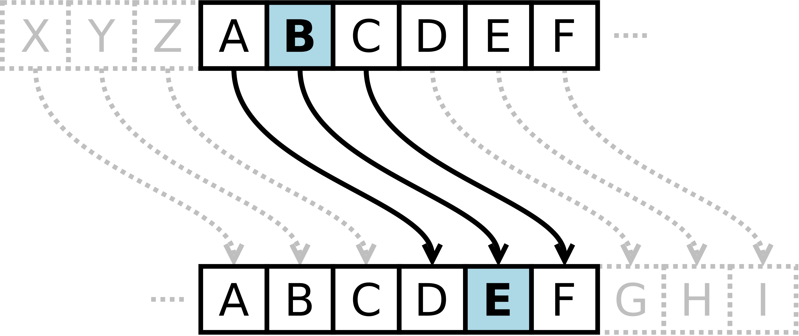
Background
Cryptography be used to protect information from curious eyes. The applications of modern cryptography including symmetric-key, public-key and hash function.
Put research pictures here
Caesar cipher is one of the simplest and most widely known encryption technique.

Slide 4
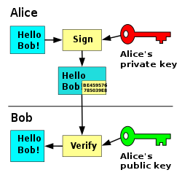
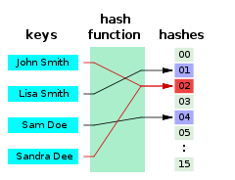
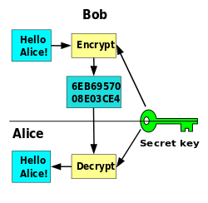
Background
Put research pictures here
Public-key encryption
Hash Function
Symmetric-key encryption
These diagrams shows the principle of three encryptions.

Slide 5

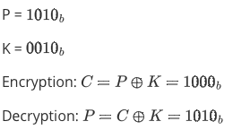
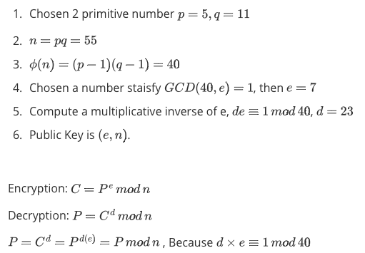
Background
A simple example of Modular Hash function
A simple example of Symmetric-key encryption
A simple example of RSA
These diagrams shows the principle of three encryptions.

Slide 6
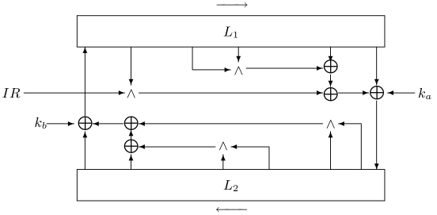
Background-Lightweight Cipher
Fig. The Outline of a round of the KATAN/KTANTAN ciphers
Lightweight cryptography - Cryptographic algorithm tailored for implementation in constrained including RFID tags, sensors, contactless smart cards, healthcare devices, and so on. environments
This study focus on KATAN family, is a lightweight cipher and a hardware-oriented block ciphers.

Slide 7
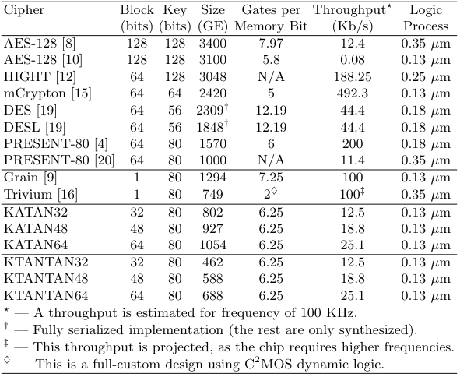
Background-Lightweight Cipher
KATAN family has three variants - KATAN32, KATAN48 and KATAN64.
The name implies the block size, e.g. KATAN32 has a 32-bit block size.
It uses an 80-bit secret key that is expanded into 508 subkey bits.
There is a variant of KATAN known as KTANTAN with a simplified key schedule.
This study focus on KATAN32.
Table 1. Comparison of Ciphers Designed for Low-End Environments (optimized for size).

Slide 8
Background-Lightweight Cipher
THE ADVANTAGES of KATAN FAMILIY
KATAN family has implemented the 8-bit LFSR counter.
The 8-bit LFSR counter took 60 gates, but 8-bit counter took 80 gates.
The speed of the 8-bit LFSR is shorter than the one for 8-bit counter.
The 8-bit LFSR counter is more irregular manner than in a counter, can enhance security of KATAN.
So far, full-rounds(254) KATAN still provides adequate security.

Slide 9
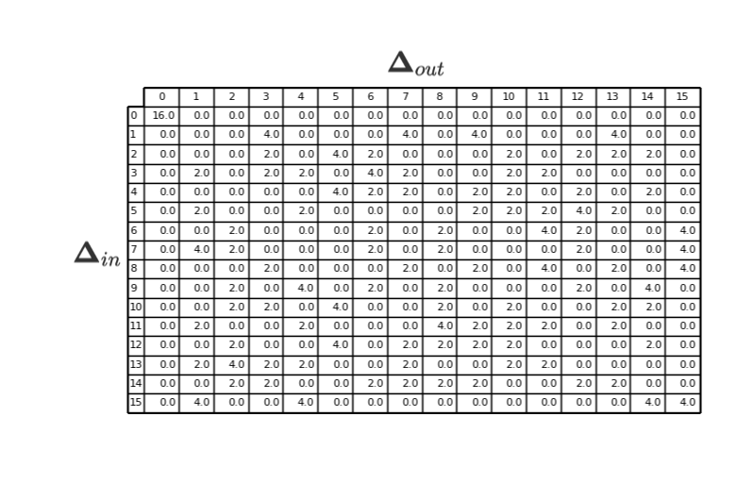
Background-Differential Attacks
The differential attack is one most effective methods to attack iterative block ciphers, and it is an important index for evaluating the security of block ciphers.
The process of Differential Attack:
Find the nonlinear part of the cipher, exp. S-BOX for Present, the bitwise AND of KATAN
Create Difference Distribution Table(DDT)
Use DDT to find the best differential path
Use the best differential path to create a valid distinguisher.
Table 2. DDT for present cipher

Slide 10
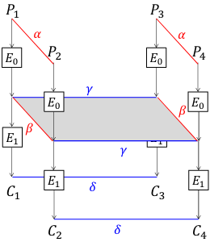
Background-Boomerang Attacks
The boomerang attack is based on differential cryptanalysis.
It is a chosen plaintext attack and is used to analyze symmetric cryptography, compare to differential cryptanalysis, which provides a more efficient method to analyze more complex ciphers.
The boomerang attack attempts to generate a quartet structure at an intermediate value halfway through the cipher and it split an entire differential trails into two sub-trails.
Fig 2. Boomerang Attack

Slide 11


Background-Boomerang Attacks
Four plaintexts $P_{1}, P_{2}, P_{3}, P_{4}$and with their respective ciphertexts $C_{1}, C_{2}, C_{3}, C_{4}$.
The $E\left(◦\right)$present the encryption operation and decompose the cipher into $E=E_{0}◦E_{1}$ where $E_{0}$ represent the first half of the cipher and $E_{0}$ presents last half.
There are four differential trails, $α→β$ for $E_{0}$; $γ→δ$ for $E_{1}$ ; $δ→γ$for $E_{1}^{−1}$ and $β→α$for $E_{0}^{−1}$
$$E_{0}\left(P_{3}\right)⊕E_{0}\left(P_{4}\right)=E_{0}\left(P_{1}\right)⊕E_{0}\left(P_{2}\right)⊕E_{0}\left(P_{1}\right)⊕E_{0}\left(P_{3}\right)⊕E_{0}\left(P_{2}\right)⊕E_{0}\left(P_{4}\right)= E_{0\left(P_{1}\right)}⊕E_{0\left(P_{2}\right)}⊕E_{1}^{−1}\left(C_{1}\right)⊕E_{1}^{−1}\left(C_{3}\right)⊕E_{1}^{−1}\left(C_{2}\right)⊕E_{1}^{−1}\left(C_{4}\right)=β⊕γ⊕γ=β$$
Fig 2. Boomerang Attack

Slide 12
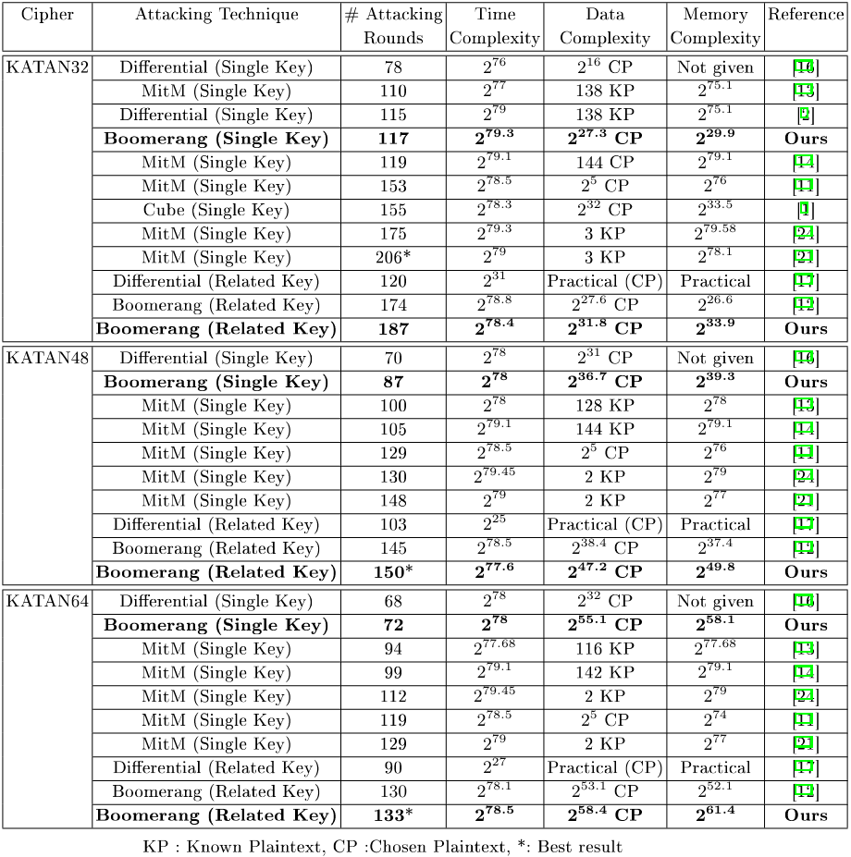
LITERATURE REVIEW
The best differential attack on KATAN used an extended boomerang attack in related-key setting was proposed by Chen et al.
But, a study thinks, the result of boomerang attacks(including the amplified boomerang attack, and the rectangle attack) have not reliability enough Murphy(2011) .
Figure 3. Comparison of attacks against KATAN family.

Slide 13
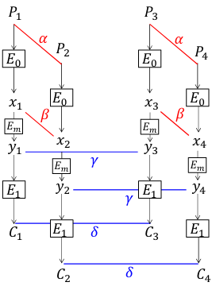
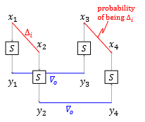
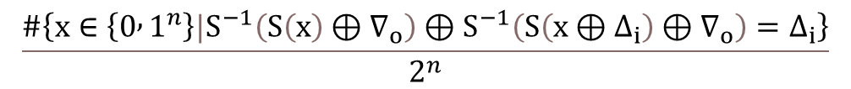
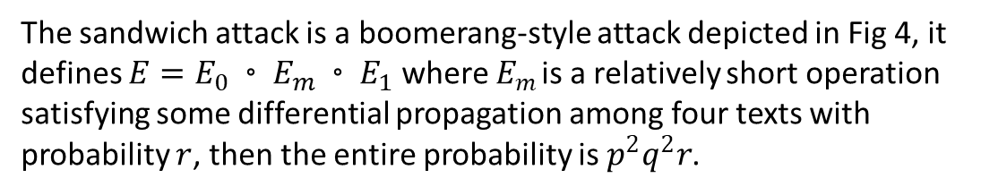

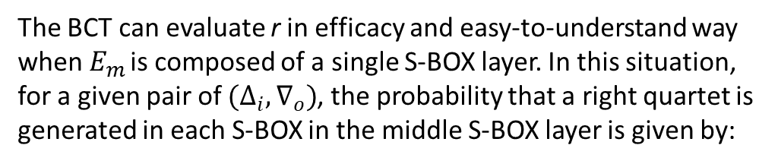
LITERATURE REVIEW
Murphy (2011) published results of several experiments, to demonstrate the boomerang analysis can commonly give highly inaccurate probability values and he shows the boomerang attack is used to analyse DES and AES on some parameters, then the boomerang never comes back.
For the problem, Cid et al. (2018) gives a solution. It proposed new tools to improve the reliability of the sandwich attack, called Boomerang Connectivity Table(BCT).
The sandwich attack is a boomerang-style attack depicted in Fig 4, it defines $E=E_{0}◦E_{m}◦E_{1}$ where $E_{m}$ is a relatively short operation satisfying some differential propagation among four texts with probability $r$, then the entire probability is $p^{2}q^{2}r$.
The BCT can evaluate r in efficacy and easy-to-understand way when $E_{m}$ is composed of a single S-BOX layer. In this situation, for a given pair of $(Δ_{i},∇_{o})$, the probability that a right quartet is generated in each S-BOX in the middle S-BOX layer is given by:
Fig 4. Sandwich Attack
Fig 5. Middle-Layer $E_{m}$
$$\frac{\#\left\{x∈\left\{0 , 1^{n}\right\}{|S}^{−1}\left(S\left(x\right)⊕∇_{o}\right)⊕S^{−1}\left(S\left(x⊕Δ_{i}\right)⊕∇_{o}\right)=Δ_{i}\right\}}{2^{n}}$$

Slide 14
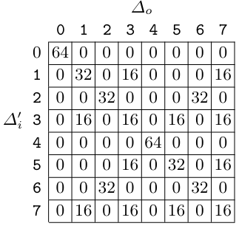
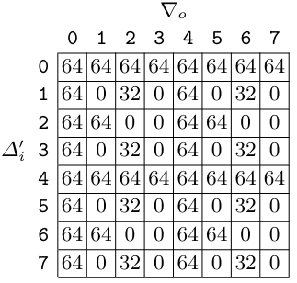
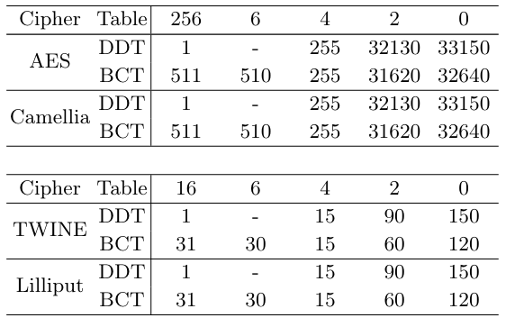
LITERATURE REVIEW
The left table shows the advantage of BCT, the BCT can find differentials with higher probability for ciphers based on S-BOX.
The right tables shows the advantage of BCT for ciphers based on Modular Addition, but the paper does not give practical examples.
So far, no studies have shown the compatibility of BCT for AND operations.
Tab 5. DDT of 3-bit modular addition.
Tab 6. BCT of 3-bit modular addition.
Tab 4. Number of entries for each value for the DDT and BCT for the S-boxes in AES,Camellia, TWINE and Lilliput

Slide 15
Project Purpose
Murphy(2011) published results of several experiments, to demonstrate the boomerang analysis can commonly give highly inaccurate probability values and he shows the boomerang attack is used to analyse DES and AES on some parameters, then the boomerang never comes back. But Cid et al. (2018) gives a solution. It proposed new tools to improve the reliability of the sandwich attack, called Boomerang Connectivity Table(BCT).
The research questions of the study include
The research objectives of the study include
How can BCT be adapted to non-S-box ciphers?
Are the boomerang attacks on KATAN valid?
Can the boomerang attacks on KATAN be improved?
To propose BCT for the AND operation.
To investigate the validity of past boomerang attacks on KATAN
To propose improved boomerang attacks on KATAN

Slide 16
Methodology
Activities |  | Research Objectives
Literature Review and Research |  | N/A
 | Design of Blocks as well as cryptanalysis attacks.
 | Design details of KATAN family ciphers.
 | Design of boomerang attack and BCT tool.
2. Designing the scheme of BTC tool for KATAN. |  | To propose BCT for the AND operation.
 | Verifying that the previous KATAN boomerang attacks are valid.
 | Modifying BCT tool to adapt AND operation.
Creating a SMT model to search for optimal boomerang distinguisher for KATAN |  | To investigate the validity of past boomerang attacks on KATAN
 | Investigating effectiveness of boomerang switch over multiple rounds.
Using the best boomerang distinguisher for a key recovery attack. |  | To propose improved boomerang attacks on KATAN
Note.
The nonlinear part of KATAN is AND operation
BTC has not been practiced on ARX ciphers.
Boomerang Attack maybe offers results that are not reliability.
Figure 4. Research Methodology

Slide 17
Reference
Biham, E., Dunkelman, O., & Keller, N. (2001). The rectangle attack—rectangling the serpent. In International conference on the theory and applications of crypto- graphic techniques (pp. 340–357).
Biham, E., Dunkelman, O., & Keller, N. (2005). A related-key rectangle attack on the full kasumi. In International conference on the theory and application of cryptol- ogy and information security (pp. 443–461).
Biham, E., & Shamir, A. (1991). Differential cryptanalysis of des-like cryptosystems. Journal of CRYPTOLOGY, 4(1), 3–72.
Biryukov, A., De Cannière, C., & Dellkrantz, G. (2003). Cryptanalysis of safer++. In D. Boneh (Ed.), Advances in cryptology - crypto 2003 (pp. 195–211). Berlin, Heidelberg: Springer Berlin Heidelberg.
Biryukov, A., & Khovratovich, D. (2009). Related-key cryptanalysis of the full aes- 192 and aes-256. In International conference on the theory and application of cryptology and information security (pp. 1–18).
Chen, J., Teh, J. S., Su, C., Samsudin, A., & Fang, J. (2016, 07). Improved (related- key) attacks on round-reduced katan-32/48/64 based on the extended boomerang framework. In (Vol. 9723, p. 333-346). doi: 10.1007/978-3-319-40367-0_21
Cid, C., Huang, T., Peyrin, T., Sasaki, Y., & Song, L. (2018). Boomerang connectivity table: A new cryptanalysis tool. In J. B. Nielsen & V. Rijmen (Eds.), Advances in cryptology – eurocrypt 2018 (pp. 683–714). Cham: Springer International Pub- lishing.
De Cannière, C., Dunkelman, O., & Kneževic ́, M. (2009). Katan and ktantan — a family of small and efficient hardware-oriented block ciphers. In C. Clavier & K. Gaj (Eds.), Cryptographic hardware and embedded systems - ches 2009 (pp. 272–288). Berlin, Heidelberg: Springer Berlin Heidelberg.
Dunkelman, O., Keller, N., Ronen, E., & Shamir, A. (2020). The retracing boomerang attack. In Annual international conference on the theory and applications of cryp- tographic techniques (pp. 280–309).
Dunkelman, O., Keller, N., & Shamir, A. (2010). A practical-time related-key attack on the kasumi cryptosystem used in gsm and 3g telephony. In Annual cryptology conference (pp. 393–410).
Dworkin, M. J., Barker, E. B., Nechvatal, J. R., Foti, J., Bassham, L. E., Roback, E., . . . others (2001). Advanced encryption standard (aes).
Dworkin, M. J., et al. (2015). Sha-3 standard: Permutation-based hash and extendable- output functions.
Kelsey, J., Kohno, T., & Schneier, B. (2000). Amplified boomerang attacks against reduced-round mars and serpent. In International workshop on fast software en- cryption (pp. 75–93).
Matsui, M. (1993). Linear cryptanalysis method for des cipher. In Workshop on the theory and application of of cryptographic techniques (pp. 386–397).
Murphy, S. (2011). The return of the cryptographic boomerang. IEEE Transactions on Information Theory, 57(4), 2517-2521. doi: 10.1109/TIT.2011.2111091
Pub, F. (1999). Data encryption standard (des). FIPS PUB, 46–3. Shannon, C. E. (1949). Communication theory of secrecy systems. The Bell System
Technical Journal, 28(4), 656-715. doi: 10.1002/j.1538-7305.1949.tb00928.x Wagner, D. (1999). The boomerang attack. In L. Knudsen (Ed.), Fast software en-
cryption (pp. 156–170). Berlin, Heidelberg: Springer Berlin Heidelberg.

Slide 18

Thanks for your attention

Slide 19
THE END

