Slide 1
Chapter 10: Physical Storage Systems and File Organization

Slide 2
Classification of Physical Storage Media
Can differentiate storage into:
volatile storage: loses contents when power is switched off
non-volatile storage:
Contents persist even when power is switched off.
Includes secondary and tertiary storage, as well as batter-backed up main-memory.
Factors affecting choice of storage media include
Speed with which data can be accessed
Cost per unit of data
Reliability

Slide 3
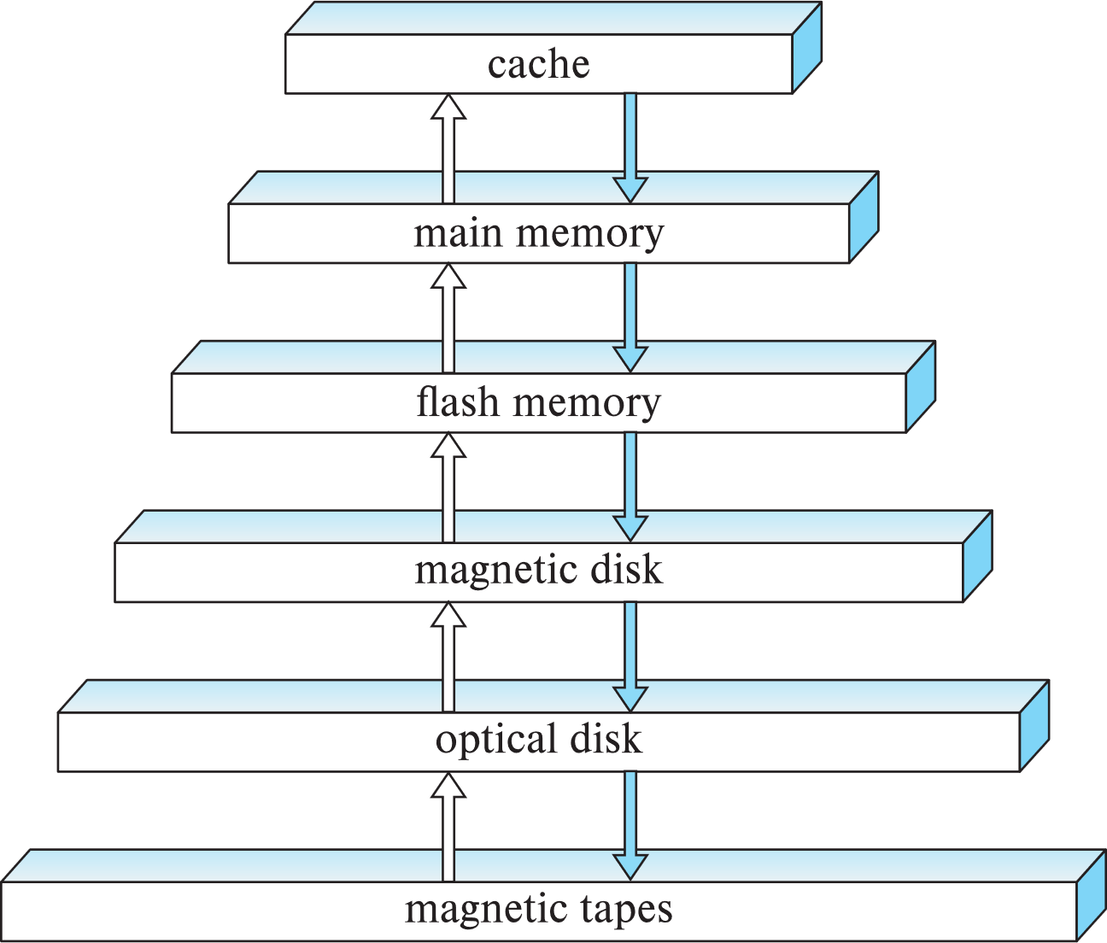
Storage Hierarchy

Slide 4
Storage Hierarchy (Cont.)
primary storage: Fastest media but volatile (cache, main memory).
secondary storage: next level in hierarchy, non-volatile, moderately fast access time
Also called on-line storage
E.g., flash memory, magnetic disks
tertiary storage: lowest level in hierarchy, non-volatile, slow access time
also called off-line storage and used for archival storage
e.g., magnetic tape, optical storage
Magnetic tape
Sequential access, 1 to 12 TB capacity
A few drives with many tapes
Juke boxes with petabytes (1000’s of TB) of storage

Slide 5
Storage Interfaces
Disk interface standards families
SATA (Serial ATA)
SATA 3 supports data transfer speeds of up to 6 gigabits/sec
SAS (Serial Attached SCSI)
SAS Version 3 supports 12 gigabits/sec
NVMe (Non-Volatile Memory Express) interface
Works with PCIe connectors to support lower latency and higher transfer rates
Supports data transfer rates of up to 24 gigabits/sec
Disks usually connected directly to computer system
In Storage Area Networks (SAN), a large number of disks are connected by a high-speed network to a number of servers
In Network Attached Storage (NAS) networked storage provides a file system interface using networked file system protocol, instead of providing a disk system interface

Slide 6
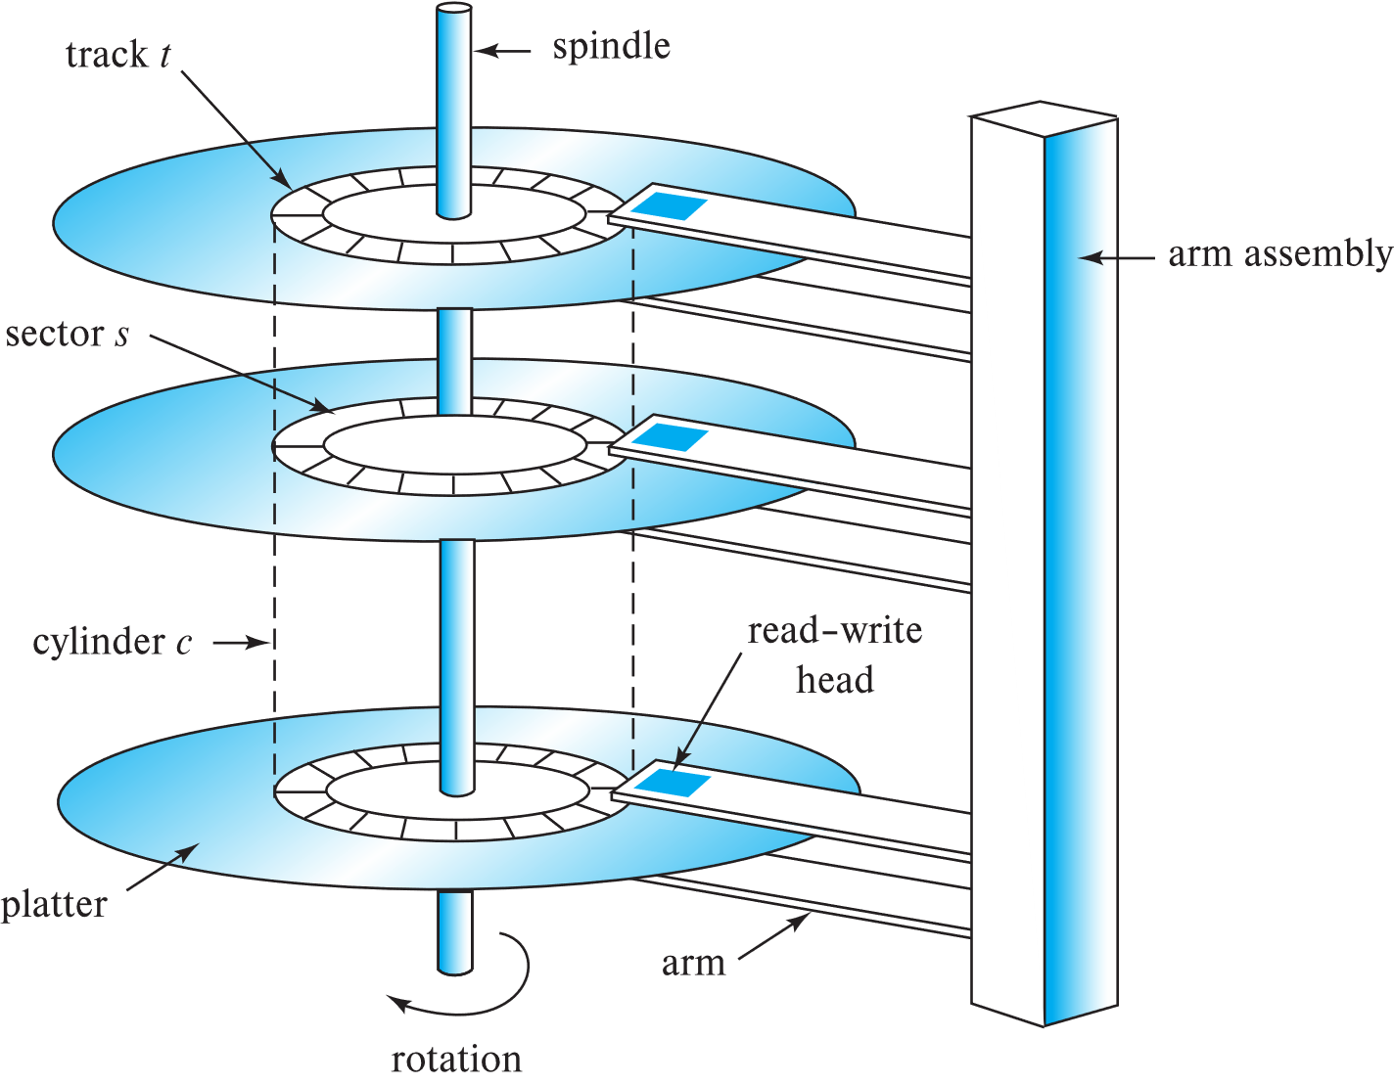
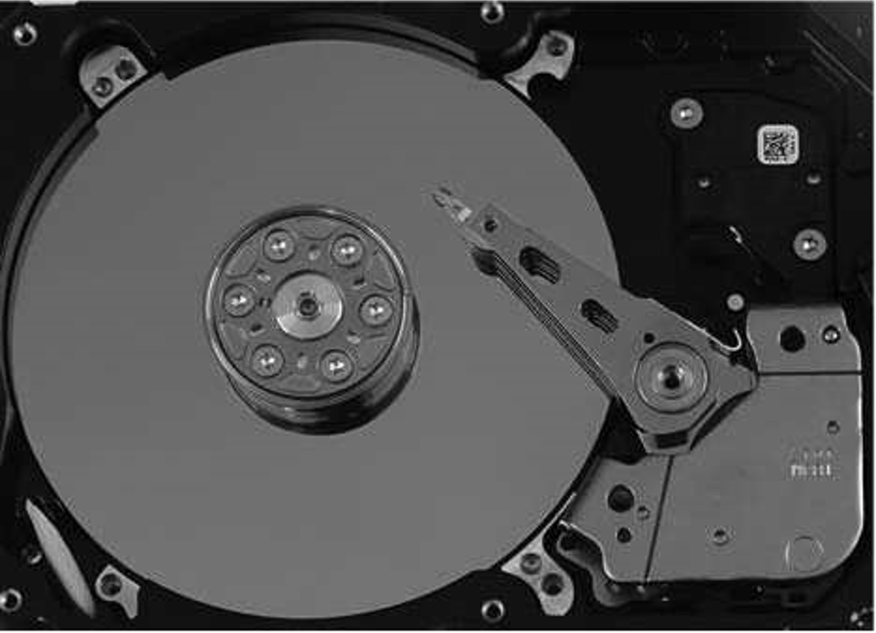
Magnetic Hard Disk Mechanism
Schematic diagram of magnetic disk drive
Photo of magnetic disk drive
Notes:
http://c.biancheng.net/view/879.html

Slide 7
Magnetic Disks
Read-write head
Surface of platter divided into circular tracks
Over 50K-100K tracks per platter on typical hard disks
Each track is divided into sectors.
A sector is the smallest unit of data that can be read or written.
Sector size typically 512 bytes
Typical sectors per track: 500 to 1000 (on inner tracks) to 1000 to 2000 (on outer tracks)
To read/write a sector
disk arm swings to position head on right track
platter spins continually; data is read/written as sector passes under head
Head-disk assemblies
multiple disk platters on a single spindle (1 to 5 usually)
one head per platter, mounted on a common arm.
Cylinder i consists of i^{th} track of all the platters
Notes:
Mention: checksums, bad sector remapping

Slide 8
Magnetic Disks (Cont.)
Disk controller – interfaces between the computer system and the disk drive hardware.
accepts high-level commands to read or write a sector
initiates actions such as moving the disk arm to the right track and actually reading or writing the data
Computes and attaches checksums to each sector to verify that data is read back correctly
If data is corrupted, with very high probability stored checksum won’t match recomputed checksum
Ensures successful writing by reading back sector after writing it
Performs remapping of bad sectors

Slide 9
Performance Measures of Disks
Access time – the time it takes from when a read or write request is issued to when data transfer begins. Consists of:
Seek time – time it takes to reposition the arm over the correct track.
Average seek time is 1/2 the worst case seek time.
Would be 1/3 if all tracks had the same number of sectors, and we ignore the time to start and stop arm movement
4 to 10 milliseconds on typical disks
Rotational latency – time it takes for the sector to be accessed to appear under the head.
4 to 11 milliseconds on typical disks (5400 to 15000 r.p.m.)
Average latency is 1/2 of the above latency.
Overall latency is 5 to 20 msec depending on disk model
Data-transfer rate – the rate at which data can be retrieved from or stored to the disk.
25 to 200 MB per second max rate, lower for inner tracks

Slide 10
Performance Measures (Cont.)
Disk block is a logical unit for storage allocation and retrieval
4 to 16 kilobytes typically
Smaller blocks: more transfers from disk
Larger blocks: more space wasted due to partially filled blocks
Sequential access pattern
Successive requests are for successive disk blocks
Disk seek required only for first block
Random access pattern
Successive requests are for blocks that can be anywhere on disk
Each access requires a seek
Transfer rates are low since a lot of time is wasted in seeks
I/O operations per second (IOPS)
Number of random block reads that a disk can support per second
50 to 200 IOPS on current generation magnetic disks

Slide 11
Performance Measures (Cont.)
Mean time to failure (MTTF) – the average time the disk is expected to run continuously without any failure.
Typically 3 to 5 years
Probability of failure of new disks is quite low, corresponding to a “theoretical MTTF” of 500,000 to 1,200,000 hours for a new disk
E.g., an MTTF of 1,200,000 hours for a new disk means that given 1000 relatively new disks, on an average one will fail every 1200 hours
MTTF decreases as disk ages

Slide 12
Flash Storage
NOR flash vs NAND flash
NAND flash
used widely for storage, cheaper than NOR flash
requires page-at-a-time read (page: 512 bytes to 4 KB)
20 to 100 microseconds for a page read
Not much difference between sequential and random read
Page can only be written once
Must be erased to allow rewrite
Solid state disks
Use standard block-oriented disk interfaces, but store data on multiple flash storage devices internally
Transfer rate of up to 500 MB/sec using SATA, and up to 3 GB/sec using NVMe PCIe

Slide 13
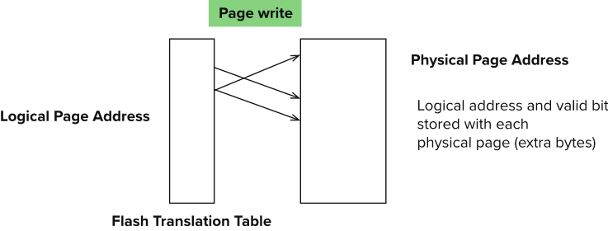
Flash Storage (Cont.)
Erase happens in units of erase block
Takes 2 to 5 millisecs
Erase block typically 256 KB to 1 MB (128 to 256 pages)
Remapping of logical page addresses to physical page addresses avoids waiting for erase
Flash translation table tracks mapping
also stored in a label field of flash page
remapping carried out by flash translation layer
After 100,000 to 1,000,000 erases, erase block becomes unreliable and cannot be used
wear leveling
Notes:
Where is FTL stored? How is it reconstructed on system startup?
How to track number of erases per block (extra storage per block)

Slide 14
SSD Performance Metrics
Random reads/writes per second
Typical 4 KB reads: 10,000 reads per second (10,000 IOPS)
Typical 4KB writes: 40,000 IOPS
SSDs support parallel reads
Typical 4KB reads:
100,000 IOPS with 32 requests in parallel (QD-32) on SATA
350,000 IOPS with QD-32 on NVMe PCIe
Typical 4KB writes:
100,000 IOPS with QD-32, even higher on some models
Data transfer rate for sequential reads/writes
400 MB/sec for SATA3, 2 to 3 GB/sec using NVMe PCIe
Hybrid disks: combine small amount of flash cache with larger magnetic disk

Slide 15
Storage Class Memory
3D-XPoint memory technology pioneered by Intel
Available as Intel Optane
SSD interface shipped from 2017
Allows lower latency than flash SSDs
Non-volatile memory interface announced in 2018
Supports direct access to words, at speeds comparable to main-memory speeds

Slide 16
RAID
RAID: Redundant Arrays of Independent Disks
disk organization techniques that manage a large numbers of disks, providing a view of a single disk of
high capacity and high speed by using multiple disks in parallel,
high reliability by storing data redundantly, so that data can be recovered even if a disk fails
The chance that some disk out of a set of N disks will fail is much higher than the chance that a specific single disk will fail.
E.g., a system with 100 disks, each with MTTF of 100,000 hours (approx. 11 years), will have a system MTTF of 1000 hours (approx. 41 days)
Techniques for using redundancy to avoid data loss are critical with large numbers of disks

Slide 17
Improvement of Reliability via Redundancy
Redundancy – store extra information that can be used to rebuild information lost in a disk failure
E.g., Mirroring (or shadowing)
Duplicate every disk. Logical disk consists of two physical disks.
Every write is carried out on both disks
Reads can take place from either disk
If one disk in a pair fails, data still available in the other
Data loss would occur only if a disk fails, and its mirror disk also fails before the system is repaired
Probability of combined event is very small
Except for dependent failure modes such as fire or building collapse or electrical power surges
Mean time to data loss depends on mean time to failure, and mean time to repair
E.g., MTTF of 100,000 hours, mean time to repair of 10 hours gives mean time to data loss of 500*10⁶ hours (or 57,000 years) for a mirrored pair of disks (ignoring dependent failure modes)

Slide 18
Improvement in Performance via Parallelism
Two main goals of parallelism in a disk system:
1. Load balance multiple small accesses to increase throughput
2. Parallelize large accesses to reduce response time.
Improve transfer rate by striping data across multiple disks.
Bit-level striping – split the bits of each byte across multiple disks
In an array of eight disks, write bit i of each byte to disk i.
Each access can read data at eight times the rate of a single disk.
But seek/access time worse than for a single disk
Bit level striping is not used much any more
Block-level striping – with n disks, block i of a file goes to disk (i mod n) + 1
Requests for different blocks can run in parallel if the blocks reside on different disks
A request for a long sequence of blocks can utilize all disks in parallel

Slide 19
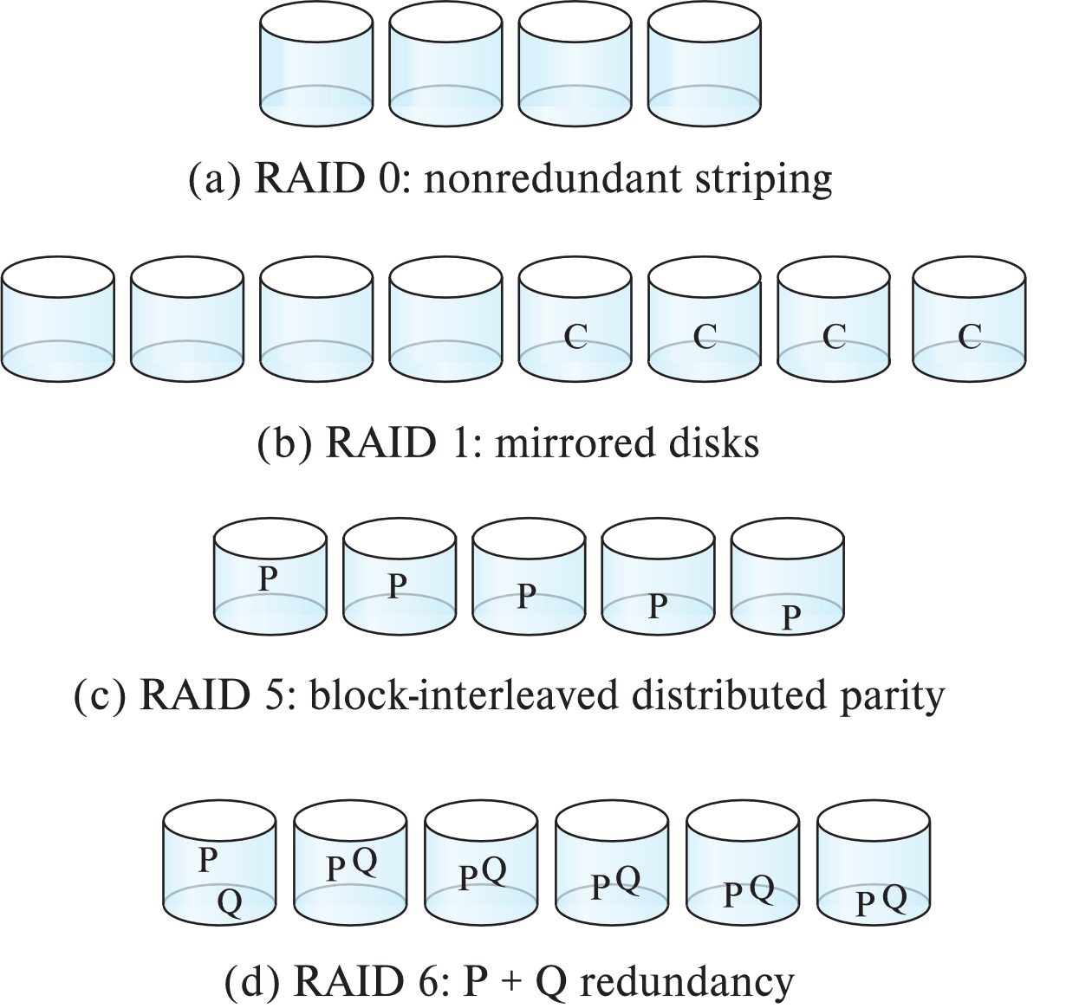
RAID Levels
Schemes to provide redundancy at lower cost by using disk striping combined with parity bits
Different RAID organizations, or RAID levels, have differing cost, performance and reliability characteristics
RAID Level 0: Block striping; non-redundant.
Used in high-performance applications where data loss is not critical.
RAID Level 1: Mirrored disks with block striping(镜像)
Offers best write performance.
Popular for applications such as storing log files in a database system.

Slide 20
RAID Levels (Cont.)
Parity blocks（奇偶校验块）: Parity block j stores XOR of bits from block j of each disk
When writing data to a block j, parity block j must also be computed and written to disk
Can be done by using old parity block, old value of current block and new value of current block (2 block reads + 2 block writes)
Or by recomputing the parity value using the new values of blocks corresponding to the parity block
More efficient for writing large amounts of data sequentially
To recover data for a block, compute XOR of bits from all other blocks in the set including the parity block

Slide 21
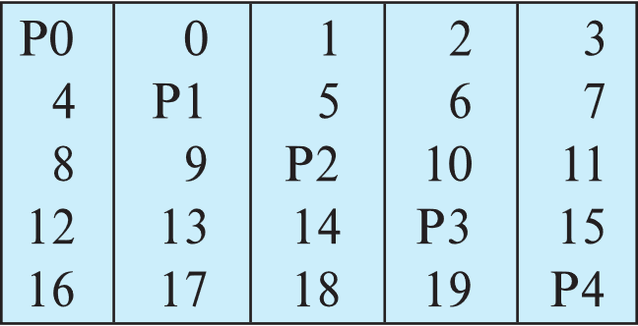
RAID Levels (Cont.)
RAID Level 5: Block-Interleaved Distributed Parity; partitions data and parity among all N + 1 disks, rather than storing data in N disks and parity in 1 disk.
E.g., with 5 disks, parity block for nth set of blocks is stored on disk (n mod 5) + 1, with the data blocks stored on the other 4 disks.

Slide 22
RAID Levels (Cont.)
RAID Level 5 (Cont.)
Block writes occur in parallel if the blocks and their parity blocks are on different disks.
RAID Level 6: P+Q Redundancy scheme; similar to Level 5, but stores two error correction blocks (P, Q) instead of single parity block to guard against multiple disk failures.
Better reliability than Level 5 at a higher cost
Becoming more important as storage sizes increase

Slide 23
RAID Levels (Cont.)
Other levels (not used in practice):
RAID Level 2: Memory-Style Error-Correcting-Codes (ECC) with bit striping.
RAID Level 3: Bit-Interleaved Parity
RAID Level 4: Block-Interleaved Parity; uses block-level striping, and keeps a parity block on a separate parity disk for corresponding blocks from N other disks.
RAID 5 is better than RAID 4, since with RAID 4 with random writes, parity disk gets much higher write load than other disks and becomes a bottleneck

Slide 24
Choice of RAID Level
Factors in choosing RAID level
Monetary cost
Performance: Number of I/O operations per second, and bandwidth during normal operation
Performance during failure
Performance during rebuild of failed disk
Including time taken to rebuild failed disk
RAID 0 is used only when data safety is not important
E.g., data can be recovered quickly from other sources

Slide 25
Choice of RAID Level (Cont.)
Level 1 provides much better write performance than level 5
Level 5 requires at least 2 block reads and 2 block writes to write a single block, whereas Level 1 only requires 2 block writes
Level 1 had higher storage cost than level 5
Level 5 is preferred for applications where writes are sequential and large (many blocks), and need large amounts of data storage
RAID 1 is preferred for applications with many random/small updates
Level 6 gives better data protection than RAID 5 since it can tolerate two disk (or disk block) failures
Increasing in importance since latent block failures on one disk, coupled with a failure of another disk can result in data loss with RAID 1 and RAID 5.

Slide 26
Hardware Issues
Software RAID: RAID implementations done entirely in software, with no special hardware support
Hardware RAID: RAID implementations with special hardware
Use non-volatile RAM to record writes that are being executed
Beware: power failure during write can result in corrupted disk
E.g., failure after writing one block but before writing the second in a mirrored system
Such corrupted data must be detected when power is restored
Recovery from corruption is similar to recovery from failed disk
NV-RAM helps to efficiently detected potentially corrupted blocks
Otherwise all blocks of disk must be read and compared with mirror/parity block

Slide 27
Hardware Issues (Cont.)
Latent failures: data successfully written earlier gets damaged
can result in data loss even if only one disk fails
Data scrubbing:
continually scan for latent failures, and recover from copy/parity
Hot swapping: replacement of disk while system is running, without power down
Supported by some hardware RAID systems,
reduces time to recovery, and improves availability greatly
Many systems maintain spare disks which are kept online, and used as replacements for failed disks immediately on detection of failure
Reduces time to recovery greatly
Many hardware RAID systems ensure that a single point of failure will not stop the functioning of the system by using
Redundant power supplies with battery backup
Multiple controllers and multiple interconnections to guard against controller/interconnection failures

Slide 28
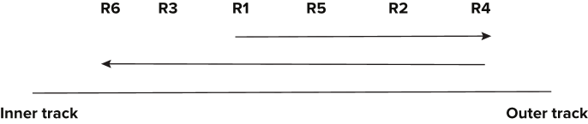
Optimization of Disk-Block Access
Buffering: in-memory buffer to cache disk blocks
Read-ahead: Read extra blocks from a track in anticipation that they will be requested soon
Disk-arm-scheduling algorithms re-order block requests so that disk arm movement is minimized
elevator algorithm

Slide 29
Optimization of Disk Block Access (Cont.)
File organization
Allocate blocks of a file in as contiguous a manner as possible
Allocation in units of extents
Files may get fragmented
E.g., if free blocks on disk are scattered, and newly created file has its blocks scattered over the disk
Sequential access to a fragmented file results in increased disk arm movement
Some systems have utilities to defragment the file system, in order to speed up file access
Non-volatile write buffers

Slide 30
File Organization
The database is stored as a collection of files. Each file is a sequence of records. A record is a sequence of fields.
One approach
Assume record size is fixed
Each file has records of one particular type only
Different files are used for different relations
This case is easiest to implement; will consider variable length records later
We assume that records are smaller than a disk block
.

Slide 31
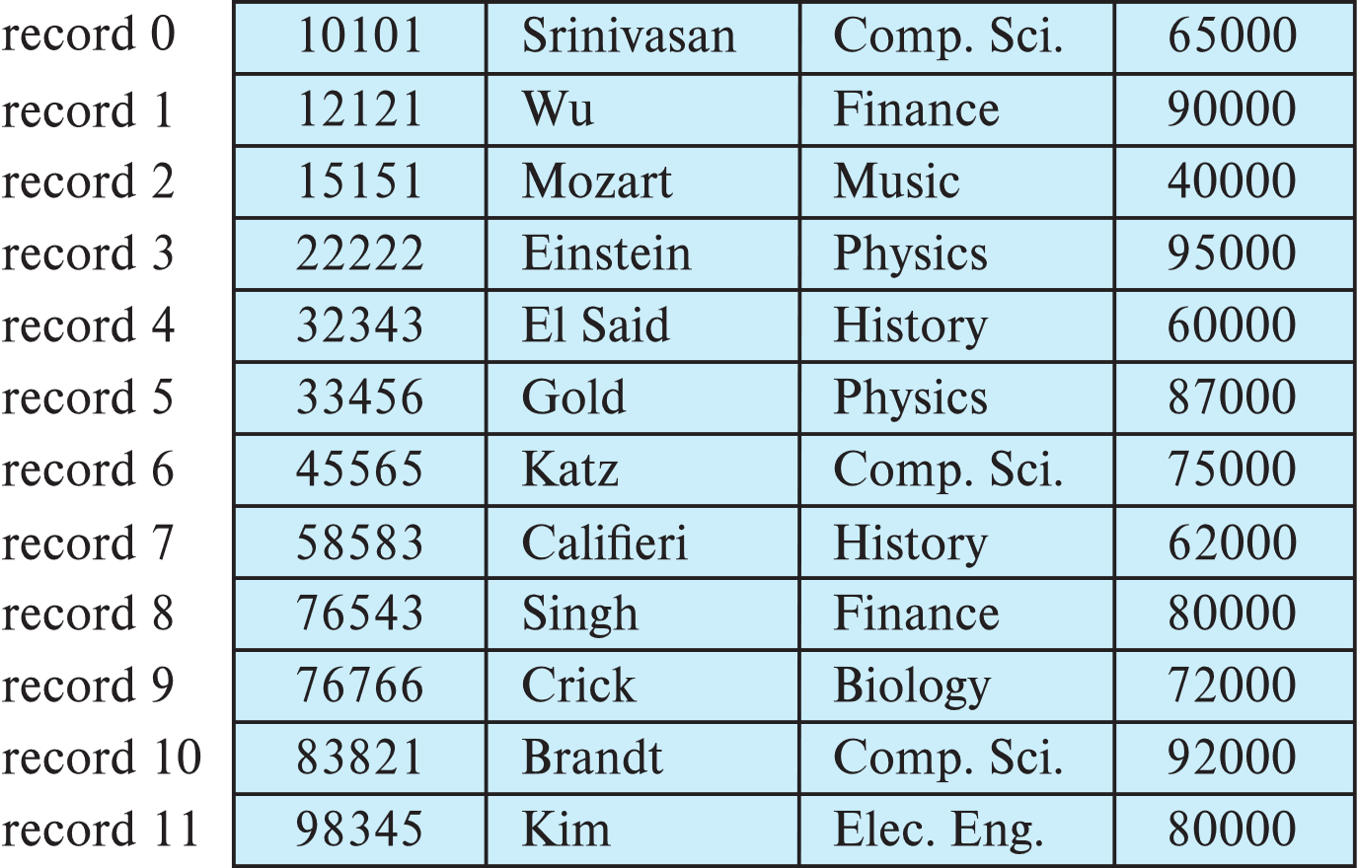
Fixed-Length Records
Simple approach:
Store record i starting from byte n ∗ (i – 1), where n is the size of each record.
Record access is simple but records may cross blocks
Modification: do not allow records to cross block boundaries

Slide 32
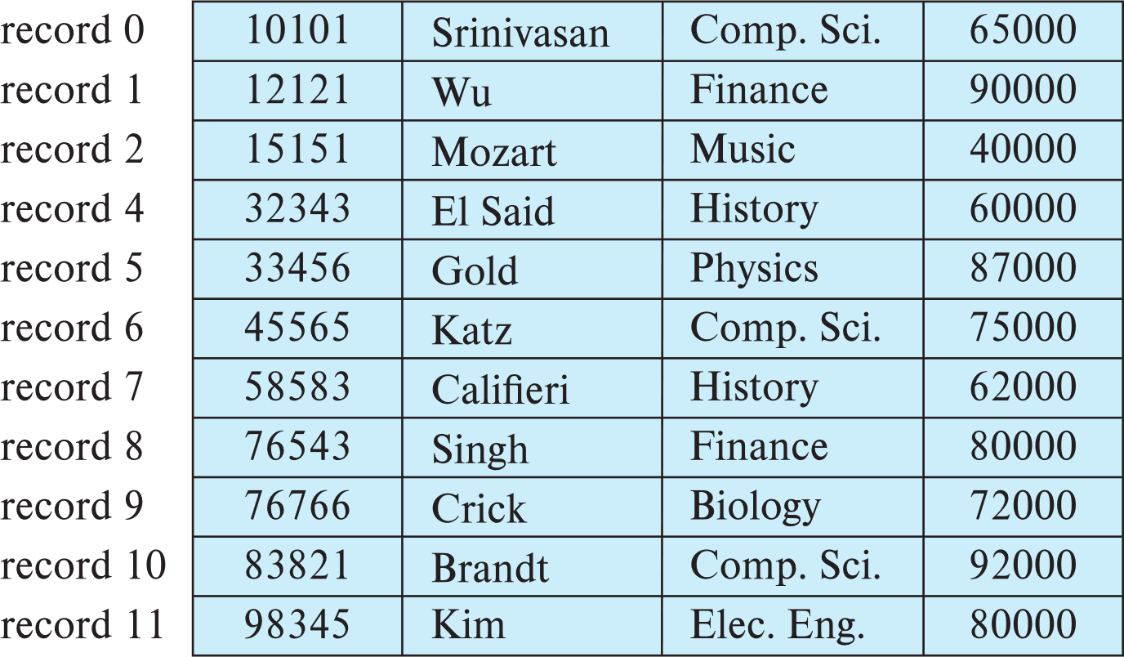
Fixed-Length Records
Deletion of record i: alternatives:
move records i + 1, . . ., n to i, . . . , n – 1
move record n to i
do not move records, but link all free records on a free list
Record 3 deleted

Slide 33
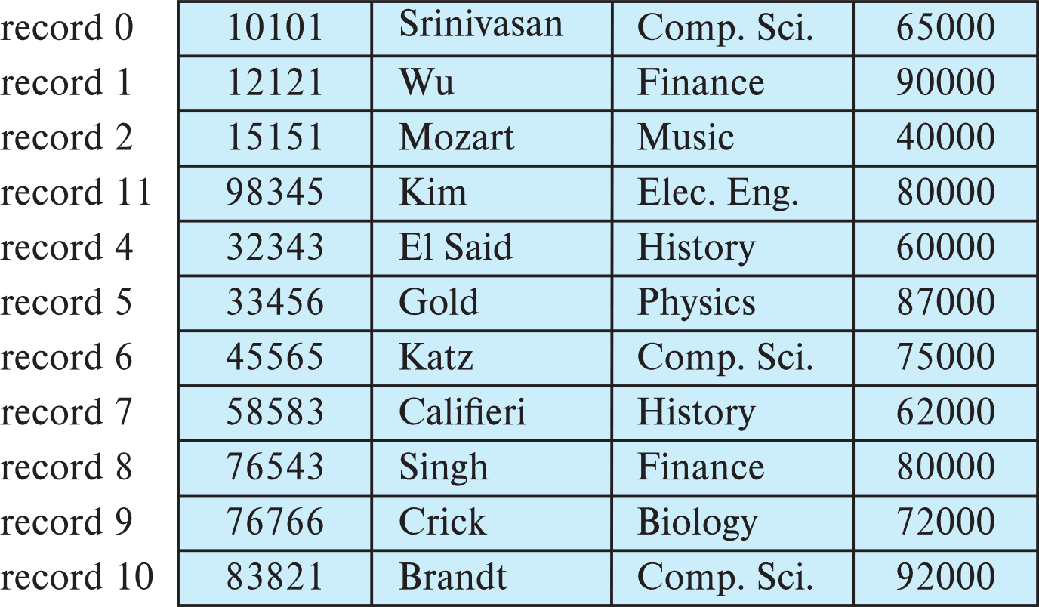
Fixed-Length Records
Deletion of record i: alternatives:
move records i + 1, . . ., n to i, . . . , n – 1
move record n to i
do not move records, but link all free records on a free list
Record 3 deleted and replaced by record 11

Slide 34
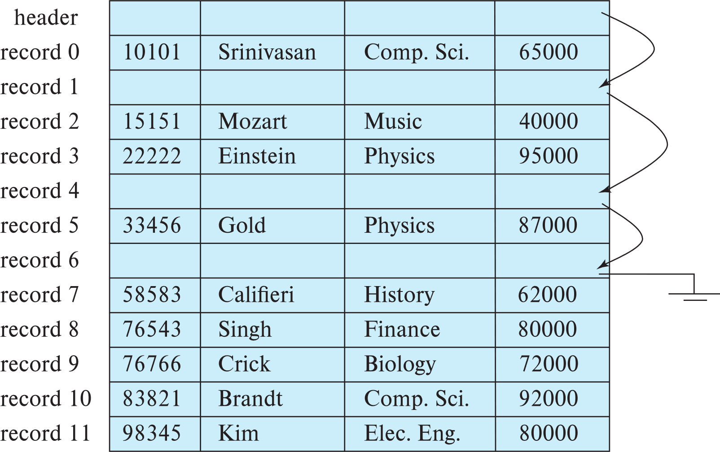
Fixed-Length Records
Deletion of record i: alternatives:
move records i + 1, . . ., n to i, . . . , n – 1
move record n to i
do not move records, but link all free records on a free list

Slide 35
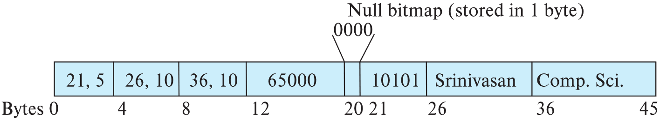
Variable-Length Records
Variable-length records arise in database systems in several ways:
Storage of multiple record types in a file.
Record types that allow variable lengths for one or more fields such as strings (varchar)
Record types that allow repeating fields (used in some older data models).
Attributes are stored in order
Variable length attributes represented by fixed size (offset, length), with actual data stored after all fixed length attributes
Null values represented by null-value bitmap

Slide 36
Variable-Length Records: Slotted Page Structure
Slotted page header contains:
number of record entries
end of free space in the block
location and size of each record
Records can be moved around within a page to keep them contiguous with no empty space between them; entry in the header must be updated.
Pointers should not point directly to record — instead they should point to the entry for the record in header.

Slide 37
Storing Large Objects
E.g., blob/clob types
Records must be smaller than pages
Alternatives:
Store as files in file systems
Store as files managed by database
Break into pieces and store in multiple tuples in separate relation
PostgreSQL TOAST

Slide 38
Organization of Records in Files
Heap – record can be placed anywhere in the file where there is space
Sequential – store records in sequential order, based on the value of the search key of each record
In a multitable clustering file organization records of several different relations can be stored in the same file
Motivation: store related records on the same block to minimize I/O
B⁺-tree file organization
Ordered storage even with inserts/deletes
Hashing – a hash function computed on search key; the result specifies in which block of the file the record should be placed

Slide 39
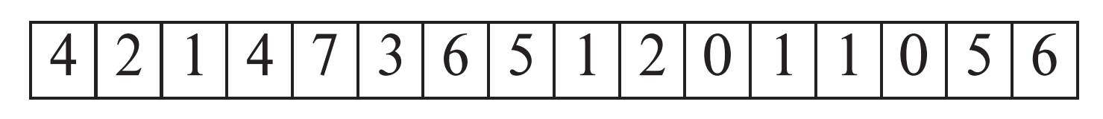
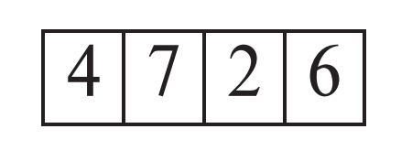
Heap File Organization
Records can be placed anywhere in the file where there is free space
Records usually do not move once allocated
Important to be able to efficiently find free space within file
Free-space map
Array with 1 entry per block. Each entry is a few bits to a byte, and records fraction of block that is free
In example below, 3 bits per block, value divided by 8 indicates fraction of block that is free
Can have second-level free-space map
In example below, each entry stores maximum from 4 entries of first-level free-space map
Free space map written to disk periodically, OK to have wrong (old) values for some entries (will be detected and fixed)

Slide 40
Sequential File Organization
Suitable for applications that require sequential processing of the entire file
The records in the file are ordered by a search-key

Slide 41
Sequential File Organization (Cont.)
Deletion – use pointer chains
Insertion –locate the position where the record is to be inserted
if there is free space insert there
if no free space, insert the record in an overflow block
In either case, pointer chain must be updated
Need to reorganize the file from time to time to restore sequential order

Slide 42
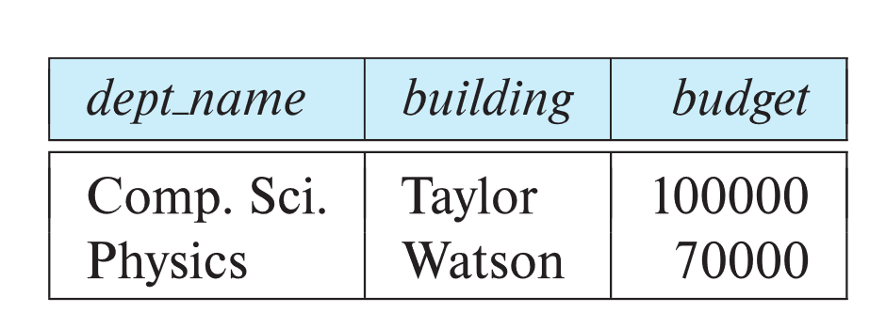
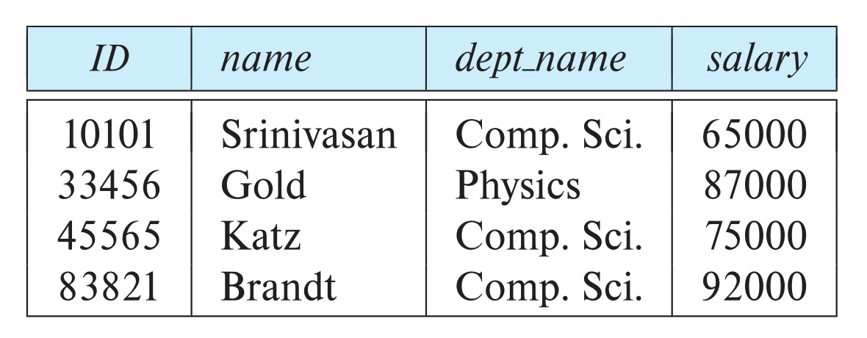
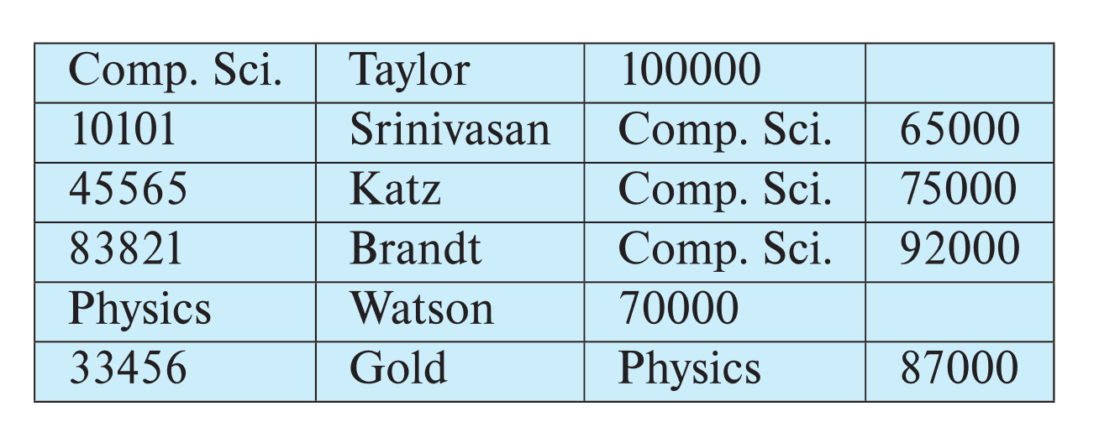
Multitable Clustering File Organization
Store several relations in one file using a multitable clustering file organization
department
instructor
multitable clustering
of department and
instructor

Slide 43
Multitable Clustering File Organization (cont.)
good for queries involving department ⨝ instructor, and for queries involving one single department and its instructors
bad for queries involving only department
results in variable size records
Can add pointer chains to link records of a particular relation

Slide 44
Partitioning
Table partitioning: Records in a relation can be partitioned into smaller relations that are stored separately
E.g., transaction relation may be partitioned into transaction_2018, transaction_2019, etc.
Queries written on transaction must access records in all partitions
Unless query has a selection such as year=2019, in which case only one partition in needed
Partitioning
Reduces costs of some operations such as free space management
Allows different partitions to be stored on different storage devices
E.g., transaction partition for current year on SSD, for older years on magnetic disk

Slide 45
Data Dictionary Storage
The Data dictionary (also called system catalog) stores metadata; that is, data about data, such as
Information about relations
names of relations
names, types and lengths of attributes of each relation
names and definitions of views
integrity constraints
User and accounting information, including passwords
Statistical and descriptive data
number of tuples in each relation
Physical file organization information
How relation is stored (sequential/hash/…)
Physical location of relation
Information about indices

Slide 46
Relational Representation of System Metadata
Relational representation on disk
Specialized data structures designed for efficient access, in memory

Slide 47
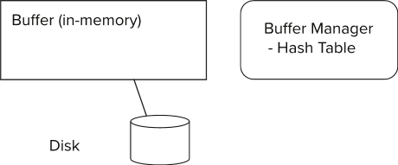
Storage Access
Blocks are units of both storage allocation and data transfer.
Database system seeks to minimize the number of block transfers between the disk and memory. We can reduce the number of disk accesses by keeping as many blocks as possible in main memory.
Buffer – portion of main memory available to store copies of disk blocks.
Buffer manager – subsystem responsible for allocating buffer space in main memory.

Slide 48
Buffer Manager
Programs call on the buffer manager when they need a block from disk.
If the block is already in the buffer, buffer manager returns the address of the block in main memory
If the block is not in the buffer, the buffer manager
Allocates space in the buffer for the block
Replacing (throwing out) some other block, if required, to make space for the new block.
Replaced block written back to disk only if it was modified since the most recent time that it was written to/fetched from the disk.
Reads the block from the disk to the buffer, and returns the address of the block in main memory to requester.

Slide 49
Buffer Manager
Buffer replacement strategy (details coming up!)
Pinned block: memory block that is not allowed to be written back to disk
Pin done before reading/writing data from a block
Unpin done when read /write is complete
Multiple concurrent pin/unpin operations possible
Keep a pin count, buffer block can be evicted only if pin count = 0
Shared and exclusive locks on buffer
Needed to prevent concurrent operations from reading page contents as they are moved/reorganized, and to ensure only one move/reorganize at a time
Readers get shared lock, updates to a block require exclusive lock
Locking rules:
Only one process can get exclusive lock at a time
Shared lock cannot be concurrently with exclusive lock
Multiple processes may be given shared lock concurrently

Slide 50
Buffer-Replacement Policies
Most operating systems replace the block least recently used (LRU strategy)
Idea behind LRU – use past pattern of block references as a predictor of future references
LRU can be bad for some queries
Queries have well-defined access patterns (such as sequential scans), and a database system can use the information in a user’s query to predict future references
Mixed strategy with hints on replacement strategy provided by the query optimizer is preferable
Example of bad access pattern for LRU: when computing the join of 2 relations r and s by a nested loops
for each tuple tr of r do for each tuple ts of s do if the tuples tr and ts match …

Slide 51
Buffer-Replacement Policies (Cont.)
Toss-immediate strategy – frees the space occupied by a block as soon as the final tuple of that block has been processed
Most recently used (MRU) strategy – system must pin the block currently being processed. After the final tuple of that block has been processed, the block is unpinned, and it becomes the most recently used block.
Buffer manager can use statistical information regarding the probability that a request will reference a particular relation
E.g., the data dictionary is frequently accessed. Heuristic: keep data-dictionary blocks in main memory buffer
Operating system or buffer manager may reorder writes
Can lead to corruption of data structures on disk
E.g., linked list of blocks with missing block on disk
File systems perform consistency check to detect such situations
Careful ordering of writes can avoid many such problems

Slide 52
Optimization of Disk Block Access (Cont.)
Buffer managers support forced output of blocks for the purpose of recovery (more in Chapter 19)
Nonvolatile write buffers speed up disk writes by writing blocks to a non-volatile RAM or flash buffer immediately
Writes can be reordered to minimize disk arm movement
Log disk – a disk devoted to writing a sequential log of block updates
Used exactly like nonvolatile RAM
Write to log disk is very fast since no seeks are required
Journaling file systems write data in-order to NV-RAM or log disk
Reordering without journaling: risk of corruption of file system data

Slide 53
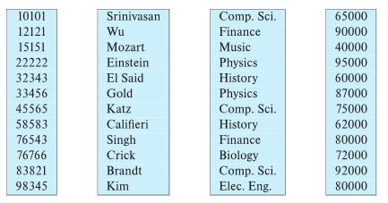
Column-Oriented Storage
Also known as columnar representation
Store each attribute of a relation separately
Example

Slide 54
Columnar Representation
Benefits:
Reduced IO if only some attributes are accessed
Improved CPU cache performance
Improved compression
Vector processing on modern CPU architectures
Drawbacks
Cost of tuple reconstruction from columnar representation
Cost of tuple deletion and update
Cost of decompression
Columnar representation found to be more efficient for decision support than row-oriented representation
Traditional row-oriented representation preferable for transaction processing
Some databases support both representations
Called hybrid row/column stores

Slide 55
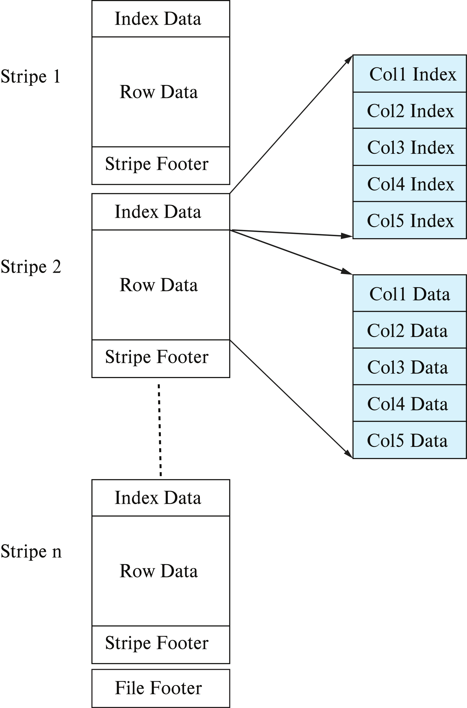
Columnar File Representation
ORC and Parquet: file formats with columnar storage inside file
Very popular for big-data applications
Orc file format shown on right:

Slide 56
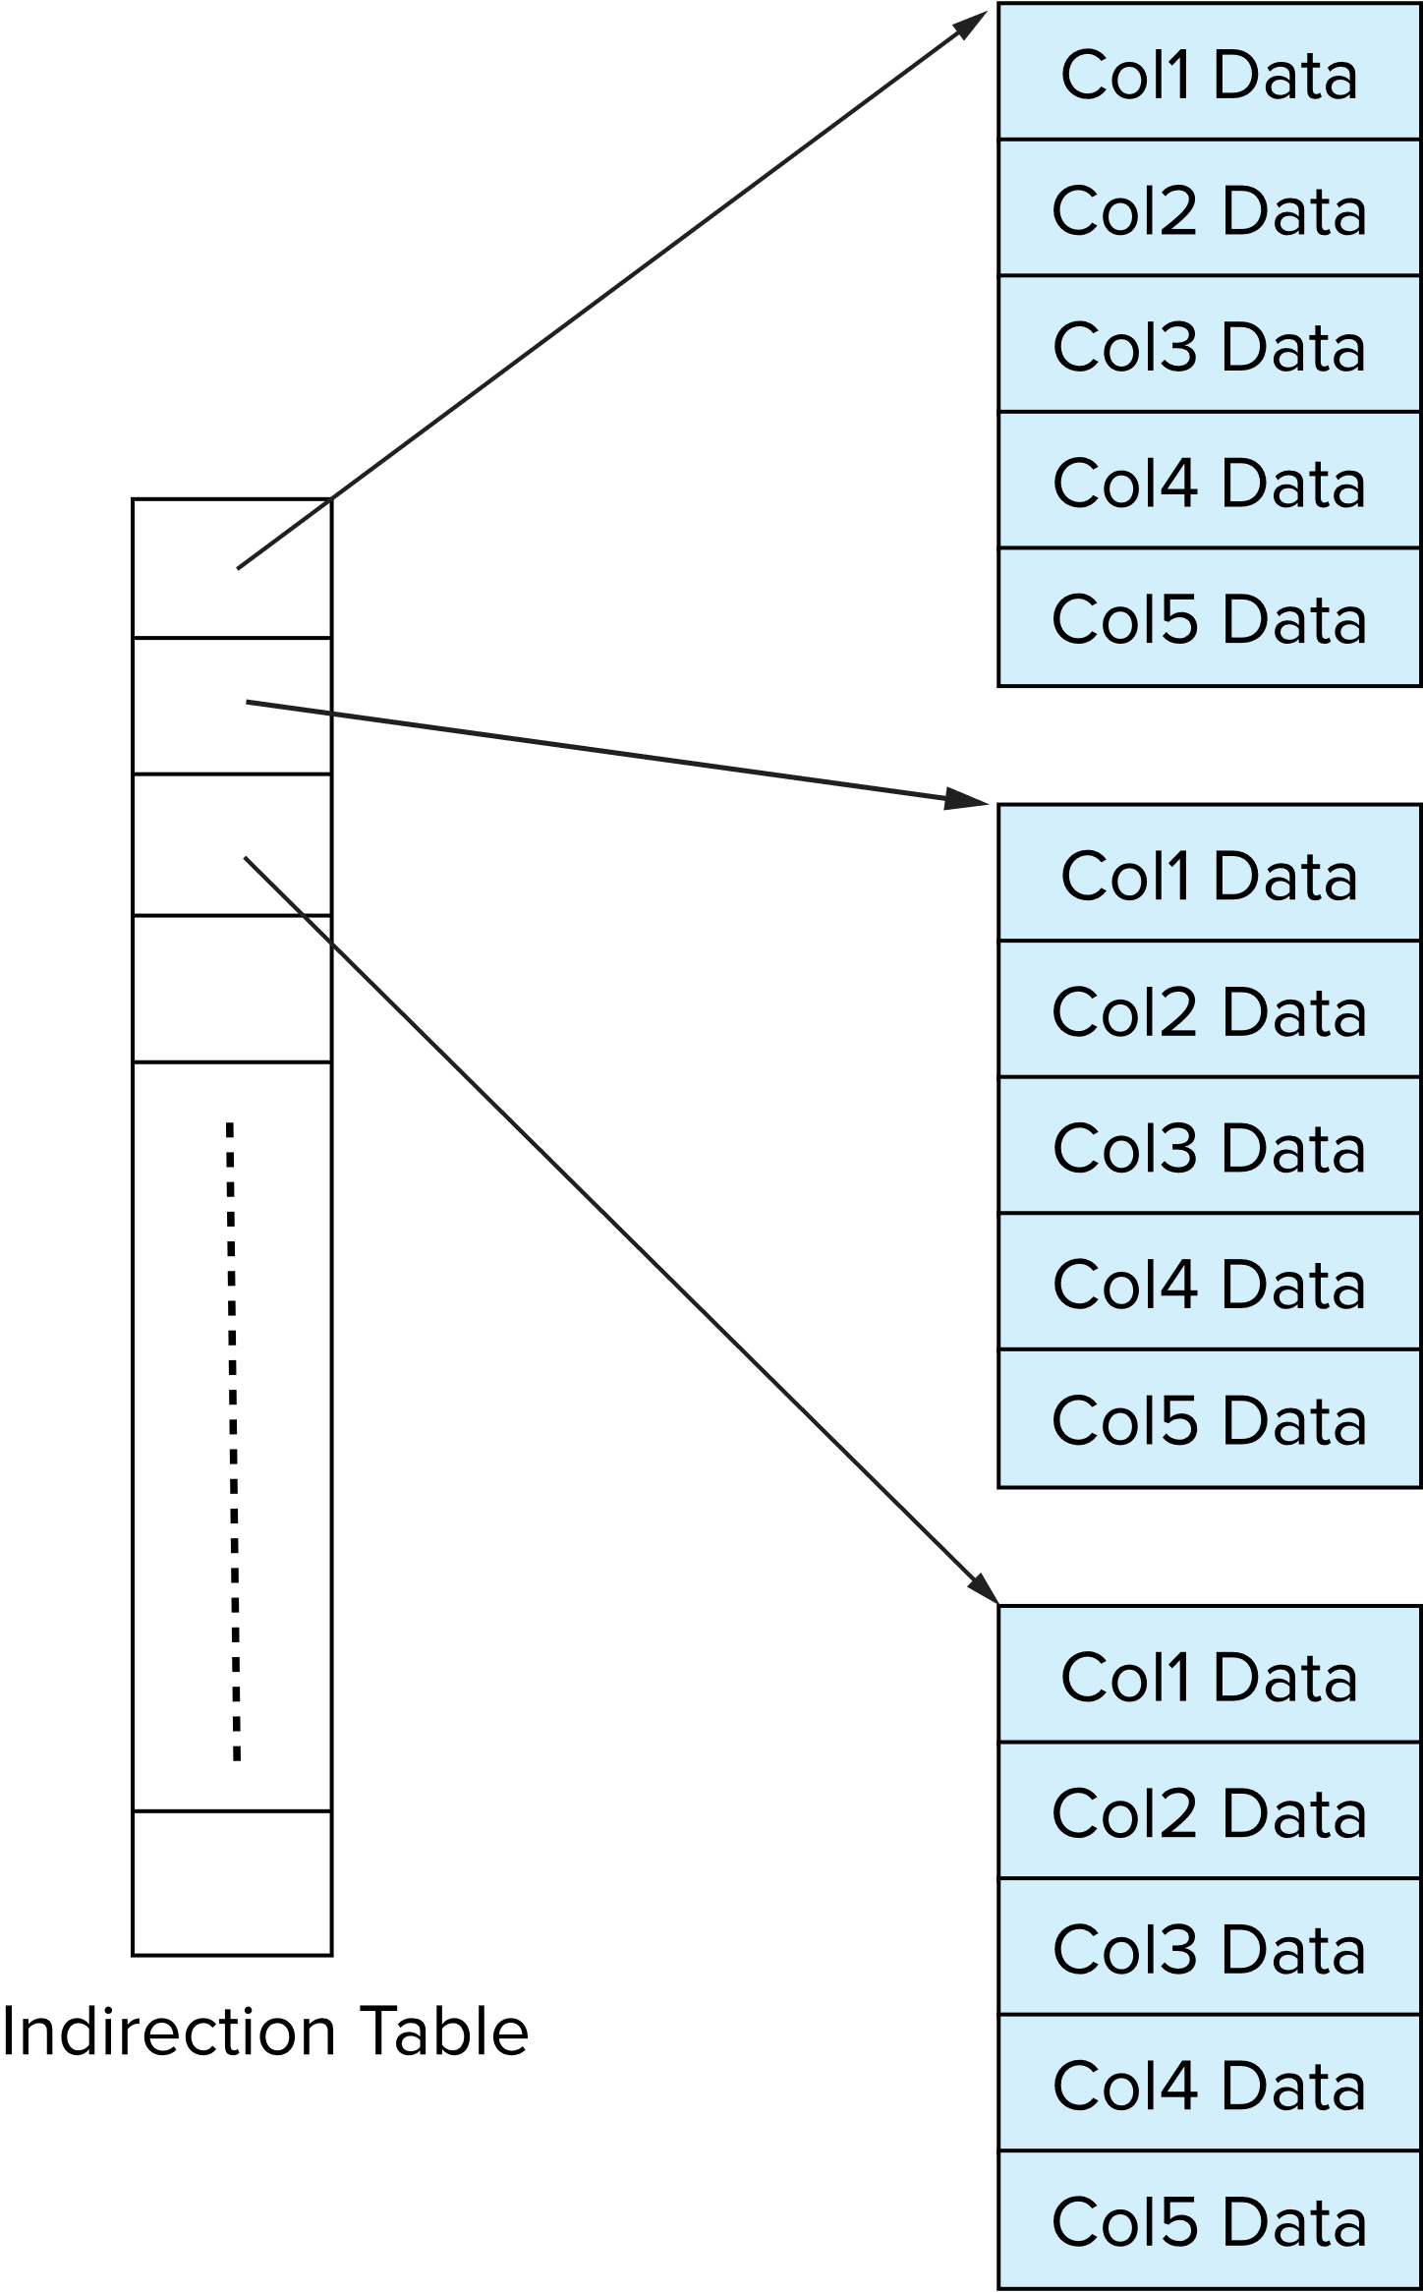
Storage Organization in Main-Memory Databases
Can store records directly in memory without a buffer manager
Column-oriented storage can be used in-memory for decision support applications
Compression reduces memory requirement

Slide 57
End of Chapter 10

Slide 58
Magnetic Tapes
Hold large volumes of data and provide high transfer rates
Few GB for DAT (Digital Audio Tape) format, 10-40 GB with DLT (Digital Linear Tape) format, 100 GB+ with Ultrium format, and 330 GB with Ampex helical scan format
Transfer rates from few to 10s of MB/s
Tapes are cheap, but cost of drives is very high
Very slow access time in comparison to magnetic and optical disks
limited to sequential access.
Some formats (Accelis) provide faster seek (10s of seconds) at cost of lower capacity
Used mainly for backup, for storage of infrequently used information, and as an off-line medium for transferring information from one system to another.
Tape jukeboxes used for very large capacity storage
Multiple petabyes (10¹⁵ bytes)

