Slide 1
Chapter 15 : Concurrency Control

Slide 2
Outline
We need a way to guarantee that all execution schedules are correct (i.e., serializable) without knowing the entire schedule ahead of time.
Lock-Based Protocols
Timestamp-Based Protocols
Multiversion Schemes

Slide 3
Lock Based Concurrency Control

Slide 4
Lock-Based Protocols
A lock is a mechanism to control concurrent access to a data item
Data items can be locked in two modes :
1. exclusive (X) mode(排他锁). Data item can be both read as well as
written. X-lock is requested using lock-X instruction.
2. shared (S) mode. Data item can only be read. S-lock is
requested using lock-S instruction.
Lock requests are made to concurrency-control manager. Transaction can proceed only after request is granted.

Slide 5
Lock-Based Protocols (Cont.)
Lock-compatibility matrix
A transaction may be granted a lock on an item if the requested lock is compatible with locks already held on the item by other transactions
Any number of transactions can hold shared locks on an item,
But if any transaction holds an exclusive on the item no other transaction may hold any lock on the item.
Notes:
If a lock cannot be granted, the requesting transaction is made to wait till all incompatible locks held by other transactions have been released. The lock is then granted.

Slide 6
Lock-Based Protocols (Cont.)
Example of a transaction performing locking:
T₂: lock-S(A);
read (A);
unlock(A);
lock-S(B);
read (B);
unlock(B);
display(A+B)
Locking as above is not sufficient to guarantee serializability

Slide 7
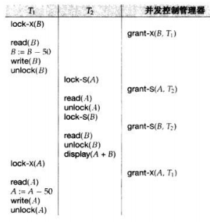
Schedule With Lock Grants
Grants omitted in rest of chapter
Assume grant happens just before the next instruction following lock request
This schedule is not serializable (why?)
A locking protocol is a set of rules followed by all transactions while requesting and releasing locks.
Locking protocols enforce serializability by restricting the set of possible schedules.

Slide 8
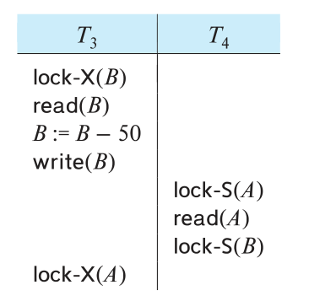
Deadlock
Consider the partial schedule
Neither T₃ nor T₄ can make progress — executing lock-S(B) causes T₄ to wait for T₃ to release its lock on B, while executing lock-X(A) causes T₃ to wait for T₄ to release its lock on A.
Such a situation is called a deadlock.
To handle a deadlock one of T₃ or T₄ must be rolled back and its locks released.

Slide 9
Deadlock (Cont.)
The potential for deadlock exists in most locking protocols. Deadlocks are a necessary evil.
Starvation is also possible if concurrency control manager is badly designed. For example:
A transaction may be waiting for an X-lock on an item, while a sequence of other transactions request and are granted an S-lock on the same item.
The same transaction is repeatedly rolled back due to deadlocks.
Concurrency control manager can be designed to prevent starvation.

Slide 10
The Two-Phase Locking Protocol
A protocol which ensures conflict-serializable schedules.
Phase 1: Growing Phase
Transaction may obtain locks
Transaction may not release locks
Phase 2: Shrinking Phase
Transaction may release locks
Transaction may not obtain locks
The protocol assures serializability. It can be proved that the transactions can be serialized in the order of their lock points (i.e., the point where a transaction acquired its final lock). （Why？）
Locks
Time

Slide 11
EXAMPLE
T1
Lock-S (B)
Lock-X (A)
read(B);
read(A);
A := A + 0.1*B
unLock (B)
write(A);
unLock (A)
commit
T1
Lock-S (B)
read(B);
unLock (B)
Lock-X (A)
read(A);
A := A + 0.1*B
write(A);
unLock (A)
commit
符合两阶段封锁协议
不符合两阶段封锁协议

Slide 12
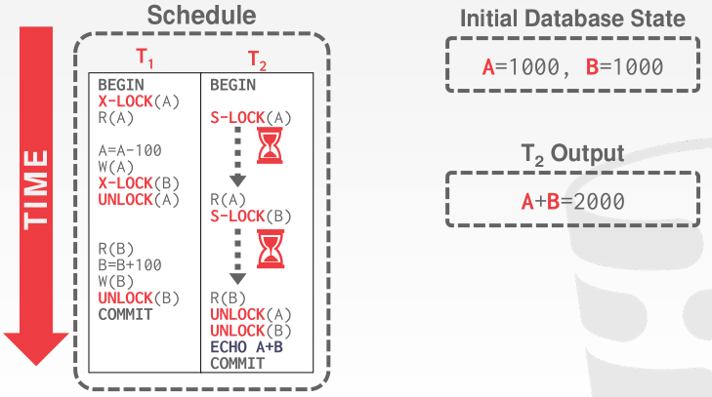
The Two-Phase Locking Protocol (Cont.)
2PL EXAMPLE
T_1已经加了一个排他锁，T_2的共享锁要等到解锁之后才可以

Slide 13
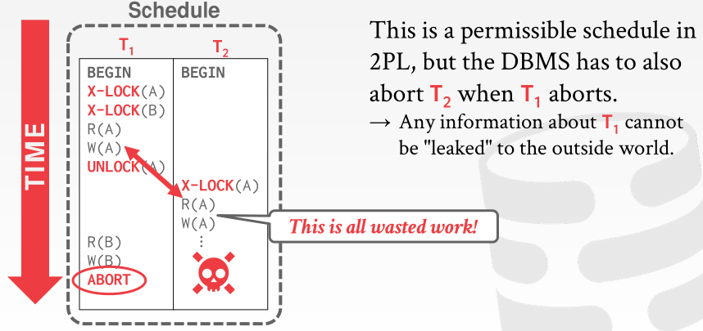
The Two-Phase Locking Protocol (Cont.)
Two-phase locking does not ensure freedom from deadlocks
Extensions to basic two-phase locking needed to ensure recoverability of freedom from cascading roll-back
CASCADING ABORTS

Slide 14
The Two-Phase Locking Protocol (Cont.)
Extensions to basic two-phase locking needed to ensure recoverability of freedom from cascading roll-back
Strict two-phase locking: a transaction must hold all its exclusive locks till it commits/aborts.
Ensures recoverability and avoids cascading roll-backs
Rigorous two-phase locking: a transaction must hold all locks till commit/abort.
Transactions can be serialized in the order in which they commit.
Most databases implement rigorous two-phase locking, but refer to it as simply two-phase locking

Slide 15
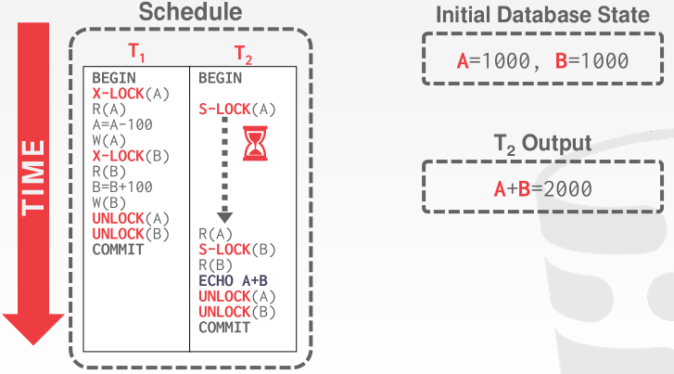
The Two-Phase Locking Protocol (Cont.)
Rigorous 2PL EXAMPLE

Slide 16
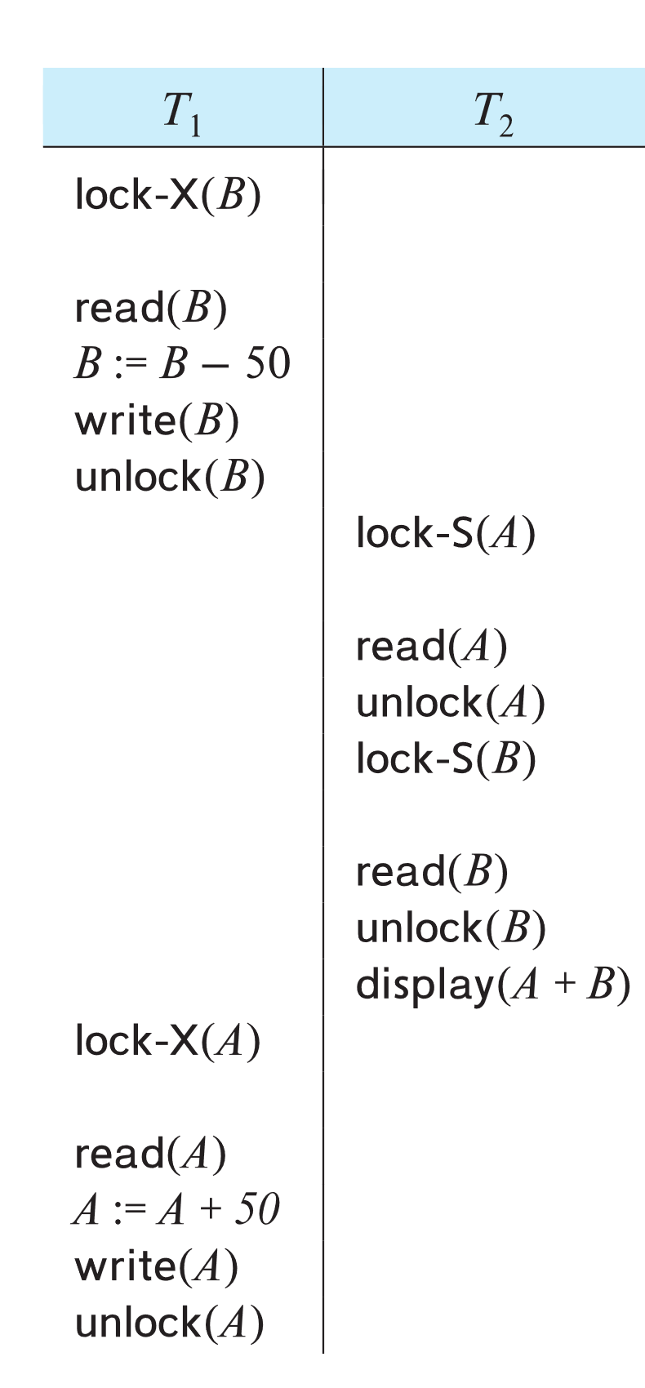
The Two-Phase Locking Protocol (Cont.)
Two-phase locking is not a necessary condition for serializability 充分而不是必要条件
There are conflict serializable schedules that cannot be obtained if the two-phase locking protocol is used.
In the absence of extra information (e.g., ordering of access to data), two-phase locking is necessary for conflict serializability in the following sense:
Given a transaction T_{i} that does not follow two-phase locking, we can find a transaction T_{j} that uses two-phase locking, and a schedule for T_{i} and T_{j} that is not conflict serializable.

Slide 17
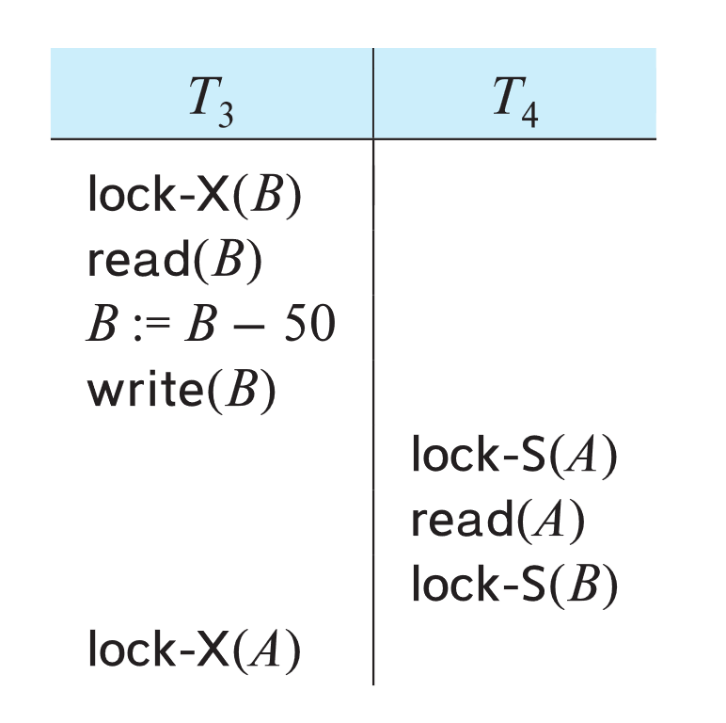
Deadlock Handling
System is deadlocked if there is a set of transactions such that every transaction in the set is waiting for another transaction in the set.（如果存在一组事务，使得该组中的每个事务都在等待该组中的另一个事务，则系统将陷入死锁。）

Slide 18
Deadlock Handling
Deadlock prevention protocols ensure that the system will never enter into a deadlock state. Some prevention strategies:
（死锁预防协议确保系统永远不会进入死锁状态。 一些预防策略：）
Require that each transaction locks all its data items before it begins execution (pre-declaration).
Impose partial ordering of all data items and require that a transaction can lock data items only in the order specified by the partial order (graph-based protocol).

Slide 19
More Deadlock Prevention Strategies
wait-die scheme — non-preemptive
Older transaction may wait for younger one to release data item.
Younger transactions never wait for older ones; they are rolled back instead.
A transaction may die several times before acquiring a lock
wound-wait scheme — preemptive
Older transaction wounds (forces rollback) of younger transaction instead of waiting for it.
Younger transactions may wait for older ones.
Fewer rollbacks than wait-die scheme.
In both schemes, a rolled back transactions is restarted with its original timestamp.
Ensures that older transactions have precedence over newer ones, and starvation is thus avoided.

Slide 20
Deadlock prevention (Cont.)
Timeout-Based Schemes:
A transaction waits for a lock only for a specified amount of time. After that, the wait times out and the transaction is rolled back.
Ensures that deadlocks get resolved by timeout if they occur
Simple to implement
But may roll back transaction unnecessarily in absence of deadlock
Difficult to determine good value of the timeout interval.
Starvation is also possible

Slide 21
Deadlock Detection
Wait-for graph
Vertices: transactions
Edge from T_{i} →T_{j}. : if T_{i} is waiting for a lock held in conflicting mode by T_{j}
The system is in a deadlock state if and only if the wait-for graph has a cycle.
Invoke a deadlock-detection algorithm periodically to look for cycles.
Wait-for graph without a cycle
Wait-for graph with a cycle

Slide 22
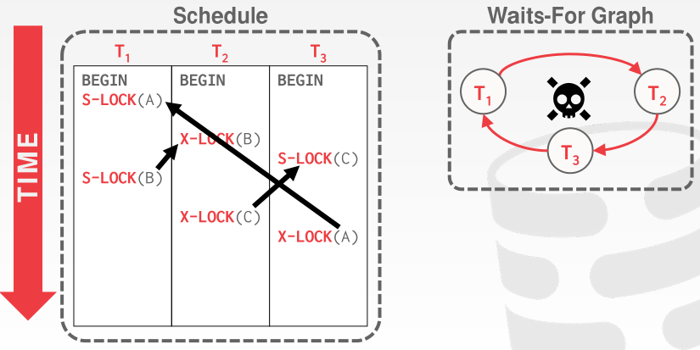
Deadlock Detection
Wait-for graph

Slide 23
Deadlock Recovery
When deadlock is detected :
Some transaction will have to rolled back (made a victim) to break deadlock cycle.
Select that transaction as victim that will incur minimum cost
Rollback -- determine how far to roll back transaction
Total rollback: Abort the transaction and then restart it.
Partial rollback: Roll back victim transaction only as far as necessary to release locks that another transaction in cycle is waiting for
Starvation can happen (why?)
One solution: oldest transaction in the deadlock set is never chosen as victim

Slide 24
Multiple Granularity
Allow data items to be of various sizes and define a hierarchy of data granularities, where the small granularities are nested within larger ones
Can be represented graphically as a tree (but don't confuse with tree-locking protocol)
When a transaction locks a node in the tree explicitly, it implicitly locks all the node's descendants in the same mode.
Granularity of locking (level in tree where locking is done):
Fine granularity (lower in tree): high concurrency, high locking overhead
Coarse granularity (higher in tree): low locking overhead, low concurrency

Slide 25
Example of Granularity Hierarchy
The levels, starting from the coarsest (top) level are
database
area
file
record

Slide 26
Example of Granularity Hierarchy
The levels, starting from the coarsest (top) level are
database
area
file
record
The corresponding tree

Slide 27
Intention Lock Modes
In addition to S and X lock modes, there are three additional lock modes with multiple granularity:
intention-shared (IS): indicates explicit locking at a lower level of the tree but only with shared locks.
intention-exclusive (IX): indicates explicit locking at a lower level with exclusive or shared locks
shared and intention-exclusive (SIX): the subtree rooted by that node is locked explicitly in shared mode and explicit locking is being done at a lower level with exclusive-mode locks.
Intention locks allow a higher level node to be locked in S or X mode without having to check all descendent nodes.

Slide 28
Compatibility Matrix with Intention Lock Modes
The compatibility matrix for all lock modes is:

Slide 29
Multiple Granularity Locking Scheme
Transaction T_{i} can lock a node Q, using the following rules:
The lock compatibility matrix must be observed.
2. The root of the tree must be locked first, and may be locked in any
mode.
3. A node Q can be locked by T_{i} in S or IS mode only if the parent of Q is
currently locked by T_{i} in either IX or IS mode.
4. A node Q can be locked by T_{i} in X, SIX, or IX mode only if the parent
of Q is currently locked by T_{i} in either IX or SIX mode.
5. T_{i} can lock a node only if it has not previously unlocked any node (that
is, T_{i} is two-phase).
6. T_{i} can unlock a node Q only if none of the children of Q are currently
locked by T_{i}.
Observe that locks are acquired in root-to-leaf order, whereas they are released in leaf-to-root order.
Lock granularity escalation: in case there are too many locks at a particular level, switch to higher granularity S or X lock

Slide 30
Timestamp Based Concurrency Control

Slide 31
Timestamp-Based Protocols
Each transaction T_{i} is issued a timestamp TS(T_{i}) when it enters the system.
Each transaction has a unique timestamp
Timestamp could be based on a logical counter
Real time may not be unique
Can use (wall-clock time, logical counter) to ensure
Timestamp-based protocols manage concurrent execution such that time-stamp order = serializability order
If TS(T_{i})< TS(T_{j}), then the DBMS must ensure that the execution schedule is equivalent to a serial schedule where T_{i} appears before T_{j}.

Slide 32
Timestamp-Ordering Protocol
The timestamp ordering (TSO) protocol
Maintains for each data Q two timestamp values:
W-timestamp(Q) is the largest time-stamp of any transaction that executed write(Q) successfully.
R-timestamp(Q) is the largest time-stamp of any transaction that executed read(Q) successfully.
Check timestamps for every operation:
If txn tries to access an object "from the future", it aborts and restarts.
Imposes rules on read and write operations to ensure that
Any conflicting operations are executed in timestamp order
Out of order operations cause transaction rollback

Slide 33
Timestamp-Based Protocols (Cont.)
Suppose a transaction T_{i} issues a read(Q)
1. If TS(T_{i}) < W-timestamp(Q), then T_{i} needs to read a value of Q that was already overwritten.
Hence, the read operation is rejected, and T_{i} is rolled back.
2. If TS(T_{i}) ≥ W-timestamp(Q), then the read operation is executed, and R-timestamp(Q) is set to
max(R-timestamp(Q), TS(T_{i})).

Slide 34
Timestamp-Based Protocols (Cont.)
Suppose that transaction T_{i} issues write(Q).
1. If TS(T_{i}) < R-timestamp(Q), then the value of Q that T_{i} is producing was needed previously, and the system assumed that that value would never be produced.
Hence, the write operation is rejected, and T_{i} is rolled back.
2. If TS(T_{i}) < W-timestamp(Q), then T_{i} is attempting to write an obsolete value of Q.
Hence, this write operation is rejected, and T_{i} is rolled back.
3. Otherwise, the write operation is executed, and W-timestamp(Q) is set to TS(T_{i}).

Slide 35
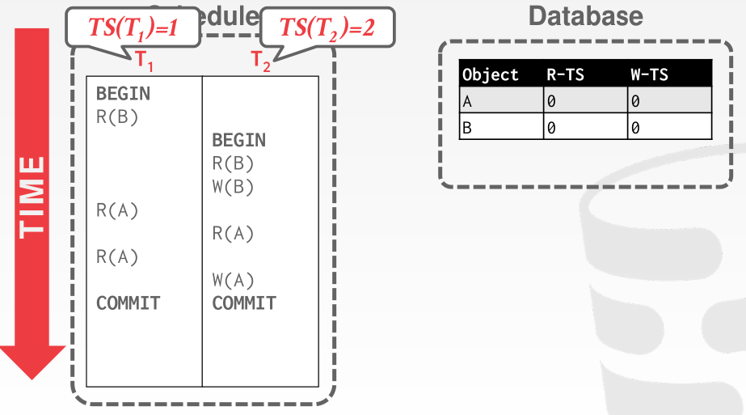
Example of Schedule Under TSO

Slide 36
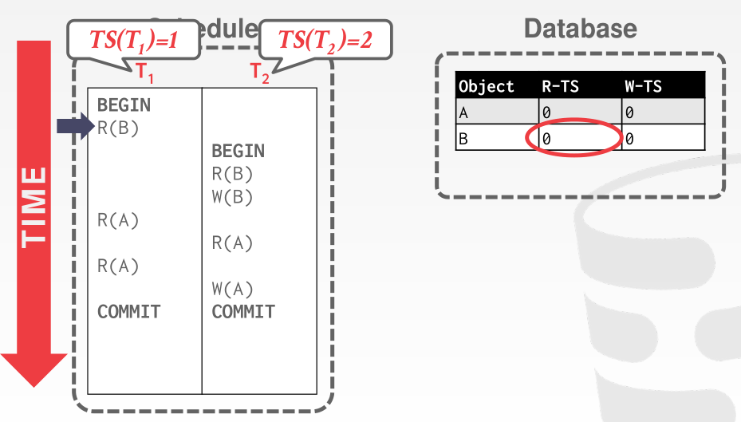
Example of Schedule Under TSO

Slide 37
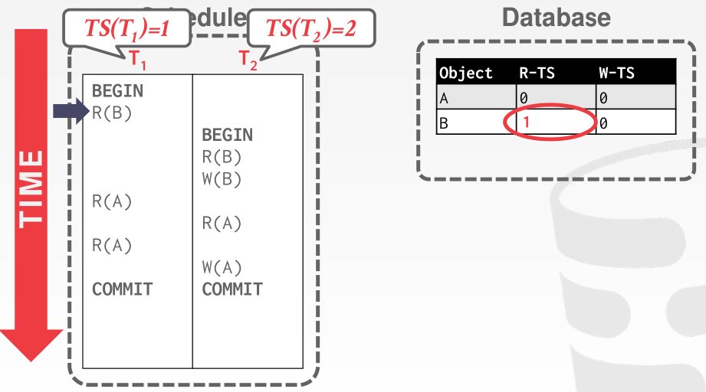
Example of Schedule Under TSO

Slide 38

Example of Schedule Under TSO

Slide 39
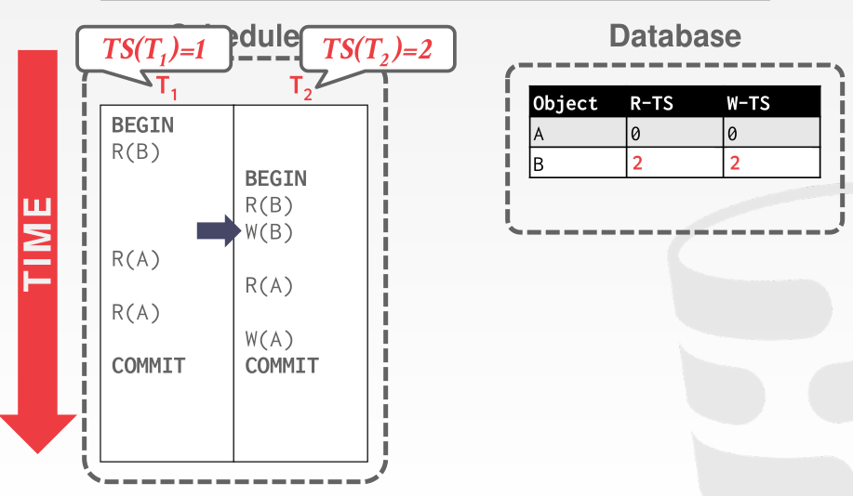
Example of Schedule Under TSO

Slide 40
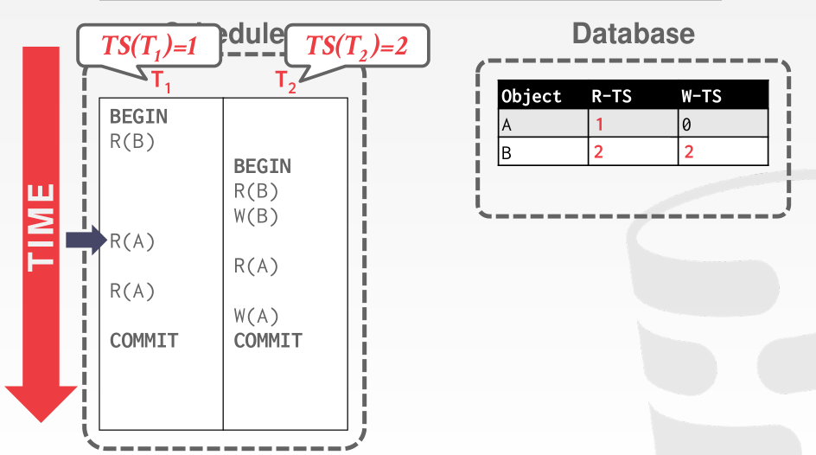
Example of Schedule Under TSO

Slide 41
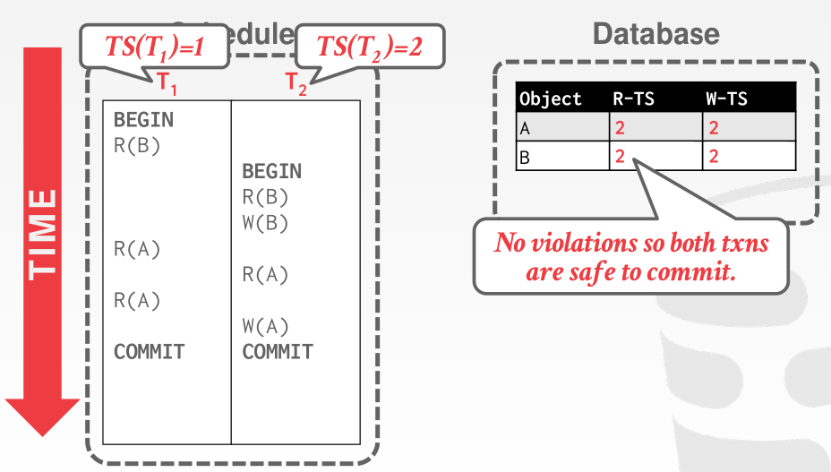
Example of Schedule Under TSO

Slide 42
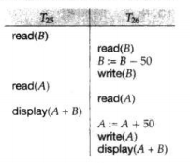

Example of Schedule Under TSO
Is this schedule valid under TSO?
Assume that initially:
R-TS(A) = W-TS(A) = 0
R-TS(B) = W-TS(B) = 0
Assume TS(T₂₅) = 25 and TS(T₂₆) = 26
How about this one, where initially R-TS(Q)=W-TS(Q)=0

Slide 43
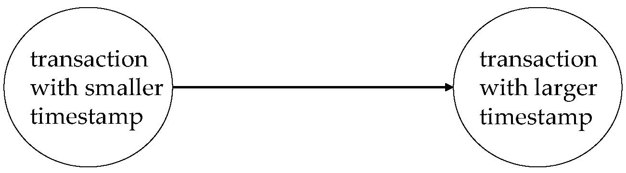
Correctness of Timestamp-Ordering Protocol
The timestamp-ordering protocol guarantees serializability since all the arcs in the precedence graph are of the form:
Thus, there will be no cycles in the precedence graph
Timestamp protocol ensures freedom from deadlock as no transaction ever waits.
But the schedule may not be cascade-free, and may not even be recoverable.

Slide 44
Thomas’ Write Rule
Modified version of the timestamp-ordering protocol in which obsolete write operations may be ignored under certain circumstances.
When T_{i} attempts to write data item Q, if TS(T_{i}) < W-timestamp(Q), then T_{i} is attempting to write an obsolete value of {Q}.
Rather than rolling back T_{i} as the timestamp ordering protocol would have done, this {write} operation can be ignored. （把写操作去掉不会影响结果，因为该写操作最后都会被覆盖）
Otherwise this protocol is the same as the timestamp ordering protocol.
Thomas' Write Rule allows greater potential concurrency.
Allows some view-serializable schedules that are not conflict-serializable.

Slide 45
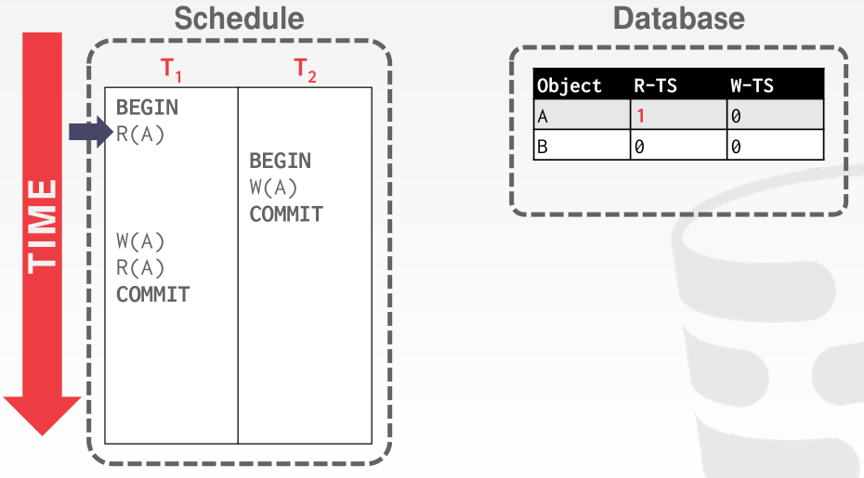
Thomas’ Write Rule

Slide 46
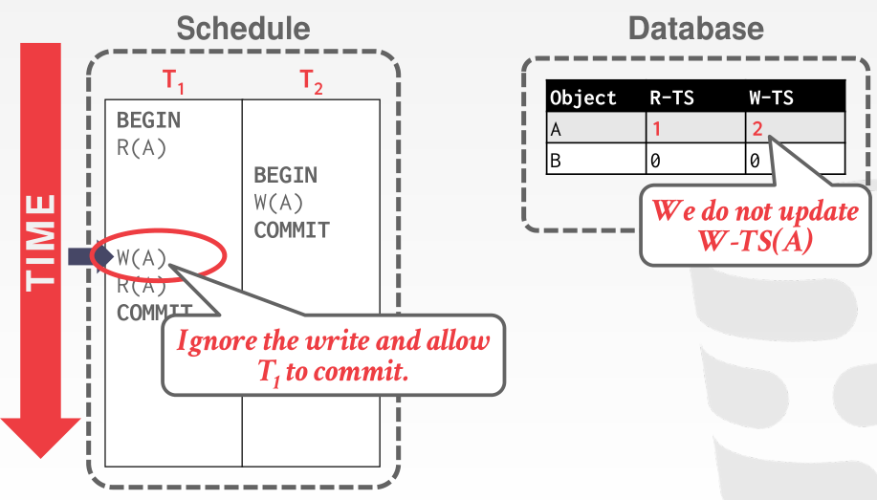
Thomas’ Write Rule

Slide 47
Validation-Based Protocol
Idea: can we use commit time as serialization order?
To do so:
Postpone writes to end of transaction
Keep track of data items read/written by transaction
Validation performed at commit time, detect any out-of-serialization order reads/writes
Also called as optimistic concurrency control (乐观并发控制) since transaction executes fully in the hope that all will go well during validation

Slide 48
Validation-Based Protocol
Execution of transaction T_{i} is done in three phases.
1. Read and execution phase: Transaction T_{i} writes only to
temporary local variables
2. Validation phase: Transaction T_{i} performs a '‘validation test''
to determine if local variables can be written without violating
serializability.
3. Write phase: If T_{i} is validated, the updates are applied to the
database; otherwise, T_{i} is rolled back.
The three phases of concurrently executing transactions can be interleaved, but each transaction must go through the three phases in that order.
We assume for simplicity that the validation and write phase occur together, atomically and serially
I.e., only one transaction executes validation/write at a time.

Slide 49
Validation-Based Protocol (Cont.)
Each transaction T_{i} has 3 timestamps
StartTS(T_{i}) : the time when T_{i} started its execution
ValidationTS(T_{i}): the time when T_{i} entered its validation phase
FinishTS(T_{i}) : the time when T_{i} finished its write phase
Validation tests use above timestamps and read/write sets to ensure that serializability order is determined by validation time
Thus, TS(T_{i}) = ValidationTS(T_{i})
Validation-based protocol has been found to give greater degree of concurrency than locking/TSO if probability of conflicts is low.

Slide 50
Validation Test for Transaction T_{j}
If for all T_{i} with TS (T_{i}) < TS (T_{j}) either one of the following condition holds:
finishTS(T_{i}) < startTS(T_{j})
startTS(T_{j}) < finishTS(T_{i}) < validationTS(T_{j}) and the set of data items written by T_{i} does not intersect with the set of data items read by T_{j}.
then validation succeeds and T_{j} can be committed.
Otherwise, validation fails and T_{j} is aborted.
Justification:
First condition applies when execution is not concurrent
The writes of T_{j} do not affect reads of T_{i} since they occur after T_{i} has finished its reads.
If the second condition holds, execution is concurrent, T_{j} does not read any item written by T_{i}.

Slide 51
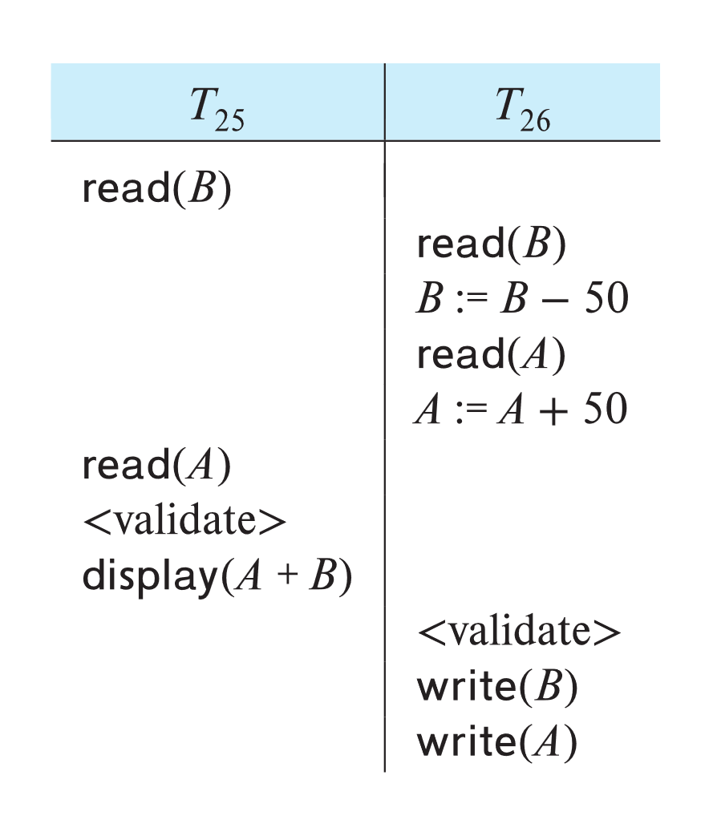
Schedule Produced by Validation
Example of schedule produced using validation

Slide 52
Multiversion Concurrency Control

Slide 53
Multiversion Schemes
The DBMS maintains multiple physical versions of a single logical object in the database:
When a txn writes to an object, the DBMS creates a new version of that object.
When a txn reads an object, it reads the newest version that existed when the txn started.
reads never have to wait as an appropriate version is returned immediately.

Slide 54
Multiversion Schemes
Multiversion schemes keep old versions of data item to increase concurrency. Several variants:
Multiversion Timestamp Ordering
Multiversion Two-Phase Locking
Snapshot isolation
Key ideas:
Each successful write results in the creation of a new version of the data item written.
Use timestamps to label versions.
When a read(Q) operation is issued, select an appropriate version of Q based on the timestamp of the transaction issuing the read request, and return the value of the selected version.

Slide 55
Multiversion Timestamp Ordering
Each data item Q has a sequence of versions <Q₁, Q₂,...., Q_{m}>. Each version Q_{k} contains three data fields:
Content -- the value of version Q_{k}.
W-timestamp(Q_{k}) -- timestamp of the transaction that created (wrote) version Q_{k}
R-timestamp(Q_{k}) -- largest timestamp of a transaction that successfully read version Q_{k}

Slide 56
Multiversion Timestamp Ordering (Cont)
Suppose that transaction T_{i} issues a read(Q) or write(Q) operation. Let Q_{k} denote the version of Q whose write timestamp is the largest write timestamp less than or equal to TS(T_{i}).
1. If transaction T_{i} issues a read(Q), then
the value returned is the content of version Q_{k}
If R-timestamp(Q_{k}) < TS(T_{i}), set R-timestamp(Q_{k}) = TS(T_{i}),
2. If transaction T_{i} issues a write(Q)
if TS(T_{i}) < R-timestamp(Q_{k}), then transaction T_{i} is rolled back.
if TS(T_{i}) = W-timestamp(Q_{k}), the contents of Q_{k} are overwritten
Otherwise, a new version Q_{i} of Q is created
W-timestamp(Q_{i}) and R-timestamp(Q_{i}) are initialized to TS(T_{i}).

Slide 57
Multiversion Timestamp Ordering (Cont)
Observations
Reads always succeed
A write by T_{i} is rejected if some other transaction T_{j} that (in the serialization order defined by the timestamp values) should read T_{i}'s write, has already read a version created by a transaction older than T_{i}.
Protocol guarantees serializability

Slide 58
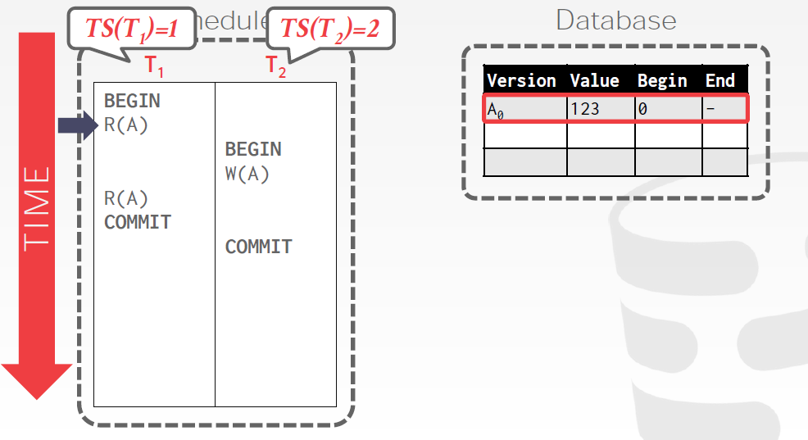
Example

Slide 59
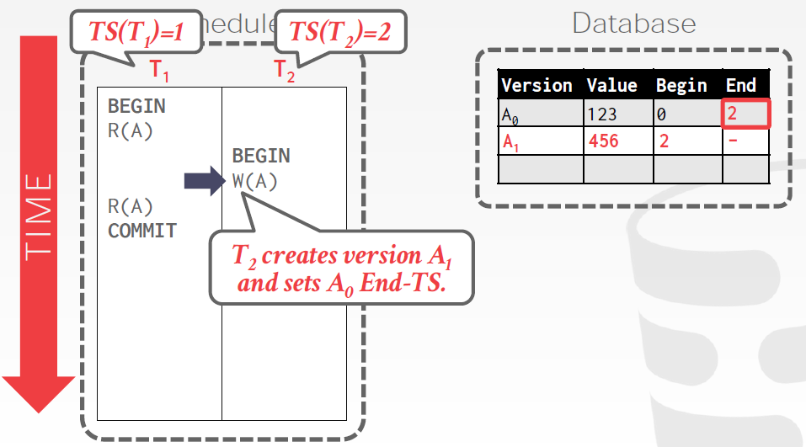
Example

Slide 60
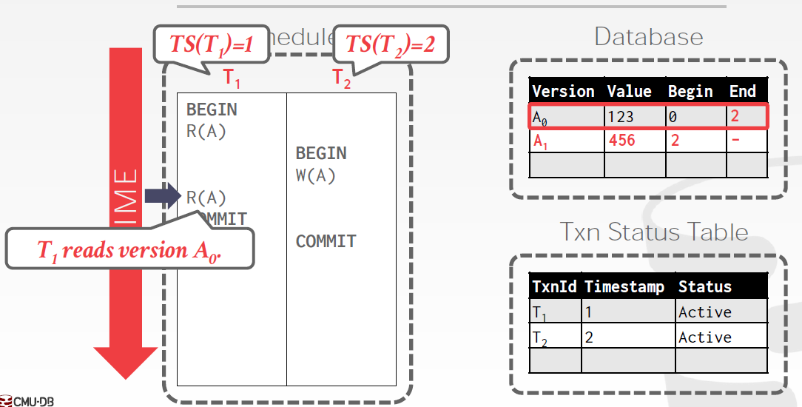
Example

Slide 61
Multiversion Two-Phase Locking
Differentiates between read-only transactions and update transactions
Update transactions acquire read and write locks, and hold all locks up to the end of the transaction. That is, update transactions follow rigorous two-phase locking.
Read of a data item returns the latest version of the item
The first write of Q by T_{i} results in the creation of a new version Q_{i} of the data item Q written
W-timestamp(Q_{i}) set to ∞ initially
When update transaction T_{i} completes, commit processing occurs:
Value ts-counter stored in the database is used to assign timestamps
ts-counter is locked in two-phase manner
Set TS(T_{i}) = ts-counter + 1
Set W-timestamp(Q_{i}) = TS(T_{i}) for all versions Q_{i} that it creates
ts-counter = ts-counter + 1

Slide 62
Multiversion Two-Phase Locking (Cont.)
Read-only transactions
are assigned a timestamp = ts-counter when they start execution
follow the multiversion timestamp-ordering protocol for performing reads
Do not obtain any locks
Read-only transactions that start after T_{i} increments ts-counter will see the values updated by T_{i}.
Read-only transactions that start before T_{i} increments the ts-counter will see the value before the updates by T_{i}.
Only serializable schedules are produced.

Slide 63
MVCC: Implementation Issues
Creation of multiple versions increases storage overhead
Extra tuples
Extra space in each tuple for storing version information
Versions can, however, be garbage collected
E.g., if Q has two versions Q5 and Q9, and the oldest active transaction has timestamp > 9, than Q5 will never be required again
Issues with
primary key and foreign key constraint checking
Indexing of records with multiple versions
See textbook for details

Slide 64
Snapshot Isolation
Motivation: Decision support queries that read large amounts of data have concurrency conflicts with OLTP transactions that update a few rows
Poor performance results
Solution 1: Use multiversion 2-phase locking
Give logical “snapshot” of database state to read only transaction
Reads performed on snapshot
Update (read-write) transactions use normal locking
Works well, but how does system know a transaction is read only?
Solution 2 (partial): Give snapshot of database state to every transaction
Reads performed on snapshot
Use 2-phase locking on updated data items
Problem: variety of anomalies such as lost update can result
Better solution: snapshot isolation level (next slide)

Slide 65
Snapshot Isolation
A transaction T1 executing with Snapshot Isolation
Takes snapshot of committed data at start
Always reads/modifies data in its own snapshot
Updates of concurrent transactions are not visible to T1
Writes of T1 complete when it commits
First-committer-wins rule:
Commits only if no other concurrent transaction has already written data that T1 intends to write.
T1 | T2 | T3
W(Y := 1) Commit
 | Start R(X) → 0 R(Y)→ 1
 |  | W(X:=2) W(Z:=3) Commit
 | R(Z) → 0 R(Y) → 1 W(X:=3) Commit-Req Abort
Concurrent updates not visible
Own updates are visible
Not first-committer of X
Serialization error, T2 is rolled back

Slide 66
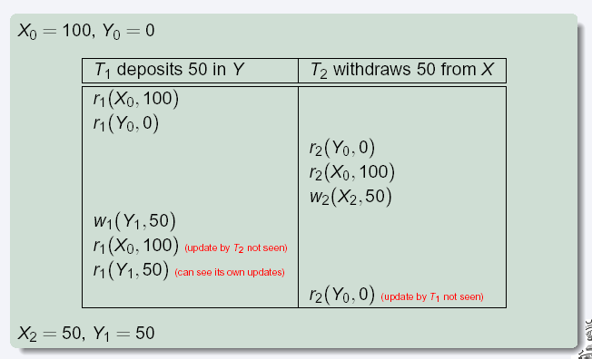
Snapshot Read
Concurrent updates invisible to snapshot read

Slide 67
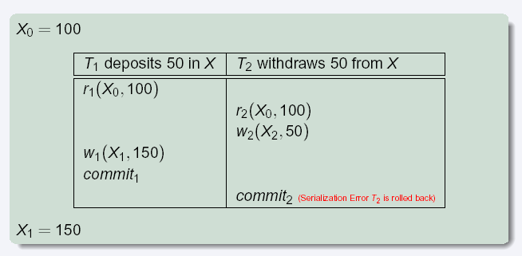
Snapshot Write: First Committer Wins
Variant: “First-updater-wins”
Check for concurrent updates when write occurs by locking item
But lock should be held till all concurrent transactions have finished
(Oracle uses this plus some extra features)
Differs only in when abort occurs, otherwise equivalent

Slide 68
End of Chapter 15

