Slide 1
Chapter 4 : Intermediate SQL

Slide 2
Outline
Join Expressions
Views
Transactions
Integrity Constraints
SQL Data Types and Schemas
Index Definition in SQL
Authorization
Notes:
1

Slide 3
Joined Relations
Join operations take two relations and return as a result another relation.
A join operation is a Cartesian product which requires that tuples in the two relations match (under some condition). It also specifies the attributes that are present in the result of the join
The join operations are typically used as subquery expressions in the from clause
Three types of joins:
Natural join（自然连接）
Inner join
Outer join

Slide 4
Natural Join in SQL
Natural join matches tuples with the same values for all common attributes, and retains only one copy of each common column.
（自然联接为所有公共属性匹配具有相同值的元组，并且只保留每个公共列的一个副本。）对于相同的属性要求其全部相等
List the names of instructors along with the course ID of the courses that they taught
select name, course_id from students, takes where student.ID = takes.ID;
Same query in SQL with “natural join” construct
select name, course_id from student natural join takes;

Slide 5
Natural Join in SQL (Cont.)
The from clause can have multiple relations combined using natural join:
select A₁, A₂, … A_{n} from r₁ natural join r₂ natural join .. natural join r_{n} where P ;

Slide 6
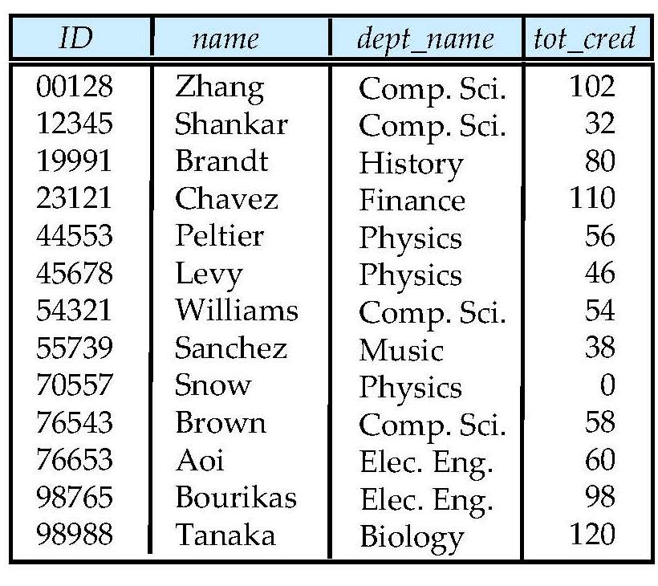
Student Relation

Slide 7
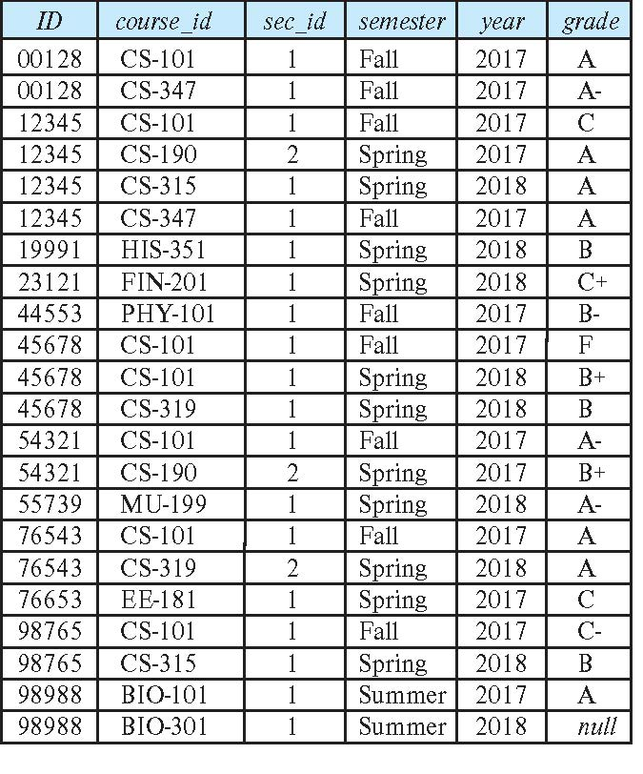
Takes Relation

Slide 8
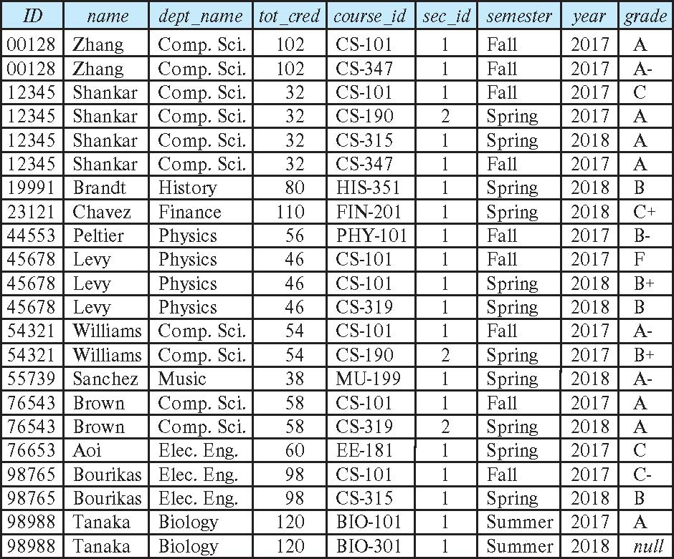
student natural join takes

Slide 9
Dangerous in Natural Join
Beware of unrelated attributes with same name which get equated incorrectly（相同的属性却又不同的含义）
Example -- List the names of students instructors along with the titles of courses that they have taken
Correct version
select name, title from student natural join takes, course where takes.course_id = course.course_id;
Incorrect version
select name, title from student natural join takes natural join course;
This query omits all (student name, course title) pairs where the student takes a course in a department other than the student's own department.
The correct version (above), correctly outputs such pairs.

Slide 10
Natural Join with Using Clause
To avoid the danger of equating attributes erroneously, we can use the “using” construct that allows us to specify exactly which columns should be equated.
（为了避免错误地相等属性的危险，我们可以使用“using”结构，它允许我们精确地指定哪些列应该相等。）（后面跟属性名）
Query example
select name, title from (student natural join takes) join course using (course_id)
<指定只用course_id来判断>

Slide 11
Join Condition
The on condition allows a general predicate over the relations being joined
This predicate is written like a where clause predicate except for the use of the keyword on （如果属性名不一致但又希望作为条件）
Query example
select * from student join takes on student_ID = takes_ID
The on condition above specifies that a tuple from student matches a tuple from takes if their ID values are equal.
Equivalent to:
select * from student , takes where student_ID = takes_ID

Slide 12
Outer Join 外连接
An extension of the join operation that avoids loss of information.
Computes the join and then adds tuples form one relation that does not match tuples in the other relation to the result of the join.
Uses null values.
Three forms of outer join:
left outer join
right outer join
full outer join

Slide 13
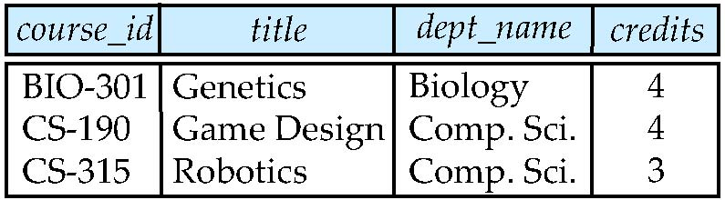
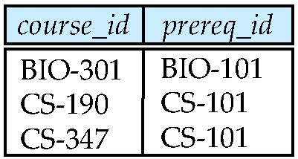
Outer Join Examples
Relation course
Relation prereq
Observe that
course information is missing CS-437
prereq information is missing CS-315

Slide 14
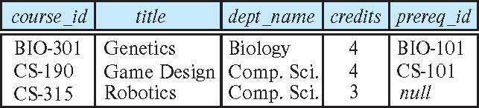
Left Outer Join
course natural left outer join prereq（保留course的）
In relational algebra: course ⟕ prereq

Slide 15
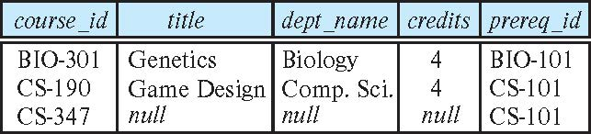
Right Outer Join
course natural right outer join prereq（保留prereq）
In relational algebra: course ⟖ prereq

Slide 16
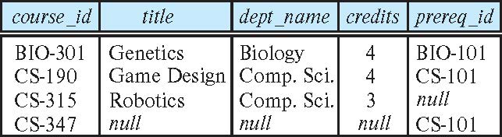
Full Outer Join
course natural full outer join prereq（保留全部，没有的用null）
In relational algebra: course ⟗ prereq

Slide 17
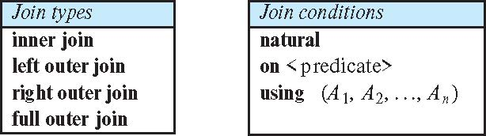
Joined Types and Conditions
Join operations take two relations and return as a result another relation.
These additional operations are typically used as subquery expressions in the from clause
Join condition – defines which tuples in the two relations match.
Join type – defines how tuples in each relation that do not match any tuple in the other relation (based on the join condition) are treated.

Slide 18
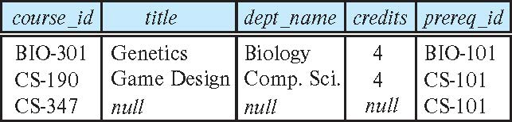
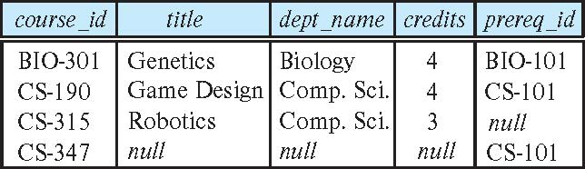
Joined Relations – Examples
course natural right outer join prereq
course full outer join prereq using (course_id)

Slide 19
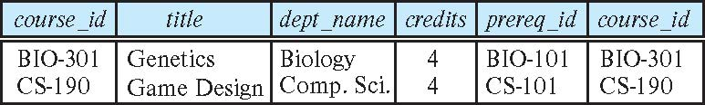
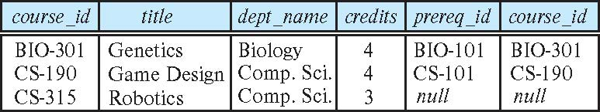
Joined Relations – Examples
course inner join prereq on course.course_id = prereq.course_id
What is the difference between the above, and a natural join?
course left outer join prereq on course.course_id = prereq.course_id

Slide 20
Joined Relations – Examples
course natural right outer join prereq
course full outer join prereq using (course_id)

Slide 21
总结：连接关系
连接关系
在From子句中的两个相邻关系之间，可以是一个逗号 —— 表示做笛卡尔积; 也可以是一个连接操作 —— 表示将它们连接成一个新的关系
每个连接操作由一个连接类型和一个连接条件组成
连接条件
natural : 连接两边元组条件为同名属性相等（自然连接）
using (属性1, 属性2, …) : 类似自然连接，但是只限于列出的的属性相等
on 条件 : 按照指定的条件连接两边元组

Slide 22
连接关系
连接类型
(inner) join : 内连接。结果不包含失配元组*
* 这里失配元组指的是因不满足连接条件，无法和其它元组相连接的元组
left (outer) join : 左外连接。结果包含左边关系的失配元组
right (outer) join : 右外连接。结果包含右边关系的失配元组
full (outer) join : 全外连接。结果包含两边关系的失配元组

Slide 23
练习：连接关系
连接关系的应用
Stu: 学生关系
Class：班级关系
有些学生还未分配到相应班级，有些班级也未包含任何学生
Stu
Class
学号 | 姓名 | 班号
01 | 王红 | C01
02 | 张军 | C02
03 | 刘朝 | null
04 | 陈平 | C01
班号 | 班名 | 班主任
C01 | 财会 | 老王
C02 | 计算机 | 老陈
C03 | 电子 | 老刘

Slide 24
练习：连接关系
每个学生的姓名和班级?
Stu right join Class on …
每个班级的学生人数?
Stu full join Class on …
列出学生和班主任之间的全部联系?
Stu left join Class on …
Stu
Class
学号 | 姓名 | 班号
01 | 王红 | C01
02 | 张军 | C02
03 | 刘朝 | null
04 | 陈平 | C01
班号 | 班名 | 班主任
C01 | 财会 | 老王
C02 | 计算机 | 老陈
C03 | 电子 | 老刘

Slide 25
Views
In some cases, it is not desirable for all users to see the entire logical model (that is, all the actual relations stored in the database.)
Consider a person who needs to know an instructors name and department, but not the salary. This person should see a relation described, in SQL, by select ID, name, dept_name from instructor
A view provides a mechanism to hide certain data from the view of certain users.
视图提供了一种向某些用户的视图隐藏某些数据的机制。
Any relation that is not of the conceptual model but is made visible to a user as a “virtual relation” is called a view.
任何不属于概念模型的关系，但作为“虚拟关系”对用户可见的关系称为视图。

Slide 26
View Definition
A view is defined using the create view statement which has the form
create view v as < query expression >
where <query expression> is any legal SQL expression. The view name is represented by v.
Once a view is defined, the view name can be used to refer to the virtual relation that the view generates.
View definition is not the same as creating a new relation by evaluating the query expression
Rather, a view definition causes the saving of an expression; the expression is substituted into queries using the view.

Slide 27
View Definition and Use
A view of instructors without their salary create view faculty as select ID, name, dept_name from instructor
Find all instructors in the Biology department select name from faculty where dept_name = 'Biology'
Create a view of department salary totals create view departments_total_salary(dept_name, total_salary) as select dept_name, sum (salary) from instructor group by dept_name;

Slide 28
Views Defined Using Other Views
One view may be used in the expression defining another view
A view relation v₁ is said to depend directly on a view relation v₂ if v₂ is used in the expression defining v₁
A view relation v₁ is said to depend on view relation v₂ if either v₁ depends directly to v₂ or there is a path of dependencies from v₁ to v₂
A view relation v is said to be recursive if it depends on itself.

Slide 29
Views Defined Using Other Views 由视图创建视图
create view physics_fall_2017 as select course.course_id, sec_id, building, room_number from course, section where course.course_id = section.course_id and course.dept_name = 'Physics' and section.semester = 'Fall' and section.year = '2017’;
create view physics_fall_2017_watson as select course_id, room_number from physics_fall_2017 where building= 'Watson';

Slide 30
View Expansion 嵌套试图编译时展开
Expand the view :
create view physics_fall_2017_watson as select course_id, room_number from physics_fall_2017 where building= 'Watson'
To:
create view physics_fall_2017_watson as
select course_id, room_number
from (select course.course_id, building, room_number
from course, section
where course.course_id = section.course_id
and course.dept_name = 'Physics'
and section.semester = 'Fall'
and section.year = '2017')
where building= 'Watson';

Slide 31
View Expansion (Cont.)
A way to define the meaning of views defined in terms of other views.
Let view v₁ be defined by an expression e₁ that may itself contain uses of view relations.
View expansion of an expression repeats the following replacement step: （展开视图）
repeat Find any view relation v_{i} in e₁ Replace the view relation v_{i} by the expression defining v_{i} until no more view relations are present in e₁
As long as the view definitions are not recursive, this loop will terminate

Slide 32
Materialized Views
Certain database systems allow view relations to be physically stored.
Physical copy created when the view is defined.
Such views are called Materialized view:
If relations used in the query are updated, the materialized view result becomes out of date
Need to maintain the view, by updating the view whenever the underlying relations are updated.
create materialized view
Notes:
某些数据库系统允许将某一时刻视图的内容（对应查询的结果关系）保存起来，得到一个“快照” 。我们称为物化视图。

Slide 33
视图的优点
简化用户的操作
例如，当经常进行某一复杂查询时，可将其固定的部分定义为一个视图，再用这个视图来重写查询，从而得到简化
对于同一数据，不同用户可以从不同角度观察
一个关系中，不同的用户可能关注不同的部分(不同的行/列)，我们把这些部分定义成不同的视图，分配给他们
表面上看，这些视图是内容不一样的“关系”。实际上，它们源自相同的基础关系，也不占用实际的存储空间。

Slide 34
视图的优点
例如，我们可以定义Class1和Class2两个视图，用户看起来它们具有不同的数据，但实际上来自同一个关系S。同时，在实际关系或者存储的数据的情况下，用户可以使用的“关系”增加了。
Class1 = ？
create view class1 as(
select *
from S
where 班级=‘‘1班’’
)
Class2 = ？
S
学号 | 姓名 | 性别 | 班级
01 | 小张 | 男 | 1班
02 | 小李 | 女 | 1班
11 | 小陈 | 女 | 2班
12 | 小刘 | 男 | 2班
学号 | 姓名 | 性别 | 班级
01 | 小张 | 男 | 1班
02 | 小李 | 女 | 1班
学号 | 姓名 | 性别 | 班级
11 | 小陈 | 女 | 2班
12 | 小刘 | 男 | 2班

Slide 35
视图的优点
增强安全性
“知必所需”
用视图来限制用户数据的访问范围。例如，在为用户定义视图时，通过选择和投影操作限制用户只能访问数据库关系中的某些行和某些列

Slide 36
视图的优点
例如，规定对于教师关系T，学生用户只能访问编号和姓名属性，而不能访问电话号码。
那么我们可以定义如下的视图view_forstudent，然后把它分配给学生用户，而不是把整个关系T分配给他们。
？
T
编号 | 教师姓名 | 电话
T01 | 老王 | 85213347
T02 | 老孙 | 85213109
T12 | 老何 | 85211109
编号 | 教师姓名
C01 | 老王
C02 | 老孙
C12 | 老何

Slide 37
视图的优点
思考：对教师用户“老王”，如果想限制他只能观察自己的记录，应该怎么办?
？
T
编号 | 教师姓名 | 电话
T01 | 老王 | 85213347
T02 | 老孙 | 85213109
T12 | 老何 | 85211109
编号 | 教师姓名 | 电话
T01 | 老王 | 85213347

Slide 38
Update of a View
Add a new tuple to faculty view which we defined earlier
insert into faculty
values ('30765', 'Green', 'Music');
This insertion must be represented by the insertion into the instructor relation
Must have a value for salary.
Two approaches
Reject the insert
Inset the tuple
('30765', 'Green', 'Music', null)
into the instructor relation

Slide 39
Some Updates Cannot be Translated Uniquely
create view instructor_info as select ID, name, building from instructor, department where instructor.dept_name= department.dept_name;
insert into instructor_info
values ('69987', 'White', 'Taylor');
Issues
Which department, if multiple departments in Taylor?
What if no department is in Taylor?

Slide 40
And Some Not at All
create view history_instructors as select * from instructor where dept_name= 'History';
What happens if we insert
('25566', 'Brown', 'Biology', 100000)
into history_instructors?

Slide 41
View Updates in SQL
Most SQL implementations allow updates only on simple views
The from clause has only one database relation.
The select clause contains only attribute names of the relation, and does not have any expressions, aggregates, or distinct specification.
Any attribute not listed in the select clause can be set to null
The query does not have a group by or having clause.

Slide 42
修改视图
如何修改?
对视图的插入、删除、修改操作和基础关系相同。即在Insert、Delete、Update语句中，直接使用视图（代替关系）即可
受限制的修改
视图是一个不存在的“虚拟”关系，所以对视图的修改也要转化为对基础关系的修改。
这种转化不一定成功 —— 导致对视图的修改是受限的，并非所有视图都能被修改。

Slide 43
修改视图
情况一：信息缺失。如果视图定义不包括基础关系的主码，则在对视图的修改转化为对基础关系的修改时，往往会因为缺乏主码值而无法完成。例如视图class2
Create View Class2 as Select 姓名, 性别 From S Where 班级= ‘2班’
S
Class2
学号 | 姓名 | 性别 | 班级
01 | 小张 | 男 | 1班
02 | 小李 | 女 | 1班
11 | 小陈 | 女 | 2班
12 | 小刘 | 男 | 2班
姓名 | 性别
小陈 | 女
小刘 | 男

Slide 44
修改视图
情况二：信息歧义。⑴ 当一个视图是来自对多个基础关系的查询时，无法决定将对视图的修改转化为对哪个基础关系的修改。例如视图View_SC（3班）
Create View View_SC as Select 学号, 姓名, S.班级, 班主任 From S, C Where S.班级=C.班级
View_SC
S
C
学号 | 姓名 | 性别 | 班级
01 | 小张 | 男 | 1班
02 | 小李 | 女 | 1班
11 | 小陈 | 女 | 2班
班级 | 班主任
1班 | 老王
2班 | 老何
学号 | 姓名 | 班级 | 班主任
01 | 小张 | 1班 | 老王
02 | 小李 | 1班 | 老王
11 | 小陈 | 2班 | 老何
20 | 小武 | 3班 | 老章
？

Slide 45
修改视图
情况二：信息歧义。⑵ 当视图的一个元组是“来自”关系里面的多个元组时，同样修改无法转化。例如视图Count_Class
Create View Count_Class as
Select 班级, count(*) as 人数 From S Group by 班级
Count_Class
S
学号 | 姓名 | 性别 | 班级
01 | 小张 | 男 | 1班
02 | 小李 | 女 | 1班
11 | 小陈 | 女 | 2班
？
班级 | 人数
1班 | 2
2班 | 2
3班 | 3

Slide 46
修改视图
出现以下情况之一，则视图是无法修改的
（查询的）Select 子句不包括主码
Select 子句中用聚集函数或算术表达式构造的新属性
Select 子句存在distinct关键字
From 子句中有多个关系
有Group By子句

Slide 47
修改视图
同时满足以下条件，视图才是可修改的
Select 子句中包含主码
Select 子句中只出现原有属性，而没有用聚集函数或算术表达式构造的新属性
Select 子句中无distinct关键字
From 子句中只有一个关系
无Group By子句
删除视图
drop view 视图名

Slide 48
修改视图
例如，下面的视图Class1是可以修改的
Create View Class1 as
Select 学号，姓名，班级 From S Where 班级=‘1班’
S
Class1
学号 | 姓名 | 性别 | 班级
01 | 小张 | 男 | 1班
02 | 小李 | 女 | 1班
11 | 小陈 | 女 | 2班
12 | 小刘 | 男 | 2班
14 | 小何 | null | 2班
学号 | 姓名 | 班级
01 | 小张 | 1班
02 | 小李 | 1班
14 | 小何 | 2班
with check option导致无法插入这条记录
Notes:
with check option可以这么解释：通过视图进行的修改，必须也能通过该视图看到修改后的结果。
比如你insert，那么加的这条记录在刷新视图后必须可以看到； 如果修改，修改完的结果也必须能通过该视图看到；如果删除，当然只能删除视图里有显示的记录。

Slide 49
总结： 视图
视图的本质：有名字的查询
一个视图总是对应一个select查询，且有唯一的名字（视图名）
查询中使用到的关系，称为基础关系。视图就是定义在基础关系上的
视图的表象：“虚拟”关系
用户访问视图时，看到的是一个 基础关系+查询 所派生（计算）出来的“虚拟”关系，和真正的关系有相同的地方，也有不同的地方：
关系（的元组）是实际存在的，即是存储在数据库中的；而视图（的元组）并不实际存在，而是通过查询“算”出来。每一次访问视图，不管在什么时候，都要通过查询“算”一次，以获得最新的内容。
但在使用上，两者非常类似。在查询、添加、删除、更新操作中都可以使用视图，就像使用一个真正的关系一样。

Slide 50
视图
因此要注意以下几点
1、当基础关系发生变化后，我们再去访问视图，看到的虚拟关系也会发生相应的变化。
2、用户对视图的查询，系统在执行时必须转化为对基础关系的查询。
3、用户对视图的修改，系统在执行时必须转化为对基础关系的修改。

Slide 51
Integrity Constraints
Integrity constraints guard against accidental damage to the database, by ensuring that authorized changes to the database do not result in a loss of data consistency.
A checking account must have a balance greater than $10,000.00
A salary of a bank employee must be at least $4.00 an hour
A customer must have a (non-null) phone number

Slide 52
完整性的概念
完整性的原义
数据的完整性，指数据的正确性、有效性和相容性
大多数情况下，我们所提到的完整性，实际是指完整性规则
为保证完整性，数据应该满足的约束条件
又称为完整性约束

Slide 53
关系模型中的完整性
在关系模型中
完整性又称为关系完整性，是三要素（关系, 关系完整性, 关系操作）之一
具体地，包括三种完整性规则
实体完整性；
参照完整性；
用户定义完整性；
用于解决现实世界映射到关系数据库后，产生的三类问题
如何保证映射以后，一个实体是可识别（区分）的
如何保证映射以后，能够从一个实体找到另一个相关联的实体，而不会出现找不到的情况
如何保证映射以后，实体属性的取值是合理的

Slide 54
三类关系完整性规则
实体完整性
规则：元组在主码的每个属性上取唯一值，且不能为空。
意义：在实体映射为元组后，不同元组靠主码来相互区分。保证每一元组/实体，可与其它元组/实体是可区分的。
班级
班级
班号 | 班名
C1 | 1班
C2 | 2班
C3 | 3班
Null | 4班
班号 | 班名
C1 | 1班
C2 | 2班
C3 | 3班
×

Slide 55
三类关系完整性规则
要点：
如果一个关系的主码由多个属性构成，那么每个属性都不能取空值
选修
选修
学号 | 课程号 | 成绩
NULL | NULL | 65
S1 | C1 | 65
S2 | C3 | 78
S2 | C2 | 90
S3 | C1 | 92
×
学号 | 课程号 | 成绩
NULL | C1 | 65
S1 | C1 | 65
S2 | C3 | 78
S2 | C2 | 90
S3 | C1 | 92
×

Slide 56
Constraints on a Single Relation
not null
primary key
unique
check (P), where P is a predicate

Slide 57
Not Null Constraints
not null
Declare name and budget to be not null
name varchar(20) not null budget numeric(12,2) not null

Slide 58
Unique Constraints
unique ( A₁, A₂, …, A_{m})
The unique specification states that the attributes A₁, A₂, …, A_{m} form a candidate key.
Candidate keys are permitted to be null (in contrast to primary keys).

Slide 59
Referential Integrity
Ensures that a value that appears in one relation for a given set of attributes also appears for a certain set of attributes in another relation.
Example: If “Biology” is a department name appearing in one of the tuples in the instructor relation, then there exists a tuple in the department relation for “Biology”.
Let A be a set of attributes. Let R and S be two relations that contain attributes A and where A is the primary key of S. A is said to be a foreign key of R if for any values of A appearing in R these values also appear in S.

Slide 60
Example
班级
学生
班号 | 班名
C1 | 1班
C2 | 2班
C3 | 3班
班号 | 学号 | 姓名 | 年龄
C1 | S1 | 小王 | 22
C2 | S2 | 小张 | 20
C2 | S3 | 小李 | 24
Null | S4 | 小孙 | 23
C4 | S5 | 小何 | 22
×

Slide 61
Referential Integrity (Cont.)
Foreign keys can be specified as part of the SQL create table statement
foreign key (dept_name) references department
By default, a foreign key references the primary-key attributes of the referenced table.
SQL allows a list of attributes of the referenced relation to be specified explicitly.
foreign key (dept_name) references department (dept_name)

Slide 62
Cascading Actions in Referential Integrity
When a referential-integrity constraint is violated, the normal procedure is to reject the action that caused the violation.
An alternative, in case of delete or update is to cascade
create table course ( (… dept_name varchar(20), foreign key (dept_name) references department on delete cascade on update cascade, . . .)
Instead of cascade we can use :
set null,
set default

Slide 63
外部码约束
参照动作
说明当某个主码值被删除/更新时（这个主码值在被参照关系中），如何处理对应的外部码值（这些外部码值在参照关系中）
RESTRICT 方式：仅当没有任何对应的外码值时，才可以删除/更新这个主码值，否则系统拒绝执行此操作
CASCADE 方式：连带将所有对应的外码值一块删除/更新（删除外码值，实际上就是将所在的元组删除掉）
SET NULL 方式：将所有对应的外码值设为空值

Slide 64
三类关系完整性规则
参照完整性
规则：如果关系R的外部码对应关系S的主码，则R每个元组在外部码上的取值必须满足：
要么等于空值
要么等于某个对应的主码值（S某个元组的主码值）
意义：元组/实体的外部码，说明跟另外一个元组/实体（的主码）相联系的。保证这一联系有意义，不会联系不存在的元组/实体。

Slide 65
Integrity Constraint Violation During Transactions
Consider:
create table person ( ID char(10), name char(40), mother char(10), father char(10), primary key ID, foreign key father references person, foreign key mother references person)
How to insert a tuple without causing constraint violation?
Insert father and mother of a person before inserting person
OR, set father and mother to null initially, update after inserting all persons (not possible if father and mother attributes declared to be not null)
OR defer constraint checking

Slide 66
课堂练习
依次执行如下操作，哪些能够成功？
1．零件关系： 添加 (3, 绿, null)
2．供应商关系： 添加 (null, 四化, 广州) 【×】
3．供应商关系： 添加 (E, 北电, 广州)
4．零件关系： 修改 (2, 白, A) 为 (2, 黑, F) 【×】
5．供应商关系： 删除 (A, 红星, 北京)
6．零件关系： 修改 (3, 蓝, B) 为 (3, 蓝, E)
供应商
零件
供应商号 | 供应商名 | 所在城市
A | 红星 | 北京
B | 宇宙 | 上海
C | 黎明 | 广州
D | 立新 | 深圳
零件号 | 颜色 | 供应商号
1 | 红 | B
2 | 白 | A
3 | 蓝 | B

Slide 67
三类关系完整性规则
用户定义完整性
规则：用户根据具体的应用环境定义
例如
年龄的取值范围为0到100，性别只能是“男”或“女”
职工编号是4位整数
意义：
保证元组/实体的属性取值合理，反映现实世界的真实情况
反映了程序编制的要求

Slide 68
The check clause
The check (P) clause specifies a predicate P that must be satisfied by every tuple in a relation.
Example: ensure that semester is one of fall, winter, spring or summer
create table section
(course_id varchar (8),
sec_id varchar (8),
semester varchar (6),
year numeric (4,0),
building varchar (15),
room_number varchar (7),
time slot id varchar (4),
primary key (course_id, sec_id, semester, year),
check (semester in ('Fall', 'Winter', 'Spring', 'Summer')))

Slide 69
练习
学生的Ssex只能是“男” 或 “女”
学生的年纪Sage 在 0到100之间
Create TABLE student (
Sno CHAR(10) primiary key,
Ssex CHAR (2)
……
Sage SMALLINT
)
check(Sage >= 0 and Sage <= 100)
？
？

Slide 70
练习
例：CET4是一个记录四级成绩的表，有两个属性: “result”和“grade”。如何保证“grade”的值（及格、不及格两档）和“result”的值能够正确对应？
420 到 710为及格，0-419为不及格
create table CET4 (sno VARCHAR (20),
grade VARCHAR (10),
result FLOAT,
primary key (sno)
)
语句： Alter Table CET4
Add Constraint C1 CHECK (((grade <= 710 and grade >= 420) and result = ‘及格’) or (!(grade <= 710 and grade >= 420) and result = ‘不及格’))
建表之后增加约束
Notes:
删除约束： Alter Table CET4 Drop Constraint C1

Slide 71
Complex Check Conditions
The predicate in the check clause can be an arbitrary predicate that can include a subquery.
check (time_slot_id in (select time_slot_id from time_slot))
The check condition states that the time_slot_id in each tuple in the section relation is actually the identifier of a time slot in the time_slot relation.
The condition has to be checked not only when a tuple is inserted or modified in section , but also when the relation time_slot changes

Slide 72
Assertions断言
An assertion is a predicate expressing a condition that we wish the database always to satisfy.
The following constraints, can be expressed using assertions:
For each tuple in the student relation, the value of the attribute tot_cred must equal the sum of credits of courses that the student has completed successfully.
An instructor cannot teach in two different classrooms in a semester in the same time slot
An assertion in SQL takes the form:
create assertion <assertion-name> check (<predicate>);

Slide 73
断言
断言就是一个谓词（条件），施加在较大范围，比如可以是整个数据库的所有数据
主码约束、检查约束等作用范围较小 （一个元组或属性内部），可以看作是“小断言”
如果作用范围比较大，比如约束几个关系之间必须满足什么条件，就要“大断言”

Slide 74
断言
定义
create assertion 断言名 check (条件)
断言创建以后，系统要对每个可能违反该断言的修改操作进行检查。这种检查会带来巨大的系统负载，因此应该谨慎使用断言。
所以实际上很少数据库软件支持断言，而倾向用其它的等价方法，比如触发器。

Slide 75
断言
例：2班每个学生选修的课程数不得超过10门
create assertion sc_assert1 check (10 >= all (select count(课程号)
from S, SC
where S.学号 = SC.学号 and S.班级= ‘2班’
group by S.学号)
)
子查询:
2班学生选修的课程数
S
SC
C
学号 | 姓名 | 班级
… | … | …
学号 | 课程号 | 成绩
… | … | …
课程号 | 名称 | 学时
… | … | …

Slide 76
断言
例：1班的学生全部选修数据库课程⇔不存在未选修数据库课程的1班学生
create assertion sc_assert2 check (
not exists (select 学号
from S SC
where SC.cid not in(C, where cname = ‘db’)
）
)
子查询:
未选修数据库的1班学生
子子查询:
选修数据库的学号
S
SC
C
学号 | 姓名 | 班级
… | … | …
学号 | 课程号 | 成绩
… | … | …
课程号 | 名称 | 学时
… | … | …

Slide 77
Built-in Data Types in SQL
date: 日期，包含（4 位）年、月和日期
Example: date '2005-7-27'
time: 一天中的时间，以小时、分钟和秒为单位。
Example: time '09:00:30' time '09:00:30.75'
timestamp（时间戳）: date plus time of day
Example: timestamp '2005-7-27 09:00:30.75'
interval（间隔）: period of time
Example: interval '1' day
Subtracting a date/time/timestamp value from another gives an interval value
间隔值可以添加到日期/时间/时间戳值

Slide 78
Large-Object Types
Large objects (照片、视频、CAD 文件等) are stored as a large object:
blob: 二进制大对象——对象是未解释的二进制数据的大集合（其解释留给数据库系统之外的应用程序）
clob: 字符大对象——对象是字符数据的大集合
当查询返回大对象时，返回的是指针而不是大对象本身。

Slide 79
User-Defined Types
create type construct in SQL creates 创建用户定义的类型
create type Dollars as numeric (12,2) final
Example:
create table department (dept_name varchar (20), building varchar (15), budget Dollars);

Slide 80
Domains
create domain construct in SQL-92 creates user-defined domain types
create domain person_name char(20) not null
Types and domains are similar. Domains can have constraints, such as not null, specified on them.
Example:
create domain degree_level varchar(10) constraint degree_level_test check (value in ('Bachelors', 'Masters', 'Doctorate'));

Slide 81
Index Creation
Many queries reference only a small proportion of the records in a table.
It is inefficient for the system to read every record to find a record with particular value
An index on an attribute of a relation is a data structure that allows the database system to find those tuples in the relation that have a specified value for that attribute efficiently, without scanning through all the tuples of the relation.
We create an index with the create index command
create index <name> on <relation-name> (attribute);

Slide 82
Index Creation Example
create table student (ID varchar (5), name varchar (20) not null, dept_name varchar (20), tot_cred numeric (3,0) default 0, primary key (ID))
create index studentID_index on student(ID)
The query:
select * from student where ID = '12345'
can be executed by using the index to find the required record, without looking at all records of student

Slide 83
总结：索引
索引是关系型数据库的一个基本概念。
数据库的索引类似图书的索引，能够使数据库程序不用浏览整个表，就可以找到表中的数据。
索引是一个表中所包含的值的列表，它说明了表中包含各个值的行所在的存储位置。
用户可以利用索引快速访问数据库表中的特定信息。
但使用索引存储地址将占用磁盘空间，同时在数据维护时，也将花费一定的时间。因此要合理设计索引。

Slide 84
Authorization
We may assign a user several forms of authorizations on parts of the database.
Read - allows reading, but not modification of data.
Insert - allows insertion of new data, but not modification of existing data.
Update - allows modification, but not deletion of data.
Delete - allows deletion of data.
Each of these types of authorizations is called a privilege. We may authorize the user all, none, or a combination of these types of privileges on specified parts of a database, such as a relation or a view.

Slide 85
Authorization (Cont.)
Forms of authorization to modify the database schema
Index - allows creation and deletion of indices.
Resources - allows creation of new relations.
Alteration - allows addition or deletion of attributes in a relation.
Drop - allows deletion of relations.

Slide 86
Authorization Specification in SQL
The grant statement is used to confer authorization（赋予权限）
grant <privilege list> on <relation or view > to <user list>
<user list> is:
a user-id
public, which allows all valid users the privilege granted
A role (more on this later)
Example:
grant select on department to Amit, Satoshi
Granting a privilege on a view does not imply granting any privileges on the underlying relations.
The grantor of the privilege must already hold the privilege on the specified item (or be the database administrator).

Slide 87
Privileges in SQL
select: allows read access to relation, or the ability to query using the view
Example: grant users U₁, U₂, and U₃ select authorization on the instructor relation:
grant select on instructor to U₁, U₂, U₃
insert: the ability to insert tuples
update: the ability to update using the SQL update statement
delete: the ability to delete tuples.
all privileges: used as a short form for all the allowable privileges

Slide 88
Revoking Authorization in SQL
The revoke statement is used to revoke authorization.（回收权限）
revoke <privilege list> on <relation or view> from <user list>
Example:
revoke select on student from U₁, U₂, U₃
<privilege-list> may be all to revoke all privileges the revokee may hold.
If <revokee-list> includes public, all users lose the privilege except those granted it explicitly.
If the same privilege was granted twice to the same user by different grantees, the user may retain the privilege after the revocation.
All privileges that depend on the privilege being revoked are also revoked.

Slide 89
Roles
A role is a way to distinguish among various users as far as what these users can access/update in the database.
To create a role we use:
create a role <name>
Example:
create role instructor
Once a role is created we can assign “users” to the role using:
grant <role> to <users>

Slide 90
Roles Example
create role instructor;
grant instructor to Amit;
Privileges can be granted to roles:
grant select on takes to instructor;
Roles can be granted to users, as well as to other roles
create role teaching_assistant
grant teaching_assistant to instructor;
Instructor inherits all privileges of teaching_assistant
Chain of roles
create role dean;
grant instructor to dean;
grant dean to Satoshi;

Slide 91
Authorization on Views
create view geo_instructor as (select * from instructor where dept_name = 'Geology');
grant select on geo_instructor to geo_staff
Suppose that a geo_staff member issues
select * from geo_instructor;
What if
geo_staff does not have permissions on instructor?
Creator of view did not have some permissions on instructor?

Slide 92
Other Authorization Features
references privilege to create foreign key
grant reference (dept_name) on department to Mariano;
Why is this required?
transfer of privileges
grant select on department to Amit with grant option;
revoke select on department from Amit, Satoshi cascade;
revoke select on department from Amit, Satoshi restrict;
And more!

Slide 93
End of Chapter 4

