Slide 1
Stacks and Queues
COMP171
Fall 2006

Slide 2
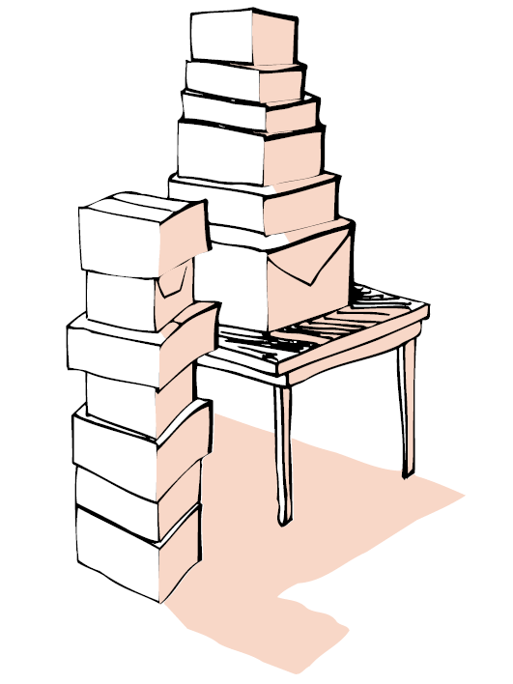
You take one on the top
You put one on the top
Imaging that you want to have a program which reads a list of integers and then output them in the reverse order.
How do you program it?

Slide 3
More Examples
When solving a problem, you may need some mechanism that has the property “last in and first out”.
Examples:
  Balancing symbols or bracket matching: To check that every right brace, bracket, and parentheses must correspond to its left counterpart
    e.g. [( )] is legal, but [( ] ) is illegal
  Postfix expression (reverse polish notation) evaluation: an operator is placed after their operands
    e.g. a b * c +, a b c+*, a b+c*, a b +c +.

Slide 4
STL stack
STL stack can perform “last in, first out”.
It has the following basic operations:
  Push( obj) will put obj on the top of the stack;
  Pop() will give you the last obj you push into the stack;
  Top() return a reference to the top element.
It is a template class that allows you manipulate any type of objects: include <stack> and provide the type parameter stack<int>, for example.
Example: a program that reads in a list of integers and outputs them in the reverse order.

Slide 5
Application: Balancing Symbols
To check that every right brace, bracket, and parentheses must correspond to its left counterpart
  e.g. [( )] is legal, but [( ] ) is illegal
Algorithm
  (1) Make an empty stack.
  (2) Read characters until end of file
    i. If the character is an opening symbol, push it onto the stack
    ii. If it is a closing symbol, then if the stack is empty, report an error
    iii. Otherwise, pop the stack. If the symbol popped is not the
    corresponding opening symbol, then report an error
  (3) At end of file, if the stack is not empty, report an error

Slide 6
Postfix Expressions
Postfix expression (reverse polish notation): an operator is placed after their operands
  No braces are required
  Easy to compute by using stacks
Postfix expression computation:
  When an operand is read, push it into stack;
  When an operator is read, pop its operands, compute the result and push the result onto stack
Exercise: Write an algorithm that converts an infix expression to a postfix expression.

Slide 7
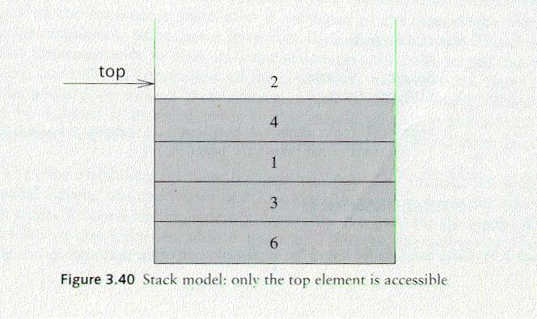
Stack ADT
A stack is a list in which insertion and deletion take place at the same end
  This end is called top
  The other end is called bottom
Stacks are known as LIFO (Last In, First Out) lists.
  The last element inserted will be the first to be retrieved

Slide 8
push and pop
Primary operations: push and pop
push
  Add an element to the top of the stack
pop
  Remove the element at the top of the stack
empty stack
push an element
push another
pop
top
B
top
top
top
A
A
A

Slide 9
Implementation of Stacks
Any list implementation could be used to implement a stack
  Arrays (static: the size of stack is given initially)
  Linked lists (dynamic: never become full)
We will explore implementations based on arrays and linked lists
Let’s see how to use an array to implement a stack first

Slide 10
Stack class
typedef doulbe T;
class Stack {
public:
Stack();// constructor
~Stack(); // destructor
Stack(const Stack &rhs);
const Stack & operator=(const Stack &rhs);
bool empty() const;
bool full() const;
const T& top()const;//examine, without popping
void push(const T x);
void pop(); //not efficient if design: T pop()
private:
int size; //size of the array values
int maxtop; // max stack size = size - 1
int top; // current top of stack
T* values; // element array
};

Slide 11
Stack class
typedef double T;
class Stack {
public:
Stack() // constructor
~Stack() { delete [] values; } // destructor
Stack(const Stack &rhs);
const Stack & operator=(const Stack &s);
bool empty() { return top == -1; }
bool full() { return top == maxtop; }
const T& top()const; // examine, without popping
void push(const T x);
void pop();
private:
int size; //size of the array values
int maxtop; // max stack size = size - 1
int top; // current top of stack
T* values; // element array
};

Slide 12
Stack class
Attributes of Stack
  maxtop: the max size of stack
  top: the index of the top element of stack
  values: points to an array which stores elements of stack
Operations of Stack
  empty: returns true if stack is empty, returns false otherwise
  full: returns true if stack is full, returns false otherwise
  top: returns the element at the top of stack
  push: adds an element to the top of stack
  pop: deletes the element at the top of stack

Slide 13
Array Implementations: Create Stack
The constructor of Stack
  Allocate a stack array of size. By default,
  size = 0.
  Initially top is set to -1. It means the stack is empty.
  When the stack is full, top will have its maximum value, i.e. size – 1.
Stack::Stack():size(256) {
values = new T[size];
top = -1;
maxtop = size - 1;
}
Although the constructor dynamically allocates the stack array, the stack is still static. The size is fixed after the initialization.

Slide 14
Array Implementations: push Stack
void push(const T x);
  push an element onto the stack
  Precondition: stack is not full
  Note top always represents the index of the top element. After pushing an element, increment top.
void Stack::push(const T x) {
if (!full())
values[++top] = x;
}

Slide 15
Array Implementations: pop Stack
void pop()
  pop the element at the top of the stack
  Precondition: stack is not empty
  Don’t forget to decrement top
void Stack::pop() {
if (!empty()) {
top--;
}
}

Slide 16
Array Implementations: Stack top
Const T& top()const
  Returns the top element of the stack
  Precondition: stack is not empty
  Unlike pop, this function does not remove the top element
Const T& Stack::top()const {
if (!empty())
return values[top];
}

Slide 17
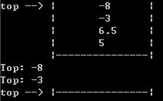
Using Stack
result
int main(void) {
Stack stack();
stack.push(5.0);
stack.push(6.5);
stack.push(-3.0);
stack.push(-8.0);
cout << "top: " << stack.top() << endl;
stack.pop();
cout << "top: " << stack.top() << endl;
while (!stack.empty()) {
stack.pop();
}
return 0;
}

Slide 18
Implementations based on Linked List
We could use list as the data member to store stack elements.
To make the best out of the code of List, we implement Stack by inheriting List
  To let Stack access private member head, we make Stack as a friend of List
class List {
public:
List(void) { head = NULL; } // constructor
~List(void); // destructor
bool empty()const;
Node* insert(Node* p, T x);
Node* find (T x);
Node* erase(Node *p);
private:
Node* head;
friend class Stack;
};

Slide 19
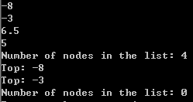
Implementation based on Linked List
Stack will not export other methods of lists.
class Stack : private List {
public:
Stack() {} // constructor
~Stack() {} // destructor
bool empty()const{return List::empty();}
const T& top()const {
if (head != NULL) {
return head->data;
}
void push(const T x) { insert (head, x); }
void pop() {
if (head != NULL) {
T val = head->data;
DeleteNode(val);
}
}
};
Note: the stack implementation based on a linked list will never be full.

Slide 20
Array implementation versus linked list implementations
push, pop, top are all constant-time operations in both array implementation and linked list implementation
  For array implementation, the operations are performed in very fast constant time

Slide 21
Recursion and Stacks
Recursive calls are implemented by using stacks;
Recursion can be replaced by stacks and iteration (迭代);

Slide 22
Function A calls B, B calls C:
Save returning address and parameters
A
B
C
Start from the saved address
First started, last finished

Slide 23
Stack Frames for Subprograms
When a program calls a subprogram, the system:
Store returning location and parameters;
Allocate storage for all the local variables.
Then the control is passed to the subprogram.
The information about the returning address, parameters and local variables is stored in the activation record(活动记录） for the function call.

Slide 24
When the subprogram is finished,
Returns the result of the subprogram;
Releases the storage allocated for the subprogram;
the control is passed to the caller and execution starts at the returning address.

Slide 25
Temporary storage areas for use by functions would be allocated in a list with the property last in, first out. So, stack is the data structure to manage function call mechanism.
When a function call is made:
the activation record is pushed into the stack, and
when the function is finished, the activation record for the function is popped off.
There is no difference between this recursive call and other function calls: for each recursive call, an activation record for the instance of the call is pushed into the stack.
Notes:
^{fsd}

Slide 26
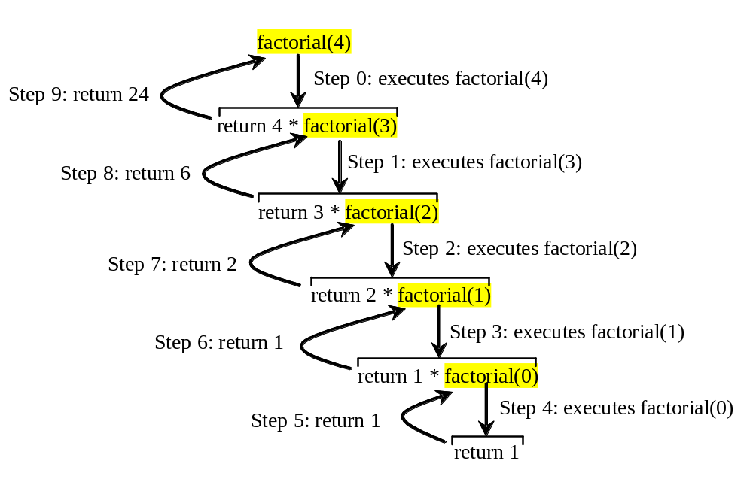
Computing factorial(4)
factorial(0) =1;
factorial(n) = n*factorial(n-1);

Slide 27

Stack Frame for factorial

Slide 28
Stack Application: function calls and recursion
Take the example of factorial! And run it.
int fac(int n){
int product;
if(n <= 1) product = 1;
else product = n * fac(n-1);
return product;
}
void main(){
int number;
cout <<"Enter a positive integer:"<< endl;
cin >> number;
cout << fac(number) << endl;
}
L1
L2
L3
L0
Activation Record: (return address, parameters, local vars)

Slide 29
Call is to ‘push’ and return is to ‘pop’!
int fac(int n){
int product;
if(n <= 1) product = 1;
else product = n * fac(n-1);
return product;
}
L1
L2
Compute fac(2):

Slide 30
Call is to ‘push’ and return is to ‘pop’!
int fac(int n){
int product;
if(n <= 1) product = 1;
else product = n * fac(n-1);
return product;
}
L1
L2
Compute fac(2):
Stack
product:1
n:1
Add:L2
product:
n: 2
Add: L0
product:n*1
n:2
Add:L0
product:
n: 2
Add: L0
(A) 调用f(2)，活动记录入栈，转去执行f
(D) f(2)调用结束，弹出活动记录，将结果2返回，转L0继续执行。
(B) 调用f(1), product赋值1，f(1)返回product, 活动记录出栈
(C ) 转L2,将函数返回值与n之积赋product

Slide 31
Space for recursion algorithms
Space for recursion is the maximum number of activation records, or the number of embedded recursive calls, or the height of the recursion tree
For recursive factorial, S(n) = O(n);
For Hanoi tower, S(n) = O(n).

Slide 32

Queue Overview
Queue ADT
Basic operations of queue
  Enqueuing, dequeuing etc.
Implementation of queue
  Array
  Linked list

Slide 33
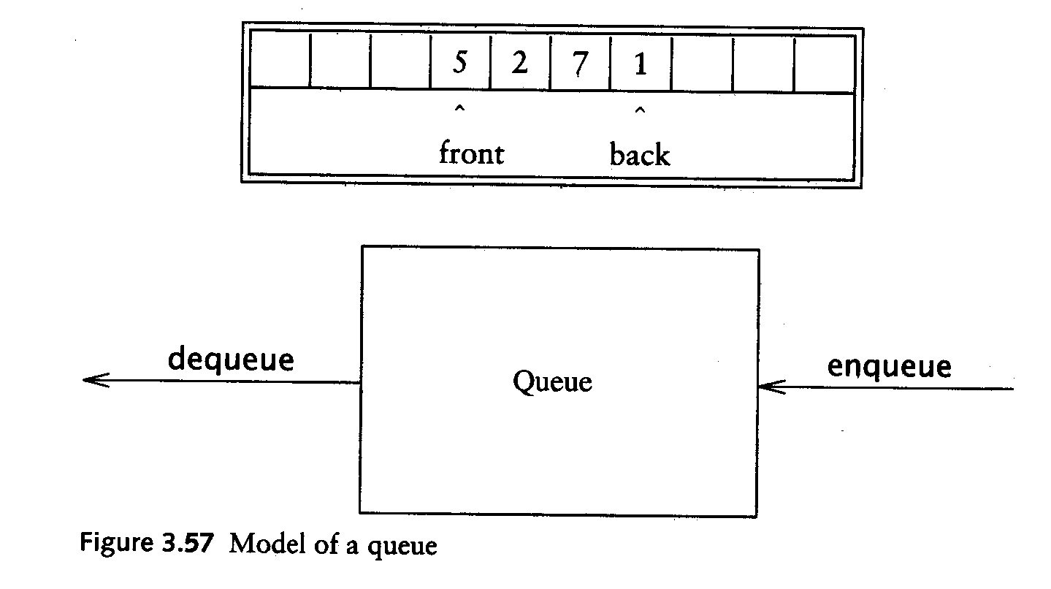
Queue ADT
Like a stack, a queue is also a list. However, with a queue, insertion is done at one end, while deletion is performed at the other end.
Accessing the elements of queues follows a First In, First Out (FIFO) order.
  Like customers standing in a check-out line in a store, the first customer in is the first customer served.

Slide 34
Enqueue and Dequeue
Primary queue operations: Enqueue and Dequeue
Like check-out lines in a store, a queue has a front and a rear.
Enqueue – insert an element at the rear of the queue
Dequeue – remove an element from the front of the queue
Remove
(Dequeue)
Insert
(Enqueue)
front
rear

Slide 35
Implementation of Queue
Just as stacks can be implemented as arrays or linked lists, so with queues.
Dynamic queues have the same advantages over static queues as dynamic stacks have over static stacks

Slide 36
Queue Implementation of Array
There are several different algorithms to implement Enqueue and Dequeue
Naïve way
  When enqueuing, the front index is always fixed and the rear index moves forward in the array.
rear
rear
rear
3
3
6
3
6
9
front
front
front
Enqueue(3)
Enqueue(6)
Enqueue(9)

Slide 37
Queue Implementation of Array
Naïve way (cont’d)
  When dequeuing, the front index is fixed, and the element at the front the queue is removed. Move all the elements after it by one position. (Inefficient!!!)
rear
rear
rear = -1
6
9
9
front
front
front
Dequeue()
Dequeue()
Dequeue()

Slide 38
Queue Implementation of Array
A better way
  When an item is enqueued, the rear index moves forward.
  When an item is dequeued, the front index also moves forward by one element
(front)
XXXXOOOOO (rear)
OXXXXOOOO (after 1 dequeue, and 1 enqueue)
OOXXXXXOO (after another dequeue, and 2 enqueues)
OOOOXXXXX (after 2 more dequeues, and 2 enqueues)
The problem here is that the rear index cannot move beyond the last element in the array.

Slide 39
Implementation using Circular Array
Using a circular array
When an element moves past the end of a circular array, it wraps around to the beginning, e.g.
  OOOOO7963 → 4OOOO7963 (after Enqueue(4))
  After Enqueue(4), the rear index moves from 3 to 4.
How to detect an empty or full queue, using a circular array algorithm?
  Use a counter of the number of elements in the queue.

Slide 40
Queue Implementation of Circular Array
class Queue {
public:
Queue(int size = 10); // constructor
~Queue() { delete [] values; } // destructor
Queue(const Queue &rhs);
const Queue & operator(const Queue &rhs)
bool empty(void)const;
bool full(void)const;
bool push(T x); //enqueue
bool pop(T & x);//dequeue
const T& head()const;//return the front element
private:
int front; // front element index
int rear; // rear index
int counter; // number of elements
int maxSize; // size of array queue
T* values; // element array
};

Slide 41
Queue Class
Attributes of Queue
  front/rear: front/rear index
  counter: number of elements in the queue
  maxSize: capacity of the queue
  values: point to an array which stores elements of the queue
Operations of Queue
  empty: return true if queue is empty, return false otherwise
  full: return true if queue is full, return false otherwise
  push: add an element to the rear of queue
  pop: delete the element at the front of queue

Slide 42
Create Queue
Queue(int size = 10)
  Allocate a queue array of size. By default, size = 10.
  front is set to 0, pointing to the first element of the array
  rear is set to -1. The queue is empty initially.
Queue::Queue(int size /* = 10 */) {
values = new T[size];
maxSize = size;
front = 0;
rear = -1;
counter = 0;
}

Slide 43
empty & full
Since we keep track of the number of elements that are actually in the queue: counter, it is easy to check if the queue is empty or full.
bool Queue::empty() const{
if (counter) return false;
else return true;
}
bool Queue::full() const{
if (counter < maxSize) return false;
else return true;
}

Slide 44
Enqueue
bool Queue::push(T x) {
if (full()) {
return false;
}
else {
// calculate the new rear position (circular)
rear = (rear + 1) % maxSize;
// insert new item
values[rear] = x;
// update counter
counter++;
return true;
}
}

Slide 45
Dequeue
bool Queue::pop(T & x) {
if (empty()) {
return false;
}
else {
// retrieve the front item
x = values[front];
// move front
front = (front + 1) % maxSize;
// update counter
counter--;
return true;
}
}

Slide 46
Using Queue
int main(void) {
Queue queue(5);
cout << "Enqueue 5 items." << endl;
for (int x = 0; x < 5; x++)
queue.push(x);
cout << "Now attempting to enqueue again..." << endl;
queue.push(5);
T value;
queue.pop(value);
cout << "Retrieved element = " << value << endl;
queue.pop(7);
return 0;
}

Slide 47
Queue Implementation based on Linked List
class Queue {
public:
Queue() { // constructor
front = rear = NULL;
counter = 0;
}
~Queue() { // destructor
T value;
while (!empty()) Dequeue(value);
}
//add big three
bool empty()const {
if (counter) return false;
else return true;
}
void push(T x);
bool pop(T & x);
private:
Node* front; // pointer to front node
Node* rear; // pointer to last node
int counter; // number of elements
};

Slide 48
Enqueue
void Queue::push(T x) {
Node* newNode = new Node;
newNode->data = x;
newNode->next = NULL;
if (empty()) {
front = newNode;
rear = newNode;
}
else {
rear->next = newNode;
rear = newNode;
}
counter++;
}
rear
8
5
rear
8
5
newNode

Slide 49
Dequeue
bool Queue::pop(T & x) {
if (empty()) {
return false;
}
else {
x = front->data;
Node* nextNode = front->next;
delete front;
front = nextNode;
counter--;
}
}
front
3
8
5
front
8
5

Slide 50
Summary
Read Weiss chapter 3.
Get familiar with vector, list, stack and queue in STL, and make sure you can solve problems by using these ADTs.
Understand the advantages and disadvantages of list and vector.
Make sure you can implement these ADTs. And you appreciate ADTs.
Understand how recursion is implemented and why recursion could be inefficient.
Exercises:3.22,3.23,3.28,3.33. Write a function to computer Ackermann’s function.

Slide 51
Quiz
Implement Stack methods using linked lists: constructor, push, and pop methods.
typedef doulbe T;
class Stack {
public:
Stack();// constructor
~Stack(); // destructor
Stack(const Stack &rhs)
const Stack & operator=(const Stack &rhs);
bool empty() const;
const T& top()const; // examine, without popping
void push(const T x);
void pop();
private:
int count; // max stack size = size - 1
Node * top; // current top of stack
};

Slide 52
Start to Use STL ADTs
Use ADTs: vector, list, stack , queue, …
Many reasons to get familiar with these ADTs;
Don’t reinvent the wheel;
Understand how they are implemented;
Be able to implement them yourself.
Look at more details of vector, list and stack;
  Understand overloading of methods: for example, begin(), [] and front in vector.

