Slide 1
The Container Map
See sgi.com/tech/stl.
An ordered associative container:
  Associative: an element is a pair of key and its associative value;
  Ordered: if you traverse the container, you get an ordered (by the key) list of the elements.
Operations:
  Iterator insert(pair(key, value));
  iterator find(key).
Example: building a phone book.
Question: how do you implement a map?
See sgi.com/tech/stl for more ADT, including set and priority_queue.

Slide 2
Binary Trees, Binary Search Trees
COMP171
Fall 2006
Contributed by Long Quan at HKUST

Slide 3
Binary Search Trees
How to search in a list with frequent insertions and deletions?
Linked lists: sequential search is inefficient, though insertions and deletions are easy.
Ordered contiguous lists: binary search is efficient, but insertions and deletions are not.
Combining the advantages of linked storage and obtain the speed of binary search:
  Store the list of nodes as a binary tree with the structure of the comparison tree of binary search.

Slide 4
Trees
Trees
  Basic concepts
  Tree traversal
  Binary tree
  Binary search tree and its operations

Slide 5

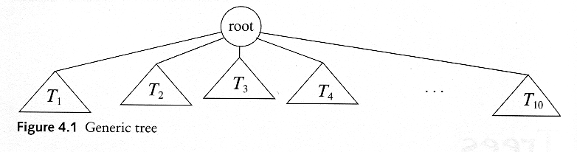
Trees
A (rooted) tree is a collection of nodes
  The collection can be empty
  (inductive definition) If not empty, a tree consists of a distinguished node r (the root), and zero or more nonempty subtrees T₁, T₂, ...., T_{k}, each of whose roots are connected by a directed edge from r

Slide 6
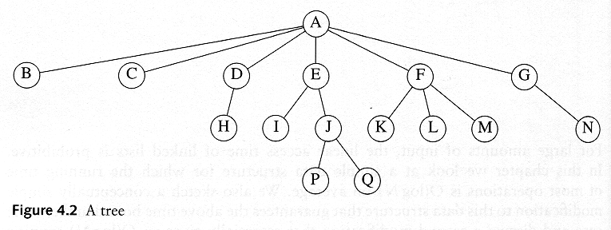

Some Terminologies
Child and Parent
  Every node except the root has one parent
  A node can have an zero or more children
Leaves
  Leaves are nodes with no children
Sibling
  nodes with same parent

Slide 7
More Terminologies
Path
  A sequence of edges
Length of a path
  number of edges on the path
Depth of a node
  length of the unique path from the root to that node
The height of a tree = the depth of the deepest leaf
Ancestor and descendant
  If there is a path from n1 to n2
  n1 is an ancestor of n2, n2 is a descendant of n1
  Proper ancestor and proper descendant

Slide 8
Path
Length of a path
Depth of a node
The height of a tree = the depth of the deepest leaf
Ancestor and descendant

Slide 9
Inductive Definitions, Induction Proofs and Recursive Algorithms
root
How do you prove that the number of edges is the number of edges minus 1 for nonempty trees?
How to count the number of nodes in a tree, or compute the size of the tree?

Slide 10
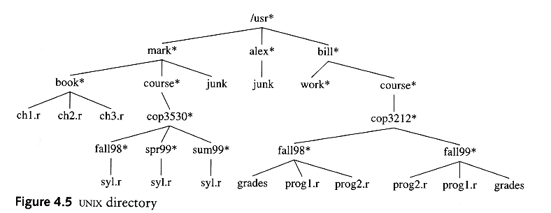
Example: UNIX Directory
How to print out all the files in a directory, or how to find a file in a directory?
Look at your computer using commands dir and cd.

Slide 11
Tree Traversal
Used to print out the data in a tree in a certain order
Pre-order traversal
  If tree is empty, done. Otherwise,
  ‘visit’ the root
  Recursively pre-order traverse the first subtree
  Recursively pre-order traverse the other subtrees

Slide 12
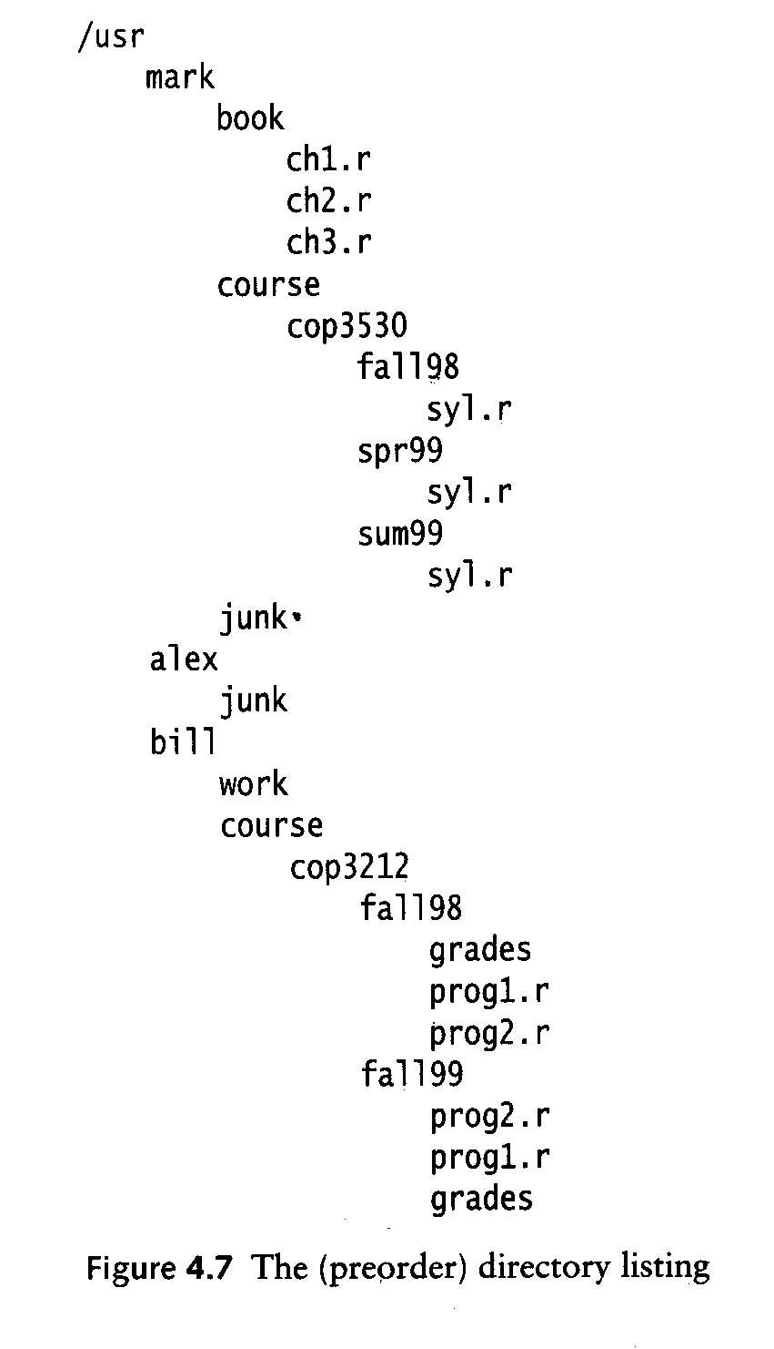
Print All Files in a Directory

Slide 13
A Recursive Algorithm
//Starting from the root print all the names in pre-order
//if the node has depth k, its name is indented k tabs
Algorithm listAll(r, ind):
Input: r is the root of the tree, ind is the number of tabs where r is printed.
1. print the name of r with ind tabs;
2. if r is a directory
3. for every child c of r
4. listAll(c, ind+1); //list all files in directory c
//else it is a leaf and it is done for the subtree rooted at r.

Slide 14
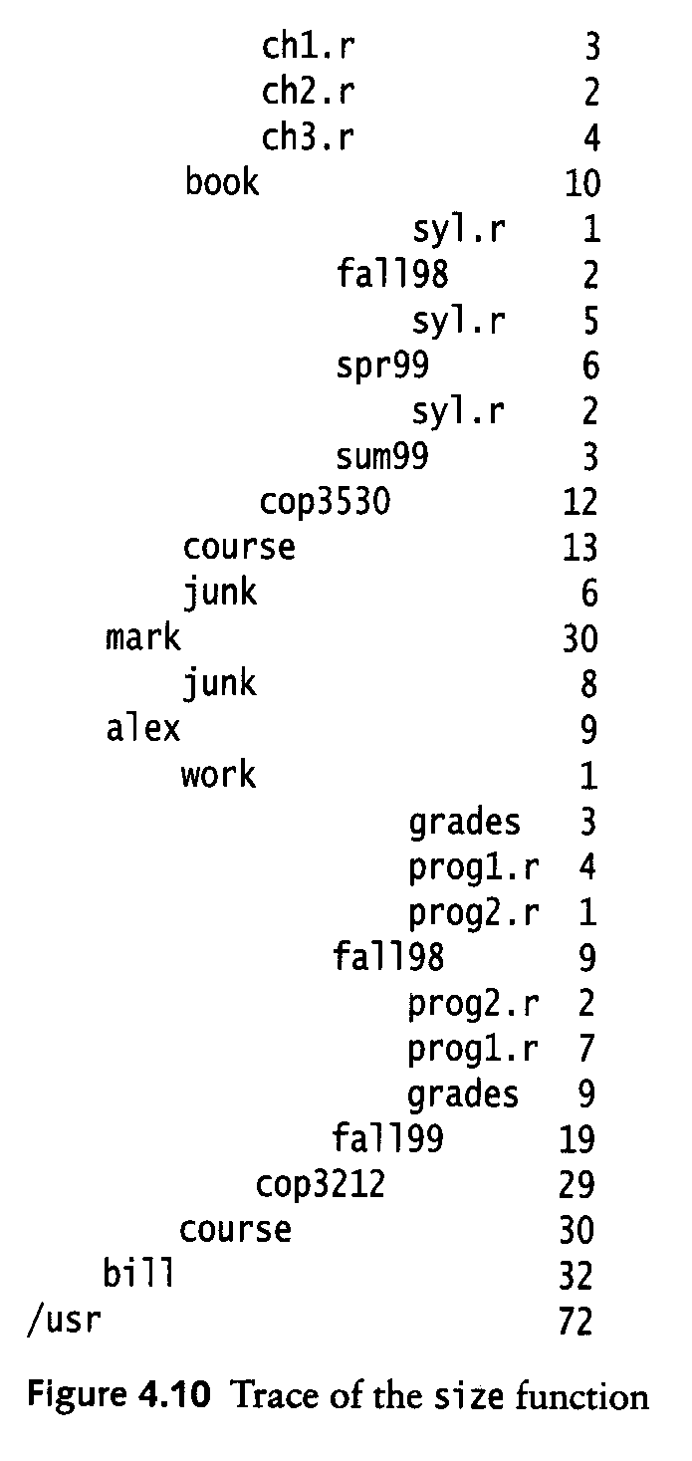
Post-order Traversal
PreOrder
PostOrder
Post-order traversal of a tree:
  Recursively post-order traverse the first subtree
  Recursively post-order traverse the other subtrees
  ‘visit’ the root finally
How to compute the total size of file (directory)?

Slide 15
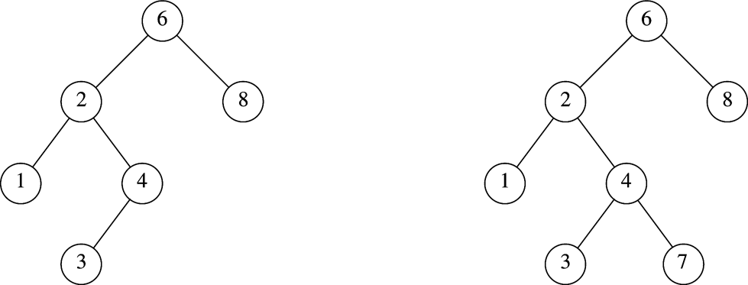
Binary Trees
Every node has at most two children, a left one and a right one.
If there is only one, it is specified either as its left child or its right child.
A binary tree is either empty, or it has a root, left subtree and rightsubtee, both are binary trees.

Slide 16
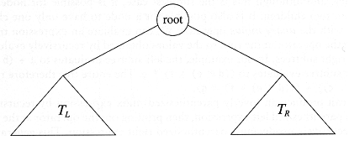
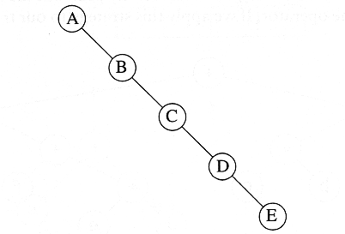
Binary Trees
A generic binary tree
The depth of an “average” binary tree is considerably smaller than N, the number of nodes, although in the worst case, the depth can be as large as N – 1.
Worst-case
binary tree

Slide 17
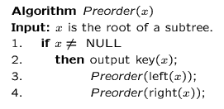
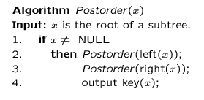
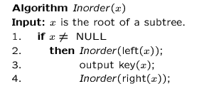
Preorder, Postorder and Inorder Traversal of Binary Trees

Slide 18
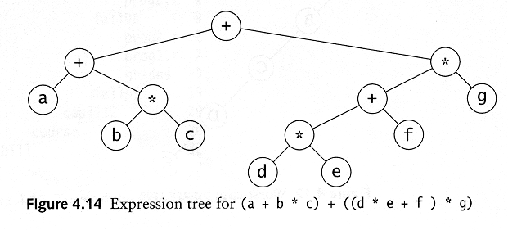
Example: Expression Trees
Leaves are operands (constants or variables)
The internal nodes contain operators
Will not be a binary tree if some operators are not binary

Slide 19
Preorder, Postorder and Inorder
Preorder traversal
  node, left, right
  prefix expression
    ++a*bc*+*defg

Slide 20
Preorder, Postorder and Inorder
Postorder traversal
  left, right, node
  postfix expression
    abc*+de*f+g*+
Inorder traversal
  left, node, right
  infix expression
    a+b*c+d*e+f*g

Slide 21
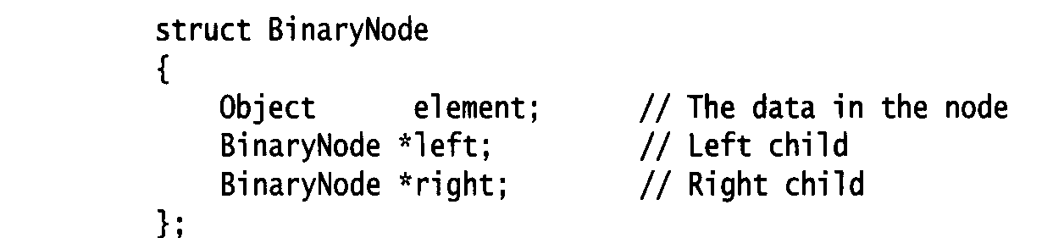
Representation of Binary Trees
Possible operations on the Binary Tree ADT
  Parent, left_child, right_child, sibling, root, etc
Implementation
  Because a binary tree has at most two children, we can keep direct pointers to them

Slide 22
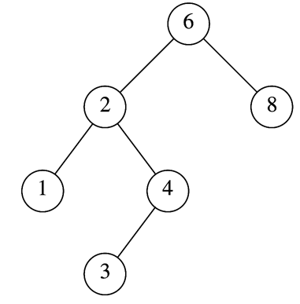
Example: constructing a binary tree
typedef int T;
struct BinaryNode{
T element;
BinaryNode *left, *right;
BinaryNode(T d, BinaryNode *l=NULL, BinaryNode* r=NULL):element(d), left(l), right(r) {};
};
BinaryNode * t2 = new BinaryNode(8);
BinaryNode * t1 = new BinaryNode(2, t11, t12);
BinaryNode *t = new BinaryNode(6,t1,t2);
t
t1
t2

Slide 23
Inorder Traversal: the recursive version
void inorder(BinaryNode *root, void(*visit)(T &x))
//inorder traversal of the tree with root root.
{
if (root !=NULL){
inorder(root->left, visit);
(*visit)(root->element);
inorder(root -> right, visit);
}
}
Use of inorder: inorder(t, print);//print is a function on T
Exercise1: write a non-recursive version.
Exercise2: write a level traversal of binary trees.

Slide 24
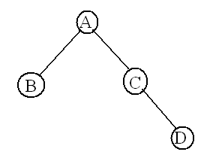
Nonrecursive inorder traversal
Starting from an example
Traverse the tree p (which points to the root)：
If p!= NULL, push it into stack;
Traveser p->left, that is p = p->left;
If p==NULL, pop out the root, visit the root, and then traverse the right subtree root->right, that is
p = root->right;
Repeat the process until the stack is empty。

Slide 25
Nonrecursive inorder traversal
void nonRecursiveInorder(BinaryNode *root, void(*visit)(T &x))
stack<BinaryNode*> s； p=root；//p points the current root of traversal
while(p || !s.empty())
if(p){// push root into stack and traverse the left subtree
s.push(p)； p=p->left；
}
else{
//no left subtree, pop out the root, visit the root
//and traverse the right subtree
p = s.top()；
visit(p->data)) ；
s.pop();
p=p->right；
}
}
}

Slide 26
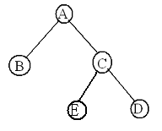
Level traversal of a tree
Visit the first level, then the second level, … 􀼯􁇯􀒪􀑒􀧥􀄠􁄝􀹝􁁂􀒪􁇏􀄑􀶨􀾽􀘓􀢲􀗄􁇯􁁂􀙠􀻙􀁢
Visit A, then A’s left child B and right child C, then B’s left child and right child, and then C’ left child and right child.
So, one needs a queue to denote which one’s child to visit first.

Slide 27
void level_traverse(Node * root, void (*visit)(T &))
/* Post: The tree is traversed level by level, starting from the top.
The operation *visit is applied to all entries.
*/
{
Node *sub_root;
if (root != NULL) {
queue<Node*> waiting_nodes;
// Queue<Binary_node<Entry> *> waiting_nodes;
waiting_nodes.push(root);
do {
sub_root = waiting_nodes.front();
(*visit)(sub_root->data);
if (sub_root->left) waiting_nodes.push(sub_root->left);
if (sub_root->right) waiting_nodes.push(sub_root->right);
waiting_nodes.pop();
} while (!waiting_nodes.empty());
}
}

Slide 28
Constructing an Expression Tree
Example input, a postfix expression:
a b + c d + *
when an operand is read, construct a leaf and store in the stack;
when an operator is read, take its left subtree and right subtree, construct a binary tree and store the tree in the stack;

Slide 29
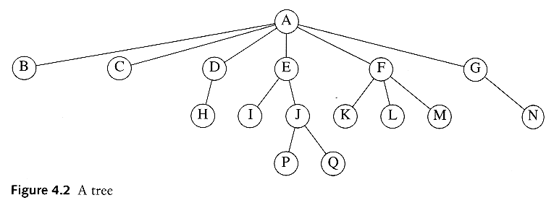
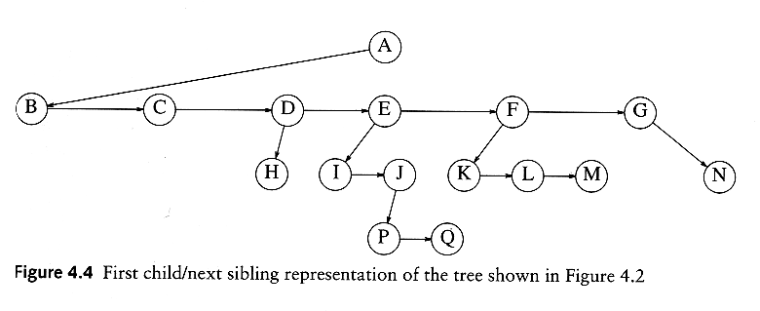
Convert a Generic Tree to a Binary Tree

Slide 30
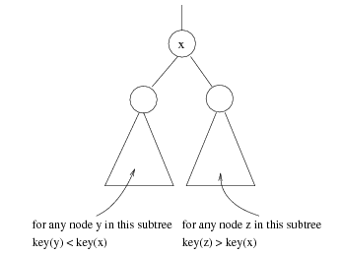
Binary Search Trees (BST)
A data structure for efficient searching, insertion and deletion
Binary search tree property
  For every node X
  All the keys in its left
  subtree are smaller than
  the key value in X
  All the keys in its right
  subtree are larger than the
  key value in X

Slide 31

Binary Search Trees
How about the inductive definition of BST?
What is the result when a BST is traversed in inorder?
A binary search tree
Not a binary search tree

Slide 32
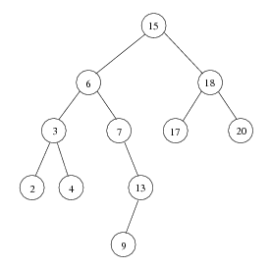
Inorder Traversal of BST
Inorder traversal of BST prints out all the keys in sorted order, hence resulting in a sorting method.
Inorder: 2, 3, 4, 6, 7, 9, 13, 15, 17, 18, 20

Slide 33

Binary Search Trees
The same set of keys may have different BSTs

Slide 34
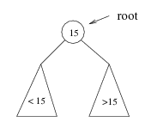
Searching BST
If we are searching for 15, then we are done.
If we are searching for a key < 15, then we should search in the left subtree.
If we are searching for a key > 15, then we should search in the right subtree.

Slide 35
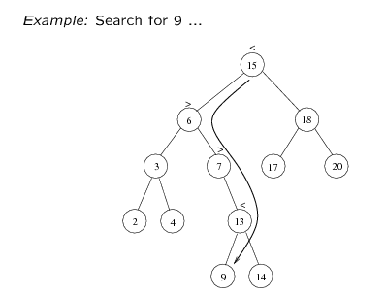
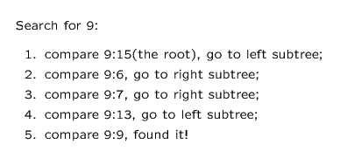

Slide 36
Design BST Using OOP
You specify the behaviors and attributes of a class.
Which public operations are provided by a BST? This is the interface for both client programs and for implementations.
How the data can be represented and organized so the operations specified in the interface can be implemented efficiently.

Slide 37
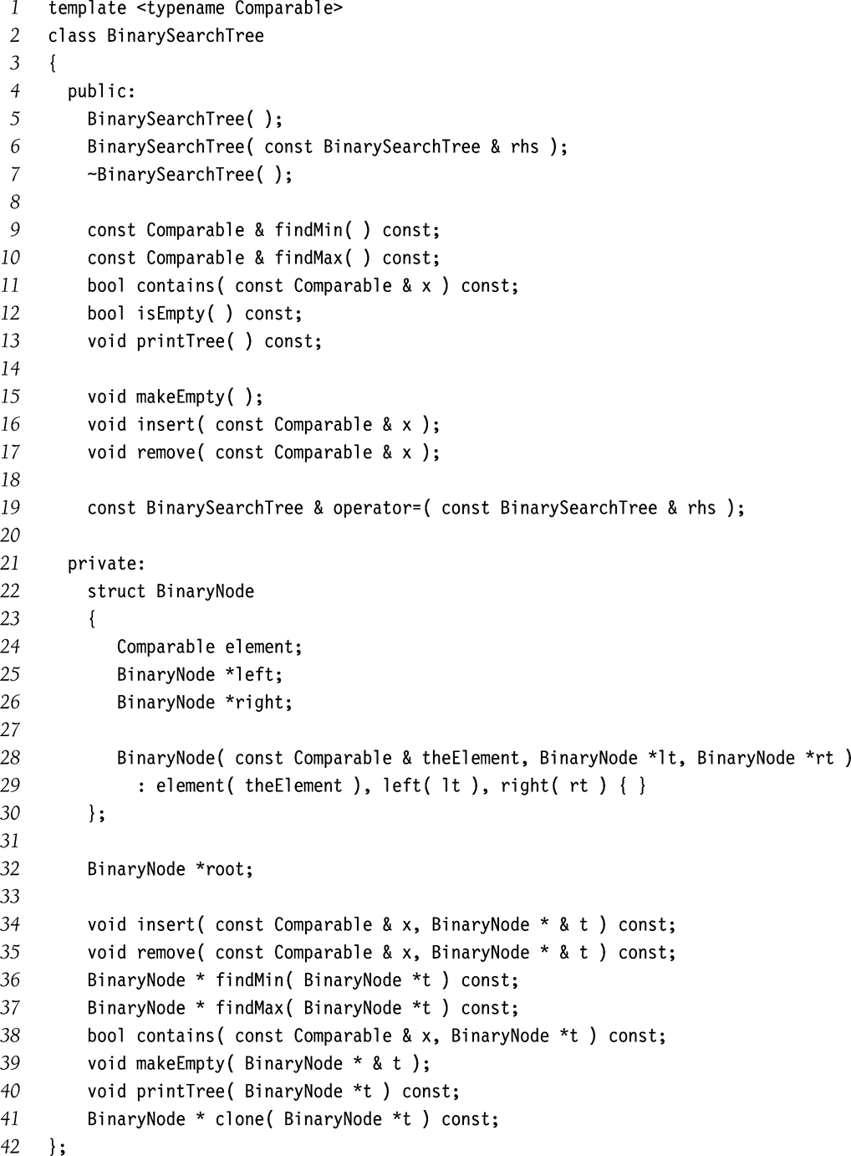
ADT BST

Slide 38
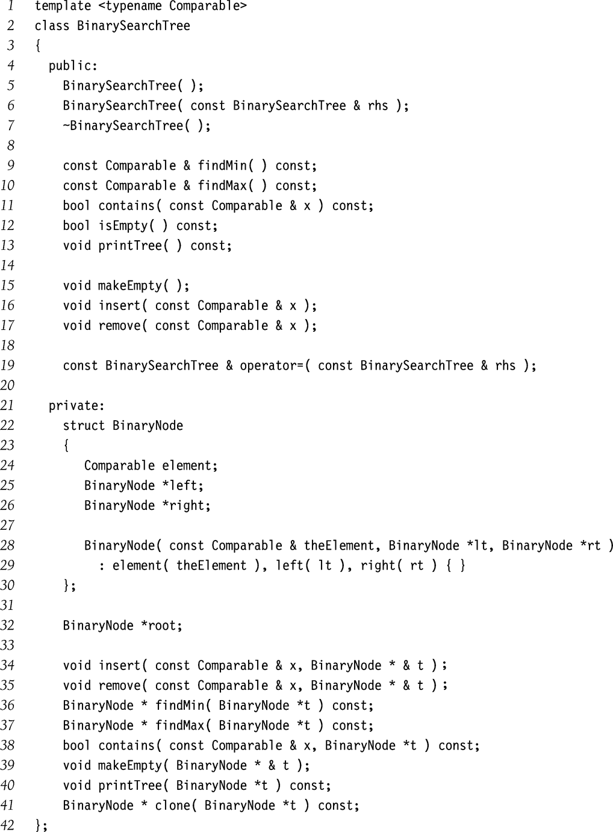

Slide 39
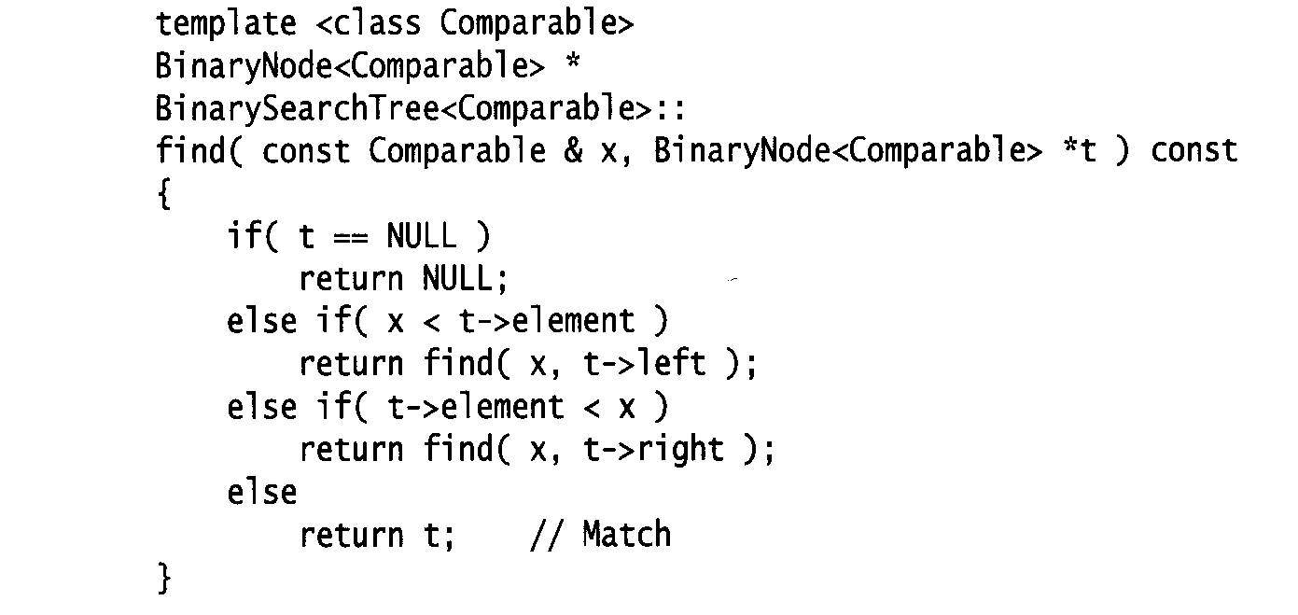
Searching (Find)
Find X: return a pointer to the node that has key X, or NULL if there is no such node
Time complexity: O(height of the tree)
Assuming ‘<‘ is defined on Comparable, x matches y
if only if both x<y and y<x are false.

Slide 40
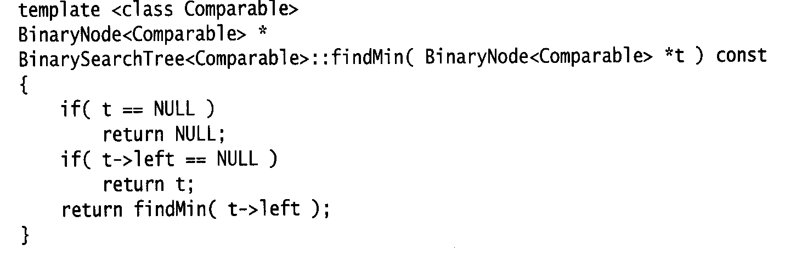
findMin/ findMax
Goal: returns the node containing the smallest (largest) key in the tree
Algorithm: Start at the root and go left (right) as long as there is a left (right) child. The stopping point is the smallest (largest) element
Time complexity = O(height of the tree)

Slide 41
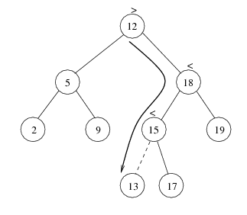
Insertion
Proceed down the tree as you would with a find
If X is found, do nothing (or update something)
Otherwise, insert X at the last spot on the path traversed
Time complexity = O(height of the tree)

Slide 42
Implementation of Insertion
How to write the prototype of the insertion?

Slide 43
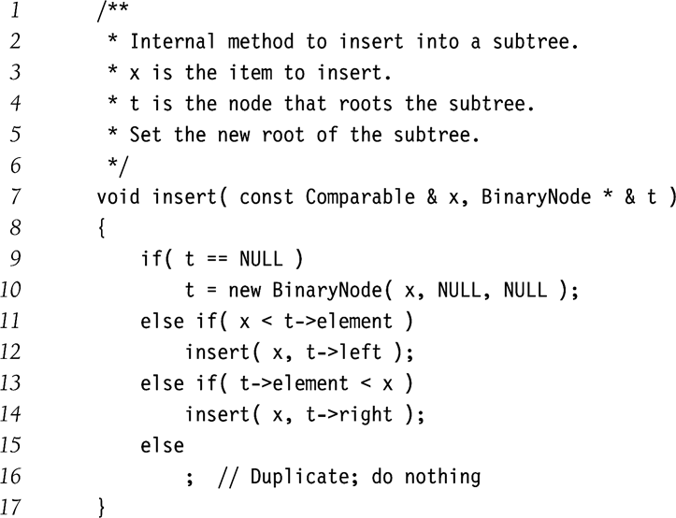
Implementation of insertion
Use reference because the root may change after the insertion.
An old link is replaced by a new link.

Slide 44
Deletion
When we delete a node, we need to consider how we take care of the children of the deleted node.
  This has to be done such that the property of the search tree is maintained.
Starting from
the simplest case

Slide 45
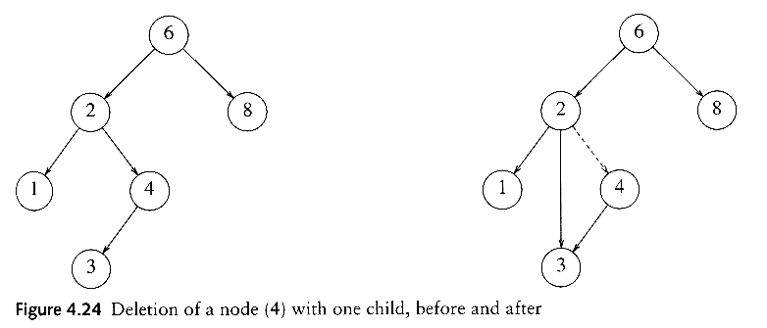
Deletion under Different Cases
Case 1: the node is a leaf
  Delete it immediately
Case 2: the node has one child
  Adjust a pointer from the parent to bypass that node

Slide 46
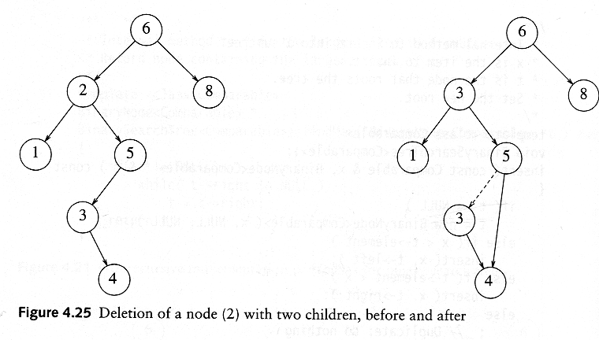
Deletion Case 3
Case 3: the node has 2 children
  Replace the key of that node with the minimum element at the right subtree
  Delete that minimum element
    Has either no child or only right child because if it has a left child, that left child would be smaller and would have been chosen. So invoke case 1 or 2.
Time complexity = O(height of the tree)

Slide 47
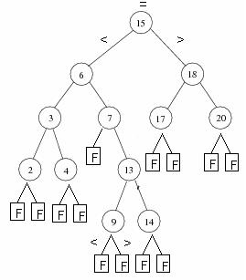
Average Node Depth of BST
Every search stops at some node:
  Successful at internal nodes, number of comparisons is the depth +1;
  Unsuccessful at leaves, number of comparison is the depth of the leaf;
For n+1 unsuccessful searches, the total number of comparisons is the external path length E(T), and the average is E(T)/(n+1).
The total number of comparisons for successful searches is I(T) + n, where I(T) is the internal path length (summing all depths of internal nodes), the average is I(T)/n + 1.
Theorem: For 2-trees E(T) = I(T) + 2q, q is the number of internal nodes. In this case q = n.

Slide 48
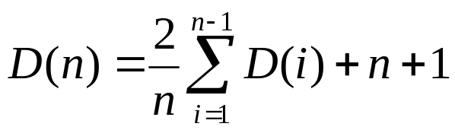
Average External Path Length
Let D(n) be the average external path length for binary search tree of n nodes, which has n+1 leaves.
D(1) = 0;
D(n) =D(i) + i+1+ D(n-i-1) + n-i=D(i) + D(n-i) + n+1; assuming the left subtree has i nodes and i+1 leaves.
Assuming the size of left subtree can take any size from 1 to n-1, the same for the right subtree, then D(i)=D(n-i-1) = (D(0)+D(1)+…D(n-1))/n;

Slide 49
Average External Path Length
Solving the recurrence, D(n) = O(nlogn).
Average height of BST is O(logn).
Average depth of internal nodes (D(n) – 2n)/n=O(logn)
Average number of comparisons for searching, insertions and deletions are O(log n).

Slide 50
Summary
Understand the inductive definitions of trees, binary trees and binary search trees. Inductive definitions lead to induction proofs and recursive algorithms.
Binary trees: traversals and expression trees
Binary Trees Representation: linked representation.
Binary Search Trees, searching, insertion and deletion. Notice how trees are passed in these operations.
Problems:
  How about other tree representations?
  Implement Huffman Tree algorithm.
  Exercises 4.2, 4.4, 4.6, 4.9.

