Slide 1
AVL-Trees
COMP171
Fall 2006

Slide 2
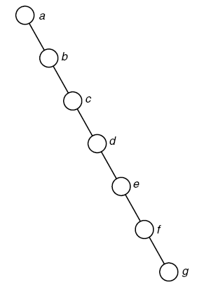
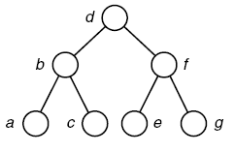
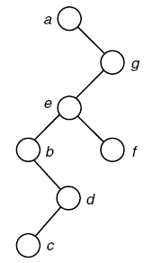
Behavior of search in binary search trees
The same set of keys a, b, …, g can be stored in different shapes of binary search trees and time complexity of searching vary.
The number of comparisons is O(lg n)
The worst case: The number of comparisons is O(n).

Slide 3
Balanced Binary Search Trees
Worst case height of binary search tree: N-1
  Insertion, deletion can be O(N) in the worst case
We want a tree with small height
Height of a binary tree with N node is at least Θ(log N)
Goal: keep the height of a binary search tree O(log N)
Balanced binary search trees
  Examples: AVL tree, red-black tree

Slide 4
Balanced Trees?
Suggestion 1: the left and right subtrees of root have the same height
  Doesn’t force the tree to be shallow
Suggestion 2: every node must have left and right subtrees of the same height
  Only complete binary trees satisfy
  Too rigid to be useful
Our choice: for each node, the height of the left and right subtrees can differ at most 1

Slide 5
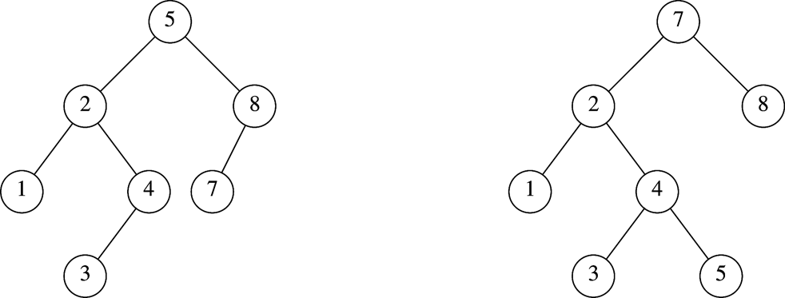
AVL Tree
An AVL tree is a binary search tree in which
  for every node in the tree, the height of the left and right subtrees differ by at most 1.
AVL tree
AVL property violated here

Slide 6
AVL Trees
An AVL tree (Balanced Binary Trees,平衡二叉树) is a binary search tree in which
the heights of the left and right subtrees of the root differ by at most 1 and
the left and right subtrees are again AVL trees.
Define the Balance Factor of a binary tree as the difference of the height of the left subtree and the height of the right subtree.
A binary tree is an AVL Tree iff the absolute value of every node is less than or equal to 1.
An AVL tree of n nodes has height O(lg n), so the average search length is O(lg n).

Slide 7
-1
1
1
-1
1
0
0
0
1
0
0
2
-1
-1
0
Balance lost at the root node
0
-2
Balance lost in the right subtree
0
0
1
0
1
0
0
Nodes are labeled with balance factors.

Slide 8
AVL Tree with
Minimum Number of Nodes
Can you draw an AVL tree of 5 nodes? What is the maximum height with 5 nodes?
What is the maximum height of an AVL tree with n nodes? Or
What is the smallest (size) AVL tree of a given height?
N₀ = 1
N₁ = 2
N₂ =4
N₃ = N₁+N₂+1=7

Slide 9
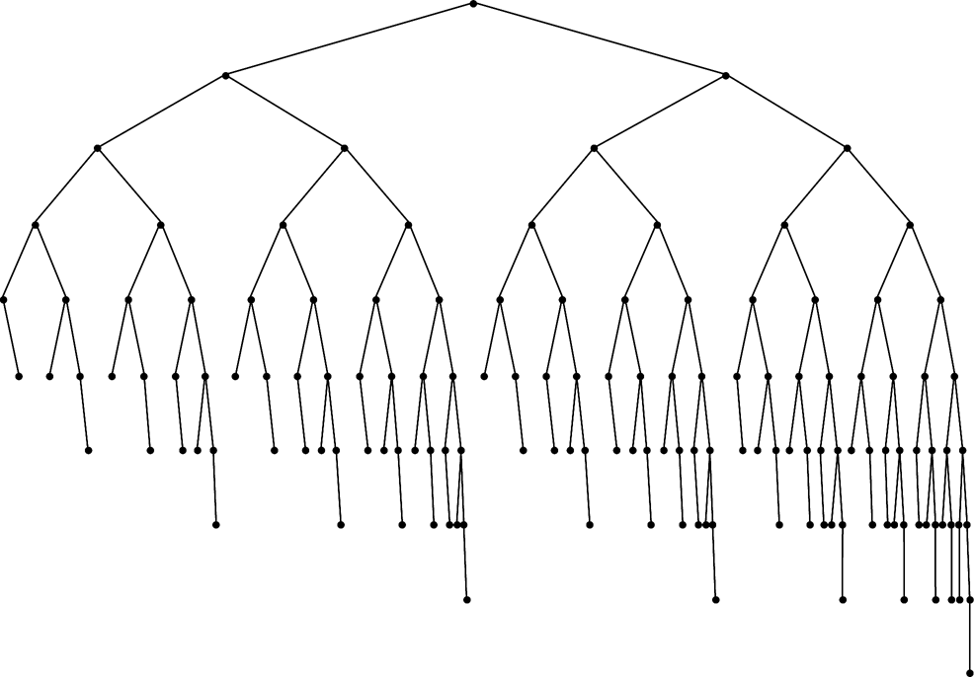
Smallest AVL tree
of height 7
Smallest AVL tree
of height 8
Smallest AVL tree of height 9

Slide 10


Height of AVL Tree
Denote N_{h} the minimum number of nodes in an AVL tree of height h
N₀=1, N₁ =2
N_{h}= N_{h-1} + N_{h-2} +1
N_{h}= F_{h+2}-1, F_{h} is hth Fibonacci number
F_{h} ≈
h ≈ 1.44 lg n
Thus, searching on an AVL tree will take O(log n) time

Slide 11
Constructing an AVL tree
Assuming keys (13，24，37，90，53)
-2
13
Left rotation
0
24
Ø
0
13
-1
13
-1
24
0
13
0
24
0
37
0
37
-2
24
24
-1
24
0
13
-2
37
13
-2
37
0
13
0
53
1
90
-1
53
Right rotation
0
53
0
90
0
37
0
90
Left rotation

Slide 12
Left rotation
A
C
0
-1
A
-2
E
B
0
C
B
-1
C
A
0
h
D
E
h
D
E
D
h
+
1
B
h
h
h
h
+
1
h
h
A node is inserted
into E
(c)Left rotation
(b) The height of E increased
Node A is the deepest node that becomes unbalanced, and the ‘shape’ is right-right higher (insertion is done in the right child’s right subtree), then one left rotation is performed.

Slide 13
Right rotation
A
1
A
2
0
B
B
0
C
B
1
C
D
0
A
D
E
h
D
E
h
h
+
1
E
C
h
h
h
+
1
h
h
h
(c) right rotation
(a)A node is inserted into B’s left subtree
(b) Left subtree of A is higher
Symmetric case:Node A is the deepest node that becomes unbalanced, and the ‘shape’ is left-left higher (insertion in done in the left child’s left subtree), then one right rotation is performed.

Slide 14
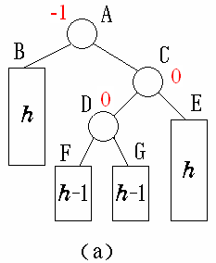
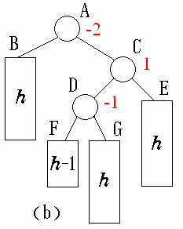
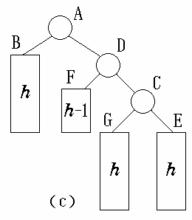
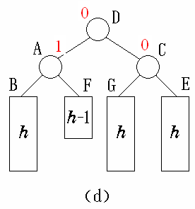
Double Rotations: right-left higher
Node A is the deepest unbalanced node: A node is inserted into the right child’s left subtree.
Right rotation
Left rotation

Slide 15
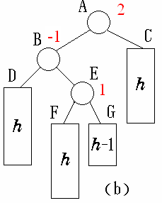
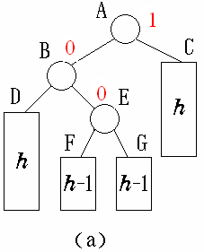
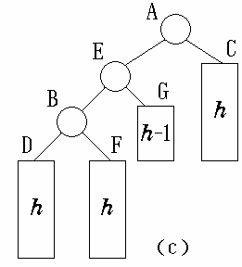
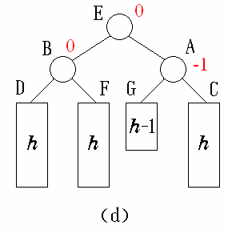
Double Rotations: left-right higher
Node A is the deepest unbalanced node: A node is inserted into the left child’s right subtree.
Left rotation
Right rotation

Slide 16
Assuming keys { 16, 3, 7, 11, 9, 26, 18, 14, 15 }，draw the AVL tree by repeated insertion
16
16
16
DLRR
7
7
0
-1
0
0
1
3
3
3
16
3
0
16
0
7
11
-2
-1
-2
7
7
7
2
0
-1
3
16
SRR
3
11
3
11
1
0
0
-1
11
9
16
9
16
0
0
9
26

Slide 17
0
-1
11
11
SLR
0
-1
-2
DRLR
7
16
7
16
1
3
9
26
3
9
26
0
18
0
-1
11
11
0
1
7
18
7
18
0
0
1
3
9
16
26
3
9
16
26
0
14

Slide 18
-2
-1
11
11
2
DLRR
1
7
18
7
18
2
0
3
9
16
26
3
9
15
26
-1
0
0
14
14
16
0
15

Slide 19
Insertion in AVL Tree
Basically follows insertion strategy of binary search tree
Rebalance the tree at the deepest unbalanced node, this also guarantees that the entire tree satisfies the AVL property
Insertion can be done recursively.

Slide 20
Deletion from AVL Tree
Delete a node x as in ordinary binary search tree
  Note that the last (deepest) node in a tree deleted is a leaf or a node with one child
Then trace the path from the new leaf towards the root
For each node x encountered, check if heights of left(x) and right(x) differ by at most 1.
  If yes, proceed to parent(x)
  If no, perform an appropriate rotation at x
Continue to trace the path until we reach the root

Slide 21
Deletion Example 1
20
20
10
35
15
35
5
15
25
40
10
18
25
40
18
30
38
45
30
38
45
50
50
Single Rotation
Delete 5, Node 10 is unbalanced

Slide 22
Cont’d
20
35
15
35
20
40
10
18
25
40
15
25
38
45
30
38
45
10
18
30
50
Continue to check parents
Oops!! Node 20 is unbalanced!!
50
Single Rotation
For deletion, after rotation, we need to continue tracing upward to see if AVL-tree property is violated at other node.

Slide 23
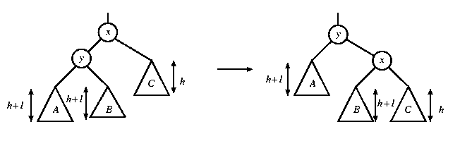
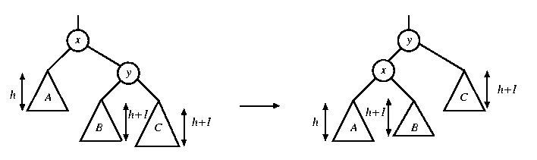
Rotation in Deletion
The rotation strategies (single or double) we learned can be reused here
Except for one new case: two subtrees of y are of the same height
rotate with left child
rotate with right child

Slide 24
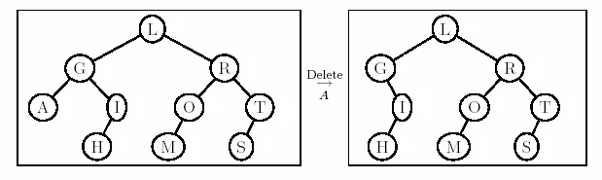
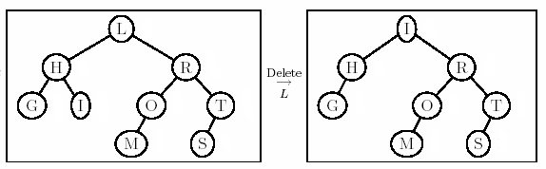
Deletion Example 2
Right most child of left subtree
Double rotation

Slide 25
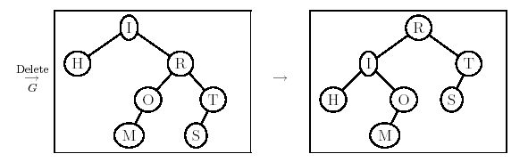
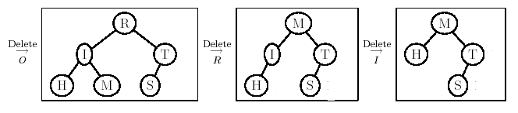
Example 2 Cont’d
New case

Slide 26
STL set and map
STL container set is an ordered container, supporting logarithmic insertion, deletion and searching.
Map is an ordered associative container, supporting logarithmic insertion, deletion and searching.
How they can be implemented?
Using balanced binary search trees, with threads (threaded threes).

Slide 27
Huffman tree and its application
Coding using 0,1s：“CANADA”
First method:: fixed-length codes:
A(00), C(01),D(10), N(11)
Encoded string: 010011001000
The requirements:
1) Uniquely decodable, or no ambiguity to get the original text from encoded string;
2) the overall length of the encoded string is short.

Slide 28
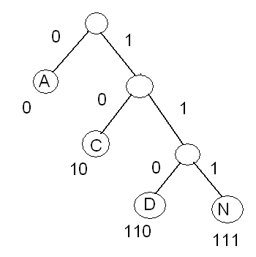
Prefix-free code
Prefix-free code: the bit string representing some particular symbol is never a prefix of the bit string representing any other symbol
Prefix-free code is a variable length code.
Binary trees can be used to design prefix-free code.
The overall length of the encoded string?
编码结果:
10011101100

Slide 29
Decoding
Decoding is done by finding the characters when the input is
Starting at the root and following the branches according to the current input until a leaf is reached, then a character is found.
Repeat the step about until all input is consumed.
decoding:
a) 100100
b) 10011101100
Result：
a）CACA
b) CANADA

Slide 30
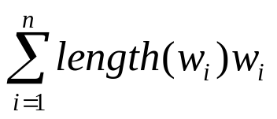
The problem
Why this is a better code?
What is the general problem?
Given A set of symbols {a₁, …, a_{n}} and their weights { w_{i} }(usually proportional to probabilities), find a binary tree with minimum weight

Slide 31
Huffman coding
(1) Given weights {w₁, w₂, …, w_{n}}，construct a set of binary trees F = {T₁, T₂, …, T_{n}}，where each T_{i} is single node binary tree with weight w_{i}
(2) Repeat the following step until one tree is left in F:
Choose two trees s and t with minimum weights in F and merge them into one new tree: a new root with weight weight(s) + weight(t), and s and t as the left subtree and the right subtree.

Slide 32
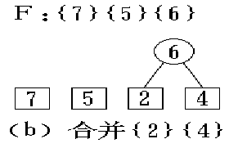
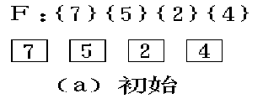
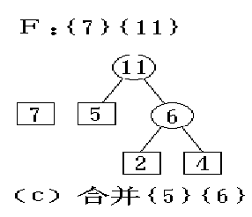
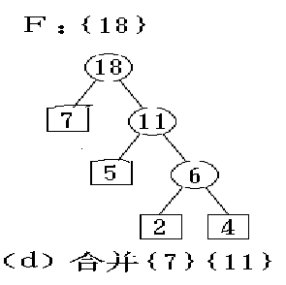
Constructing Huffman Tree

Slide 33
Summary
Running time of search in binary search trees depend on the shape of the tree, or the depth of the tree, which is O(n) in the worst case.
AVL tree is an efficient search data structure, where running times for search, insertion and deletion are O(log n).
Understand insertion and deletion for AVL trees.
Exercises: 4.18, 4.19, 4.20, 4.21
Implement AVL insertion.
Implement a lossless data compression program based on Huffman coding.

Slide 34
How to write a program that takes parameters from command line?

