Slide 1
B⁺-Trees
COMP171
Fall 2006

Slide 2
Contents
Why B⁺ Tree?
B⁺ Tree Introduction
Searching and Insertion in B⁺ Tree

Slide 3
Motivation
AVL tree with N nodes is an excellent data structure for searching, indexing, etc.
  The Big-Oh analysis shows most operations finishes within O(logN) time
The theoretical conclusion works as long as the entire structure can fit into the main memory
When the data size is too large and has to reside on disk, the performance of AVL tree may deteriorate rapidly

Slide 4
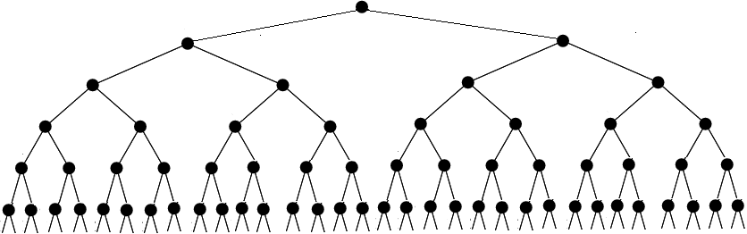
Motivation
A database with 1,000,000 items, 8 bytes each (assume the type is pair<int, void *> ) will take about 8G space.
Imaging the large binary tree is stored in a disk (links are disk addresses).
The naïve way to do searching may take about lg N disk accesses, this amounts to 20 disk accesses for N=1,000,000.

Slide 5


Motivation
Let’s calculate a typical searching time
  A successful search need lg 1000000 = 20 disk accesses;
  A 500-MIPS machine, with 7200 RPM hard disk, 500 million instruction executions, and approximately 120 disk accesses each second, i.e. 4,000,000 instructions are executed during one disk accesses.
A disk access is too slow.
We want to reduce the number of disk accesses to a very small number.

Slide 6
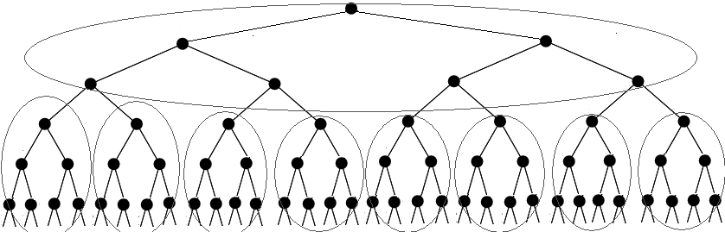
From Binary to M-ary
Divide the table into 7-node pages: every node has 7 items, the searching table becomes a 8-way searching tree.
Tree height is log₈ 1000000 = 7, searching is 3 times faster.
With 128 branching, height = 3, a searching needs at most 3 seeks.
More branching less seeks, but a node should fit one page so it can be read in main memory in one disk access.

Slide 7
From Binary to M-ary
Idea: allow a node in a tree to have many children
  Less disk access = less tree height = more branching
As branching increases, the depth decreases
An M-ary tree allows M-way branching
  Each internal node has at most M children
A complete M-ary tree has height that is roughly log_{M}N instead of log₂N
  if M = 128, then log₁₂₈ 1000000 < 3
  Thus, we can speedup the search significantly

Slide 8
M-ary Search Tree
For binary search trees, one node has one key and two branches
For M-ary search trees, one node with M-way branching needs M-1 keys to decide which branch to take
M-ary search tree should be balanced in some way too
  We don’t want an M-ary search tree to degenerate to a linked list, or even a binary search tree

Slide 9
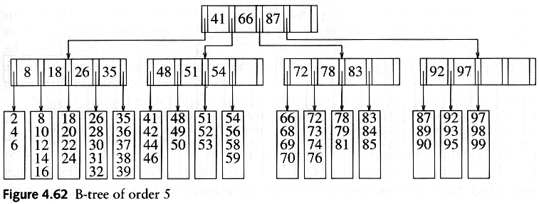
5 way Search Tree Example

Slide 10
B⁺ -Tree
A B⁺-tree of order M is an M-ary tree with the following properties:
  The data items are stored at leaves
  The root is either a leaf or has between two and M children
  All non-leaf nodes (except the root) have between ⎡M/2⎤ and M children
  The non-leaf nodes store up to M-1 keys to guide the searching; key i represents the smallest key in sub-tree i+1
  All leaves are at the same depth and have between ⎡L/2⎤ and L data items, for some L (usually L << M(?), but we will assume M=L in most examples)
Note there are various definitions of B-trees, but mostly in minor ways.
The above definition is one of the popular forms.

Slide 11
Keys in Internal Nodes
Which keys are stored at the internal nodes?
There are several ways to do it. Different books adopt different conventions.
We will adopt the following convention:
  key i in an internal node is the smallest key in its i+1 sub-tree (i.e. right sub-tree of key i)
Even following this convention, there is no unique B⁺-tree for the same set of records.

Slide 12
B⁺ -Tree Example 1 (M=L=5)
Records are stored at the leaves (we only show the keys here)
Since L=5, each leaf has between 3 and 5 data items
Since M=5, each non-leaf node has between 3 to 5 children
Requiring nodes to be half full guarantees that the B+ tree does not degenerate into a simple binary tree

Slide 13
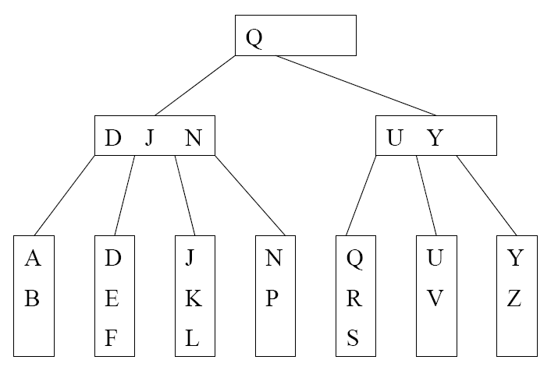
B⁺ -Tree Example 2 (M=L=4)
We can still talk about left and right child pointers
E.g. the left child pointer of N is the same as the right child pointer of J
We can also talk about the left sub-tree and right sub-tree of a key in internal nodes

Slide 14
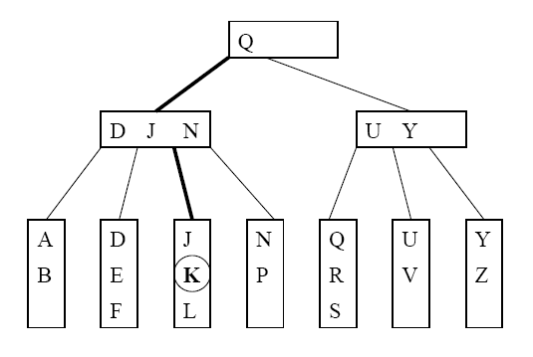
Searching Example
Suppose that we want to search for the key K. The path traversed is shown in bold.

Slide 15
Searching Algorithm
Let x be the input search key.
Start the searching at the root
If we encounter an internal node v, search (linear search or binary search) for x among the keys stored at v
  If x < K_{min} at v, follow the left child pointer of K_{min}
  If K_{i} ≤ x < K_{i+1} for two consecutive keys K_{i} and K_{i+1} at v, follow the left child pointer of K_{i+1}
  If x ≥ K_{max} at v, follow the right child pointer of K_{max}
If we encounter a leaf v, we search (linear search or binary search) for x among the keys stored at v. If found, we return the entire record; otherwise, report not found.

Slide 16
Insertion Procedure
Insert a,b,c,d,… starting from the empty B⁺ -tree of order 5 with L=3.

Slide 17
Insertion Procedure
Suppose that we want to insert a key K and its associated record.
Search for the key K using the search procedure
This will bring us to a leaf x
Insert K into x
  Splitting (instead of rotations in AVL trees) of nodes is used to maintain properties of B⁺-trees [next slide]

Slide 18
Insertion into a Leaf
If leaf x contains < L keys, then insert K into x (at the correct position in node x)
If x is already full (i.e. containing L keys). Split x
  Cut x off from its parent
  Insert K into x, pretending x has space for K. Now x has L+1 keys.
  After inserting K, split x into 2 new leaves x_{L} and x_{R}, with x_{L} containing the ⎣(L+1)/2⎦ smallest keys, and x_{R} containing the remaining ⎡(L+1)/2⎤ keys. Let J be the minimum key in x_{R}
  Make a copy of J to be the parent of x_{L} and x_{R}, and insert the copy together with its child pointers into the old parent of x.

Slide 19
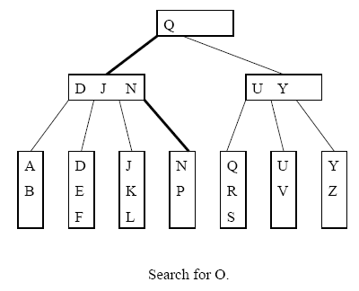
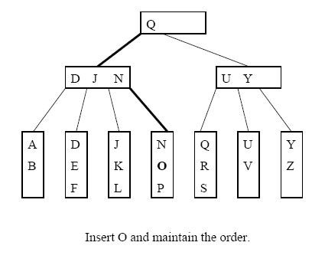
Inserting into a Non-full Leaf (L=3)

Slide 20
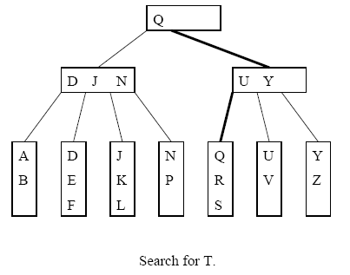
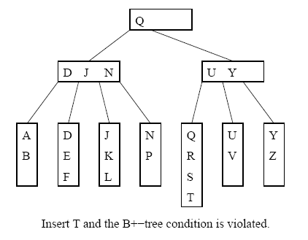
Splitting a Leaf: Inserting T

Slide 21
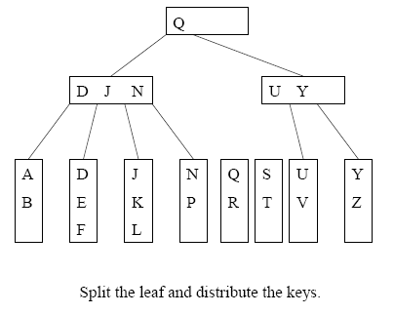
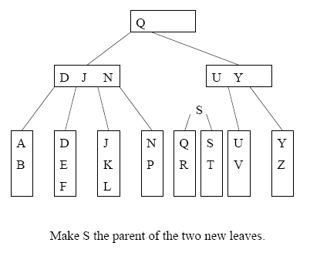
Splitting Example 1

Slide 22
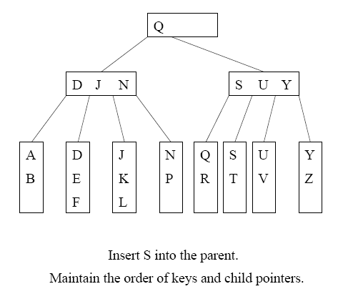
Two disk accesses to write the two leaves, one disk access to update the parent
For L=32, two leaves with 16 and 17 items are created. We can perform 15 more insertions without another split

Slide 23
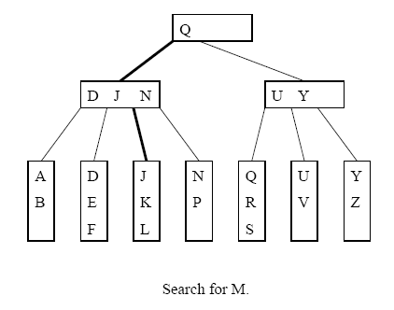
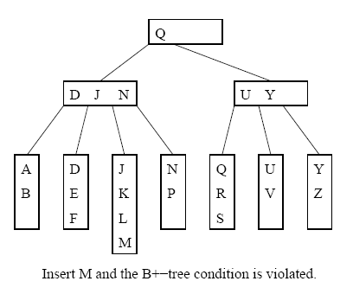
Splitting Example 2

Slide 24
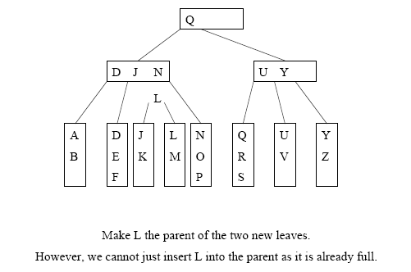
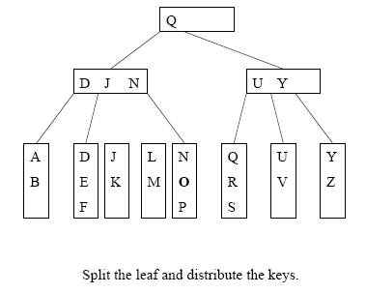
Cont’d
=> Need to split the internal node

Slide 25
Splitting an Internal Node
To insert a key K into a full internal node x:
Cut x off from its parent
Insert K and its left and right child pointers into x, pretending there is space. Now x has M keys.
Split x into 2 new internal nodes x_{L} and x_{R}, with x_{L} containing the ( ⎡M/2⎤ - 1 ) smallest keys, and x_{R} containing the ⎣M/2⎦ largest keys. Note that the (⎡M/2⎤)th key J is not placed in x_{L} or x_{R}
Make J the parent of x_{L} and x_{R}, and insert J together with its child pointers into the old parent of x.

Slide 26
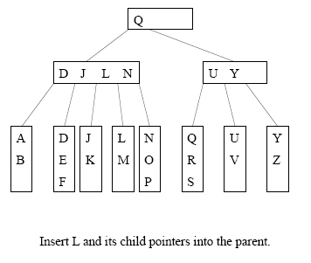
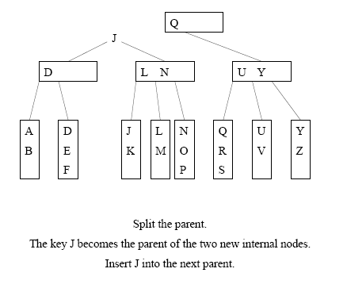
Example: Splitting Internal Node (L=3,M=5)

Slide 27
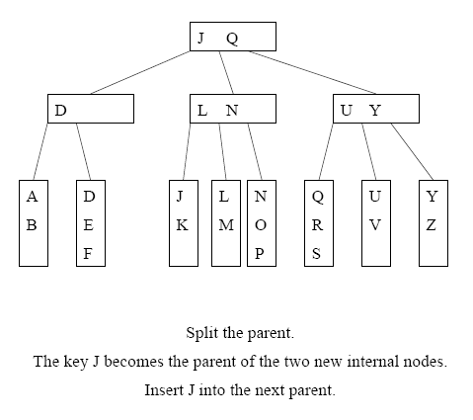
Cont’d

Slide 28
Termination
Splitting will continue as long as we encounter full internal nodes
If the split internal node x does not have a parent (i.e. x is a root), then create a new root containing the key J and its two children

Slide 29
Deletion
To delete a key target, we find it at a leaf x, and remove it.
Two situations to worry about:
  (1) target is a key in some internal node (needs to be replaced, according to our convention)
  (2) After deleting target from leaf x, x contains less than ⎡L/2⎤ keys (needs to merge nodes)

Slide 30
Situation 1: Removal of a Key
target can appear in at most one ancestor y of x as a key (why?)
Node y is seen when we searched down the tree.
After deleting from node x, we can access y directly and replace target by the new smallest key in x

Slide 31
Situation 2:
Handling Leaves with Too Few Keys
Suppose we delete the record with key target from a leaf.
Let u be the leaf that has ⎡L/2⎤ - 1 keys (too few)
Let v be a sibling of u
Let k be the key in the parent of u and v that separates the pointers to u and v
There are two cases

Slide 32

Handling Leaves with Too Few Keys
Case 1: v contains ⎡L/2⎤+1 or more keys and v is the right sibling of u
  Move the leftmost record from v to u
Case 2: v contains ⎡L/2⎤+1 or more keys and v is the left sibling of u
  Move the rightmost record from v to u
Then set the key in parent of u that separates u and v to be the new smallest key in u (or v)

Slide 33
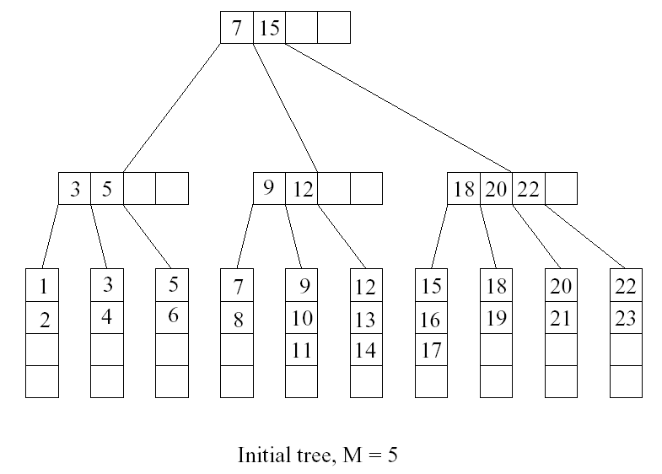
Deletion Example
Want to delete 15

Slide 34
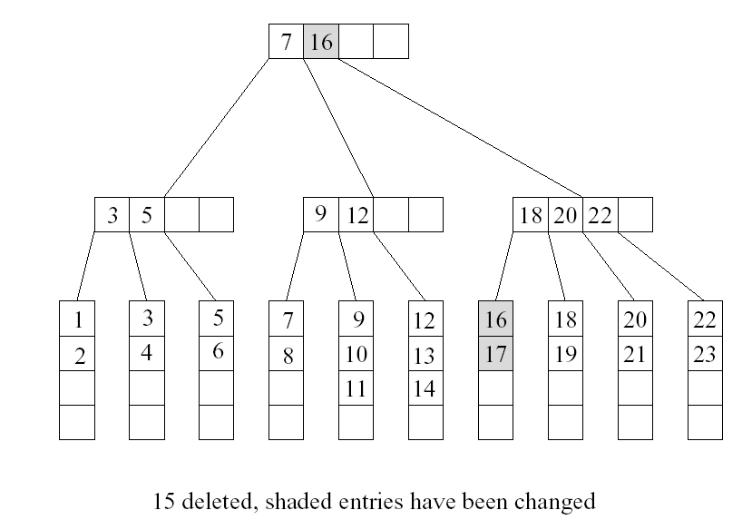
Want to delete 9

Slide 35
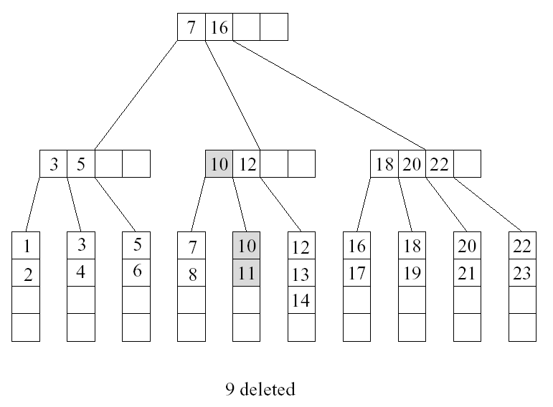
Want to delete 10, situation 1

Slide 36
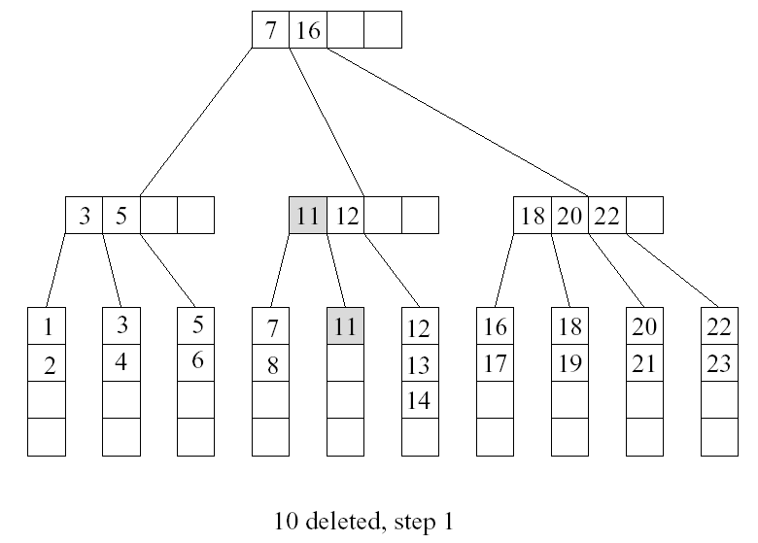
Deletion of 10 also incurs situation 2
u
v

Slide 37
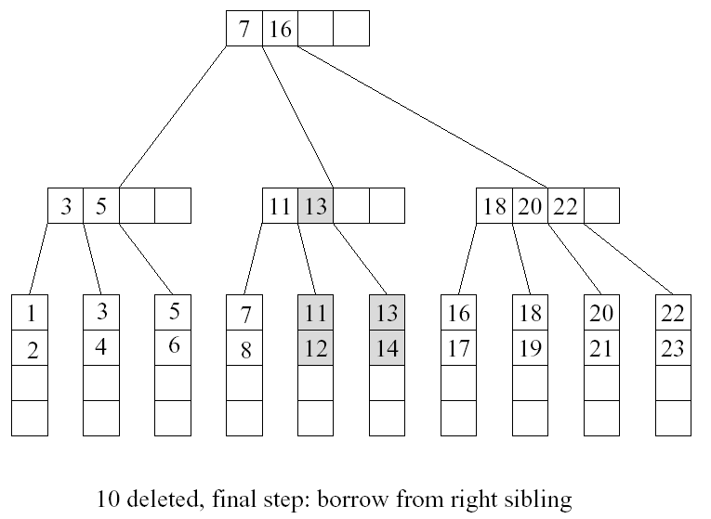

Slide 38

Merging Two Leaves
If no sibling leaf with ⎡L/2⎤+1 or more keys exists, then merge two leaves.
Case 1: Suppose that the right sibling v of u contains exactly ⎡L/2⎤ keys. Merge u and v
  Move the keys in u to v
  Remove the pointer to u at parent
  Delete the separating key between u and v from the parent of u

Slide 39
Merging Two Leaves (Cont’d)
Case 2: Suppose that the left sibling v of u contains exactly ⎡L/2⎤ keys. Merge u and v
  Move the keys in u to v
  Remove the pointer to u at parent
  Delete the separating key between u and v from the parent of u

Slide 40
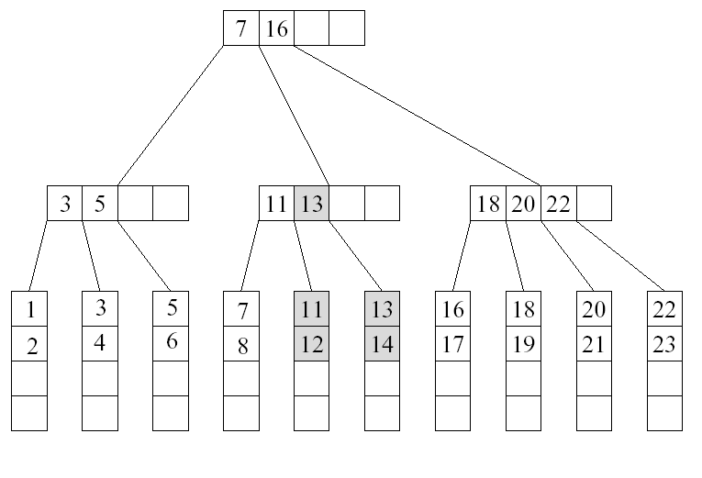
Example
Want to delete 12

Slide 41
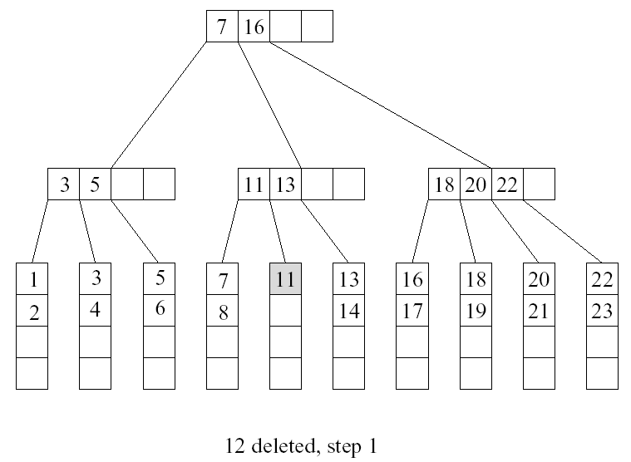
Cont’d
u
v

Slide 42
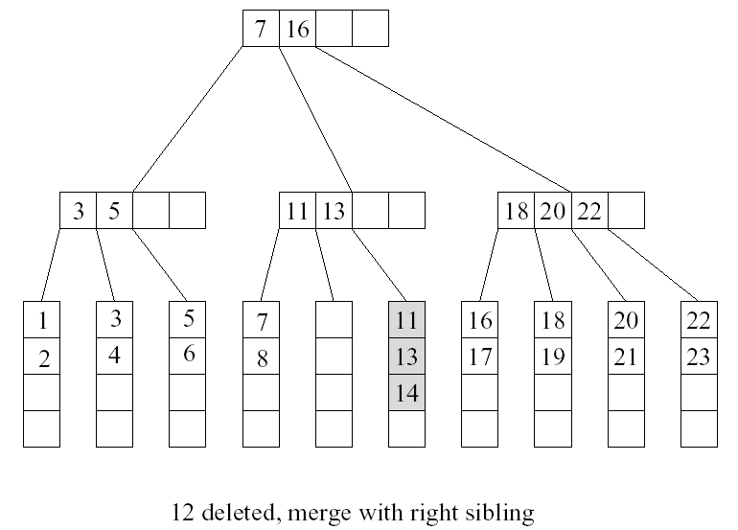
Cont’d

Slide 43
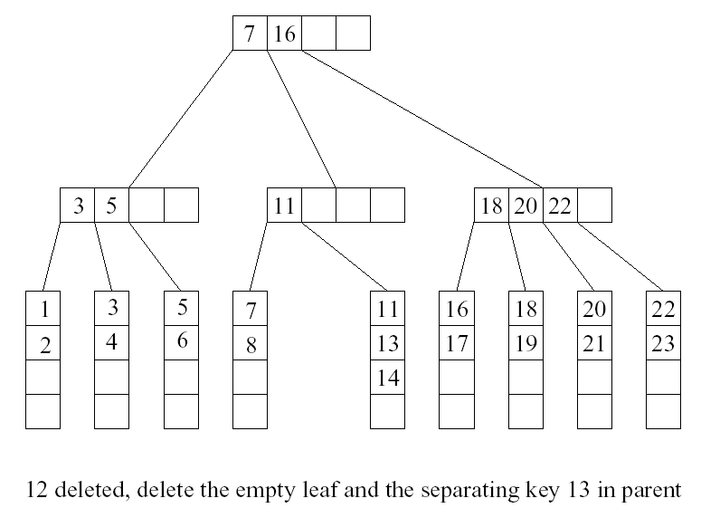
Cont’d
too few keys! …

Slide 44
Deleting a Key in an Internal Node
Suppose we remove a key from an internal node u, and u has less than ⎡M/2⎤ -1 keys after that
Case 1: u is a root
  If u is empty, then remove u and make its child the new root

Slide 45
Deleting a key in an internal node
Case 2: the right sibling v of u has ⎡M/2⎤ keys or more
  Move the separating key between u and v in the parent of u and v down to u
  Make the leftmost child of v the rightmost child of u
  Move the leftmost key in v to become the separating key between u and v in the parent of u and v.
Case 2: the left sibling v of u has ⎡M/2⎤ keys or more
  Move the separating key between u and v in the parent of u and v down to u.
  Make the rightmost child of v the leftmost child of u
  Move the rightmost key in v to become the separating key between u and v in the parent of u and v.

Slide 46
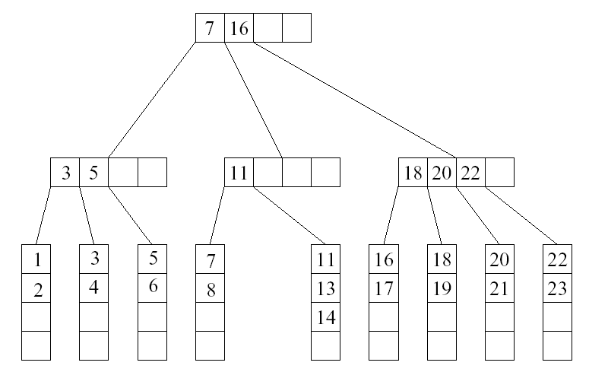
…Continue From Previous Example
case 2
u
v

Slide 47
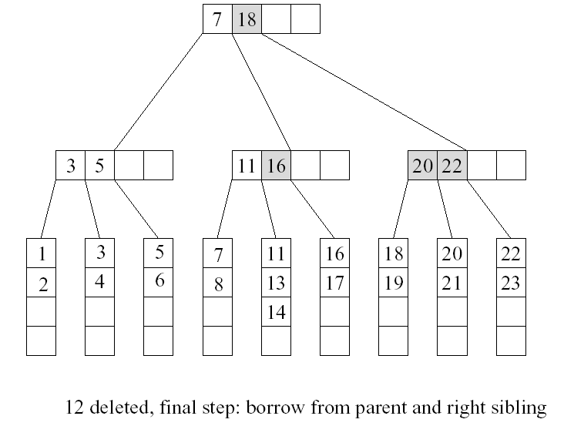
Cont’d

Slide 48
Deleting a key in an internal node
Case 3: all sibling v of u contains exactly ⎡M/2⎤ - 1 keys
  Move the separating key between u and v in the parent of u and v down to u
  Move the keys and child pointers in u to v
  Remove the pointer to u at parent.

Slide 49
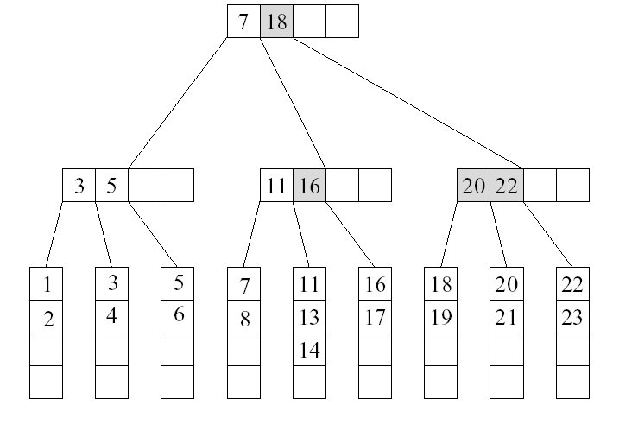
Example
Want to delete 5

Slide 50
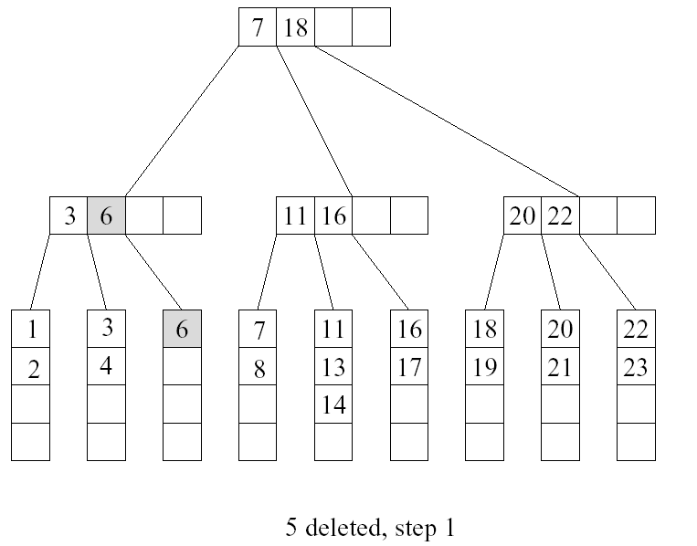
Cont’d
u
v

Slide 51
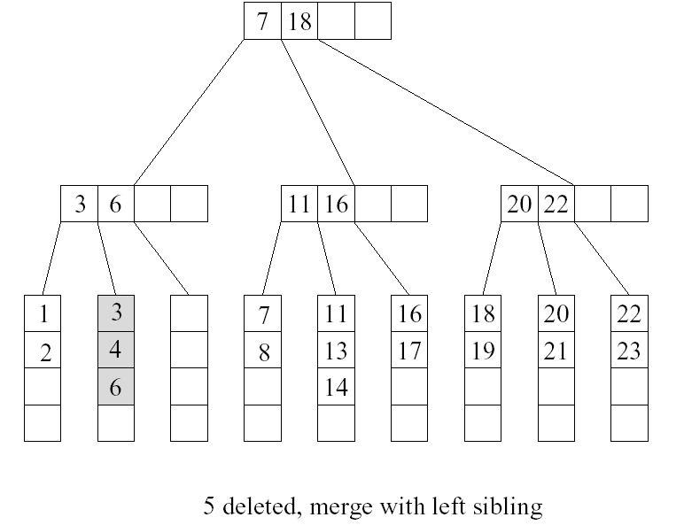
Cont’d

Slide 52
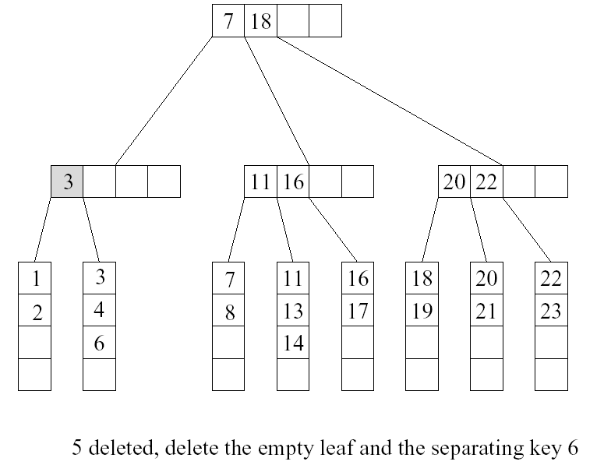
Cont’d
case 3
u
v

Slide 53
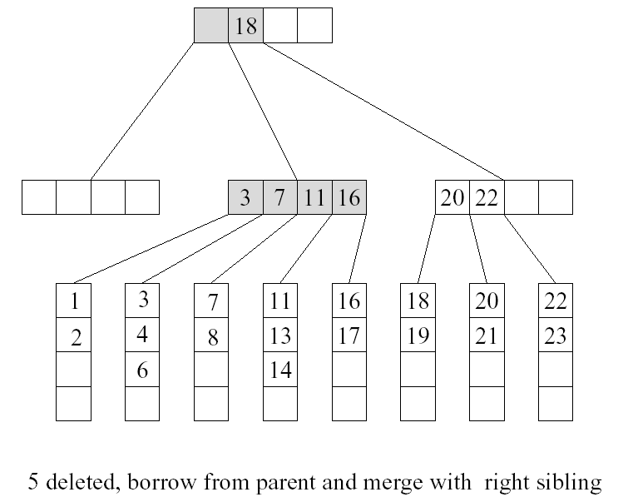
Cont’d

Slide 54
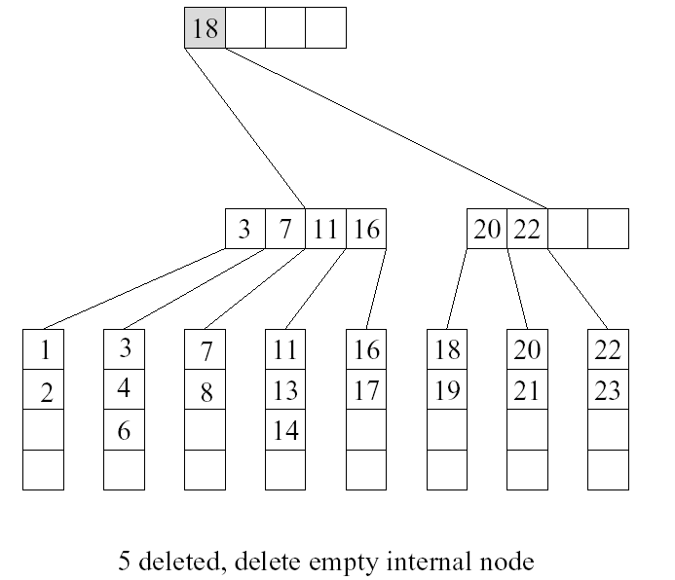
Cont’d

Slide 55
B-trees of order m (from Knuth)
Every node has at mot m children.
Every node, except for the root and the leaves, has at least m/2 children.
The root has at least 2 children (unless it is a leaf).
All leaves appear on the same level, and carry no information.
A nonleaf node with k children contains k-1 keys.

Slide 56
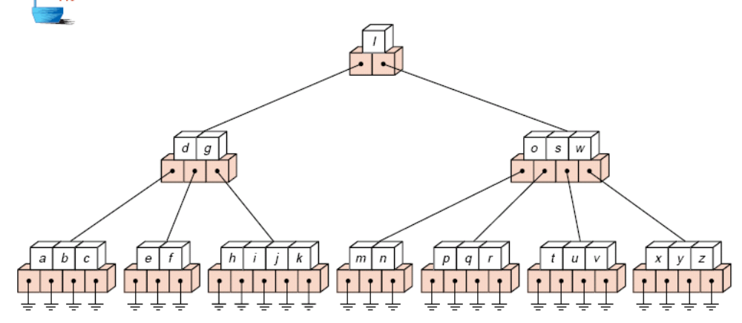
A B-tree of order 5

Slide 57
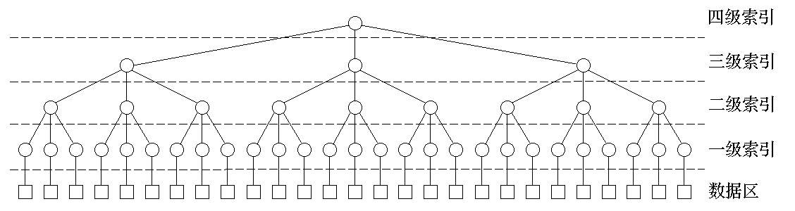
Index Structures

Slide 58
B⁺ -Tree in Practical Usage
Each internal node/leaf is designed to fit into one I/O block of data. An I/O block usually can hold quite a lot of data. Hence, an internal node can keep a lot of keys, i.e., large M. This implies that the tree has only a few levels and only a few disk accesses can accomplish a search, insertion, or deletion.
B⁺-tree is a popular structure used in commercial databases. To further speed up the search, the first one or two levels of the B⁺-tree are usually kept in main memory.
The disadvantage of B⁺-tree is that most nodes will have less than M-1 keys most of the time. This could lead to severe space wastage. Thus, it is not a good dictionary structure for data in main memory.
The textbook calls the tree B-tree instead of B⁺-tree. In some other textbooks, B-tree refers to the variant where the actual records are kept at internal nodes as well as the leaves. Such a scheme is not practical. Keeping actual records at the internal nodes will limit the number of keys stored there, and thus increasing the number of tree levels.

Slide 59
Summary
B⁺-Trees are balanced M-way search trees;
To make a B⁺-tree balanced, a node is required half-full;
A B⁺-tree of order M(L=M) has height h ≤ log _{⎡M / 2⎤} ( N / M ) +1
For M=128, h <=3. Searching never needs more than 3 disk accesses for N=1000,000.
Inserting a key may split a node and deletion may need to merge two nodes.

