Slide 1
高性能计算程序设计基础
任课教师：
卢宇彤（Lu, Yutong）
黄聃（Huang，Dan）

Slide 2
Roadmap
# Chapter Subtitle
Why we need ever-increasing performance.
Why we’re building parallel systems.
Why we need to write parallel programs.
How do we write parallel programs?
What we’ll be doing.
Concurrent, parallel, distributed!

Slide 3
Changing times
From 1986 – 2002, microprocessors were speeding like a rocket, increasing in performance an average of 50% per year.
Since then, it’s dropped to about 20% increase per year.

Slide 4
An intelligent solution
Instead of designing and building faster microprocessors, put multiple processors on a single integrated circuit.

Slide 5
Now it’s up to the programmers
Adding more processors doesn’t help much if programmers aren’t aware of them…
… or don’t know how to use them.
Serial programs don’t benefit from this approach (in most cases).

Slide 6
Why we need ever-increasing performance
Computational power is increasing, but so are our computation problems and needs.
Problems we never dreamed of have been solved because of past increases, such as decoding the human genome.
More complex problems are still waiting to be solved.

Slide 7

Climate modeling

Slide 8
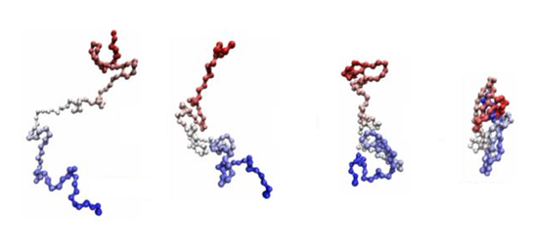
Protein folding

Slide 9


Drug discovery

Slide 10


Energy research

Slide 11



Data analysis

Slide 12
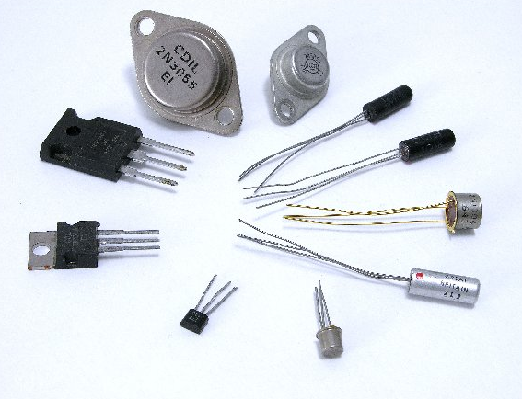
Why we’re building parallel systems
Up to now, performance increases have been attributable to increasing density of transistors.
But there are inherent problems.

Slide 13
A little physics lesson
Smaller transistors = faster processors.
Faster processors = increased power consumption.
Increased power consumption = increased heat.
Increased heat = unreliable processors.

Slide 14
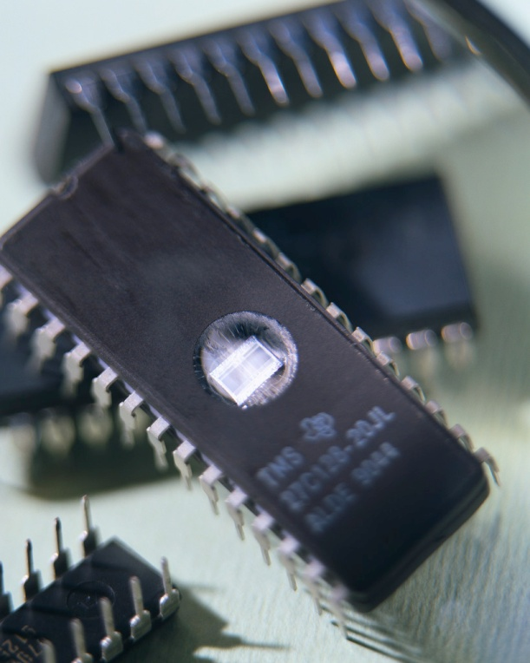
Solution
Move away from single-core systems to multicore processors.
“core” = central processing unit (CPU)
Introducing parallelism!!!

Slide 15

Why we need to write parallel programs
Running multiple instances of a serial program often isn’t very useful.
Think of running multiple instances of your favorite game.
What you really want is for it to run faster.

Slide 16
Approaches to the serial problem
Rewrite serial programs so that they’re parallel.
Write translation programs that automatically convert serial programs into parallel programs.
This is very difficult to do.
Success has been limited.

Slide 17
More problems
Some coding constructs can be recognized by an automatic program generator, and converted to a parallel construct.
However, it’s likely that the result will be a very inefficient program.
Sometimes the best parallel solution is to step back and devise an entirely new algorithm.

Slide 18
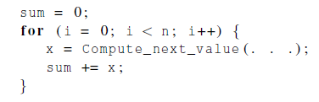
Example
Compute n values and add them together.
Serial solution:

Slide 19
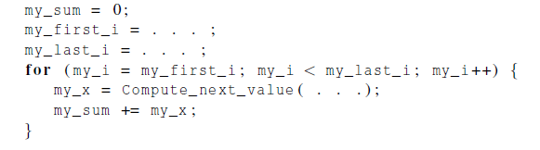
Example (cont.)
We have p cores, p much smaller than n.
Each core performs a partial sum of approximately n/p values.
Each core uses it’s own private variables
and executes this block of code independently of the other cores.

Slide 20
Example (cont.)
After each core completes execution of the code, is a private variable my_sum contains the sum of the values computed by its calls to Compute_next_value.
Ex., 8 cores, n = 24, then the calls to Compute_next_value return:
1,4,3, 9,2,8, 5,1,1, 5,2,7, 2,5,0, 4,1,8, 6,5,1, 2,3,9

Slide 21
Example (cont.)
Once all the cores are done computing their private my_sum, they form a global sum by sending results to a designated “master” core which adds the final result.

Slide 22
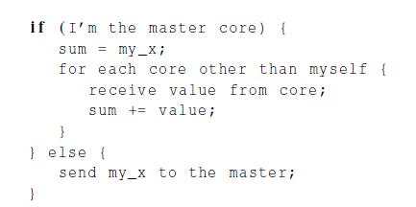
Example (cont.)

Slide 23
Example (cont.)
Core | 0 | 1 | 2 | 3 | 4 | 5 | 6 | 7
my_sum | 8 | 19 | 7 | 15 | 7 | 13 | 12 | 14
Global sum
8 + 19 + 7 + 15 + 7 + 13 + 12 + 14 = 95
Core | 0 | 1 | 2 | 3 | 4 | 5 | 6 | 7
my_sum | 95 | 19 | 7 | 15 | 7 | 13 | 12 | 14

Slide 24

But wait!
There’s a much better way to compute the global sum.

Slide 25
Better parallel algorithm
Don’t make the master core do all the work.
Share it among the other cores.
Pair the cores so that core 0 adds its result with core 1’s result.
Core 2 adds its result with core 3’s result, etc.
Work with odd and even numbered pairs of cores.

Slide 26
Better parallel algorithm (cont.)
Repeat the process now with only the evenly ranked cores.
Core 0 adds result from core 2.
Core 4 adds the result from core 6, etc.
Now cores divisible by 4 repeat the process, and so forth, until core 0 has the final result.

Slide 27
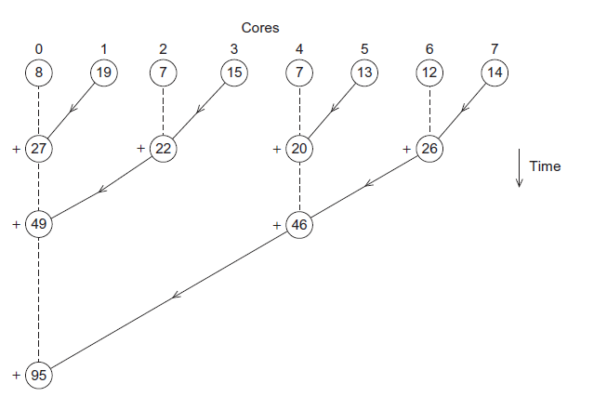
Multiple cores forming a global sum

Slide 28
Analysis
In the first example, the master core performs 7 receives and 7 additions.
In the second example, the master core performs 3 receives and 3 additions.
The improvement is more than a factor of 2!

Slide 29
Analysis (cont.)
The difference is more dramatic with a larger number of cores.
If we have 1000 cores:
The first example would require the master to perform 999 receives and 999 additions.
The second example would only require 10 receives and 10 additions.
That’s an improvement of almost a factor of 100!

Slide 30
How do we write parallel programs?
Task parallelism
Partition various tasks carried out solving the problem among the cores.
Data parallelism
Partition the data used in solving the problem among the cores.
Each core carries out similar operations on it’s part of the data.

Slide 31

Professor P
15 questions
300 exams

Slide 32

Professor P’s grading assistants
TA#1
TA#2
TA#3

Slide 33
Division of work – data parallelism
TA#1
TA#3
100 exams
100 exams
TA#2
100 exams

Slide 34
Division of work – task parallelism
TA#1
TA#3
Questions 11 - 15
Questions 1 - 5
TA#2
Questions 6 - 10

Slide 35
Division of work – data parallelism

Slide 36
Division of work – task parallelism
Tasks
Receiving
Addition
Sending

Slide 37
Coordination and enhancement
Cores usually need to coordinate their work.
Communication – one or more cores send their current partial sums to another core.
Load balancing – share the work evenly among the cores so that one is not heavily loaded.
Synchronization – because each core works at its own pace, make sure cores do not get too far ahead of the rest.

Slide 38
What we’ll be doing
Learning to write programs that are explicitly parallel.
Using the C language.
Using three different extensions to C.
Message-Passing Interface (MPI)
Posix Threads (Pthreads)
OpenMP

Slide 39
Type of parallel systems
Shared-memory
The cores can share access to the computer’s memory.
Coordinate the cores by having them examine and update shared memory locations.
Distributed-memory
Each core has its own, private memory.
The cores must communicate explicitly by sending messages across a network.

Slide 40
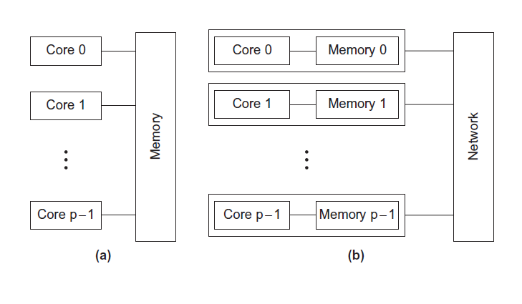
Type of parallel systems
Shared-memory
Distributed-memory

Slide 41
Terminology
Concurrent computing – a program is one in which multiple tasks can be in progress at any instant.
E.g. E-business website
Parallel computing – a program is one in which multiple tasks cooperate closely to solve a problem
Parallel matrix multiplication solver
Distributed computing – a program may need to cooperate with other programs to solve a problem.

Slide 42
Concluding Remarks (1)
The laws of physics have brought us to the doorstep of multicore technology.
Serial programs typically don’t benefit from multiple cores.
Automatic parallel program generation from serial program code isn’t the most efficient approach to get high performance from multicore computers.

Slide 43
Concluding Remarks (2)
Learning to write parallel programs involves learning how to coordinate the cores.
Parallel programs are usually very complex and therefore, require sound program techniques and development.

