Slide 1
高性能计算程序设计基础
任课教师：黄聃（Huang，Dan）

Slide 2
Roadmap
Problems programming shared memory systems.
Controlling access to a critical section.
Thread synchronization.
Programming with POSIX threads.
Mutexes.
Producer-consumer synchronization and semaphores.
Barriers and condition variables.
Read-write locks.
Thread safety.

Slide 3
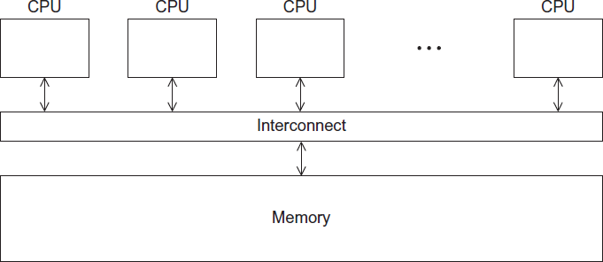
A Shared Memory System

Slide 4
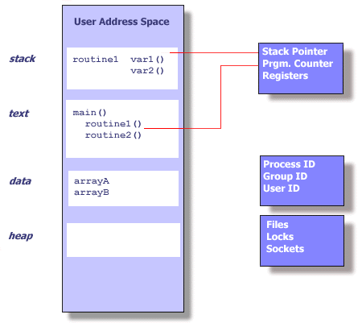
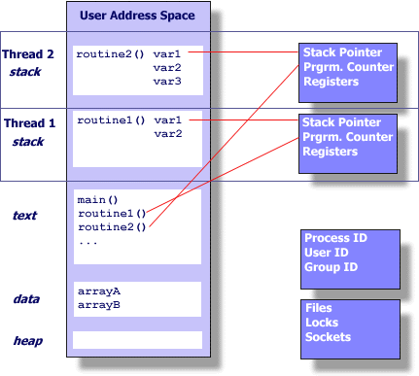
Processes and Threads
A process is an instance of a running (or suspended) program.
Threads are analogous to a “light-weight” process.
In a shared memory program, a single process may have multiple threads of control.

Slide 5
POSIX® Threads
Portable Operating System Interface (POSIX)
Also known as Pthreads.
A standard for Unix-like operating systems.
A library that can be linked with C programs.
Specifies an application programming interface (API) for multi-threaded programming.
https://computing.llnl.gov/tutorials/pthreads/

Slide 6
Lightweight Pthread vs Fork()
Platform | fork() |  |  | pthread_create()
 | real | user | sys | real | user | sys
Intel 2.6 GHz Xeon E5-2670 (16 cores/node) | 8.1 | 0.1 | 2.9 | 0.9 | 0.2 | 0.3
Intel 2.8 GHz Xeon 5660 (12 cores/node) | 4.4 | 0.4 | 4.3 | 0.7 | 0.2 | 0.5
AMD 2.3 GHz Opteron (16 cores/node) | 12.5 | 1.0 | 12.5 | 1.2 | 0.2 | 1.3
AMD 2.4 GHz Opteron (8 cores/node) | 17.6 | 2.2 | 15.7 | 1.4 | 0.3 | 1.3
IBM 4.0 GHz POWER6 (8 cpus/node) | 9.5 | 0.6 | 8.8 | 1.6 | 0.1 | 0.4
IBM 1.9 GHz POWER5 p5-575 (8 cpus/node) | 64.2 | 30.7 | 27.6 | 1.7 | 0.6 | 1.1
IBM 1.5 GHz POWER4 (8 cpus/node) | 104.5 | 48.6 | 47.2 | 2.1 | 1.0 | 1.5
INTEL 2.4 GHz Xeon (2 cpus/node) | 54.9 | 1.5 | 20.8 | 1.6 | 0.7 | 0.9
INTEL 1.4 GHz Itanium2 (4 cpus/node) | 54.5 | 1.1 | 22.2 | 2.0 | 1.2 | 0.6

Slide 7
Lightweight Pthread vs Fork()
pthread_create()
Purpose is to create a new thread in the program which is given the same process of the caller
Threads within the same process can communicate using shared memory. Zero copy compared to MPI
Thread will share data, open files, signal handlers and signal dispositions, current working directory, user and group ID's. The new thread will get its own stack, thread ID, and registers though.
fork()
Purpose is to create a new process, which becomes the child process of the caller
Both processes will execute the next instruction following the fork() system call
Two identical copies of the computer's address space, code, and stack are created one for parent and child.
Thinking of the fork as it was a person; Forking causes a clone of your program (process), that is running the code it copied.

Slide 8
Pthread vs MPI
Platform | MPI Shared Memory Bandwidth (GB/sec) | Pthreads Worst Case Memory-to-CPU Bandwidth (GB/sec)
Intel 2.6 GHz Xeon E5-2670 | 4.5 | 51.2
Intel 2.8 GHz Xeon 5660 | 5.6 | 32
AMD 2.3 GHz Opteron | 1.8 | 5.3
AMD 2.4 GHz Opteron | 1.2 | 5.3
IBM 1.9 GHz POWER5 p5-575 | 4.1 | 16
IBM 1.5 GHz POWER4 | 2.1 | 4
Intel 2.4 GHz Xeon | 0.3 | 4.3
Intel 1.4 GHz Itanium 2 | 1.8 | 6.4

Slide 9

Caveat （注意）
The Pthreads API is only available on POSIXR systems — Linux, MacOS X, Solaris, HPUX, …

Slide 10
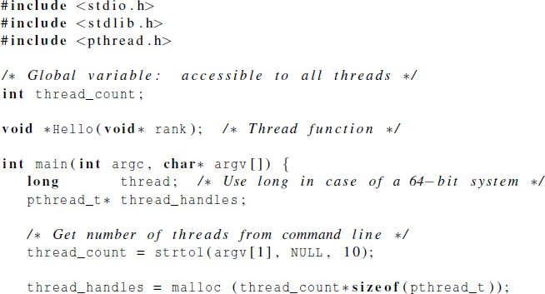
Hello World! (1)
declares the various Pthreads
functions, constants, types, etc.
https://pubs.opengroup.org/onlinepubs/7908799/xsh/pthread.h.html

Slide 11
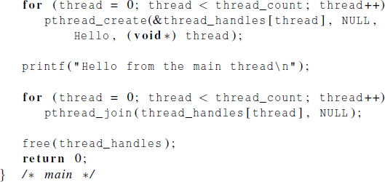
Hello World! (2)

Slide 12
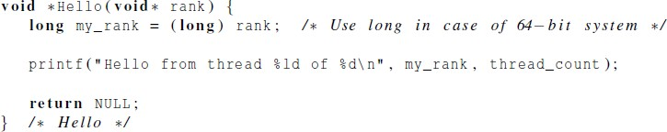
Hello World! (3)

Slide 13
Compiling a Pthread program
gcc −g −Wall −o pth_hello pth_hello . c −lpthread
link in the Pthreads library

Slide 14
Running a Pthreads program
. /pth_hello <number of threads>
. /pth_hello 1
Hello from the main thread Hello from thread 0 of 1
. /pth_hello 4
Hello from the main thread Hello from thread 0 of 4
Hello from thread 1 of 4
Hello from thread 2 of 4
Hello from thread 3 of 4

Slide 15

Global variables
Can introduce subtle and confusing bugs!
Limit use of global variables to situations in which they’re really needed.
Shared variables.

Slide 16
Starting the Threads
Processes in MPI are usually started by a script.
In Pthreads the threads are started by the program executable.

Slide 17
Starting the Threads
pthread.h
One object for each thread.
pthread_t
int pthread_create (
pthread_t* thread_p
const pthread_attr_t* attr_p
/* out */ ,
/* in */ ,
void* | (*start_routine ) ( void ) | /* in */ ,
void* | arg_p | /* in */ ) ;

Slide 18
pthread_t objects
Opaque
The actual data that they store is system-specific.
Their data members aren’t directly accessible to user code.
However, the Pthreads standard guarantees that a pthread_t object does store enough information
to uniquely identify the thread with which it’s associated.
https://man7.org/linux/man-pages/man7/pthreads.7.html

Slide 19
A closer look (1)
int pthread_create (
pthread_t* thread_p /* out */ ,
const pthread_attr_t* attr_p /* in */ , void* (*start_routine ) ( void ) /* in */ , void* arg_p /* in */ ) ;
We won’t be using, so we just pass NULL.
https://man7.org/linux/man-pages/man3/pthread_create.3.html
https://man7.org/linux/man-pages/man3/pthread_attr_init.3.html
Allocate before calling.

Slide 20
A closer look (2)
int pthread_create (
pthread_t* thread_p /* out */ ,
const pthread_attr_t* attr_p /* in */ , void* (*start_routine ) ( void ) /* in */ , void* arg_p /* in */ ) ;
Pointer to the argument that should
be passed to the function start_routine.
The function that the thread is to run.

Slide 21
Function started by pthread_create
Prototype:
void* thread_function ( void* args_p ) ;
Void* can be cast to any pointer type in C.
So args_p can point to a list containing one or more values needed by thread_function.
Similarly, the return value of thread_function can point to a list of one or more values.

Slide 22
Pointer to a function
Unlike normal pointers, a function pointer points to code, not data. Typically a function pointer stores the start of executable code.
Not allocate de-allocate memory using function pointers.
A function’s name can also be used to get functions’ address.
#include <stdio.h>
typedef void (* proto_1)();
typedef void proto_2();
void my_function(int j){
printf("hello from function. I got %d.\n",j);
}
void call_arg_1(proto_1 arg){
arg(5);
}
void call_arg_2(proto_2 arg){
arg(5);
}
void main(){
call_arg_1(&my_function);
call_arg_1(my_function);
call_arg_2(&my_function);
call_arg_2(my_function);
printf("%d\n", my_function);
printf("%d\n", *my_function);
printf("%d\n", &my_function);
}
hello from function. I got 5.
hello from function. I got 5.
hello from function. I got 5.
hello from function. I got 5.
-1067448758
-1067448758
-1067448758

Slide 23
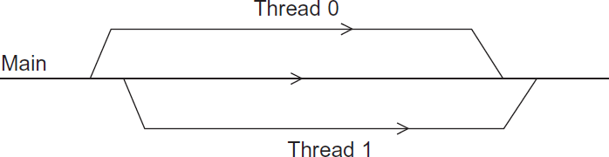
Running the Threads
Main thread forks and joins two threads.

Slide 24
Stopping the Threads
We call the function pthread_join once for each thread.
A single call to pthread_join will wait for the thread associated with the pthread_t object to complete.
If that thread has already terminated, then pthread_join() returns immediately.
int pthread_join(pthread_t thread, void **retval);
https://man7.org/linux/man-pages/man3/pthread_join.3.html

Slide 25
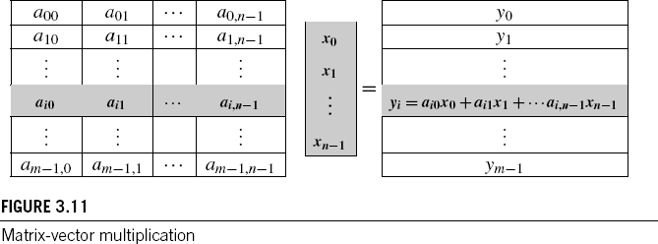
Matrix-Vector Multiplication in pthreads

Slide 26
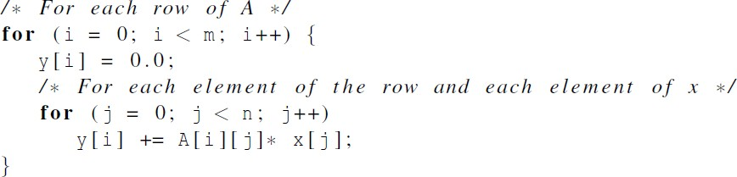

Serial pseudo-code

Slide 27
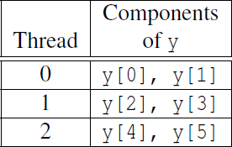


Using 3 Pthreads
thread 0
general case

Slide 28
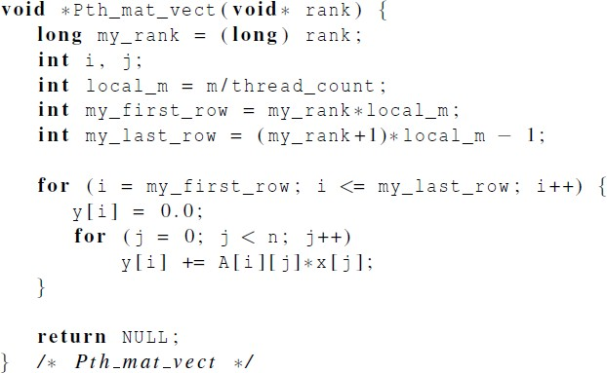
Pthreads matrix-vector multiplication

Slide 29

Critical sections

Slide 30

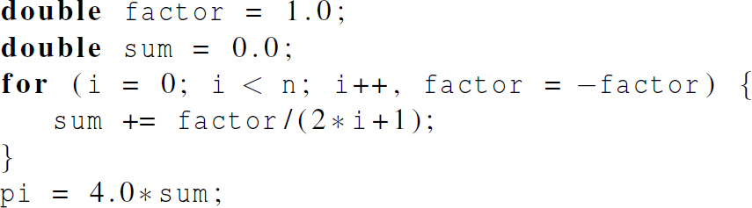
Estimating π

Slide 31
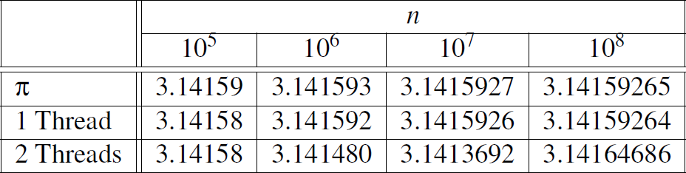
Using a dual core processor
Note that as we increase n, the estimate with one thread gets better and better.

Slide 32
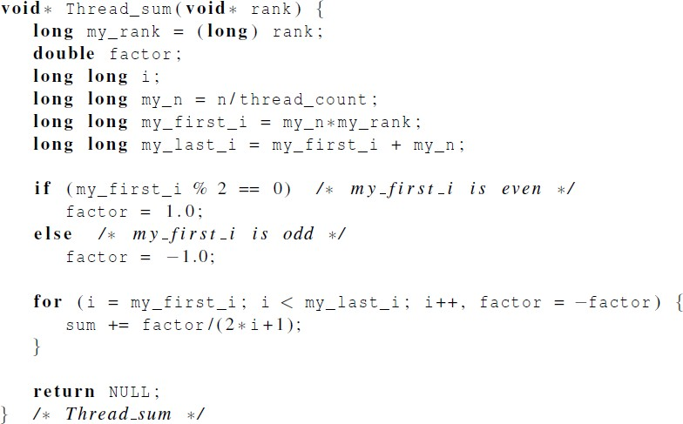
A thread function for computing π
Critical section
Critical section

Slide 33
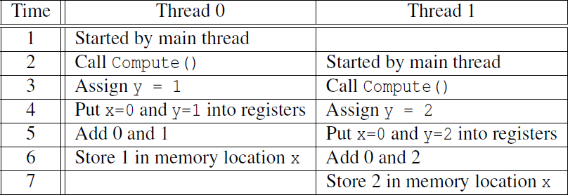

Possible race condition
y= compute() x=x+y
x=1+2 (expected) x=2?

Slide 34
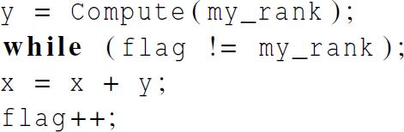
Busy-Waiting
A thread repeatedly tests a condition, but, effectively, does no useful work until the condition has the appropriate value.
Beware of optimizing compilers, though!
“volatile” key word in C.
flag initialized to 0 by main thread

Slide 35
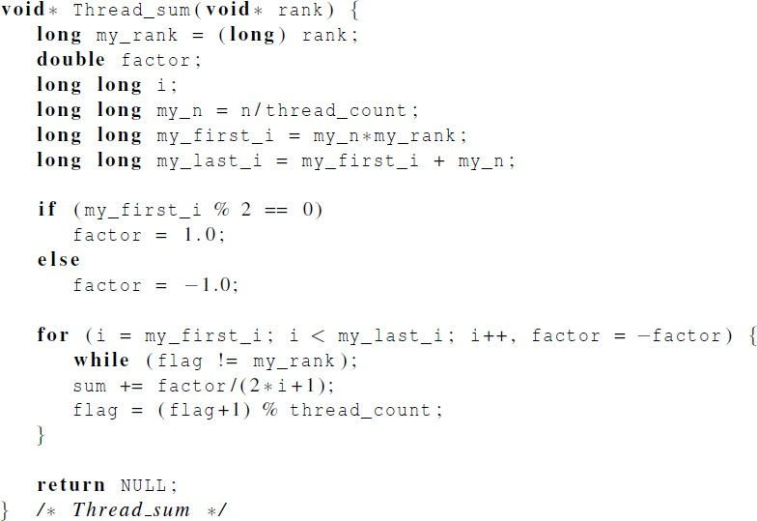
Pthreads global sum with busy-waiting

Slide 36
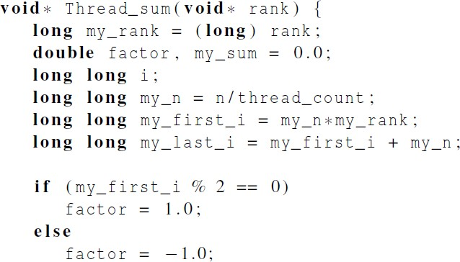
Global sum function with critical section after loop (1)

Slide 37
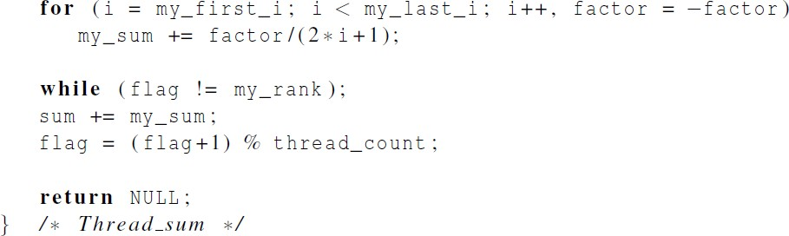
Global sum function with critical section after loop (2)

Slide 38
Mutexes
A thread that is busy-waiting may continually use the CPU accomplishing nothing.
Mutex (mutual exclusion) is a special type of variable that can be used to restrict access to a critical section to a single thread at a time.

Slide 39

Mutexes
Used to guarantee that one thread “excludes” all other threads while it executes the critical section.
The Pthreads standard includes a special type for mutexes: pthread_mutex_t.
https://pubs.opengroup.org/onlinepubs/007908799/xsh/pthread_mutex_init.html

Slide 40
Mutexes
In order to gain access to a critical section a thread calls
When a thread is finished executing the code in a critical section, it should call

Slide 41
Mutexes
When a Pthreads program finishes using a mutex, it should call

Slide 42
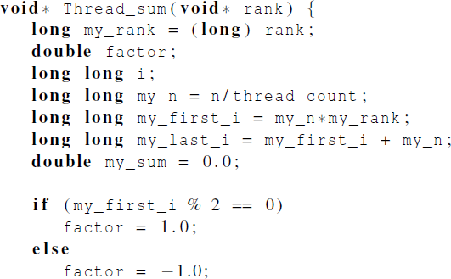
Global sum function that uses a mutex (1)

Slide 43
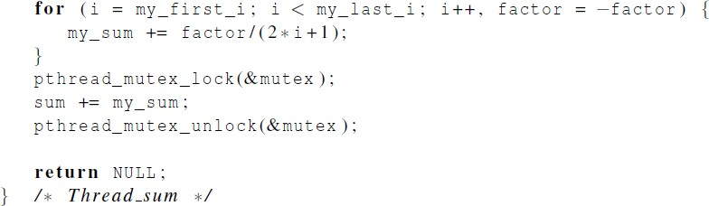
Global sum function that uses a mutex (2)

Slide 44
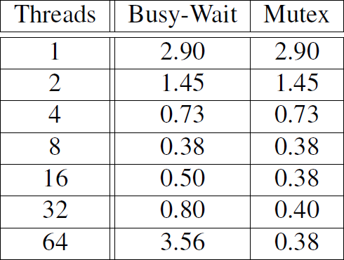

程序4-5
程序4-6
# of threads > # of cores
Run-times (in seconds) of π programs using n = 10⁸ terms on a system with two four-core processors.

Slide 45
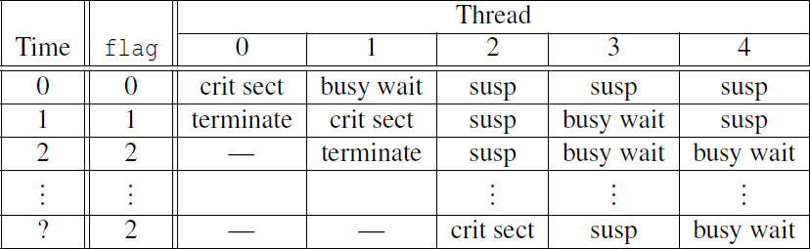
5 threads
2 cores
http://pages.cs.wisc.edu/~remzi/OSTEP/
Possible sequence of events with busy-waiting and more threads than cores.

Slide 46
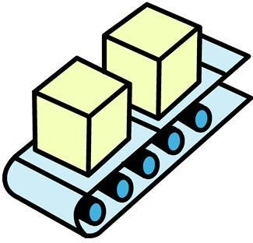
Producer-Consumer Synchronization and Semaphores

Slide 47
Issues
Busy-waiting enforces the order threads access a critical section.
Using mutexes, the order is left to chance and the system.
There are applications where we need to control the order threads access the critical section.

Slide 48
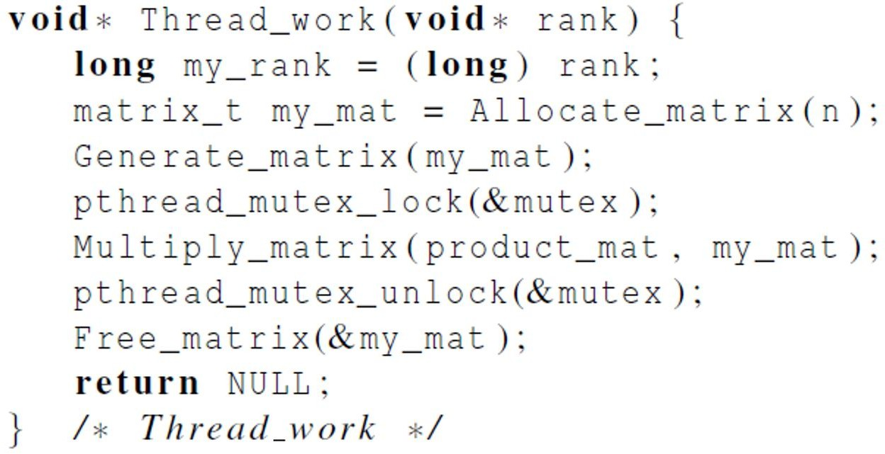
Problems with a mutex solution
Problem: matrix multiplication is not commutative
For example, A * B * C ≠ C * B * A

Slide 49
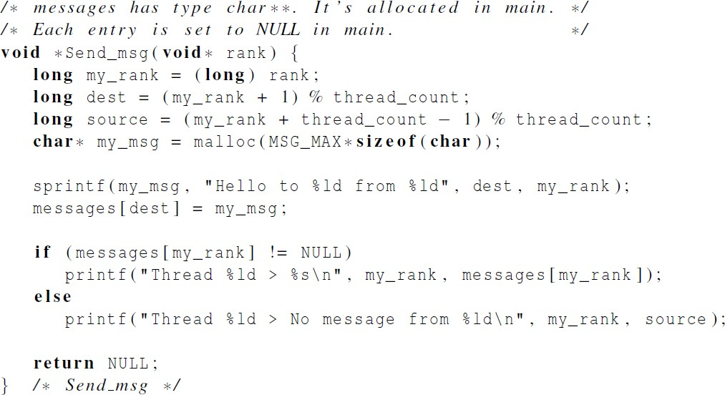
A first attempt at sending messages using pthreads
Problem: If running 2+ threads on a dual-core
system, some of the messages are never received.

Slide 50
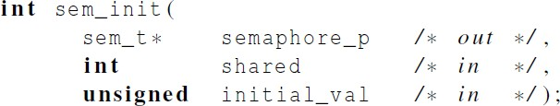

Syntax of the various semaphore functions
Semaphores are not part of Pthreads;
you need to add this.
https://www.man7.org/linux/man-pages/man3/sem_init.3.html

Slide 51
Using Semaphores to send msgs
/* semaphores are initialized to 0 (locked) */
void* Send_msg(void* rank) {
long my_rank = (long) rank;
long dest = (my_rank + 1) % thread_count;
char* my_msg = malloc(MSG_MAX*sizeof(char));
sprintf(my_msg, "Hello to %ld from %ld", dest, my_rank); messages[dest] = my_msg;
sem_post(&semaphores[dest]); /*unlock the semaphore of dest*/
/*wait for our semaphore to be unlocked*/ sem_wait(&semaphores[my_rank]);
printf("Thread %ld > %s\n", my_rank, messages[my_rank]); return NULL;
}
47

Slide 52

Barriers and Condition Variables

Slide 53
Barriers
Synchronizing the threads to make sure that they all are at the same point in a program is called a barrier.
No thread can cross the barrier until all the threads have reached it.

Slide 54
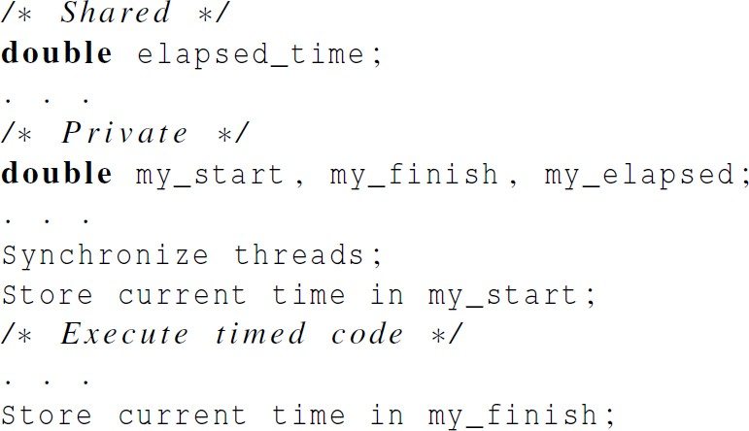
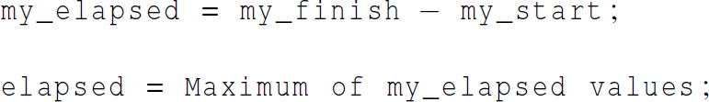
Using barriers to time the slowest thread

Slide 55
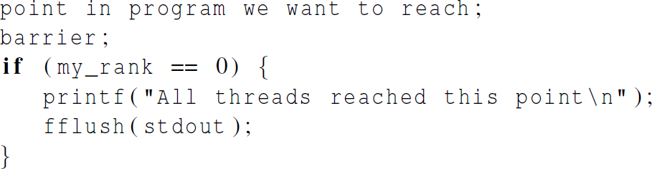

Using barriers for debugging

Slide 56
Busy-waiting and a Mutex
Implementing a barrier using busy-waiting and a mutex is straightforward.
We use a shared counter protected by the mutex.
When the counter indicates that every thread has entered the critical section, threads can leave the critical section.

Slide 57
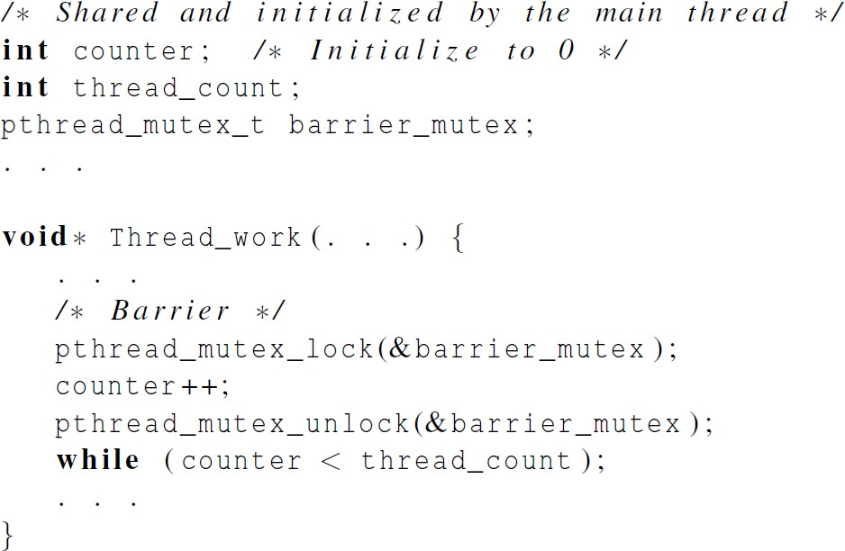
Busy-waiting and a Mutex
We need one counter variable for each instance of
the barrier, otherwise problems are likely to occur.

Slide 58
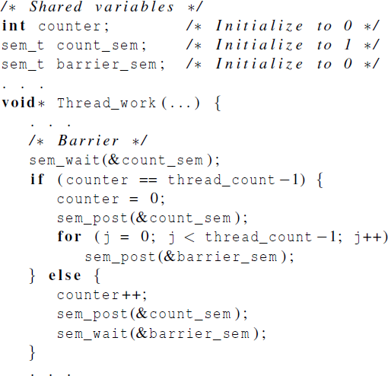
Implementing a barrier with semaphores

Slide 59
Condition Variables
A condition variable is a data object that allows a thread to suspend execution until a certain event or condition occurs.
When the event or condition occurs another thread can signal the thread to “wake up.”
A condition variable is always associated with a mutex.

Slide 60
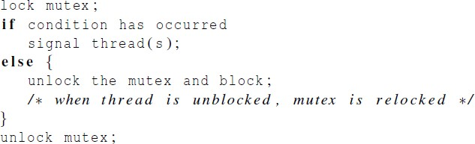
Condition Variables

Slide 61
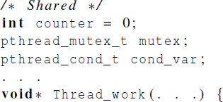
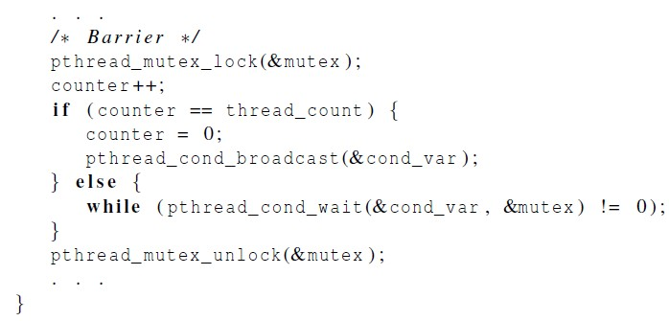
Implementing a barrier with condition variables
pthread_mutex_unlock(&mutex); wait_on_signal(&cond_var); pthread_mutex_lock(&mutex)

Slide 62

Read-Write Locks

Slide 63
Controlling access to a large, shared data structure
Let’s look at an example.
Suppose the shared data structure is a sorted linked list of ints, and the operations of interest are Member, Insert, and Delete.

Slide 64

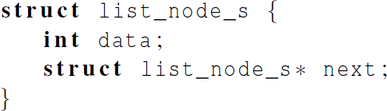
Linked Lists

Slide 65
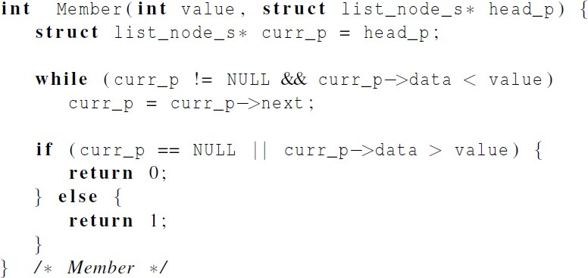
Linked List Membership

Slide 66
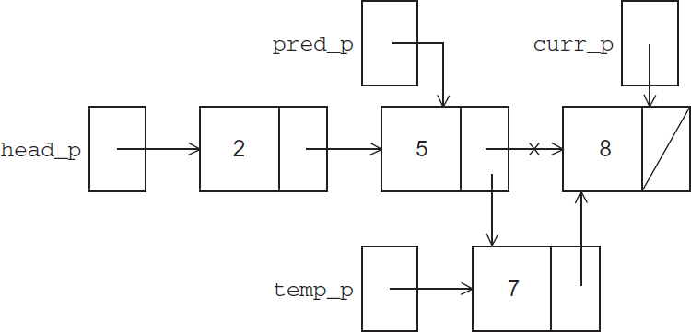
Inserting a new node into a list

Slide 67
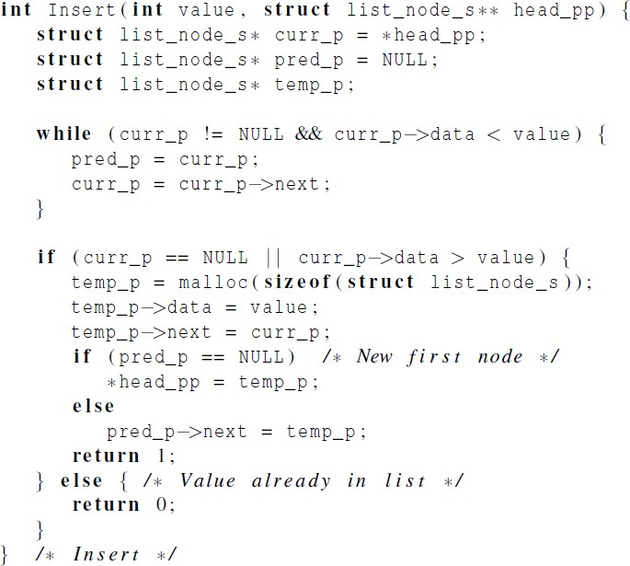
Inserting a new node into a list

Slide 68
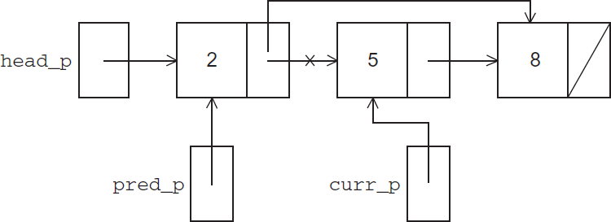
Deleting a node from a linked list

Slide 69
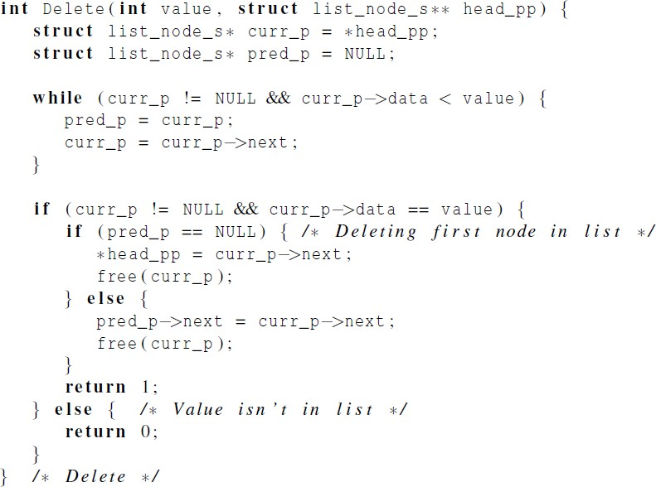
Deleting a node from a linked list

Slide 70
A Multi-Threaded Linked List
Let’s try to use these functions in a Pthreads program.
In order to share access to the list, we can define head_p to be a global variable.
This will simplify the function headers for Member, Insert, and Delete
since we won’t need to pass in either head_p or a pointer to head_p
we’ll only need to pass in the value of interest.

Slide 71
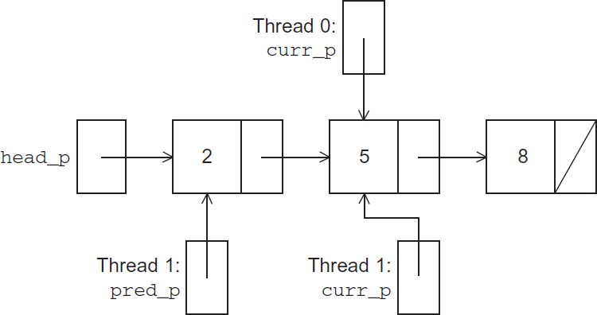
Simultaneous access by two threads
Thread0: Member(5)
Thread1: Delete(5)
Problem: Element 5 may be deleted even before thread 0 returns.

Slide 72
Simultaneous access by two threads
Thread0: Member(8)
Thread1: Delete(5)
Problem: thread1 may free the memory used for the node storing 5 before thread0 can advance to the node storing 8.
Or segment fault error.

Slide 73
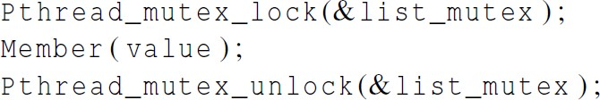
Solution #1
An obvious solution is to simply lock the list any time that a thread attempts to access it.
A call to each of the three functions (Member, Insert and Delete) can be protected by a mutex.
In place of calling Member(value).
73

Slide 74
Issues
We’re serializing access to the list.
If the vast majority of our operations are calls to Member, we’ll fail to exploit this opportunity for parallelism.
On the other hand, if most of our operations are calls to Insert and Delete, then this may be the best solution
since we’ll need to serialize access to the list for most of the operations, and this solution will certainly be easy to implement.
74

Slide 75
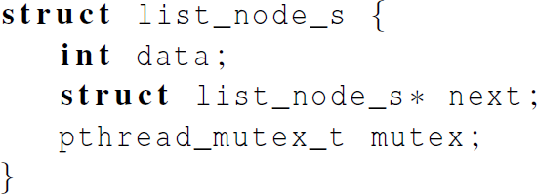
Solution #2
Instead of locking the entire list, we could try to lock individual nodes.
A “finer-grained” approach.
75

Slide 76
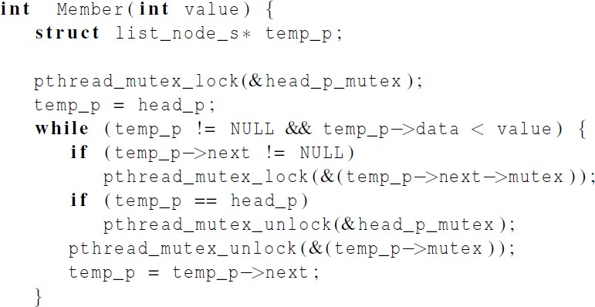
Implementation of Member with one mutex per list node (1)
temp_p
76

Slide 77
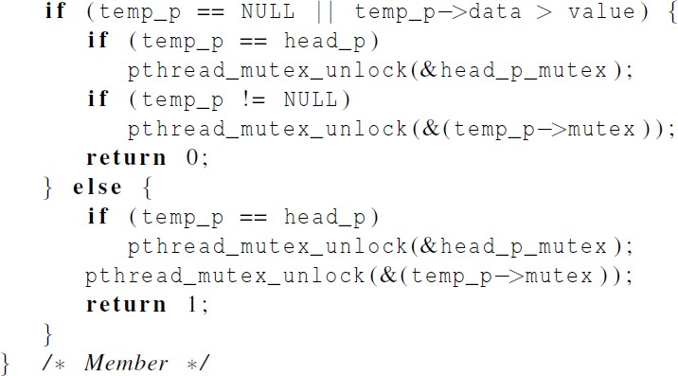
Implementation of Member with one mutex per list node (2)
77

Slide 78
Issues
This is much more complex than the original Member function.
It is also much slower, since, in general, each time a node is accessed, a mutex must be locked and unlocked.
The addition of a mutex field to each node will substantially increase the amount of storage needed for the list.
78

Slide 79
Pthreads Read-Write Locks
Neither of our multi-threaded linked lists exploits the potential for simultaneous access to any node by threads that are executing Member.
The first solution only allows one thread to access the entire list at any instant.
The second only allows one thread to access any given node at any instant.
79

Slide 80
Pthreads Read-Write Locks
A read-write lock is somewhat like a mutex except that it provides two lock functions.
The first lock function locks the read-write lock for reading, while the second locks it for writing.
80

Slide 81
Pthreads Read-Write Locks
So multiple threads can simultaneously obtain the lock by calling the read-lock function, while only one thread can obtain the lock by calling the write- lock function.
Thus, if any threads own the lock for reading, any threads that want to obtain the lock for writing will block in the call to the write-lock function.
81

Slide 82

Pthreads Read-Write Locks
If any thread owns the lock for writing, any threads that want to obtain the lock for reading or writing will block in their respective locking functions.
82

Slide 83
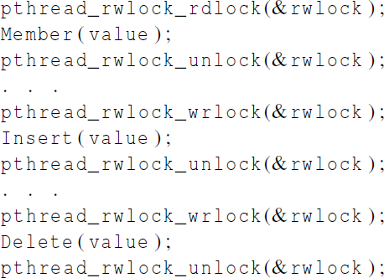
Protecting our linked list functions
83

Slide 84
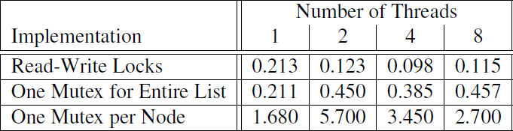
Linked List Performance
100,000 ops/thread
99.9% Member
0.05% Insert
0.05% Delete
If there is very few Inserts/Deletes, the RW locks do a very good job of allowing concurrent access to the list.
84

Slide 85
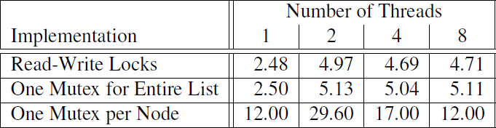
Linked List Performance
100,000 ops/thread
80% Member
10% Insert
10% Delete
If there are a relatively large # of Inserts/Deletes, there is very little difference between RW lock and single mutex.
85

Slide 86
Caches, Cache-Coherence, and False Sharing
Recall that chip designers have added blocks of relatively fast memory to processors called cache memory.
The use of cache memory can have a huge impact on shared-memory.
A write-miss occurs when a core tries to update a variable that’s not in cache, and it has to access main memory.
86

Slide 87
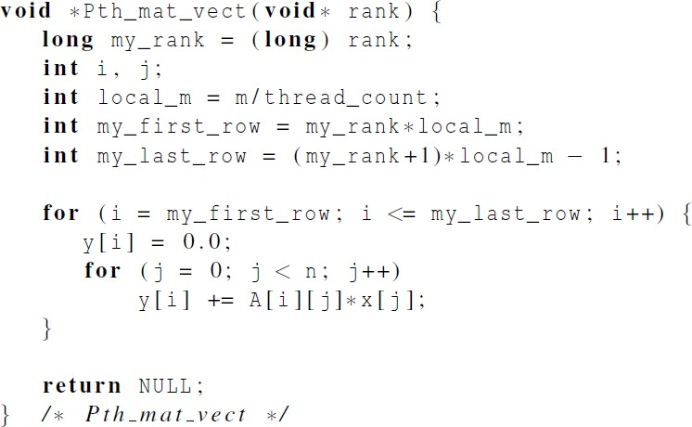
Pthreads matrix-vector multiplication
87

Slide 88

Run-times and efficiencies of matrix-vector multiplication
(times are in seconds)
64M addition/multiplication operations in total
With 1 thread, 8M*8 requires 14% more time than 8K*8K, and 8*8M requires 28% more time than 8K*8K.
The above differences are partially attributed to cache performance.
Efficiency of multi-thread version is even worse for 8M*8 and 8*8M.
88

Slide 89
Cache coherence in Matrix-vector multiplication
CPU0
CPU1
CPU2
CPU3
L1
Cache line 64 Bytes,
store 8 doubles
x
for (…. )
y[i] += A[i][j] * x[j];
Cache coherence
A
=
y
for ( ….)
tmp += A[i][j] * x[j];
y[i] = tmp
8 x 8,000,000
8 x 1

Slide 90
Cache coherence in Matrix-vector multiplication
CPU0
CPU1
CPU2
CPU3
L1
0-7
200000-2000007
400000-4000007
600000-6000007
Cache line 64 Bytes,
store 8 doubles
A
y
Thread 0, [0, 2 000 000)
for (…. )
y[i] += A[i][j] * x[j];
x
Thread 1, [2 000 000, 4 000 000)
=
Thread 2, [4 000 000, 6 000 000)
No cache coherence
Thread 3, [6 000 000, 8 000 000)
8,000,000 x 8
8,000,000 x 1

Slide 91

Thread-Safety
91

Slide 92

Thread-Safety
A block of code is thread-safe if it can be simultaneously executed by multiple threads without causing problems.
92

Slide 93

Example
The tokens are just contiguous sequences of characters separated from the rest of the text by white-space — a space, a tab, or a newline.
Suppose we want to use multiple threads to “tokenize” a file that consists of ordinary English text.
93

Slide 94
Simple approach
Divide the input file into lines of text and assign the lines to the threads in a round-robin fashion.
The first line goes to thread 0,
the second goes to thread 1,
. . . ,
the t-th goes to thread t,
the t +1st goes to thread 0,
etc.
94

Slide 95
Simple approach
We can serialize access to the lines of input using semaphores.
After a thread has read a single line of input, it can tokenize the line using the strtok function.
95

Slide 96

The strtok function
The first time it’s called the string argument should be the text to be tokenized.
Our line of input.
For subsequent calls, the first argument should be NULL.
96

Slide 97
The strtok function
The idea is that in the first call, strtok caches a pointer to string, and for subsequent calls it returns successive tokens taken from the cached copy.
my_string = strtok(my_line, “\t\n”);
……
my_string = strtok(NULL, “\t\n”);
97

Slide 98

Multi-threaded tokenizer (1)
Thread 0’s semaphore is initialized to 1, and others are initialized to 0
sems
1
0
0
0
98

Slide 99

Multi-threaded tokenizer (2)
99

Slide 100
Running with one thread
It correctly tokenizes the input stream.
Pease porridge hot. Pease porridge cold. Pease porridge in the pot Nine days old.
100

Slide 101

Running with two threads
Oops!
Missing…
101

Slide 102
What happened?
strtok caches the input line by declaring a variable to have static storage class.
https://code.woboq.org/userspace/glibc/string/strtok.c.html
https://code.woboq.org/userspace/glibc/string/strtok_r.c.html
This causes the value stored in this variable to persist from one call to the next.
Unfortunately for us, this cached string is shared, not private.
102

Slide 103

What happened?
Thus, thread 0’s call to strtok with the third line of the input has apparently overwritten the contents of thread 1’s call with the second line.
So the strtok function is not thread-safe.
If multiple threads call it simultaneously, the output may not be correct.
103

Slide 104
Other unsafe C library functions
Regrettably, it’s not uncommon for C library functions to fail to be thread-safe.
The random number generator random in stdlib.h.
rand()
srand()
rand_r()
https://linux.die.net/man/3/rand_r
The time conversion function localtime in time.h.
https://linux.die.net/man/3/localtime
104

Slide 105

“re-entrant” (thread safe) functions
In some cases, the C standard specifies an alternate, thread-safe, version of a function.
https://code.woboq.org/userspace/glibc/string/strtok_r.c.html
Saveptr_p keeps track of where the func is in the input string.
my_string = strtok(my_line, “\t\n”);
……
my_string = strtok(NULL, “\t\n”);
my_string = strtok_r(my_line, “\t\n”, &saveptr);
……
my_string = strtok_r(NULL, “\t\n”, &saveptr);
105

Slide 106
Concluding Remarks (1)
A thread in shared-memory programming is analogous to a process in distributed memory programming.
However, a thread is often lighter-weight than a full-fledged process.
In Pthreads programs, all the threads have access to global variables, while local variables usually are private to the thread running the function.
106

Slide 107
Concluding Remarks (2)
When indeterminacy results from multiple threads attempting to access a shared resource, the accesses can result in an error, and we have a race condition.
107

Slide 108
Concluding Remarks (3)
A critical section is a block of code that updates a shared resource that can only be updated by one thread at a time.
So the execution of code in a critical section should, effectively, be executed as serial code.
108

Slide 109
Concluding Remarks (4)
Busy-waiting can be used to avoid conflicting access to critical sections with a flag variable and a while- loop with an empty body.
It can be very wasteful of CPU cycles.
It can also be unreliable if compiler optimization is turned on.
109

Slide 110
Concluding Remarks (5)
A mutex can be used to avoid conflicting access to critical sections as well.
Think of it as a lock on a critical section, since mutexes arrange for mutually exclusive access to a critical section.
110

Slide 111
Concluding Remarks (6)
A semaphore is the third way to avoid conflicting access to critical sections.
It is an unsigned int together with two operations: sem_wait and sem_post.
Semaphores are more powerful than mutexes since they can be initialized to any nonnegative value.
111

Slide 112
Concluding Remarks (7)
A barrier is a point in a program at which the threads block until all of the threads have reached it.
A read-write lock is used when it’s safe for multiple threads to simultaneously read a data structure,
but if a thread needs to write to the data structure, then only that thread can access the data structure during the modification.
112

Slide 113
Concluding Remarks (8)
Some C functions cache data between calls by declaring variables to be static, causing errors when multiple threads call the function.
This type of function is not thread-safe.
113

