Slide 1
并行程序开发
任课教师：黄聃

Slide 2
Roadmap
Solving non-trivial problems.
The n-body problem.
The traveling salesman problem.
Applying Foster’s methodology.
Starting from scratch on algorithms that have no
serial analog.

Slide 3


Two N-Body Solvers

Slide 4
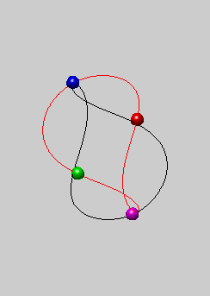
The n-body problem
Find the positions and velocities of a collection of
interacting particles over a period of time.
An n-body solver is a program that finds the solution to an n-body problem by simulating the behavior of the particles.

Slide 5

Position_{time 0}
mass
N-body solver
Position_{time x}
Velocity_{time x}
Velocity_{time 0}

Slide 6
Simulating motion of planets
Determine the positions and velocities:
Newton’s second law of motion.牛顿第二定理
Newton’s law of universal gravitation. 万有引力定理

Slide 7
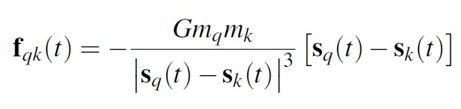

Force on particle q exerted by k
mass
|𝑆_{𝑞} 𝑡 − 𝑆_{𝑘} 𝑡 |
distance
𝑚_{𝑞}
q
𝑆_{𝑞} 𝑡
k
𝑆_{𝑘} 𝑡
𝑚_{𝑘}
G: gravitational constant
position

Slide 8
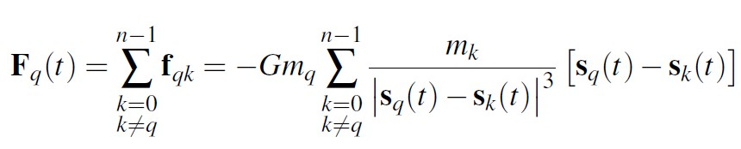

Total force on particle q
0
^{f}𝑞0
…
^{f}𝑞𝑘
𝑚_{𝑞}
q
𝑆_{𝑞} 𝑡
k
𝑚_{𝑘}
^{f}𝑞,𝑛−1
𝑆_{𝑘} 𝑡
…
n-1

Slide 9
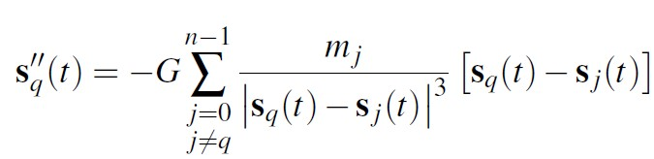


Acceleration of particle q
According to Newton’s second law of motion:
′′
F_{𝑞} = 𝑚_{𝑞}𝑎_{𝑞} 𝑡 = 𝑚_{𝑞} 𝑆_{𝑞}
𝑡 𝑡
F_{𝑞} 𝑡
𝑎_{𝑞}
′′
𝑡 = 𝑆_{𝑞} 𝑡 =
𝑚
𝑞

Slide 10
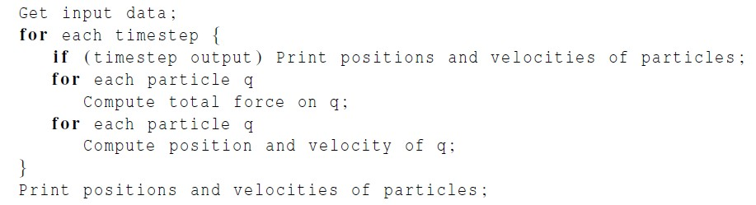
Serial pseudo-code
10

Slide 11
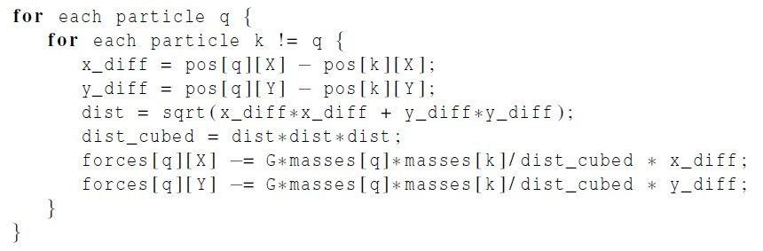
Computation of the forces
k
dist
y_diff
q
x_diff

Slide 12
Newton’s third law of motion
For every action, there is an equal and opposite
reaction.
The force on q due to k
^{𝑓}𝑞𝑘
q k
𝑓_{𝑘𝑞} = −𝑓_{𝑞𝑘}
The force on k due to q

Slide 13
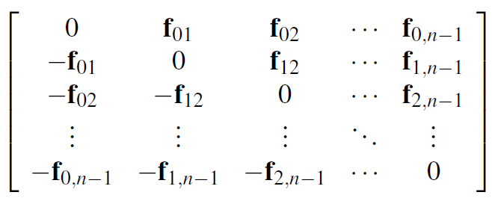
The individual forces
^{𝑓}𝑞𝑘
𝑓_{𝑘𝑞} = −𝑓_{𝑞𝑘}
^{𝑓}𝑞𝑘
q
k
𝑓_{𝑘𝑞} = −𝑓_{𝑞𝑘}

Slide 14
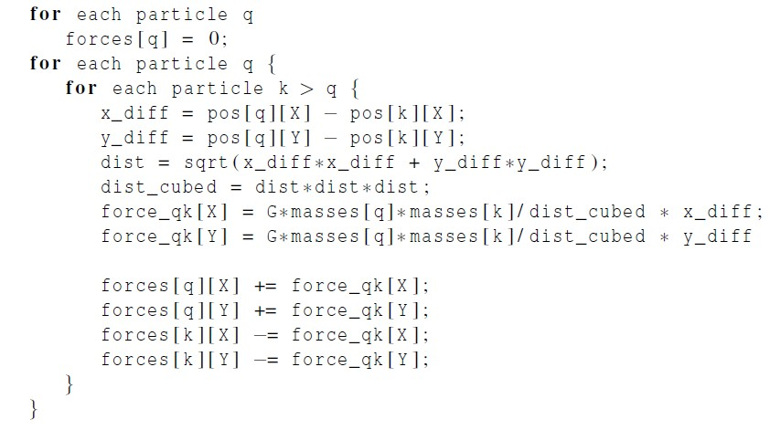
A Reduced Algorithm for Computing
N-Body Forces

Slide 15
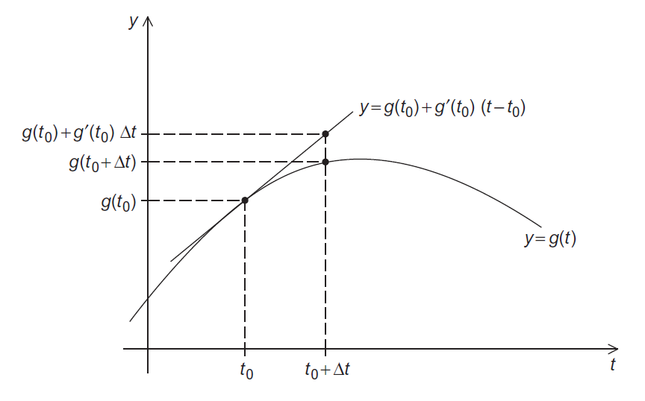
Using the Tangent Line to Approximate a Function
15

Slide 16
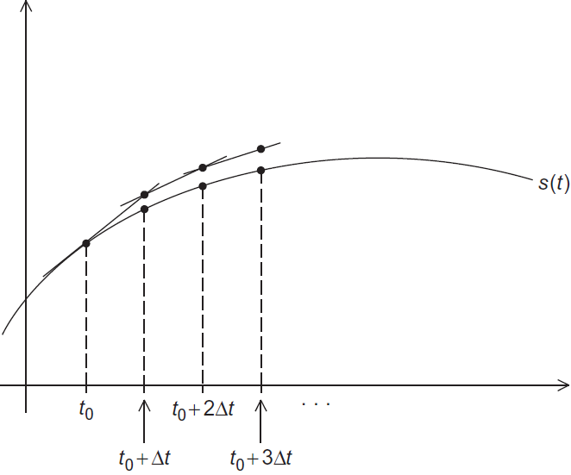
Euler’s Method

Slide 17
Parallelizing the N-Body Solvers
Apply Foster’s methodology.
Initially, we want a lot of tasks.
Start by making our tasks the computations of the positions, the velocities, and the total forces at each timestep.

Slide 18
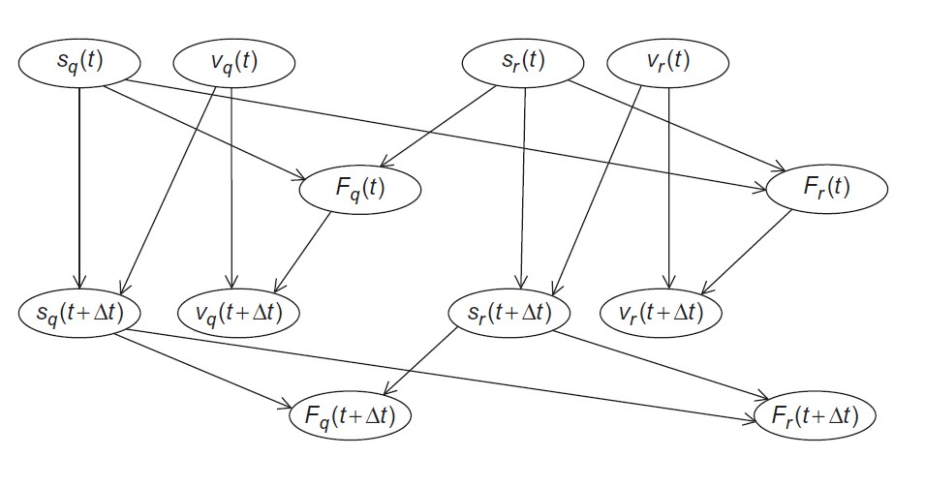
Communications Among Tasks in
the Basic N-Body Solver

Slide 19
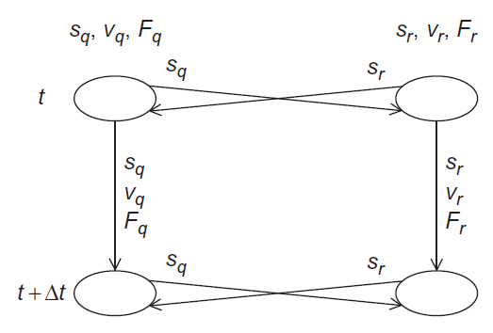
Communications Among Agglomerated
Tasks in the Basic N-Body Solver

Slide 20
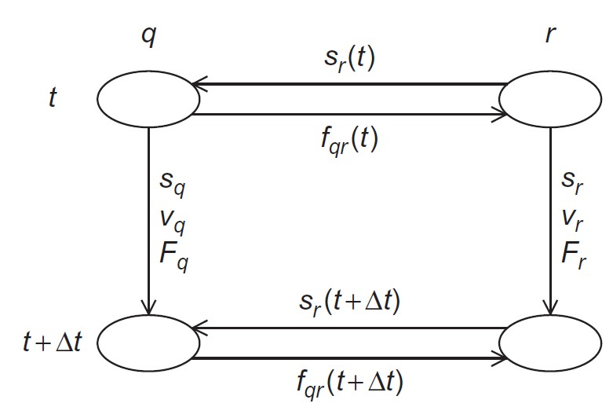
Communications Among Agglomerated
Tasks in the Reduced N-Body Solver
q < r
20

Slide 21
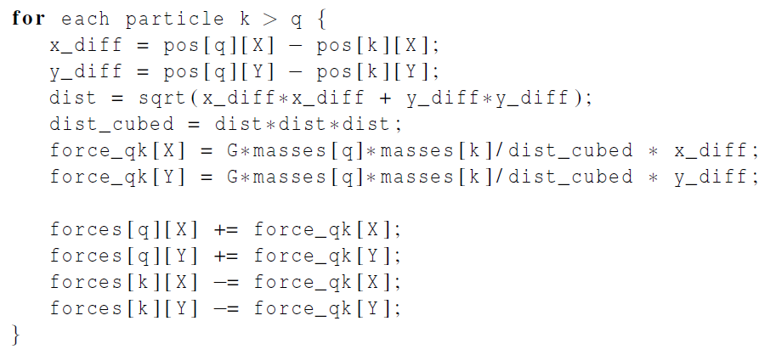
Computing the total force on particle
q in the reduced algorithm

Slide 22
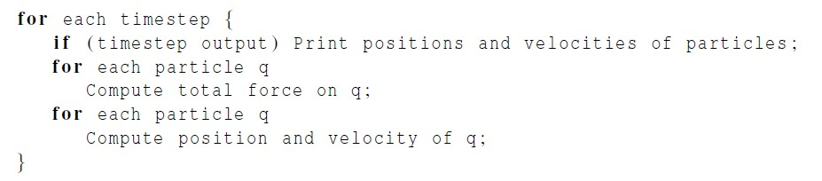
Serial pseudo-code
iterating over particles
In principle, parallelizing the two inner
for loops will map tasks/particles to cores.

Slide 23
Parallelizing the Basic
Solver using OpenMP

Slide 24
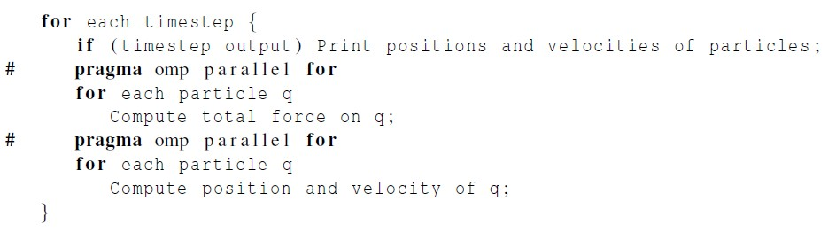
First attempt
Let’s check for race conditions caused
by loop-carried dependences.

Slide 25
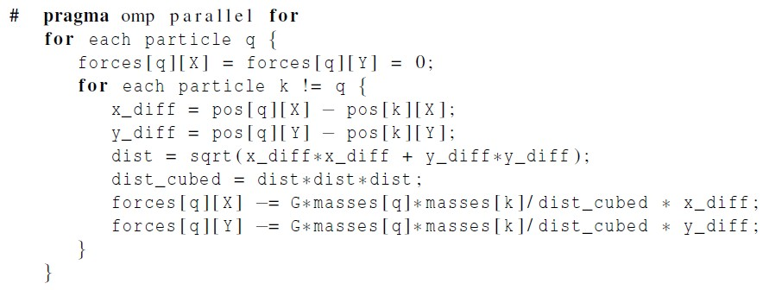
First loop
No race conditions in parallelization of the first loop
Only one thread will access forces[q] for any q.
Accesses to pos and masses array are read.

Slide 26
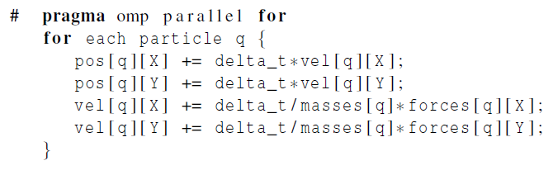
Second loop
No race conditions in parallelization of the second loop
A single thread accesses pos[q], vel[q], masses[q], forces[q]
for any particle q.
Scalar variables are only read.

Slide 27
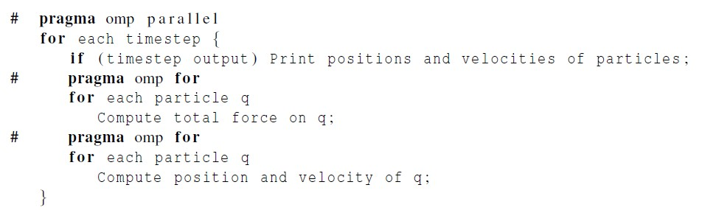
Repeated forking and joining of
threads
The same team of threads will be used in both loops and for every iteration of the outer loop.
Problem: every thread will print all the positions and velocities.

Slide 28
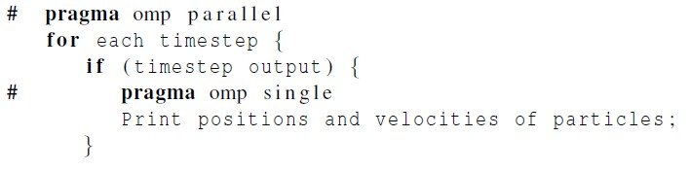
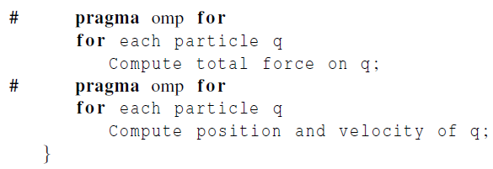
Adding the single directive
Single: only one of the threads can
execute the following block of code.

Slide 29
Parallelizing the Reduced
Solver using OpenMP

Slide 30
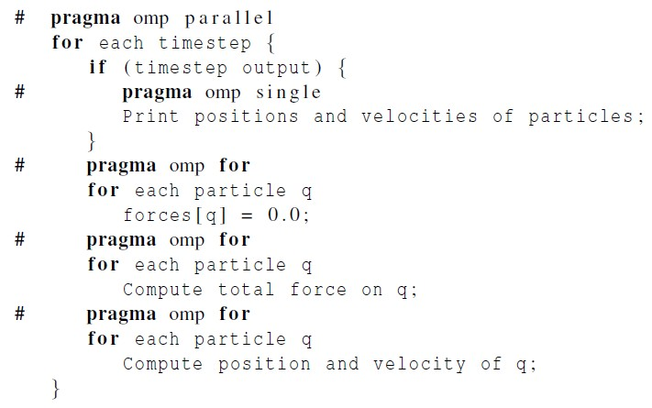
Parallelizing the Reduced Solver Using OpenMP
Parallelization of the initialization of forces is fine, as there is no dependence among the iterations.
30

Slide 31


Problems
Updates to forces[3] create a race condition.
Why?
Unlike basic version, in the reduced version, a thread may update elements in the forces array other than those corresponding to its assigned particles.
0
−f₀₁
Two threads attempt to access F₃
^{f}01 ^{f}02 ^{f}03
^{0 f}12 ^{f}13
−f −f 0 f₂₃
−f₂₃ 0
Thread 0
𝐹₃ = forces[3]
Thread 1
02
12
−f₀₃
−f₁₃
31

Slide 32
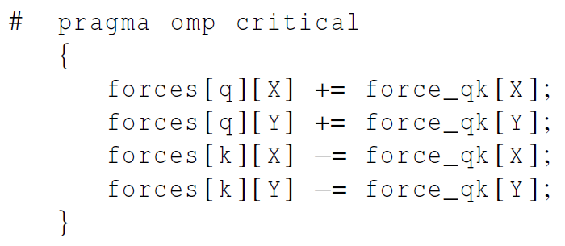
First solution attempt
before all the updates to forces
Drawback: Access to the forces array
will be effectively serialized!!!

Slide 33
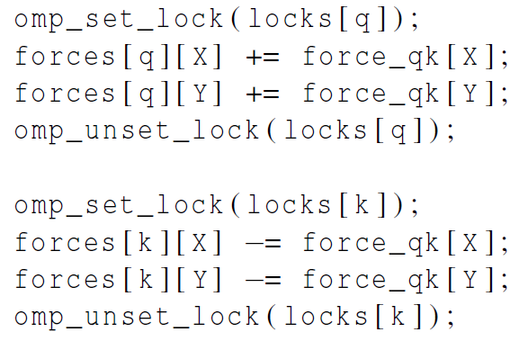
Second solution attempt
Use one lock for
each particle.
The performance is not as good as serial code.

Slide 34
Third solution attempt
Solution: to carry out the computation of forces in
two phases:
(Phase I) each thread performs calculations and stores results in its own array of forces;
(Phase II) the thread that has been assigned particle q will add the contributions that have been computed by different threads.
Thread 0
Thread 1

Slide 35
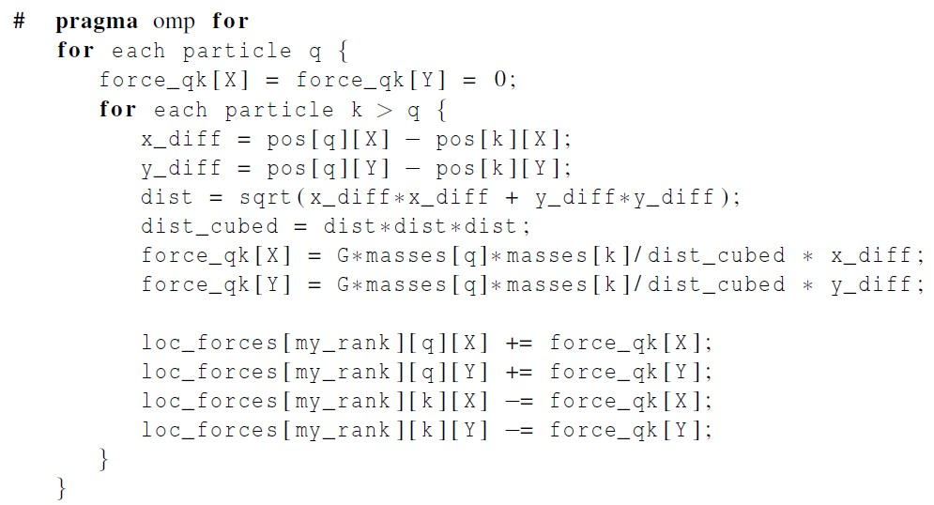
Revised algorithm – phase I
(1) each thread performs calculations and
stores results in its own array of forces;
35

Slide 36
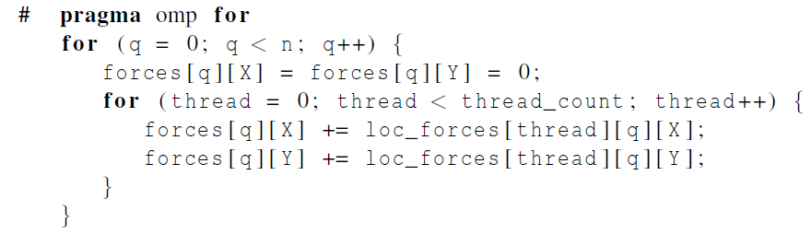
Revised algorithm – phase II
(2) the thread that has been assigned particle q will add the contributions that have been computed by different threads.

Slide 37
Another example
6 particles, 3 threads, block partition
0
^{f}01 ^{f}02 ^{f}03 ^{f}04 ^{f}05 ^{0 f}12 ^{f}13 ^{f}14 ^{f}15
Particle 0
Thread 0
−f₀₁
Particle 1
Particle 2
Particle 3
Particle 4
Particle 5
−f₀₂
−f₁₂ 0
^{f}23 ^{f}24 ^{f}25
Thread 1
−f₀₃
−f₀₄
−f₁₃
−f₁₄
−f₂₃
−f₂₄
^{0 f}34 ^{f}35
−f₃₄ 0 f₄₅
Thread 2
−f₀₅
−f₁₅
−f₂₅
−f₃₅
−f₄₅ 0

Slide 38
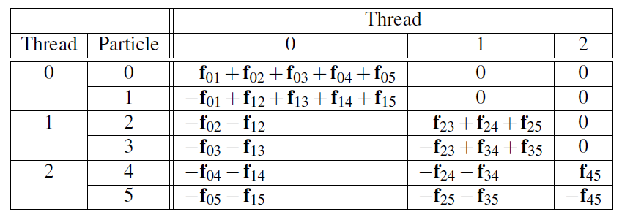
First Phase Computations for Reduced
Algorithm with Block Partition
Imbalanced workload among three threads

Slide 39
Another example - continued
6 particles, 3 threads, cyclic partition
0
−f₀₁ 0
−f₀₂ −f₁₂ 0
−f₀₃ −f₁₃
−f₀₄ −f₁₄
−f₀₅ −f₁₅
Thread 0
Thread 1
Thread 2
^{f}01 ^{f}02 ^{f}03 ^{f}04 ^{f}05
Particle 0
^{f}12 ^{f}13 ^{f}14 ^{f}15
Particle 1
^{f}23 ^{f}24 ^{f}25
Particle 2
Particle 3
Particle 4
Particle 5
Thread 0
Thread 1
Thread 2
−f₂₃ 0
−f₂₄ −f₃₄
−f₂₅ −f₃₅
^{f}34 ^{f}35
0 f₄₅
−f₄₅ 0

Slide 40
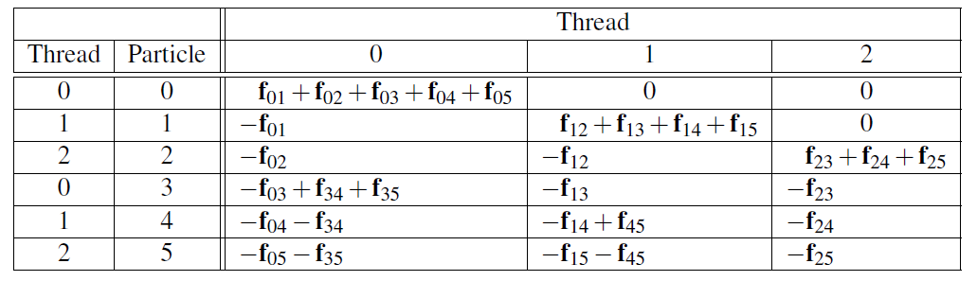
First Phase Computations for Reduced
Algorithm with Cyclic Partition
More balanced workload among three
threads with cyclic partition
40

Slide 41
Parallelizing the Solvers
using Pthreads

Slide 42
Parallelizing the Solvers Using
Pthreads
By default, local variables in Pthreads are private.
All shared variables are global in the Pthreads.
The principle data structures in the Pthreads version
are identical to those in the OpenMP version
Startup for Pthreads is basically the same as the
startup for OpenMP

Slide 43
Parallelizing the Solvers Using
Pthreads
The main difference between Pthreads and OpenMP
is in the details of parallelizing the inner loops.
We must explicitly determine which values of the loop variables correspond to each thread’s calculations.

Slide 44
Parallelizing the Solvers Using
Pthreads
Another difference between the Pthreads and the
OpenMP versions has to do with barriers.
At the end of a parallel for OpenMP has an implied barrier.
We need to add explicit barriers after the inner loops when a race condition can arise.
The Pthreads standard includes a barrier. However, some systems don’t implement it.

Slide 45
Parallelizing the Solvers
using MPI

Slide 46
Parallelizing the Basic Solver Using MPI
Choices with respect to the data structures:
Each process stores the entire global array of particle
masses.
Each process only uses a single n-element array for the positions.
Each process uses a pointer loc_pos that refers to the start of its block of pos.
On process 0 local_pos = pos;
on process 1 local_pos = pos + loc_n;
etc.

Slide 47
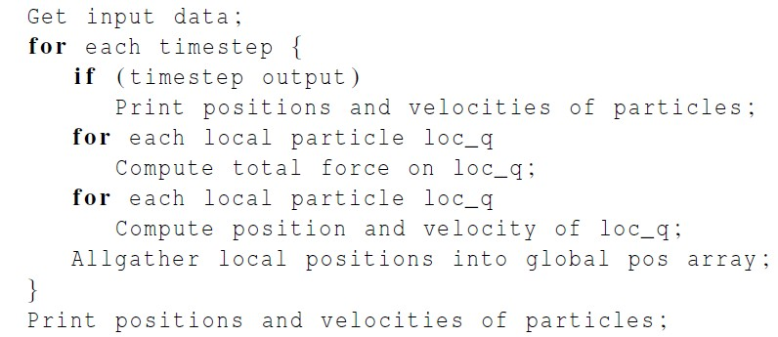
Pseudo-code for the MPI version of the
basic n-body solver

Slide 48
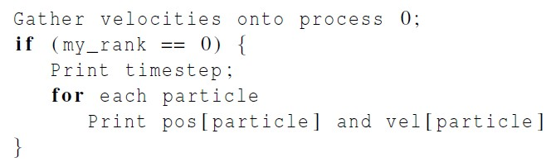

Pseudo-code for output

Slide 49
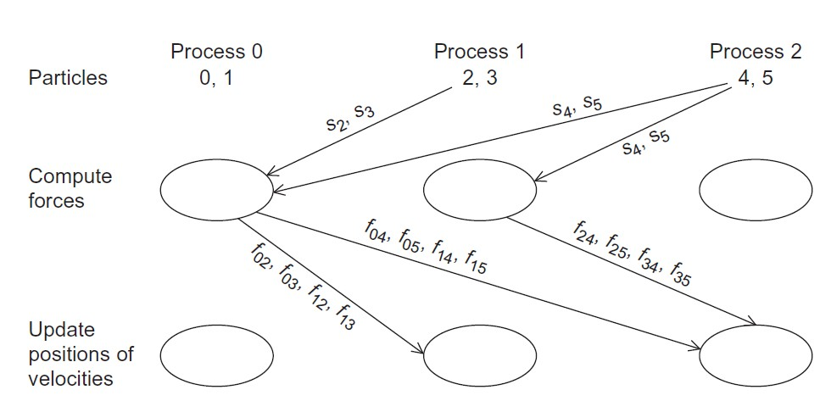
Communication In A Possible MPI
Implementation of the N-Body Solver
(for a reduced solver)
Complicated!
Unless the implementation were very carefully done,
it would probably be very slow.

Slide 50
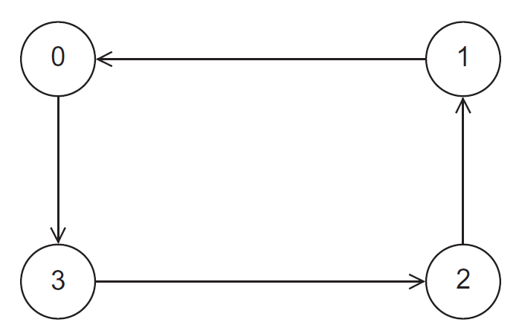
A Ring of Processes
By repeatedly sending and receiving data using the ring,
each process has access to positions of all the particles.

Slide 51
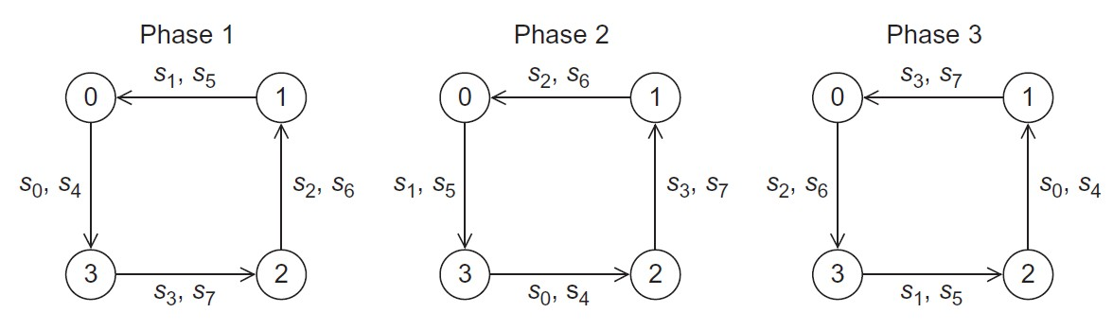
Ring Pass of Positions
4 processes, 8 particles, cyclic partition
Phase 1: each process will send positions of its assigned particles to its “lower- ranked” neighbor and receive positions of particles assigned to its “higher- ranked” neighbor
Phase 2: each process will forward the positions it received in the first phase.

Slide 52
Computation of Forces in Ring Pass
In each phase, a process can
compute inter-particle forces resulting from interaction between its assigned particles and the particles whose positions it has received;
once an inter-particle force has been computed, the process can add the force into a local array of forces, and subtract the force from the received array of forces.

Slide 53
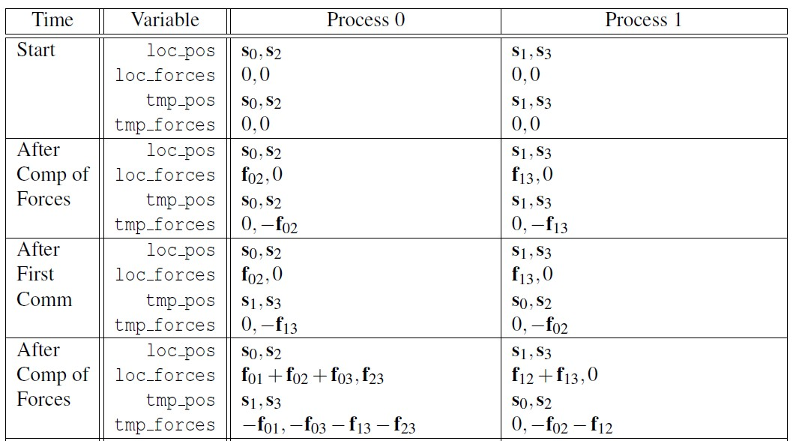
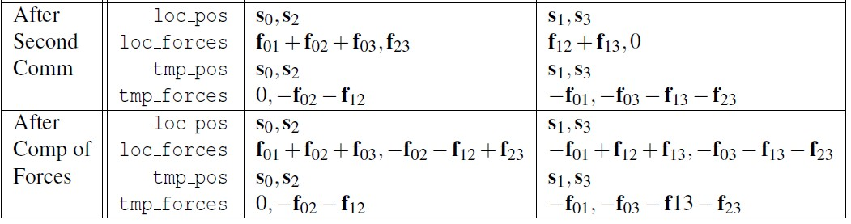
Computation of Forces in Ring Pass
2 processes, 4 particles, cyclic partition
Final phase: carry out a vector sum

Slide 54
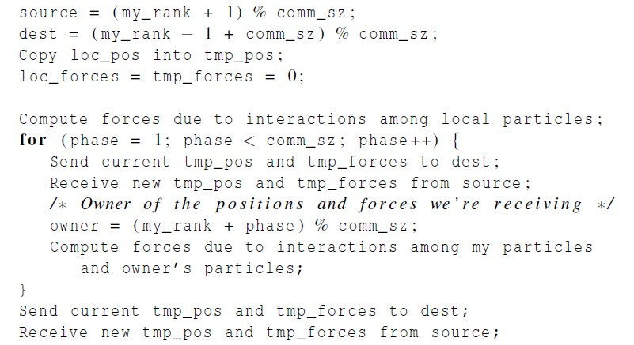
Pseudo-code for the MPI implementation
of the reduced n-body solver

Slide 55
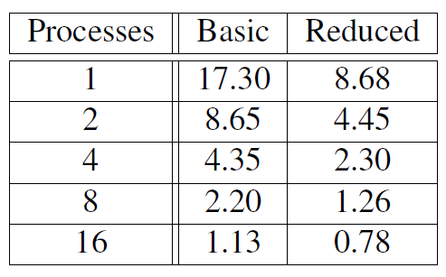
Performance of the MPI n-body solvers
(in seconds)
Reduced solver is better than basic solver

Slide 56
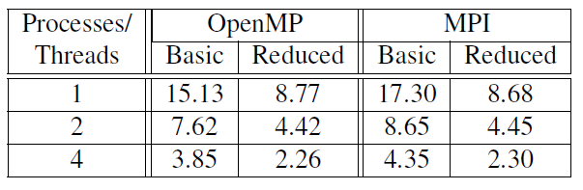
Run-Times for OpenMP and MPI N-
Body Solvers
(in seconds)
Basic OpenMP solver is faster than basic MPI solver.
Reduced solver: OpenMP ≈ MPI

Slide 57

Tree search

Slide 58
Tree search problem (TSP)
An NP-complete problem.
No known solution to TSP that is better in all cases than exhaustive search.
Ex., the travelling salesperson problem, finding a minimum cost tour.

Slide 59
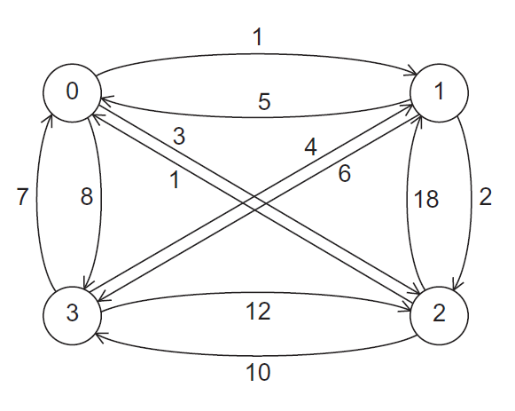

A Four-City TSP

Slide 60
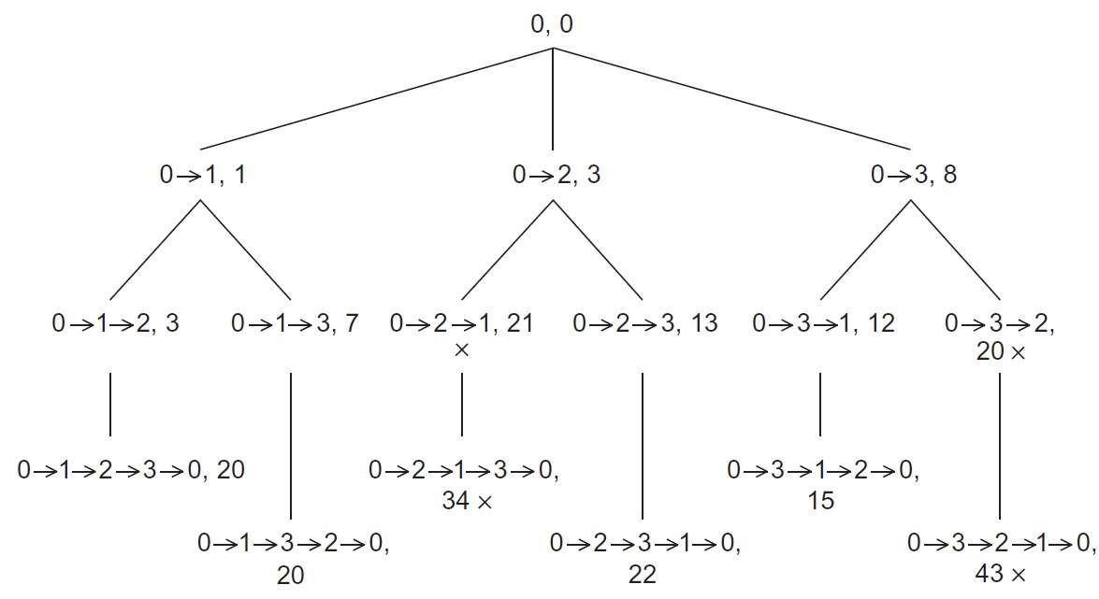
Search Tree for Four-City TSP
60

Slide 61
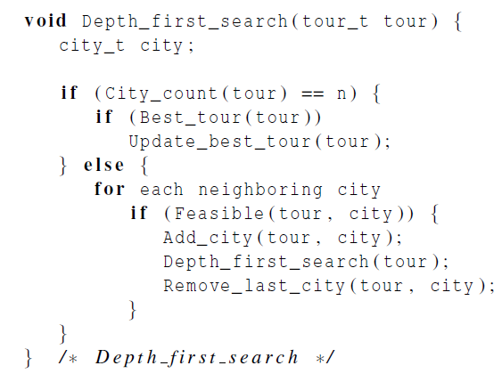
Pseudo-code for a recursive solution to
TSP using depth-first search
To see if there are n cities in the partial tour
To see if the complete tour has a lower cost than the current “best tour”
Replace the current best tour with the tour
To see if city has been visited, and if not, whether the city can possibly lead to a least-cost tour.
Remove city from the tour, as it shouldn’t be included in the tour in subsequent recursive calls.

Slide 62
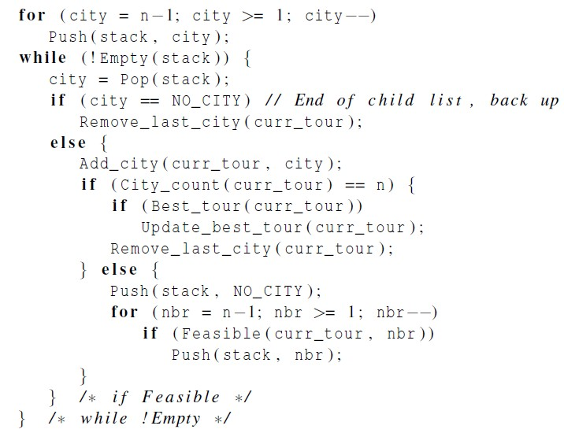
Pseudo-code for an implementation of a
depth-first solution to TSP without recursion
NO_CITY is a marker so that we can tell when we’ve visited all children of a tree node
2
1
0
N
Non-start nodes added into stack at initialization phase.
1
2
4
3
N
3
4
N
N
Before pushing all children of a node, we push NO_CITY marker

Slide 63
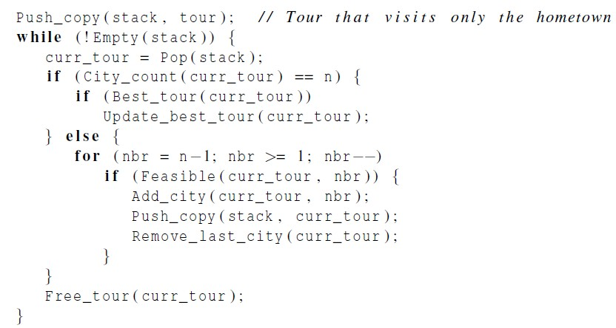
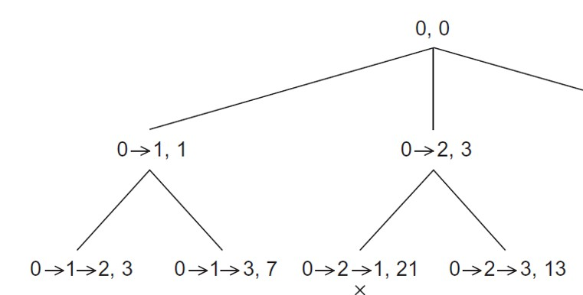





Pseudo-code for a second solution to TSP
that doesn’t use recursion
Stack
63

Slide 64
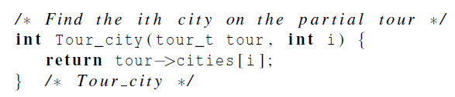

Using pre-processor macros

Slide 65
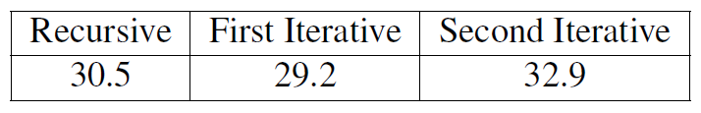

Run-Times of the Three Serial
Implementations of Tree Search
(in seconds)
First iterative solution is faster, as it eliminates some overhead due to repeated function calls.
Second iterative solution is slower because of repeated copying of tour data structure.
The second iterative one is easy to parallelize.

Slide 66
Making sure we have the “best tour” (1)
When a process finishes a tour, it needs to check if
it has a better solution than recorded so far.
The global Best_tour function only reads the global best cost, so we don’t need to tie it up by locking it. There’s no contention with other readers.
If the process does not have a better solution, then
it does not attempt an update.

Slide 67
Making sure we have the “best tour” (2)
If another thread is updating while we read, we
may see the old value or the new value.
The new value is preferable, but to ensure this would be more costly than it is worth.
Update_best_tour:
Pthread_mutex_lock(best_tour_mutex):
/* We are already checked Best_tour, but we
need to check it again */
If (Best_tour(tour)){
Replace old best tour with tour.
}
Pthread_mutex_unlock(best_tour_mutex);

Slide 68
Making sure we have the “best
tour” (3)
In the case where a thread tests and decides it has a better global solution, we need to ensure two things:
1) That the process locks the value with a mutex, preventing a race condition.
2) In the possible event that the first check was against an old value while another process was updating, we do not put a worse value than the new one that was being written.
We handle this by locking, then testing again.

Slide 69
First scenario
global tour value
process y
local tour value
process x
local
tour value
37
22
27
3. test
6. lock
7. test again
update
unlock
37
test
lock
update
unlock
27
22

Slide 70
Second scenario
global tour value
process y
local tour value
process x
local
tour value
37
29
27
3. test
6. lock
7. test again
8. unlock
37
test
lock
update
unlock
27
70

Slide 71

Parallelizing the Tree Search Programs Using Pthreads

Slide 72
Static Parallelization of Tree Search
using Pthreads
Idea: a single thread use BFS to generate at least thread_count partial tours to distribute among threads, then each thread takes its partial tours and runs iterative tree search on them.
Four differences compared with iterative serial one:
The use of my_stack instead of stack;
Initialization of the stack;
Implementation of Best_tour func;
Implementation of Update_best_tour func.

Slide 73
Partition Tree for Four-City TSP
60

Slide 74
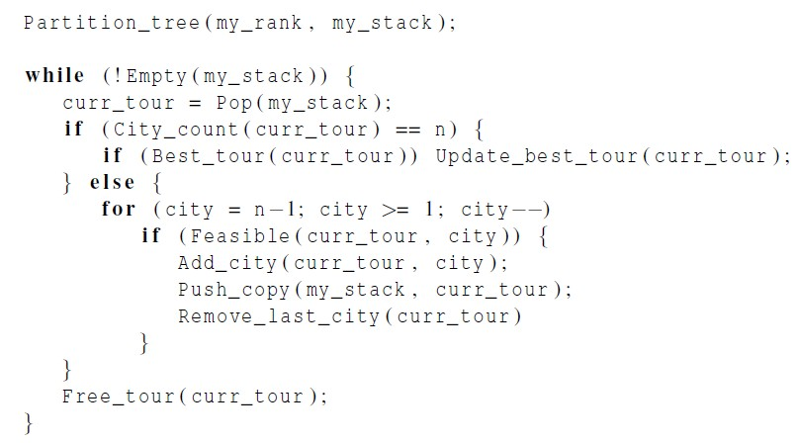
Pseudo-code for a Pthreads implementation of
a statically parallelized solution to TSP

Slide 75
Dynamic Parallelization of Tree Search
using Pthreads
Basic Idea:
when a thread runs out of work, it waits to see if
another thread can provide more work.
if a thread still has work and finds that there is at least one thread without work, it can split its stack and provide work for one of the threads.
Note: using pthread_cond_wait, pthread_cond_signal,
pthread_cond_broadcast for implementation.

Slide 76
Dynamic Parallelization of Tree Search
Using Pthreads
Code executed by a thread before it splits:
It checks that it has at least two tours in its stack.
It checks that there are threads waiting.
It checks whether the new_stack variable is NULL.
Termination issues.
Only when all the threads have run out of work.
Terminated function is used instead of Empty(stack)

Slide 77
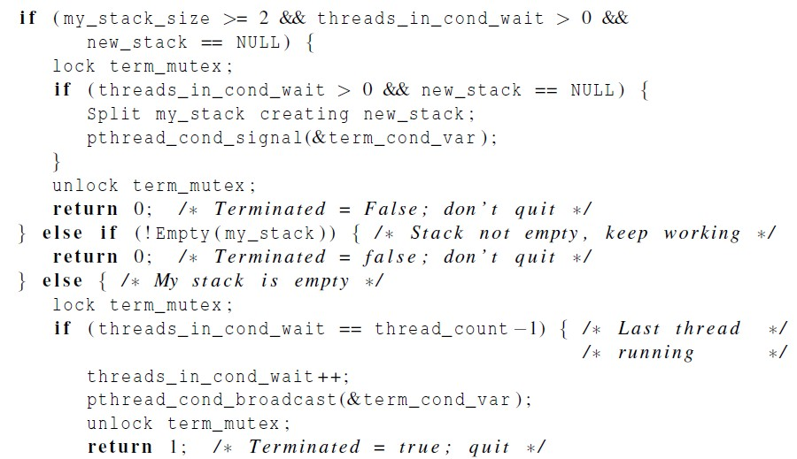
Pseudo-Code for Pthreads Terminated Function (1)

Slide 78
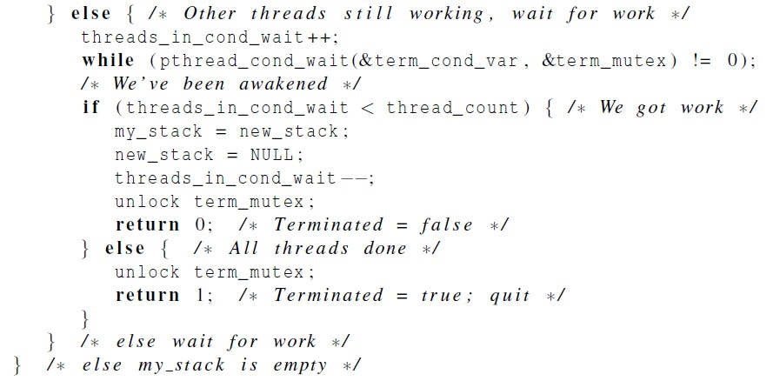
Pseudo-Code for Pthreads Terminated Function (2)

Slide 79
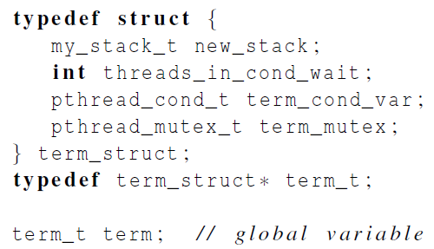
Grouping the termination variables

Slide 80

Run-times of Pthreads tree search programs
15-city problems
(in seconds)
numbers of times stacks were split

Slide 81
Parallelizing the Tree Search Programs Using OpenMP
80

Slide 82



Parallelizing the Tree Search Programs
Using OpenMP
Same basic issues implementing the static and
dynamic parallel tree search programs as Pthreads.
A few small changes can be noted.

Slide 83


OpenMP emulated condition wait
. . .
Busy-waiting !

Slide 84

Performance of OpenMP and Pthreads
implementations of tree search
(in seconds)
For most parts, OpenMP implementation is comparable to Pthreads implementation.

Slide 85
Implementation of Tree Search Using MPI and Static Partitioning

Slide 86
Implementation using MPI and
static partitioning
Read the adjacency matrix on process 0, and
broadcast it to all the processes;
Partitioning the tree
Checking and updating the best tour
After the search has terminated, making sure that
process 0 has a copy of the best tour for output

Slide 87

Partitioning the tree
MPI_Scatter: cannot be used, as # of initial partial tours may not be evenly divisible by comm_sz.
MPI_Scatterv: a variant of MPI_Scatter, which can send different # of objects to different processes.
Data sent to process q will begin in location (sendtype = MPI_INT)
Start index: sendbuf + displacement[q],
size: sendcounts[q]

Slide 88

Gathering a different number of objects from
each process in the communicator
MPI_Gatherv: a variant of MPI_Gather, which can gather different # of objects from different processes.

Slide 89
Maintaining the best tour
When a process finds a new best tour, it should
send it to other processes.
MPI_Bcast cannot be used, as it is blocking.
New tour should be sent in a way that the sender won’t block indefinitely.

Slide 90


Maintaining the best tour
MPI_Iprobe: checking to see if a message is available
It doesn’t actually try to receive a message
Status_p->MPI_SOURCE will be assigned the rank of message source
If such a msg is available,*msg_avail_p is assigned TRUE
89

Slide 91
MPI code to check for new best
tour costs
comm,
MPI_Iprobe(MPI_ANY_SOURCE, NEW_COST_TAG,
&msg_avail, &status);
while(msg_avail)
{
MPI_Recv(&received_cost, 1, MPI_INT, status.MPI_SOURCE,
NEW_COST_TAG, comm, MPI_STATUS_IGNORE );
if (received_cost < best_tour_cost) best_tour_cost = received_cost;
MPI_Iprobe(MPI_ANY_SOURCE, NEW_COST_TAG, comm,
&msg_avail, &status);
}
90

Slide 92
Modes and Buffered Sends - 1
MPI provides four modes for sends.
Standard: MPI_Send
Synchronous: MPI_Ssend
Ready: MPI_Rsend
Buffered: MPI_Bsend

Slide 93
Modes and Buffered Sends - 2
Standard: MPI_Send
MPI implementation decides whether to copy the message content into its own storage, or to block until a matching receive is posted.
Synchronous: MPI_Ssend
The send will block until a matching receive is posted

Slide 94
Modes and Buffered Sends - 3
Ready: MPI_Rsend
The send is erroneous unless a matching Receive is
posted before the Send is started.
Buffered: MPI_Bsend
MPI implementation must copy the message into local temporary storage if a matching Receive hasn’t been posted.
The temporary storage must be provided by the user
program, not MPI implementation.

Slide 95


Printing the best tour
Have each process store its local best tour
After completing searches, call MPI_Allreduce
The process with the global best tour can then send it to process 0 for output
94

Slide 96
MPI for Four-City TSP
mpi_isend, mpi_iprobe_ mpi_recv or mpi_scatterv
Print
mpi_allreduce
60

Slide 97
Implementation of Tree Search Using MPI and Dynamic Partitioning

Slide 98
Using MPI and Dynamic Partitioning
Key difference with OpenMP/pthreads:
There is no central repository of information on
which processes are waiting for work.
Rather than simply going into a busy-wait or termination, a process that has run out of work should send a request for work to another process.

Slide 99
Pseudocode for dynamically parallelized solution to TSP
Partition tree(my_rank, my_stack);
while (!Teminated(my_stack)) {
curr_tour = Pop(my_stack);
if (City count(curr_tour) == n) {
if (Best tour(curr_tour)) Update best tour(curr_tour);
} else {
for (city = n-1; city >= 1; city--)
if (Feasible(curr tour, city)) {
Add_city(curr tour, city);
Push_copy(my stack, curr tour);
Remove_last_city(curr tour);
}
}
Free tour(curr tour);
}

Slide 100
Terminated function for a Dynamically
Partitioned TSP solver that Uses MPI
Start Terminated func
Yes
Check if the proc has work to split
No
Send_rejects
Fulfill_request
Yes
Check if the stack is empty
If it is the only left one, return true;
Otherwise, announce it is out-of-work
No
Return false, still more work
Yes
Check if no work left for all processes
No
Quit
Request work from someone
97

Slide 101

Terminated Function for a Dynamically
Partitioned TSP solver with MPI (1)
the proc has work to split
the proc has no more work to split
the proc has work to do, cannot terminate
Only one proc is left, and it has no work, quit
When stack is empty,
announce it is out-of-work
If all procs have no work left, quit

Slide 102

Terminated Function for a Dynamically
Partitioned TSP solver with MPI (2)
Send work request to other proc
Check for work, if there is work available, receive work from the remote proc.

Slide 103



Splitting the stack and data packing
MPI_Pack: Packing data into a buffer of contiguous memory
Split_stack packs the contents of new stack into contiguous memory and send the block of contiguous memory to the receiver
100

Slide 104



Splitting the stack and data packing

Slide 105
Distributed Termination Detection
Out_of_work() and No_work_left() implements the
termination detection algorithm.
The termination detection algorithm used in shared- memory programs will have problems in MPI.
Suppose each proc stores a variable oow to indicate the number of processes that are out of work
Initially, oow = 0
Each time a process runs out of work (or receive work), it sends a message to other processes, so that others will update their copies of oow.

Slide 106

The error here is that the work sent from process 1 to process 0 is lost
The reason is that proc 0 receives notification that proc 2 is out of work before it receives notification that proc 1 has received work.

Slide 107
A simple distributed termination
detection algorithm
Idea: keeping track of a quantity that is conserved
and can be measured precisely (e.g., energy)
Algorithm:
Initially, each process has 1 unit of energy
When a process runs out of work, it sends its energy to
process 0.
When a process fulfills a request for work, it divides its energy in half, keeping half for itself, and sending half to another
The program should terminate when process 0 receives a total energy of comm_sz units

Slide 108

Performance of MPI and Pthreads
implementations of tree search
(in seconds)
Pthreads outperforms MPI implementation for small
shared-memory systems.
For large problems, MPI program is much more scalable and can provide better performance.

Slide 109
Concluding Remarks (1)
In developing the reduced MPI solution to the n- body problem, the “ring pass” algorithm proved to be much easier to implement and is probably more scalable.
In a distributed memory environment in which processes send each other work, determining when to terminate is a nontrivial problem.

Slide 110
Concluding Remarks (2)
When deciding which API to use, we should consider whether to use shared- or distributed- memory.
We should look at the memory requirements of the application and the amount of communication among the processes/threads.

Slide 111
Concluding Remarks (3)
If the memory requirements are great or the distributed memory version can work mainly with cache, then a distributed memory program is likely to be much faster.
On the other hand if there is considerable communication, a shared memory program will probably be faster.

Slide 112
Concluding Remarks (3)
In choosing between OpenMP and Pthreads, if there’s an existing serial program and it can be parallelized by the insertion of OpenMP directives, then OpenMP is probably the clear choice.
However, if complex thread synchronization is
needed then Pthreads will be easier to use.

