Slide 1



AUCpreD: protein disorder prediction by AUC-maximized Deep Convolutional Neural Fields
ECCB 2016
Sep 6, The Hague, Netherlands
Sheng Wang
Toyota Technological Institute at Chicago,
Joint work with Jianzhu Ma, and Jinbo Xu

Slide 2
Outline
Why and how to predict Intrinsically Disordered Regions (IDRs)?
IDRs and ordered regions are highly imbalanced in PDB, how to solve?
What are our approaches?
How does our method perform?

Slide 3
Why and how to predict Intrinsically Disordered Regions (IDRs)?
Part I

Slide 4
Order and disorder region
Conformational flexibility in SUMO-1 protein (PDB:1a5r)
disorder
order
disorder

Slide 5
IDRs are enriched with SLiMs
Short Linear Motifs (SLiMs) play critical roles in many biological process, such as:
1) Post Translational Modification (PTM)
2) Protein Protein Interaction (PPI)
P
PTM
PPI

Slide 6
Sequence only for IDR prediction
Input Features with sequence only
Amino acid
K
R
Y
F
D
L
K
E
Order/disorder
label
1
1
0
0
0
0
1
1
Here we denote order residue as 1,
While disorder residue as 0.

Slide 7
Sequence only for IDR prediction
Sequence only features allows proteome-level prediction
Input Features with sequence only
Amino acid
K
R
Y
F
D
L
K
E
Order/disorder
label
1
1
0
0
0
0
1
1
Here we denote order residue as 1,
While disorder residue as 0.

Slide 8
Sequence profile for IDR prediction
Input Features with sequence profile
Predicted ACC
Predicted SSE
Evolutionary
Profile
Amino acid
K
R
Y
F
D
L
K
E
Order/disorder
label
1
1
0
0
0
0
1
1
Here we denote order residue as 1,
While disorder residue as 0.

Slide 9
Notable Prediction Software
IUpred
sequence only
Espritz (two modes)
sequence only or sequence profile
DisoPred3 (two modes)
sequence profile or template use

Slide 10
Conditional Random Fields
Input features
1st layer
X_{i-2}
X_{i-1}
X_{i}
X_{i+1}
X_{i+2}
U
y_{i-3}
y_{i-2}
y_{i-1}
y_{i}
y_{i+1}
Label layer
Output labels
T
In Conditional Random Fields (CRF), the parameter U specifies the relationship between the input features and the output labels, and T specifies the binary relationship between adjacent labels.

Slide 11
Deep Convolutional Neural Fields
Windows size
Input features
1st layer
X_{i-2}
X_{i-1}
X_{i}
X_{i+1}
X_{i+2}
W¹
H_{i-2}
H_{i-1}
H_{i}
H_{i+2}
2nd layer
²
²
²
H_{i+1}
²
²
W^{K-1}
……………..
H_{i-2}
H_{i-1}
H_{i+2}
K-th layer
^{K}
^{K}
^{K}
H_{i+1}
H_{i}
^{K}
^{K}
U
Hidden layers
DCNN
y_{i-3}
y_{i-2}
y_{i-1}
y_{i}
y_{i+1}
Label layer
Output labels
T

Slide 12
IDRs and ordered regions are highly imbalanced in PDB, how to solve?
Part II

Slide 13
Class imbalance issue
In IDR prediction, the label distribution is highly imbalanced.
Only ~6% protein amino acid residues are disordered in PDB.
By random guess we may have a predictor that has ~94% per-residue accuracy.

Slide 14
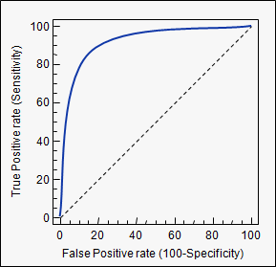


The Merit of ROC curve
True class
FN
TP
TPrate =$TP/(TP+FN)$
Predicted
class
TN
FP
AUC: Area Under the ROC Curve
Confusion Matrix
FPrate =$FP/(FP+TN)$
ROC curves are insensitive to changes in class distribution between True Class and False Class of confusion matrix. This is because ROC curves are based upon TP rate and FP rate, in which each term is a ratio within the rows.

Slide 15
Balanced Class data example
True class
FN
TP
TPrate =$TP/(TP+FN)$
Predicted
class
TN
FP
AUC: Area Under the ROC Curve
Confusion Matrix
FPrate =$FP/(FP+TN)$

Slide 16
Imbalanced Class data example
True class
FN
TP
TPrate =$TP/(TP+FN)$
Predicted
class
TN
FP
AUC: Area Under the ROC Curve
Confusion Matrix
FPrate =$FP/(FP+TN)$

Slide 17
Balanced Class data
Example

Slide 18


Balanced Class data example
Predicted threshold
True samples
False samples
1
2
3
1
2
2
1
3
2
1
0.0
0.1
0.2
0.3
0.4
0.5
0.6
0.7
0.8
0.9
1.0
TP_rate =$TP/(TP+FN)$=9/9=1.0
1.0
True class
0.9
0.8
0
9
0.7
FN
TP
0.6
TP_rate
0.5
Predicted class
0.4
0
9
0.3
TN
FP
0.2
0.1
0.0
0.0
0.1
0.2
0.3
0.4
0.5
0.6
0.7
0.8
0.9
1.0
FP_rate
FP_rate =$FP/(FP+TN)$=9/9=1.0

Slide 19

Balanced Class data example
Predicted threshold
True samples
False samples
1
2
3
1
2
2
1
3
2
1
0.0
0.1
0.2
0.3
0.4
0.5
0.6
0.7
0.8
0.9
1.0
TP_rate =$TP/(TP+FN)$=9/9=1.0
1.0
True class
0.9
0.8
0
9
0.7
FN
TP
0.6
TP_rate
0.5
Predicted class
0.4
1
8
0.3
TN
FP
0.2
0.1
0.0
0.0
0.1
0.2
0.3
0.4
0.5
0.6
0.7
0.8
0.9
1.0
FP_rate
FP_rate =$FP/(FP+TN)$=8/9=0.89

Slide 20

Balanced Class data example
Predicted threshold
True samples
False samples
1
2
3
1
2
2
1
3
2
1
0.0
0.1
0.2
0.3
0.4
0.5
0.6
0.7
0.8
0.9
1.0
TP_rate =$TP/(TP+FN)$=9/9=1.0
1.0
True class
0.9
0.8
0
9
0.7
FN
TP
0.6
TP_rate
0.5
Predicted class
0.4
3
6
0.3
TN
FP
0.2
0.1
0.0
0.0
0.1
0.2
0.3
0.4
0.5
0.6
0.7
0.8
0.9
1.0
FP_rate
FP_rate =$FP/(FP+TN)$=6/9=0.67

Slide 21

Balanced Class data example
Predicted threshold
True samples
False samples
1
2
3
1
2
2
1
3
2
1
0.0
0.1
0.2
0.3
0.4
0.5
0.6
0.7
0.8
0.9
1.0
TP_rate =$TP/(TP+FN)$=9/9=1.0
1.0
True class
0.9
0.8
0
9
0.7
FN
TP
0.6
TP_rate
0.5
Predicted class
0.4
6
3
0.3
TN
FP
0.2
0.1
0.0
0.0
0.1
0.2
0.3
0.4
0.5
0.6
0.7
0.8
0.9
1.0
FP_rate
FP_rate =$FP/(FP+TN)$=3/9=0.33

Slide 22

Balanced Class data example
Predicted threshold
True samples
False samples
1
2
3
1
2
2
1
3
2
1
0.0
0.1
0.2
0.3
0.4
0.5
0.6
0.7
0.8
0.9
1.0
TP_rate =$TP/(TP+FN)$=8/9=0.89
1.0
True class
0.9
0.8
1
8
0.7
FN
TP
0.6
TP_rate
0.5
Predicted class
0.4
6
3
0.3
TN
FP
0.2
0.1
0.0
0.0
0.1
0.2
0.3
0.4
0.5
0.6
0.7
0.8
0.9
1.0
FP_rate
FP_rate =$FP/(FP+TN)$=3/9=0.33

Slide 23

Balanced Class data example
Predicted threshold
True samples
False samples
1
2
3
1
2
2
1
3
2
1
0.0
0.1
0.2
0.3
0.4
0.5
0.6
0.7
0.8
0.9
1.0
TP_rate =$TP/(TP+FN)$=8/9=0.89
1.0
True class
0.9
0.8
1
8
0.7
FN
TP
0.6
TP_rate
0.5
Predicted class
0.4
8
1
0.3
TN
FP
0.2
0.1
0.0
0.0
0.1
0.2
0.3
0.4
0.5
0.6
0.7
0.8
0.9
1.0
FP_rate
FP_rate =$FP/(FP+TN)$=1/9=0.11

Slide 24

Balanced Class data example
Predicted threshold
True samples
False samples
1
2
3
1
2
2
1
3
2
1
0.0
0.1
0.2
0.3
0.4
0.5
0.6
0.7
0.8
0.9
1.0
TP_rate =$TP/(TP+FN)$=6/9=0.67
1.0
True class
0.9
0.8
3
6
0.7
FN
TP
0.6
TP_rate
0.5
Predicted class
0.4
8
1
0.3
TN
FP
0.2
0.1
0.0
0.0
0.1
0.2
0.3
0.4
0.5
0.6
0.7
0.8
0.9
1.0
FP_rate
FP_rate =$FP/(FP+TN)$=1/9=0.11

Slide 25

Balanced Class data example
Predicted threshold
True samples
False samples
1
2
3
1
2
2
1
3
2
1
0.0
0.1
0.2
0.3
0.4
0.5
0.6
0.7
0.8
0.9
1.0
TP_rate =$TP/(TP+FN)$=6/9=0.67
1.0
True class
0.9
0.8
3
6
0.7
FN
TP
0.6
TP_rate
0.5
Predicted class
0.4
9
0
0.3
TN
FP
0.2
0.1
0.0
0.0
0.1
0.2
0.3
0.4
0.5
0.6
0.7
0.8
0.9
1.0
FP_rate
FP_rate =$FP/(FP+TN)$=0/9=0.0

Slide 26

Balanced Class data example
Predicted threshold
True samples
False samples
1
2
3
1
2
2
1
3
2
1
0.0
0.1
0.2
0.3
0.4
0.5
0.6
0.7
0.8
0.9
1.0
TP_rate =$TP/(TP+FN)$=3/9=0.33
1.0
True class
0.9
0.8
6
3
0.7
FN
TP
0.6
TP_rate
0.5
Predicted class
0.4
9
0
0.3
TN
FP
0.2
0.1
0.0
0.0
0.1
0.2
0.3
0.4
0.5
0.6
0.7
0.8
0.9
1.0
FP_rate
FP_rate =$FP/(FP+TN)$=0/9=0.0

Slide 27

Balanced Class data example
Predicted threshold
True samples
False samples
1
2
3
1
2
2
1
3
2
1
0.0
0.1
0.2
0.3
0.4
0.5
0.6
0.7
0.8
0.9
1.0
TP_rate =$TP/(TP+FN)$=1/9=0.11
1.0
True class
0.9
0.8
8
1
0.7
FN
TP
0.6
TP_rate
0.5
Predicted class
0.4
9
0
0.3
TN
FP
0.2
0.1
0.0
0.0
0.1
0.2
0.3
0.4
0.5
0.6
0.7
0.8
0.9
1.0
FP_rate
FP_rate =$FP/(FP+TN)$=0/9=0.0

Slide 28

Balanced Class data example
Predicted threshold
True samples
False samples
1
2
3
1
2
2
1
3
2
1
0.0
0.1
0.2
0.3
0.4
0.5
0.6
0.7
0.8
0.9
1.0
TP_rate =$TP/(TP+FN)$=0/9=0.0
1.0
True class
0.9
0.8
9
0
0.7
FN
TP
0.6
AUC = 0.9
TP_rate
0.5
Predicted class
0.4
9
0
0.3
TN
FP
0.2
0.1
0.0
0.0
0.1
0.2
0.3
0.4
0.5
0.6
0.7
0.8
0.9
1.0
FP_rate
FP_rate =$FP/(FP+TN)$=0/9=0.0

Slide 29
Class imbalance data
Example

Slide 30
Balanced Class data example
Predicted threshold
True samples
False samples
1
2
3
1
2
2
1
3
2
1
0.0
0.1
0.2
0.3
0.4
0.5
0.6
0.7
0.8
0.9
1.0
TP_rate =$TP/(TP+FN)$=9/9=1.0
1.0
True class
0.9
0.8
0
9
0.7
FN
TP
0.6
TP_rate
0.5
Predicted class
0.4
0
9
0.3
TN
FP
0.2
0.1
0.0
0.0
0.1
0.2
0.3
0.4
0.5
0.6
0.7
0.8
0.9
1.0
FP_rate
FP_rate =$FP/(FP+TN)$=9/9=1.0

Slide 31

Imbalanced Class data example
Predicted threshold
True samples
False samples
3
6
9
1
6
2
3
3
2
1
0.0
0.1
0.2
0.3
0.4
0.5
0.6
0.7
0.8
0.9
1.0
TP_rate =$TP/(TP+FN)$=9/9=1.0
1.0
True class
0.9
0.8
0
9
0.7
FN
TP
0.6
TP_rate
0.5
Predicted class
0.4
0
27
0.3
TN
FP
0.2
0.1
0.0
0.0
0.1
0.2
0.3
0.4
0.5
0.6
0.7
0.8
0.9
1.0
FP_rate
FP_rate =$FP/(FP+TN)$=27/27=1.0

Slide 32

Imbalanced Class data example
Predicted threshold
True samples
False samples
3
6
9
1
6
2
3
3
2
1
0.0
0.1
0.2
0.3
0.4
0.5
0.6
0.7
0.8
0.9
1.0
TP_rate =$TP/(TP+FN)$=9/9=1.0
1.0
True class
0.9
0.8
0
9
0.7
FN
TP
0.6
TP_rate
0.5
Predicted class
0.4
3
24
0.3
TN
FP
0.2
0.1
0.0
0.0
0.1
0.2
0.3
0.4
0.5
0.6
0.7
0.8
0.9
1.0
FP_rate
FP_rate =$FP/(FP+TN)$=24/27=0.89

Slide 33

Imbalanced Class data example
Predicted threshold
True samples
False samples
3
6
9
1
6
2
3
3
2
1
0.0
0.1
0.2
0.3
0.4
0.5
0.6
0.7
0.8
0.9
1.0
TP_rate =$TP/(TP+FN)$=9/9=1.0
1.0
True class
0.9
0.8
0
9
0.7
FN
TP
0.6
TP_rate
0.5
Predicted class
0.4
9
18
0.3
TN
FP
0.2
0.1
0.0
0.0
0.1
0.2
0.3
0.4
0.5
0.6
0.7
0.8
0.9
1.0
FP_rate
FP_rate =$FP/(FP+TN)$=18/27=0.67

Slide 34

Imbalanced Class data example
Predicted threshold
True samples
False samples
3
6
9
1
6
2
3
3
2
1
0.0
0.1
0.2
0.3
0.4
0.5
0.6
0.7
0.8
0.9
1.0
TP_rate =$TP/(TP+FN)$=9/9=1.0
1.0
True class
0.9
0.8
0
9
0.7
FN
TP
0.6
TP_rate
0.5
Predicted class
0.4
18
9
0.3
TN
FP
0.2
0.1
0.0
0.0
0.1
0.2
0.3
0.4
0.5
0.6
0.7
0.8
0.9
1.0
FP_rate
FP_rate =$FP/(FP+TN)$=9/27=0.33

Slide 35
Imbalanced Class data example
Predicted threshold
True samples
False samples
3
6
9
1
6
2
3
3
2
1
0.0
0.1
0.2
0.3
0.4
0.5
0.6
0.7
0.8
0.9
1.0
TP_rate =$TP/(TP+FN)$=8/9=0.89
1.0
True class
0.9
0.8
1
8
0.7
FN
TP
0.6
TP_rate
0.5
Predicted class
0.4
18
9
0.3
TN
FP
0.2
0.1
0.0
0.0
0.1
0.2
0.3
0.4
0.5
0.6
0.7
0.8
0.9
1.0
FP_rate
FP_rate =$FP/(FP+TN)$=9/27=0.33

Slide 36

Imbalanced Class data example
Predicted threshold
True samples
False samples
3
6
9
1
6
2
3
3
2
1
0.0
0.1
0.2
0.3
0.4
0.5
0.6
0.7
0.8
0.9
1.0
TP_rate =$TP/(TP+FN)$=8/9=0.89
1.0
True class
0.9
0.8
1
8
0.7
FN
TP
0.6
TP_rate
0.5
Predicted class
0.4
24
3
0.3
TN
FP
0.2
0.1
0.0
0.0
0.1
0.2
0.3
0.4
0.5
0.6
0.7
0.8
0.9
1.0
FP_rate
FP_rate =$FP/(FP+TN)$=3/27=0.11

Slide 37
Imbalanced Class data example
Predicted threshold
True samples
False samples
3
6
9
1
6
2
3
3
2
1
0.0
0.1
0.2
0.3
0.4
0.5
0.6
0.7
0.8
0.9
1.0
TP_rate =$TP/(TP+FN)$=6/9=0.67
1.0
True class
0.9
0.8
3
6
0.7
FN
TP
0.6
TP_rate
0.5
Predicted class
0.4
24
3
0.3
TN
FP
0.2
0.1
0.0
0.0
0.1
0.2
0.3
0.4
0.5
0.6
0.7
0.8
0.9
1.0
FP_rate
FP_rate =$FP/(FP+TN)$=3/27=0.11

Slide 38

Imbalanced Class data example
Predicted threshold
True samples
False samples
3
6
9
1
6
2
3
3
2
1
0.0
0.1
0.2
0.3
0.4
0.5
0.6
0.7
0.8
0.9
1.0
TP_rate =$TP/(TP+FN)$=6/9=0.67
1.0
True class
0.9
0.8
3
6
0.7
FN
TP
0.6
TP_rate
0.5
Predicted class
0.4
27
0
0.3
TN
FP
0.2
0.1
0.0
0.0
0.1
0.2
0.3
0.4
0.5
0.6
0.7
0.8
0.9
1.0
FP_rate
FP_rate =$FP/(FP+TN)$=0/27=0.0

Slide 39
Imbalanced Class data example
Predicted threshold
True samples
False samples
3
6
9
1
6
2
3
3
2
1
0.0
0.1
0.2
0.3
0.4
0.5
0.6
0.7
0.8
0.9
1.0
TP_rate =$TP/(TP+FN)$=3/9=0.33
1.0
True class
0.9
0.8
6
3
0.7
FN
TP
0.6
TP_rate
0.5
Predicted class
0.4
27
0
0.3
TN
FP
0.2
0.1
0.0
0.0
0.1
0.2
0.3
0.4
0.5
0.6
0.7
0.8
0.9
1.0
FP_rate
FP_rate =$FP/(FP+TN)$=0/27=0.0

Slide 40
Imbalanced Class data example
Predicted threshold
True samples
False samples
3
6
9
1
6
2
3
3
2
1
0.0
0.1
0.2
0.3
0.4
0.5
0.6
0.7
0.8
0.9
1.0
TP_rate =$TP/(TP+FN)$=1/9=0.11
1.0
True class
0.9
0.8
8
1
0.7
FN
TP
0.6
TP_rate
0.5
Predicted class
0.4
27
0
0.3
TN
FP
0.2
0.1
0.0
0.0
0.1
0.2
0.3
0.4
0.5
0.6
0.7
0.8
0.9
1.0
FP_rate
FP_rate =$FP/(FP+TN)$=0/27=0.0

Slide 41
Imbalanced Class data example
Predicted threshold
True samples
False samples
3
6
9
1
6
2
3
3
2
1
0.0
0.1
0.2
0.3
0.4
0.5
0.6
0.7
0.8
0.9
1.0
TP_rate =$TP/(TP+FN)$=0/9=0.0
1.0
True class
0.9
0.8
9
0
0.7
FN
TP
0.6
AUC = 0.9
TP_rate
0.5
Predicted class
0.4
27
0
0.3
TN
FP
0.2
0.1
0.0
0.0
0.1
0.2
0.3
0.4
0.5
0.6
0.7
0.8
0.9
1.0
FP_rate
FP_rate =$FP/(FP+TN)$=0/27=0.0

Slide 42
Other metric will suffer class imbalance issue
Example

Slide 43
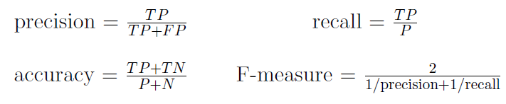
Other metric will suffer class imbalance issue
True class
3
6
FN
TP
Predicted class
8
1
TN
FP

Slide 44

Balanced Class data example
Predicted threshold
True samples
False samples
1
2
3
1
2
2
1
3
2
1
0.0
0.1
0.2
0.3
0.4
0.5
0.6
0.7
0.8
0.9
1.0
True class
3
6
FN
TP
Predicted class
8
1
TN
FP
precision =$TP/(TP+FP)$=6/7=0.86
accuracy=$(TP+TN)/(TP+FP+TN+FN)$=14/18=0.78

Slide 45

Imbalanced Class data example
Predicted threshold
True samples
False samples
3
6
9
1
6
2
3
3
2
1
0.0
0.1
0.2
0.3
0.4
0.5
0.6
0.7
0.8
0.9
1.0
True class
3
6
FN
TP
Predicted class
24
3
TN
FP
precision =$TP/(TP+FP)$=6/9=0.67
accuracy=$(TP+TN)/(TP+FP+TN+FN)$=30/36=0.83

Slide 46
What are our approaches to optimize auc?
Part III

Slide 47
Our approaches for AUC optimization
AUC function by definition is hard to optimize
We first use Wilcoxon rank-sum to estimate AUC^{wmw} function
We then use polynomial expansion to further approximate AUC^{wmw} in linear form

Slide 48
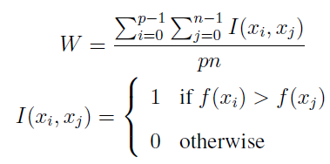
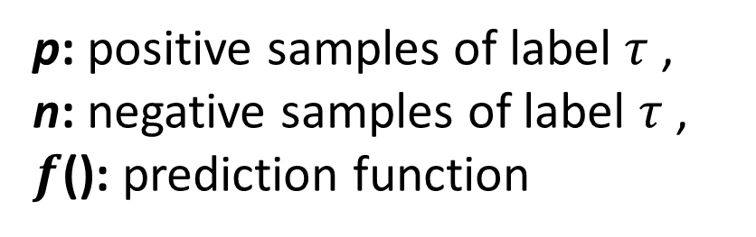
Wilcoxon rank-sum statistic
Area Under the ROC curve (AUC) could be unbiased estimated by:
AUC^{wmw}
Where,
p: positive samples of label $τ$ ,
n: negative samples of label $τ$ ,
$f$(): prediction function

Slide 49
Wilcoxon Rank-sum statistic of AUC
Example

Slide 50
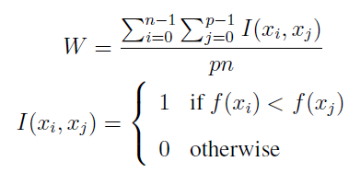

p=true class number (2)
n=false class number (3)
True samples
Less than 2 true class points
False samples
1
1
1
1
1
0.0
0.1
0.2
0.3
0.4
0.5
0.6
0.7
0.8
0.9
1.0
Wilcoxon Rank-sum statistic:
1.0
$$W_{0}$$
0.9
(i=0)
0.8
0.7
=1.0/3
0.6
TP_rate
0
0.5
0.4
0.3
0.2
0.1
0.0
0.0
0.1
0.2
0.3
0.4
0.5
0.6
0.7
0.8
0.9
1.0
FP_rate

Slide 51

p=true class number (2)
n=false class number (3)
True samples
Less than 2 true class points
False samples
1
1
1
1
1
0.0
0.1
0.2
0.3
0.4
0.5
0.6
0.7
0.8
0.9
1.0
Wilcoxon Rank-sum statistic:
1.0
$$W_{0}$$
0.9
$$W_{1}$$
(i=1)
0.8
0.7
=1.0/3
0.6
TP_rate
1
0.5
0.4
0.3
0.2
0.1
0.0
0.0
0.1
0.2
0.3
0.4
0.5
0.6
0.7
0.8
0.9
1.0
FP_rate

Slide 52

p=true class number (2)
n=false class number (3)
True samples
Less than 1 true class points
False samples
1
1
1
1
1
0.0
0.1
0.2
0.3
0.4
0.5
0.6
0.7
0.8
0.9
1.0
AUC = 0.834
Wilcoxon Rank-sum statistic:
1.0
$$W_{0}$$
0.9
$$W_{1}$$
(i=2)
0.8
0.7
= 0.5/3
0.6
TP_rate
2
0.5
0.4
$$W_{2}$$
0.3
0.2
0.1
0.0
0.0
0.1
0.2
0.3
0.4
0.5
0.6
0.7
0.8
0.9
1.0
FP_rate

Slide 53
Area under the roc curve
Example

Slide 54


p=true class number (2)
n=false class number (3)
True samples
Predicted threshold
False samples
1
1
1
1
1
0.0
0.1
0.2
0.3
0.4
0.5
0.6
0.7
0.8
0.9
1.0
TP_rate =$TP/(TP+FN)$=2/2=1.0
1.0
True class
0.9
0.8
0
2
0.7
FN
TP
0.6
TP_rate
0.5
Predicted class
0.4
0
3
0.3
TN
FP
0.2
0.1
0.0
0.0
0.1
0.2
0.3
0.4
0.5
0.6
0.7
0.8
0.9
1.0
FP_rate
FP_rate =$FP/(FP+TN)$=3/3=1.0

Slide 55

p=true class number (2)
n=false class number (3)
True samples
Predicted threshold
False samples
1
1
1
1
1
0.0
0.1
0.2
0.3
0.4
0.5
0.6
0.7
0.8
0.9
1.0
TP_rate =$TP/(TP+FN)$=2/2=1.0
1.0
True class
0.9
0.8
0
2
0.7
FN
TP
0.6
TP_rate
0.5
Predicted class
0.4
1
2
0.3
TN
FP
0.2
0.1
0.0
0.0
0.1
0.2
0.3
0.4
0.5
0.6
0.7
0.8
0.9
1.0
FP_rate
FP_rate =$FP/(FP+TN)$=2/3=0.66

Slide 56

p=true class number (2)
n=false class number (3)
True samples
Predicted threshold
False samples
1
1
1
1
1
0.0
0.1
0.2
0.3
0.4
0.5
0.6
0.7
0.8
0.9
1.0
TP_rate =$TP/(TP+FN)$=2/2=1.0
1.0
True class
0.9
0.8
0
2
0.7
FN
TP
0.6
TP_rate
0.5
Predicted class
0.4
2
1
0.3
TN
FP
0.2
0.1
0.0
0.0
0.1
0.2
0.3
0.4
0.5
0.6
0.7
0.8
0.9
1.0
FP_rate
FP_rate =$FP/(FP+TN)$=1/3=0.33

Slide 57

p=true class number (2)
n=false class number (3)
True samples
Predicted threshold
False samples
1
1
1
1
1
0.0
0.1
0.2
0.3
0.4
0.5
0.6
0.7
0.8
0.9
1.0
TP_rate =$TP/(TP+FN)$=1/2=0.5
1.0
True class
0.9
0.8
1
1
0.7
FN
TP
0.6
TP_rate
0.5
Predicted class
0.4
2
1
0.3
TN
FP
0.2
0.1
0.0
0.0
0.1
0.2
0.3
0.4
0.5
0.6
0.7
0.8
0.9
1.0
FP_rate
FP_rate =$FP/(FP+TN)$=1/3=0.33

Slide 58

p=true class number (2)
n=false class number (3)
True samples
Predicted threshold
False samples
1
1
1
1
1
0.0
0.1
0.2
0.3
0.4
0.5
0.6
0.7
0.8
0.9
1.0
TP_rate =$TP/(TP+FN)$=1/2=0.5
1.0
True class
0.9
0.8
1
1
0.7
FN
TP
0.6
TP_rate
0.5
Predicted class
0.4
3
0
0.3
TN
FP
0.2
0.1
0.0
0.0
0.1
0.2
0.3
0.4
0.5
0.6
0.7
0.8
0.9
1.0
FP_rate
FP_rate =$FP/(FP+TN)$=0/3=0.0

Slide 59

p=true class number (2)
n=false class number (3)
True samples
Predicted threshold
False samples
1
1
1
1
1
0.0
0.1
0.2
0.3
0.4
0.5
0.6
0.7
0.8
0.9
1.0
AUC = 0.834
TP_rate =$TP/(TP+FN)$=0/2=0.0
1.0
True class
0.9
0.8
2
0
0.7
FN
TP
0.6
TP_rate
0.5
Predicted class
0.4
3
0
0.3
TN
FP
0.2
0.1
0.0
0.0
0.1
0.2
0.3
0.4
0.5
0.6
0.7
0.8
0.9
1.0
FP_rate
FP_rate =$FP/(FP+TN)$=0/3=0.0

Slide 60
Polynomial approximation of the AUC function
Problems of rank-sum statistic of AUC (AUC^{wmw}):
1. The indicator function in AUC^{wmw} is infeasible.
2. For a large dataset, the computational cost of AUC^{wmw} is high due to the pairwise rank-sum form.
Solution:
Using the polynomial Chebyshev approximation for the indicator function, we can approximate AUC^{wmw} in linear form and solve it directly.

Slide 61
How does our method perform?
Part IV

Slide 62
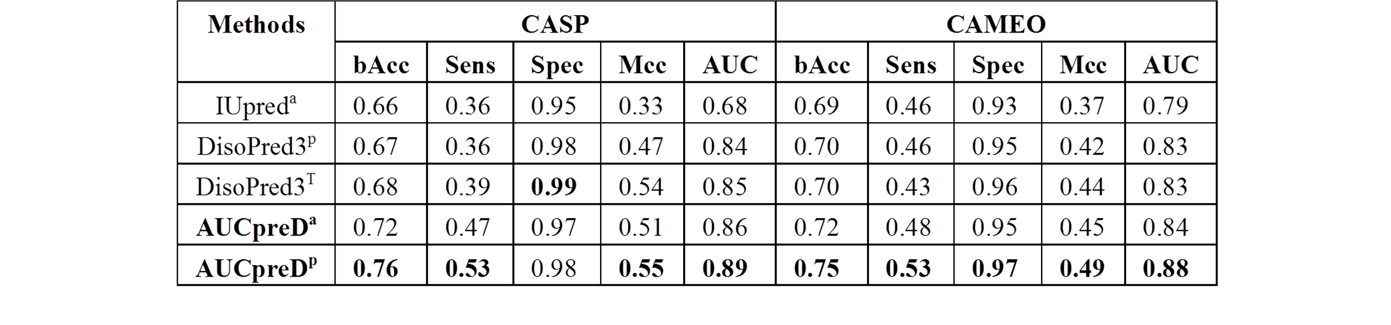
Our method is better than “sequence only (a)”, “sequence profile (p)”, and “template used (T)” methods.

Slide 63
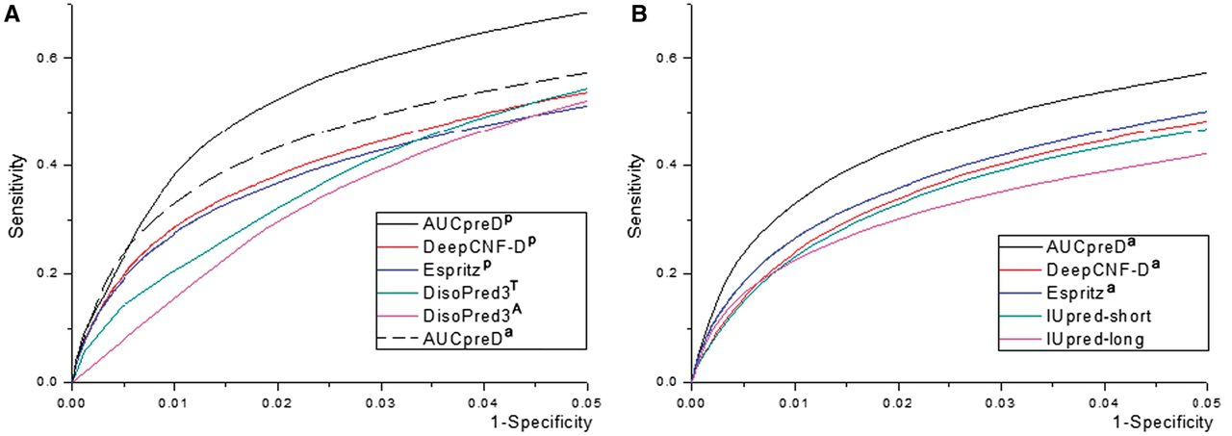
Our method is better than “sequence only (a)”, “sequence profile (p)”, and “template used (T)” methods.
Large-scale prediction on the human proteome (data from MobiDB)

Slide 64
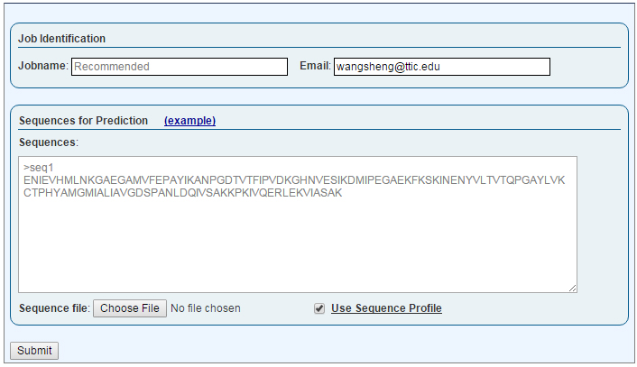
Welcome to RaptorX-Property server
Submit Page
http://raptorx.uchicago.edu/StructurePropertyPred/predict/
A single input sequence or a batch.
Or, upload sequence(s) in FASTA file.
Use sequence profile as input feature or not.
Submit the job !

Slide 65
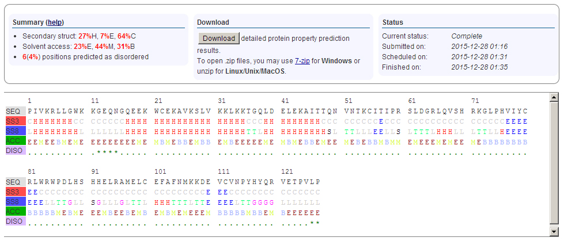
http://raptorx2.uchicago.edu/StructurePropertyPred/myjobs/25754864_105156/
Overall summary of the property prediction result
Download the property prediction result
Result Page 1
Summary prediction result:
1st line displays the user input sequence,
2nd line shows the result of 3-state secondary structure (SS3) prediction,
3rd line shows the result of 8-state secondary structure (SS8) prediction,
4th line shows the result of 3-state solvent accessibility (ACC) prediction,
5th line show the result of order/disorder regions (DISO) prediction with * indicating disorder.

Slide 66
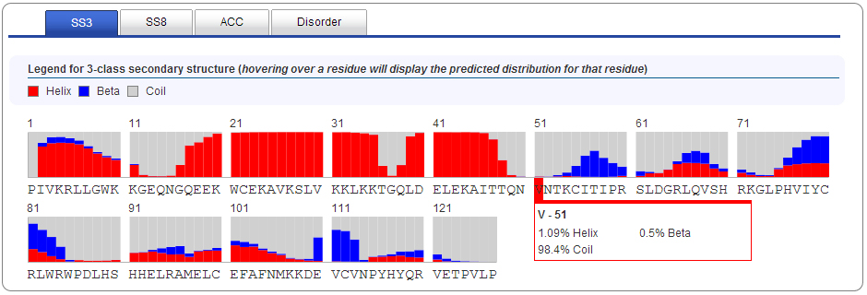
http://raptorx2.uchicago.edu/StructurePropertyPred/myjobs/25754864_105156/
Detailed prediction results of SS3, SS8, ACC, and DISO for the input sequence
Result Page 2
Distribution of the property classes for each residue.
Hovering over a residue to display its predicted distribution of property classes in a popup box appearing next to the residue.

Slide 67


Thank you
Jinbo Xu
Jianzhu Ma
National Institutes of Health (R01GM0897532)
National Science Foundation (DBI-0960390)
NSF CAREER award CCF-1149811
Alfred P. Sloan Research Fellowship

Slide 68
Up/Down sampling
Unstructured data:
Sequential data:

