Slide 1
DynaPDM
Developments in the near future
Modeling Process Supporting
Web Access
2004. 9. 11

Slide 2
Development Plan & Direction
1. DynaPDM History
2. DynaPDM & MOAD Development Plan
3. CAD Integration Plan
4. CAD Integration Direction

Slide 3

1. DynaPDM History
EDMS
PDM
PLM
cPDM
DynaPDM
V4.1 Web Portal
DynaPDM v4
Built by DynaMOAD
DynaPDM
V3.0
DynaPDM
V2.7
DynaPDM
V2.5
DynaPDM
V2.0
DynaPDM
V1.0
1999
2000
2001
2002
2003
2004
2005

Slide 4
1. DynaPDM History
DynaPDM v1
  Built by PowerBuilder
  2-tier Architecture
  Part, Drawing, Document, PSM Module
1999
DynaPDM v2
  Built by Java Technology (JDK 1.1.8)
  3-tier Architecture (DynaFramework)
  Part, Drawing, Document, PSM, Project Module
2000
DynaPDM v2.5
  Improve Stability
  Improve Project Module
  Add Option BOM Module
  Add 3D CAD Integrations (SolidWorks, Pro/E, etc)
2001

Slide 5
1. DynaPDM History
DynaPDM v2.7
  Built by Java 2 Technology (J2SE 1.4.x)
  New Look & Feel
  Add Workspace Management Feature
  Add FMEA Management Module
  Add 4M Management Module
2003
DynaPDM v2.7 Web Access
  Built by J2EE Technology (J2EE 1.3)
  Support Tomcat, Resin, WebLogic, etc
DynaPDM v3
  Framework Re-modeling
  Apply CBD Technology
  Improve Customizing Convenience of Client Side
  Integrate Variant Functions of Version 2.x
2004

Slide 6

1. DynaPDM History
DynaPDM v4
  Built by DynaMOAD
  New Look & Feel
  New PDM Model
2004
DynaPDM v4 Web Access
  Built by J2EE Technology (J2EE 1.3)

Slide 7
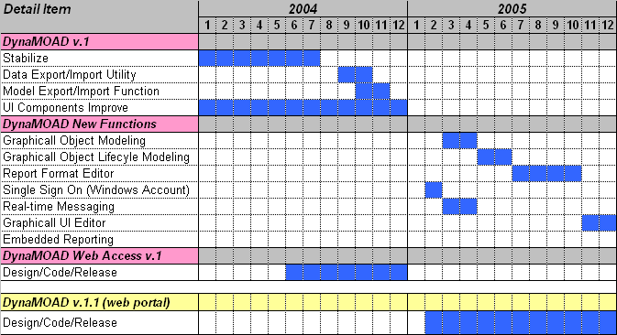
2. DynaPDM & MOAD
Development Plan
DynaMOAD v1.0 & v1.1
INOPS PLM Dev. 1 Team

Slide 8

Thank You
We provide
“ World Best PLM Solution & Service ”
www.inops.co.kr
Head Quarter
Address : 2F Fine Bldg, 673-5 Deungchon-Dong,
Kangseo-Ku, Seoul, Korea
Tel : 82-2-3664-5558
Fax : 82-2-3661-8914
E-mail : kiminkyung@inops.co.kr
Pusan Office
Address : No.2035, Jaeil bdlg., 728-10,
Mora 1-dong, Pusan, Korea
Tel : 82-51-301-5528
Fax : 82-51-301-5170
ShangHai Office
Address : Rm.2615, Lippo Plaza, No.222
Huaihai Zhong Rd., Shanghai,
China 200021
Tel : +86-21-5396-6131
Fax : +86-21-5396-6020

