Slide 1
DynaPDM Reference Site
- From v2.x To v4.0
- World Clients
2004. 9. 11

Slide 2
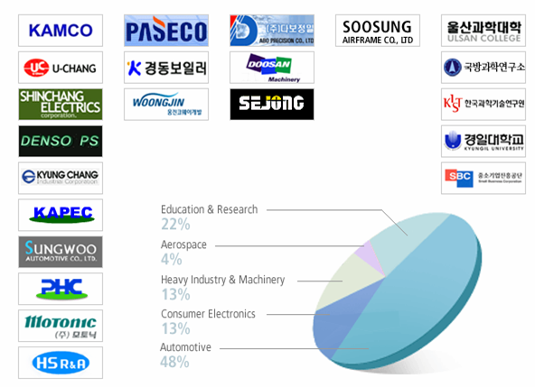



DynaPDM Client Overview
Automotive
Consumer
Electronics
Heavy Industry
& Machinery
Aerospace
Education
& Research

Slide 3
DynaPDM Clients
Company Name ( Homepage Link ) | Category | Product main Item | Period / Year | Implement Module
Ulsan College | R&D | Mechanical Engineering | 2M / 2000 | DynaPDM V1 Academic System
ADD Agency for Defense Development | R&D | Sub marine | 5M / 2000 | DynaPDM V1 Base / CADI System
Shin-Chang Electrics | Automotive | Multiple Function Switch Key Set | 9M / 2000 | DynaPDM V2 Base / PRJ / CADI /ERPI System
KAMCO Robert Bosch KAMCO | Automotive | Motor Wiper System | 4M / 2000 | DynaPDM V1 Base System
Hyun-dai Automotive | Automotive | Seat | 9M / 2000 | DynaPDM V2 Base / PRJ / CADI /ERPI System
KAPEC KOREA Powertrain | Automotive | Torque Converter | 11M / 2001 | DynaPDM V2 Base / PRJ / CADI /ERPI DCM / FMEA / WEB System
PASECO | Consumer Electronics | Cook Top, Refrigerator | 8M / 2001 | DynaPDM V2 Base / PRJ / CADI /ERPI System
Kyung-Dong Boiler | Consumer Electronics | Boiler | 6M / 2001 | DynaPDM V2 Base / CADI /ERPI System

Slide 4
DynaPDM Clients
Company Name ( Homepage Link ) | Category | Product main Item | Period / Year | Implement Module
Pyung-Hwa Precision | Automotive | Door Module | 8M / 2002 | DynaPDM V2 Base / CADI /ERPI System
DABO Precision | Heavy Industry | Injection Machine | 5M / 2002 | DynaPDM V2 Base / CADI /ERPI System
Kyung-Chang Industry | Automotive | Cable Wiper System | 7M / 2002 | DynaPDM V2 Base / CADI /ERPI System
Soo-Sung Airframe | Aerospace | Airplane Body | 8M / 2002 | DynaPDM V2 Base / PRJ / CADI /ERPI System
U-Chang Precision | Automotive | Multifunction Switch, Key Set | 3M / 2002 | DynaPDM V2 Base / PRJ / CADI /ERPI System
Denso-PS Electronics | Automotive | Dash Board -S/W, Sensor, Meter | 7M / 2003 | DynaPDM V2 Base / PRJ / CADI /ERPI System
WJ Coway Development | Consumer Electronics | Bidet Air Cleaner | 6M / 2003 | DynaPDM V2 Base / CADI /ERPI System
Motonic | Automotive | Air Injection Component | 9M / 2003 | DynaPDM V2 Base / PRJ / CADI /ERPI / FMEA System

Slide 5
DynaPDM Clients
Company Name ( Homepage Link ) | Category | Product main Item | Period / Year | Implement Module
Hwa-Seung R&A | Automotive | Weather Strip Hose(Break..) | 9M / 2003 | DynaPDM V2 Base / PRJ / CADI / ERPI / WEB System
Sea-Jong Parmatech | Heavy Industry | Capsule Filling Machine | 5M / 2003 | DynaPDM V2 Base / PRJ / CADI System
KRRI Korea railway reseach Institute | R&D | Train | 3M / 2003 | DynaPDM V2 Base / PRJ / CADI /ERPI / WEB System
Sewon ECS | Automotive | Wire Harness | 9M / 2003 | DynaPDM V2 Base / PRJ / CADI / ERPI /WEB System
MS Autotech | Automotive | Door Assembly | 7M / 2003 | DynaPDM V2 Base / PRJ / CADI /ERPI System
Dong-Hae Electronics | Automotive | Wire Harness | 7M / 2004 | DynaPDM V2 Base / PRJ / CADI /ERPI / WEB System
Apolo Industry | Automotive | Bumper, Dash Board | 7M / 2004 | DynaPDM V2 Base / PRJ / CADI /ERPI / WEB System
IL-Jin Automotive | Automotive | Bearing | 6M / 2004 | DynaPDM V2 Base / PRJ / CADI /ERPI System

Slide 6







DynaPDM v2.7 (Korea)
- SungWoo Company Introduction
  Product :
    Car Seat, Alloy Wheel,
    Case Iron Part etc.
  Revenue : USD 90million (2000)
  Employee : 350 people (2000)
  Major Customers:
  Affiliated Companies :
  Hyundai Automotive Co., Ltd.
  Hyundai Enercell Co., Ltd.
  SungWoo Corporation.
  KMRC (Korea Motor Racing Committee) Corporation.
  SungWoo USA.

Slide 7




DynaPDM v2.7 (Korea)
- SungWoo Project Scope
Project Scope
  Part, Drawing, Document Management
  Option-BOM & PSM Management
  Engineering Changing Management
  Project Management
  CATIA V4 Integration
  MRP Interface
Number of Users, Locations
  Headquarters in ASAN : 50 users
  Factory in ULSAN : 20 users

Slide 8

DynaPDM v4.0 (Korea)
- HSRNA Company Introduction
  Sales Revenue : USD300Million (2002 Export – USD100million)
  Employee : 944 people (2002)
  Clients : Korean 4 Major Motor Company (Hyundai, Kia, SsangYong, Daewoo)
  Foreign Motor (Toyota, GM, Ford, Daimler Chrysler etc.)
  Industrial (POSCO, Korea Electric Power Corp, Hyundai/Daewoo/ Samsung Heavy Industries, Japan Sumitomo Metal, USA Texcel,
  Hong Kong Electric etc.)
  Products : Automobile part (Brake Hose , Air Conditioning Hose, Power Steering Hose, General High Pressure & Low Pressure Hose, Plastic Tube)
  Industrial rubber products (Conveyor Belt, Dock Fender, Rubber & PVC Hose, Rubber Sheet & Matting, Expansion-Joint &Others)
  Homepage : http://www.hsrna.co.kr/english/
  Technical Cooperation
    Tokai Kogyo Co., Ltd., JAPAN
    Nichirin Co., Ltd., JAPAN
    Showa Electric Wire&Cable Co., Ltd., JAPAN
  Overseas Company:
    JVC, HSI Automotives Ltd., in India
    HST R&A Co.,Ltd. in China
    HSLS Rubber Industries Sdn. Bhd. in Malaysia
    HS Automotive Alabama Inc. in U.S.A.June.
    Beijing Hecheng R&A Vehicle Parts in China

Slide 9
DynaPDM v4.0 (Korea)
- HSRNA Project Feature
  Installation Period:
  2003.07 ~ 2004.05
  Usage:
  Enterprise Use, Concurrent 30 User
  Feature:
  Concurrent Log in and collaboratively work with distant users (Abroad Located Factory) by using Web
  Module:
  Product/Part Management, Drawing Management, Document Management, BOM Management, EO/ECR Management, Project Management, FMEA Management, ERP/MRP Interface, CAD Integration, Web Version.
  CAD Integration : CATIA V4/V5, AutoCAD, Pro-E

Slide 10



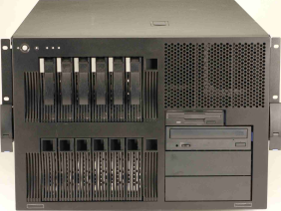
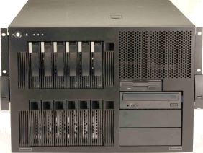
DynaPDM v4.0 (Korea)
- HSRNA System Structure
PDM Server
- DB Server
- File Server
HS R&A
Outsourcing
POP
Server
firewall
Internet
Production Management System
MRP
System
WEB
Server
VPN/SDLC/Internet
LAN
Abroad Factory
(India, USA, China)
HQ
Factory 1
Factory 2
Factory 3

Slide 11
DynaPDM v4.0 (Japan)
- Renesas Company Introduction
  Name : Renesas Technology Corp.
  Head Office : Marunouchi Bldg., 4-1, Marunouchi 2-chome, Chiyoda-ku, Tokyo, Japan
  Paid-in capital : 50 billion Yen
  (Hitachi, Ltd. 55% Mitsubishi Electric Corporation 45%)
  Established : April 1, 2003
  Business : Semiconductor field
        Development, design, manufacture, sales and servicing of system LSIs, including microcomputers, logic and analog devices, discrete devices and memory products, including flash memory and SRAM.
  Jointly founded by Hitachi and Mitsubishi Electric in 2003

Slide 12


DynaPDM v4.0 (Japan)
- Renesas World Network
U.S.A.
E.U.
Beijing
Japan
SuZhou
Headquarters
Sales Offices
Design and applied technologies companies
Manufacturing companies

Slide 13
DynaPDM v4.0 (Japan)
- Renesas Project Feature
  Installation Period : 2004.07 ~ 2004.09
  Usage : Enterprise Use, Concurrent 40 User
  Feature : Real Time Communication with MRP and exchange Drawing / BOM / EC Information.
    Install Plot Control System which can manage thousands of papers/data at once.
  Module : Drawing Management, EC management, BOM management, Plotting management, MRP interface
  CAD Integration : Zuo CAD

Slide 14
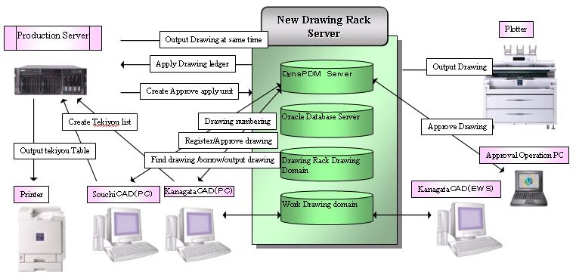
DynaPDM v4.0
- Renesas System Structure

Slide 15

Thank You
We provide
“ World Best PLM Solution & Service ”
www.inops.co.kr
Head Quarter
Address : 2F Fine Bldg, 673-5 Deungchon-Dong,
Kangseo-Ku, Seoul, Korea
Tel : 82-2-3664-5558
Fax : 82-2-3661-8914
E-mail : kiminkyung@inops.co.kr
Pusan Office
Address : No.2035, Jaeil bdlg., 728-10,
Mora 1-dong, Pusan, Korea
Tel : 82-51-301-5528
Fax : 82-51-301-5170
ShangHai Office
Address : Rm.2615, Lippo Plaza, No.222
Huaihai Zhong Rd., Shanghai,
China 200021
Tel : +86-21-5396-6131
Fax : +86-21-5396-6020

