Slide 1




Introduction of
“ Vehicle Design Service”
e-PLM Education & D.M.D Division

Slide 2
Business Service for
Vehicle Design & Develop.
Provide engineering services from Conceptual Design to Manufacturing stage by Integrated Engineering Methodology based on CATIA.
● Work Field : Automobile Industry, Mechanical Engineering Industries, and MORE !!!
BEST ONE for Design Methodology with CATIA.
● Domestic Users : HKMC, Renault-Samsung, SsangYoung …
and many more for small and medium enterprises
● Owned Technology
- Skin Fairing : Exterior & Interior
- Design Engineering :
Body In White, Interior & Exterior, Engine Components
- Production Engineering :
● Project experience : Total over 50 projects in experience

Slide 3

Project Concept for
Vehicle Design Service
▼ Project Proposal
▼ Model Fix
▼ Engineering Signoff
PLANING
Skin Fairing
DESIGN
Feasi. Study
Concept Design
Detail Design
Design Modification
L/O
CAE
Feasi. Analysis
Concept Analysis
Detail Analysis
Design Check
Trouble Shooting
PROTO
Mecha1
Proto1
P/P
M/P
TEST
Mecha1 Test
Proto1 Test
Cooperative work is based on customers’ working environment & standardization
Flexible organization and system operation is based on development condition.

Slide 4
A. 組織
Vehicle Design Services
Organization & Item
Organization
1st Design Team
• Turnkey Based Design project ( 完全 受注 設計業務 )
• Component Maker (Supplier) Dispatching Design (派遣 設計)
• Engineer Dispatching to Abroad Service (設計者 海外 派遣 设计)
2nd Design Team
KIA Automobile, HYUNDAI Automobile Design Service
Project Task
1. Skin fairing
2. Automobile Design ( Face Lift, Model Year , Derivative Model )
3. Automobile Components Design
- Car Body ( B.I.W of Structure & Moving )
- Equipment ( Interior , Exterior )
- Chassis
4. Power Train Components Design
- Engine parts
- T/M parts

Slide 5
Project Cases in
Vehicle Design Team
Result Clients
1. Skin fairing
▪ DLM : R1,M1,M2 Full skin Project
▪ H/KMC : HP, TB 3 door & 5 door , A1 exterior skin Project
▪ Honda Motors : Front Bumper Skin Project
▪ Honda Motors < Motor Bike > : Full skin Project
▪ SSM : Exterior & Interior Full skin Project
▪ SYM : C/Pad Skin Project
2. Automobile Design ( Face Lift, Model Year , Derivate Model )
▪ Medium Size Vehicle : Wagon Design adapting 4 N/B Sedan
▪ SUV : 300mm extended Rear Overhang Design- Side frame, Floor Change
▪ Small Size Vehicle : Face lift Design - Roof, Tailgate, Side frame change
▪ Frontier : Double Cabin Design adapting standard Cabin
▪ Carnival RHD : RHD Design adapting Standard (LHD) Vehicle - Instrument panel, Steering change
▪ Frontier RHD : RHD Design adapting Standard (LHD) Vehicle - Instrument panel, Steering change
▪ Coach RHD : RHD Design adapting Standard (LHD) Vehicle - Instrument panel, Steering change
▪ SUV RHD : RHD Design adapting Standard (LHD) Vehicle - Instrument panel, Steering change
3. Automobile Component Design
▪ B.I.W Parts ( Structure & Moving )
▪ Interior & Exterior Parts
▪ Chassis Parts
▪ Mirror System Design & Development
4. Engine Development

Slide 6
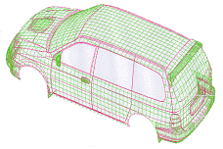
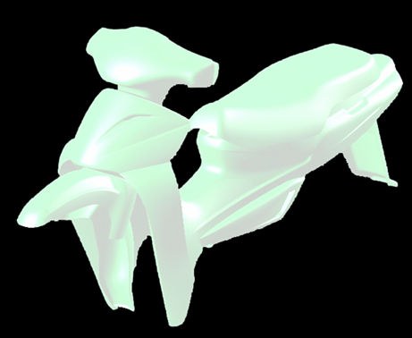
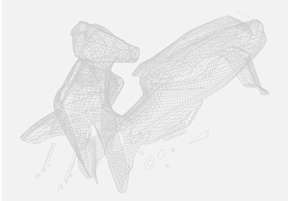
Skin Fairing Projects
▪ DL Motor : R1,M1,M2 Full Skin Project
▪ H/KMC : HP, TB 3 door & 5 door , A1 Exterior Skin Project
▪ Honda Motor : Front Bumper Skin Project
▪ Honda Motor < Motor Bike > : Full Skin Project
▪ Renault-SamSung Motor : Exterior & Interior Full Skin Project
▪ SsangYong Motor : C/Pad Skin Project

Slide 7
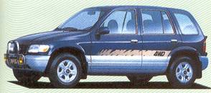
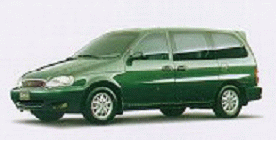
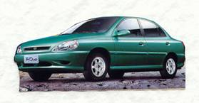
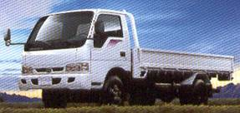
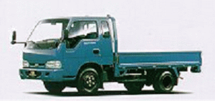
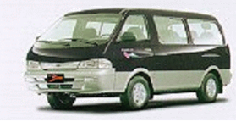
Vehicle Modify Projects
▪ Medium Size Vehicle : Wagon Design adapting 4 N/B Sedan
▪ SUV : 300mm extended Rear Overhang Design- Side frame, Floor Change
▪ Small Size Vehicle : Face lift Design - Roof, Tailgate, Side frame change
▪ Frontier : Double Cabin Design adapting standard Cabin
▪ Carnival RHD : RHD Design adapting Standard (LHD) Vehicle - Instrument panel, Steering change
▪ Frontier RHD : RHD Design adapting Standard (LHD) Vehicle - Instrument panel, Steering change
▪ Coach RHD : RHD Design adapting Standard (LHD) Vehicle - Instrument panel, Steering change
▪ SUV RHD : RHD Design adapting Standard (LHD) Vehicle - Instrument panel, Steering change
Carnival RHD
RIO
Frontier RHD
PREGIO

Slide 8
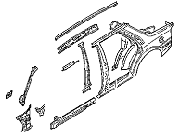
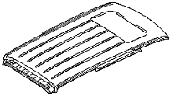
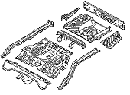
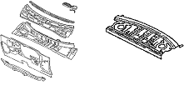
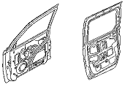
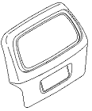
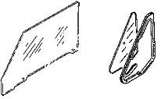

Design Engineering
Projects for Vehicle
▪ Structure of Body In White
Roof Assy Side Body Assy Floor Assy Cowl & Dash
▪ Moving of Body In White
Bonnet & Trunk Frt./Rr. Door Tailgate Glass, Etc.

Slide 9
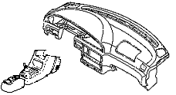

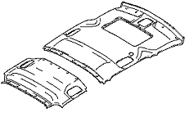

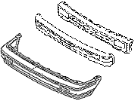

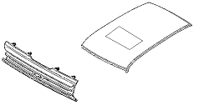
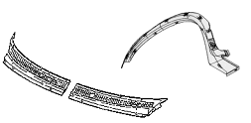
Design Engineering
Projects for Vehicle
▪ Interior
Instrument Panel Door Trim Top Ceiling Body Trim
▪ Exterior
Bumper Radiator Grille Roof Etc.

Slide 10
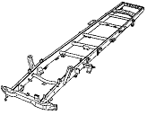
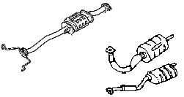
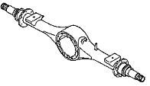
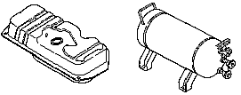
Design Engineering
Projects for Vehicle
▪ Chassis parts
Frame Axle Muffler
Fuel Tank

Slide 11
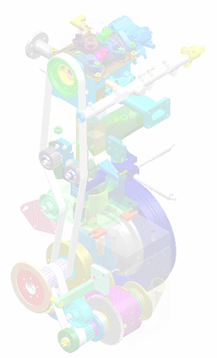
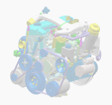
Design Engineering
Projects for Engine
▪ Power Train Components Design
▪ C/Head Design & Development
▪ C/Housing Design & Development
▪ C/Head Block Design & Development
▪ Knuckle Design & Development
▪ Intake & Exhaust manifold Design & Development
▪ Reverse Engineering of Power Train component

Slide 12

Contact Us
Thank You !
TEL : +82 2 2108 1300
URL : www.cies.co.kr
www.ates.co.kr
www.dynaview.co.kr
www.dynapdm.co.kr

